Slide 1
Introduction to
Cloud Computing
Lecture 4-1
Big Data Processing

Slide 2
Outline
Computing with Big Data
NoSQL

Slide 3
Computing with Big Data

Slide 4
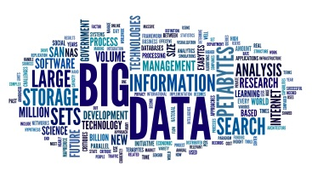


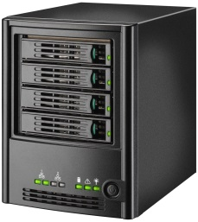
Datafication
Datafication is a modern technological trend
  turning many aspects of our life into computerized (usually digital) data
  transforming computerized data into new forms of values.
Value
digitalize
transform
This is how the big data problems arise
This is what we need to do
in the big data era

Slide 5


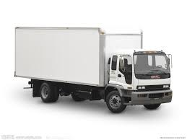




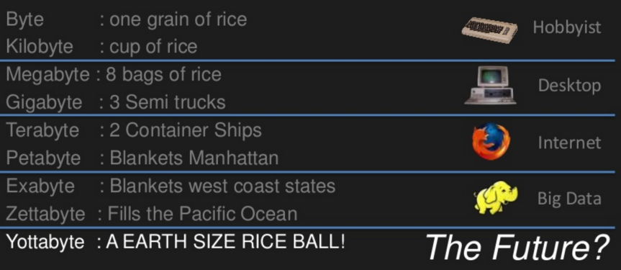
Data Volume
…
By David Wellman, Director of Software Development at Imagine Health

Slide 6




Possible Big Data Sources
Activity Data
  Ex. on-line shopping data
Conversation Data
  Ex. Data on Facebook or Twitter
Photo and Video Images
Sensor data
Internet of Things (IoT) data
Genome data of all creatures
…

Slide 7


Big or Small Data?
Big data is often described using three Vs:
  Volume
  Velocity
  Variety
And big data sometimes should consider another V:
  Veracity
Small Data?
Big Data?
7

Slide 8
Three Vs + One V
Three Vs:
  Volume
    It refers to the amount of data
    Big data implies enormous volumes of data.
  Velocity
    Velocity refers the speed at which data is generated,
    or the speed at which data moves around (streaming data)
  Variety
    Variety refers to the many sources and types of data both structured and unstructured.
One V:
  Veracity
    Veracity refers to the biases, noise and abnormality in data.

Slide 9
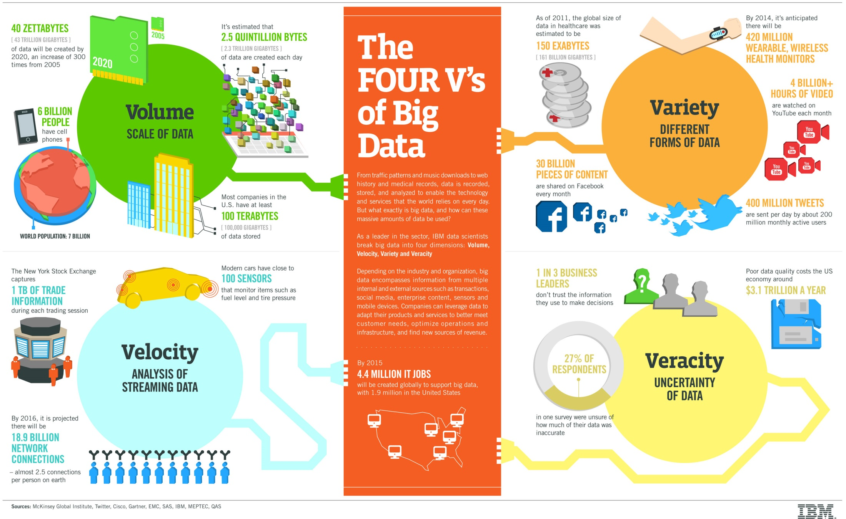
9

Slide 10
Big Data
Big Data includes huge volume, high velocity, and extensible variety of data.
The data in it will be of three types:
  Structured data : Relational data.
  Semi Structured data : XML data.
  Unstructured data : Word, PDF, Text, Media Logs.

Slide 11
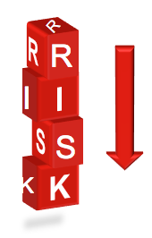


Goal of Big Data Processing
It provides more accurate analysis, which may lead to more concrete decision-making resulting in:
  greater operational efficiencies
  cost reductions
  reduced risks for the business
Efficiency

Slide 12
Choices among Big Data Technologies
Commodity vs. “exotic” hardware
Number of machines vs. processor vs. cores
Bandwidth of memory vs. disk vs. network
Different programming models

Slide 13
Software Big Data Technologies
In order to handle big data, you will need an architecture that
  can manage and process huge volumes of structured and unstructured data in real-time
  can protect data privacy and security
Two classes of big data technologies
  Operational Big Data
    This includes NoSQL Big Data systems, which take advantage of new cloud computing architectures for massive computations
  Analytical Big Data
    It provides analytical capabilities for retrospective and complex analysis that may touch most or all of the data.

Slide 14
Operational vs. Analytical Systems for Big Data
 | Operational | Analytical
Latency | 1 ms - 100 ms | 1 min - 100 min or more
Concurrency | 1000 - 100,000 | 1 - 10
Access Pattern | Writes and Reads | Reads
Queries | Selective | Unselective
Data Scope | Operational | Retrospective
End User | Customer | Data Scientist
Technology | NoSQL | MapReduce, Massively Parallel Processing (MPP)

Slide 15
Big Data Challenges
Capturing data
Curation
Storage
Searching
Sharing
Transfer
Analysis
Presentation

Slide 16
Big Data Processing
Turing big data into values
  The datafication generates large amounts of data,
  and we need the latest technology such as cloud computing and distributed systems to leverage all types of data and add value
  The key is value!
It all boils down to…
  Divide-and-conquer
  Throwing more hardware at the problem
Simple to understand… a lifetime to master…

Slide 17
Divide and Conquer
Master
Process
“Work”
Partition
w₁
w₂
w₃
“worker”
“worker”
“worker”
Worker
Processes
Compute
r₁
r₂
r₃
Master
Process
“Result”
Combine

Slide 18
Different Workers
Different threads in the same core
Different cores in the same CPU
Different CPUs in a multi-processor system
Different machines in a distributed system

Slide 19
Parallelization Problems
How do we assign work units to workers?
What if we have more work units than workers?
What if workers need to share partial results?
How do we aggregate partial results?
How do we know all the workers have finished?
What if workers die?
What is the common theme of all of these problems?
Notes:
19

Slide 20
General Theme?
Parallelization problems arise from:
  Communication between workers
  Access to shared resources (e.g., data)
Thus, we need a synchronization system!
This is tricky:
  Finding bugs is hard
  Solving bugs is even harder
Notes:
20

Slide 21
Managing Multiple Workers
Difficult because
  (Often) don’t know the order in which workers run
  (Often) don’t know where the workers are running
  (Often) don’t know when workers interrupt each other
Thus, we need:
  Semaphores (lock, unlock)
  Conditional variables (wait, notify, broadcast)
  Barriers
Still, lots of problems:
  Deadlock, livelock, race conditions, ...
Moral of the story: be careful!
  Even trickier if the workers are on different machines
Notes:
21

Slide 22
Patterns for Parallelism
Parallel computing has been around for decades
Here are some “design patterns” …
Notes:
22

Slide 23
Master/Slaves
master
slaves
Notes:
23

Slide 24
Producer/Consumer Flow
P
C
P
C
P
C
P
C
P
C
P
C
Notes:
24

Slide 25
Work Queues
P
C
shared queue
P
W
W
W
W
W
C
P
C
Notes:
25

Slide 26
Solutions?
From patterns to implementation:
  pthreads, OpenMP for multi-threaded programming
  MPI for clustering computing
  Programming architecture such as Hadoop MapReduce, Spark, …
The reality:
  Lots of one-off solutions, custom code
  Write you own dedicated library, then program with it
  Burden on the programmer to explicitly manage everything

Slide 27
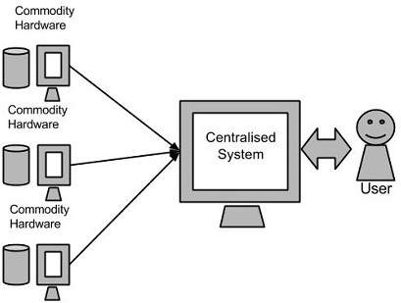
Google’s Solution
Google File System to manage big data
MapReduce to analyze big data
Google BigTable as the operational big data system

Slide 28
NoSQL

Slide 29
History of the World
Relational Databases – mainstay of business
Web-based applications caused spikes
  Especially true for public-facing e-Commerce sites
Developers begin to front RDBMS with memcache or integrate other caching mechanisms within the application
Notes:
-> For the longest time (and still true today), the big relational database vendors such as Oracle, IBM, Sybase, and a lesser extent Microsoft were the mainstay of how data was stored.
-> During the Internet boom, startups looking for low-cost RDBMS alternatives turned to MySQL and PostgreSQL.
-> The ‘Slashdot Effect’ occurs when a popular website links to a smaller site, causing a massive increase in traffic.
-> Hooking your RDBMS to a web-based application was a recipe for headaches, they are OLTP in nature. Could have hundreds of thousands of visitors in a short-time span.
-> To mitigate, began to front the RDBMS with a read-only cache such as memcache to offload a considerable amount of the read traffic.
-> As datasets grew, the simple memcache/MySQL model (for lower-cost startups) started to become problematic.

Slide 30
Scaling Up
Issues with scaling up when the dataset is just too big
RDBMS were not designed to be distributed
Began to look at multi-node database solutions
Known as ‘scaling out’ or ‘horizontal scaling’
Different approaches include:
  Master-slave
  Sharding
Notes:
-> Best way to provide ACID and a rich query model is to have the dataset on a single machine.
-> However, there are limits to scaling up (Vertical Scaling).
-> Past a certain point, an organization will find it is cheaper and more feasible to scale out (horizontal scaling) by adding smaller, more inexpensive (relatively) servers rather than investing in a single larger server.
-> A number of different approaches to scaling out (Horizontal Scaling).
-> DBAs began to look at master-slave and sharding as a strategy to overcome some of these issues.

Slide 31
Scaling RDBMS – Master/Slave
Master-Slave
  All writes are written to the master. All reads performed against the replicated slave databases
  Critical reads may be incorrect as writes may not have been propagated down
  Large data sets can pose problems as master needs to duplicate data to slaves

Slide 32
Scaling RDBMS - Sharding
Partition or sharding
  Scales well for both reads and writes
  Not transparent, application needs to be partition-aware
  Can no longer have relationships/joins across partitions
  Loss of referential integrity across shards
Notes:
-> Different sharding approaches:
-> Vertical Partitioning: Have tables related to a specific feature sit on their own server. May have to rebalance or reshard if tables outgrow server.
-> Range-Based Partitioning: When single table cannot sit on a server, split table onto multiple servers. Split table based on some critical value range.
-> Key or Hash-Based partitioning: Use a key value in a hash and use the resulting value as entry into multiple servers.
-> Directory-Based Partitioning: Have a lookup service that has knowledge of the partitioning scheme . This allows for the adding of servers or
changing the partition scheme without changing the application.
-> http://adam.heroku.com/past/2009/7/6/sql_databases_dont_scale

Slide 33
Other ways to scale RDBMS
Multi-Master replication
INSERT only, not UPDATES/DELETES
No JOINs, thereby reducing query time
  This involves de-normalizing data
In-memory databases
Notes:
-> The multi-master replication system is responsible for propagating data modifications made by each member to the rest of the group, and resolving any conflicts that might arise between concurrent changes made by different members.
-> For INSERT-only, data is versioned upon update.
-> Data is never DELETED, only inactivated.
-> JOINs are expensive with large volumes and don’t work across partitions.
-> Denormalization leads to even larger databases, reduces query time.
-> Consistency is the responsibility of the application.
-> In-memory databases have not caught on mainstream and regular RDBMS are more disk-intensive that memory-intensive. Vendors looking to fix this.

Slide 34
What is NoSQL?
Stands for Not Only SQL
Class of non-relational data storage systems
Usually do not require a fixed table schema nor do they use the concept of joins
All NoSQL offerings relax one or more of the ACID properties (will talk about the CAP theorem)
Notes:
-> NoSQL was a term coined by Eric Evans. He states that ‘… but the whole point of seeking alternatives is that you need to solve a problem that relational databases are a bad fit for. …
-> This is why people are continually interpreting nosql to be anti-RDBMS, it's the only rational conclusion when the only thing some of these projects share in common is that they are not relational databases.’
-> Emil Elfrem stated it is not a ‘NO’ SQL but more of a ‘Not Only” SQL.

Slide 35
Why NoSQL?
For data storage, an RDBMS cannot be the be-all/end-all
Just as there are different programming languages, need to have other data storage tools in the toolbox
A NoSQL solution is more acceptable to a client now than even several years ago
  Think about proposing a Ruby/Rails or Groovy/Grails solution now versus a couple of years ago
Notes:
-> Too often as consultants, when we talk about data storage, we immediately reach for a relational database.
-> Relational databases offer a very good general purpose solution to many different data storage needs.
-> In other words, it is the safe choice and will work in many situations.
-> Need to have some knowledge of alternatives, if nothing else to know when a NoSQL solution needs further investigation.

Slide 36
How did we get here?
Explosion of social media sites (Facebook, Twitter) with large data needs
Rise of cloud-based solutions such as Amazon S3 (simple storage solution)
Just as moving to dynamically-typed languages (Ruby/Groovy), a shift to dynamically-typed data with frequent schema changes
Open-source community
Notes:
-> However, the people with the largest datasets (terrabyte/petabyte) began to realize that sharding was putting a bandage on their issues. The more aggressive thought leaders (Google, Facebook, Twitter) began to explore alternative ways to store data. This became especially true in 2008/2009.
-> These datasets have high read/write rates.
-> With the advent of Amazon S3, a large respected vendor made the statement that maybe is was okay to look at alternative storage solutions other that relational.
-> All of the NoSQL options with the exception of Amazon S3 (Amazon Dynamo) are open-source solutions. This provides a low-cost entry point to ‘kick the tires’.

Slide 37
Dynamo and BigTable
Three major papers were the seeds of the NoSQL movement
  BigTable (Google)
  Dynamo (Amazon)
    Gossip protocol (discovery and error detection)
    Distributed key-value data store
    Eventual consistency
  CAP Theorem
Notes:
-> BigTable: http://labs.google.com/papers/bigtable.html
-> Dynamo: http://www.allthingsdistributed.com/2007/10/amazons_dynamo.html and http://www.allthingsdistributed.com/files/amazon-dynamo-sosp2007.pdf
-> Amazon and consistency
* http://www.allthingsdistributed.com/2010/02
* http://www.allthingsdistributed.com/2008/12

Slide 38
The Perfect Storm
Large datasets, acceptance of alternatives, and dynamically-typed data has come together in a perfect storm
Not a backlash/rebellion against RDBMS
SQL is a rich query language that cannot be rivaled by the current list of NoSQL offerings
Notes:
-> So you have reached a point where a read-only cache and write-based RDBMS isn’t delivering the throughput necessary to support a particular application.
-> You need to examine alternatives and what alternatives are out there.
-> The NoSQL databases are a pragmatic response to growing scale of databases and the falling prices of commodity hardware.
-> Most likely, 10 years from now, the majority of data is still stored in RDBMS.

Slide 39
ACID (atomicity, consistency, isolation, durability)
ACID is a set of properties that guarantee database transactions are processed reliably.
  Atomicity requires that database modifications must follow an "all or nothing" rule.
  The consistency property ensures that any transaction the database performs will take it from one consistent state to another.
  Isolation refers to the requirement that no transaction should be able to interfere with another transaction at all.
  Durability means that once a transaction has been committed, it will remain so.

Slide 40
CAP Theorem
Three properties of a system: consistency, availability and partitions
You can have at most two of these three properties for any shared-data system
To scale out, you have to partition. That leaves either consistency or availability to choose from
  In almost all cases, you would choose availability over consistency
Notes:
-> Proposed by Eric Brewer (talk on Principles of Distributed Computing July 2000).
-> Partitionability: divide nodes into small groups that can see other groups, but they can't see everyone.
-> Consistency: write a value and then you read the value you get the same value back. In a partitioned system there are windows where that's not true.
-> Availability: may not always be able to write or read. The system will say you can't write because it wants to keep the system consistent.
-> To scale you have to partition, so you are left with choosing either high consistency or high availability for a particular system. You must find the right
overlap of availability and consistency.
-> Choose a specific approach based on the needs of the service.
-> For the checkout process you always want to honor requests to add items to a shopping cart because it's revenue producing.
In this case you choose high availability. Errors are hidden from the customer and sorted out later.
-> When a customer submits an order you favor consistency because several services--credit card processing, shipping and handling, reporting—
are simultaneously accessing the data.

Slide 41
Availability
Traditionally, thought of as the server/process available five 9’s (99.999 %).
However, for large node system, at almost any point in time there’s a good chance that a node is either down or there is a network disruption among the nodes.
  Want a system that is resilient in the face of network disruption

Slide 42
Eventual Consistency
When no updates occur for a long period of time, eventually all updates will propagate through the system and all the nodes will be consistent
For a given accepted update and a given node, eventually either the update reaches the node or the node is removed from service
Known as BASE (Basically Available, Soft state, Eventual consistency), as opposed to ACID
Notes:
-> http://en.wikipedia.org/wiki/Eventual_consistency
-> http://www.allthingsdistributed.com/2008/12/eventually_consistent.html
The types of large systems based on CAP aren't ACID they are BASE (http://queue.acm.org/detail.cfm?id=1394128):
* Basically Available - system seems to work all the time
* Soft State - it doesn't have to be consistent all the time
* Eventually Consistent - becomes consistent at some later time
Everyone who builds big applications builds them on CAP and BASE: Google, Yahoo, Facebook, Amazon, eBay, etc

Slide 43
What kinds of NoSQL
NoSQL solutions fall into two major areas:
  Key/Value or ‘the big hash table’.
    Amazon S3 (Dynamo)
    Voldemort
    Scalaris
  Schema-less which comes in multiple flavors, column-based, document-based or graph-based.
    Cassandra (column-based)
    CouchDB (document-based)
    Neo4J (graph-based)
    HBase (column-based)
Notes:
-> Not an exhaustive list, just some of the more well-known.
-> HBase is the data storage solution for Hadoop.
-> Graph: is a network database that uses edges and nodes to represent and store data.
-> Document: views are stored as rows which are kept sorted by key. Can adapt to variations in document structure.

Slide 44
Key/Value
Pros:
  very fast
  very scalable
  simple model
  able to distribute horizontally
Cons:
  - many data structures (objects) can't be easily modeled as key value pairs
Notes:
-> http://chariotsolutions.blogspot.com/2010/01/why-you-need-nosql-in-your-toolbox.html

Slide 45
Schema-Less
Pros:
  - Schema-less data model is richer than key/value pairs
  eventual consistency
  many are distributed
  still provide excellent performance and scalability
Cons:
  - typically no ACID transactions or joins

Slide 46
Common Advantages
Cheap, easy to implement (open source)
Data are replicated to multiple nodes (therefore identical and fault-tolerant) and can be partitioned
  Down nodes easily replaced
  No single point of failure
Easy to distribute
Don't require a schema
Can scale up and down
Relax the data consistency requirement (CAP)
Notes:
-> As the data is written, the latest version is on at least one node. The data is then versioned/replicated to other nodes within the system.
-> Eventually, the same version is on all nodes.

Slide 47
What am I giving up?
joins
group by
order by
ACID transactions
SQL as a sometimes frustrating but still powerful query language
easy integration with other applications that support SQL
Notes:
-> No JDBC
-> Data integrity at the application layer

Slide 48
Typical NoSQL API
Basic API access:
  get(key) -- Extract the value given a key
  put(key, value) -- Create or update the value given its key
  delete(key) -- Remove the key and its associated value
  execute(key, operation, parameters) -- Invoke an operation to the value (given its key) which is a special data structure (e.g. List, Set, Map .... etc).
Notes:
-> http://horicky.blogspot.com/2009/11/nosql-patterns.html

