Slide 1
Cloud Computing: Cloud Resource Allocation Issues
Dept. of Computer Science and Information Engineering
National Central University
*Some slides are adopted from “Distributed and Cloud Computing from
Parallel Processing to the Internet of Things” by K. Hwang, G. C. Fox and J. J. Dongarra

Slide 2
Outline
Cloud Resource Allocation and Scheduling Overview
Overview of IaaS Scheduling
Overview of PaaS/SaaS Scheduling

Slide 3
Cloud Resource Allocation Overview

Slide 4
Overview of Cloud Resource Allocation and Scheduling

Slide 5
Resource Allocation and Scheduling
Resource allocation:
an approach/mechanism to allocate resources to tasks/users
Scheduling:
Scheduling is the approach/mechanism to find a schedule for all the resources that can serve all the tasks, given a set of resources and a set of tasks.
A task may have dependency on other tasks

Slide 6
Computer Resource Allocation and Scheduling
Critical function of any man-made system.
It affects the three basic criteria for measuring system performance:
Functionality.
Performance.
Cost.
Scheduling in a computing system → deciding how to allocate resources of a system, such as CPU cycles, memory, secondary storage space, I/O and network bandwidth, between users and tasks.
Policies and mechanisms for resource allocation.
Policy → principles guiding decisions.
Mechanisms → the means to implement policies.

Slide 7
Resource Allocation and Scheduling on the Cloud
It cannot violate cloud management policies
This kind of problem is usually hard:
Multi-objective optimization under complex policies and constraints
Impossible to get accurate global state information.
Affected by unpredictable events (e.g. system failures, attacks).
Cloud service providers are faced with large fluctuating workloads/demands.
The strategies for IaaS, PaaS, and SaaS are different.

Slide 8
Cloud Resource Management (CRM) Policies
Admission control → prevent the system from accepting workload in violation of high-level system policies.
Capacity allocation → allocate resources for individual activations of a service.
Load balancing → distribute the workload evenly among the servers.
Energy optimization → minimization of energy consumption.
Quality of service (QoS) guarantees → ability to satisfy timing or other conditions specified by a Service Level Agreement.

Slide 9
Mechanisms for the Implementation of Resource Management Policies
Control theory → uses the feedback to guarantee system stability and predict transient behavior.
Machine learning → does not need a performance model of the system.
Utility-based → require a performance model and a mechanism to correlate user-level performance with cost.
Market-oriented/economic → do not require a model of the system, e.g., combinatorial auctions for bundles of resources.

Slide 10
Resource Allocation in Cloud Computing
Typical cloud resource allocation problems
PaaS-> Workflow (job) Scheduling
IaaS-> Virtual Machine Placement (or Scheduling)
Scheduler decides which job/VM should go on which machine/VM. An effective scheduler can
Reduce operational cost
Reduce queue waiting time
Increase resource utilization

Slide 11
Control Model
Control Model
An Example of Cloud Control Mechanism

Slide 12
Overview of IaaS Resource Allocation

Slide 13
Overview of IaaS Resource Allocation
Static VM Placement

Slide 14
Introduction to Static VM placement
Definition:
Virtual machines V₁~V_{n}, are asked to be executed on physical machines P₁~P_{m}, such that the user defined cost function G is optimized.
VM
VM
VM
VM
VM
VM
Physical Machine
Physical Machine
Physical Machine
Physical Machine
Physical Machine

Slide 15
Static VM Placement: Assumptions
Assumptions may be made:
Each physical machine P_{a} has a list of k resources <Pr_{a,1}~Pr_{a,k}> and each VM V_{b} may request different amount of resources <Vr_{b,1}~Vr_{b,k} >. The VMs are asked to be placed on the physical machines.
Resources: # of CPUs, memory size, disk size, bandwidth guaranteed
VMs can co-locate at a physical machine. Typically a physical machine cannot serve unlimited VMs because each physical resource is limited
Deployment is OK
Running VM:
2 CPUs
4 GB memory
Running VM:
1 CPU
8 GB memory
VM:
1 CPU
4 GB memory
Physical Machine:
4 CPUs
16 GB memory
Deployment is not OK
VM:
1 CPU
8 GB memory

Slide 16
VM Placement: Cost Function
Money spent:
There are p types of chargeable resources. Each VM V_{b} is associated with an expected per-hour-resource-usage list <Vr_{b,1}~Vr_{b,p} >, and each different cloud Ci has a fix price list <Vr_{i,1}~Vr_{i,p}>
The placement of VMs must minimize the money to be spent.
Fine-grained energy consumption:
Similar to the money function. However, the problem usually only considers the CPU-usage and a given energy consumption function of the CPU-usage.
The placement of VMs must minimize the energy consumption of the system
The number of used physical machines (coarse-grained energy consumption):
The placement of VMs must minimize the number of used physical machines.

Slide 17
VM Placement: Cost Function (Cont.)
Load balancing:
The placement makes a similar workload of each physical host
Multi-objective optimization:
Try to optimize several goals at a time.

Slide 18
Possible Strategies for Different Problems
Resource provisioning without any cost function consideration)
Best-fit, Worst-fit, First-fit, Second-Fit, …
Resource provisioning with the goal of optimizing a cost function
Random
Round-robin
Heuristic algorithms:
Longest job (biggest VM/expensive VM) first,
Shortest job (smallest VM/cheapest VM) first
Min-min, min-max, max-min
Algorithms derived from meta-heuristics
Ex. ant colony, swarm optimization, simulated annealing, …
Simulated marketing systems
Probability-based random algorithms

Slide 19
Another Strategy: Combinatorial Auctions for Cloud Resources
Users provide bids for desirable bundles and the price they are willing to pay.
Prices and allocation are set as a result of an auction.
Ascending Clock Auction, (ASCA) → the current price for each resource is represented by a “clock” seen by all participants at the auction.
The algorithm involves user bidding in multiple rounds; to address this problem the user proxies automatically adjust their demands on behalf of the actual bidders.
Not used in real environment.

Slide 20
The schematics of the ASCA algorithm; to allow for a single round auction users are represented by proxies which place the bids x_{u}(t). The auctioneer determines if there is an excess demand and, in that case, it raises the price of resources for which the demand exceeds the supply and requests new bids.

Slide 21
Overview of IaaS Resource Allocation
Dynamic VM Placement

Slide 22
Effects of Live VM Migration
Benefits:
Shifting workload from one physical machine to another physical machine
Continuous execution of a running VM
Drawbacks:
Network bandwidth consumption during migration
Some VM migration methods do not allow any failure during migration, since the failure may crash the VM

Slide 23
Dynamic VM Placement
Dynamic VM placement:
Use VM migration to reconfigure the cloud system periodically
Migration may introduce overheads
Possible Goal:
Re-optimize the cost function (used in static VM placement)
The assumption is that resource usage of a VM is a time function. So reconfiguration may have benefits
Disaster prevention
Example case: a physical machine has been detected an abnormal working temperature. We can migrate the VM to another physical machine in advance since the abnormal physical machine may crash at any time.
When to do reconfiguration:
Periodically
Event-driven

Slide 24
Overview of IaaS Resource Allocation
Auto-Scaling

Slide 25
Auto-scaling problem
Problem: how can we handle workload with the consideration of Quality-of-Service preservation and operational cost?
…
User requests (workload)
Front-End VM
Front-End VM
…
Front-End VM
Strategy: Increase
the power of
the services
Web service
Back-End VM
Back-End VM
…
Back-End VM

Slide 26
Auto-Scaling
It is a popular technology for web services
Auto-scaling refers to the ability to dynamically increase/decrease the computing power of a system
VM scaling:
Horizontal scaling
Adding new VMs to the system
Vertical scaling
Increasing the computing power of the working VMs
Ex. adding new vCPUs and new virtual memory space

Slide 27
Issues of Auto-Scaling
Auto-scaling issues:
When to activate auto-scaling
Cannot be too sensitive and too slow
How many resources (VMs) should be increased/decreased
Typically horizontal scaling is used
Very few systems use vertical scaling

Slide 28
Strategy of Auto-Scaling: Reactive Auto-Scaling

Slide 29
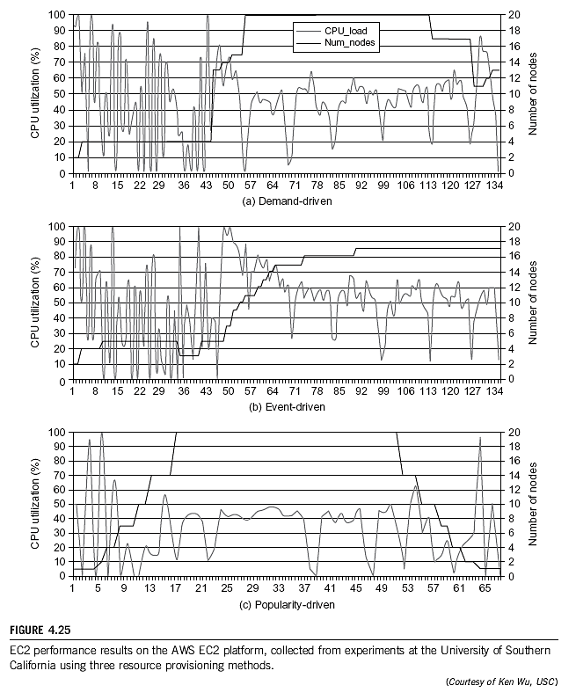
Possible Reactive Strategies
Demand-driven
Event-driven
Popularity-driven

Slide 30
Example: OpenStack Reactive Auto-Scaling

Slide 31
Strategy of Auto-Scaling: Predictive Auto-Scaling

Slide 32
Possible Predictive Strategies
They can predict the resources that will be used
Prediction workload
Linear regression calculation [1]
Using Chaos Theory to predict [2]
Auto-regressive model[3]
Bayesian Network with machine learning techniques[4]
[1] K. Qazi, Yang Li, and A. Sohn, “Workload Prediction of Virtual Machines for Harnessing Data Center Resources,” in 2014 IEEE 7th International Conference on Cloud Computing (CLOUD), 2014, pp. 522–529.
[2] L. Yazdanov and C. Fetzer, “Lightweight automatic resource scaling for multi-tier web applications,” in 2014 IEEE 7th International Conference on Cloud Computing (CLOUD), 2014, pp. 466–473
[3] A. Bashar, “Autonomic scaling of Cloud Computing resources using BN-based prediction models,” in 2013 IEEE 2nd International Conference on Cloud Networking (CloudNet), 2013, pp. 200–204
[4] L. Zhang, Y. Zhang, P. Jamshidi, L. Xu, and C. Pahl, “Workload Patterns for Quality-Driven Dynamic Cloud Service Configuration and Auto-Scaling,” in Proceedings of the 2014 IEEE/ACM 7th International Conference on Utility and Cloud Computing, 2014, pp. 156–165.

Slide 33
Example: Linear Regression Prediction

Slide 34
Comparison of Reactive and Predictive Strategies
Reactive auto-scaling:
Tell the system when to do auto-scaling
Predictive auto-scaling:
In most studies, it tells the system how to do auto-scaling
Studies for temporal prediction are very few

Slide 35
Overview of IaaS Resource Allocation
Choice: Private cloud or public cloud

Slide 36
Public Cloud or Private Data Center?
Assume usage-based pricing
Assume the customer’s revenue is directly proportional to the total number of user-hours.

Slide 37
Decision Model (Simplified Standard Capital-Budgeting Format) for Purchase
Purchased
Net Present Value
所謂淨現值係指一個投資項目的全部現金流入的折現值和全部現金流出的折現值之間的差額。如果NPV>0，說明該投資的現金流入現值大於現金流出現值，其結果可以增加淨利。
P_{T} is the annual profit resulting from the purchased asset in year T;
C^{p}_{T} is the asset’s expected annual operating cost at year T;
I_{K} is the firm’s cost of capital, defined as the interest rate of its outstanding debt used to finance the purchase;(折現率)
N is the asset’s productive life in years;
S is the asset’s salvage value (資產可利用值) after N years;
E is the asset’s purchase (capital) cost.

Slide 38
Decision Model (Simplified Standard Capital-Budgeting Format) for Lease
Leased
C_{T}^{L} is the leased asset’s expected annual operating cost at year T;
L_{T} is the lease payment at year T;
I_{R} is the interest rate for financing the lease payments.

Slide 39
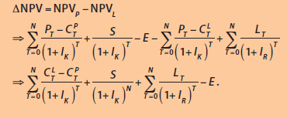

Slide 40
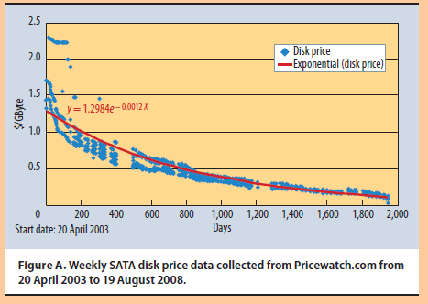
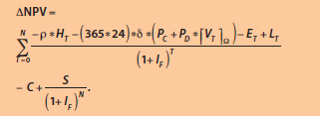

Slide 41
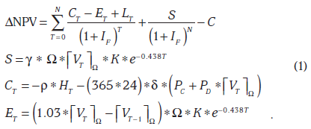
Decision Model
buy-or-lease decision
If the incremental NPV (ΔNPV) ≥ 0 →buy; if Δ NPV < 0 → lease, where Δ NPV = NPV_{P} - NPV_{L}.
We assume ⎡V⎤_{Ω} is an operator returning the minimum number of Ω-sized disk drives needed to store V Gbytes of data.
S: the expected end-of-life disk salvage value,
C_{T}: the operating cost in year T
E_{T}: the capital cost in year T,

Slide 42
Single-user computers

Slide 43
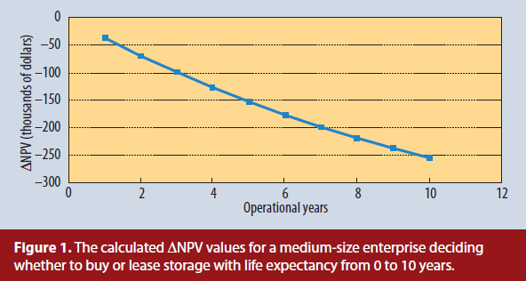
Medium-size enterprises

Slide 44
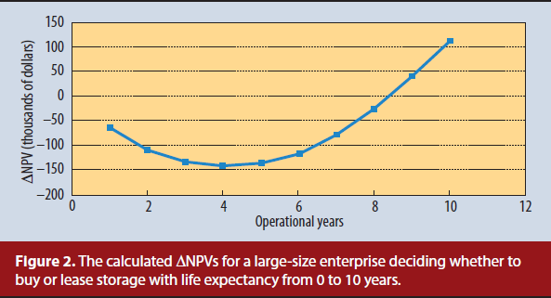
Large-size enterprises

Slide 45
Other Topics
Network Bandwidth Allocation
Soft real-time scheduling
Hard real-time scheduling
High Reliability/Availability issues
What should the system do if a failure happened?
Resource allocation for virtual clusters or virtual datacenters
Emulating communication inside a physical host can reduce network bandwidth consumption
Impact of dynamic load-balancing on virtual clusters

Slide 46
Overview of PaaS/SaaS Resource Allocation

Slide 47
Overview of PaaS/SaaS Resource Allocation
Concept of PaaS/SaaS Scheduling

Slide 48
Terminology Definition
Job
A computing work unit that should be carried out by a processing unit
Task
A independent small piece of a job.
A Job consists of one to many tasks.
Processing unit
Can be a CPU, a vCPU, a VM, a physical machine, a process, a software service
Job/Task Queue
A place that temporarily hold jobs/tasks

Slide 49
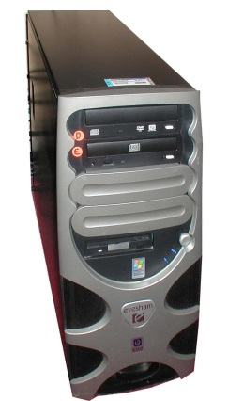
A Typical Scheduling Model
Scheduler
Jobs Workload/Time Estimator
Jobs Dispatcher
Decision Maker/
Scheduling
Jobs
Jobs Selector
Assign
jobs
User
Monitor
Queues
Jobs
User
Monitoring
data collection
Jobs
User
Processing Units

Slide 50
Job/Task and Processing Units
Job (or task) properties:
Priority
Dependency
Estimated work length measured in million instructions
Deadline
Resource usage model during execution
Processing unit properties:
Processing power such as million instructions per second (MIPS)
Sharable or non-sharable
Preemptable or non-preemptable

Slide 51
Job Dependency: Workflow Scheduling
Jobs can be arranged as workflows.
Usually defined as DAG or Chain
Nodes represents tasks
edges represents flow
Job completion time depends on
DAG/Chain design
Scope of parallelism
Wait time in queue
A
A
B
B
C
C
D
E
DAG
D
E
Chain

Slide 52
Classical Scheduling Problems
Classical Scheduling Problems
Job shop scheduling
there are n jobs and m identical stations. Each job should be executed on a single machine. This is usually regarded as an online problem.
Open shop scheduling
there are n jobs and m different stations. Each job should spend some time at each station, in a free order.
Flow shop scheduling
there are n jobs and m different stations. Each job should spend some time at each station, in a pre-determined order.
The problems are usually NP-Hard

Slide 53
Job/Task Scheduling on Clouds
Most scheduling problems on the clouds belong to Job shop scheduling
Job scheduling means to place jobs to a set of processing units for execution
Task scheduling has a similar definition
Assume we are given a set of jobs to be executed and a set of processing units:
A job scheduler should calculate “a schedule” for each job describing when the job is started on which processing unit
It must ensure no rules (constraints) are broken
It may need to calculate the “cost” of the schedule, given a cost function (such as a pricing model on an open cloud)

Slide 54
Cost Function to be Optimized
Makespan (the time the last job finishes)
Money spent
Energy consumption
Number of processing units used
Load balancing
Number of executed jobs without violating their deadlines
Number of executed jobs (throughput)
Average/maximum user response time
Fairness (average waiting time)
Multi-objective optimization

Slide 55
Overview of PaaS/SaaS Resource Allocation
Scheduling Strategies

Slide 56
Preconditions of Scheduling
The work length (in million instructions) of a job can or cannot be estimated
The pool of processing units is homogeneous or heterogeneous
The specific scheduling constraints
Failure rate of processing unit
Price of using the processing units
…

Slide 57
Scheduling Methods for Unknown Work Length with Homogeneous Environment
Round-Robin
Random
High-Priority-First

Slide 58
Scheduling Methods for Estimable Work Length with Homogeneous Environment
Shortest-task-first
Longest-task-first
Round-Robin
Random
High-Priority-First

Slide 59
Scheduling Methods for Unknown Work Length with Heterogeneous Environment
Round-Robin for task selection, and for machine selection (each machine must have an order, such as fastest to the slowest)
Random

Slide 60
Scheduling Methods for Estimable Work Length with Heterogeneous Environment
All the above strategies are applicable
We will only introduce the following methods:
Random Task Selection with MCT
Min-min
Max-min
Min-max
The following methods are applicable but we are not going to introduce them
Meta-Heuristics-based algorithms
Probability-based algorithms

Slide 61
MCT: Minimum Completion Time
Let l be the job/task length (e.g. million instructions to be executed), P = <P₁, P₂, ..., P_{n}> be the processing speed (e.g. MIPS) of Machines 1~n, and A = <A₁, A₂, ..., A_{n}> be the earliest available time of Machines 1~n. Then
MCT(l, P, A) =Min{ (A_{i} + l /P_{i})| for i = 1 to n}
MCT considers the earliest available time of each machine.

Slide 62
Minimum Execution Time (MET)
Let L be the job/task length (e.g. million instructions to be executed), P₁, P₂, ..., P_{n} be the processing speed (e.g. MIPS) of Machines 1~n. Then
MET(L) =Min( {L/P_{i} | for i = 1 to n} )

Slide 63
Min-Min
Min-Min: The min-min algorithm is based on the MCT algorithm. It selects the task and the machine that has the minimal MCT.
Algorithm:
1. While (all tasks/jobs are scheduled ) {
2. Calculate MCT for every available Task/Job
2. Choose the task/job i with the minimal MCT
3. Choose the machine j with the minimal MCT, given the task/job i
4. Update the schedule and the earliest available time of each machine
5. }

Slide 64
Max-Min
Max-Min: The max-min chooses the job with the largest MCT. The goal of max-min algorithm is to reduce the cost of executing the job with long MCT.
Algorithm:
1. While (all tasks/jobs are scheduled ) {
2. Calculate MCT for every available Task/Job
2. Choose the task/job i with the maximal MCT
3. Choose the machine j with the maximal MCT, given the task/job i
4. Update the schedule and the earliest available time of each machine
5. }

Slide 65
Min-Max
Min-Max: The min-max heuristic selects the task/job with the largest MCT/MET. The task is then assigned to the machine that has the minimal MCT for the task.
Algorithm:
1. While (all tasks/jobs are scheduled ) {
2. Calculate MCT and MET for every available Task/Job
2. Choose the task/job i with the maximal MCT/MET
3. Choose the machine j with the minimal MCT, given the task/job i
4. Update the schedule and the earliest available time of each machine
5. }

Slide 66
Example: Random Task Selection with MCT on Two Job-Chains
Choose MCT among all machines
Choose min completion time (MCT) among all machines
Choose a Job randomly
Choose a Job randomly
M1
100
FT = 4
J1,2
600
J1,1
200
FT = 1
FT = 5
FT = 4
M2
200
J2,2
200
J2,1
400
Schedule:
M1
M2
Choose a Job randomly
Choose MCT among all machines
Choose MCT among all machines
Choose a Job randomly
J _{2,1}
J _{1,1}
J _{1,2}
J _{2,2}
4
5
Time
0
1

Slide 67
Example: Min-Min on Two Job-Chains
Compute MCT for each available Task
Choose the Task with the minimal MCT
MCT = 5 on m2
MCT = 7 on m2
MCT = 1 on m2
FT = 2
J1,2
1600
J1,1
400
M1
200
FT = 1
FT = 7
FT = 3
J2,2
400
J2,1
800
M2
400
Schedule:
M1
M2
MCT = 3 on m2
MCT = 2 on m1
MCT = 2 on m2
J _{2,2}
J _{1,1}
J _{2,1}
J _{1,2}
Time
0
1
2
3
7

Slide 68
Example: Max-Min on Two Job-Chains
Compute MCT for each available Task
Choose the Task with the maximal MCT
MCT = 6 on m2
MCT = 1 on m2
FT = 2
MCT = 2 on m1
FT = 4
J1,2
1600
J1,1
400
M1
200
Randomly Choose Either J_{1,1} or J_{2,2}
FT = 6
FT = 2
J2,2
400
J2,1
800
M2
400
MCT = 2 on m1
MCT = 2 on m2
MCT = 4 on m1
Schedule:
M1
M2
MCT = 3 on m2
J _{1,2}
J _{2,2}
J _{2,1}
J _{1,2}
Time
0
2
4
6

Slide 69
Example: Min-Max on Two Job-Chains
Choose the machine with the minimal MCT for the task
Choose the task with the maximal MCT/MET
MCT/MET
= 8/4
MCT/MET
=6/3
MCT/MET
= 3/3
MCT/MET
= 5/3
Randomly Choose Either J_{1,1} or J_{2,1}
J1,2
1600
J1,1
1200
M1
200
FT = 8
FT = 3
FT = 2
FT = 6
J2,2
400
J2,1
800
M2
400
Schedule:
M1
M2
MCT/MET
= 2/1
MCT/MET
= 2/2
J _{1,2}
J _{2,1}
J _{2,2}
J _{1,1}
Time
0
2
3
6
8

Slide 70
Practice
Given two machines and four job chains as shown on the right side, please calculate the schedule using
Min-Min
Max-Min
Min-Max
Longest-Task-First + Round-Robin Machine Selection
J1,3
400
J1,2
600
J1,1
400
J2,1
600
J3,2
1200
J3,1
800
J4,2
1000
J4,1
200
M2
400
M1
200

