Slide 1
Cloud Computing: Datacenter and Virtualization
Dept. of Computer Science and Information Engineering
National Central University
*Some slides are adopted from “Distributed and Cloud Computing from
Parallel Processing to the Internet of Things” by K. Hwang, G. C. Fox and J. J. Dongarra

Slide 2
Outline
Impact of Cloud Computing
Datacenter
Virtualization Technologies in Datacenters

Slide 3

Impact of Cloud Computing

Slide 4
A Berkeley View
On Cloud Computing's Fundamental Impact
"Cloud Computing is likely to have the same impact on software that foundries have had on the hardware industry."
On the Economic Benefits of the Cloud
"Although the economic appeal of Cloud Computing is often described as 'converting capital expenses to operating expenses' (CapEx to OpEx), we believe the phrase 'pay as you go' more directly captures the economic benefit to the buyer."
On the Opportunities for Application Developers
"While we have yet to see fundamentally new types of applications enabled by Cloud Computing, we believe that several important classes of existing applications will become even more compelling with Cloud Computing and contribute further to its momentum."
Above the Clouds: A Berkeley View of Cloud Computing by Michael Armbrust et al.

Slide 5
A Berkeley View - New Application Opportunities
Mobile interactive applications
Parallel batch processing
The rise of analytics
Extension of compute-intensive desktop applications
“Earthbound” applications
Above the Clouds: A Berkeley View of Cloud Computing by Michael Armbrust et al.

Slide 6
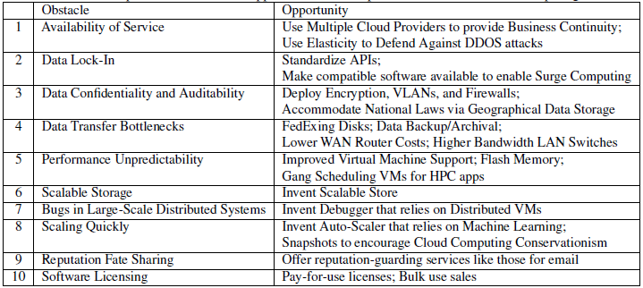
A Berkeley View - Top 10 Obstacles and Opportunities

Slide 7
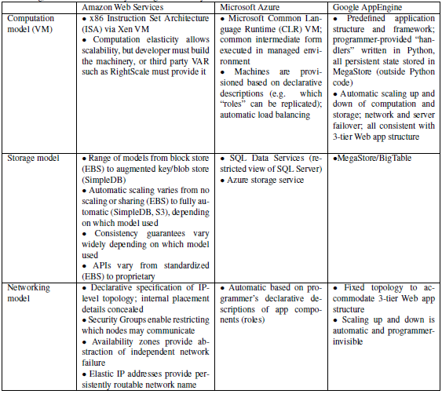

Slide 8
Ian Foster et al.: Seven risks a Cloud user should raise with vendors
Privileged user access
Regulatory compliance
Data location
Data segregation
Recovery
Investigative support
Long-term viability
By Ian Foster et al.

Slide 9
A Microsoft View: Cloud Computing Futures
The organization will strive to lower hardware costs, power consumption, and the environmental impact of such facilities
An intelligent closed-loop control system can determine when to put a processor to sleep and when to awaken it to serve the workload
It works by taking regular measurements of the system, such as CPU utilization, response time, and energy consumption; combining these data with the estimated future workload; then adjusting the number of servers in each power state

Slide 10
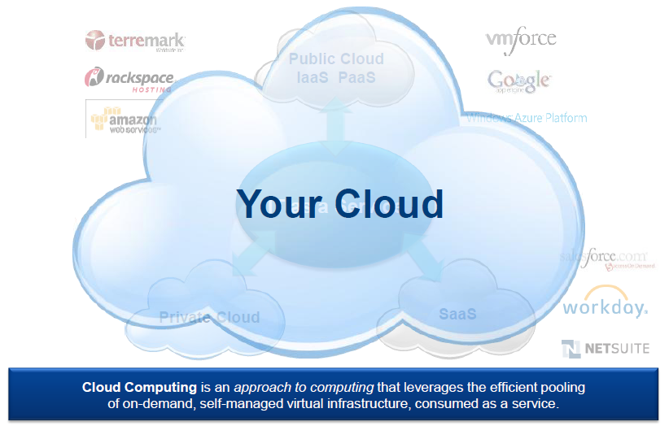
A VMWare View – Your Cloud, Own It
Your Cloud = Optimized IT production
for business consumption

Slide 11
A VMWare View: Intelligent Virtual Infrastructure for Private Cloud
Your Cloud
Cloud Infrastructure
Automation
Management
Compute
Storage
Networking
Integrated Security

Slide 12
Datacenter

Slide 13
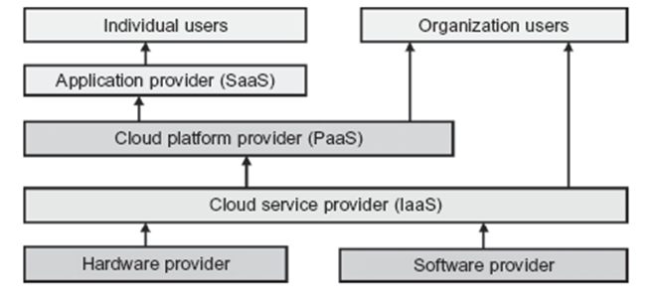
Cloud Eco-System

Slide 15
Cloud Services and Major Providers
Notes:
Cloud applications are the key global opportunity for developers during next four years
2009: $8.5 billion
2013: $16.8 billion

Slide 16
Cloud Hardware: The Datacenter
A data center (or datacentre) is a facility used to house computer systems and associated components, such as telecommunications and storage systems. It generally includes redundant or backup power supplies, redundant data communications connections, environmental controls (e.g., air conditioning, fire suppression) and security devices.

Slide 17
Big Data: The Motivation of Using Datacenters
Google processes 20 PB a day (2008)
“all words ever spoken by human beings” ~ 5 EB
NOAA has ~1 PB climate data (2007)
CERN’s LHC will generate 15 PB a year (2008)

Slide 18
Large Data Centers
Clear trend: centralization of computing resources in large data centers
Necessary ingredients: fiber, electricity, and space
Important Issues:
Redundancy
Efficiency
Utilization
Management

Slide 19
The Datacenter Industry
10¹~10²
Traditional Cluster Computers
A small number of racks/cabinets
10²~10³
Container Computer
for high efficiency and environmental conservation
Software packages are installed before shipping
Large Cluster
Tens of racks/Cabinets
10³~10⁵
Warehouse-Scale Computer (WSC)
A datacenter hosting only one application/service
Bundled software (Cloud OS)
Unified platform on top of homogeneous computers/OSes
IaaS/PaaS Datacenter
Hosting various applications
Usually uses server virtualization
Scale
Notes:
Alll of the above leading a New Data Center Industry!!!

Slide 20

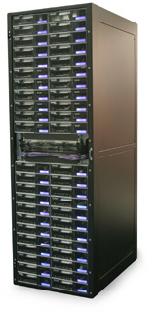
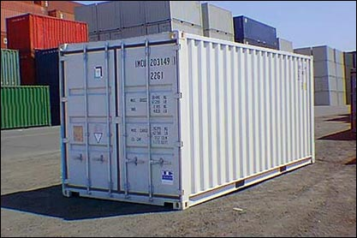
Larger Datacenter Growth
One at a time:
1 system
Racking & networking: 14 hrs ($1,330)
Rack at a time:
~ 40 systems
Install & networking: .75 hrs ($60)
Container at a time:
~1,000 systems
No packaging to remove
No floor space required
Power, network, & cooling only
Weatherproof & easy to transport
Datacenter construction takes 24+ months
Both new build & DC expansion require regulatory approval
Notes:
20

Slide 21
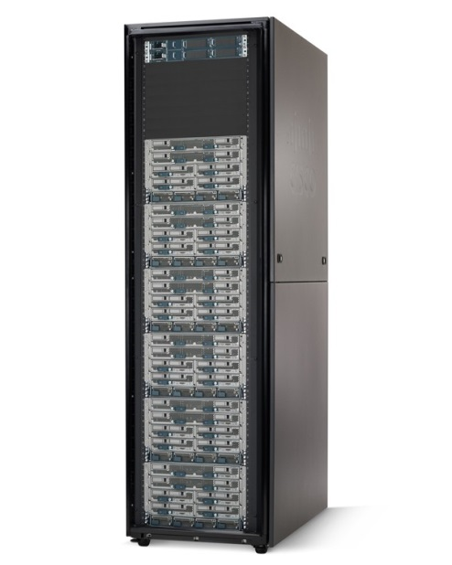
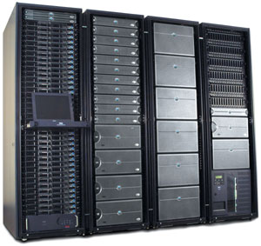
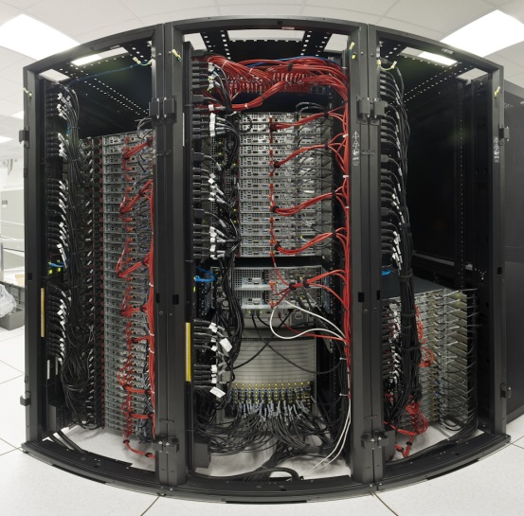
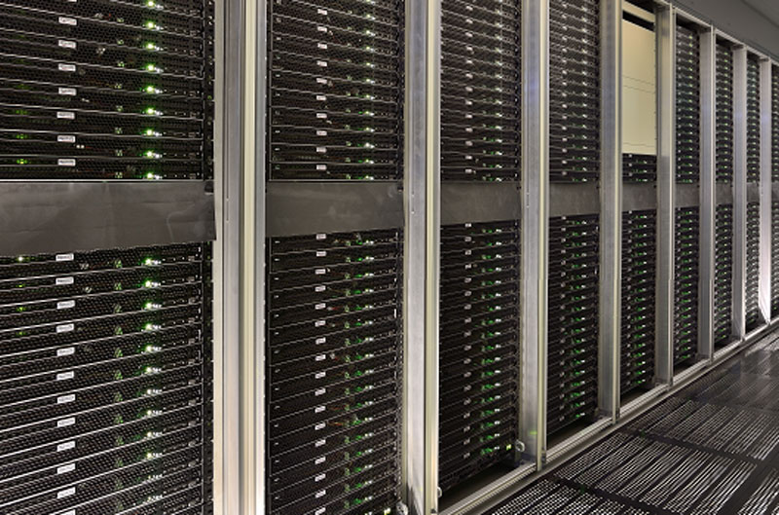
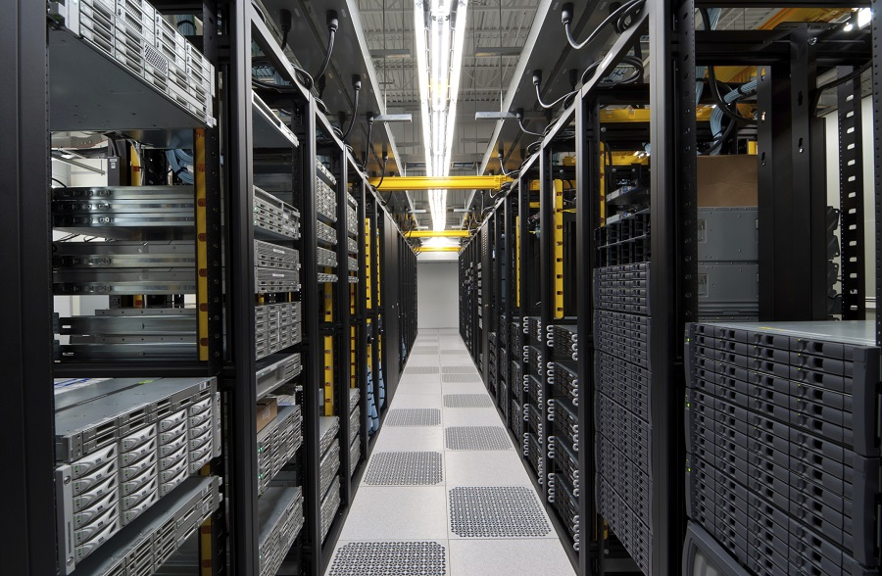
Computer Racks and Cabinets

Slide 22
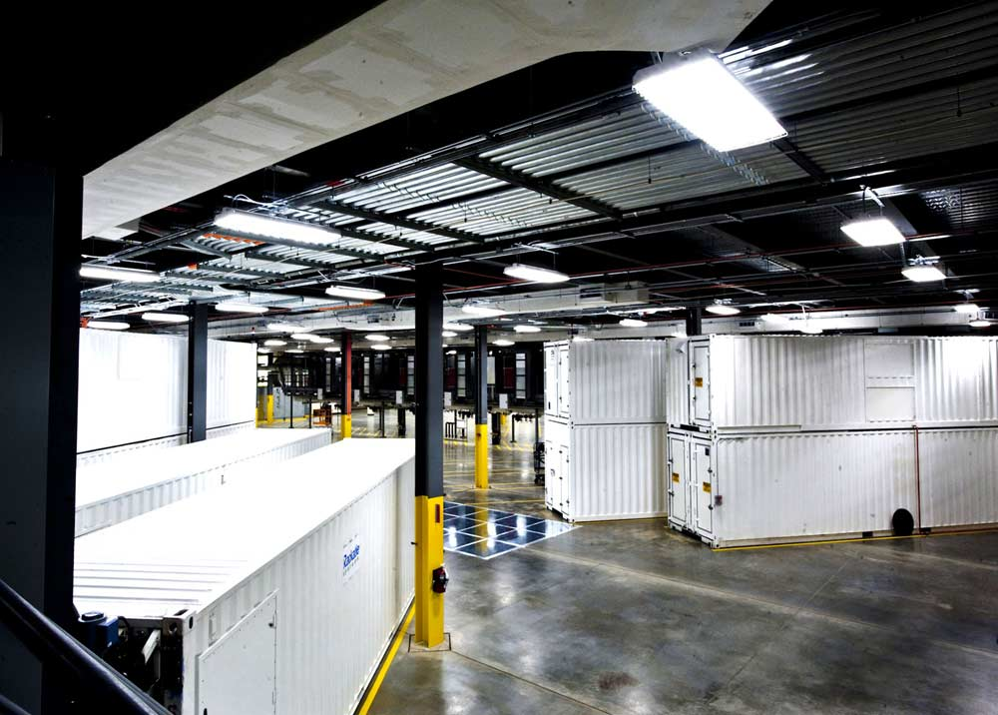


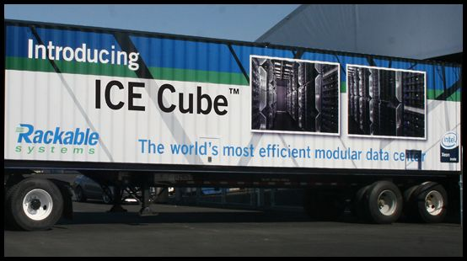
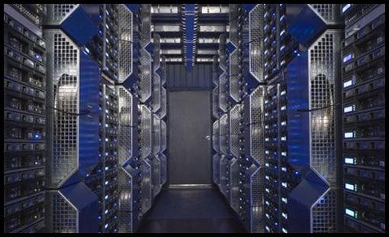
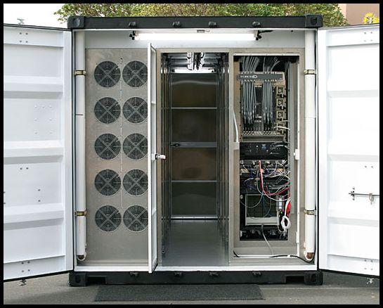
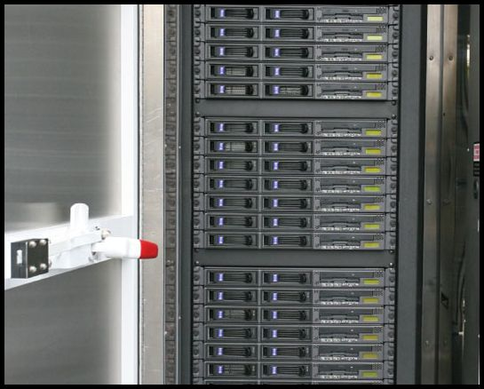
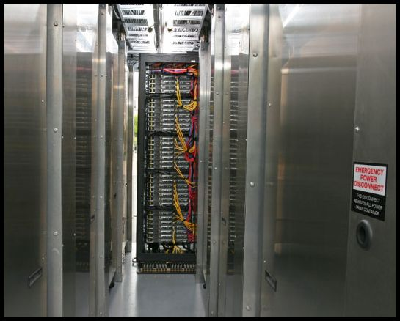
Container Computers
22

Slide 24
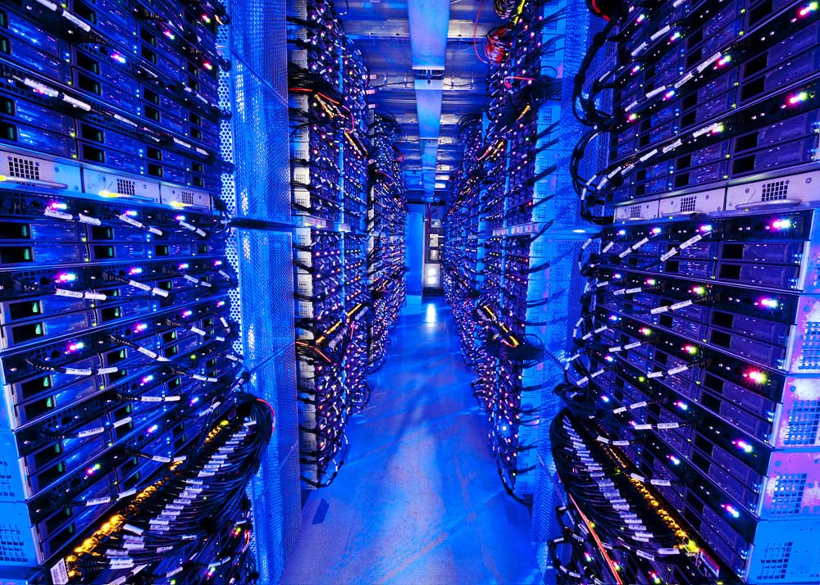
Google “Warehouse Style Computer” Data Center
Notes:
This is already shrinking to a container (modular approach)

Slide 25
The Architecture of a Small Server Cluster ( ~ 1000 servers)
interconnected by an Ethernet switch and housed in a warehouse or in a container environment
(Courtesy of Luiz Barroso and Urs Holzle, Google Inc., 2009)
Notes:
25

Slide 26
Warehouse-Scale Computer (WSC)
Provides Internet services
Search, social networking, online maps, video sharing, online shopping, email, cloud computing, etc.
Differences with HPC “clusters”:
Clusters have higher performance processors and network
Clusters emphasize thread-level parallelism, WSCs emphasize request-level parallelism
Differences with datacenters:
Datacenters consolidate different machines and software into one location
Datacenters emphasize virtual machines and hardware heterogeneity in order to serve varied customers
(Courtesy of Hennessy and Patterson, 2012)
Notes:
The University of Adelaide, School of Computer Science
15 February 2017
Chapter 2 — Instructions: Language of the Computer
26

Slide 27
Design Considerations for WSC:
Cost-performance
Small savings add up
Energy efficiency
Affects power distribution and cooling
Work per joule
Dependability via redundancy
Network I/O
Interactive and batch processing workloads
Ample computational parallelism is not important
Most jobs are totally independent
“Request-level parallelism”
Operational costs count
Power consumption is a primary constraint when designing system
Scale and its opportunities and problems
Can afford customized systems since WSC require volume purchase
(Courtesy of Hennessy and Patterson, 2012)
Notes:
The University of Adelaide, School of Computer Science
15 February 2017
Chapter 2 — Instructions: Language of the Computer
27

Slide 28
Typical Datacenter Layout

Slide 29
Power Consumption in Servers

Slide 30
(Courtesy of Luiz Andre Barroso and Urs Holzle, Google Inc., 2009)

Slide 31
Measuring Efficiency of a WSC
Power Utilization Effectiveness (PEU)
= Total facility power / IT equipment power
Median PUE on 2006 study was 1.69
Performance
Latency is important metric because it is seen by users
Bing study: users will use search less as response time increases
Service Level Objectives (SLOs)/Service Level Agreements (SLAs)
E.g. 99% of requests be below 100 ms
(Courtesy of Hennessy and Patterson, 2012)
Notes:
The University of Adelaide, School of Computer Science
15 February 2017
Chapter 2 — Instructions: Language of the Computer
31

Slide 32
Power and Cooling Requirements
Cooling system also uses water (evaporation and spills)
E.g. 70,000 to 200,000 gallons per day for an 8 MW facility
Power cost breakdown:
Chillers: 30-50% of the power used by the IT equipment
Air conditioning: 10-20% of the IT power, mostly due to fans
How many servers can a WSC support?
Each server:
“Nameplate power rating” gives maximum power consumption
To get actual, measure power under actual workloads
Oversubscribe cumulative server power by 40%, but monitor power closely
(Courtesy of Hennessy and Patterson, 2012)
Notes:
The University of Adelaide, School of Computer Science
15 February 2017
Chapter 2 — Instructions: Language of the Computer
32

Slide 33
Architecture of WSC
WSC often use a hierarchy of networks for interconnection
Each 19” rack holds 48 1U servers connected to a rack switch
Rack switches are uplinked to switch higher in the hierarchy
Uplink has 48 / n times lower bandwidth, where n = # of uplink ports
Goal is to maximize locality of communication relative to the rack
(Courtesy of Hennessy and Patterson, 2012)
Notes:
The University of Adelaide, School of Computer Science
15 February 2017
Chapter 2 — Instructions: Language of the Computer
33

Slide 34
(Courtesy of Luiz Andre Barroso and Urs Holzle, Google Inc., 2009)

Slide 35
Storage and Array Switch
Storage options:
Use disks inside the servers, or
Network attached storage through Infiniband
WSCs generally rely on local disks
Google File System (GFS) uses local disks and maintains at least three relicas
Switch that connects an array of racks
Array switch should have 10 X the bisection bandwidth of rack switch
Cost of n-port switch grows as n²
Often utilize content addressible memory chips and FPGAs
(Courtesy of Hennessy and Patterson, 2012)
Notes:
The University of Adelaide, School of Computer Science
15 February 2017
Chapter 2 — Instructions: Language of the Computer
35

Slide 36
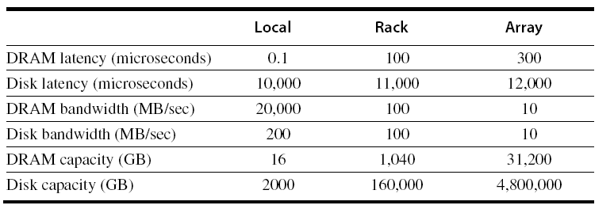
WSC Memory Hierarchy
Servers can access DRAM and disks on other servers using a NUMA-style interface
(Courtesy of Hennessy and Patterson, 2012)
Notes:
The University of Adelaide, School of Computer Science
15 February 2017
Chapter 2 — Instructions: Language of the Computer
36

Slide 37
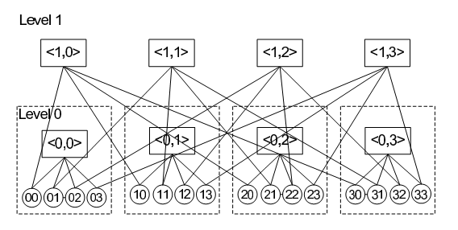
Interconnection Networks

Slide 38
Benefits of WSC
WSCs offer economies of scale that cannot be achieved with a datacenter:
5.7 times reduction in storage costs
7.1 times reduction in administrative costs
7.3 times reduction in networking costs
This has given rise to cloud services such as Amazon Web Services
“Utility Computing”
Based on using open source virtual machine and operating system software
(Courtesy of Hennessy and Patterson, 2012)
Notes:
The University of Adelaide, School of Computer Science
15 February 2017
Chapter 2 — Instructions: Language of the Computer
38

Slide 39
Virtualization Technologies in Datacenters

Slide 40
Advantages of Virtualization i
Virtualization improves resource utilization rate!
But it does not mean:
Less IT investment
Higher costumer satisfaction rate
More profits
Utilization rate
100
75
50
25
Time
A Common Case
in CPU Utilization Rate

Slide 41
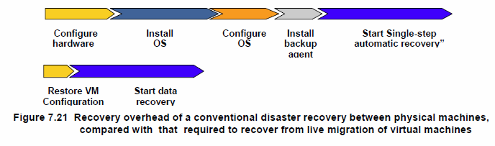
Advantages of Virtualization ii
Flexibility and Fast Failover!

Slide 42
Key Technology: Virtualization
Virtualization is the idea of partitioning or dividing the resources of a single server into multiple segregated VMs (virtual machines)
A VM is a software implementation of a machine (i.e., a computer) that executes programs like a physical machine

Slide 43
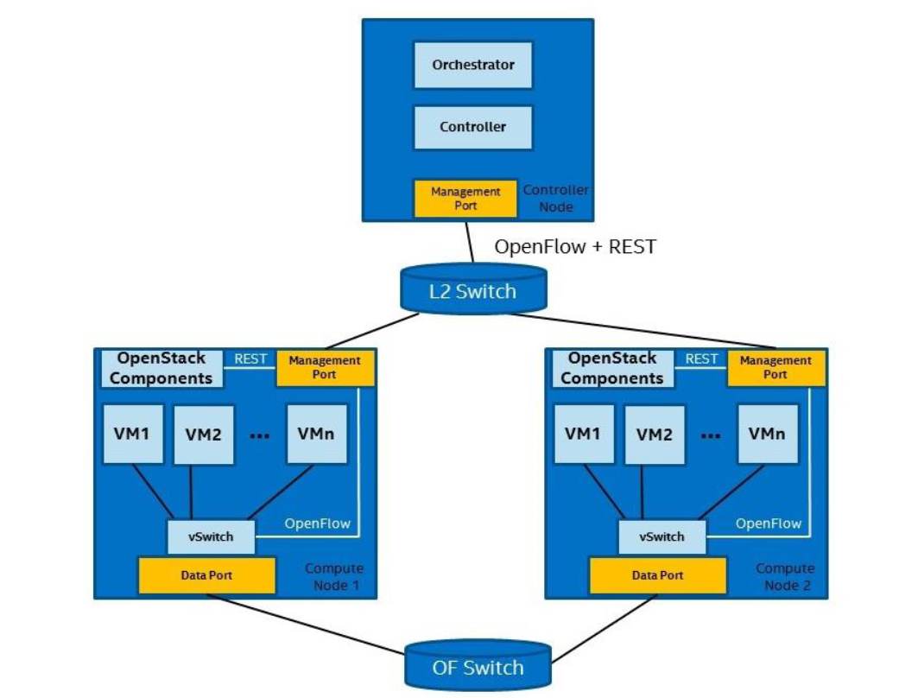
Example of Resource Management Architecture: Intel Open Network Platform

Slide 44
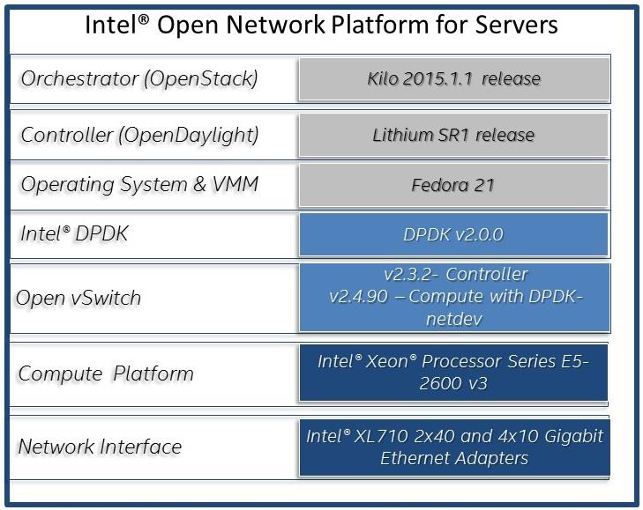

Slide 45
Example: Microsoft Bing
Queries
Japan
Great Britain
0:00
12:00
24:00
Time
Bing uses tens of thousand servers all over the world
It cannot achieve resource sharing between two data centers
Source: A Microsoft report in 2012

Slide 46
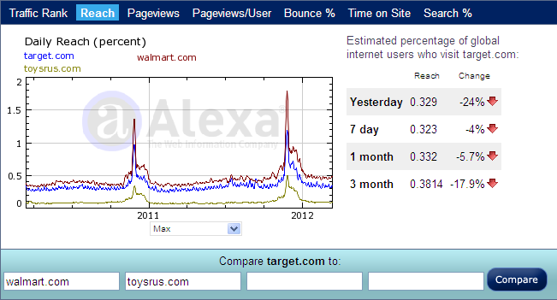
Other Challenge in Virtualization
Virtualization cannot solve the problem of resource sharing among different enterprises
Source: Alexa

Slide 47
Inefficient IT Investment
IT Resources
Purchased Resources
Expected IT Consumption
Real IT Consumption
Time

Slide 48
Trend: Virtualizing the Data Center: From Silos to Clouds
Sprawled
Component-Orientation
Virtualized
Layer Orientation
Automated
Service Orientation
Policies
Cloud- enabled
Optimization
Workloads
Data
Resources
Identities
Provisioning
Availability
Hardware costs down, flexibility up
Service levels and agility up
Services
2002
2002-2012
2010-2020
By Gartner
Notes:
Virtualization is having a huge impact on infrastructure architectures, processes and operations, people and skills, and the business. It is the most important and impactful trend in infrastructure and operations through 2012 — changing how you manage, how/what you buy, how you deploy, how you plan, how you charge. It also shakes up the industry, in terms of licensing, pricing and component management. Infrastructure is on an inevitable shift from components that are either physically integrated by vendors (for example, monolithic servers), or manually integrated by users, to logically composed "fabrics" of computing, I/O and storage components.
But virtualization is only an enabler to very important future trends. Virtualization creates a pool of manageable, flexible capacity. Automation and service centricity will take that pool of resource and do useful work based on business policies and service-level requirements. Also, the decoupling created by virtualization combined with defined service offerings and automation are great enablers of cloud computing. Essentially, real-time infrastructure (RTI) is a private cloud computing engine. The infrastructure engine in cloud service providers will be RTIs. But more than that, the services-oriented interfaces created between an RTI and its customers enable an IT organization to leverage external cloud services where appropriate. Cloud computing is the inevitable result of a service provider evolving to RTI, and the best customers of cloud computing will be startups, or IT organizations that are themselves evolving toward RTI.
Key Issue: How will virtualization change IT and business?

Slide 49
Cloud Operating Systems
VM instances management
Providing Local Storage
Fault Tolerance
Power Management
Automatic Computing
Self-Provisioning
…

Slide 50
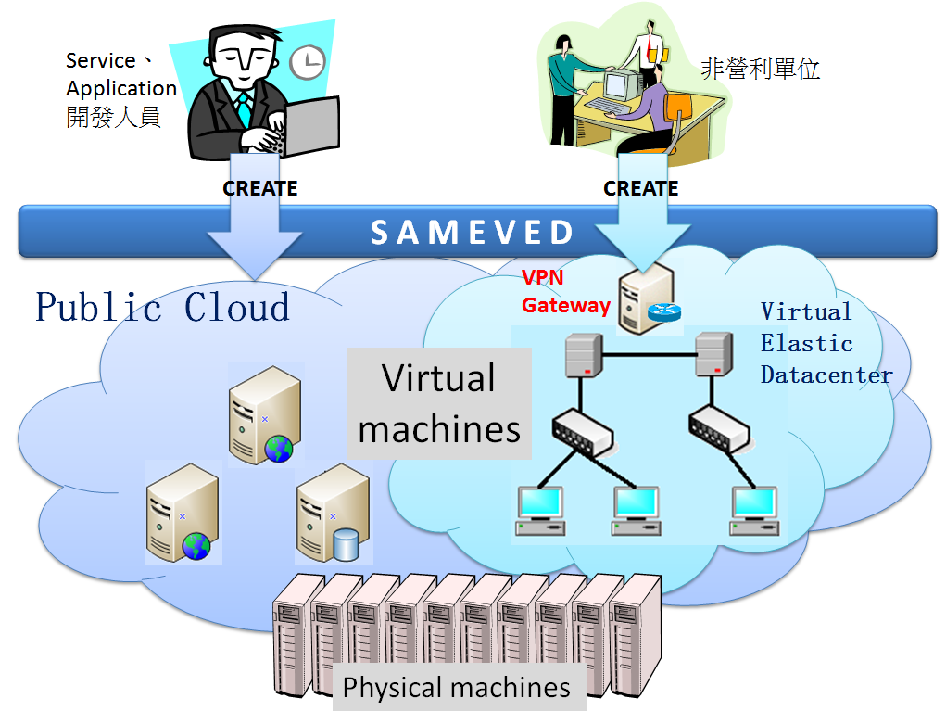
Virtual Private Cloud
Organization
Interface

Slide 51
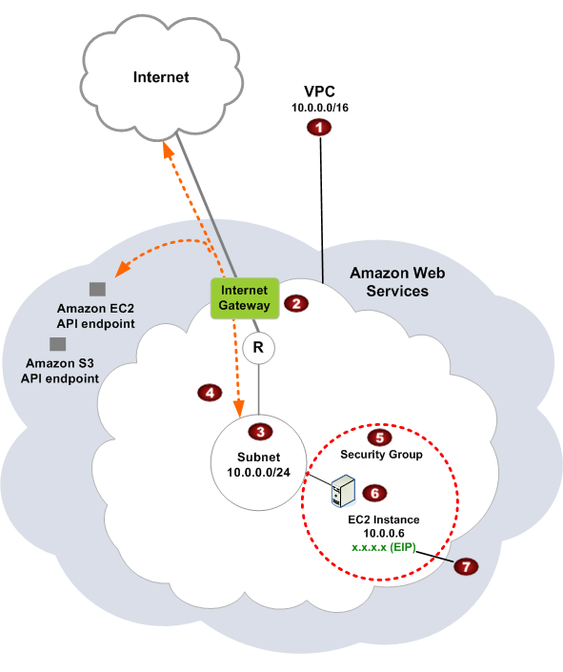
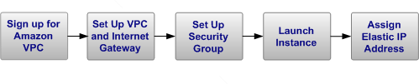
Customized Hybrid Clouds
Example: Amazon Virtual Private Cloud

Slide 52
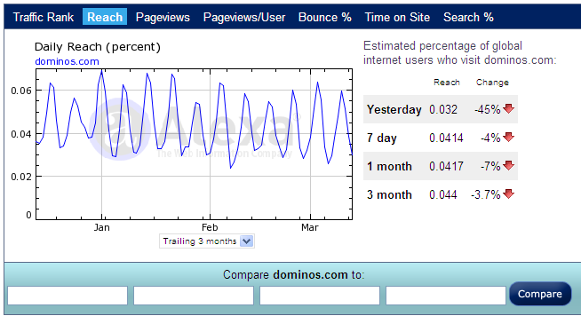
Example: Domino’s Pizza
Source: Alexa

Slide 53
A Hybrid Cloud Model: Domino’s Pizza
Web site of the Domino’s Pizza
On Windows Azure
Redirected Requests
Web site of the Domino’s Pizza
Requests

