Slide 1
Introduction to
Cloud Computing
Lecture 1
Wei-Jen Wang

Slide 2
Outline
Concept of cloud computing
Parallel computing
Distributed computing
Cluster computing
Grid computing
Cloud computing
Cloud vs. grid
P2P computing
Volunteer computing
IoT and fog computing

Slide 3
Concept of Cloud Computing

Slide 4
Cloud Computing Definition
Clouds: Resources or services over internet
Cloud computing: Internet-based computing, whereby shared resources, software and information are provided to computers and other devices on-demand, like electricity
Cloud computing characteristics: involves over-the-Internet provision of dynamically, scalable and often virtualized on demand resources

Slide 5
Concept of Cloud Computing
Public Data
Personal Data
Produce
Consume
Cloud Computing
Resources
Client Devices
Communicate
Cloud Side
Client Side

Slide 6
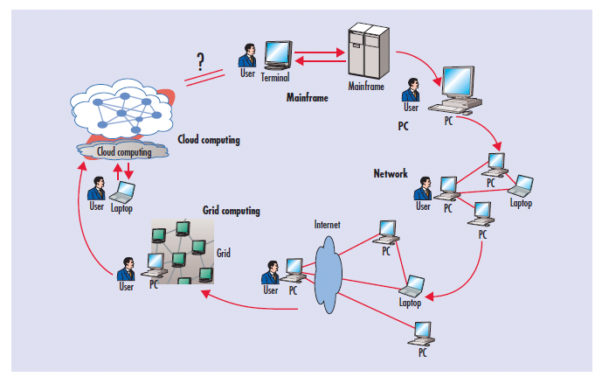
Computing Paradigm Shifting
By Jeffrey Voas, Science Applications International Corporation
Jia Zhang, Northern Illinois University

Slide 7
Cloud Computing in Summary
Cloud computing
  a parallel/distributed computing paradigm
  Its scale is usually larger than the scale of cluster computing
  It was considered the same as grid computing (But not for now and future)
  It is very different from P2P computing and volunteer computing
  It is an important part in the IoT architecture and Fog computing

Slide 8
Parallel Computing

Slide 9
Parallel Computing
Parallel Computing
  A form of computation in which many calculations are carried out simultaneously
  Large problems can often be divided into smaller ones, which are then solved concurrently ("in parallel")
Advantages
  Cost efficient
  High performance
  Improve Utilization

Slide 10
Flynn's Taxonomy
Programs and computers are classified by
  whether they were operating using a single set or multiple sets of instructions
  whether or not those instructions were using a single or multiple sets of data
 | Single Instruction | Multiple Instructions
Single Data | SISD | MISD
Multiple Data | SIMD | MIMD

Slide 11
Degrees of Parallelism
Bit-level parallelism (BLP) vs. bit-serial processing
  4-bit , 8-bit, …, 64-bit CPU
Instruction-level parallelism (ILP) vs. one instruction at a time
  Pipelining, super-scalar computing, VLIW, …
Data-level parallelism (DLP): SIMD
Task-level parallelism (TLP): MISD or MIMD
Job-level parallelism (JLP): group of tasks

Slide 12
Parallel Programming Models
Parallel programming model
  A set of software technologies to express parallel algorithms and match applications with the underlying parallel systems
Shared-memory or Distributed-memory model

Slide 13
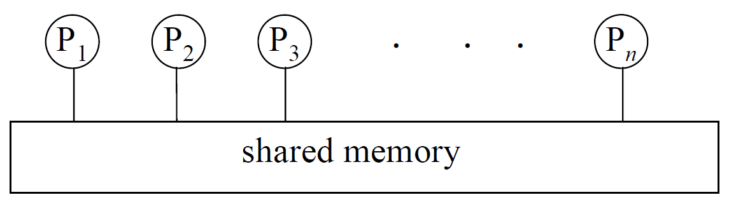
Two Basic Models
Shared memory model
  Memory can be simultaneously accessed by multiple process with an intent to provide communication among them or avoid redundant copies

Slide 14
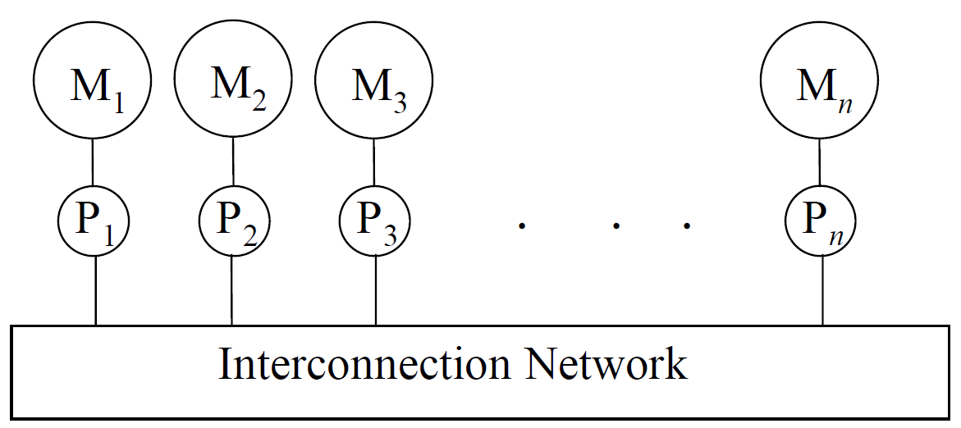
Two Basic Models
Distributed memory model
  A multiple-processor computer system in which each processor has its own private memory
  Computational tasks can only operate on local data, and if remote data is required, the computational task must communicate with one or more remote processors

Slide 15
Distributed Computing

Slide 16
Distributed Computing
A computer system in which several interconnected computers share the computing tasks assigned to the system
Paradigms
  Cluster computing
  Grid computing
  Cloud computing

Slide 17
How to Run Applications Faster
There are 3 ways to improve performance:
  Work Harder
  Work Smarter
  Get Help
Computer analogy
  Using faster hardware
  Using optimized algorithms and techniques to solve computational tasks
  Using multiple computers to solve a particular task

Slide 18
History
In the 1980s
  Computer performance was best improved by creating faster and more efficient processors
In the early 1990s
  An increasing trend to move away from expensive and specialized proprietary parallel supercomputers towards networks of workstations

Slide 19
Towards Commodity Computing
Trend of computing
  From specialized traditional supercomputing platforms
  To inexpensive, general purpose systems consisting of loosely coupled components built up from single or multiprocessor PCs or workstations
Low-cost commodity supercomputing
  Linking together two or more computers to jointly solve some computational problem
  Providing high performance computational facilities for large-scale and grand-challenge applications

Slide 20
Rise & Fall of Computing Technologies
Mainframes
Mini-Computers
Personal Computers
Distributed
Computing
Mini-Computers
Personal
Computers
Network
Computing
1970
1980
1995
2000+

Slide 21
Cluster Computing

Slide 22
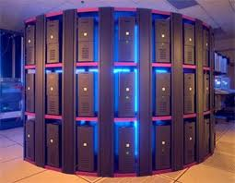
Cluster Computing
A cluster is a type of parallel and distributed system,
  It consists of a collection of inter-connected stand-alone computers
  The Computers work together as a single integrated computing resource

Slide 23
The Cluster
A Node
  A single or multiprocessor system with memory, I/O facilities, & OS
A Cluster:
  Generally two or more computers (nodes) connected together
  In a single cabinet, or physically separated & connected via a LAN
  Appear as a single system to users and applications
  Provide a cost-effective way to gain features and benefits

Slide 24
Computer Collaboration in Cluster
How machines co-work in cluster?
  Using a “Programming Framework” to coordinate the stand-alone computers
Typical programming frameworks for clusters:
  Message Passing Interface (MPI)
  Hadoop MapReduce
  Apache Spark
This course will not cover MPI programming. So we will go through MPI quickly in the following slides

Slide 25
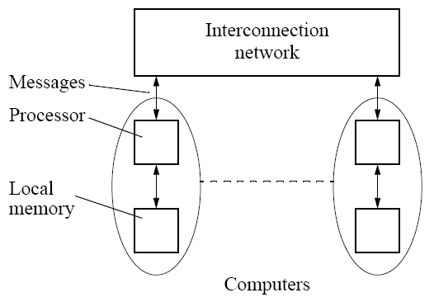
Massage Passing Interface (i)
Distributed memory programming model
Complete computers connected through an interconnection network

Slide 26
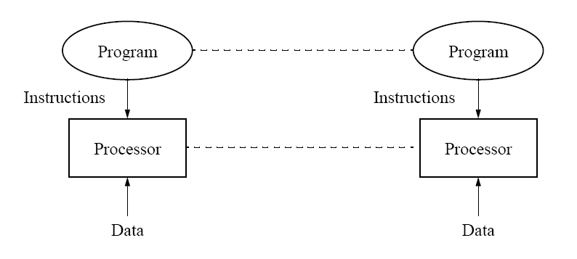
Massage Passing Interface (ii)
Single program with multiple data (SPMD)
  Similar to SIMD (single instruction multiple data)
the same program

Slide 27
Massage Passing Interface (iii)
Typical parallel execution flow :
Start
Initialization
Process 1
Process 2
Process 3
▪ ▪ ▪ ▪ ▪ ▪ ▪
Process N
Communication
Communication
Communication
Finalization
Complete

Slide 28
Cluster Applications
Cluster had become the mainstream computing system
Apply parallel program to
  Computing intensive
  Data intensive
  Timing critical system
  … any time you are pleased

Slide 29
Grid Computing

Slide 30
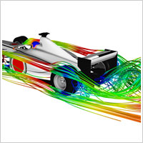
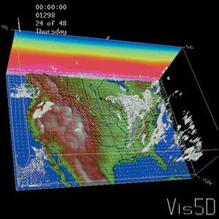
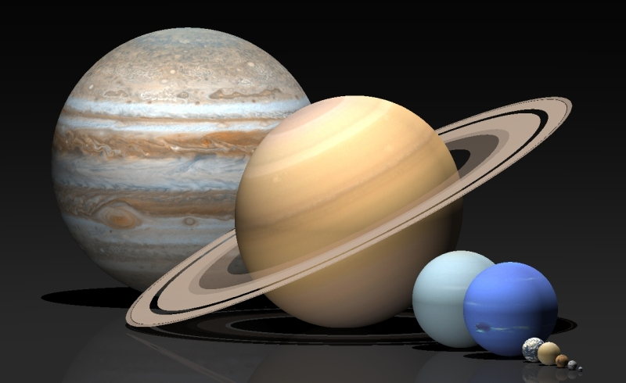
Demand for More Computing Power
The large-scale, computational-/data-intensive scientific applications require more resources
Applications
  Scientific application
  Computer animation
  Computer games
  Image processing
  Data mining
  … etc

Slide 31
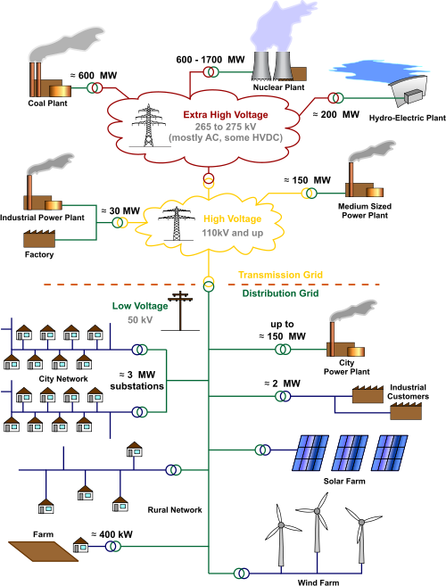
The Grid
Grid
  An analogy with the electric power grid around 1910
  In the mid-1990s, this term is coined to denote a proposed distributed computing infrastructure for advanced science and engineering

Slide 32
Resource Collaboration in Grids
Virtual Organization (VO)
  A set of individuals and/or institutions defined by such sharing rules form
    what is shared
    who is allowed to share
    the conditions under which sharing occurs
An actual organization can participate in one or more VOs by sharing some or all of its resources

Slide 33
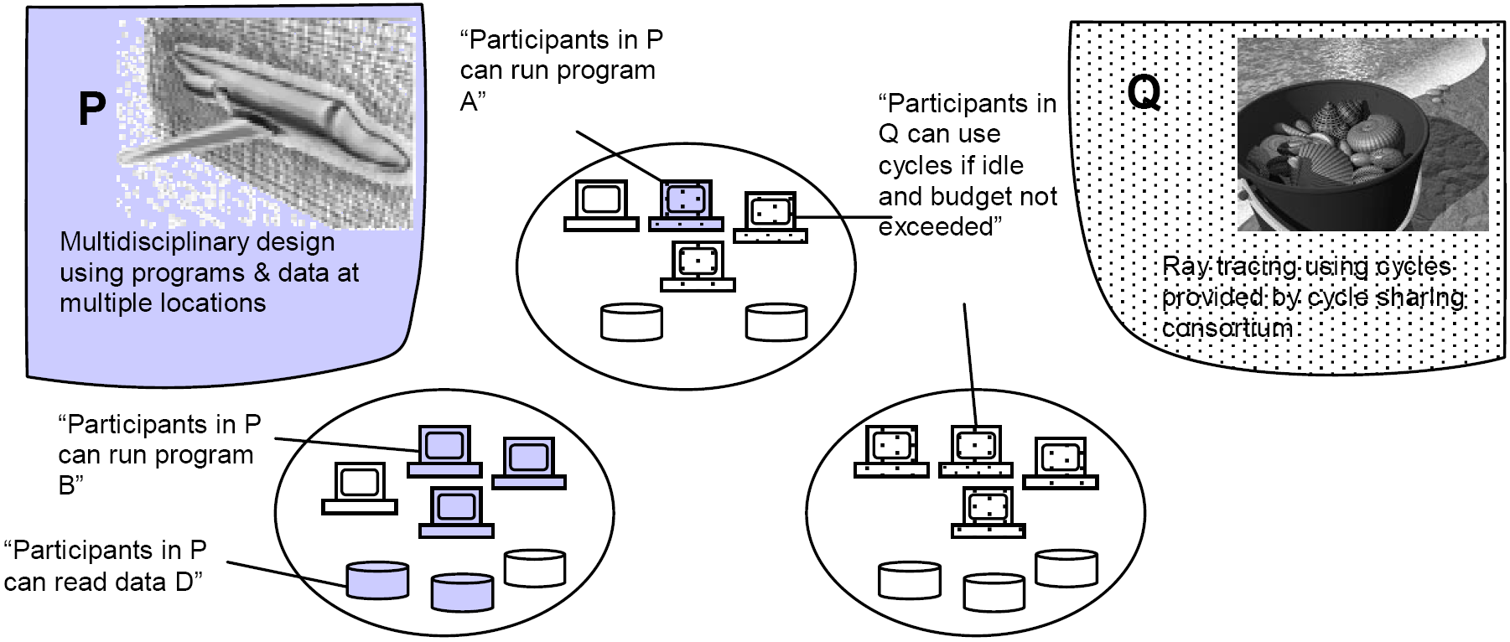
Example of VOs
Three actual organizations (the ovals) & Two VOs (P, Q)
  P: links participants in an aerospace design consortium
  Q: links colleagues who have agreed to share spare computing to run ray tracing computations

Slide 34
Grid Environments
Resources are heterogeneous
  supercomputers, storage systems, data sources, and specialized devices owned by different administrative domains
Enables the sharing, selection, and aggregation of a wide variety of geographically distributed resources
To solve large scale resource-intensive problems in science, engineering, and commerce
Hailed as the next revolution after the Internet and the World Wide Web

Slide 35

Batch Computing in Grid
Compute node
Compute node
Compute node
Compute node
CPU
Manager
CPU
Manager
CPU
Manager
CPU
Manager
Internet
Home
storage
Job queue
Scheduler
1
2
1
2
3
4
3
4
Notes:
Notice that these jobs have dependencies (e.g. 1 must run before 3).
Explain why they have dependencies (3 reads input from the output of 1, therefore can’t run until one is finished).

Slide 36

Cloud Computing

Slide 37
Computing Paradigm Shifting I
By Jeffrey Voas, Science Applications International Corporation
Jia Zhang, Northern Illinois University

Slide 38
Computing Paradigm Shifting II
Cloud computing is a new computing paradigm
Cloud computing is comprised of many parallel/distributed computing concepts and technologies
Therefore, we will introduce related issues and technologies of cloud computing in the following slides.

Slide 39
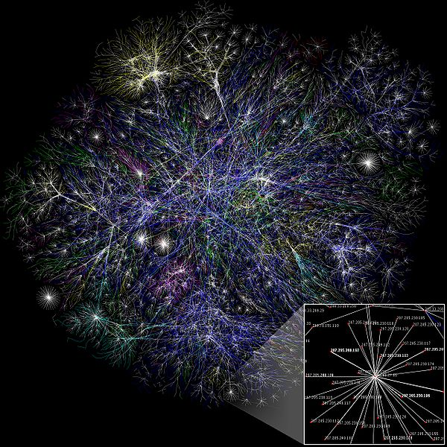
The Internet and Cloud
The Internet can be defined as a worldwide interconnection of computers and computer networks that facilitate the sharing or exchange of information among users
The term "cloud" is used as a metaphor for the Internet.
From Wikipedia

Slide 40
Related Terms in Cloud Computing
Utility computing (on-demand Computing)
Automatic computing
Web 2.0 and web services
Cloud platform
Virtualization
Big data
Cloud security
Green IT
…
Then, what is cloud?

Slide 41
A NIST Definition:
Types of Cloud Services
Cloud Software as a Service (SaaS).
Cloud Platform as a Service (PaaS).
Cloud Infrastructure as a Service (IaaS).
By Nist.gov.

Slide 42
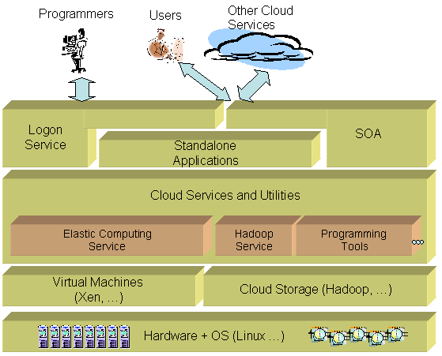
Example: Component Stack of
Cloud Services
Softwareas a
Service (SaaS)
Platform as a
Service (PaaS)
Infrastructure as
a Service (IaaS)

Slide 43
A NIST Definition:
Cloud Deployment Models
Public Cloud
  Utility computing
  Web services
Private Cloud
  Interval services
  Centralized management in a private network environment
  Applying cloud management technologies in a private network environment
Hybrid Cloud
Community Cloud

Slide 44

Cloud Definition from NIST
Visual Model of NIST’s Working Definition of Cloud Computing
Essential
Characteristics
Measured Service
Rapid Elasticity
On-Demand
Self Service
Broad Network
Access
Resource Pooling
Service
Models
Software as a Service (SaaS)
Platform as a Service (PaaS)
Infrastucture as a Service (IaaS)
Deployment
Models
Public
Private
Hybrid
Community
http://www.csrc.nist.gov/groups/SNS/cloud-computing/index.html
Notes:
1. resource pooling
2. provide services rapidly and elasticity
3. on-demand and self service
4. broad network access
5. measured service
Service model:
SaaS: provide software on the cloud
PaaS: provide platform on the cloud
Iaas: provide infrastructure on the cloud
Deployment Models:
Scope

Slide 45
NIST: Essential Characteristics of Cloud Computing
On-demand self-service
Broad network access
Resource pooling
Rapid elasticity
Measured Service

Slide 46
Benefits from Cloud Computing
Q: Rate the benefits commonly ascribed to the 'cloud'/on-demand model
Pay only for what you use
77.9%
Easy/fast to deploy to end-users
77.7%
Monthly payments
75.3%
Encourages standard systems
68.5%
Requires less in-house IT staff, costs
67.0%
Always offers latest functionality
64.6%
Sharing systems with partners simpler
63.9%
Seems like the way of the future
54.0%
0%
10%
20%
30%
40%
50%
60%
70%
80%
90%
Source: IDC Enterprise Panel, 3Q09, n = 263, September 2009

Slide 47
Adoption of Cloud Computing
Q: Rate your likelihood to pursue the cloud model for the following
Collaboration applications
67.3%
Web applications/Web serving
66.9%
Data Back-up or Archive services
59.4%
Business apps (CRM, HR, ERP)
55.6%
Personal productivity apps
55.1%
Data/Content Distribution services
54.8%
Storage capacity on demand
52.9%
IT Management software
51.3%
Server capacity on demand
50.6%
Business Intelligence/Analytics
49.8%
Application dev/test/deploy platform
49.1%
IT/Information Security
48.6%
0%
10%
20%
30%
40%
50%
60%
70%
80%
Source: IDC Enterprise Panel, 3Q09, n = 263, September 2009

Slide 48
Pay for what is used
Cloud pricing models based on paying for what is used
Avoid the upfront cost for infrastructure and the financial risk
  Cloud pricing models allow pay for what is used
  Scare capital needed to invest in infrastructure is replaced with an operating expense
Pay for what is used
Typical IT budget models :
  Applications: 35%
  Infrastructure: 60%
  Other: 5%

Slide 49
Service Delivery
Cloud computing sample architecture for Service Delivery
  Users/Brokers
  SLA Resource Allocator (Service Request Examiner and Admission Control): VM Monitor, Dispatcher, Service Request Monitor, Accounting and Pricing
  Virtual Machines (VMs)
  Physical Machines

Slide 50
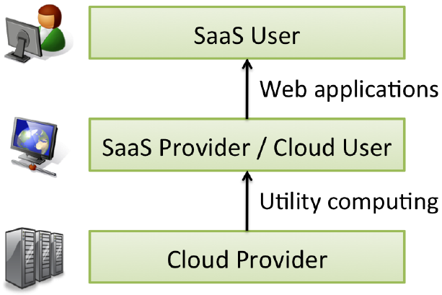
Cloud Ecosystem
Players can act as Users or Providers in the Cloud Ecosystem

Slide 51
Cloud Computing Economy
Enable SaaS providers that do not own IT infrastructure
Semiconductor
Industry
Software
Industry
Analogy
Foundries
(TSMC, UMC)
Cloud
Computing
Enable
Enable
Fabless
Chip Design
(e.g. nVidia…)
Datacenter-less
SaaS provider

Slide 52
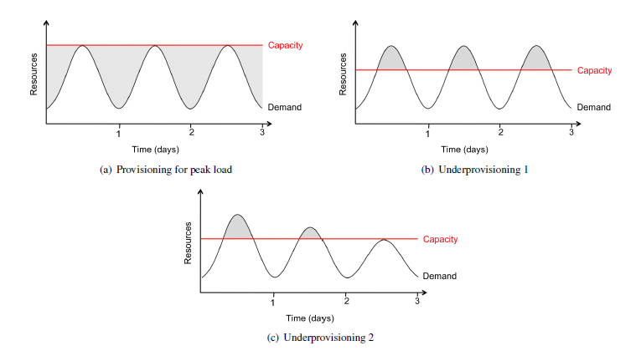
A Berkeley View -
Elasticity: Shifting the Risk
“pay as you go” more directly captures the economic benefit to the buyer.

Slide 53
Public Cloud or
Private Data Center?
Pricing Model
Transferring Risks
Security Issues
Regulatory Issues and Constraints

Slide 54
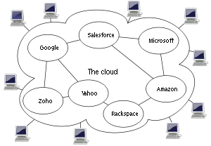
Cloud Federation
Cloud Federation:
  consists of several similar cloud services (Ex. IaaS, PaaS, …)
  Users can choose any service of the cloud federation by paying different cost
  No centralized control over the cloud services

Slide 55
Cloud vs. Grid

Slide 56
Cloud Computing Definition
- WikiPedia
Wiki:
  Cloud computing is Internet-based computing, whereby shared resources, software, and information are provided to computers and other devices on demand, like the electricity grid.
Question:
  Why not just name it “grid computing”?

Slide 57


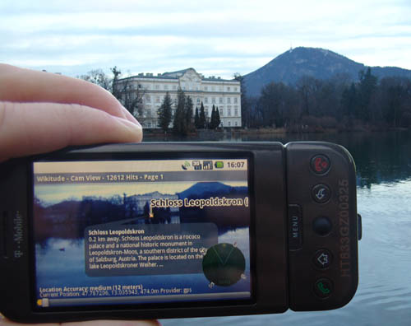
Cloud or Non-Cloud?
Example 1: Mobile Apps

Slide 58
Cloud or Non-Cloud?
Example 2: Web Services
Google search engine
Yahoo e-Business
Facebook.com
Amazon.com
…

Slide 59
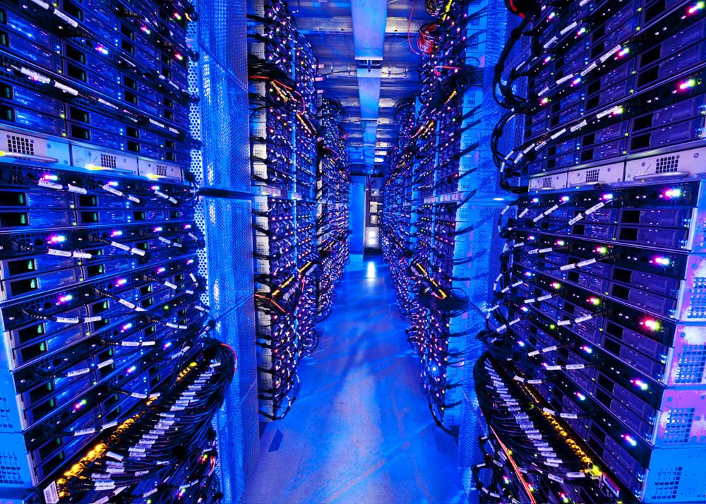
Cloud or Non-Cloud?
Example 3: Data Centers

Slide 60
Definition:
Grid
For many decades, it usually refers to electricity infrastructure
Now it also refers to Computational Grid
  Powerful processors
  Broadband network
  Software/middleware

Slide 61
Definition:
Computational Grid
A computational grid is a hardware and software infrastructure that provides dependable, consistent, pervasive, and inexpensive access to high-end computational capabilities (1996)
A Grid is a system that is able to (2002)
  coordinate “resources that are not subject to centralized control”
  Use “standard, open, general-purpose protocols and interfaces”
  “to deliver nontrivial qualities of service.”

Slide 62
Grid Architecture
By Ian Foster et al.

Slide 63
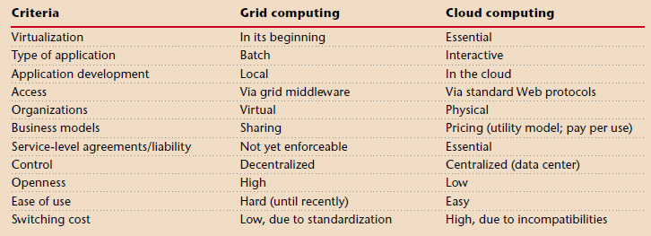
Grid vs. Cloud
By Christof Weinhardt, Arun Anandasivam, Benjamin Blau, and Jochen Stößer

Slide 64
P2P Computing

Slide 65
P2P introduction:
P2P systems:
  Peer-to-Peer systems are Internet applications that harness the resources of a large number of autonomous participants.
Peer
  a computing resource that has both Client and Server roles.
Collaboration in P2P systems:
  Nonexistent trust relationships
  Poor administration
  Operated with no prior agreement between peers
  Composed of nodes that act in their own interests

Slide 66
P2P features
All peers in P2P network are theoretically the same.
Data and computation is decentralized.
Peers and their connections are volatile.
Search for information in P2P networks is more relevant compared to static searches (such as Google or Yahoo).

Slide 67
Types of P2P System (Apps)
E-commerce systems
– eBay…
File sharing systems
– Napster, Gnutella, Freenet, …
Distributed Databases
– Mariposa …
Networks
– Wireless ad-hoc networks

Slide 68
P2P System models (1)
Centralized model
– global index held by a central authority (single point of failure)
– direct contact between requestors and providers
– Example: Napster

Slide 69
P2P System models (2)
Decentralized model
– Examples: Freenet, Gnutella
– no global index, no central coordination, global behavior emerges from local interactions, etc.
– direct contact between requestors and providers (Gnutella) or mediated by a chain of intermediaries (Freenet)

Slide 70
P2P System models (3)
Hierarchical model
– introduction of “super-nodes” (super-peers)
– mix of centralized and decentralized model
– Example: FastTrack

Slide 71
Napster: Overview
Central (virtual) database which holds an index of offered MP3/WMA files
Client peers connect to this metadata server, identify themselves (account) and send a list of MP3/WMA files they are sharing (C/S)
Other client peers can search the index and learn from which ones they can retrieve the file (P2P)
Combination of client/server and P2P approaches
First time users must register an account

Slide 72
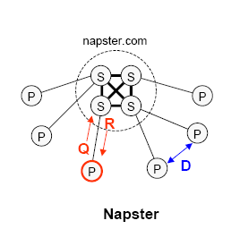
Napster: Communication Model

Slide 73
Gnutella: Overview
No central server
– cannot be sued (Napster)
Constrained broadcast
– Every peer sends packets it receives to all of its peers (typically 4)
– Life-time of packets limited by time -to-live (typically set to 7)
– Packets have unique ids to detect loops
Hooking up to the Gnutella systems requires that a new peer knows at least one Gnutella host
– gnutellahosts.com:6346
– Outside the Gnutella protocol specification

Slide 74
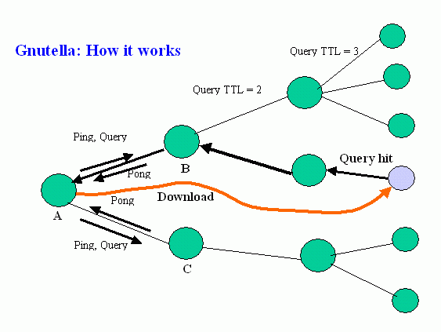
Gnutella: Communication model

Slide 75
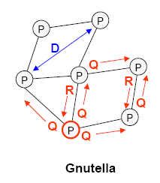
Gnutella: Communication Model,
Another View

Slide 76
Gnutella: Topology of Gnutella
Small-world properties verified (“find everything close by”)
Backbone + outskirts

Slide 77
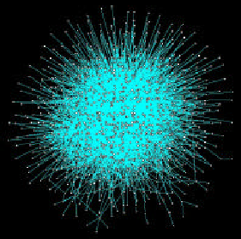
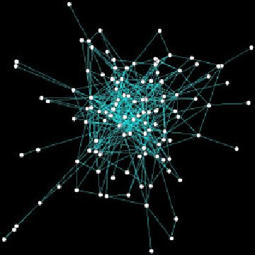

Slide 78
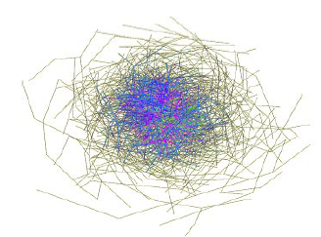
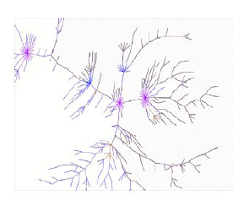
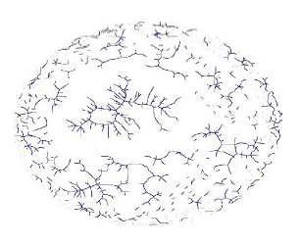
1771 peers in 2001, Gnutella
Randomly removed 30% nodes
Removed 4% highest-degree nodes

Slide 79
Gnutella: Super nodes (peers)
Super nodes index the files shared by peers connected to them, and proxy search requests on behalf of these peers.
  All queries are therefore initially directed to super nodes.
The latest Gnutella has introduced the idea of super nodes:
  Use some strategies to assign super nodes
    Peer elections
    Processing power and network bandwidth

Slide 80
Gnutella: Network Traffic Problem
Reputation of peers is not addressed
Simple, robust, and scalable (at the moment)
Protocol causes high network traffic (e.g., 3.5Mbps). For example:
– 4 connections C / peer, TTL = 7
– 1 ping packet can cause packets

Slide 81
Freenet
Freenet is a typical, purely decentralized loosely-structured content distribution system.
It uses file and node identifier similarity to produce an estimate of where a file may be located
a chain mode propagation approach to forward queries from node-to-node.

Slide 82
Freenet properties
Adaptive P2P system which supports publication, replication, and retrieval of data
Anonymity & File Content Security!
Requests are routed to the most likely physical location
– no central server as in Napster
– no constrained broadcast as in Gnutella

Slide 83
Freenet
Data manipulation
Files in Freenet are identified by unique binary keys.
Each Freenet node maintains its own local data store
To search for a file, the user sends a request message specifying the key and a timeout value.

Slide 84
Volunteer computing

Slide 85
Volunteer computing
Volunteer computing
  is an arrangement in which people (volunteers) provide computing resources to projects
  Volunteers are typically members of the general public who own Internet-connected PCs
  Projects are typically academic (university-based) and do scientific research
    SETI, …

Slide 86
Why is Volunteer Computing Important
Because of the huge number (> 1 billion) of PCs in the world
Volunteer computing power can't be bought; it must be earned. A research project that has limited funding but large public appeal can get huge computing power.
Volunteer computing encourages public interest in science

Slide 87
Desktop Grid Computing
'Desktop grid' computing –
  which uses desktop PCs within an organization
  superficially similar to volunteer computing, but has accountability and lacks anonymity

Slide 88
Comparison to Grid Computing
Grid computing: The term generally refers to the sharing of computing resources within and between organizations
  Each organization can act as either producer or consumer of resources
  The organizations are mutually accountable

Slide 89
Comparison to P2P Computing
Volunteer computing uses central servers. There is typically no peer-to-peer communication.
P2P networks benefit the participants (i.e. the people sharing files).

Slide 90
BOINC
http://boinc.berkeley.edu/
BOINC is a software platform for
  volunteer computing
  desktop Grid computing
Which applications are suitable for BOINC?
  Public appeal
  Low data/compute ratio

Slide 91
Internet of Things &
Fog Computing

Slide 92
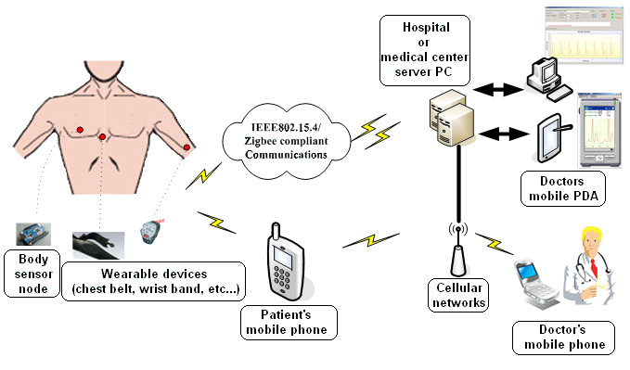
IoT Telemedicine Applications:
Patient Data Transferred Using a Wireless Sensor Network.
(Courtesy of Inftech, 2007)

Slide 93
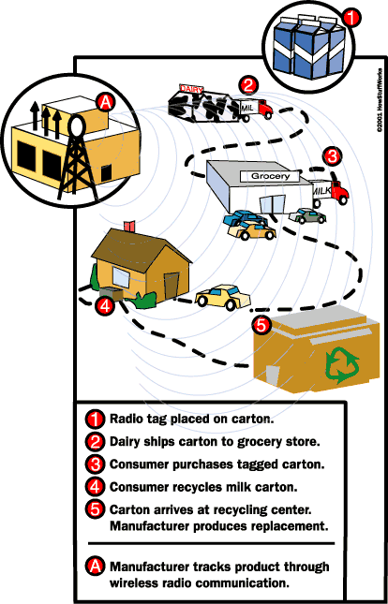
Retail and logistics : How RFID Works in Business Sales ?

Slide 94
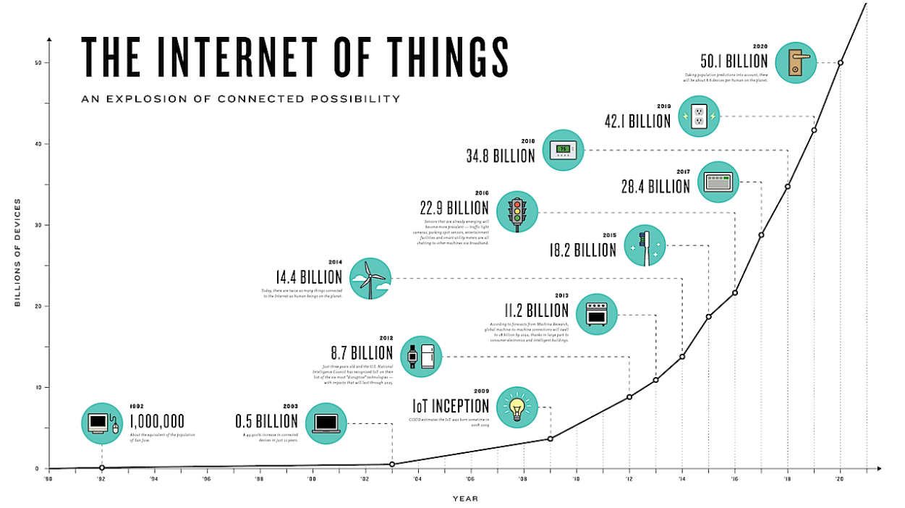

Slide 95
Cloud Computing Limitations
Connectivity to the Cloud is a pre-requisite of cloud computing
Cloud computing assumes that there is enough bandwidth to collect the data
Cloud computing centralizes the analytics thus defining the lower bound reaction time of the system

Slide 96
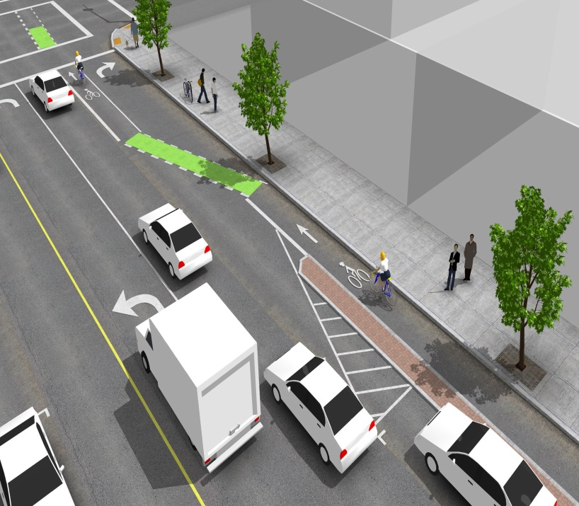
Connectivity Problem
Driver assistance applications can’t rely on a connection to the cloud to be always available
Decisions that require short reaction time, or that have to be taken on a decentralized fashion can’t rely on the cloud

Slide 97
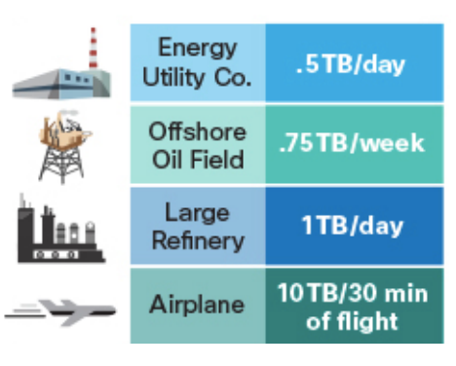
Bandwidth and Reaction-Time Problem
For some Industrial Internet of Things applications it is just not realistic to stream all data to a cloud

Slide 98

What is Fog Computing
Fog computing is about computing on the edge
In Fog computing devices communicate peer-to-peer to efficiently share/store data and take local decisions

Slide 99
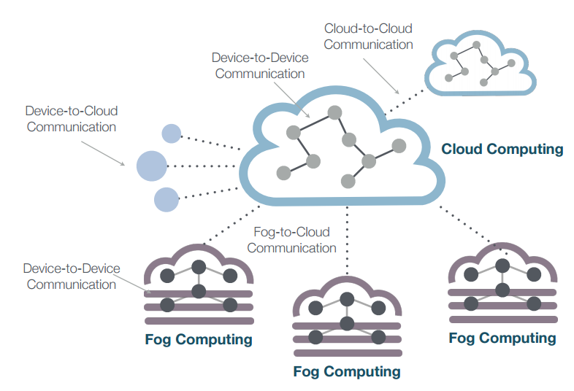
Fog and Cloud Computing
Fog and Cloud computing are synergistic, not exclusive
IoT systems require both!

