Slide 1
Introduction to Cloud Computing Lab II: Pig
2019 spring

Slide 2
Practicing pig

Slide 3
Pig
Pig is made up of two pieces:
The language used to express data flows, called Pig Latin.
The execution environment to run Pig Latin programs.
There are currently two environments:
Local execution in a single JVM
Distributed execution on a Hadoop cluster
Pig handles semi-structure data

Slide 4
has the following key properties:
Ease of programming. It is trivial to achieve parallel execution of simple, "embarrassingly parallel" data analysis tasks. Complex tasks comprised of multiple interrelated data transformations are explicitly encoded as data flow sequences, making them easy to write, understand, and maintain.
Optimization opportunities. The way in which tasks are encoded permits the system to optimize their execution automatically, allowing the user to focus on semantics rather than efficiency.
Extensibility. Users can create their own functions to do special-purpose processing.

Slide 5
Execution Types
Local mode:
/usr/local/pig/bin/pig -x local
Hadoop mode:
Hadoop mode is the default
Pig translates queries into MapReduce jobs and runs them on a Hadoop cluster.
Tell Pig which version of Hadoop you are using and where your cluster is running by setting the following environment variables
export PIG_HADOOP_VERSION=20
export PIG_CLASSPATH=$HADOOP_INSTALL/conf/
Our Focus!

Slide 6
Running Pig Programs
There are three ways of executing Pig programs, all of which work in both local and Hadoop mode:
Script
Pig can run a script file that contains Pig commands.
Grunt
an interactive shell for running Pig commands.
It is also possible to run Pig scripts from within Grunt using run and exec.
Embedded
You can run Pig programs from Java, much like you can use JDBC to run SQL programs from Java.

Slide 7
Copy test data
$ cd ~
$ mkdir mypig
$ cp /usr/local/pig/examples/test.txt ~/mypig
$ cd mypig

Slide 8
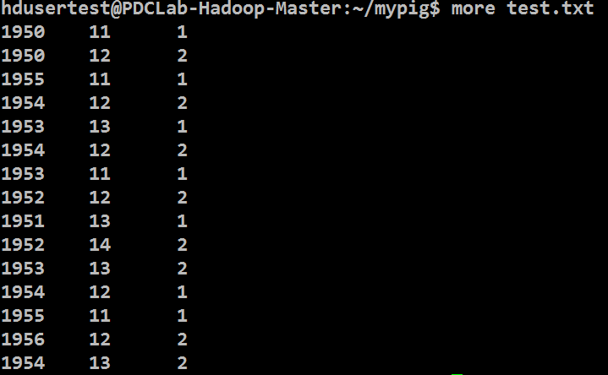
test.txt

Slide 9
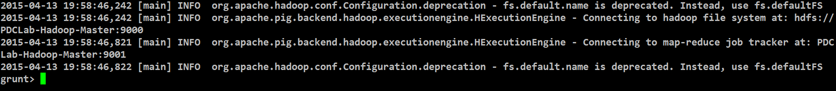
Executing pig
$ hadoop fs -put test.txt input/test.txt
$ /usr/local/pig/bin/pig

Slide 10
Load data of test.txt
grunt> records = LOAD 'input/test.txt' AS (year:chararray, temperature:int, quality:int);

Slide 11
Show the structure of a relation
grunt> DESCRIBE records;

Slide 12
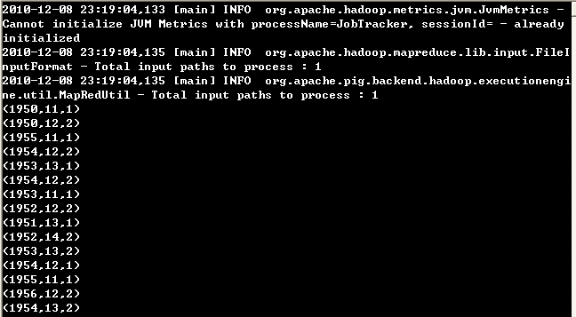
Show test.txt
grunt> DUMP records;

Slide 13
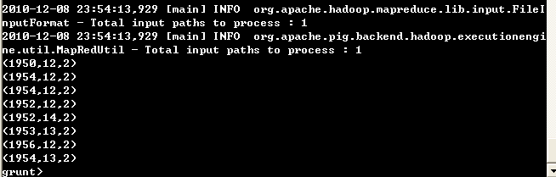
Data Filtering
grunt> rec1 = FILTER records BY temperature >11 AND (quality == 0 OR quality == 2);
grunt> DUMP rec1;

Slide 14
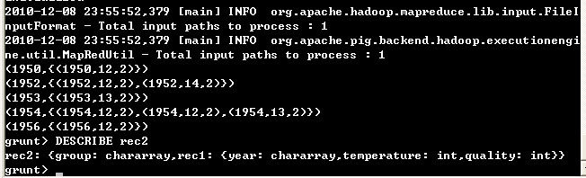
Data Grouping
grunt> rec2 = GROUP rec1 BY year;
grunt> DUMP rec2;
Group key
Bag of tuples

Slide 15
Reduce
grunt> maxt = FOREACH rec2 GENERATE group, MAX(rec1.temperature);

Slide 16
FOREACH and GENERATE
FOREACH processes every row to generate a derived set of rows,
using a GENERATE clause to define the fields in each derived row.

Slide 17
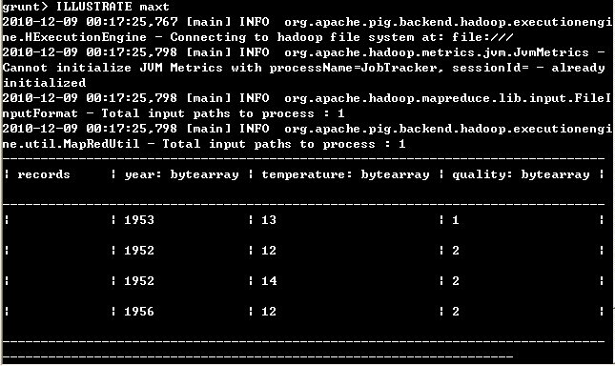
ILLUSTRATE
grunt> ILLUSTRATE maxt
shows where the result come from

Slide 18
Comparisons
Database: SQL commands, pre-defined schema
Hadoop Hive: SQL-Like commands on Hadoop HDFS
Pig: Data flow commands and runtime schema on Hadoop HDFS

Slide 19
Pig Latin Program
Create a test.pig file as shown in the figure.
$ cp /usr/local/pig/examples/test.pig ~/mypig
$ cd ~/mypig
comments
-- pig latin example
records = LOAD 'input/test.txt' AS (year:chararray, temperature:int, quality:int);
rec1 = FILTER records BY temperature >11 AND (quality == 0 OR quality == 2);
rec2 = GROUP rec1 BY year;
maxt = FOREACH rec2 GENERATE group, MAX(rec1.temperature);
DUMP maxt;

Slide 20
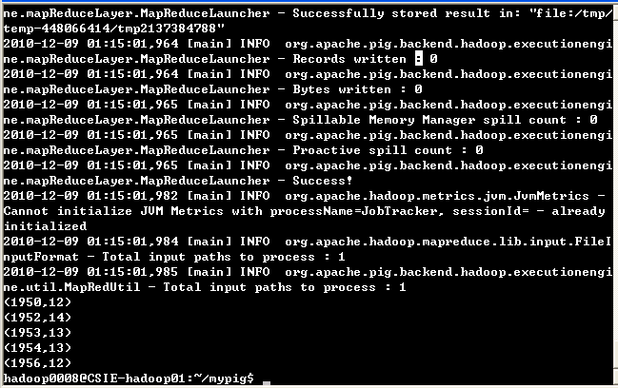
Executing Pig Latin Program
$ pig test.pig

Slide 21
Practice 2
Write a pig latin script to:
Collect all the data after 1951 (1951 is not included)
Filter the data where quality = 1
Group the data by temperature, and then calculate the largest year for each temperature

Slide 22
Solution
-- pig latin, practice 3
records = LOAD 'input/test.txt' AS (year:int, temperature:int, quality:int);
rec1 = FILTER records BY year > 1951 AND quality == 1;
rec2 = GROUP rec1 BY temperature;
maxt = FOREACH rec2 GENERATE group, MAX(rec1.year);
DUMP maxt;

Slide 23
Advanced pig

Slide 24
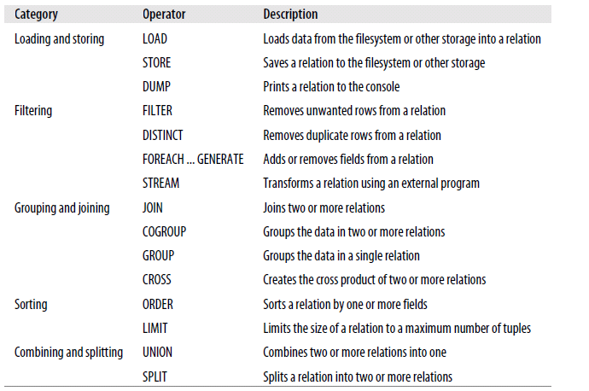
relational operators

Slide 25
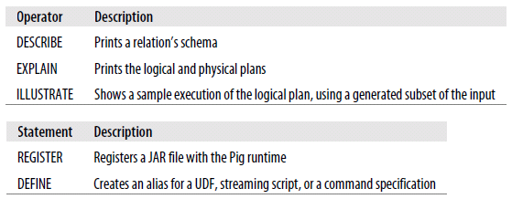
diagnostic operators and UserDefinedFunction statements

Slide 26
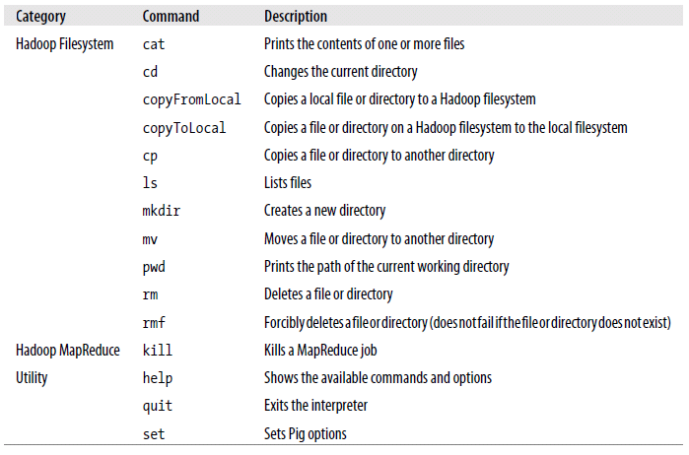
Environment commands

Slide 27
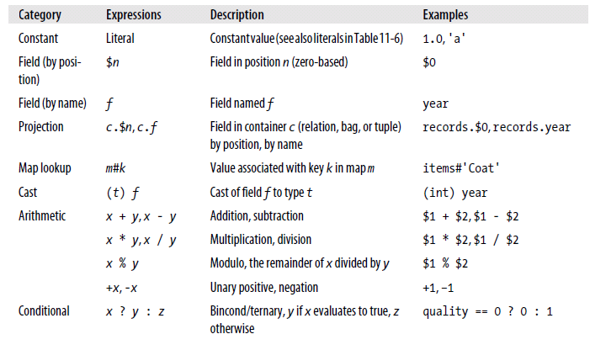
Expressions 1

Slide 28
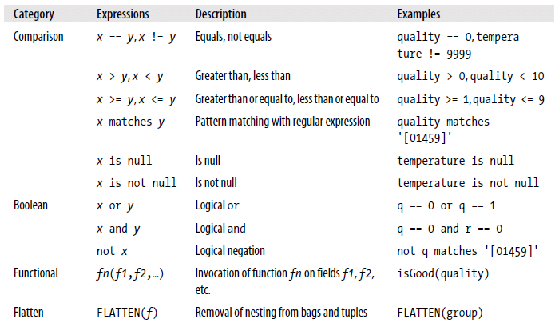
Expressions 2

Slide 29
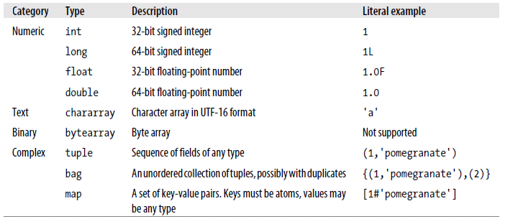
Type

Slide 30
Handling bad data (1)
$ wget pdc19.csie.ncu.edu.tw/lab2/bad.txt
$ hadoop fs -put bad.txt /user/a000000000/bad.txt
$ pig

Slide 31
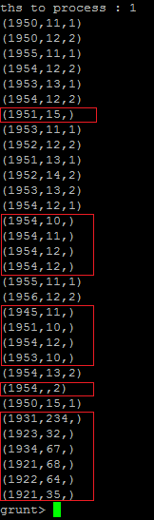
Handling bad data (2)
grunt> records = load '/user/a000000000/bad.txt' using PigStorage(' ') as (year:int, temp:int, quality:int);
grunt> dump records;
Null data

Slide 32

Handling bad data (3)
Get all bad data:
grunt> badrec= FILTER records BY temp is null OR quality is null;
grunt> DUMP badrec;
Count all bad data:
grunt> badgroup= GROUP badrec ALL;
grunt> counter = FOREACH badgroup GENERATE group, COUNT(badrec);
grunt> DUMP counter;

Slide 33
Splitting Data
grunt> records = LOAD '/user/a000000000/bad.txt' using PigStorage(' ') AS (year:int, temp:int, quality:chararray);
grunt> SPLIT records INTO good IF temp is not null AND quality is not null, bad IF temp is null OR quality is null;
grunt> SPLIT good INTO newdata IF quality matches '[0123456789]', olddata IF not quality matches '[0123456789]';
grunt> DUMP good;
grunt> DUMP bad;
grunt> DUMP newdata;
grunt> DUMP olddata;
Use the Java format for regular expressions.
bad
newdata
records
good
olddata

Slide 34
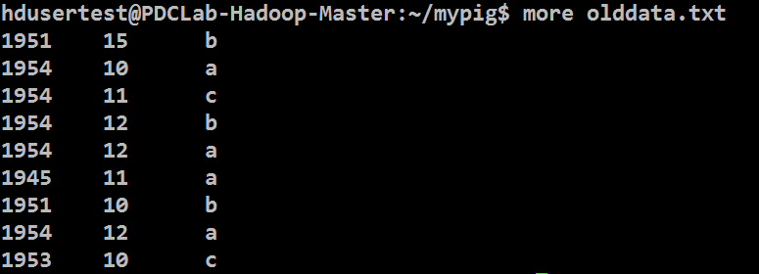
Storing the Results
grunt> STORE newdata INTO '/user/a000000000/newdata' USING PigStorage('\t');
grunt> quit
$ hadoop fs -lsr newdata
$ hadoop fs -get newdata/part-m-00000 olddata.txt
$ more newdata.txt

Slide 35
Practice 2
Write a pig latin script:
Load pbad.txt, remove bad data.
Split good data into new data if quality matches ‘[0123456789]’, and old data if quality does not match ‘[0123456789]’.
Convert temperature in degrees Celsius (°C) to in degrees Fahrenheit (°F)
Use dump to show the maximum temperature with decimal fraction for each year in the old data

Slide 36
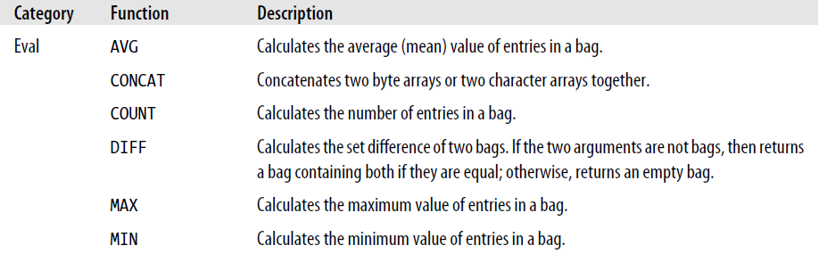
Pig Functions (1)

Slide 37
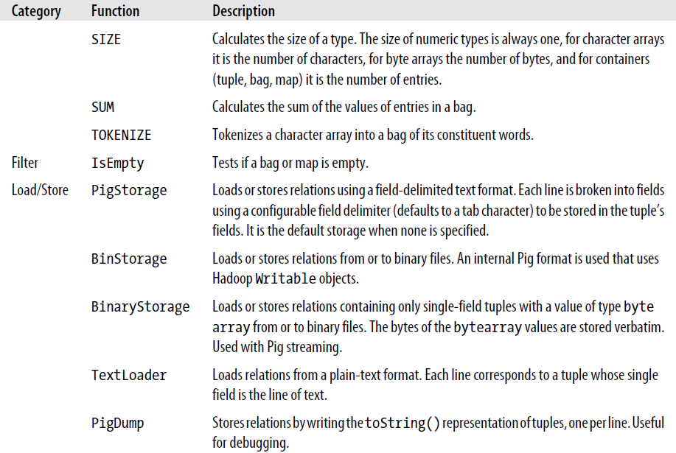
Pig Functions (2)

Slide 38

SIZE operator
Find the year that has more than one record in the old data:
grunt> groupold = GROUP olddata BY year;
grunt> x = FILTER groupold BY SIZE(olddata) > 1;
grunt> DUMP x;
Count the number of tuples
in a bag

Slide 39
User-Defined Functions
A user can define his/her pig function using Java
To use user-defined functions,
Write a Java class that extends a pig function class
Overwrite related functions
Compile the java source files, and pack the .class files into a .jar file
Put the jar file in a reachable directory
Register the jar file by the command REGISTER
For convenience, the user can rename the function name in pig to a shorter name.

Slide 40
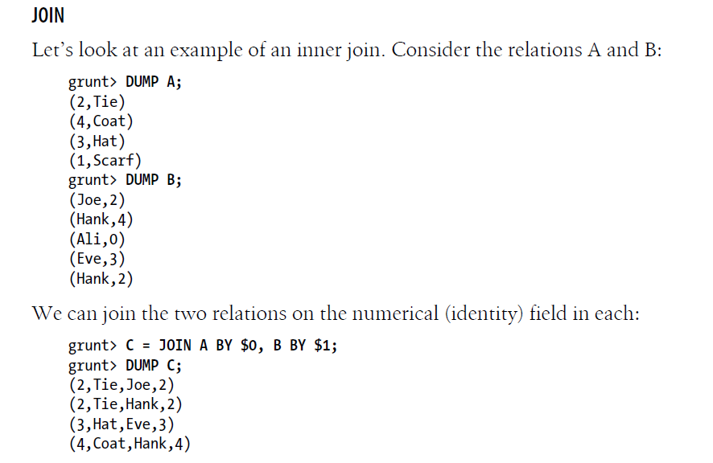
JOIN

