Slide 1
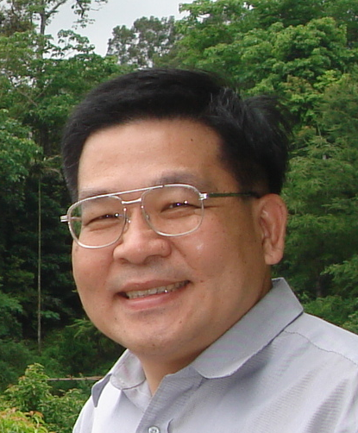
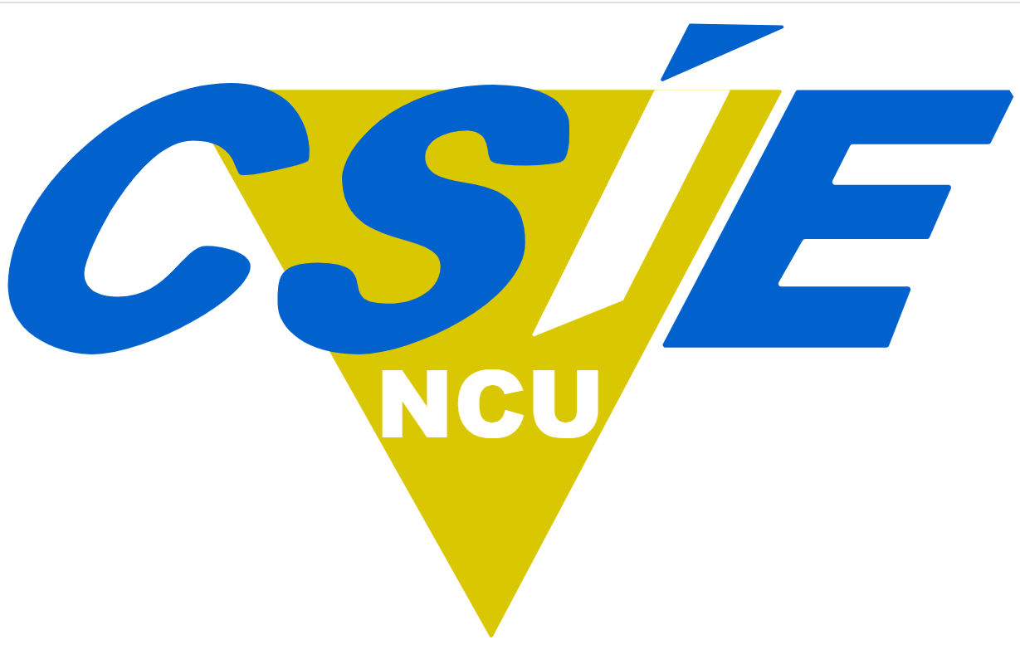
Quantum Annealing
量子退火
Department of Computer Science and Information Engineering
National Central University, Taiwan
Jehn-Ruey Jiang (江振瑞)

Slide 2
Outline
What is Quantum Annealing?
QUBO Formula and Ising Model
Quantum Annealer and Quantum-inspired Annealer
  D-Wave Quantum Annealer (QA)
  Fujitsu Digital Annealer (DA)
  Compal GPU Annealer (GPUA)
  Benchmarking QA, DA, GPUA, and CA (Classical Algorithm)

Slide 3
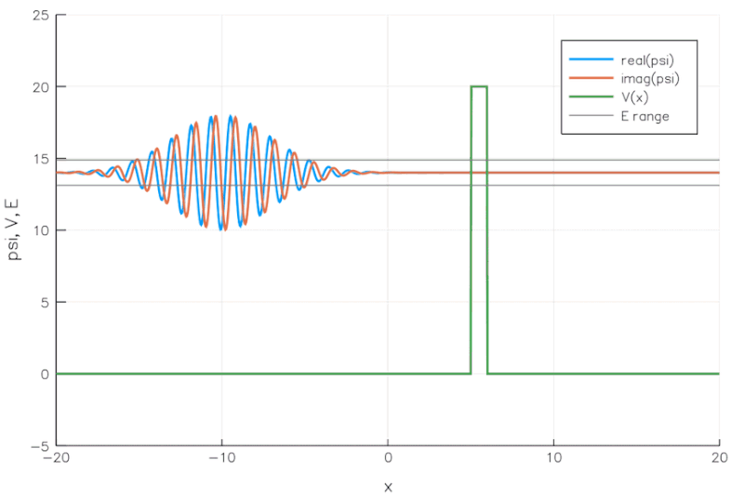
Quantum Tunneling
Quantum tunneling is the quantum mechanical phenomenon where a wavefunction of a quantum entity can propagate through a potential barrier.
source: https://commons.wikimedia.org/wiki/File:E14-V20-B1.gif by Becarlson CC BY-SA 4.0
Notes:
Quantum Tunneling: A simulation of a wave packet incident on a potential barrier according to the Time-Dependent Schrodinger Equation.
加拿大公司 D-Wave 使用稱為“量子退火”的技術開發了專用量子計算設備，通過利用量子穿隧效應找到優化問題的解決方案。
在優化問題中，我們需要從許多可能的組合中尋找最好的組合，物理學可以幫助解決這類問題， 物理學的一個基本規則是，一切都趨向於尋求最小能量狀態因為您可以將它們視為能量最小化問題。 物體滑下山坡； 熱的東西會隨著時間的推移而冷卻。 這種行為在量子物理學領域也是如此。 量子退火只是使用量子物理學來尋找問題的低能狀態，從而找到最佳或接近最佳的元素組合。
量子穿隧
量子穿隧效應屬於量子力學的研究領域，量子力學研究在量子尺度所發生的事件。設想一個運動中的粒子遭遇到一個位能壁壘，試圖從位能壁壘的一邊（區域 A）移動到另一邊（區域 C），這可以被類比為一個圓球試圖滾動過一座小山。量子力學與古典力學對於這問題給出不同的解答。古典力學預測，假若粒子所具有的能量低於位能壁壘的位能，則這粒子絕對無法從區域 A移動到區域 C。量子力學不同地預測，這粒子可以機率性地從區域 A穿越到區域 C。

Slide 4
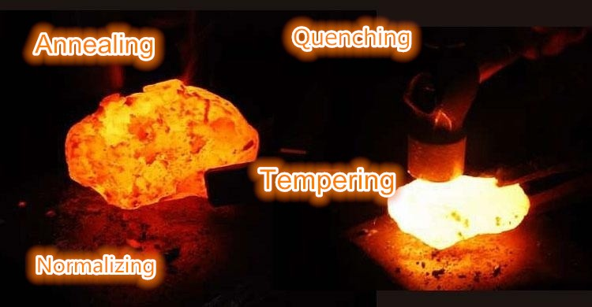
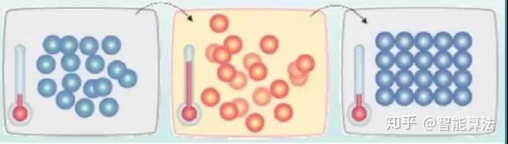
Annealing
    Annealing is a heat treatment process to slowly heat the metal to a certain temperature, keep it in warn for a while, then slowly cool it.
    The atoms in the metal are thus more compact to have good properties.
    The process alters the physical and sometimes chemical properties of the metal to increase its ductility and reduce its hardness, making it more workable.
Notes:
退火（Annealing）是一種熱處理（heat treatment）工藝，透過將金屬緩慢加熱至特定溫度，保持一段時間後再緩慢冷卻。
這使得金屬內部的原子排列更緊密（compact），從而改善其性能（properties）。
此過程會改變金屬的物理性質（physical properties），有時也會影響其化學性質（chemical properties），使其延展性（ductility）增加、硬度（hardness）降低，從而提高可加工性（workability）。
翻譯與說明
Annealing（退火）
翻譯：退火是一種將金屬緩慢加熱至特定溫度，保持一段時間後再緩慢冷卻的熱處理工藝。
說明：此過程可使金屬的內部結構變得更加均勻，減少內部應力，增強延展性（ductility）並降低硬度（hardness），從而提高可加工性（workability）。退火常用於鋼、銅、鋁等金屬，以改善其機械性能。
Quenching（淬火）
翻譯：淬火是一種將金屬加熱至高溫後，迅速浸入冷卻介質（如水、油或空氣）進行快速冷卻的熱處理方法。
說明：淬火可使金屬內部的晶體結構發生變化，提高其硬度和強度，但也會導致脆性增加。因此，淬火後通常需要進一步回火（tempering）來調整其機械性能。鋼鐵材料常透過淬火來獲得高強度結構。
Tempering（回火）
翻譯：回火是一種在淬火後，將金屬加熱至較低的溫度並保持一段時間，然後緩慢冷卻的熱處理工藝。
說明：回火的主要目的是降低淬火後金屬的脆性，同時保持較高的強度和韌性（toughness）。透過適當的回火，可以改善材料的機械性能，使其更適合實際應用，例如彈簧、工具和機械零件等。
Normalizing（正火）
翻譯：正火是一種將金屬加熱至高於臨界溫度，保持一段時間後在空氣中自然冷卻的熱處理方法。
說明：正火主要用於改善金屬的顯微結構，使其晶粒細化，提升韌性和機械強度，並消除內部應力。與退火相比，正火的冷卻速度較快，因此產生的金屬組織較硬，適用於需要高強度和均勻結構的零件，例如齒輪、軸承和機械構件等。
這些熱處理工藝各有其特定的用途，適用於不同的材料和應用需求。
金屬的**強度（Strength）**是指金屬材料在受外力作用時抵抗變形或斷裂的能力。強度是衡量金屬機械性能的重要指標之一，通常可以根據不同的受力情況分為以下幾種類型：
拉伸強度（Tensile Strength）
指金屬在拉伸載荷作用下，能夠承受的最大應力。當金屬被拉伸到極限時，若超過其拉伸強度，則會發生斷裂。
單位：通常以兆帕（MPa）或牛頓/平方毫米（N/mm²）表示。
應用範例：鋼索、橋梁鋼材等需要高拉伸強度的結構。
屈服強度（Yield Strength）
指金屬在受力時開始產生永久變形（塑性變形）的應力值。當應力超過屈服強度後，材料即使卸除外力也無法恢復原狀。
應用範例：汽車結構件、建築鋼筋等，需具備良好的屈服強度以防止過早變形。
壓縮強度（Compressive Strength）
指金屬在受壓時能承受的最大應力。與拉伸強度不同，金屬在受壓時通常不容易破裂，而是會發生屈曲或壓縮變形。
應用範例：支撐結構、軸承材料等。
剪切強度（Shear Strength）
指金屬在剪切應力（即沿著平行於力方向的斷面受力）作用下，能夠承受的最大應力。
應用範例：鉚釘、螺栓等連接件需具有良好的剪切強度，以確保結構穩固。
抗疲勞強度（Fatigue Strength）
指金屬材料在反覆受力的情況下，能夠承受的最大應力。金屬長期承受交變載荷時，可能會因疲勞而發生微裂紋，最終導致斷裂。
應用範例：飛機機翼、橋樑、車輛懸掛系統等需長時間承受變動載荷的結構。
抗衝擊強度（Impact Strength）
指金屬在瞬間受力（如錘擊或撞擊）時抵抗斷裂的能力。通常由**夏比衝擊試驗（Charpy Impact Test）或伊左德衝擊試驗（Izod Impact Test）**測得。
應用範例：汽車保險桿、頭盔材料、裝甲鋼板等。
總結
金屬的強度決定了其在不同應用中的適用性。例如，高拉伸強度的材料適合用於承受拉力的結構，而高抗衝擊強度的材料適合用於需要吸收能量的應用（如汽車保護裝置）。選擇金屬材料時，需根據實際應用需求來考量不同的強度類型。

Slide 5
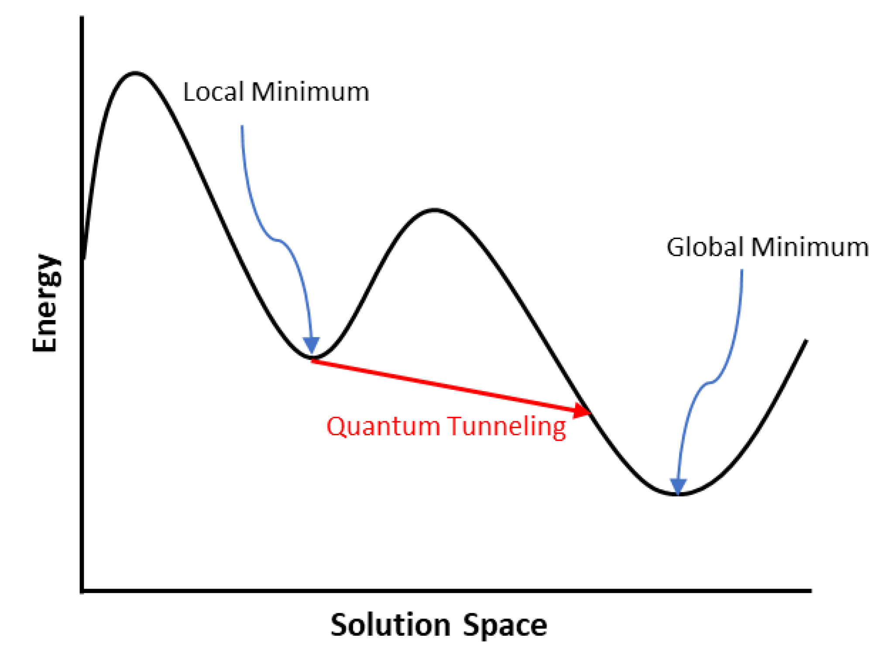
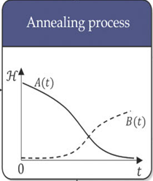

Quantum Annealing
Everything tends to seek a minimum energy state. Based on the quantum tunneling phenomenon, quantum annealing can quickly find low-energy states of a quantum system.
If we can associate the state with the solution to a problem, then we can find the optimal solution to the problem by locating the state with the minimum system energy (or the lowest Hamiltonian).
System Configuration (State)
Notes:
This step defines the initial Hamiltonian Hi and the final Hamiltonian Hf for the entire system. Each Hamiltonian represents the total energy of the system in a specific state. Hi is configured to maintain qubits in a superposition state, while Hf is tailored based on the QUBO formula to ensure that the minimum final Hamiltonian corresponds to the optimal solution to the COP at hand. The system’s Hamiltonian H(t) at time t during quantum annealing is expressed in the following Equation (8):
The energy scaling functions A(t) and B(t) in Equation (8), depicted in the lower right part of Figure 3, illustrate changes during the annealing process. As time t progresses, A(t) gradually decreases, while B(t) increases. Consequently, the influence of the final Hamiltonian Hf becomes more pronounced, while the impact of the initial Hamiltonian Hi decreases. By the end of annealing, the behavior of the system aligns mainly with the final Hamiltonian Hf .
Quantum Tunneling: A simulation of a wave packet incident on a potential barrier according to the Time-Dependent Schrodinger Equation.
加拿大公司 D-Wave 使用稱為“量子退火”的技術開發了專用量子計算設備，通過利用量子穿隧效應找到優化問題的解決方案。
在優化問題中，我們需要從許多可能的組合中尋找最好的組合，物理學可以幫助解決這類問題， 物理學的一個基本規則是，一切都趨向於尋求最小能量狀態因為您可以將它們視為能量最小化問題。 物體滑下山坡； 熱的東西會隨著時間的推移而冷卻。 這種行為在量子物理學領域也是如此。 量子退火只是使用量子物理學來尋找問題的低能狀態，從而找到最佳或接近最佳的元素組合。
量子穿隧
量子穿隧效應屬於量子力學的研究領域，量子力學研究在量子尺度所發生的事件。設想一個運動中的粒子遭遇到一個位能壁壘，試圖從位能壁壘的一邊（區域 A）移動到另一邊（區域 C），這可以被類比為一個圓球試圖滾動過一座小山。量子力學與古典力學對於這問題給出不同的解答。古典力學預測，假若粒子所具有的能量低於位能壁壘的位能，則這粒子絕對無法從區域 A移動到區域 C。量子力學不同地預測，這粒子可以機率性地從區域 A穿越到區域 C。

Slide 6
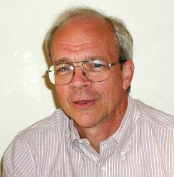
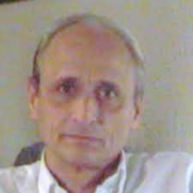
Scott Kirkpatrick, Professor, Hebrew University of Jerusalem, Israel
Kirkpatrick et al. used the technique, which they called simulated annealing to solve the traveling salesman problem in 1983.
Bruno Apolloni, Professor, University of Milan, Italy
B. Apolloni et al. proposed the term “quantum annealing” in a quantum-inspired classical algorithm using quantum tunneling in 1988.
Notes:
S. Kirkpatrick, C.D. Gelatt and M.P. Vecchi, Optimization by simulated annealing, Science 220 (1983) 671-680.
In 1983, this approach was used by Kirkpatrick, Gelatt Jr., and Vecchi^{[6]} for a solution of the traveling salesman problem. They also proposed its current name, simulated annealing.
1953Metropolis et al.（洛斯阿拉莫斯）提出模擬熱平衡的 Metropolis 演算法，為 SA 提供接受機率的數學基礎Equation of state calculations by fast computing machines, J. Chem. Phys.
1983S. Kirkpatrick, C. D. Gelatt, M. P. Vecchi（貝爾實驗室）將退火原理首次引入組合最佳化問題，發展成 Simulated Annealing經典文獻：Optimization by Simulated Annealing, Science
1985Geman & Geman提出在對數冷卻下，SA 保證收斂至全域最小解（理論性質）Stochastic relaxation, Gibbs distributions, and the Bayesian restoration of images, PAMI1987Aarts & Korst發展成系統性演算法框架，提出溫度策略與理論分析Simulated Annealing and Boltzmann Machines, Wiley
1990s多篇研究將 SA 應用於 TSP、VLSI 設計、排程等經典 NP 問題—
三、Metropolis 演算法（1953）
這是 SA 的核心原型，其基本步驟如下：
給定初始狀態 x 和能量 E(x)E(x)E(x)
隨機產生新狀態 x′
若 ΔE=E(x′)−E(x)<0，接受
否則以機率 e^(−ΔE/T)接受壞解
此機制後來直接應用於 SA 中控制解的接受與跳躍。
五、經典文獻摘要
🔸Kirkpatrick et al., Science, 1983
Title: Optimization by Simulated Annealing
SA 首次被提出為「通用組合最佳化」方法
實驗驗證：TSP、電路布局問題
提出幾何降溫策略 T_{k+1}=αT_k​
🔸 Geman & Geman, 1984–85
從機率角度證明：
若溫度下降為 T(t)∝ \frac{1}{\log(t)}T(t)​，則收斂至 global minimum
提供了SA 收斂性的數學保證
1953 Metropolis et al.（洛斯阿拉莫斯） 提出模擬熱平衡的 Metropolis 演算法，為 SA 提供接受機率的數學基礎 Equation of state calculations by fast computing machines, J. Chem. Phys.
1983 S. Kirkpatrick, C. D. Gelatt, M. P. Vecchi（貝爾實驗室） 將退火原理首次引入組合最佳化問題，發展成 Simulated Annealing 經典文獻：Optimization by Simulated Annealing, Science
1985 Geman & Geman 提出在對數冷卻下，SA 保證收斂至全域最小解（理論性質） Stochastic relaxation, Gibbs distributions, and the Bayesian restoration of images, PAMI
1987 Aarts & Korst 發展成系統性演算法框架，提出溫度策略與理論分析 Simulated Annealing and Boltzmann Machines, Wiley
1990s 多篇研究將 SA 應用於 TSP、VLSI 設計、排程等經典 NP 問題 —
The term "quantum annealing" was first proposed in 1988 by B. Apolloni, N. Cesa Bianchi and D. De Falco as a quantum-inspired classical algorithm.^{[2][3]} It was formulated in its present form by T. Kadowaki and H. Nishimori (ja) in 1998,^{[4]} though an imaginary-time variant without quantum coherence had been discussed by A. B. Finnila, M. A. Gomez, C. Sebenik and J. D. Doll in 1994.^{[5]}
Apolloni, Bruno; Cesa-Bianchi, Nicolo; De Falco, Diego (July 1988). "A numerical implementation of quantum annealing". Stochastic Processes, Physics and Geometry, Proceedings of the Ascona-Locarno Conference.
^ Apolloni, Bruno; Carvalho, Maria C.; De Falco, Diego (1989). "Quantum stochastic optimization". Stoc. Proc. Appl. 33 (2): 233–244. doi:10.1016/0304-4149(89)90040-9.
^ Jump up to:ª ^{b} Kadowaki, T.; Nishimori, H. (1998). "Quantum annealing in the transverse Ising model". Phys. Rev. E. 58 (5): 5355. arXiv:cond-mat/9804280. Bibcode:1998PhRvE..58.5355K. doi:10.1103/PhysRevE.58.5355. S2CID 36114913. Archived from the original on 2013-08-11.

Slide 7
Simulated Annealing (for minimization)
Local Search
Cost function
?P.?
Solution space
Notes:
Simulated Annealing（模擬退火）是一種用來解決組合最佳化問題的隨機化啟發式演算法。靈感來自**金屬退火（Annealing）**過程：
❝金屬加熱到高溫後再緩慢冷卻，能使晶體結構趨於穩定，避免陷入不良結構。❞
❝模擬退火則是透過「高溫亂跳、低溫穩定」的方式，尋找全域最小值。❞

Slide 8
Simulated Annealing Pseudo Code
SimulatedAnnealing(problem):
current ← initial solution
best ← current
T ← initial temperature
while T > min_temperature:
neighbor ← random neighbor of current
ΔE ← cost(neighbor) - cost(current)
if ΔE < 0 or random(0,1) < exp(-ΔE / T):
current ← neighbor
if cost(current) < cost(best):
best ← current
T ← T * alpha // alpha ∈ (0, 1)
return best
Notes:
溫度 T 越高 → 越容易接受壞解，探索性強，有助於跳出局部最佳。
ΔE 越小 → 壞解「不太壞」，比較可能被接受。
ΔE 大 且 T 低 → 幾乎不會接受壞解，變成像 Hill Climbing。

Slide 9
Acceptance Probability = e^{−ΔE/T}
ΔE | Temperature (T) | Acceptance Probability | Interpretation
1 | 10 | 0.9048 | High chance to accept
1 | 1 | 0.3679 | Moderate chance
1 | 0.1 | 0.000045 | Very low chance
5 | 10 | 0.6065 | Still likely (high T)
5 | 1 | 0.0067 | Very unlikely
10 | 5 | 0.1353 | Small chance
10 | 0.5 | 0.000045 | Almost zero chance
Notes:
The process is fit with Blotzman distribution, gives the probabiltity that a system will be in a new state. ${P\left(ΔE\right)∝e}^{−\frac{ΔE}{kT}}$
溫度 T 越高 → 越容易接受壞解，探索性強，有助於跳出局部最佳。
ΔE 越小 → 壞解「不太壞」，比較可能被接受。
ΔE 大 且 T 低 → 幾乎不會接受壞解，變成像 Hill Climbing。

Slide 10
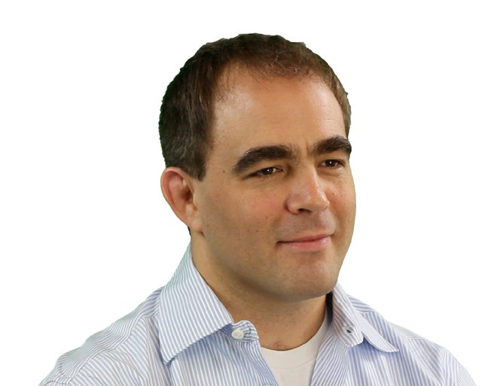
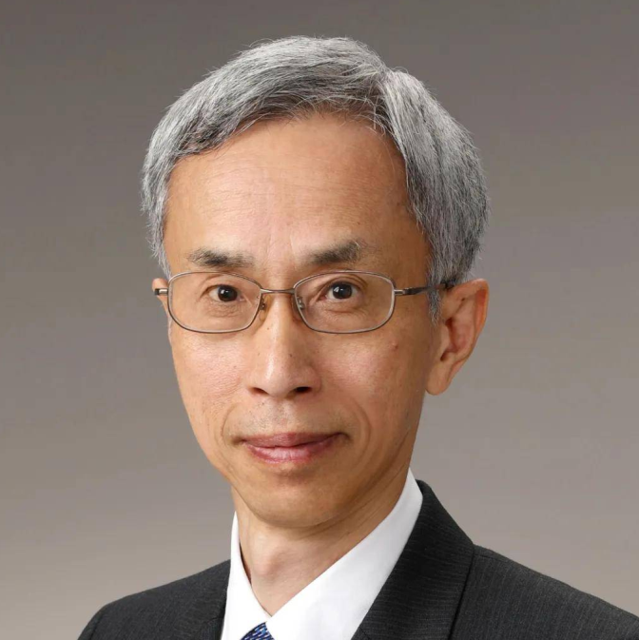
Hidetoshi Nishimori (西森秀稔), Professor, Tokyo Institute of Technology, Japan
He and his student used the concept of “quantum annealing” for solving problems uder Ising model in 1998.
Geordie Rose, D-Wave CTO and co-founder, Canada
D-Wave, founded in 1999, used the “adiabatic theorem” (similar to quantum annealing) to build “quantum annealers” for solving problems.
Notes:
Apolloni 是較早提出將量子穿隧導入最佳化的概念（1989–1990），但 Hidetoshi Nishimori 在 1998 年提出了明確針對量子 Ising 模型的「量子退火演算法的完整理論模型」，並對其統計物理性質（例如 phase transition）做了深入探討，因此他是量子退火理論的奠基者之一，但時機比 Apolloni 晚了約 8–9 年。
1998年，東京工業大學教授西森秀稔和當時還是博士研究生的門脅正史在論文中首次提出量子退火理論。但是，遠在加拿大的Rose並沒有了解這個理論，以至於他在最初幾年裡苦苦掙扎 。
D-Wave，全球首家量子計算公司，成立於1999年，但直到2007年首台量子退火計算機Orion才宣告成功。
ChatGPT:
"Quantum Annealing"（量子退火）一詞的源起可以追溯到1998年，由Toshiba 的研究人員 T. Kadowaki 和 H. Nishimori 在論文 "Quantum Annealing in the Transverse Ising Model"（Phys. Rev. E, 1998）中首次正式提出。
該論文探討了在橫場 Ising 模型（Transverse Ising Model）下，如何利用量子力學的隧道效應來幫助組合最佳化問題尋找全域最佳解，並與傳統的模擬退火（Simulated Annealing, SA）做比較。這種方法的靈感來自於經典的退火過程（Annealing），但將其擴展為利用量子漸進過程來取代傳統的熱力學漸進過程，因此被命名為Quantum Annealing（量子退火）。
在這之前，量子效應在最佳化問題中的應用已經有一些研究，例如 P. Ray, B. K. Chakrabarti, A. Chakrabarti 在 1989 年的工作 "Sherrington-Kirkpatrick Model in a Transverse Field: Absence of Replica Symmetry Breaking Due to Quantum Fluctuations"（Phys. Rev. B, 1989），但他們沒有使用「Quantum Annealing」這個名稱。
總結來說，Quantum Annealing 這個術語最早由 Kadowaki 和 Nishimori 在 1998 年提出，並迅速成為量子計算領域研究組合最佳化問題的一個重要方法。

Slide 11
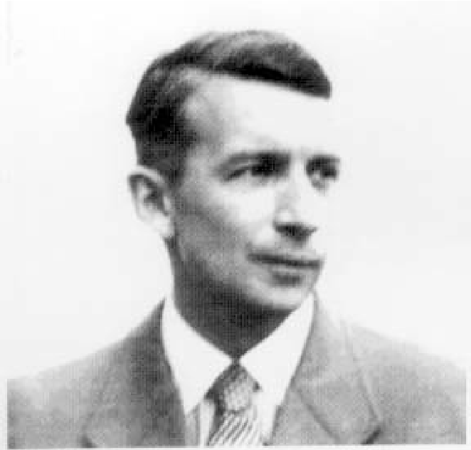
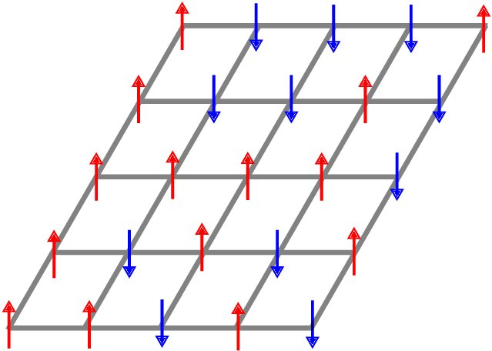

2D Ising Model
A model of ferromagnetism to represent the atom's spins in the states +1 and -1.
Ernst Ising, a German physicist
where the notation ⟨i j⟩ indicates that sites i and j are adjacent and µ is the external magnetic moment.
Source: Wald, S. S. (2017). Thermalisation and Relaxation of Quantum Systems (Doctoral dissertation, Université de Lorraine).
Notes:
The Ising model is a mathematical model of ferromagnetism in statistical mechanics. The model is composed of discrete variables representing the magnetic dipole moments of the atom's spins that can be in the state +1 or the state -1. In the 2D Ising model, the variables or spins are arranged in a 2D lattice in which each spin interacts with its neighbors. Certain interaction parameters are given between neighboring spins for specifying the interaction relationships of spins. The 2D Ising model can be represented mathematically as follows.
Ising模型中包含了可以用來描述單個原子磁矩(magnetic moment)的參數$\sigma _{i}$ ，其值只能為+1或-1，
Ising 模型是統計力學中鐵磁性的數學模型。這個模型由離散變量組成，這些變量表示原子自旋的磁偶極矩，可以處於狀態 +1 或狀態 -1。在 2D Ising 模型中，變量或自旋排列在 2D 晶格中，其中每個自旋與其相鄰的自旋相互作用。相鄰自旋之間給出了某些相互作用參數，用於指定自旋的相互作用關係。 2D Ising 模型可以用數學方式表示如下。
其中符號⟨ij⟩表示站點 i 和 j 是相鄰的，μ 是外部磁矩。
系統基態對應於哈密頓函數的最小值，該最小值又對應於優化問題的最優解。如果每個晶格點都是一個量子粒子（例如光子或電子），那麼量子退火可以利用量子隧穿效應來加速系統達到基態以獲得問題的最優解
Ising 模型是一個以德國物理學家恩斯特·易辛 (Ernst Ising) 為名的數學模型，它最初被創立是為了用來描述具有規則晶體結構材料的磁性行為。該模型包含了每個晶格上原子的自旋 (spin) 狀態$σ$，分為上旋或下旋；兩兩相鄰的原子彼此間的作用力參數 $J_{i,j}^{}$ ，偏好處在共同自旋向上（向下）或是處在一上一下的狀態；以及外部磁場對該晶格上的自旋狀態施加作用力參數 $h_{i}^{}$，導致其偏向某一個方向。

Slide 12
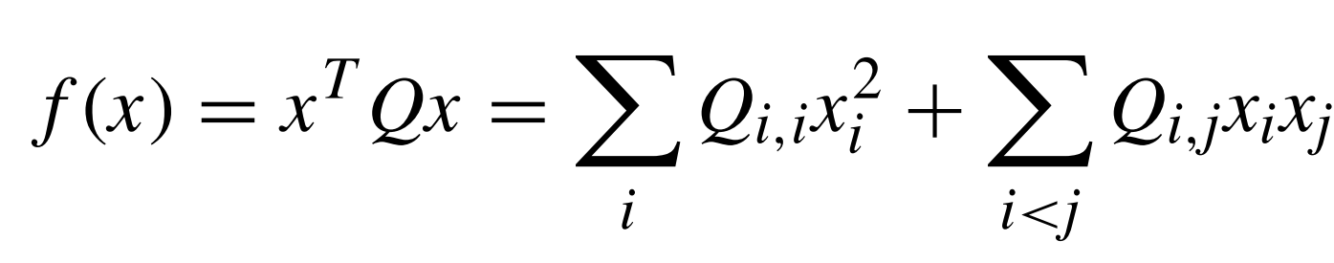

QUBO Model
The Quadratic Unconstrained Binary Optimization (QUBO) equation or formula is used to model many combinatorial optimization problems (COPs), with variables taking the value of either 1 (TRUE) or 0 (FALSE).
In the above equation, the terms Q_{i,i} are the linear coefficients, and terms Q_{i,j} are the quadratic coefficients.
The conversion between the QUBO model and the 2D Ising model is trivial.
Notes:
二次無約束二元優化問題傳統上用於計算機科學，變量取值為 1 (TRUE) 和 0 (FALSE)。 QUBO 問題是使用上對角矩陣 Q 定義的，Q 是一個 N x N 實係數上三角矩陣，以及 x，一個二元變量向量，作為最小化函數：
其中對角項 Qi,i 是線性係數，非零非對角項 Qi,j 是二次係數。 這可以更簡潔地表示為：
Ising 模型和 QUBO 之間的轉換是顯而易見的。

Slide 13
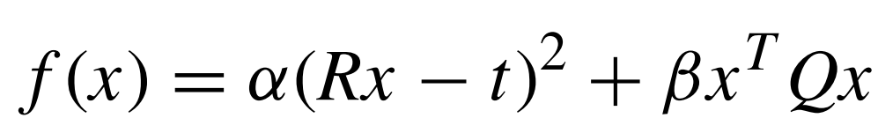
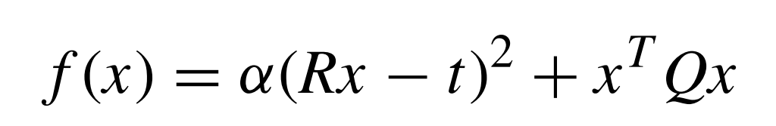
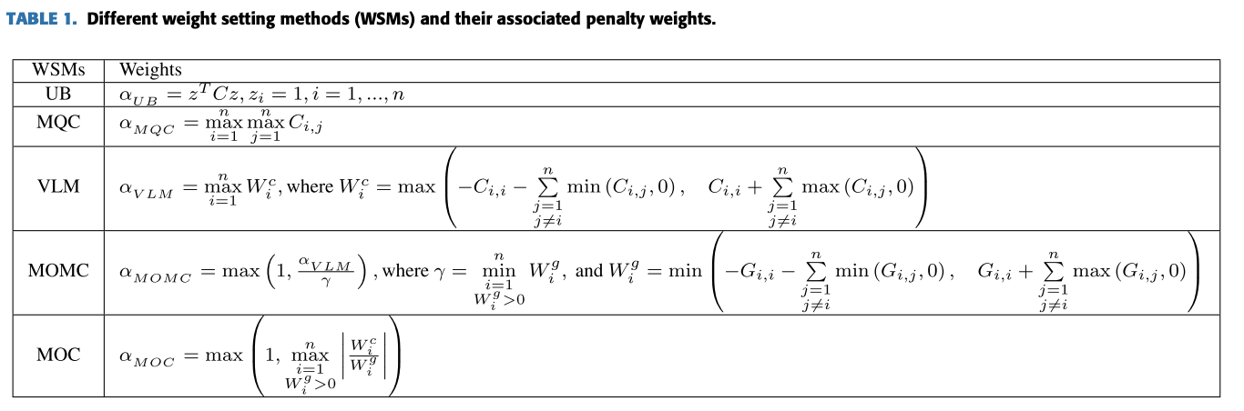
Different Weight Setting Methods (WSMs) for Penalty Weights
, or equivalently
Paper: Jehn-Ruey Jiang, and Chun-Wei Chu, "Classifying and Benchmarking Quantum Annealing Algorithms Based on Quadratic Unconstrained Binary Optimization for Solving NP-hard Problems," IEEE Access, vol. 11, pp. 104165-104178, 2023.
Notes:
Alpha is called a constraint weight or penalty weight of a real-number value.
Beta is called an optimization weight
The methods are Verma and Lewis Method (VLM), Upper Bound (UB), Maximum QUBO Coefficient (MQC), Maximum change in Objective function divided by Minimum Constraint function of infeasible solutions (MOMC), and Maximum value derived from dividing each change in Objective function with the corresponding change in Constraint function (MOC)

Slide 14
Three Types of Annealers for Benchmarking
Quantum Annealer (QA): D-Wave Advantage (2020)
  Providing 5640 qubits with 15-way connectivity
Digital Annealer (DA): Fujitsu DAU-3 ASIC (2021)
  Simulating 100,000 fully connected qubits
GPU-based Annealer (GPUA): Compal Quantix (2023)
  Simulating 60,000 fully connected qubits
  CPU: Intel Xeon CPU E5-2640 v4 2.40GHz * 20
  GPU: NVIDIA GV100 (TITAN V) * 4
Notes:
古典與 D-Wave 比較對象結果引用自 [1]
原則上所有退火機器都盡可能使用與 D-Wave 相同的 Modeling 方式
DAU 數據使用預設：num_run = 16, 回傳 5 個 sample
Quantix 參數使用預設，預設回傳 100 的 sample
Quantix 與 DAU 部分測試資料之運行時間以參數設定上限代表（有些許誤差，可在後續實驗補上）
[1] Jiang, J. R., & Chu, C. W. (2023). Classifying and benchmarking quantum annealing algorithms based on quadratic unconstrained binary optimization for solving NP-hard problems. IEEE Access.

Slide 15
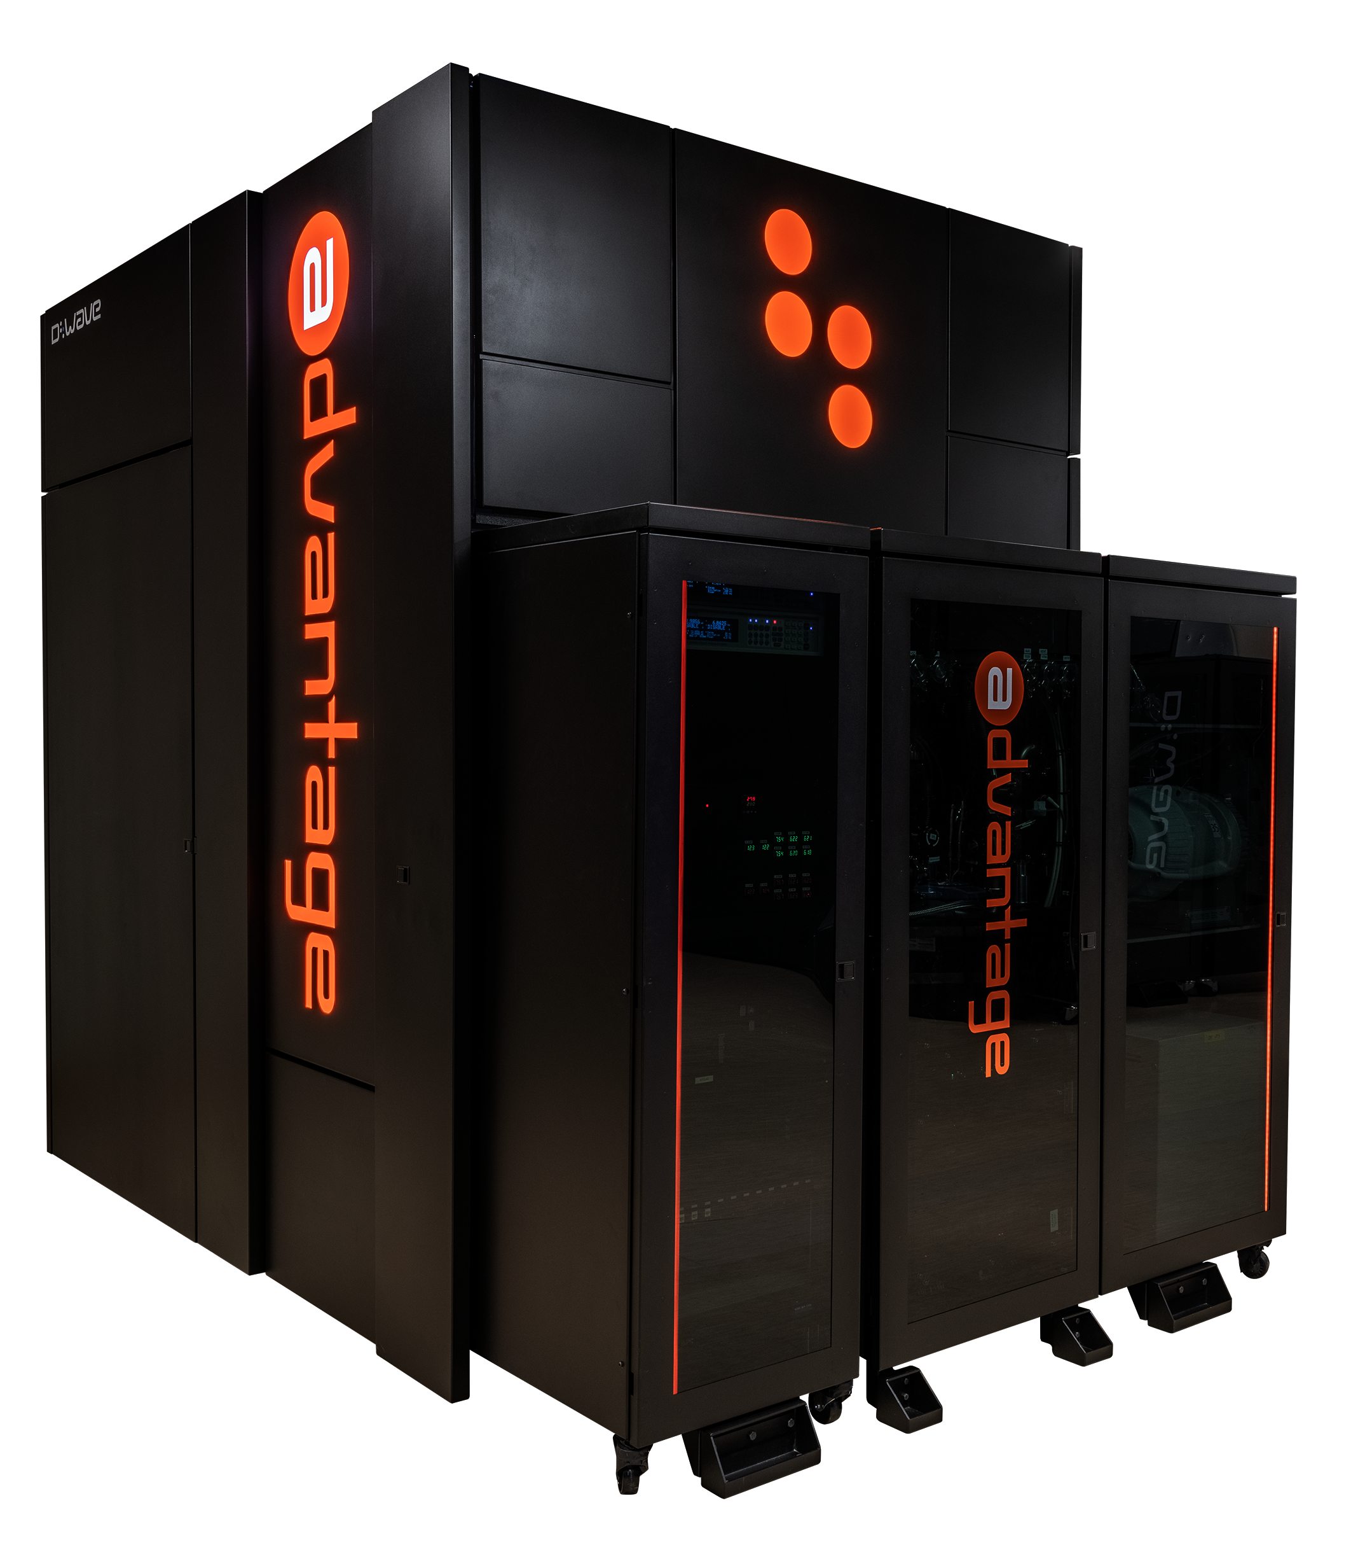
Quantum Algorithms for
D-Wave Quantum Annealers (QAs)
D-Wave Systems Inc. is a Canadian company founded in 1999.
D-Wave produced quantum annealers or quantum samplers for solving optimization problems using the concept of quantum annealing.
The company designed their first qubit by using d-wave superconductors.
D-Wave quantum annealer history:
  2007: Orion Prototype
  2011: D-Wave One (127 qubits; 352 couplers)
  2013: D-Wave Two (512 qubits; 1472 couplers)
  2015: D-Wave 2X (1152 qubits; 3360 couplers)
  2017: D-Wave 2000Q (2048 qubits; 6016 couplers; Chimera topology)
  2020: D-Wave Advantage (5640 qubits; 40484 couplers; Pegasus topology)
D-Wave Advantage
(source: https://www.dwavesys.com/solutions-and-products/systems/)

Slide 16
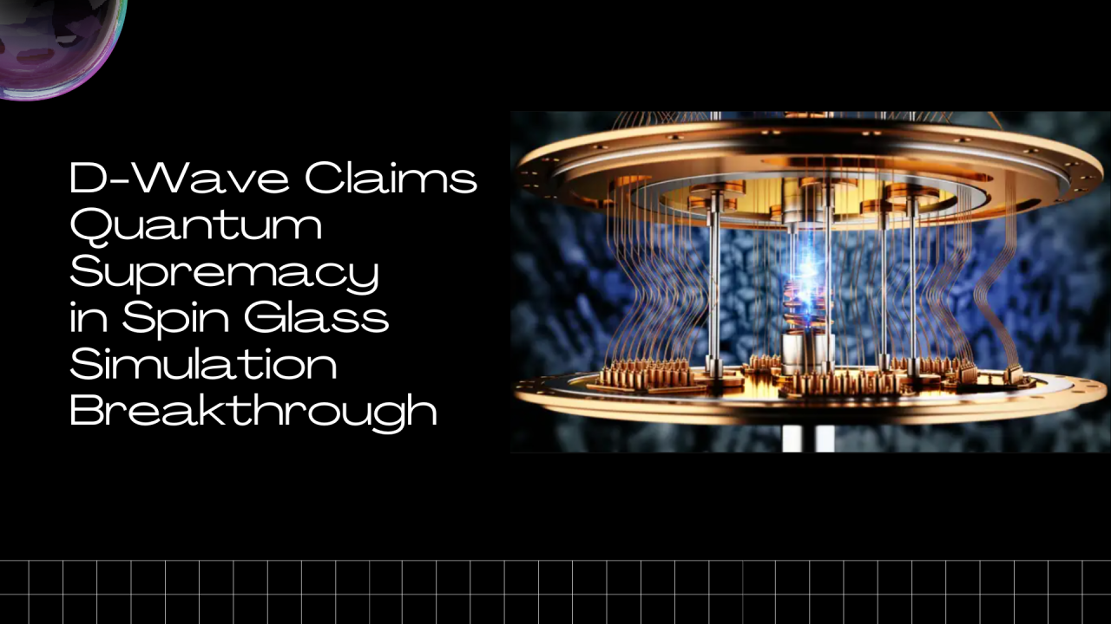
source: https://www.linkedin.com/pulse/d-wave-claims-quantum-supremacy-spin-glass-simulation-david-borish-gai3c/
Notes:
D-Wave Claims Quantum Supremacy in Spin Glass Simulation Breakthrough
David Borish
AI Strategist at Trace3 | Keynote Speaker | 25 Years in Technology & Innovation | NYU Guest Lecturer & AI Mentor | Author of "AI 2024" | Writer at "The AI Spectator"
March 13, 2025
A new study published in Science demonstrates that quantum annealers can solve problems in quantum simulation that appear to be beyond the reach of conventional computers. Researchers led by Andrew D. King at D-Wave showed that superconducting quantum annealers can simulate the dynamics of quantum spin glasses more efficiently than leading classical computational methods.
A Practical Demonstration of Quantum Advantage
While quantum computers have theoretically promised computational advantages for decades, demonstrating this advantage for practical, meaningful problems has remained challenging. Previous demonstrations of quantum advantage have primarily focused on random number generation tasks with limited practical applications.
This research represents a significant step forward by showing quantum advantage in simulating quantum phase transitions in spin glass systems—a problem with direct relevance to condensed matter physics, materials science, and optimization algorithms.
The Quantum Simulation Challenge
The researchers used superconducting quantum annealing processors to simulate the time evolution of a transverse-field Ising model (TFIM) undergoing a quantum quench. This process involves rapidly changing the strength of magnetic fields applied to a system of interacting quantum spins, driving the system through a quantum phase transition.
The team tested this simulation on multiple topologies of increasing complexity:
Two-dimensional square lattices
Three-dimensional cubic lattices
Diamond lattices
Biclique graphs (relevant to generative AI)
The researchers used two different quantum processing units (QPUs): an Advantage system (ADV1) and a prototype Advantage2 system (ADV2), both capable of generating at least 1,000 samples per second.
Rigorous Comparison with Classical Methods
To establish the quantum advantage claim, the researchers compared their quantum annealer results against state-of-the-art classical simulation methods:
Matrix Product States (MPS): A tensor network approach that leverages the area law of entanglement entropy
Projected Entangled-Pair States (PEPS): A tensor network approach better aligned with two-dimensional systems
Neural Quantum States (NQS): Neural network-based approaches including complex restricted Boltzmann machines and autoregressive models
For smaller systems where "ground truth" could be calculated with supercomputers, the quantum annealer produced results with high accuracy. The key metric used was correlation error, which measures the difference in spin-spin correlations between the approximate method and the ground truth.
Evidence of Beyond-Classical Performance
The study provides several lines of evidence for quantum advantage:
Scaling Analysis: While quantum annealer error remained roughly constant across system sizes, the classical MPS method required exponentially increasing computational resources to match the quantum annealer's accuracy as system size grew.
Area-Law Scaling: The researchers demonstrated that the bond dimension required for MPS to match QPU quality scales exponentially with the bipartition area, consistent with the expected area-law scaling of entanglement in these systems.
Universal Quantum Critical Scaling: The quantum annealer correctly reproduced the universal Kibble-Zurek exponents associated with different topologies, confirming that it accurately captures fundamental quantum critical behavior.
Resource Extrapolation: For the largest simulated systems, the researchers estimated that classical methods would require millions of years on supercomputers and exceed global annual electricity consumption to match the quantum annealer's performance.
Implications and Future Directions
This research has significant implications for:
Condensed Matter Physics: Enabling the study of quantum critical phenomena in complex systems
Materials Science: Providing insights into the behavior of quantum materials
Optimization Algorithms: Supporting the development of quantum-inspired classical algorithms
Artificial Intelligence: Potentially enhancing machine learning techniques through quantum simulation
The researchers suggest that similar methods could be used to study dissipative dynamics in open quantum systems, another classically intractable problem with important applications.
This work demonstrates that quantum annealers can now solve practical problems of scientific interest that appear to be beyond the reach of classical computation. While the research doesn't claim an absolute lower bound on classical simulation capabilities, it shows that current leading classical methods cannot match the quantum annealer's performance within reasonable time and resource constraints for these specific simulation tasks.
This represents an important milestone in quantum computing's evolution from theoretical promise to practical advantage in solving meaningful scientific problems.
Click here to read the full paper: Beyond-classical computation in quantum simulation
Thanks David Borish. I thought I was at least a novice level on Quantum, but I got lost on some of the terms like "Spin" Here's a simple version for novices like me :-) - Scientists have shown that quantum annealers (a type of quantum computer) can solve complex physics problems faster than regular computers. This marks a big step toward making quantum computers useful.
The study focused on quantum spin glasses, which are systems of tiny magnetic particles that behave unpredictably. Understanding them helps scientists in physics, materials science, and AI.
Researchers tested their quantum annealer by simulating how these particles react to changing magnetic fields. They compared it to the best computers (regular supercomputers). While classical methods worked for small problems, they required exponentially more power for larger ones. Some simulations would take millions of years on classical computers, but the quantum annealer solved them quickly.
This discovery proves that quantum computers are not just theoretical—they can solve real scientific problems faster than even the best supercomputers. In the future, this could lead to breakthroughs in electronics, AI, and optimization problems, making industries more efficient.
…more
大衛·鮑裡什
Trace3 的 AI 策略師 |主題演講者 | 25 年科技與創新 |紐約大學客座講師與人工智慧導師 | 《AI 2024》作者| 《AI 觀察者》撰稿人
2025 年 3 月 13 日
《科學》雜誌發表的一項新研究 表明，量子退火器可以解決量子模擬中似乎超出傳統電腦能力範圍的問題。 D-Wave 的 Andrew D. King 領導的研究人員表明，超導量子退火器可以比領先的經典計算方法更有效地模擬量子自旋玻璃的動力學。
量子優勢的實際證明
儘管量子電腦幾十年來在理論上一直具有計算優勢，但在實際中證明這一優勢並解決有意義的問題仍然具有挑戰性。先前的量子優勢展示主要集中在隨機數產生任務上，實際應用有限。
這項研究展示了模擬自旋玻璃系統中量子相變的量子優勢，代表著向前邁出的重要一步——這個問題與凝聚態物理、材料科學和最佳化演算法直接相關。
量子模擬挑戰
研究人員使用超導量子退火處理器模擬橫向場伊辛模型 (TFIM) 在量子淬火過程中的時間演化。該過程涉及快速改變施加到相互作用的量子自旋系統的磁場強度，從而驅動系統完成量子相變。
該團隊在越來越複雜的多種拓撲上測試了這項模擬：
QR 圖方格
三維立方晶格
鑽石格子
雙結點圖（與生成式 AI 相關）
研究人員使用了兩種不同的量子處理單元 (QPU)：Advantage 系統 (ADV1) 和原型 Advantage2 系統 (ADV2)，兩者每秒鐘都能夠產生至少 1,000 個樣本。
與傳統方法的嚴格比較
為了確立量子優勢，研究人員將他們的量子退火結果與最先進的經典模擬方法進行了比較：
矩陣積態 (MPS)：一種利用糾纏熵面積定律的張量網路方法
投影糾纏對態 (PEPS)：一種更適合二維繫統的張量網路方法
神經量子態 (NQS)：基於神經網路的方法，包括複雜的受限玻爾茲曼機和自回歸模型
對於可以使用超級電腦計算「基本事實」的小型系統，量子退火器可以產生高精度的結果。使用的關鍵指標是相關誤差，它測量近似方法和基本事實之間的自旋-自旋相關性的差異。
超越古典表現的證據
該研究為量子優勢提供了幾個證據：
縮放分析：雖然量子退火器誤差在整個系統規模內大致保持不變，但隨著系統規模的擴大，經典的 MPS 方法需要倍增計算資源才能匹配量子退火器的精確度。
面積定律縮放：研究人員證明，MPS 匹配 QPU 質量所需的鍵維度與二分面積呈指數增長，這與這些系統中糾纏的預期面積定律縮放一致。
通用量子臨界縮放：量子退火器正確地再現了與不同拓撲相關的通用 Kibble-Zurek 指數，證實它準確地捕捉到了基本的量子臨界行為。
資源外推：對於最大的模擬系統，研究人員估計，經典方法需要在超級電腦上運行數百萬年，並且超過全球年度電力消耗才能匹配量子退火器的性能。
啟示與未來方向
這項研究對於以下方面具有重要意義：
凝聚態物理學：研究複雜系統中的量子臨界現象
材料科學：深入了解量子材料的行為
最佳化演算法：支持量子啟發的經典演算法的開發
人工智慧：透過量子模擬潛在地增強機器學習技術
研究人員建議，可以使用類似的方法來研究開放式量子系統中的耗散動力學，這是另一個具有重要應用的經典難題。
這項工作表明，量子退火器現在可以解決那些似乎超出了經典計算範圍的科學實際問題。雖然該研究並沒有對經典模擬能力提出絕對的下限，但它表明，在合理的時間和資源限制內，當前領先的經典方法無法與量子退火器在這些特定的模擬任務中的性能相匹配。
這是量子計算從理論前景向解決有意義的科學問題的實際優勢演變過程中的一個重要里程碑。
點擊此處閱讀全文：量子模擬中的超經典計算
戴維·弗里切 • 第三名以上
美國國家航空暨太空總署 (NASA)、技術長、作家、教練、人工智慧
3週
感謝David Borish。我以為我至少是量子方面的新手水平，但我對“自旋”等一些術語感到困惑。這裡有一個適合我這樣的新手的簡單版本:-) - 科學家已經證明量子退火器（一種量子計算機）可以比普通計算機更快地解決複雜的物理問題。這標誌著量子電腦向實用化邁出了一大步。研究的重點是量子自旋玻璃，它是一種行為不可預測的微小磁性粒子系統。了解它們有助於物理學、材料科學和人工智慧領域的科學家。研究人員透過模擬這些粒子對變化的磁場的反應來測試他們的量子退火器。他們將其與最好的計算機（常規超級計算機）進行了比較。雖然傳統方法對於解決小問題很有效，但對於大問題則需要指數級的強大力量。有些模擬在傳統電腦上需要花費數百萬年的時間，但量子退火器很快就解決了這些問題。這項發現證明量子電腦不僅僅是理論上的——它們可以比最好的超級電腦更快地解決真正的科學問題。未來，這可能帶來電子、人工智慧和優化問題的突破，進而提高產業效率。
「Spin glass simulation（旋玻璃模擬）」是一種模擬具有複雜相互作用與無序性（disorder）的磁性系統的方法，廣泛應用在統計物理、計算物理，以及組合最佳化等領域。下面我用比較容易理解的方式說明：
🔹 什麼是「Spin Glass（旋玻璃）」？
「Spin」指的是電子的自旋，可以想像成一個磁針，朝上（+1）或朝下（-1）。
「Glass」是來自玻璃這個詞，代表無序結構：不像晶體有規律排列，而是雜亂無章。
所以「Spin Glass」是一種磁性系統，其中的自旋排列非常混亂，原因是：
有些自旋之間希望同向排列（ferromagnetic, 喜歡對齊）
有些則希望反向排列（antiferromagnetic, 喜歡反向）
然而，系統中這些偏好是隨機的，導致整個系統找不到一個簡單的方法讓大家都滿意 → 稱為“frustration”（受挫）現象
這樣的無序系統被稱為「Spin Glass」。
🔹 Spin Glass Simulation 是什麼？
就是用電腦模擬這樣的 spin glass 系統，目的是：
研究這些無序系統的熱力學性質
模擬能量最小化過程（例如退火、隨機過程）
探索相變行為（像是溫度改變時是否進入玻璃態）
或是應用於最佳化問題（像是最大切割問題、3-SAT、旅行推銷員問題等等）
🔹 常見的模擬方法：
Monte Carlo 模擬（Metropolis 或 Glauber 演算法）
在不同溫度下隨機翻轉自旋，看整體能量如何變化。
Simulated Annealing（模擬退火）
透過類似降溫的過程去找出最低能量配置（對應最佳解）。
Quantum Annealing / QUBO 對應
將 spin glass 問題轉換成 QUBO（Quadratic Unconstrained Binary Optimization）形式，然後用量子退火器或其他求解器來找最低能量。
🔹 常見的模型
Edwards-Anderson 模型（EA model）
自旋只有最近鄰交互作用，隨機正或負耦合。
Sherrington-Kirkpatrick 模型（SK model）
所有自旋彼此都有隨機交互作用（全連接模型）。
🔹 Spin Glass 為什麼重要？
在物理學上，它代表一種新的相態（玻璃態）
在計算上，spin glass 是許多 NP-hard 問題的物理對應模型
是量子計算與機器學習中的「硬問題」模擬來源
如果你有特別想模擬哪一種 spin glass 系統，或是想用 Python、Qiskit、D-Wave 來模擬，我也可以幫你做具體的設定！你有想針對哪一種情境了解嗎？

Slide 17
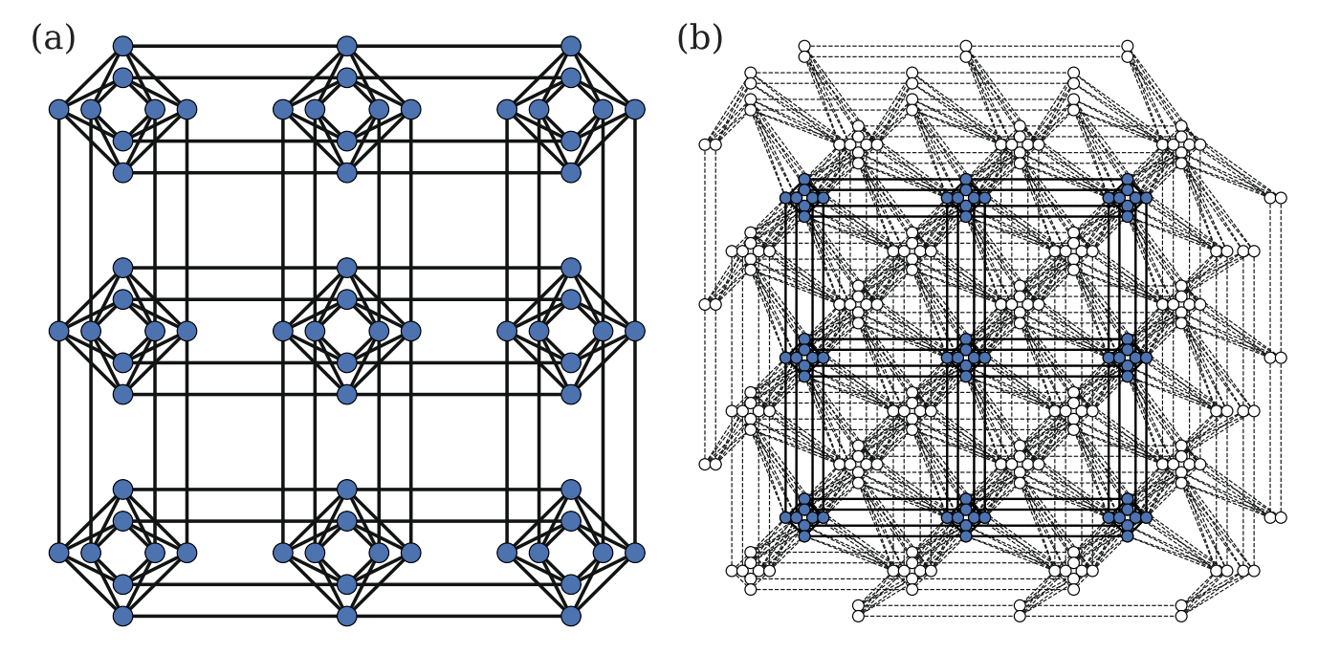
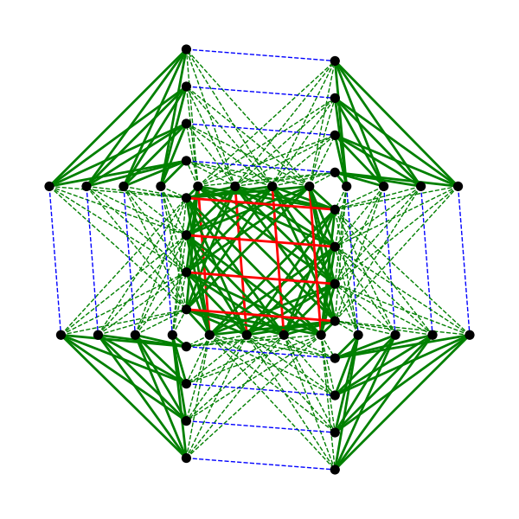
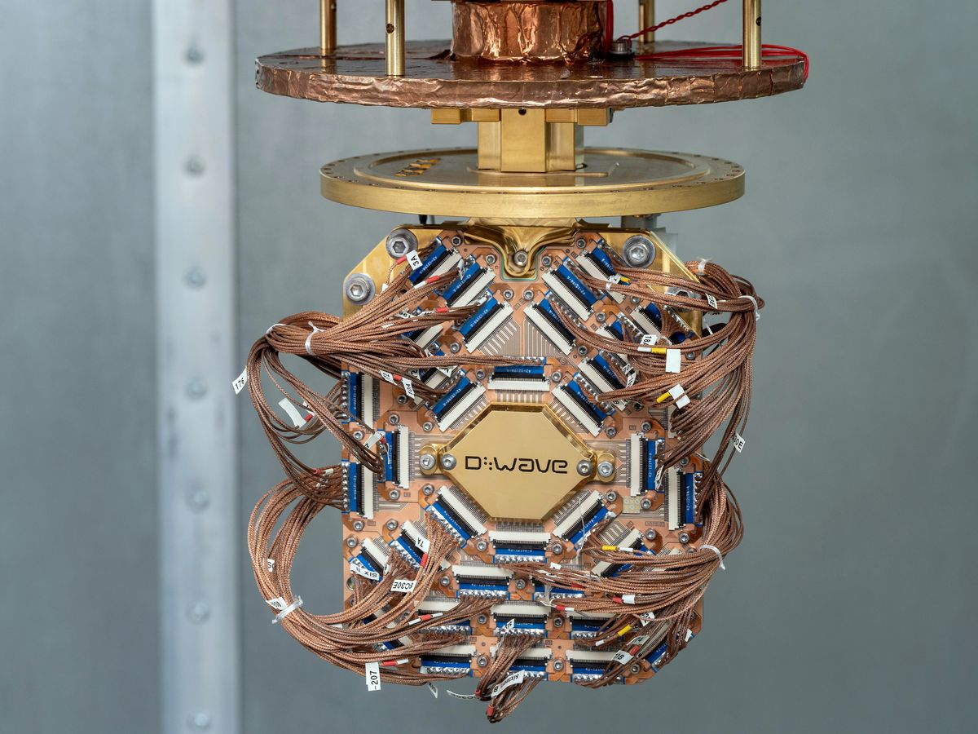
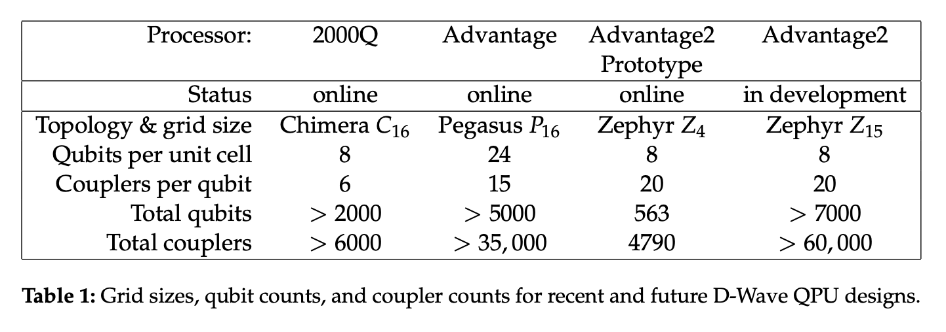
D-Wave QPU and Topology
The D-Wave quantum processing unit (QPU) is a lattice of interconnected qubits. Since a qubit connects to several other qubits via couplers, the D-Wave QPU is not fully connected.
(a) Chimera of 2000Q (b) Pegasus of Advantage (c) Zephyr of Advantage2
Source: Gonzalez Calaza, C. D., Willsch, D., & Michielsen, K. (2021). Garden optimization problems for benchmarking quantum annealers. Quantum Information Processing, 20(9), 1-22.
Source: https://docs.dwavesys.com/docs/latest/c_gs_4.html
Source: https://www.hpcwire.com/2022/06/16/d-wave-debuts-advantage2-prototype-seeks-user-exploration-and-feedback/
Notes:
Greek Mythology A fire-breathing she-monster usually represented as a composite of a lion, goat, and serpent. 【希臘神話】 客邁拉：一種通常被描繪成獅子、山羊和蛇的組合體吐火的雌性怪物
Greek Mythology A winged horse that with a stroke of his hoof caused the fountain Hippocrene to spring forth from Mount Helicon. 【希臘神話】 佩加索斯：其蹄在赫利孔山上踏出希波克裏尼靈感泉的生有翼的飛馬
D-Wave Systems 是量子計算領域的先驅，專注於量子退火技術的開發。他們的最新架構是 Advantage 系統，擁有超過 5,000 個量子位元（qubits），並採用 Pegasus 圖拓撲結構，每個量子位元具有 15 個連接。 en.wikipedia.org
在 2021 年，D-Wave 宣布了下一代系統 Advantage 2，預計在 2024 年底或 2025 年初交付。Advantage 2 將量子位元數量提升至超過 7,000 個，並轉換為 Zephyr 圖拓撲結構，每個量子位元的連接數增加到 20。 en.wikipedia.org
值得注意的是，D-Wave 與德國的尤利希超級計算中心（Jülich Supercomputing Centre, JSC）合作，將 Advantage 系統整合到正在開發的 exascale 超級計算機 Jupiter 中，這是全球首個將量子退火計算機與 exascale 計算相結合的案例。 巴倫斯
D-Wave 的這些最新架構旨在提升量子計算的性能和應用範圍，特別是在解決複雜的優化問題和推動人工智慧領域的創新。
zephyr
noun [ C ]
literary
uk
/ˈzef.ər/ us
/ˈzef.ɚ/
a light wind(和風，微風)

Slide 18
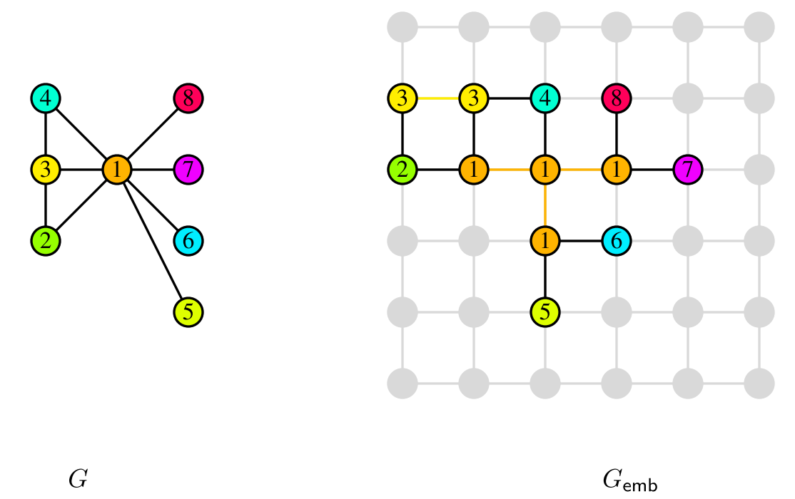
Minor-Embedding
The graph corresponding to the QUBO formula is embedded in the quantum processor or quantum processing unit (QPU) of the quantum annealer, with qubits representing nodes in the graph. Ideally, a qubit should be connected to (coupled with) other qubits.
Source: Choi, V. (2008). Minor-embedding in adiabatic quantum computation: I. The parameter setting problem. Quantum Information Processing, 7(5), 193-209.

Slide 19
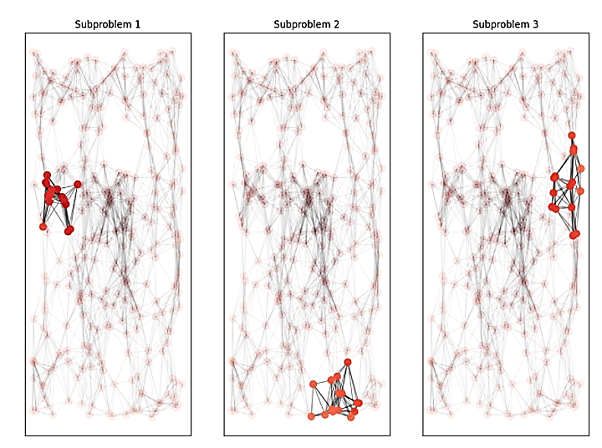
QPU Solvers: Decomposing Large Problems
When the required number of qubits exceeds the upper limit of the device, the graph corresponding to the original problem should be decomposed into subgraphs to be embedded into QPU properly. Certainly, the performance of quantum annealing is affected by graph decomposition methods.
Source: https://docs.dwavesys.com/docs/latest/handbook_decomposing.html?highlight=decomposing

Slide 20
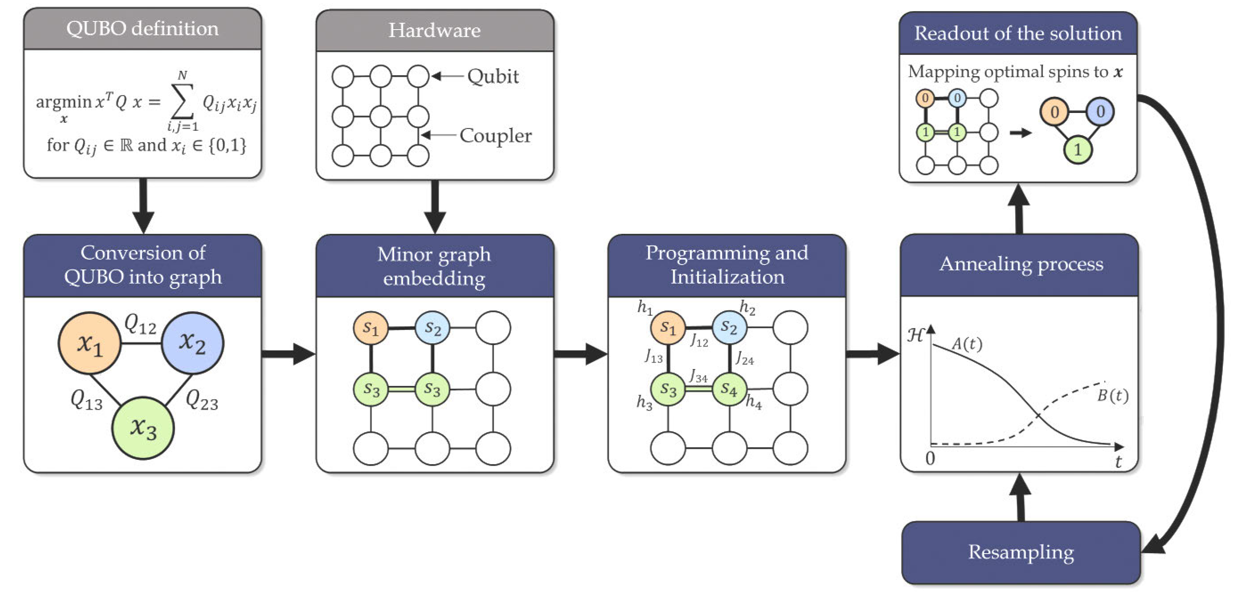
QA Problem Solving Workflow
Formulate the problem with a QUBO formula
Minor embedding / problem decomposition
Hamiltonian initialization
(all qubits in superposition)
Quantum annealing to seek the minimum over the energy landscape
Reading (resampling)
Source: https://docs.ocean.dwavesys.com/en/stable/_{overview}/solving_problems.html
Notes:
要用量子採樣器解決問題，我們可以將問題表述為目標函數，通常採用 Ising 或 QUBO 格式。 目標函數的低能量狀態代表了問題的良好解決方案。 因為我們可以將目標函數表示為圖形，所以我們可以將其映射到 QPU： 線性係數映射到量子比特偏差，二次係數映射到耦合器強度。 QPU 使用量子退火來尋找所產生的能量景觀的最小值，這對應於我們的問題的解決方案。
1.Formulate your problem as an objective function
目標（成本）函數是待優化問題的數學表達式；對於量子計算，這些是二次模型1，它們具有最低值（能量），可以很好地解決它們所代表的問題。
2.Find good solutions by sampling
採樣器是從目標函數的低能量狀態中採樣的過程。通過將我們的二次模型提交給 Ocean 的各種量子、經典和混合量子經典採樣器之一，找到好的解決方案。

Slide 21
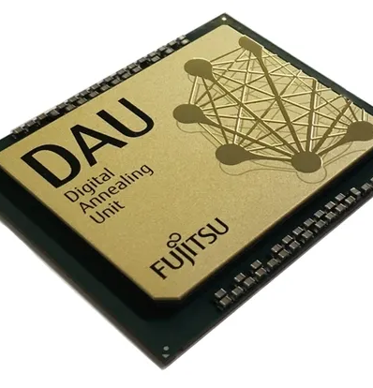
Fujitsu Digital Annealer (DA)
Quantum-inspired (CMOS-based ASIC) architecture
Third Generation Digital Annealing Unit (DAU) technology
Features:
  Up to 100,000 bits
  Fully connectivity
  Search: Markov Chain Monte Carlo (MCMC)
  Special Functionalities:
    Separated penalty terms
    Direct one-way/two-way one-hot constraints
    Direct linear inequality constraints
Notes:
Digital Annealer (DA) is a new technology inspired by quantum computing which is a hardware implementation (CMOS-based ASIC), operates at room temperature and utilizes digital circuitry for the various simulated annealing (SA) algorithm to perform complex optimization. It has superior ability to solve large and complex combinatorial optimization problems in quadratic unconstrained binary optimization (QUBO) formulation. The third-generation DA introduces a hybrid software-hardware system capable of addressing large problems, up to 100,000 bits and fully connectivity. It also separates cost and penalty terms and introduces functionalities for handling one-way/two-way one-hot constraints and linear inequality constraints directly.

Slide 22
DA example: parallel one-bit inversion to find optimum rapidly
Trial 1
Trial 2
Trial N
Bit 1
Inversion
Bit 2
Inversion
Bit N
Inversion
Value 1
Value 2
Value N
Optimal Value & Configuration
Notes:
The following figure shows the technology which DA use to find the optimal value by 1-bit inversion. By parallel computing in digital circuit, the optimal value and corresponding configuration can be found rapidly. It is also the technology for using the constraint one-way/two-way one-hot, that is, all zeros at the purple nodes and 1 on yellow node.

Slide 23
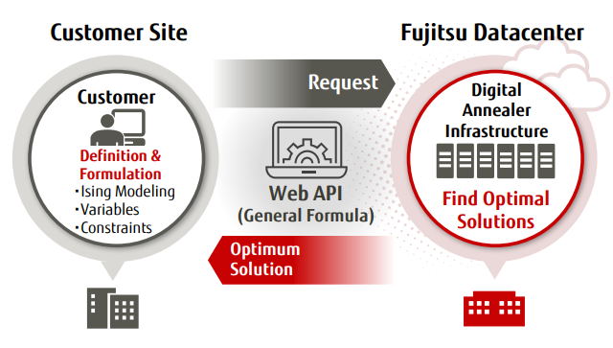
Using DA
Generate the Q matrix for QUBO
Send Q to DA by Qubo v3 API
  https://portal.aispf.global.fujitsu.com/apidoc/da/jp/api-ref/da-qubo-v3-en.html
Get the solution and the total time required to find an optimal solution
The following features of DA are not used in order to be fair
  separated penalty term
  one_way_one_hot_groups
  two_way_one_hot_groups
  direct inequality constraints
Notes:
The way for using DA is also easy. We generate the Q matrix for QUBO and send Q to DA by Qubo v3 API. After a specific waiting time, get the solution and the total time required to find an optimal solution. In order to be fair, the following features are not used in this study: penalty、one_way_one_hot_groups、two_way_one_hot_groups

Slide 24
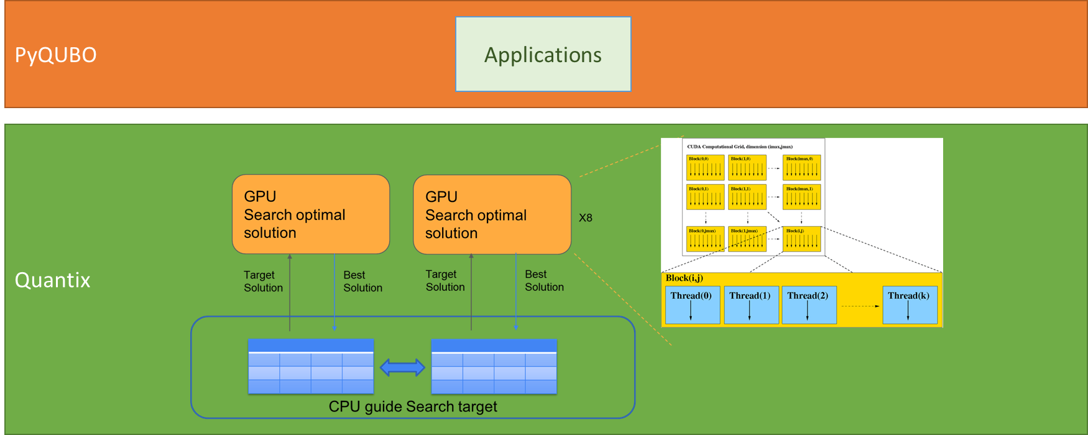
Compal GPU-based Annealer (GPUA) Framework
Formulation
TSP, Max-cut, QAP, etc.
Reduction methods
Compile
容易使用
可擴充升級
架構於現有CPU與GPU硬體上，可彈性部署於雲端或地端應用
使用CUDA平行運算，效能可以隨GPU擴充升級

Slide 25
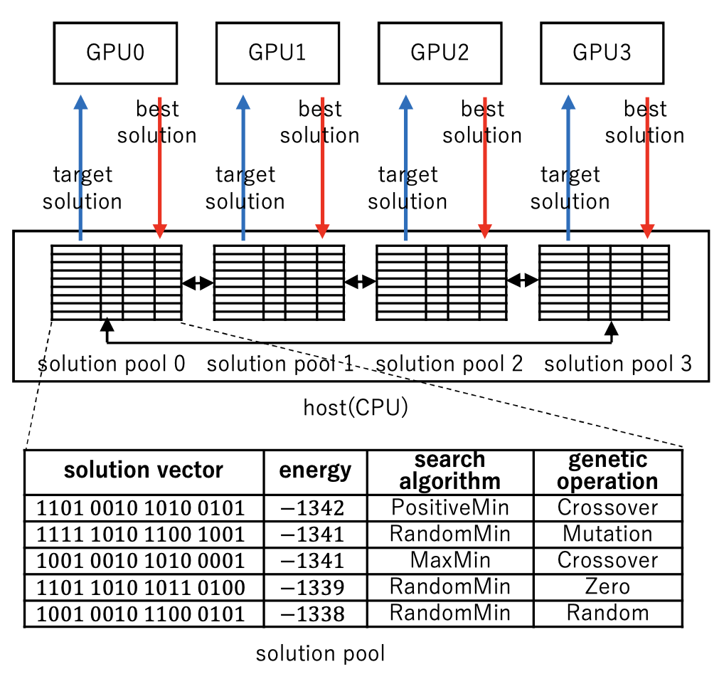
Diverse Adaptive Bulk Search (DABS)
The DABS aims to increase the diversity of genetic algorithm operations (GAOs) run by the host on CPUs and local search algorithms (LSAs) run on GPUs.
It offers five distinct LSAs, namely MaxMin, CyclicMin, RandomMin, PositiveMin, and TwoNeighbor.
Each LSA iteratively flips bits in a solution to explore the solution space for improving solutions.
During the execution of DABS, LSAs that yield better solutions are prioritized for more frequent execution.
The DABS also offers eight different GAOs, including Mutation, Crossover, Xrossover, Zero, One, IntervalZero, Best, and Random.
Similar to LSAs, the GAOs leading to better solutions are executed more frequently than others.
Source: Nakano, K., Takafuji, D., Ito, Y., Yazane, T., Yano, J., Ozaki, S., ... & Mori, R. (2023, May). Diverse Adaptive Bulk Search: a Framework for Solving QUBO Problems on Multiple GPUs. In Proc. of IPDPSW, pp. 314-325, 2023.
Notes:
The Compal company built a quantum-inspired annealer called Quantix. It is a GPU annealer (GPUA) which harnesses the computation power of graphics processing units (GPUs) to conduct the diverse adaptive bulk search (DABS) solver for finding the optimal COP solution. Quantix is built with 20 Intel Xeon CPUs and 4 NVIDIA GV100 GPUs, each of which has 5120 Compute Unified Device Architecture (CUDA) cores.
The DABS concept is proposed in [7], of which framework is depicted in Figure 5. As shown in Figure 5, the DABS framework is based on CPUs and GPUs. It has multiple solution pools maintained by a host run on CPUs. Each solution pool is associated with a GPU and contains entries to keep information of good solutions returned by the GPU. An entry in the solution pool contains the solution (or solution vector), energy, search algorithm, and genetic operation.
Based on Open Multi-Processing (OpenMP) threads, the host CPUs perform genetic algorithm operations (GAOs) on selected solutions from a solution pool or multiple solution pools to generate so-called target solutions to be sent to GPUs. Based on the received target solutions, local search algorithms (LSAs) are executed by GPUs, each with multiple CUDA blocks of numerous CUDA threads that operate concurrently.
The DABS aims to increase the diversity of GAOs and LSAs. It offers five distinct LSAs, namely MaxMin, CyclicMin, RandomMin, PositiveMin, and TwoNeighbor.
Each LSA iteratively flips bits in a solution to explore the solution space for improving solutions. During the execution of DABS, LSAs that yield better solutions are prioritized for more frequent execution. The DABS also offers eight different GAOs, including Mutation, Crossover, Xrossover, Zero, One, IntervalZero, Best, and Random. Similar to LSAs, the GAOs leading to better solutions are executed more frequently than others.

Slide 26
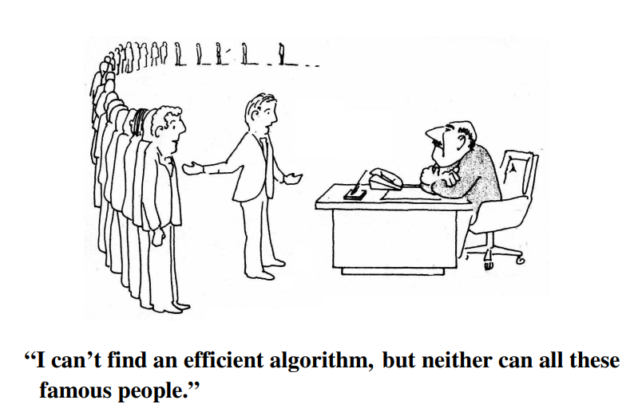
NP-hard and NP-Complete (NPC) Problems
Source: M. R. Garey and D. S. Johnson. Computers and Intractability: A Guide to the Theory of NP-completeness. W. H. Freeman, New York, 1979.

Slide 27
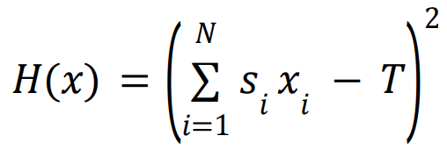


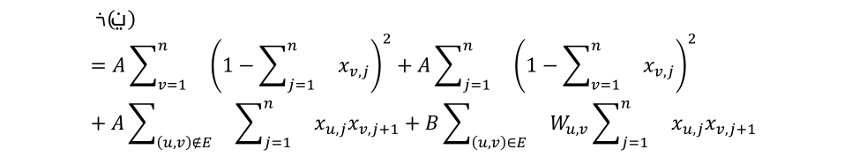
QUBO Formula Classification
Classification Criterion 1 (CC1): Does the number of variables in the QUBO formula scale linearly with the problem input parameters?
Classification Criterion 2 (CC2): Does the QUBO formula contain only optimization terms or only constraint terms?
Paper: Jehn-Ruey Jiang, and Chun-Wei Chu, "Classifying and Benchmarking Quantum Annealing Algorithms Based on Quadratic Unconstrained Binary Optimization for Solving NP-hard Problems," IEEE Access, vol. 11, pp. 104165-104178, 2023.
CC1: CC2: | Yes | No
Yes | Category 1 (e.g. SSP QUBO formula) | Category 3 (e.g. GCP QUBO formula)
No | Category 2 (e.g. VCP QUBO formula) | Category 4 (e.g. TSP QUBO formula)

Slide 28
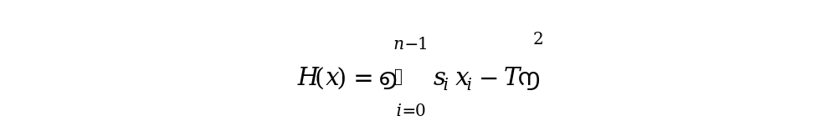
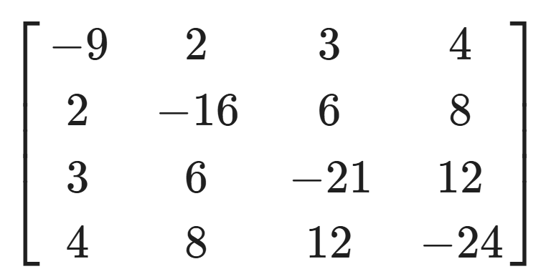
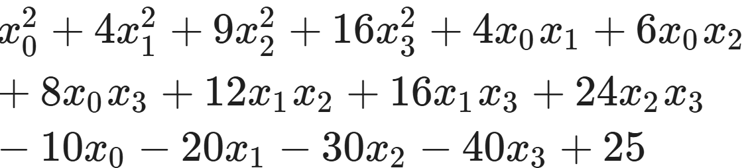
Subset Sum Problem (SSP)
Given a set 𝑆 = {𝑠₁, 𝑠₂, . . . . , 𝑠_{𝑁} } with N integers, and a target integer T, the subset sum (SS) problem is to find a subset S’ of S such that the sum of the integers in the subset S’ is exactly T.
The QA algorithm solving the SS problem has the following QUBO formula:
S = {1, 2, 3, 4}, T =5 ⇒ Yes, there is at least one answer.
H(x)=((1x₀+2x₁+3x₂+4x₃)-5)²=
1
2
4
3
Q =
offset = 25

Slide 29
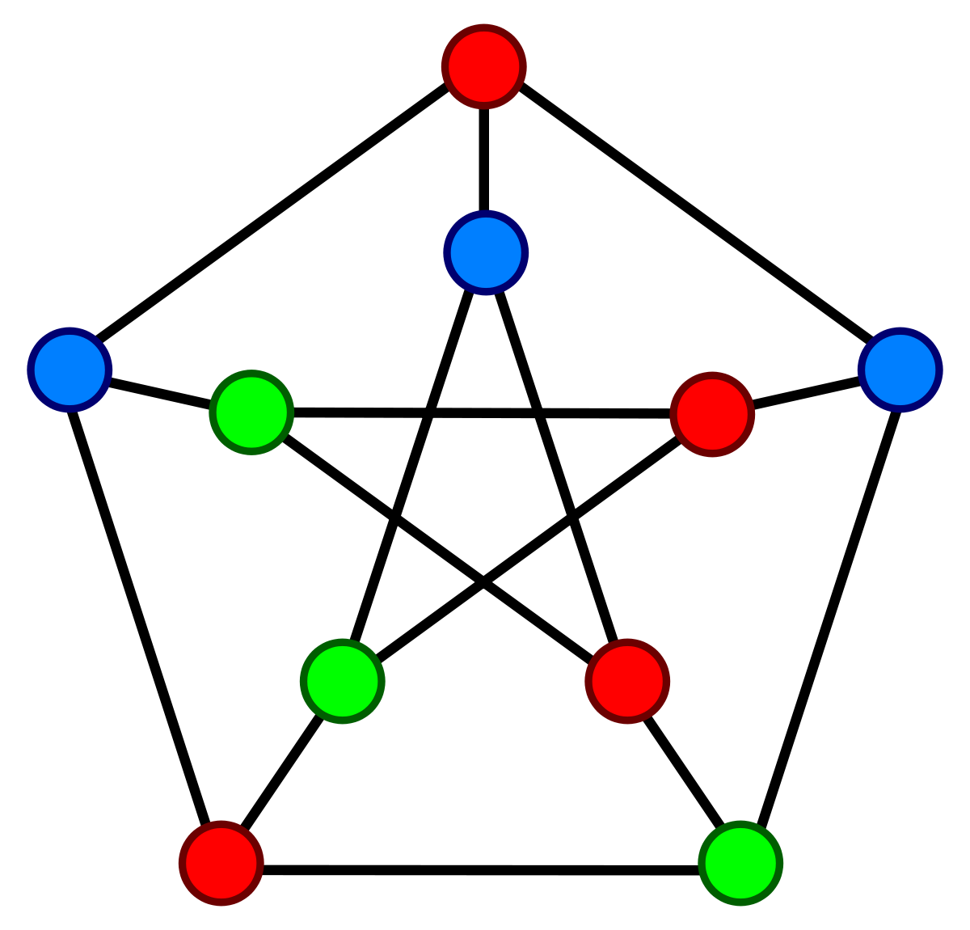
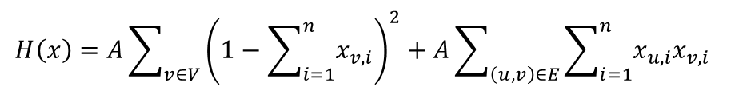
Graph Coloring Problem (GCP)
Given a chromatic number n, and an undirected graph G=(V, E) with the vertex set V and the edge set E, the graph coloring (GC) problem is to decide if it is possible to color all vertices in V such that for every edge (u, v) in E, u and v have different colors
The QA algorithm solving the GC problem has the following QUBO formula:
$$H\left(x\right)=A\sum_{v∈V}{{\left(1−\sum_{i=1}^{n}{x_{v,i}}\right)}^{2}}+A\sum_{\left(u,v\right)∈E}{\sum_{i=1}^{n}{x_{u,i}x_{v,i} }}$$

Slide 30
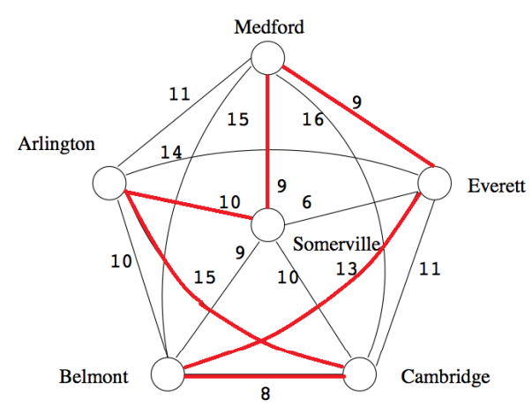
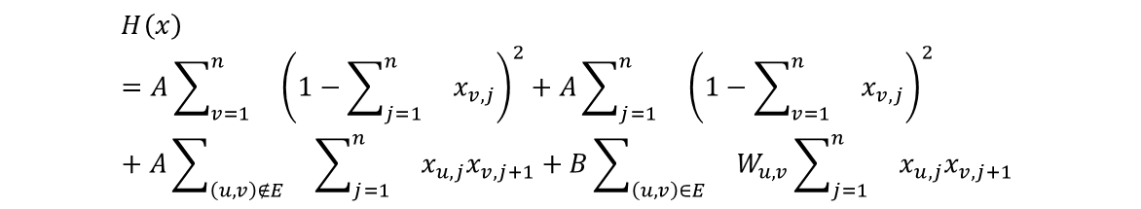
Traveling Salesperson Problem (TSP)
Given a directed graph G=(V, E) with the vertex set V of n vertices and the edge set E, the TSP is to find a tour that first visits an arbitrary vertex v, then sequentially visits vertex exactly once, and at last visits vertex v, such that the sum of weights of edges included in the tour is minimized.
The QA algorithm solving the TSP has the following QUBO formula
$$H\left(x\right)=A\sum_{v=1}^{n}{}{\left(1−\sum_{j=1}^{n}{}x_{v,j}\right)}^{2}+A\sum_{j=1}^{n}{}{\left(1−\sum_{v=1}^{n}{}x_{v,j}\right)}^{2}+A\sum_{\left(u,v\right)∉E}{}\sum_{j=1}^{n}{}x_{u,j}x_{v,j+1}+B\sum_{\left(u, v\right)∈E}{}W_{u,v}\sum_{j=1}^{n}{}x_{u,j}x_{v,j+1}$$

Slide 31
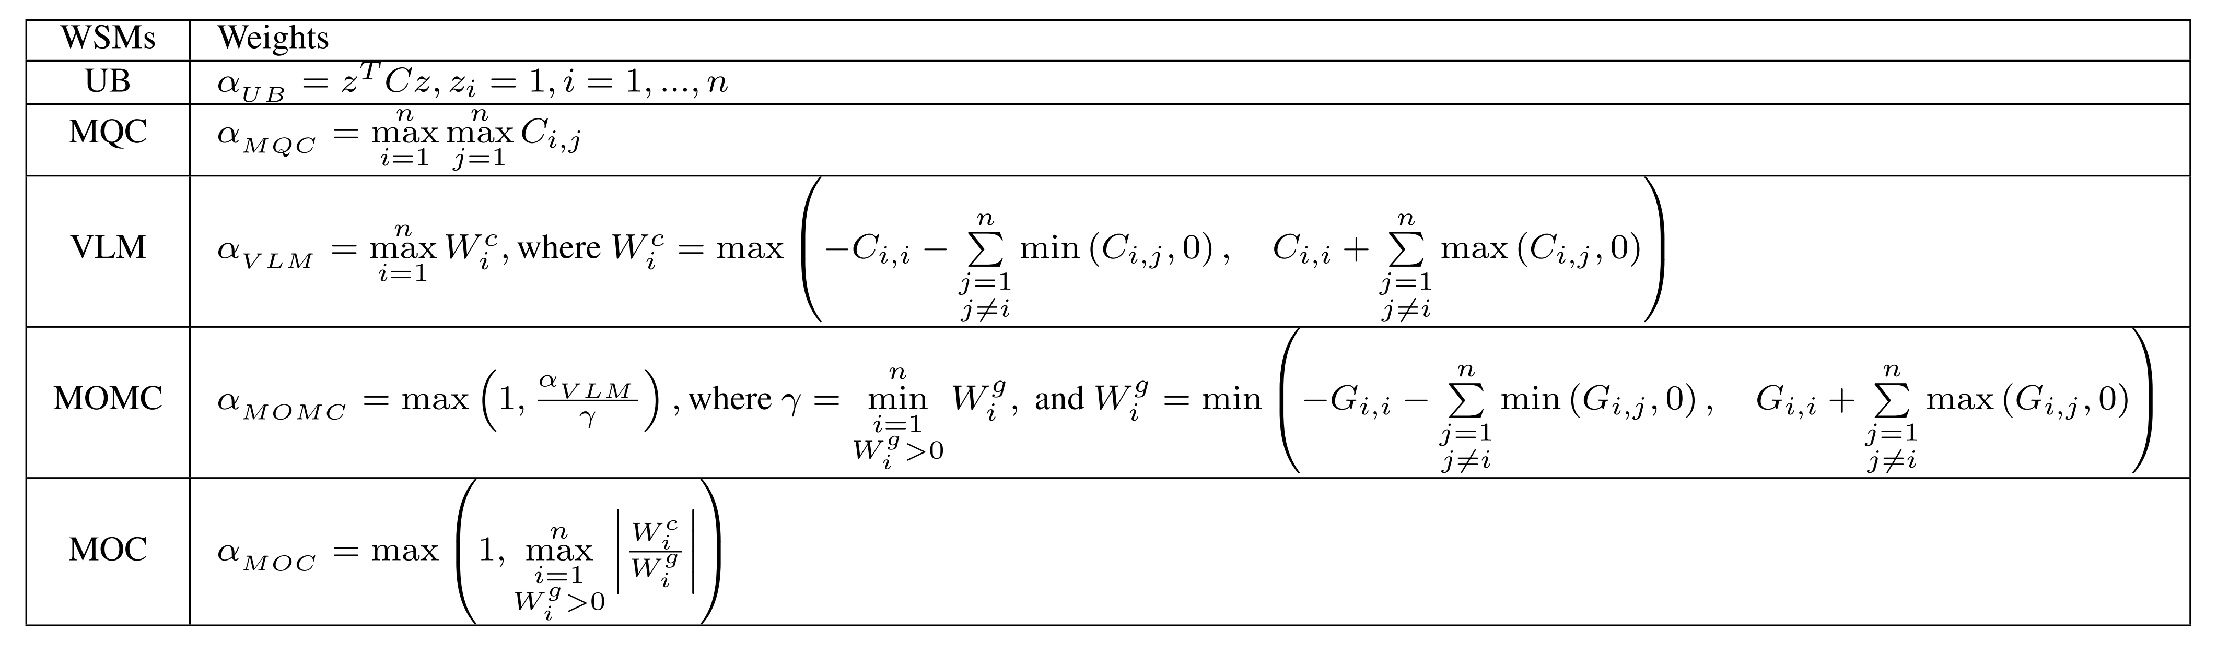
Different weight setting methods (WSMs) and penalty weights
Notes:
The methods are Verma and Lewis Method (VLM), Upper Bound (UB), Maximum QUBO Coefficient (MQC), Maximum change in Objective function divided by Minimum Constraint function of infeasible solutions (MOMC), and Maximum value derived from dividing each change in Objective function with the corresponding change in Constraint function (MOC)

Slide 32
Legends for Solution Ranking
Pink for the 1st place
Brown for the 2nd place
Green for the 3rd place
Blue for the 4th place
NF for “no feasible” solution returned
x for no QUBO Q-matrix due to insufficient memory

Slide 33
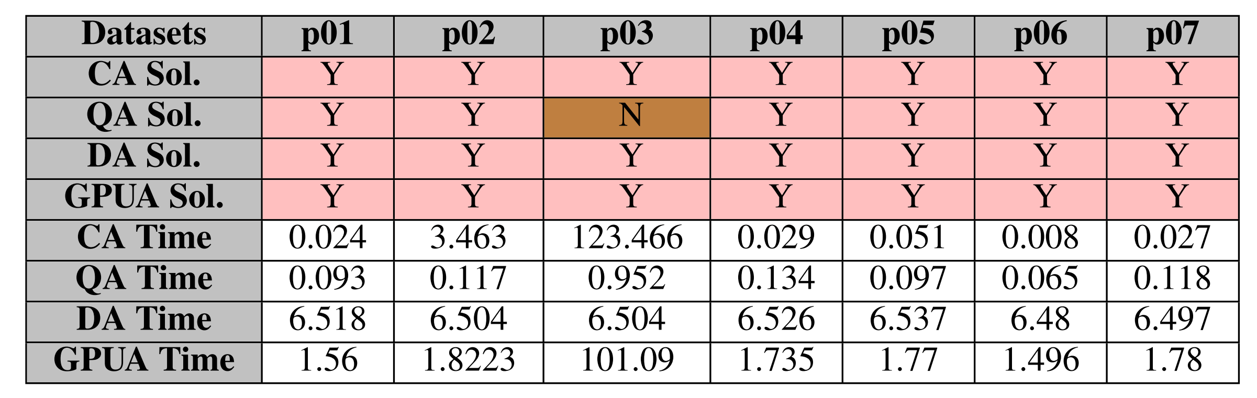
Subset Sum Problem (SSP)

Slide 34
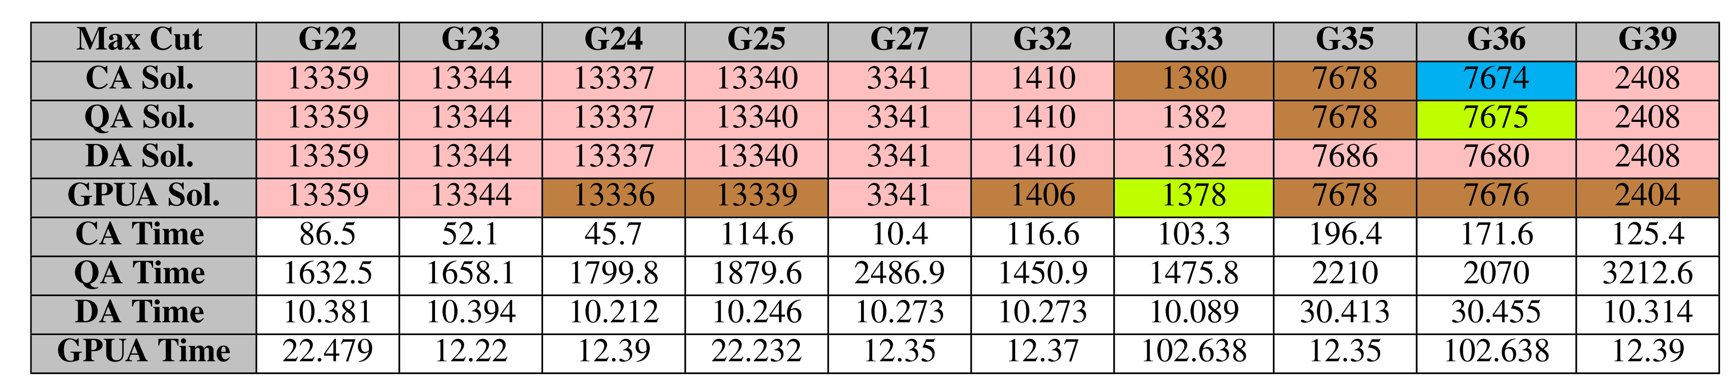
Max Cut Problem (MCP)

Slide 35
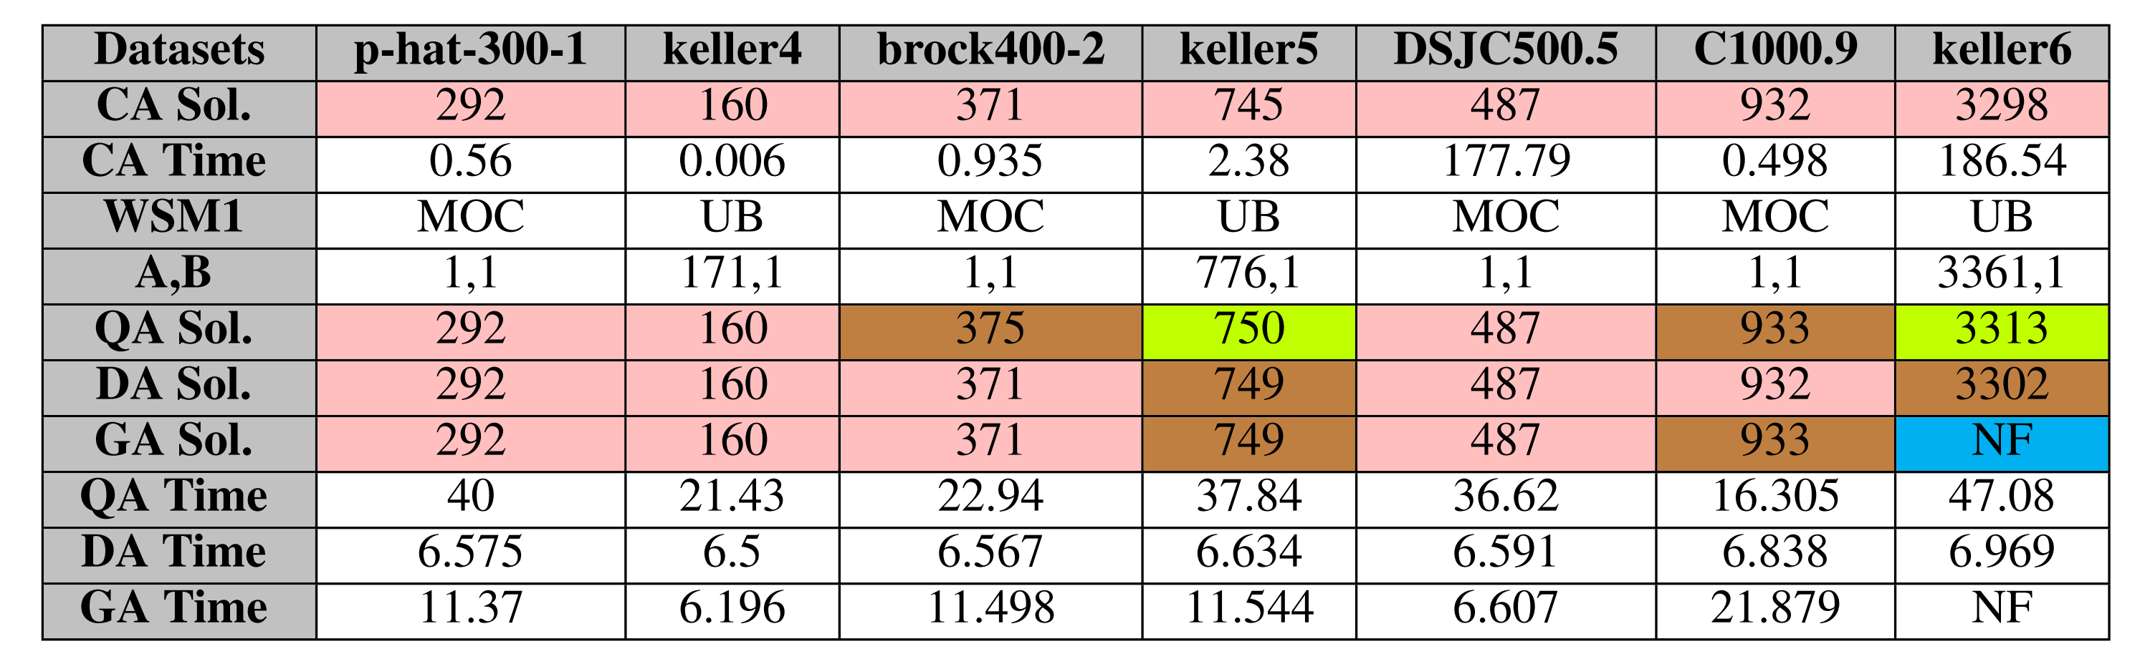
Vertex Cover Problem (VCP)

Slide 36
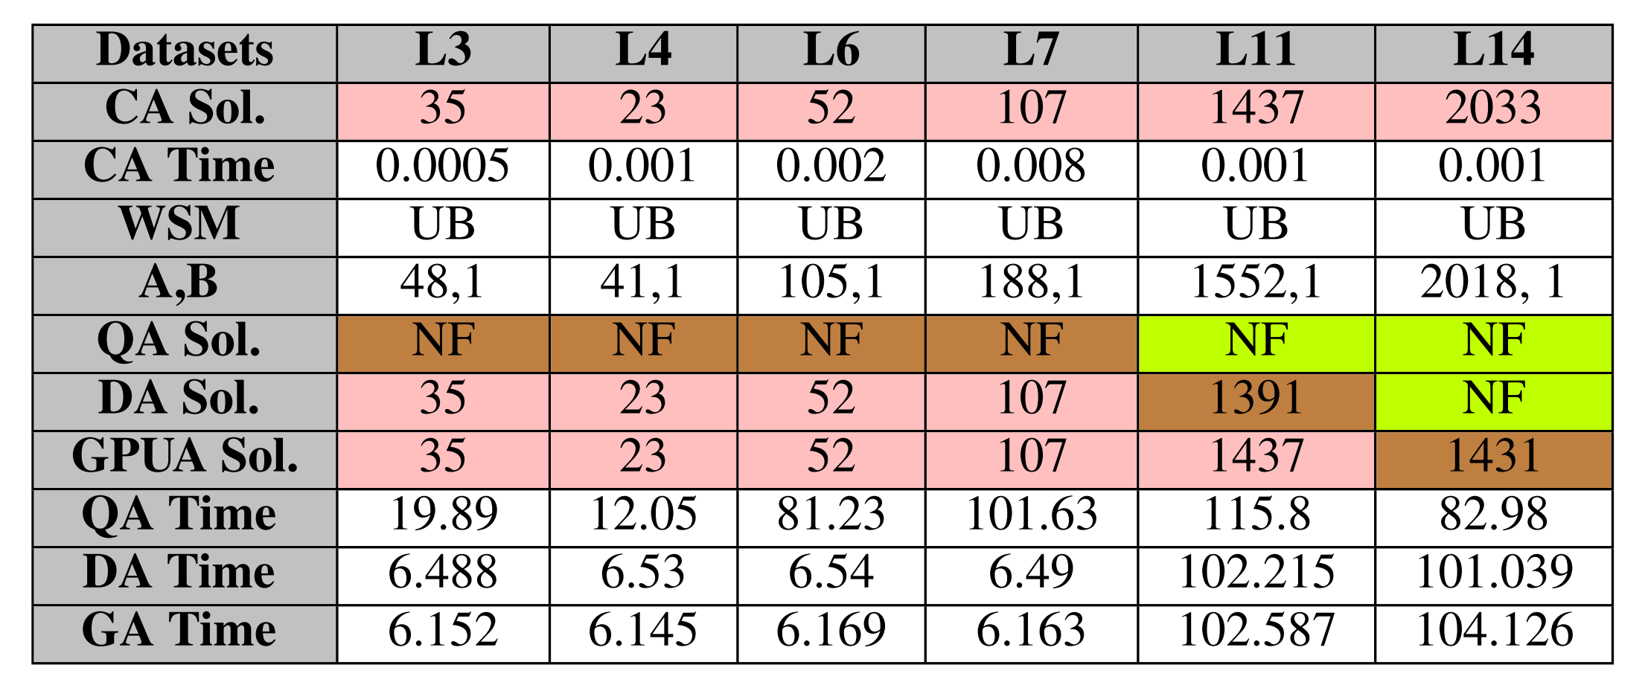
0/1 Knapsack Problem (0/1 KP)

Slide 37
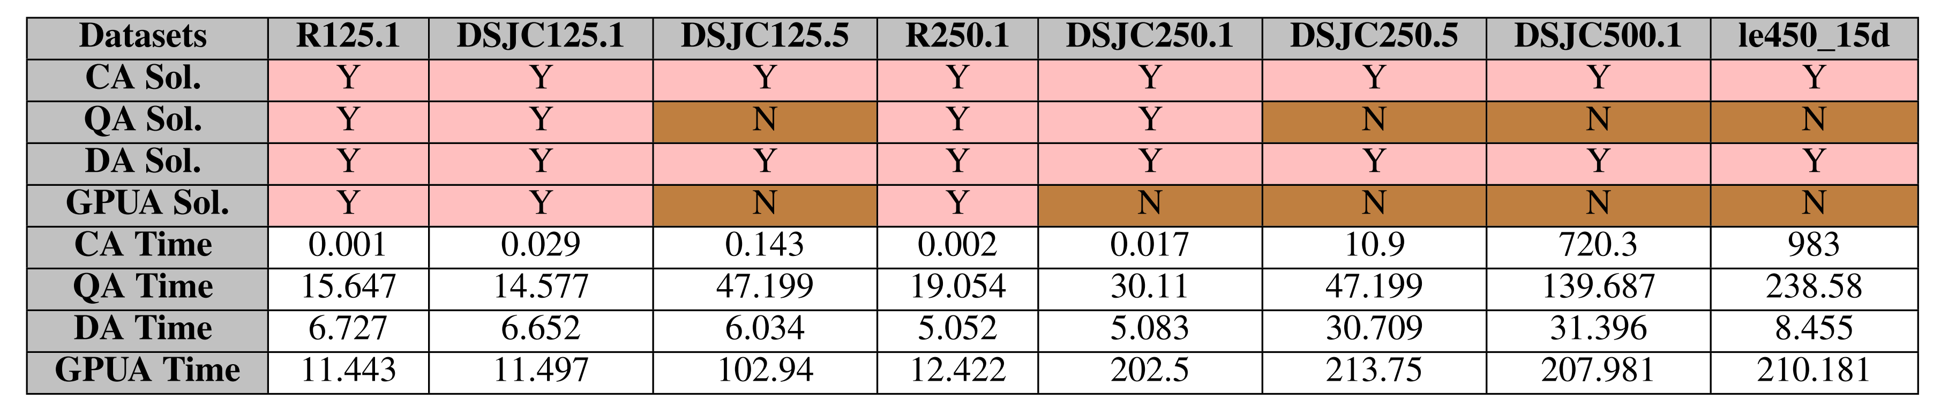
Graph Coloring Problem (GCP)

Slide 38
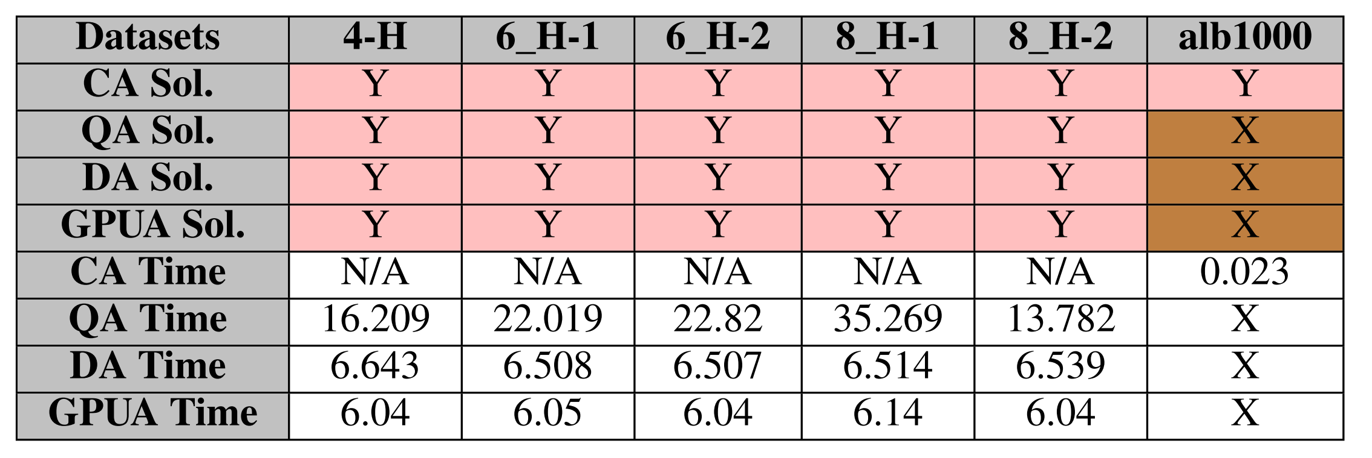
Hamiltonian Cycle Problem (HCP)

Slide 39
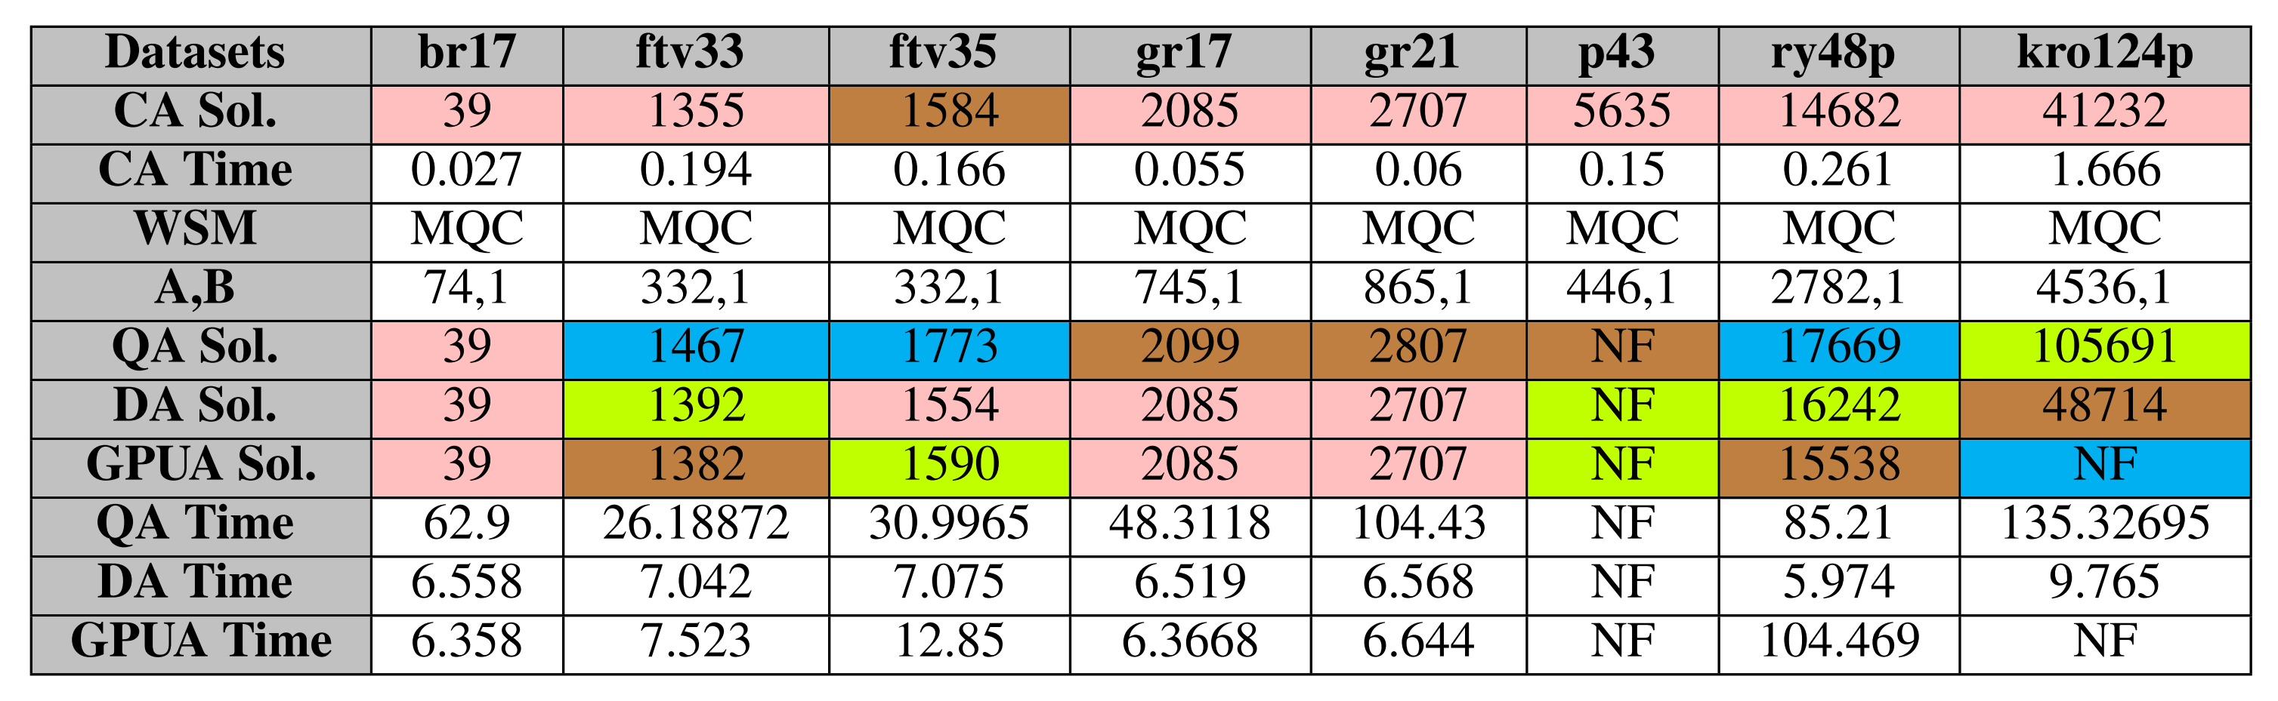
Travelling Salesperson Problem (TSP)

Slide 40
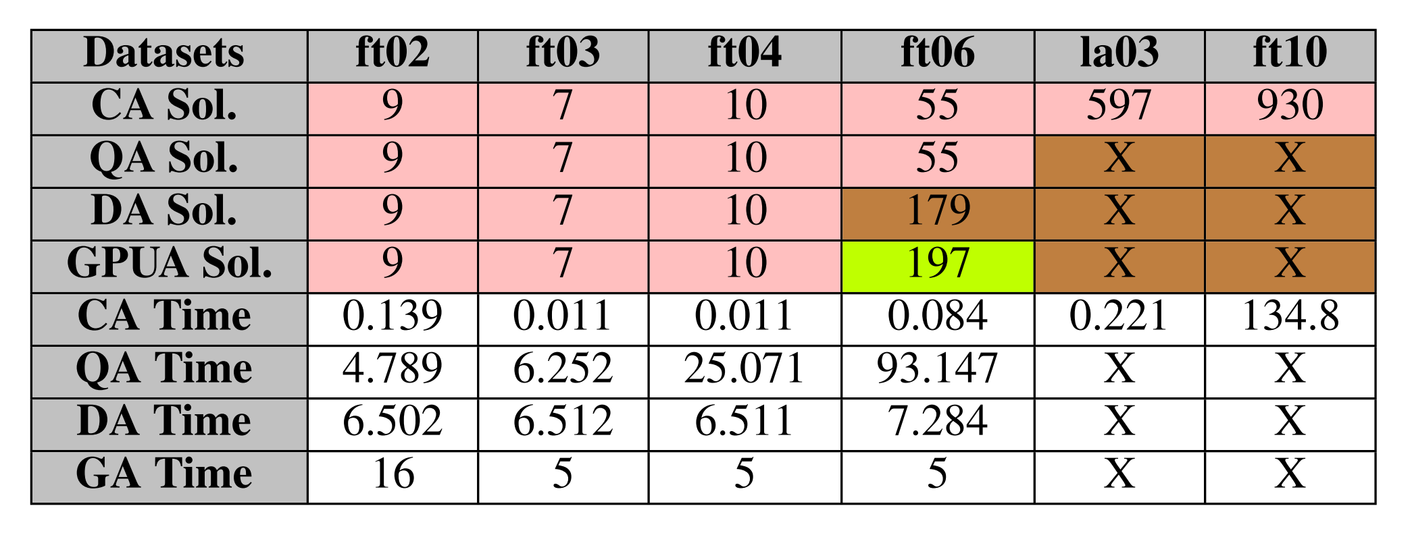
Job-shop Scheduling Problem (JSP)

Slide 41
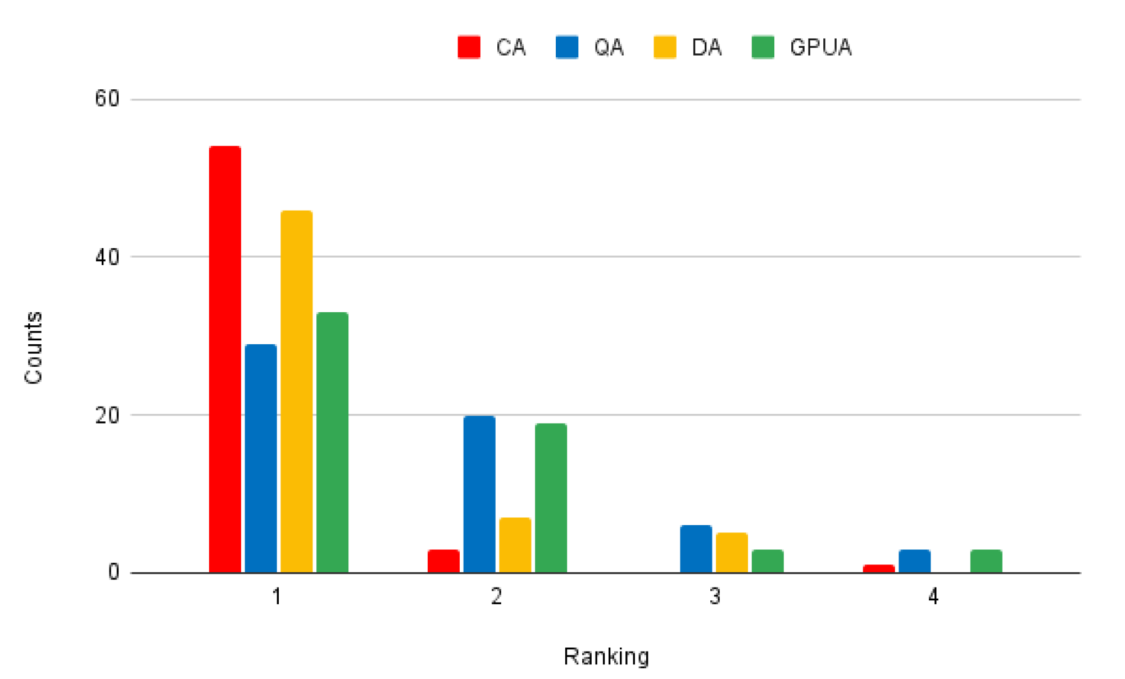

Overall Ranking Distribution

Slide 42
Annealer Overall Comparisons
Annealers | QA | DA | GPUA
Device | D-Wave Advantage | Fujitsu DAU 3 | Compal Quantix
Release Year | 2020 | 2021 | 2023
Technology | Quantum Annealing | ASIC Digital Annealing | GPU-based Annealing
No. of Qubits | 5,640 | 100,000 | ~60,000
Connectivity | At most 15 ways | Fully-connected | Fully-connected
Performance (First Place Ranking) | 3 | 1 | 2
We are trying to find possible performance improvement methods for each annealer.
Notes:
因為是模擬的事實上也許沒有 Connectivity 的問題

Slide 43


Q&A
Jehn-Ruey Jiang (江振瑞）
Email: jrjiang@g.ncu.edu.tw
Web: https://staff.csie.ncu.edu.tw/jrjiang/

