Slide 1
Quantum Circuit Based on Grover's Algorithm to Solve Exact Cover Problem
Jehn-Ruey Jiang, and Yu-Jie Wang
Advanced Computing and Networking Laboratory
Department of Computer Science and Information Engineering
National Central University, Taiwan (R. O. C.)
Notes:
Good morning ladies and gentlemen. Thank you all for being here.
Today, the paper I would like to share is Quantum Circuit Based on Grover's Algorithm to Solve Exact Cover Problem.

Slide 2
Outline
Introduction
Background Knowledge
Proposed Method
Experiment and Result
Conclusion
Notes:
This is my outline, and I will start by discussing the Introduction, followed by the Background Knowledge, the proposed method, experimental results, and finally, the Conclusion.

Slide 3
Outline
Introduction
Background Knowledge
Proposed Method
Experiment and Result
Conclusion
Notes:
First, We will start with the introduction.

Slide 4
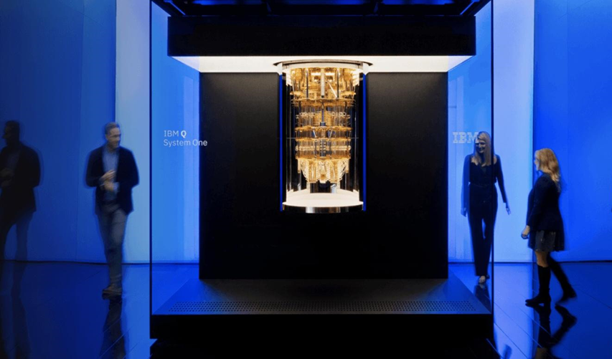
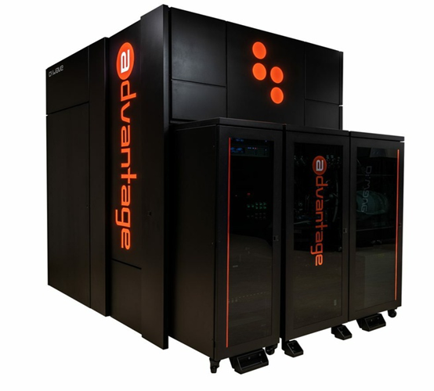
Quantum Computer
The quantum computer is a type of computing devices that leverage the principles of quantum mechanics, such as quantum superposition, entanglement, interference, and tunneling, to perform computation based on quantum bits or qubits.
Quantum computers can be broadly classified into two main classes: gate-based universal quantum computers and quantum annealers.
We are now in the NISQ (noisy intermediate-scale quantum) era.
The limitations of NISQ devices:
The number of qubits is limited.
The decoherence time is short.
The gate fidelity is low.
D-Wave Advantage in 2020
Source: https://tweakers.net/nieuws/187892/d-wave-gaat-net-als-ibm-en-google-universele-quantumcomputer-bouwen.html
IBM’s 20-qubit Q System One in 2019
Source:https://www.somagnews.com/ibm-said-the-quantum-chip-will-surpass-its-competitors-in-2-years/
Notes:
Next, I will introduce quantum computers. Quantum computers are devices that use the principles of quantum mechanics to perform computations. In quantum computing research, quantum devices can be broadly categorized into two types: Universal Quantum Computers and Quantum Annealers.
Universal Quantum Computers perform computations based on quantum logic gates on quantum bits (qubits). They have a relatively small number of qubits; for example, IBM's first commercial quantum computer had only 20 qubits. However, their advantage lies in their ability to solve a wide range of problems. This paper focuses on research related to Universal Quantum Computers.
On the other hand, Quantum Annealers use annealing algorithms to perform computations. They have a larger number of qubits; for example, D-wave's Quantum Annealer, Advantage, has up to 5640 qubits. However, their limitation is that they can only be used to solve combinatorial optimization problems.

Slide 5
Research Problem
To design a quantum circuit of the oracle of Grover’s algorithm to solve the exact cover problem (ECP), which is an intractable NPC problem. (And even more, we want to find all exact covers of the problem.)
To conceive new quantum circuit design concepts to reduce the number of qubits and gates and to lower the quantum circuit depth.
To execute the designed quantum circuit on an IBM quantum simulator or computer to validate it can run properly and correctly.
Notes:
This slide is intended to introduce the classification of problems. Despite the significant advancements in computer science, there are still many unsolved problems in real-life scenarios. Scientists commonly categorize these complex and difficult problems into P, NP, NP-complete, and NP-hard.
Among these four types of problems, our primary focus of discussion is on NP-complete and NP-hard problems because, to date, there are no efficient classical algorithms to solve them. Therefore, this thesis employs quantum algorithms to attempt to solve this class of problems.

Slide 6
Outline
Introduction
Background Knowledge
Proposed Method
Experiment and Result
Conclusion
Notes:
After Introduction, we will introduce background knowledge.

Slide 7
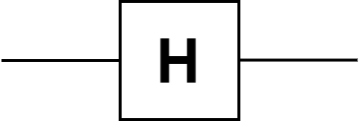

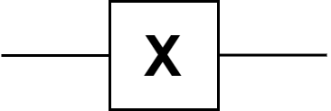


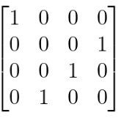
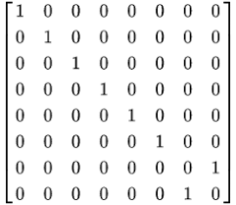
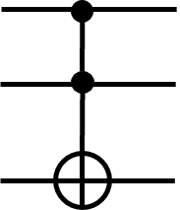
Quantum Circuit
Table : Quantum gates
Operator | Quantum Gate | Matrix Form
Hadamard
Pauli X
CNOT
Toffoli
In quantum computing, a quantum circuit consists of qubits and quantum gates.
A qubit may be in |0⟩ or |1⟩ or in the superposition of |0⟩ and |1⟩ (the mixture of |0⟩ and |1⟩).
A quantum gate is used to manipulate the state of qubits.
Quantum gates can be categorized into two types based on the number of qubits: single-qubit gates and multi-qubit gates.
Notes:
我們首先從 量子線路 的介紹講起，量子線路 的組成元件為 量子位元 與 量子閘
量子位元 與傳統電腦中的古典位元不同，量子位元可同時表達出 0 與 1 的兩種狀態，這種現象也被稱之為量子疊加態
而 量子閘 主要的功能是用來操控量子位元的狀態，來達成運算的目的，
每一個量子閘會對映到數學的一個么正矩陣，因此量子閘的運算就是一系列么正矩陣的變換過程
右表是常見的幾個 量子閘，我們會根據量子位元的數目將量子閘分為單位元量子閘以及多位元量子閘兩類
表格上面的 H 閘 跟 包立-X 閘是 單位元量子閘，而 CNOT 閘則是 多位元量子閘

Slide 8
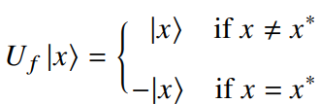
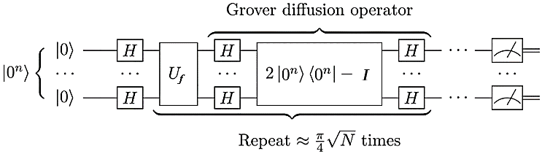
Grover’s algorithm - Oracle
Grover's algorithm [1] is a quantum algorithm proposed by Grover in 1996 to solve the unstructured data search problem with high probability.
Let 𝑈_{𝑓} be the oracle for Grover’s algorithm, the oracle is defined as follows:
Below shows the quantum circuit [2] of the Grover’s algorithm.
, where x* is the target input or solution input.
(Oracle)
(Diffuser)
Grover Iterator
[1] Grover, L. K. (1996, July). A fast quantum mechanical algorithm for database search. In Proceedings of the twenty-eighth annual ACM symposium on Theory of computing (pp. 212-219).
[2] Jehn-Ruey Jiang, Easy to learn quantum programming, Gotop Publishing Co., 2022. (in Chinese).
Notes:
First, I will introduce the quantum algorithm used in this paper, called Grover’s algorithm.
Grover’s algorithm was proposed by Grover in 1996 and is a quantum algorithm designed for finding specific inputs in unstructured data. It consists of two main parts: the Oracle and the Diffuser.
The Oracle is defined by the equation in this slide. In Grover’s algorithm, if the input is not the target input 𝑥∗, the Oracle keeps the input unchanged. However, if the Oracle's input is the target input 𝑥∗, it reverses the phase of that input.
The figure below shows the quantum circuit of the Grover’s algorithm, where the input to the circuit is a quantum superposition state. If there are N input qubits, then there are 2^N possible states. The input is then passed through the Oracle to identify and mark the target input for the problem. The final step involves using the Diffuser to perform amplitude amplification, increasing the probability of finding the target input.

Slide 9
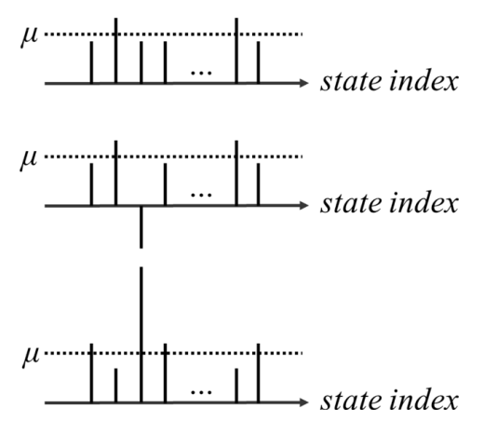
Grover’s algorithm -Diffuser
The diffuser causes the probability amplitudes of all qubits to invert around the mean 𝜇 of all amplitudes.
By the diffuser operation, the positive amplitude only decreases a little; however, the negative amplitude becomes a very large positive amplitude.
Step 1
(Initialization)
Target Input
Step 2
(Oracle)
Target Input
Step 3
(Diffuser)
Target Input
Notes:
This page is about the operation of the Diffuser, also known as inversion above mean. The image on the slide represents a schematic of the Diffuser, where the red bar indicates the amplitude of the target input.
In the first step, we show the amplitudes right after quantum initialization. After applying the Hadamard gate to the qubits, all qubits have almost the same high amplitudes.
In the second step, we pass the qubits through the Oracle, which marks the target input with a negative amplitude.
Then, in the third step, the Diffuser is applied. The Diffuser performs an amplitude inversion above mean, which means all the amplitudes inside the Diffuser undergo inversion above their average value. By comparing Step 2 and Step 3, we observe that the original positive amplitudes decrease slightly, but the amplitude of the target input becomes considerably high.
As a result, ideally, by iterating the Grover’s algorithm a suitable number of times, the amplitude of the target input approaches 100, while the amplitudes of other states tend to approach 0. With this conclusion, the subsequent slide will discuss the optimal number of iterations for the Grover’s algorithm.

Slide 10
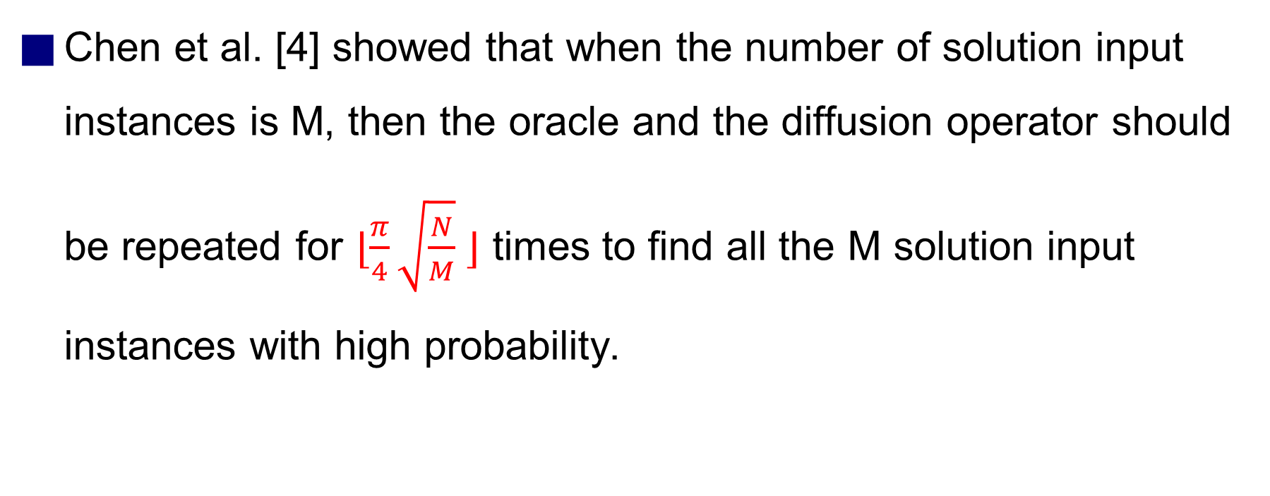
Grover’s algorithm - Iterations
Chen et al. [4] showed that when the number of solution input instances is M, then the oracle and the diffusion operator should be repeated for ⌊$\frac{π}{4}\sqrt{\frac{N}{M}}$⌋ times to find all the M solution input instances with high probability.
Reference :
[4]Chen, G., Fulling, S. A., Lee, H., & Scully, M. O. (2001). Grover’s algorithm for multiobject search in quantum computing. In Directions in Quantum Optics: A Collection of Papers Dedicated to the Memory of Dan Walls Including Papers Presented at the TAMU-ONR Workshop Held at Jackson, Wyoming, USA, 26–30 July 1999 (pp. 165-175). Springer Berlin Heidelberg.
Notes:
According to a paper by Chen et al. published in 2001, they provided a formula for calculating the number of iterations. If the number of input states is n, and the number of answer states is m, then the number of iterations can be expressed as PI/4*sqrt(N/M) rounded down to the nearest integer (Floor).
Now, let's continue with an introduction to the estimation method for M.

Slide 11
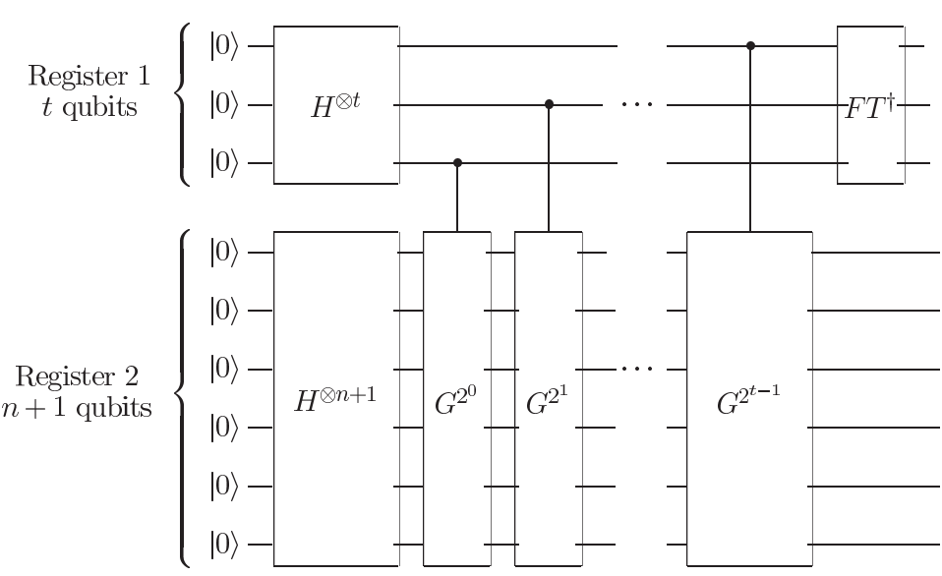
Quantum Counting - Estimating M
The quantum counting [5] algorithm can be used to estimate the number of solutions.
The algorithm is based on the concept of quantum phase estimation (QPE) of Grover iterator G using inverse quantum Fourier transform.
Reference :
[5] Brassard, G., Høyer, P., & Tapp, A. (1998, July). Quantum counting. In International Colloquium on Automata, Languages, and Programming (pp. 820-831). Springer, Berlin, Heidelberg.
[6] Michael A. Nielsen and Isaac L. Chuang. 2011. Quantum Computation and Quantum Information: 10th Anniversary Edition (10th ed.). Cambridge University Press, New York, NY, USA.
Notes:
This page will introduce how to estimate the number of feasible solutions, using the Quantum Counting algorithm. Quantum Counting is designed based on the Inverse Quantum Fourier Transform algorithm and the Grover’s algorithm.
The Quantum Counting circuit mainly consists of two types of registers: the Counting Register and the Searching Register.
In the upper part of the diagram, we have the Counting Register, which uses the Inverse Quantum Fourier Transform to calculate the phase of the Oracle and estimate the number of solutions based on the obtained phase.
The lower part holds the Searching Register, primarily composed of Controlled Grover Iterators. The Controlled Grover Iterators contain the Oracle of the problem combined with Diffusers.
In general, the more qubits in the Counting Register, the more accurately we can measure the actual number of solutions. However, increasing the number of qubits in the Counting Register also raises the complexity of the computation.

Slide 12
Exact Cover Problem - Definition
The exact cover problem (ECP) is defined as follows :
Given a universal set U = {u₁, u₂, ..., u_{m}} with m elements, and a collection S = {S₁, S₂, ..., S_{n}} of n subsets of U
The ECP is to determine whether or not there exists a sub-collection S' ⊆ S such that S' is an exact cover of U.
That is, every element in U belongs to exactly one subset in S'.
ECP has been shown to be both NP-hard and NP-complete (NPC).
E.G.: Universal set U = {1, 2, 3} Collection S of subsets of U = {A, B, C, D, E}, where A = {3}, B = {1, 3}, C = {1}, D = {2}, and E = {1, 2}. S’={A, C, D}, S’’={A, E}, S’’’={B, D} are all exact covers of U.
Applications: Sudoku, and N-queen problems
Notes:
** N - Queens problem is to place n - queens in such a manner on an n x n chessboard that no queens attack each other by being in the same row, column or diagonal.
It can be seen that for n =1, the problem has a trivial solution, and no solution exists for n =2 and n =3. So first we will consider the 4 queens problem and then generate it to n - queens problem.
** In the standard 9×9 Sudoku variant, there are four kinds of constraints:
Row-Column: Each intersection of a row and column, i.e, each cell, must contain exactly one number.
Row-Number: Each row must contain each number exactly once
Column-Number: Each column must contain each number exactly once.
Box-Number: Each box must contain each number exactly once.
Next, we will discuss the problem addressed in this thesis - the Exact Cover Problem (ECP). ECP is a shorthand for the Exact Cover Problem, and its definition is as follows:
Given a universe U = {u1, u2, ..., um} and a collection of sets S1, S2, ..., Sn, the question is whether we can find a subset S' of S that forms an exact cover of U. An exact cover means that each element in the universe U is included in at most one subset of S'. This is the definition of the problem.
The ECP problem has been proven to be NP-hard and NP-complete, indicating that there is currently no polynomial-time complexity solution available.
Moreover, the ECP problem can also be represented in terms of the bipartite graph representation.

Slide 13
Outline
Introduction
Background Knowledge
Proposed Method
Experiment and Result
Conclusion
Notes:
Next, I will introduce the method proposed in this paper.

Slide 14
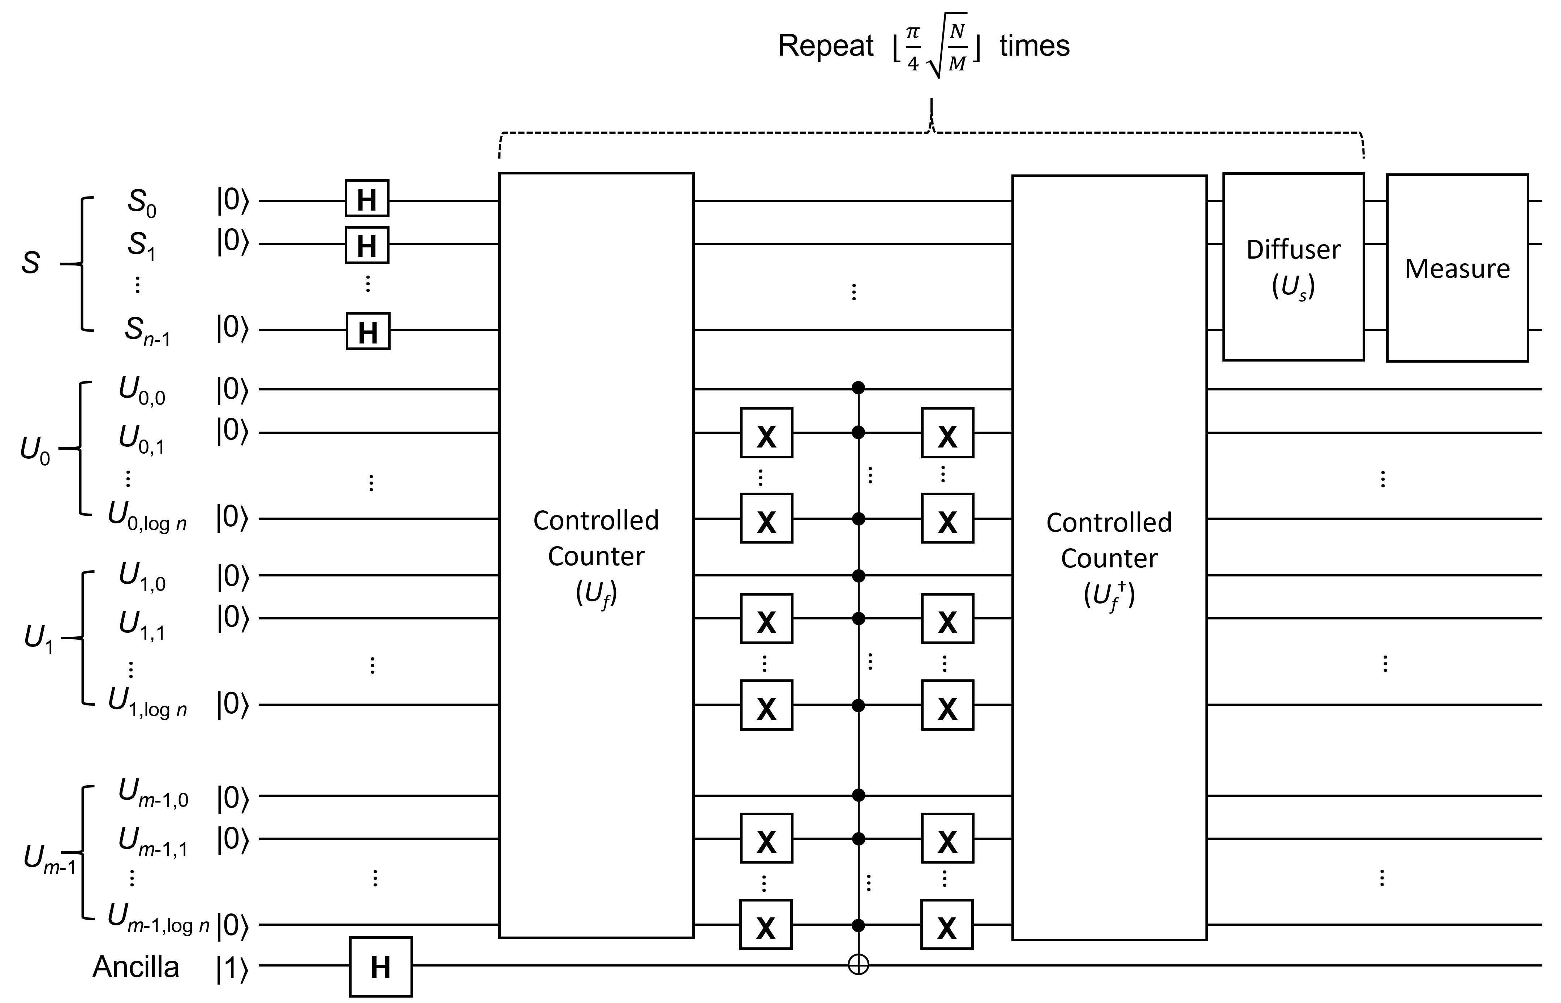
Circuit Diagram
Grover iterator:
Qubit initialization
Notes:
The circuit architecture of the proposed method in this paper is shown in the diagram on the slide. The inputs of the circuit are the collection of sets S and the universe set U.
The Oracle is primarily composed of Controlled Counters, and the second half of the circuit is a mirrored version of the first half, known as the Inverse Oracle.
In the Grover algorithm, the number of executions for the Oracle and the Diffuser should be pi/4*sqrt(N/M) times. This ensures that the optimal measurement probabilities can be obtained when the circuit is measured at the end.

Slide 15
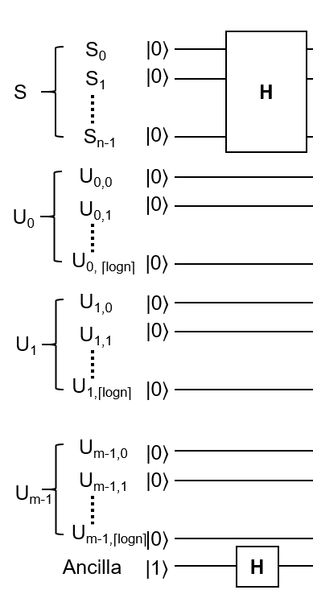
Initialization
The initialization process can be divided into three steps:
Step 1 : Reading the parameters ECP
Universal set U of m elements, U₀,…,U_{m-1}
Collection S of n subsets of U, S₀,…,S_{n-1}
Step 2 : Determining the number of qubits based on the parameters.
Step 3 : Setting the initial states of the qubits.
Notes:
Let's start by introducing the circuit initialization. The initialization in this paper consists of three main steps:
Reading the input of the Exact Cover Problem, which includes a collection of sets S and a universe set U.
Determining the number of qubits required for the circuit based on the input size of the problem.
Setting the initial state of the qubits. For the state initialization, the qubits in collection S are initialized to the |+> superposition state, the qubits in universe set U are initialized to the |0> state, and the ancillary qubit is initialized to the |-> state, which is used for phase kickback in the Oracle.

Slide 16
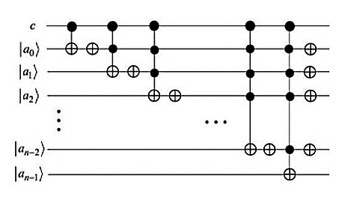
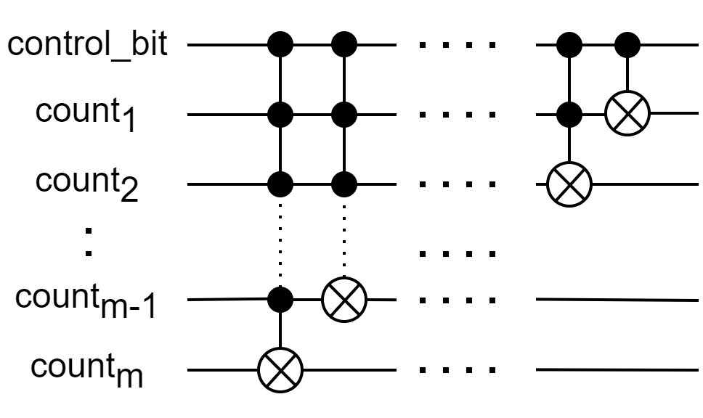
Oracle - Controlled-Counter
The exact cover S' of U in the ECP satisfies the following two conditions :
(i) Subsets in S' are mutually disjoint, as every element in U belongs to exactly one subset in S'.
(ii) The union of all subsets in S’ is U.
To check the above two conditions, a controlled counter is proposed to replace an existing one for reducing the circuit depth.
Notes:
Next, let's introduce the Oracle in this thesis, which is the Controlled Counter.
This paper designs the Oracle based on two conditions of Exact Cover. Assuming S' is a set forming an exact cover for U, the first condition requires that subsets in S' are pairwise disjoint, meaning each element in U belongs to exactly one subset in S'. The second condition states that the union of all subsets in S' equals U.
These two conditions are achieved in this paper by using the Controlled Counter. The main purpose of the Controlled Counter is to help us understand how many times an element in the universe set U is included. If the value of each Controlled Counter is exactly 1, it indicates that the subsets in S' are mutually exclusive and their union equals U.
The figure in the slide shows the Controlled Counter used in this paper. The control_bit serves as the control qubit, and count1 ~ countm are the counting qubits. When the control_bit is 1, it means the corresponding element is included in some set of the collection, and the corresponding counter should be incremented by 1. Finally, based on the count values, we can determine whether the input forms a valid solution.

Slide 17
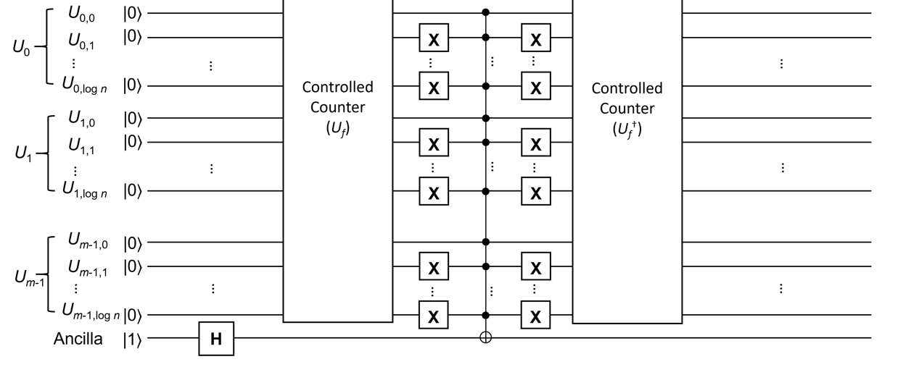
Oracle - Controlled-Counter
Notes:
In this diagram, each red box represents an element from the universe set U. To check whether all the Controlled Counters only count to 1, we need to add X gates to all qubits at the end of each controlled counter, except for the least significant bit.
When all the control qubits of the Multi-Controlled Toffoli (MCT) gate are equal to 1, it indicates that the input forms a valid exact cover. At this point, the set representing the exact cover will be marked with phase kickback.
The Inverse Oracle after the MCT gate is used to clear the qubits, avoiding the use of dirty qubits that might cause incorrect evaluations in the Oracle.

Slide 18
The number of qubits
Universal set U has m elements.
Collection S has n subsets, so n qubits are required.
Controlled counter needs ceil(log₂ n) qubits for each of m elements.
Hence, the universal set U requires a total of m*(ceil(log₂ n)) qubits for representation.
Ancilla qubits : 1
Total qubits : n + m*(ceil(log₂ n)) + 1
Notes:
Finally, let's analyze the number of qubits required for the proposed method. Below is a summary of the total number of qubits used in this paper.
Suppose we are given a collection of sets S and a universe set U, where the size of each set in S is n. Each element in S is represented by one qubit, so the total number of qubits required for S is n.
Additionally, let's assume that the size of the universe set U is m, and each Controlled Counter for each element in U is represented by ceil(log2n)) qubits. Therefore, the total number of qubits required for the universe U is m*(ceil(log2n)).
Lastly, we prepare one ancillary qubit for phase kickback, resulting in a total of n + m*(ceil(log2n)) + 1 qubits used in the proposed method in this thesis.

Slide 19
Outline
Introduction
Background and related work
Proposed Method
Experiment and Result
Conclusion
Notes:
Next we will introduce the Experiment and Result

Slide 20
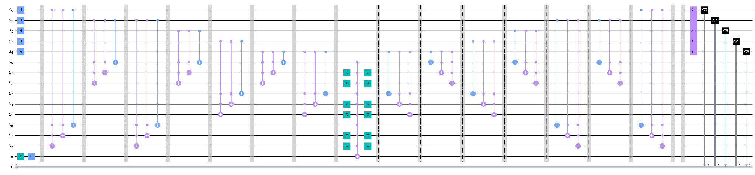
Experiment - Oracle
Collections of set U = {1, 2, 3}, A = {3}，B = {1, 3}，C = {1}，D = {2}，E = {1, 2}
U_{f}
U†_{f}
Diffuser
A
B
C
D
E
1
2
3
⌈log₂5⌉ bits = 3 bits Counter
Initialization
Phase Kickback
Notes:
The corresponding quantum circuit for this example is shown in the diagram on the slide.
The orange box on the far left represents the circuit initialization, where the qubits representing the collection of sets and the ancillary qubit are prepared in a superposition state.
Next, the red box represents the Oracle. The blue boxes inside the Oracle are Controlled Counters.
The X gate and the MCT gate in the middle are used for phase kickback. If the sum of each counter is exactly 1, the phase kickback will flip the phase of this quantum state to a negative phase.
The red box on the middle-right is the Inverse Oracle, which is the mirror of the left Oracle.
Finally, the circuit is concluded with the Diffuser, which is used to amplify the amplitudes of feasible solutions.

Slide 21
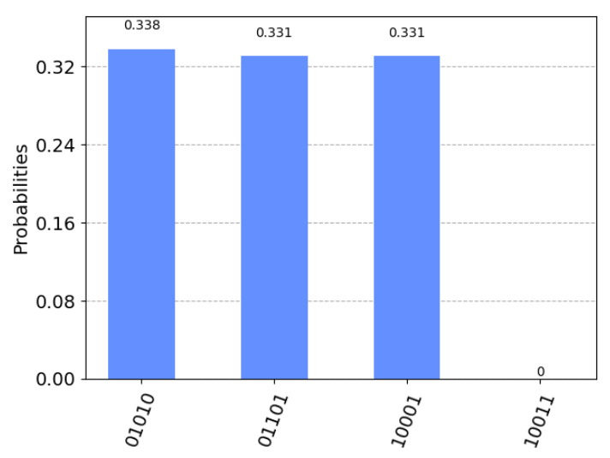
Measurement - Grover’s algorithm
Collections of set U = {1, 2, 3}, A = {3}，B = {1, 3}，C = {1}，D = {2}，E = {1, 2}
EDCBA
01010 ==> Choose B,D
01101 ==> Choose A,C,D
10001 ==> Choose A,E
10011 ==> Choose A,B,E
V
V
V
X
ibmq_qasm_simulator
Notes:
The left figure represents the measurement results on the simulator. The highest measured results in the circuit are 01010, 01101, and 10001. The result of 01010 indicates that choosing sets B and D forms an exact cover. The result of 01101 corresponds to the sets A, C, and D, while 10001 corresponds to A and E, all forming exact covers. However, 11011 violates the exact cover condition and is an infeasible solution, resulting in the lowest measurement outcome.

Slide 22
Outline
Introduction
Background and related work
Proposed Method
Experiment and Result
Conclusion
Notes:
Finally, let look at our conclusion

Slide 23
Conclusion
This paper proposes a quantum circuit to build the oracle of Grover's algorithm to solve the exact cover problem; the oracle is constructed by using newly designed controlled counters to reduce the number of gates and to lower the circuit depth.
However, we are still trying to reduce the number of qubits required.
Experiments on IBM's quantum simulator "ibmq_qasm_simulator“ are conducted to find solutions with high probability.
We plan to execute the proposed quantum circuit on IBM’s real quantum computers.
Notes:
This paper proposes a quantum circuit based on the Grover’s algorithm to solve the Exact Cover Problem, where the oracle circuit is designed using Controlled Counters.
Compared to the exhaustive search algorithm used in classical computers, the proposed method provides quadratic speedup.

Slide 24
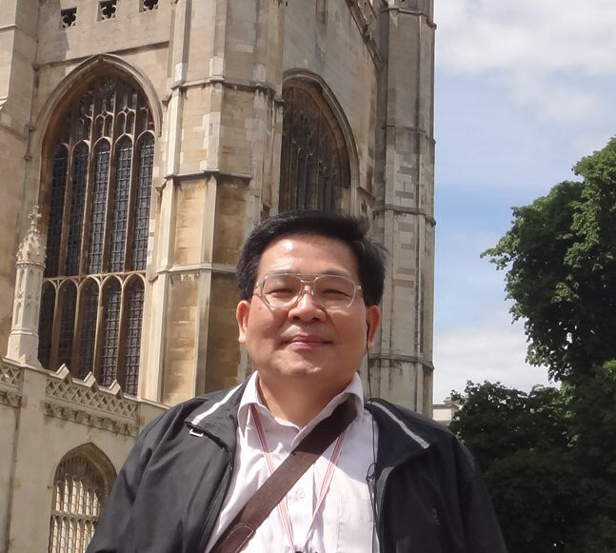


Q&A
Easy to Learn Quantum Programming -- From Quantum Bit to Quantum Algorithm
Published in August 2022.
ISBN: 9786263242715
You can buy the book via:
https://www.books.com.tw/products/0010933217?sloc=main
Jehn-Ruey Jiang (江振瑞）
Email: jrjiang@g.ncu.edu.tw
Web: https://staff.csie.ncu.edu.tw/jrjiang/

