Slide 1
A Quantum Algorithm for Evaluating the Hamming Distance
王昱傑 顏暐翰 高子豪
Notes:
思翰 Start

Slide 2
Hamming Distance

Slide 3
Proposed Algorithm - Step 1 & 2

Slide 4
 | 1/4 | 1/4 | 1/4 | 1/4
x0 | 0 | 0 | 1 | 1
x1 | 0 | 1 | 0 | 1
y_{f} | 0 | 0 | 0 | 0
y_{g} | 0 | 0 | 0 | 0
φ1 | 0 | 0 | 0 | 0
φ2 | 0 | 0 | 0 | 0

Slide 5
Proposed Algorithm - Step 3

Slide 6
Case
f(00) = 1, f(01) = 0, f(10) = 0, and f(11) = 1
g(00) = 0, g(01) = 0, g(10) = 1, and g(11) = 1
Notes:
彥廷 Start
代表 f 字串 0011 跟 g 字串 0101

Slide 7
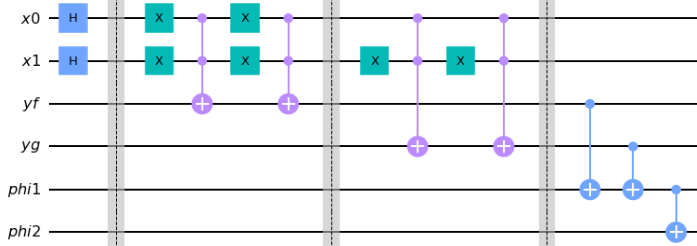
f(00) = 1, f(01) = 0, f(10) = 0, and f(11) = 1
g(00) = 0, g(01) = 0, g(10) = 1, and g(11) = 1

Slide 8
f(00) = 1, f(01) = 0, f(10) = 0, and f(11) = 1
g(00) = 0, g(01) = 0, g(10) = 1, and g(11) = 1
 | 1/4 | 1/4 | 1/4 | 1/4
x0 | 0 | 0 | 1 | 1
x1 | 0 | 1 | 0 | 1
y_{f} | 1 | 0 | 0 | 1
y_{g} | 0 | 0 | 1 | 1
φ1 | 0 | 0 | 0 | 0
φ2 | 0 | 0 | 0 | 0
Notes:
0011
0101

Slide 9
Proposed Algorithm - Step 4

Slide 11
 | 1/4 | 1/4 | 1/4 | 1/4
x0 | 0 | 0 | 1 | 1
x1 | 0 | 1 | 0 | 1
y_{f} | 1 | 0 | 0 | 1
y_{g} | 0 | 0 | 1 | 1
φ1 | 1 | 0 | 1 | 0
φ2 | 0 | 0 | 0 | 0

Slide 12
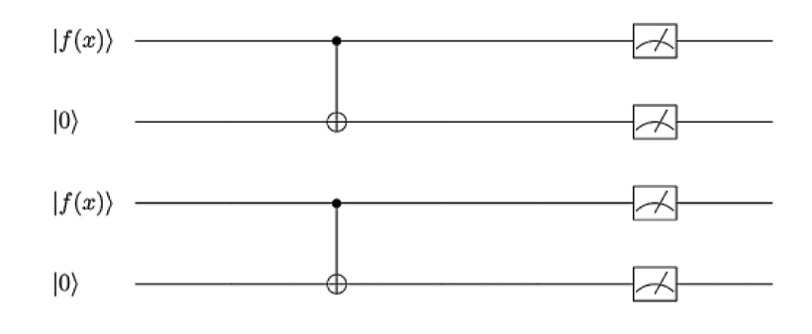
Proposed Algorithm - Step 5 & 6
Notes:
Mz 如圖

Slide 14
 | 1/4 | 1/4 | 1/4 | 1/4
x0 | 0 | 0 | 1 | 1
x1 | 0 | 1 | 0 | 1
y_{f} | 1 | 0 | 0 | 1
y_{g} | 0 | 0 | 1 | 1
φ1 | 1 | 0 | 1 | 0
φ2 | 1 | 0 | 1 | 0

Slide 15
Case Study - U_{f} & U_{g}

Slide 16
Case Study - ζ₀ & ζ₁
|x₁x₂,y_{f,}y_{g},φ₁φ₂⟩

Slide 17
Case Study - ζ₂
|x₁x₂,y_{f,}y_{g},φ₁φ₂⟩

Slide 18
Case Study - ζ₃
Previous state :
|x₁x₂,y_{f,}y_{g},φ₁φ₂⟩

Slide 19
Case Study - ζ₄
|x₁x₂,y_{f,}y_{g},φ₁φ₂⟩
Previous state :
Notes:
作用在 vi2

Slide 20
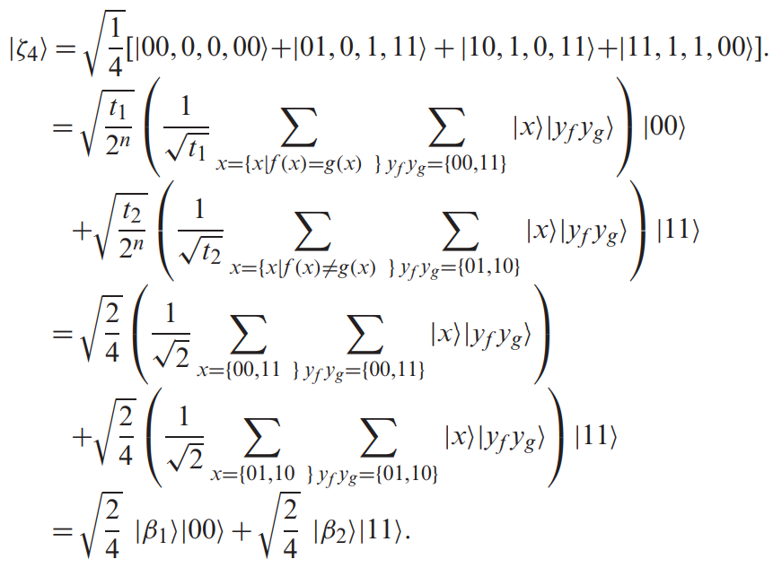
Case Study - ζ₄

Slide 21
Case Study - ξ
Notes:
下圖為Mz
xi

Slide 22
Concurrence Value
Notes:
基於量子系統中兩個輔助量子位之間的糾纏度 C
the degree of entanglement
並存值

Slide 23
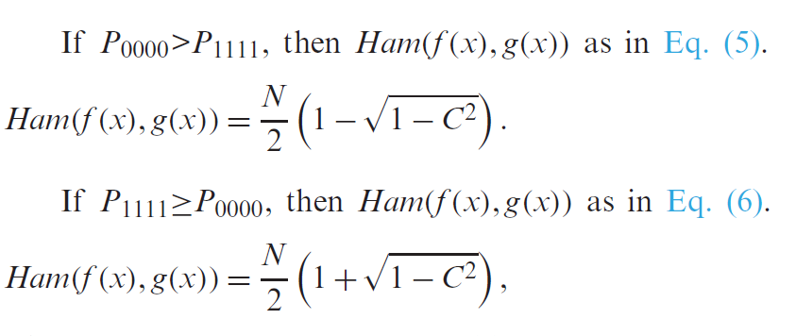
Ham(f(x), g(x))

Slide 24
Complexity
Notes:
這篇論文透過測量兩個 phi 外積的結果來計算hamming distance
在計算時間複雜度方面，在量子計算中, 演算法的時間複雜度是計算存取神諭的次數，所以在線路中我們會各呼叫f(x)及g(x)一次，所以總共是2M次
而在真實的量子電腦設備中，M = 8192(shots)，因此2M = 2¹⁴

Slide 25
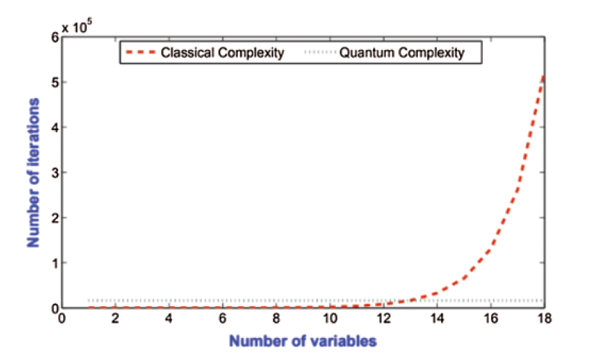
Compare - Complexity
Notes:
varaibles數量
1 ≤ n ≤ 12，quantum成本高
13相同
>13顯著提升
>18指數加速

Slide 26
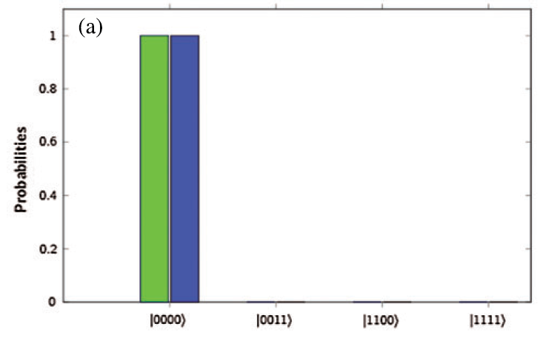
Hamming Distance = 0
Notes:
two bool variables 所以Hamming distance 有0,1,2,3,4 共5種
創造5種情況，分別去實驗
綠色 : 理論
藍色 : IBM Simulator

Slide 27
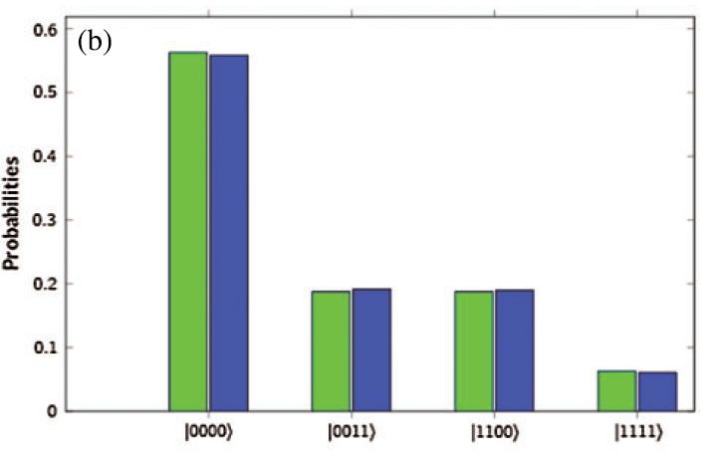
Hamming Distance = 1
Notes:
綠色 : 理論
藍色 : Simulator

Slide 28
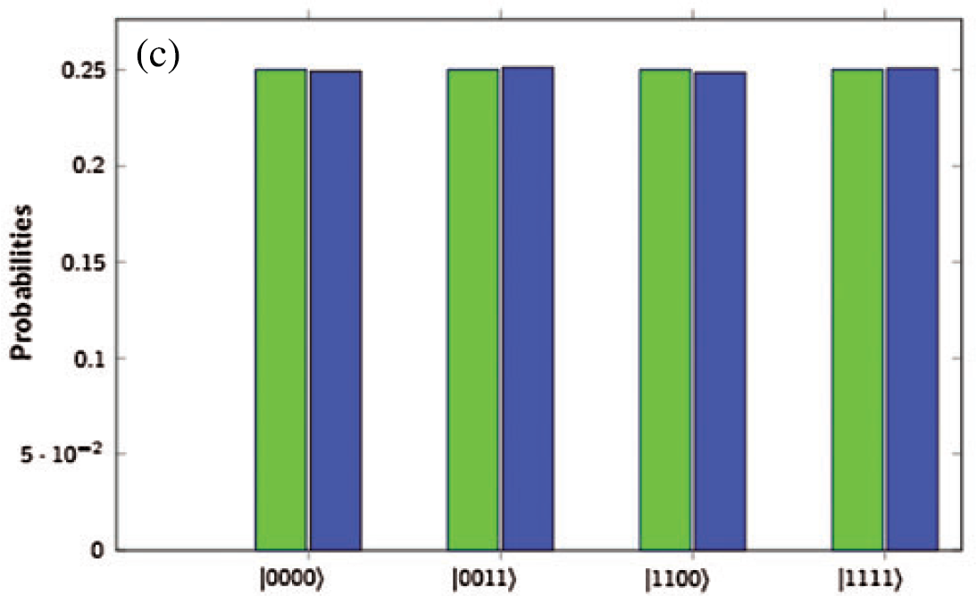
Hamming Distance = 2
Notes:
綠色 : 理論
藍色 : Simulator
圖顯示p0000>p1111

Slide 29
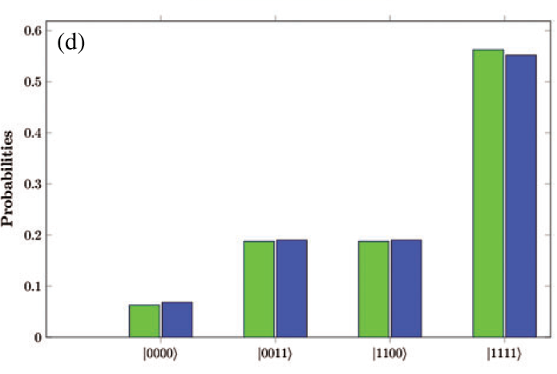
Hamming Distance = 3
Notes:
綠色 : 理論
藍色 : Simulator

Slide 30
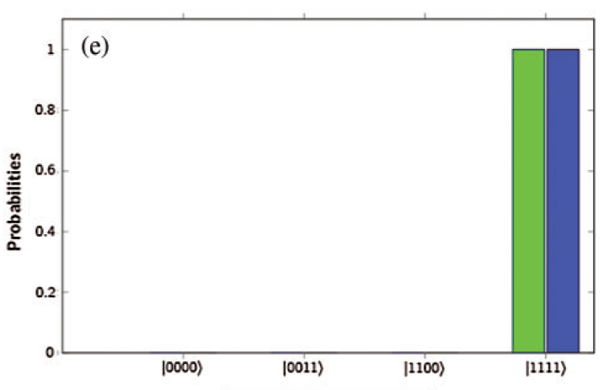
Hamming Distance = 4
Notes:
綠色 : 理論
藍色 : Simulator

Slide 31
THE END

