Slide 1
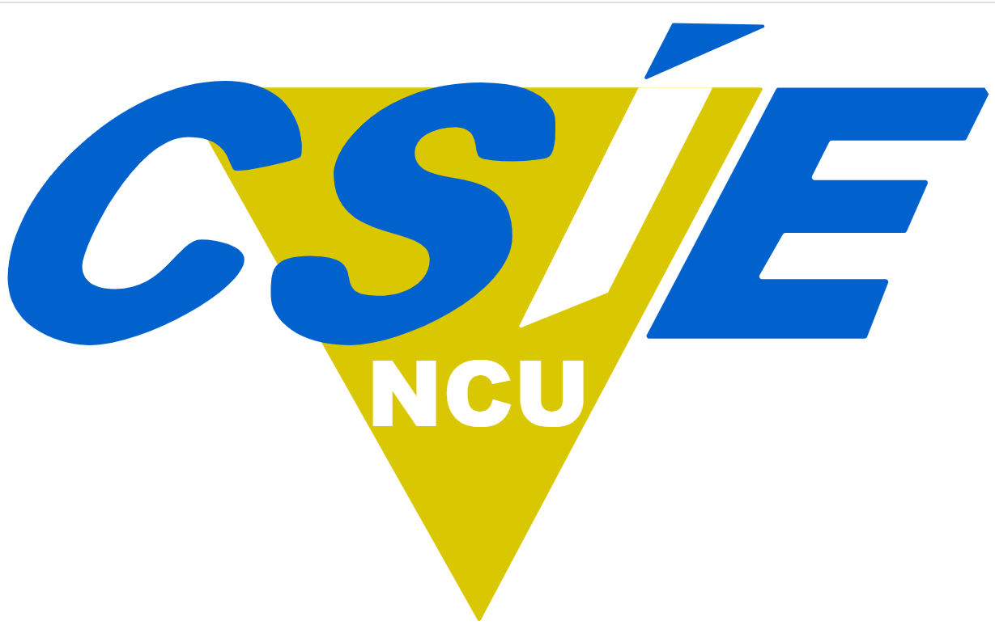
From Quantum Bit (Qubit) to Quantum Algorithm
Department of Computer Science and Information Engineering
National Central University, Taiwan
Jehn-Ruey Jiang (江振瑞)

Slide 2
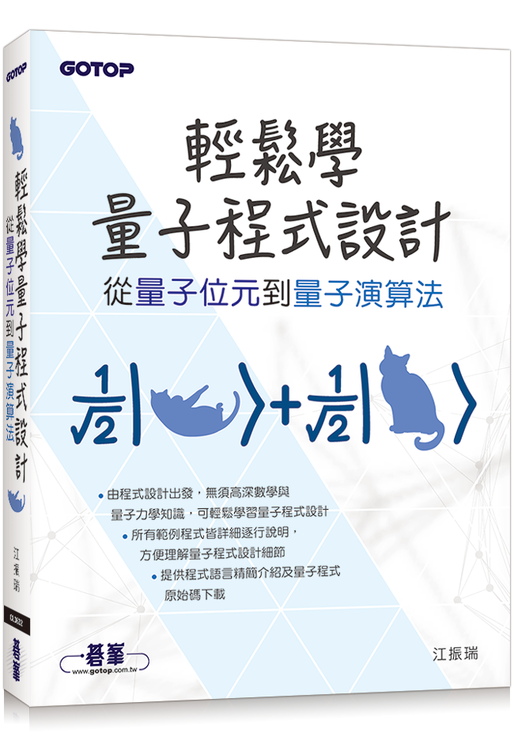
Easy to Learn Quantum Programming --
From Quantum Bit (Qubit) to Quantum Algorithm
My book published in Chinese in August 2022.
ISBN: 9786263242715
Contents:
  第1章 編寫第一個量子程式
  Ch1: The First Quantum Program
  第2章 量子位元疊加態程式設計
  Ch2: Programming Qubits in Superposition
  第3章 量子閘程式設計
  Ch3: Programming Quantum Gates
  第4章 量子位元糾纏態程式設計
  Ch4: Programming Qubits in Entanglement
  第5章 Deutsch-Jozsa演算法量子程式設計
  Ch5: Programming Deutsch-Jozsa Algorithm
  第6章 Grover演算法量子程式設計
  Ch6: Programming Grover Algorithm
  第7章 Shor演算法量子程式設計
  Ch7: Programming Shor Algorithm

Slide 3
Outline
Quantum Technologies
Quantum Supremacy
Classical Bits vs Quantum Bits
Dirac Notation and Bloch Sphere
Quantum Gates and Quantum Circuits
Shor’s Algorithm
Concluding Remarks

Slide 4
Outline
Quantum Technologies
Quantum Supremacy
Classical Bits vs Quantum Bits
Dirac Notation and Bloch Sphere
Quantum Gates and Quantum Circuits
Shor’s Algorithm
Concluding Remarks

Slide 5
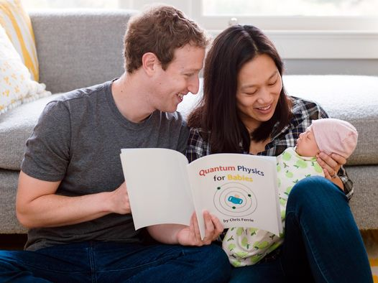
Why should we learn quantum technologies?
Source: https://www.businessinsider.com/mark-zuckerberg-reading-baby-quantum-physics-book-2015-12
Notes:
This is Mark Zuckerberg, his wife Priscilla Chan, and their baby with the book Quantum Physics for Babies.
If you have babies, you and your baby had better learn quntum technologies.

Slide 6
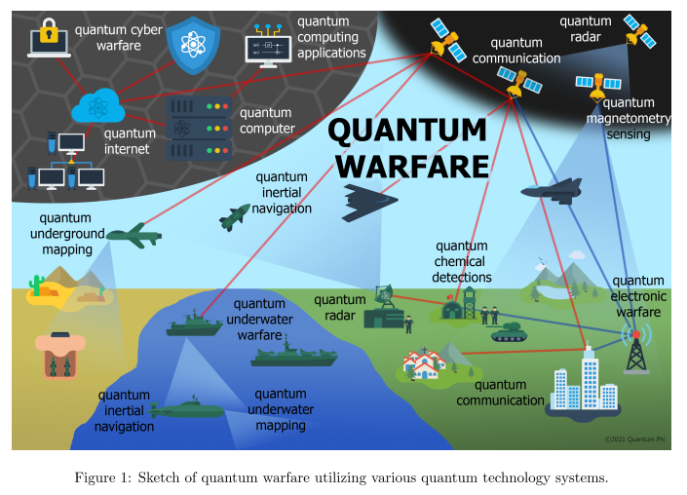
Source: M. Krelina, “Quantum warfare: definitions, overview and challenges,” arXiv:2103.12548 (2021).
Notes:
Source: M. Krelina, “Quantum warfare: definitions, overview and challenges,” arXiv:2103.12548 (2021).
Warfare refers to the general act and art of waging war. It does not refer to a particular war. We use the term "biological warfare" to refer to the use of biological toxins as a weapon of war. War is sometimes used in the same way of "warfare", but is more often used to refer to a particular armed conflict. You would refer to the "Second World War" or the "Great Patriotic War", but never the "Second World Warfare".
Quantum warfare: the use of quantum technologies as a weapon of war.

Slide 7
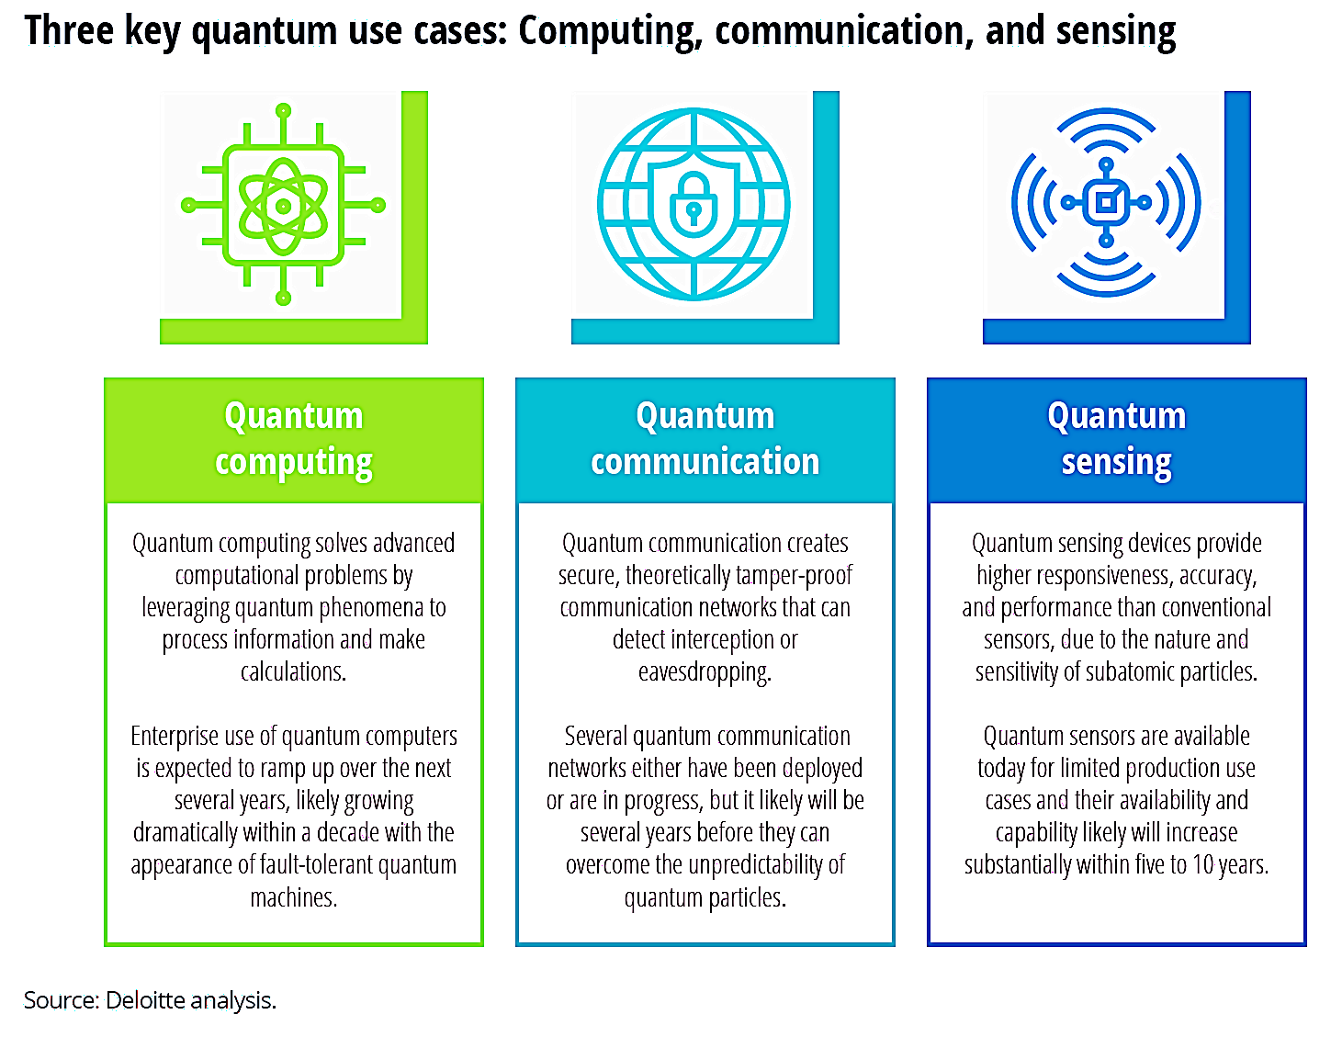
Quantum Technologies

Slide 8
Outline
Quantum Technologies
Quantum Supremacy
Classical Bits vs Quantum Bits
Dirac Notation and Bloch Sphere
Quantum Gates and Quantum Circuits
Shor’s Algorithm
Concluding Remarks

Slide 9
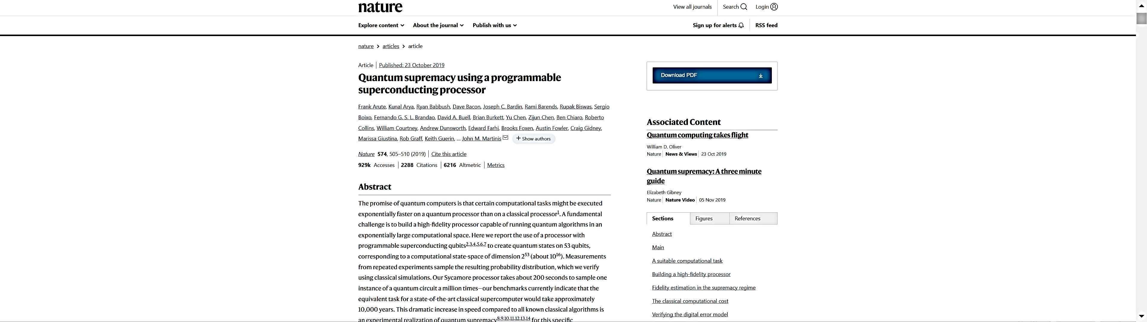
Quantum Supremacy (Advantage)
To demonstrate that a programmable quantum device can solve a problem that no classical computer can solve in any feasible amount of time (irrespective of the usefulness of the problem). (From Wiki)
A paper by Google’s researchers published in Nature claimed to reach “quantum supremacy” in Sept. 2019. It claimed that their quantum computer Sycamore was able to perform a calculation in 200 seconds that would take IBM Summit, the fastest super computer at that time, approximately 10,000 years.
Notes:
https://www.bnext.com.tw/article/57302/google-quantum-supremacy
2019年9月20日，美國NASA意外刊出了Google量子運算的研究論文，其中提及Google所研發的Sycamore（梧桐樹）量子電腦，竟僅花200秒就可完成全球最強超級電腦所需耗時1萬年的複雜運算任務，引起科學界一片譁然。眾說紛紜之際，該論文卻又緊急下架，直至10月23日才又正式在《Nature》期刊上重新發布。
Google官方宣稱該項技術的突破，可媲美1903年萊特兄弟發明全球第一架飛行器的光榮時刻，象徵人類科技史上的「Hello Quantum World !」，證明「量子霸權（Quantum Supremacy）」不再是神話，充滿量子科技的未來世界指日可待。
Google宣稱「量子世界」來到，用200秒完成超級電腦運算1萬年的任務
「量子電腦」的概念在1980年代初期由美國諾貝爾物理學獎得主Richard Feynman首度提出，運用量子力學原理所設計的「可逆計算」電腦模型，相較古典電腦具有指數級別的「超高速運算優越性」。
Google身為世界投入量子電腦的先驅，埋首量子領域13年，其最新研發的超導體量子處理器Sycamore，具有53個量子位元（原6×9二維陣列、其中1個失效），共可儲存253（≈1016=9.7千萬億）的位元串數據量。
為了證明在「量子霸權」的能力，Google設計了一項特殊問題：求解「量子電路」隨機輸出任意位元串的亂數分布機率，例如{0000101…}。由於量子干涉性（Quantum Interference），某些位元串的發生機率會較高，可藉由100萬次取樣運算，確保系統高保真度。該實驗同時以美國能源部的超級電腦Summit模擬量子電路作為對照組，比較兩者的運算結果是否相符與各自所需執行時間。
實際上，兩者之間差距為何？在初始模擬若干量子位元時，超級電腦Summit的運算能力遊刃有餘，與量子電腦Sycamore的運算時間相差無幾。但隨著量子位元數目以及取樣次數的漸進增加，系統複雜度大幅提升，兩者的時間差距呈現指數級擴大，最終Sycamore量子電腦僅花200秒便完成253個隨機亂數的發生概率，但推估Summit超級電腦完成同樣工作需耗時達1萬年！Google的測試證明，使用量子電腦可實現過去古典電腦所難以企及的問題，故主張達成「量子霸權」。
IBM暗諷Google「量子霸權」說法過於浮誇，且解決的問題不具有任何實用性
Google的研究為科研界投下了一顆震撼彈，但另一量子電腦巨頭IBM卻反對這個說法，在去年10月22日發文嚴正駁斥Google「量子霸權」的真實性。
IBM表示，Google假定的演算法並未充分發揮超級電腦的運算優勢，經過IBM團隊重新修正與驗證之後，預估超級電腦的運算時間將從1萬年大幅縮減至2.5天。因此，IBM主張用超級電腦運算此項問題並非難以企及，不應該視此為達成了「量子霸權」。同時，IBM認為量子電腦與超級電腦各有所長，兩者應互為協同合作關係，且發展量子電腦並非要取代古典電腦，暗諷Google說法過於誇大。
來源：Boykov via shutterstock
不讓Google做霸權美夢，IBM也積極投入量子電腦的研發。
此外，另有專家主張Google所設計的隨機亂數問題相當偏頗，頂多證明其高速運算效能，但距離社會大眾引頸期盼量子電腦能真正解決實用問題的理想情境，如預測氣候變化、推薦藥物最佳成分組合等，仍有一大段差距。
同時，既然超級電腦仍可費時解答Google所設計的問題，那麼實際情況並非「量子霸權」所稱「量子電腦可以解決古典電腦永遠無法處理的問題」，而更接近「量子優勢」所稱「量子電腦明顯擁有比古典電腦更快的運算能力」，因此削弱了Google刻意塑造「量子霸權」的神話地位。
「量子時代」曙光乍現，但商業應用尚處於萌芽期
儘管Google是否達到「量子霸權」仍備受爭議，但無可否認的是，相關研究的確大幅縮短了運算時間，驗證了量子電腦的未來發展潛力。正如同萊特兄弟飛機首航12秒、蘇聯首顆人造衛星Sputnik升空一般，當下雖未能證明有何實際應用，卻為下一個工業時代畫下新的起點。
不過，50個量子位元仍不足以解決現實世界的量子問題，這僅是超級電腦可以模擬單一個苯環分子結構狀態的程度。後續尚有如何發展實用的量子演算法、提高量子位元數目、延長相干時間、容錯與降低功耗等挑戰，甚至與古典電腦混合使用的新課題，可以預見這是遙遠的未來，而商業應用研究正處在早期的起步階段而已。

Slide 10
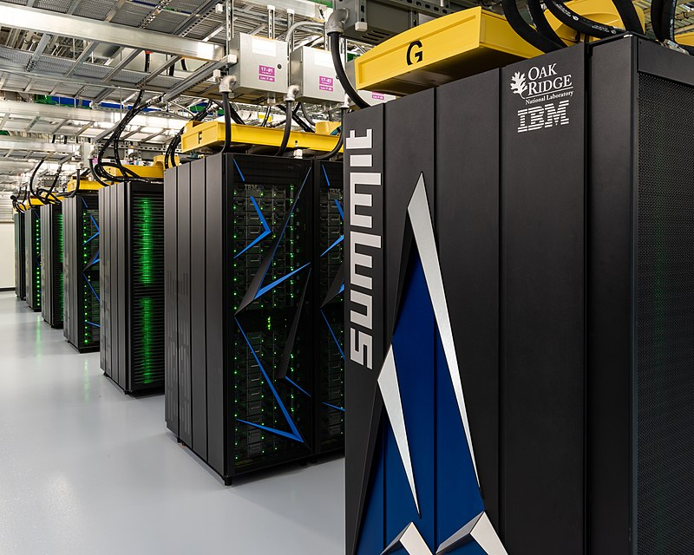
The world’s fastest super computer (June 2018 ~ May 2020 )
Summit
* USA
* IBM and Nvidia
* Speed:
148 petaFLOPS
Source: https://en.wikipedia.org/wiki/Summit_(supercomputer)#/media/File:Summit_(supercomputer).jpg
Notes:
In computing, floating point operations per second (FLOPS, flops or flop/s) is a measure of computer performance, useful in fields of scientific computations that require floating-point calculations. For such cases, it is a more accurate measure than measuring instructions per second.
kiloFLOPS,kFLOPS,10³
megaFLOPS,MFLOPS,10⁶
gigaFLOPS,GFLOPS,10⁹
teraFLOPS,TFLOPS,10¹²
petaFLOPS,PFLOPS,10¹⁵
exaFLOPS,EFLOPS,10^{18,}
zettaFLOPS,ZFLOPS,10²¹
yottaFLOPS,YFLOPS,10²⁴

Slide 11
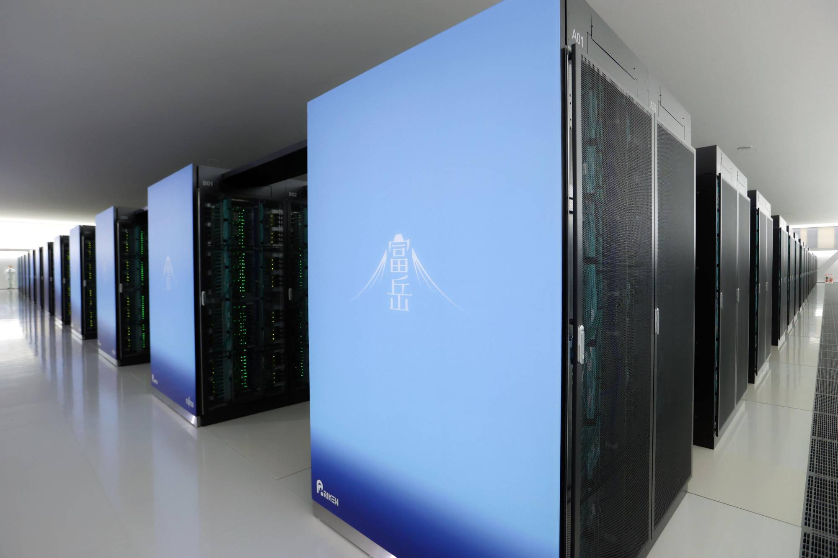
The world’s fastest super computer (June 2020 ~ May 2022 )
Fugaku (富岳)
* Japan
* Riken Research Institute and
Fujitsu Ltd.
* Speed:
422 petaFLOPS
Source: https://www.japantimes.co.jp/news/2020/06/23/national/fugaku-supercomputer-ranked-fastest/
Notes:
In computing, floating point operations per second (FLOPS, flops or flop/s) is a measure of computer performance, useful in fields of scientific computations that require floating-point calculations. For such cases, it is a more accurate measure than measuring instructions per second.
kiloFLOPS,kFLOPS,10³
megaFLOPS,MFLOPS,10⁶
gigaFLOPS,GFLOPS,10⁹
teraFLOPS,TFLOPS,10¹²
petaFLOPS,PFLOPS,10¹⁵
exaFLOPS,EFLOPS,10^{18,}
zettaFLOPS,ZFLOPS,10²¹
yottaFLOPS,YFLOPS,10²⁴

Slide 12
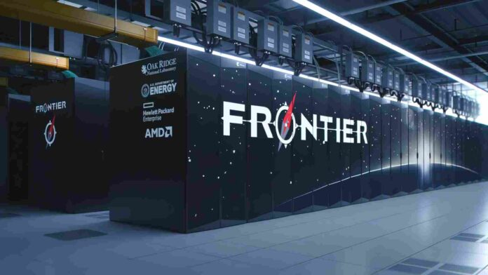
The world’s fastest super computer (June 2022 ~ )
Frontier
* USA
* Oak Ridge National Laboratory and Department of Energy
* Speed:
1.102 exaFLOPS
Source: https://www.helloscholar.in/frontier-supercomputer/
Notes:
The computing power of the fastest supercomputer is increased by a factor about 10.
In computing, floating point operations per second (FLOPS, flops or flop/s) is a measure of computer performance, useful in fields of scientific computations that require floating-point calculations. For such cases, it is a more accurate measure than measuring instructions per second.
kiloFLOPS,kFLOPS,10³
megaFLOPS,MFLOPS,10⁶
gigaFLOPS,GFLOPS,10⁹
teraFLOPS,TFLOPS,10¹²
petaFLOPS,PFLOPS,10¹⁵
exaFLOPS,EFLOPS,10^{18,}
zettaFLOPS,ZFLOPS,10²¹
yottaFLOPS,YFLOPS,10²⁴

Slide 13
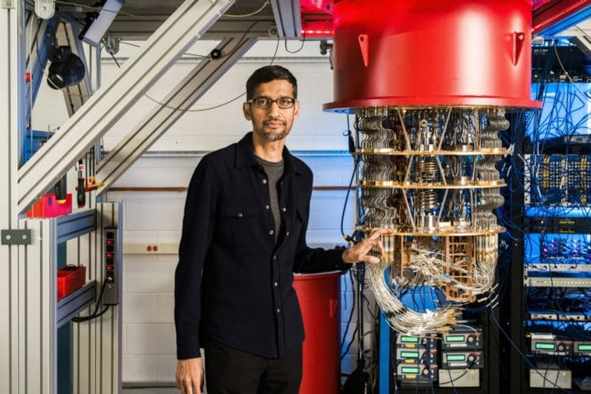
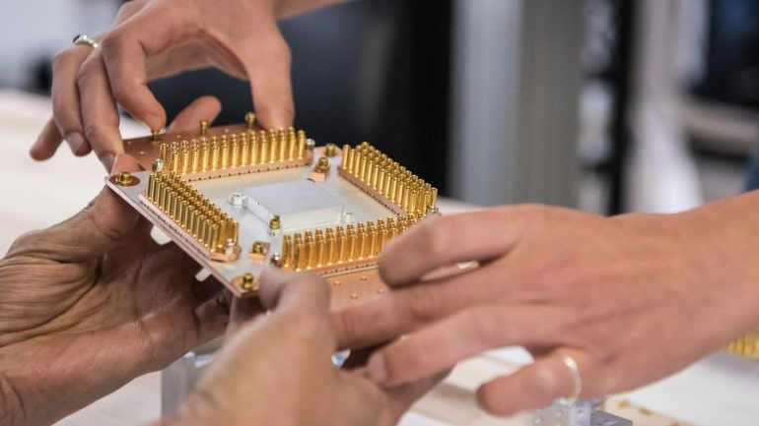
Google’s Quantum Computer in 2019:
53-qubit Sycamore
Google’s Quantum Processor
Source: https://www.mirabilisdesign.com/google-quantum-sycamore-processor/
Google’s CEO and Quantum Computer
Source: https://www.techexplorist.com/google-achieved-quantum-supremacy-sycamore/27275/

Slide 14
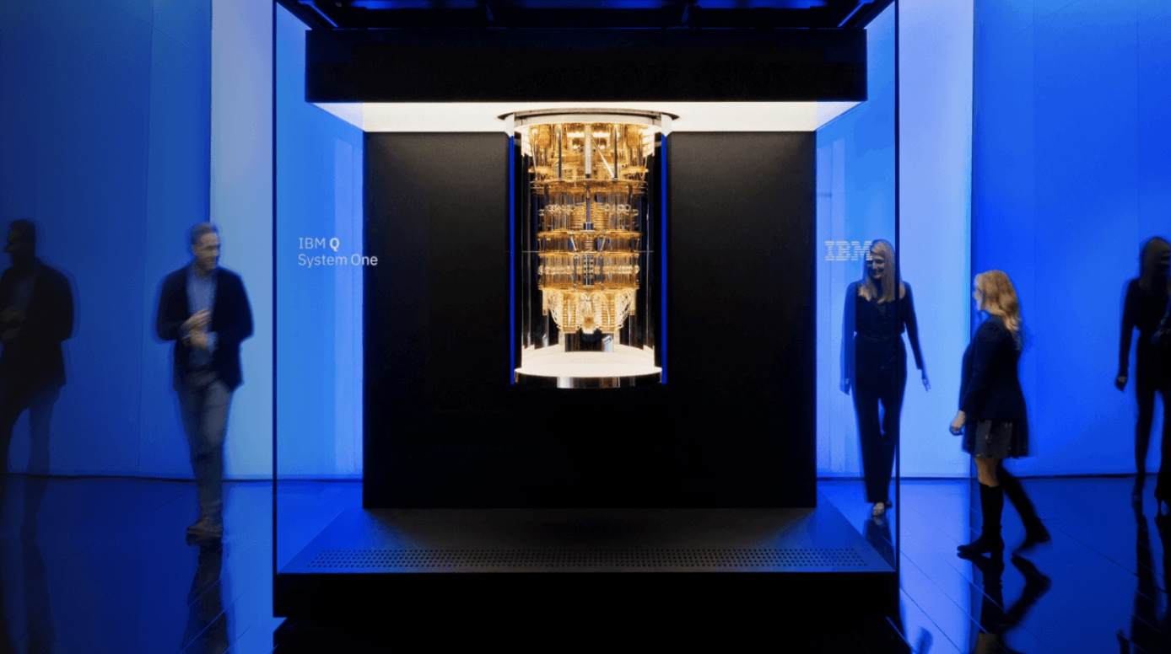
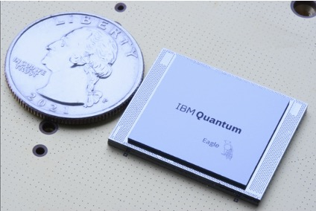
IBM’s Quantum Computer in 2021:
127-qubit Eagle Quantum Processor
IBM’s Eagle Processor in 2021
Source: https://twitter.com/jaygambetta/status/ 1460697552379076612?lang=zh-Hant
IBM’s 20-qubit Q System One in 2019
Source:https://www.somagnews.com/ibm-said-the-quantum-chip-will-surpass-its-competitors-in-2-years/
Notes:
The computing power of the general-purpose quantum computer is increased by a factor of 2^(127-53)=2^74=1.8889466e+22
If the quantum computer has an increase of n qubits, then the computing power is increased by 2^n.
萬 = 10的4次方 = 4個0
億 = 10的8次方 = 8個0
兆 = 10的12次方 = 12個0
京 = 10的16次方 = 16個0
垓 = 10的20次方 = 20個0
秭 = 10的24次方 = 24個0
穰 = 10的28次方 = 28個0
溝 = 10的32次方 = 32個0
澗 = 10的36次方 = 36個0
正 = 10的40次方 = 40個0
載 = 10的44次方 = 44個0
極 = 10的48次方 = 48個0
恆河沙 = 10的52次方 = 52個0
阿僧祇 = 10的56次方 = 56個0
那由他 = 10的60次方 = 60個0
不可思議 = 10的64次方 = 64個0
無量 = 10的68次方 = 68個0
大數 = 10的72次方 = 72個0
小數位最細的叫「涅槃寂靜」，即點數後24個位，
即是0.000000000000000000000001。
0.1 分
0.01 厘
0.001 毫
0.0001 絲
0.00001 忽
0.000001 微
0.0000001 纖
0.00000001 沙
0.000000001 塵（納）
0.0000000001 埃
0.00000000001 渺
0.000000000001 漠（皮）
0.0000000000001 模糊
0.00000000000001 逡巡
0.000000000000001 須臾（飛）
0.0000000000000001 瞬息
0.00000000000000001 彈指
0.000000000000000001 剎那（阿）
0.0000000000000000001 六德
0.00000000000000000001 空虛
0.000000000000000000001 清靜（仄）
0.0000000000000000000001 阿賴耶
0.00000000000000000000001 阿摩羅
0.000000000000000000000001 涅槃寂靜（攸）

Slide 15
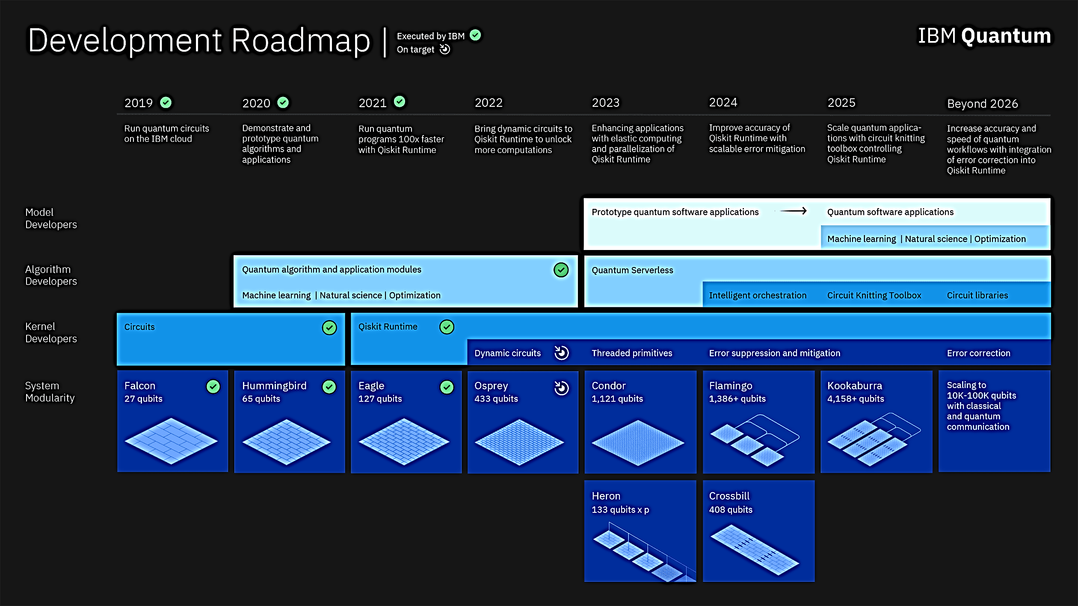
IBM Quantum Roadmap
Source: https://research.ibm.com/blog/ibm-quantum-roadmap-2025

Slide 16
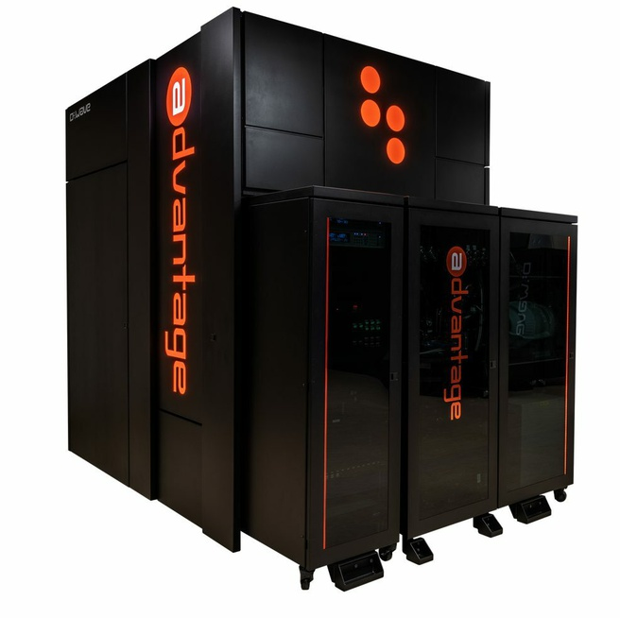
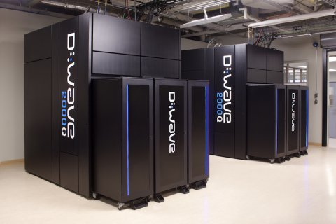
D-Wave Quantum Computer (Quantum Annealer)
D-Wave 2000Q in 2017
2000 qubits
Source: https://www.rdworldonline.com/d-wave-announces-d-wave-2000q-quantum-computer-and-first-system-order/
D-Wave Advantage in 2020
5000 qubits
Source: https://tweakers.net/nieuws/187892/d-wave-gaat-net-als-ibm-en-google-universele-quantumcomputer-bouwen.html

Slide 17
Outline
Quantum Technologies
Quantum Supremacy
Classical Bits vs Quantum Bits
Dirac Notation and Bloch Sphere
Quantum Gates and Quantum Circuits
Shor’s Algorithm
Concluding Remarks

Slide 18
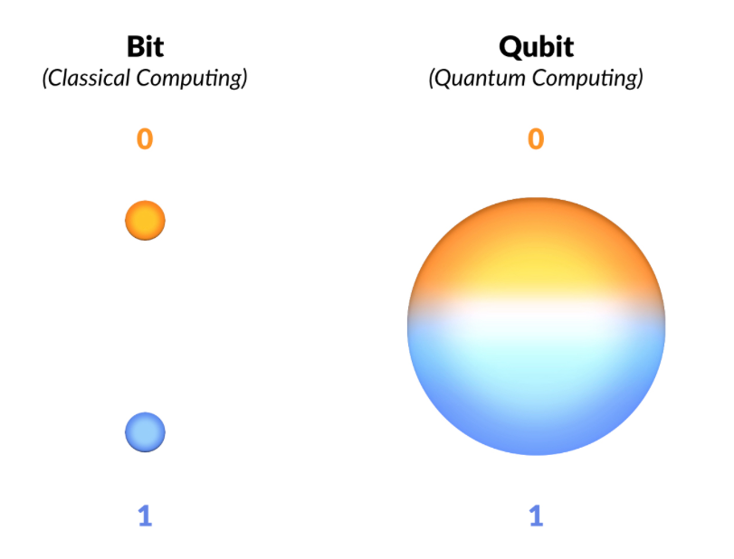
A classical bit is either zero or one: only two possible states, represented as a point, and realized by a transistor to switch on or witch off the electric current
A quantum bit or qubit is a mixture (superposition) of zero and one: a continuum of possible states, represented as the surface of a sphere (the Bloch sphere), realized by a quantum system like the system with spin-up and spin-down electrons or the system with vertically-polarized and horizontally-polarized photons.
Source: https://medium.com/@kareldumon/the-computational-power-of-quantum-computers-an-intuitive-guide-9f788d1492b6

Slide 19
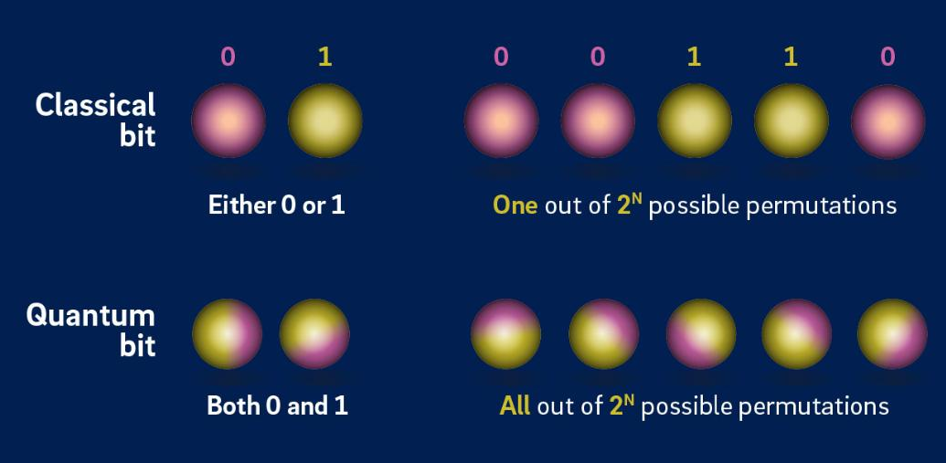
n qubits can represent all 2^{n} states simultaneously
Source: https://www.rolandberger.com/en/Insights/Publications/Quantum-technology-is-leaping-into-our-lives.html

Slide 20
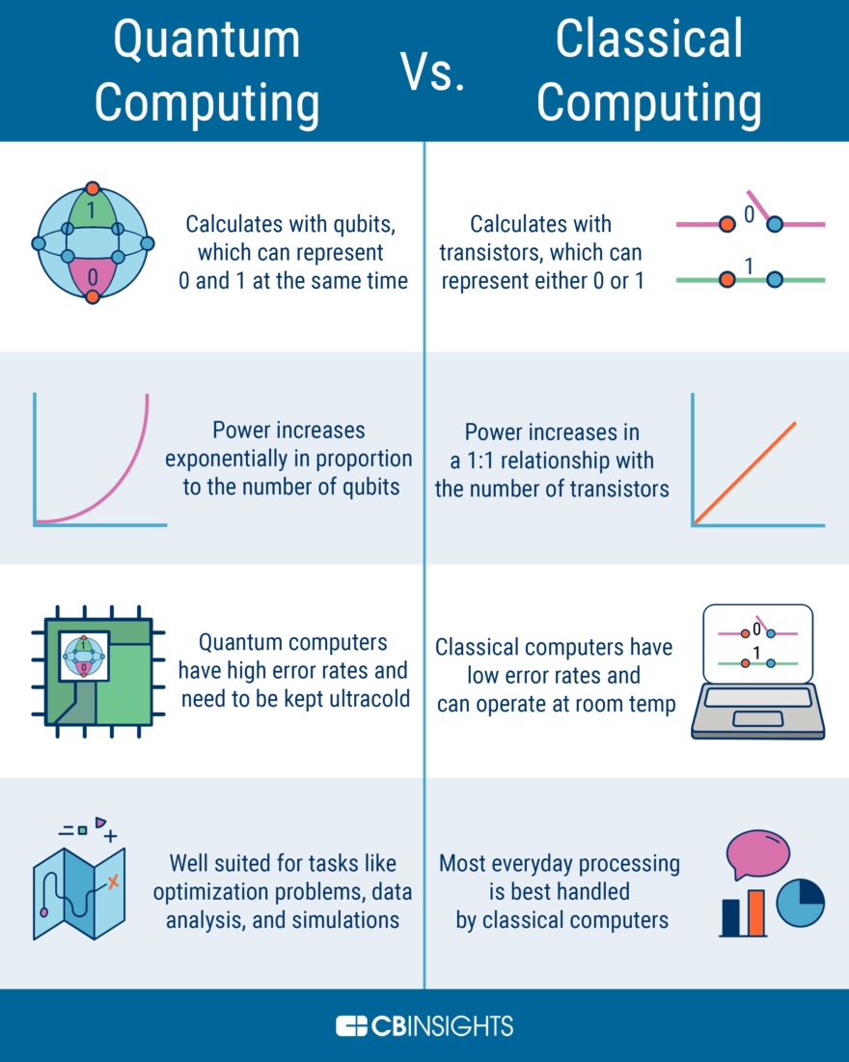
Source: https://devopedia.org/quantum-computing (CB Insights 2021.)

Slide 21



Bit vs Qubit
From macroscopic world to microscopic world
From Newtonian (or classical) mechanics to quantum mechanics
From particle to quantum entity with the wave-particle duality
Prom Newton’s Second Law or to
Schrödinger equation ,
where ψ(r, t) is the wave function with complex numbers to represent the probability amplitude that the particle (quantum entity) is on position r at time t, and |ψ(r, t)|² is the probability density to find the particle on position r at time t.
Notes:
Physics is the the use of mathematics to study, model, and predict phenomena in the observable universe. Mechanics is the branch of physics which has to do with motion, mass, acceleration and force. Often, as a shorthand, mechanics is referred to as 'Newtonian Mechanics' or 'Classical Mechanics’.
By "motion", Newton meant the quantity now called momentum, which depends upon the amount of matter contained in a body, the speed at which that body is moving, and the direction in which it is moving. In modern notation, the momentum of a body is the product of its mass and its velocity:
{\displaystyle {\vec {p}}=m{\vec {v}}\,.}
Newton's second law, in modern form, states that the time derivative of the momentum is the force:{\displaystyle {\vec {F}}={\frac {d{\vec {p}}}{dt}}\,.}
If the mass {\displaystyle m} does not change with time, then the derivative acts only upon the velocity, and so the force equals the product of the mass and the time derivative of the velocity, which is the acceleration:{\displaystyle {\vec {F}}=m{\vec {a}}\,,}
As the acceleration is the second derivative of position with respect to time, this can also be written{\displaystyle {\vec {F}}=m{\frac {d^{2}}{dt^{2}}}{\vec {s}}\,.}
{\displaystyle {\hat {H}}} 是表徵波函數總能量的哈密頓算符，{\displaystyle \Psi } 是物理系統的波函數，{\displaystyle i} 是虛數單位，{\displaystyle \hbar } 是約化普朗克常數，{\displaystyle \partial /\partial t} 是對於時間 {\displaystyle t} 的偏微分。
波函數 {\displaystyle \Psi (\mathbf {r} ,t)} 是一種複值函數，表示粒子在位置 {\displaystyle \mathbf {r} } 、時間 {\displaystyle t} 的機率幅，它的絕對值平方 {\displaystyle |\Psi (\mathbf {r} ,t)|^{2}} 是在位置 {\displaystyle \mathbf {r} } 、時間 {\displaystyle t} 找到粒子的機率密度。以另一種角度詮釋，波函數{\displaystyle \Psi (\mathbf {r} ,t)}是「在某時間、某位置發生交互作用的機率幅」。

Slide 22
Quantum
《莊子 天下篇》一尺之捶，日取其半，萬世不竭。
Zhuangzi: “If you take the half from a one-inch stick every day, then you can do so forever.”
The above concept may be conflict with that of quantum mechanics.
In 1990, Plank found that energy is discrete and consists of integer multiples of a basic unit of energy, the quantum.
A quantum (plural quanta) is the minimum amount of any physical entity (physical property) involved in an interaction.
This means that the magnitude of the physical property can take on only discrete values consisting of integer multiples of one quantum.
For example, the energy of an electron bound within an atom is quantized and can exist only in certain discrete values.
For another example, a photon is a single quantum of light.

Slide 23
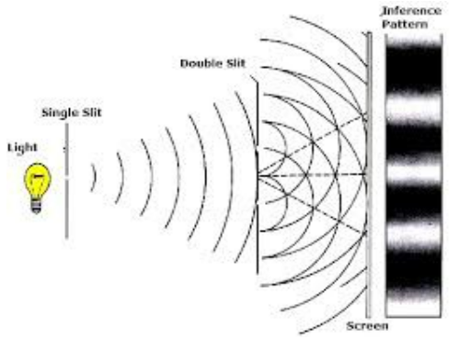
Double-slit experiment conducted by Thomas Young in 1801
Source: https://medium.com/@sriramkolar96/the-weird-world-of-quantum-mechanics-e6a83b372898

Slide 24
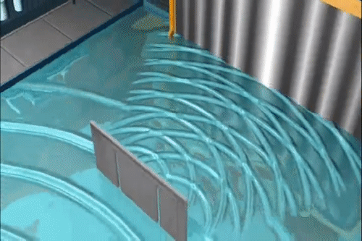
A bunch of water molecules (H₂O) has the form of a wave
Source: https://view.inews.qq.com/a/20201121A03UQS00

Slide 25
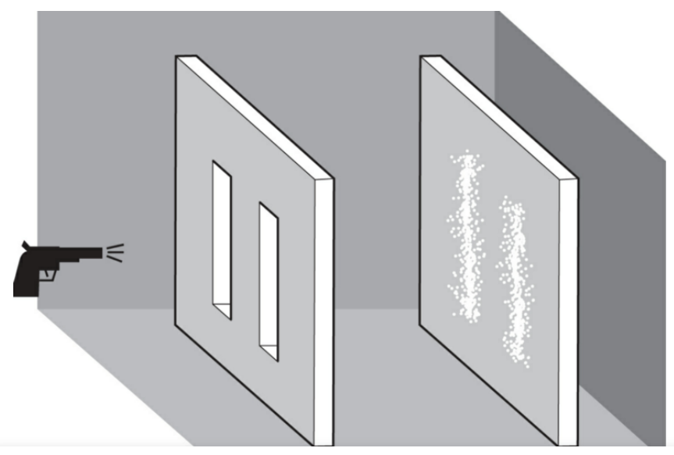
When a gun with bullets (particles) is fired between the two slits, the screen shows two bands where the slits were positioned. It is thus logical to think
Source: https://medium.com/@sriramkolar96/the-weird-world-of-quantum-mechanics-e6a83b372898

Slide 26
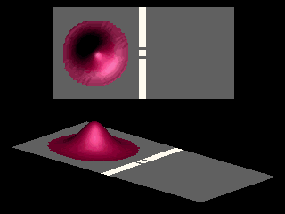
An electron or a photon alone is a wave
Source: https://kknews.cc/science/ro559p4.html

Slide 27
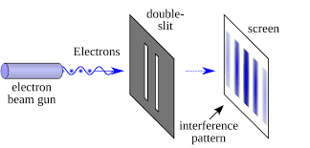
An electron or a photon alone is a wave
Source: https://medium.com/@sriramkolar96/the-weird-world-of-quantum-mechanics-e6a83b372898

Slide 28
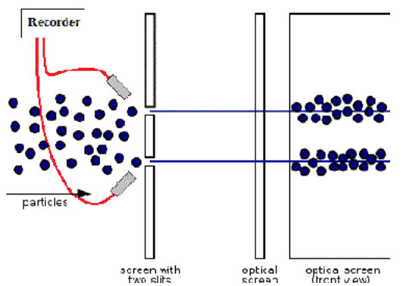
Two detectors are placed at the slits to observe in which slit the particle goes through. Now the screen showed two bands just like the ones obtained when the bullets were fired.
Source: https://medium.com/@sriramkolar96/the-weird-world-of-quantum-mechanics-e6a83b372898
Notes:
The experiment was repeated by designing the gun to fire one particle at a time through the slits. The result was still the same wave-interference pattern on the screen.
· If you think that it doesn’t get any weirder, you’re wrong. The same experiment was then repeated with two detectors being placed at the slits, to observe in which slit, the particle goes through. Now the screen showed two bands just like the ones obtained when the bullets were fired.
· The particles seemed to have lost all their creepiness and behaved like particles of classical physics! How does the act of observing change the character of the particle? How did the particles know when they were being detected? This formed the base for the most baffling concept of quantum mechanics known simply as the observer effect.
· This phenomenon was confirmed when the detectors were placed but turned off and the experiment was repeated. This time, the particles formed the same wave- pattern. What causes this phenomenon, is not yet clearly understood.
This experiment gave scientists a peek into the fascinating world of quantum physics and its possibilities that are beyond our imaginations.
The Future of Quantum Technology
Our understanding of the quantum world is very minimal and most of the concepts are still considered to be spooky (as described by Einstein). Quantum mechanics has found a few applications such as the “Ultra-precise clocks” which tend to lose or gain a second every 3.7 billion years and the concept Quantum Key distribution (QKD) which is used to send cryptographic messages.
And this is just the beginning. We can look forward to a quantum future in which near-limitless electric power may become available from laser-driven nuclear fusion when artificial molecular machines will be carrying out a vast array of tasks in the fields of engineering, biochemistry and medicine.
The twentieth century’s quantum revolution is picking up pace in the twenty-first century and will transform our lives in unimaginable ways.
2
2
More from Sri Ram
Follow
Jun 18, 2020
Reaching out to the stars
Cosmos
6 min read
Love podcasts or audiobooks? Learn on the go with our new app.
Try Knowable
Recommended from Medium
Afiq Hatta
Late Night Musings. A Mechanics Problem by Landau.
Mr.Milano
Our universe has twins where time flows backwards: A new theory of scientists
scite
in
scite
The Microbiology Society and scite Sign Indexing Agreement to Improve How Articles Are Discovered…
Robin Thurston
in
Helix
Why we’re on the brink of the next great discovery: you.
Shin Jie Yong
in
Microbial Instincts
Swine α-coronavirus Jumping to Humans: How Likely Is It?
Abhijit Deonath
The Loan of Water
Nautilus
in
Nautilus Magazine
Ingenious: Alan Lightman
Aman Iqbal
I, Homo Sapiens: An essay on parallels between science and spirituality- Part 2: Creation
AboutHelpTermsPrivacy
Get the Medium app

Slide 29
Outline
Quantum Technologies
Quantum Supremacy
Classical Bits vs Quantum Bits
Dirac Notation and Bloch Sphere
Quantum Gates and Quantum Circuits
Shor’s Algorithm
Concluding Remarks

Slide 30
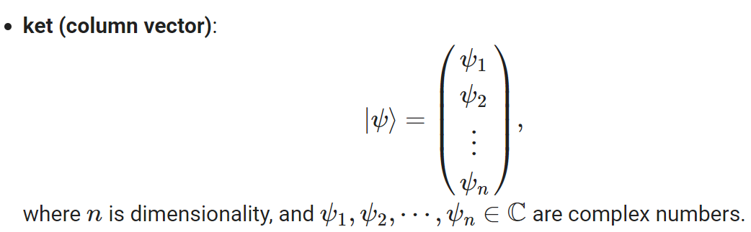
Dirac Notation (Bra-Ket) Notation

Slide 31
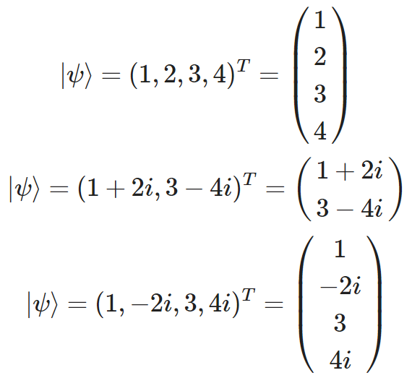
Ket Notation Examples

Slide 32
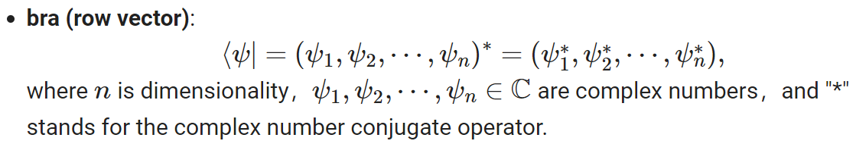
Dirac Notation (Bra-Ket) Notation

Slide 33
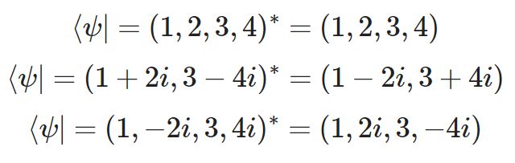
Bra Notation Examples

Slide 34
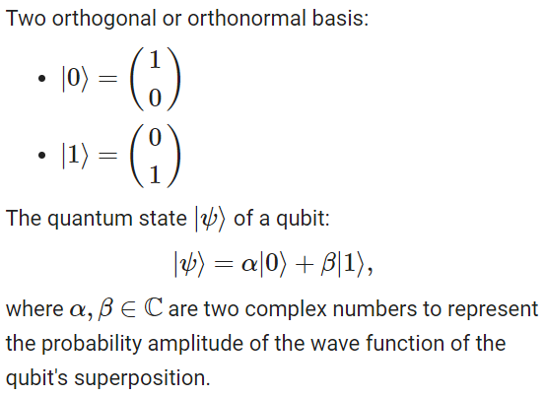

Slide 35
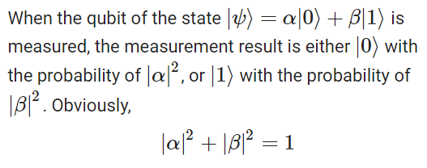
Measurement of a qubit

Slide 36
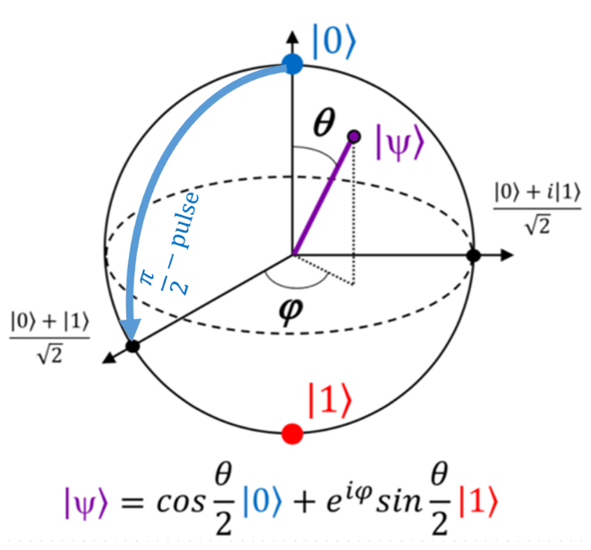
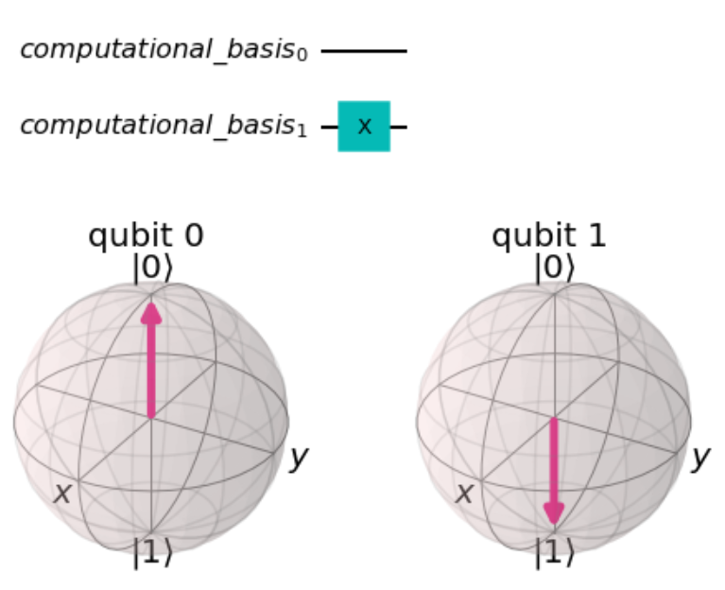
Bloch Sphere
Source: https://www.researchgate.net/figure/The-Bloch-sphere-provides-a-useful-means-of-visualizing-the-state-of-a-single-qubit-and_fig1_335028508

Slide 37
Outline
Quantum Technologies
Quantum Supremacy
Classical Bits vs Quantum Bits
Dirac Notation and Bloch Sphere
Quantum Gates and Quantum Circuits
Shor’s Algorithm
Concluding Remarks

Slide 38
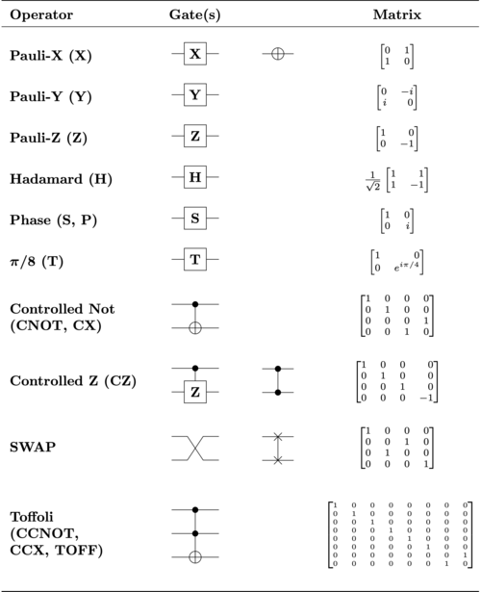
Quantum Gates and Unitary Matrix
Source: https://en.wikipedia.org/wiki/Quantum_logic_gate#/media/File:Quantum_Logic_Gates.png, by Rxtreme, Dec. 2019, CC BY-SA 4.0.

Slide 39
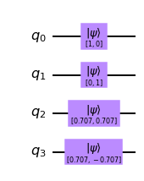
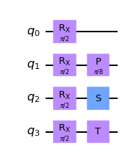
Quantum Circuit Examples:
Qubit initialization; Qubit Operation

Slide 40
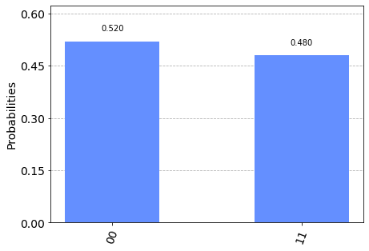
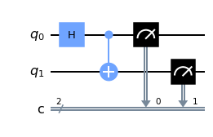
Another Quantum Circuit Example:
Bell State (A special entanglement state)

Slide 41
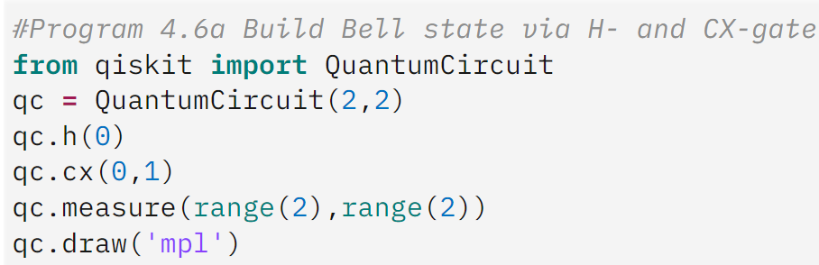
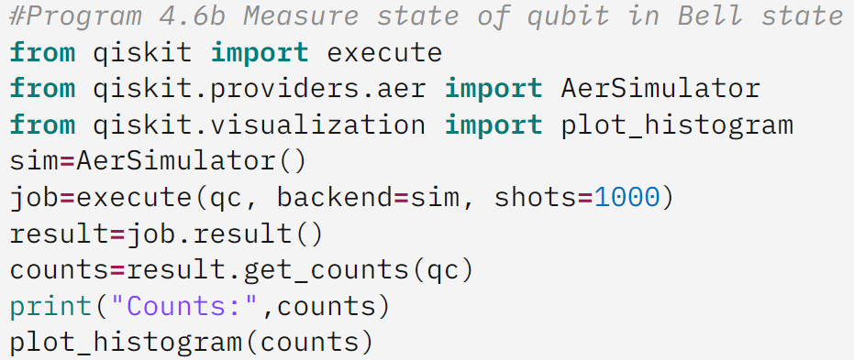
The code of Bell-state programming

Slide 42
Outline
Quantum Technologies
Quantum Supremacy
Classical Bits vs Quantum Bits
Dirac Notation and Bloch Sphere
Quantum Gates and Quantum Circuits
Shor’s Algorithm
Concluding Remarks

Slide 43
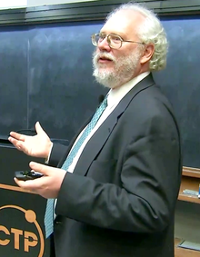
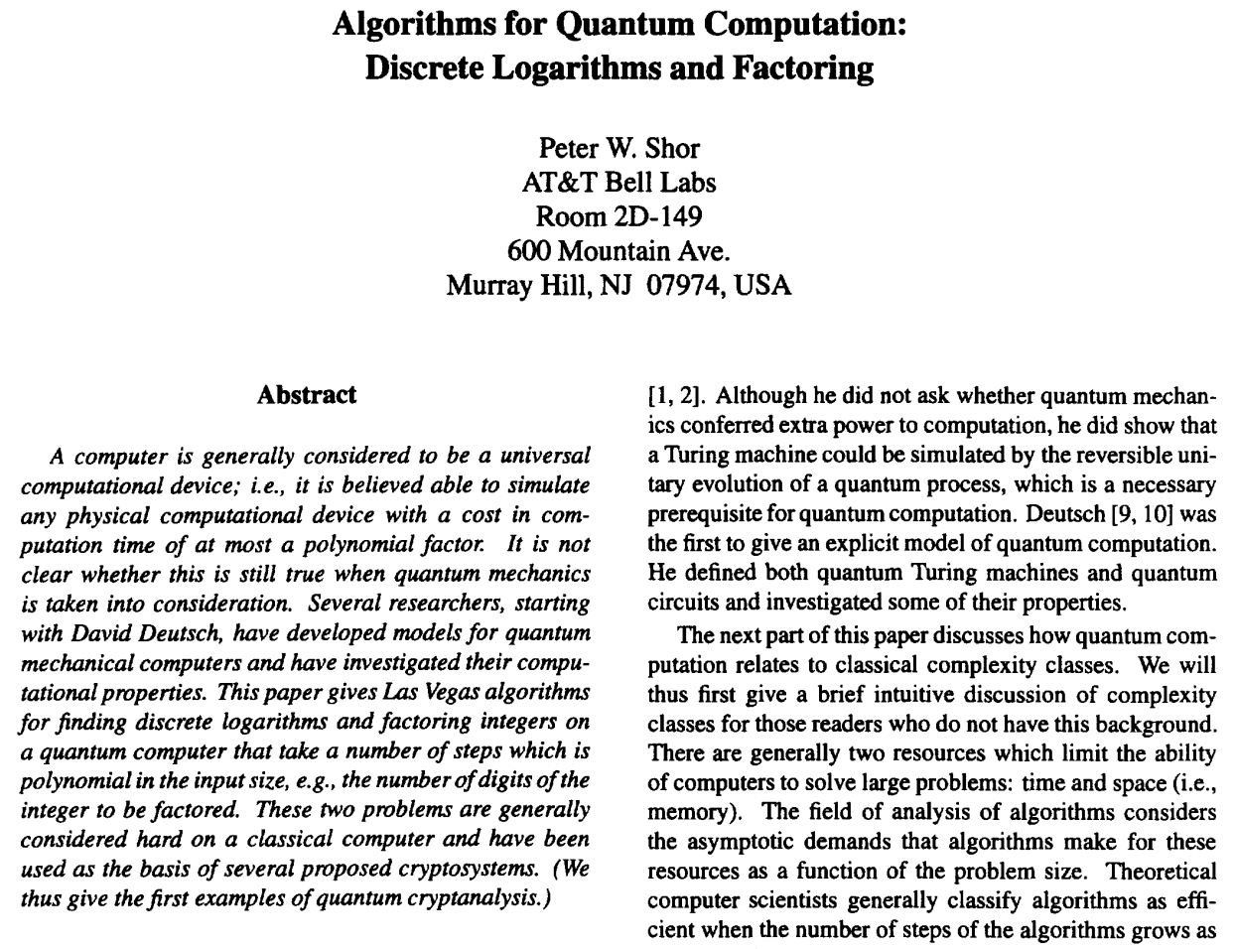
Wiki: Peter Shor (born August 14, 1959) is an American professor of applied mathematics at MIT. He is known for his work on quantum computation, in particular for devising Shor's algorithm, a quantum algorithm for factoring exponentially faster than the best currently-known algorithm running on a classical computer.
Source:https://en.wikipedia.org/wiki/Peter_Shor#/media/File:Peter_Shor_2017_Dirac_Medal_Award_Ceremony.png
Shor, Peter W. "Algorithms for quantum computation: discrete logarithms and factoring." Proceedings 35th annual symposium on foundations of computer science. IEEE, 1994..

Slide 44
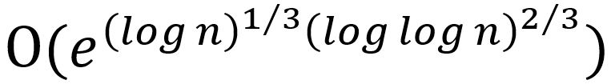
Shor’s Algorithm – to break RSA in seconds
Shor's algorithm was proposed in a paper authored by Peter Shor published in 1994.
It can be used to solve the co-prime factorization problem for finding the prime factors of a co‑prime n, an integer that is the product of two large primes.
Based on classical computation, the co-prime factorization problem is polynomially reduce to a period-finding problem to be solved in polynomial time based on quantum computation.
Its time complexity is O((log n)²(log log n)(log log log n)), where (log n) is the number of digits (bits) to represent n.
The fastest classical algorithm, the general number field sieve (GNFS) algorithm, to solve the same problem has the time complexity of .
It is possible that Shor’s algorithm takes few seconds to factor a large integer n of 1024 bits, whereas the GNFS algorithm take thousands of years to factor n. That is, it can break the RSA encryption system in seconds with a quantum computer of a large enough number of qubits and proper error rates.

Slide 45
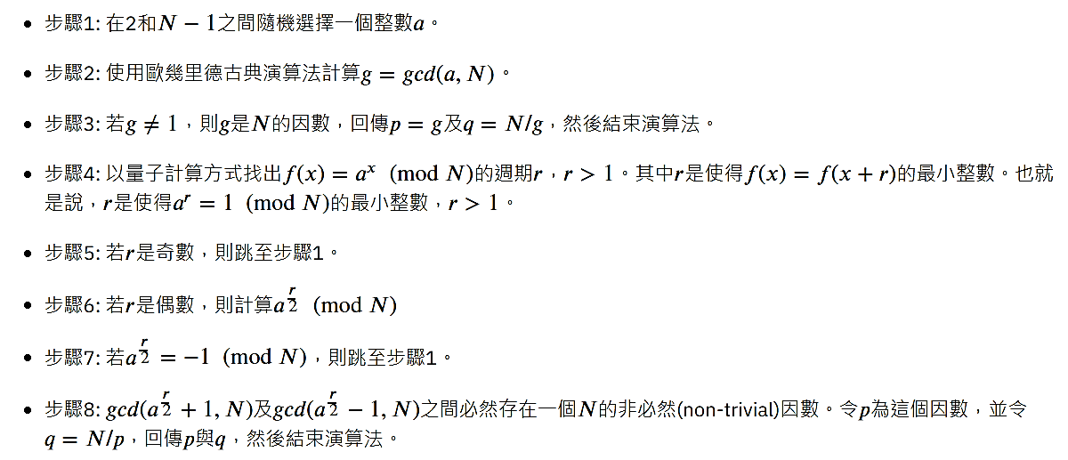
The Steps of Shor’s Algorithm

Slide 46
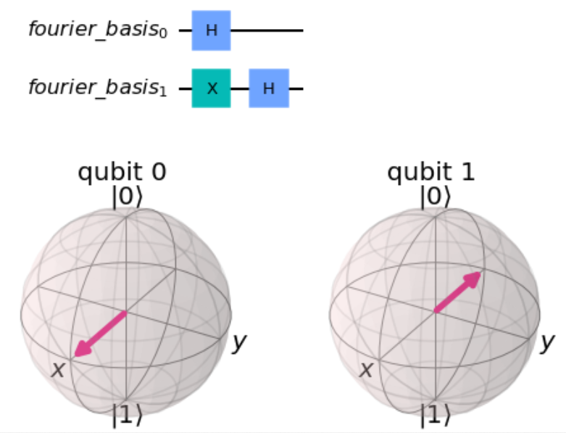
Quantum Fourier Transform (QFT)

Slide 47
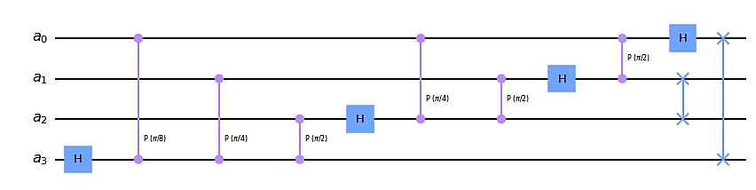
QFT Circuit of 4 Qubits

Slide 48
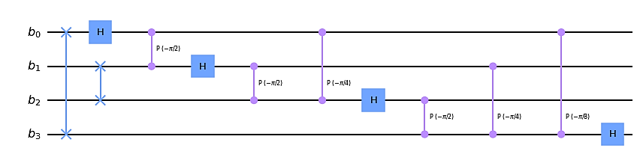
IQFT Circuit of 4 Qubits

Slide 49
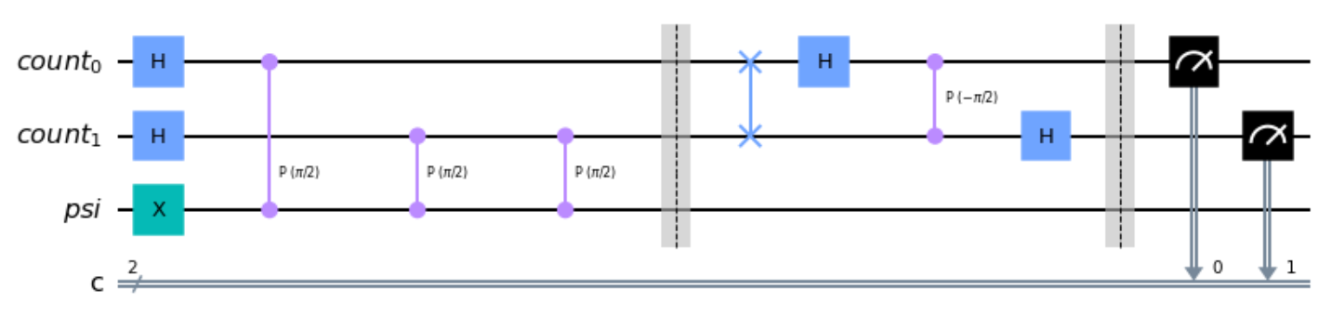
Quantum Phase Estimation (QPE)

Slide 50
Outline
Quantum Technologies
Quantum Supremacy
Classical Bits vs Quantum Bits
Dirac Notation and Bloch Sphere
Quantum Gates and Quantum Circuits
Shor’s Algorithm
Concluding Remarks

Slide 51
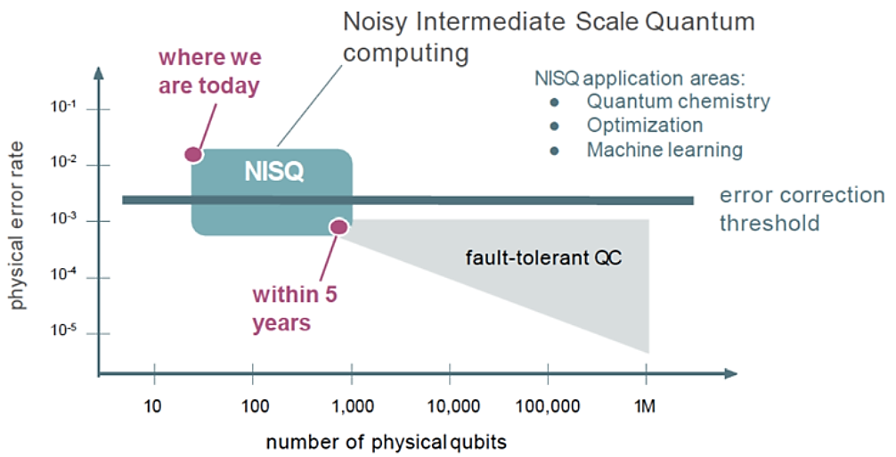
The Quantum Computation Era Is Coming
Source: Preskill, John. "Quantum computing in the NISQ era and beyond." Quantum 2 (2018): 79.
Also: https://towardsdatascience.com/quantum-advantage-b3458646bd9
Notes:
Przemek Chojecki, Quantum advantage, or a practical demonstration that quantum computers work, Nov 9, 2018.

Slide 52
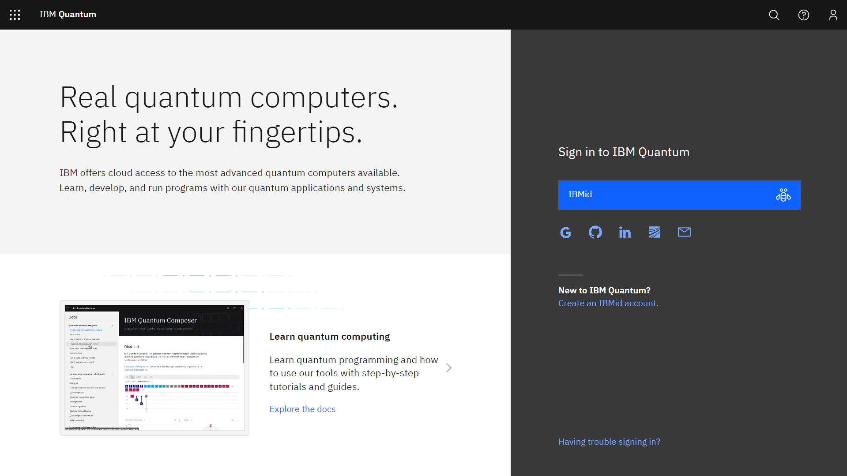

Slide 53
Q&A

