Slide 1
Machine Learning
Give a man a fish, and you feed him for a day; teach him how to fish, and you feed him for a lifetime.
Give a computer (machine) a program, and you make it useful for a time; teach it how to program, and you make it useful for a lifetime.
Prof. Jehn-Ruey Jiang
National Central University, Taiwan
Notes:
給他魚吃不如教他釣魚
Give a man (computer) a fish (program), and you feed him for a day; teach him how to fish (program), and you feed him for a lifetime.

Slide 2
A Few Quotes
“A breakthrough in machine learning would be worth ten Microsofts” (Bill Gates, Chairman, Microsoft)
“Machine learning is the next Internet” (Tony Tether, Director, DARPA)
Machine learning is the hot new thing” (John Hennessy, President, Stanford)
“Web rankings today are mostly a matter of machine learning” (Prabhakar Raghavan, Dir. Research, Yahoo)
“Machine learning is going to result in a real revolution” (Greg Papadopoulos, CTO, Sun)
Source: Slides of Dr. Pedro Domingos

Slide 3
So What Is Machine Learning?
Wiki:
Machine learning is a field of computer science that gives computers the ability to learn without being explicitly programmed.
Arthur Samuel, an American pioneer in the field of computer gaming and artificial intelligence, coined the term "Machine Learning" in 1959 while at IBM. (Arthur Samuel said in 1959: “How can computers learn to solve problems without being explicitly programmed?”)

Slide 4
So What Is Machine Learning?
Pedro Domingos:
Getting computers to program themselves
Let the data do the work instead!
Yi-Fan Chang:
A branch of artificial intelligence, concerned with the design and development of algorithms that allow computers to evolve behaviors based on empirical data.
As intelligence requires knowledge, it is necessary for the computers to acquire knowledge.

Slide 5
Traditional Programming
Machine Learning
Data
Computer
Output
Program
Data
Computer
Program
Output
Source: Slides of Dr. Pedro Domingos

Slide 6
Machine Learning: a new problem-solving paradigm
Traditional Programming Paradigm
Ex: Problem: check if a given integer n is even. People make the program according to the rule: if n is divisible by 2, then n is even.
Input (Data)
8
Machine (Computer)
Yes
Output
9
Program
No
Machine Learning Paradigm
Ex: Same Problem. People give a large number of data and associated outputs (labels), and the machine learns (infers) how to solve the problem by making models (e.g., a deep neural network).
8, 9, …..
Input (Data)
Machine
(Computer)
100
Model
(Program)
Yes, No, …
Output
Yes
Adapted from slides of Dr. Pedro Domingos

Slide 7
Sample ML Applications
Go games
Pattern (image, voice, etc.) recognition
Computational biology
Finance
E-commerce
Space exploration
Robotics
Information extraction
….

Slide 8
Magic?
No, more like gardening
Seeds = ML Algorithms
Nutrients = Data
Gardener = You (Trainer)
Plants = Programs (Model)
Source: Slides of Dr. Pedro Domingos

Slide 9
Types of Machine Learning
Supervised (inductive) learning
Training data includes labels
Unsupervised learning
Training data does not include lables
Semi-supervised learning
Training data includes a few labels
Reinforcement learning
Rewards from sequence of actions

Slide 10
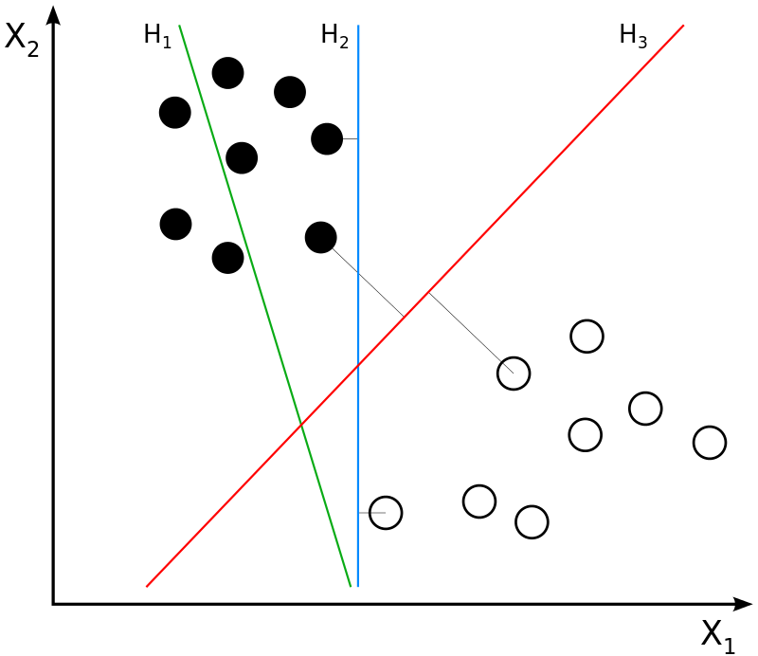
A Supervised Learning Example
Support Vector Machine (SVM)
H₁ does not separate the classes. H₂ does, but only with a small margin. H₃ separates them with the maximal margin.
Notes:
In the case of support vector machines, a data point is viewed as a p-dimensional vector (a list of p numbers), and we want to know whether we can separate such points with a (p−1)-dimensional hyperplane. This is called a linear classifier. There are many hyperplanes that might classify the data. One reasonable choice as the best hyperplane is the one that represents the largest separation, or margin, between the two classes. So we choose the hyperplane so that the distance from it to the nearest data point on each side is maximized. If such a hyperplane exists, it is known as the maximum-margin hyperplane and the linear classifier it defines is known as a maximum-margin classifier;

Slide 11
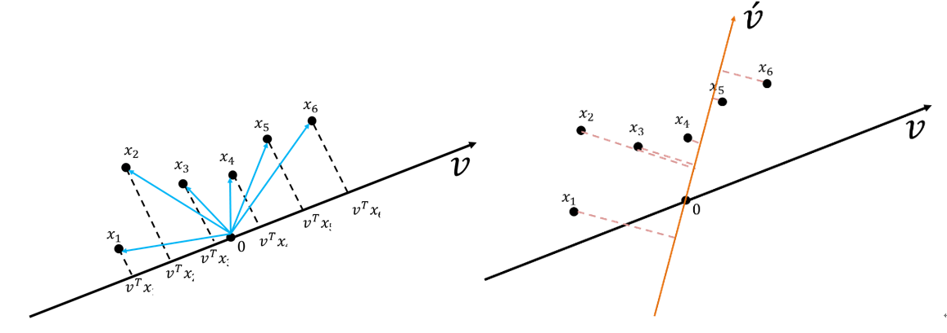
An Unsupervised Learning Example
Principal Component Analysis (PCA)
Projected data on v has a larger variance than projected data on v’.
Notes:
Wiki:
Principal component analysis (PCA) is a popular technique for analyzing large datasets containing a high number of dimensions/features per observation, increasing the interpretability of data while preserving the maximum amount of information, and enabling the visualization of multidimensional data. Formally, PCA is a statistical technique for reducing the dimensionality of a dataset. This is accomplished by linearly transforming the data into a new coordinate system where (most of) the variation in the data can be described with fewer dimensions than the initial data. Many studies use the first two principal components in order to plot the data in two dimensions and to visually identify clusters of closely related data points. Principal component analysis has applications in many fields such as population genetics, microbiome studies, and atmospheric science.^{[1]}
Principal component analysis (PCA) is a technique for reducing the dimensionality of such datasets, increasing interpretability but at the same time minimizing information loss. It does so by creating new uncorrelated variables that successively maximize variance. Finding such new variables, the principal components, reduces to solving an eigenvalue/eigenvector problem, and the new variables are defined by the dataset at hand, not a priori, hence making PCA an adaptive data analysis technique.
「主成分分析在機器學習內被歸類成為降維(Dimension reduction)內特徵擷取(Feature extraction)的一種方法，降維就是希望資料的維度數減少，但整體的效能不會差異太多甚至會更好」
這邊先簡單說維度詛咒，預測/分類能力通常是隨著維度數(變數)增加而上升，但當模型樣本數沒有繼續增加的情況下，預測/分類能力增加到一定程度之後，預測/分類能力會隨著維度的繼續增加而減小。
主成份分析的基本假設是希望資料可以在特徵空間找到一個投影軸(向量)，投影後可以得到這組資料的最大變異量。

Slide 12
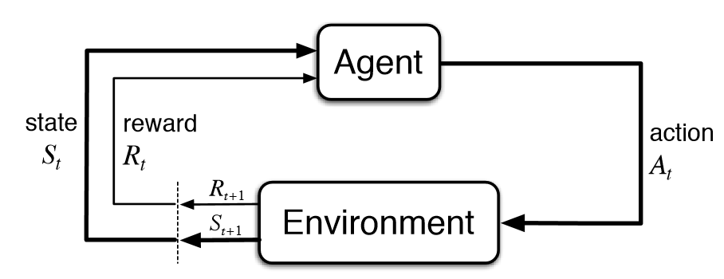
A Reinforcement Learning Example
Q-learning
Wiki: Q-learning is a model-free reinforcement learning algorithm to learn the value of an action in a particular state. It does not require a model of the environment (hence “model-free”), and it can handle problems with stochastic transitions and rewards without requiring adaptations.

Slide 13
Q&A

Slide 14
Learning techniques
Supervised learning categories and techniques
Linear classifier (numerical functions)
Parametric (Probabilistic functions)
Naïve Bayes, Gaussian discriminant analysis (GDA), Hidden Markov models (HMM), Probabilistic graphical models
Non-parametric (Instance-based functions)
K-nearest neighbors, Kernel regression, Kernel density estimation, Local regression
Non-metric (Symbolic functions)
Classification and regression tree (CART), decision tree
Aggregation
Bagging (bootstrap + aggregation), Adaboost, Random forest
Source: Slides of Dr. Yi-Fan Chang

Slide 15
Learning techniques
Unsupervised learning categories and techniques
Clustering
K-means clustering
Spectral clustering
Density Estimation
Gaussian mixture model (GMM)
Graphical models
Dimensionality reduction
Principal component analysis (PCA)
Factor analysis
Source: Slides of Dr. Yi-Fan Chang

