Slide 1
Algorithm Small Talk
Prof. Jehn-Ruey Jiang (江振瑞)
National Central University, Taiwan

Slide 2
Algorithm is IPO
Traditional Algorithm
E.G.:
Process
Input
Output
An Integer n, n>0
Process
true or false:
n is odd (true)
or even (false)

Slide 3
Algorithm Example 1
Algorithm OddNumberTest
Input: n, n∈Z⁺
Output: true (n is odd) or false (n is even)
1: r ← n % 2
2: if r≠0
3: return true
4: else
5: return false

Slide 4
Algorithm Implementation 1
def OddNumberTest(n):
r=n%2
if r!=0:
return True
else:
return False
print OddNumberTest(3)
Result: True

Slide 5

Algorithm is IPO
Machine Learning Algorithm
E.G.:
Process
Input
Output
A 64 x 64 x 256 Image M
Process
true or false:
M is a cat (true) or not (false)

Slide 6
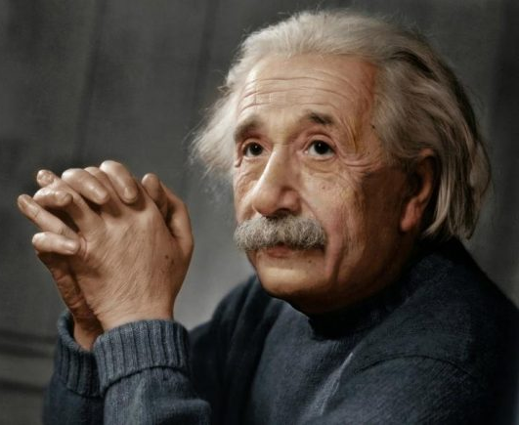
Algorithm Example 2
A 64 x 64 x 256 Image M
Process
true or false:
M is a cat (true) or not (false)

Slide 7
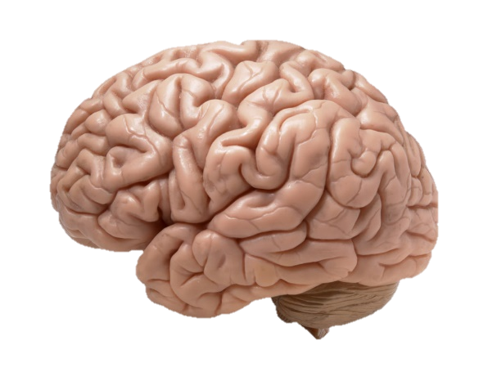
Algorithm Example 2 (Cont’d)
A 64 x 64 x 256 Image M
Process
true or false:
M is a cat (true) or not (false)

Slide 8
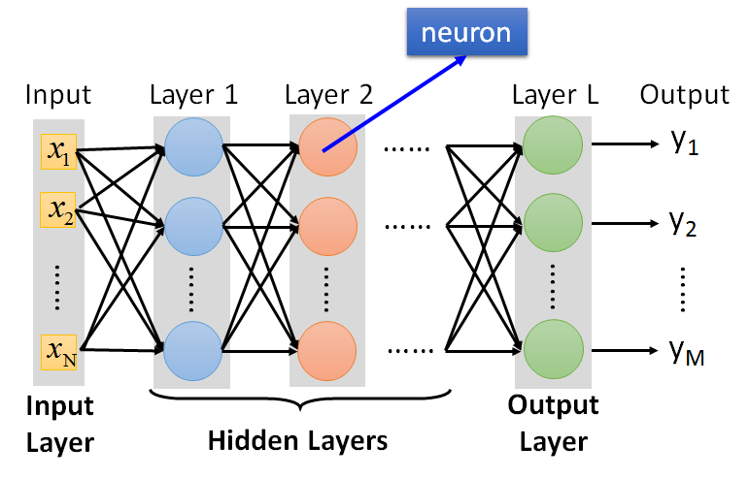
Algorithm Example 2 (Cont’d)
A 64 x 64 x 256 Image M
Process
(DNN)
true or false:
M is a cat (true) or not (false)

Slide 9
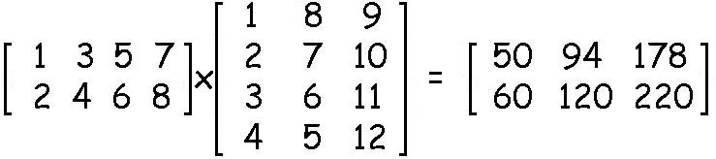
Python Programming
To calculate:
By python codes
  import numpy as np
  a=np.array([[1,3,5,7], [2,4,6,8]])
  b=np.array([[1,8,9], [2,7,10], [3,6,11], [4,5,12]])
  print np.matmul(a,b)
  Result:
  [[ 50 94 178]
  [ 60 120 220]]

Slide 10
Algorithm is IPO
prime
prime
Quantum Algorithm
E.G.:
Process
Input
Output
A very large integer (e.g., 300-digit number) n
Process
true or false:
n is a prime (true) or not (false)
n
Notes:
2 的 1024 次方
= 1.797693134862315907729305190785e+308

Slide 11
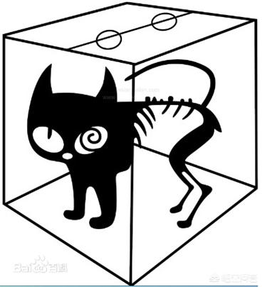
Algorithm Example 3
Process
A very large integer n
true or false:
n is a prime (true) or not (false)
Notes:
Schrodinger’s cat
薛丁格的貓

Slide 12
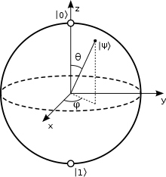
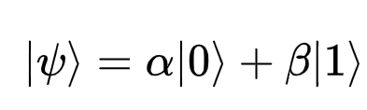
Algorithm Example 3 (Con’t)
Process
A very large integer n
true or false:
n is a prime (true) or not (false)
Notes:
單量子比特的布洛赫球(Bloch Sphere)表示
在量子力學裏，態疊加原理（superposition principle）表明，假若一個量子系統的量子態可以是幾種不同量子態中的任意一種，則它們的歸一化線性組合也可以是其量子態。稱這線性組合為「疊加態」。假設組成疊加態的幾種量子態相互正交，則這量子系統處於其中任意量子態的機率是對應權值的絕對值平方。^{[1]:316ff}
從數學表述，態疊加原理是薛丁格方程式的解所具有的性質。由於薛丁格方程式是個線性方程式，任意幾個解的線性組合也是解。這些形成線性組合（稱為「疊加態」）的解時常會被設定為相互正交（稱為「基底態」），例如氫原子的電子能級態；換句話說，這幾個基底態彼此之間不會出現重疊。這樣，對於疊加態測量任意可觀察量所得到的期望值，是對於每一個基底態測量同樣可觀察量所得到的期望值，乘以疊加態處於對應基底態的機率之後，所有乘積的總和。

Slide 13
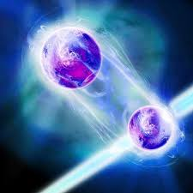
Algorithm Example 3 (Con’t)
Process
A very large integer n
true or false:
n is a prime (true) or not (false)
Notes:
Quantum Entanglement
量子纏結，即在量子力學裏，當幾個粒子在彼此相互作用後，由於各個粒子所擁有的特性已綜合成為整體性質，無法單獨描述各個粒子的性質，只能描述整體系統的性質，則稱這現象為量子缠结或量子纠缠（quantum entanglement）。 量子糾纏是一種純粹發生於量子系統的現象；在經典力學裏，找不到類似的現象。

Slide 14
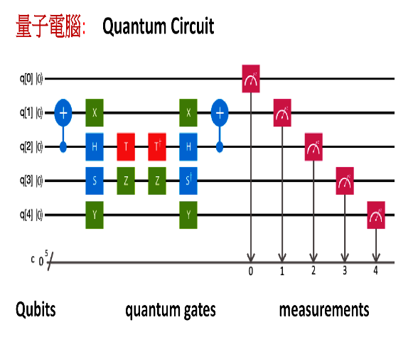
Algorithm Example 3 (Con’t)
Process
A very large integer n
true or false:
n is a prime (true) or not (false)
Notes:
Schrodinger’s cat
薛丁格的貓

Slide 15
Algorithm Example 3 (Con’t)
Process
A very large integer n
import qiskit as q
# build a 2 qubit circuit
circuit = \
q.QuantumCircuit(2,2)
circuit.x(0)
circuit.cx(0, 1)
circuit.measure([0, 1], [0, 1])
…….
true or false:
n is a prime (true) or not (false)
Notes:
import qiskit as q
# build a 2 qubit, 2 classical circuit
circuit = q.QuantumCircuit(2,2)
# apply a NOT gate to qubit 0, currently 0,0
circuit.x(0)
# now 10
# apply a CNOT gate, which flips 2nd qubit value if first qubit is a 1
circuit.cx(0, 1)
# now 11
circuit.measure([0, 1], [0, 1])

Slide 16
To be Continued

