Slide 1

AWS Braket Experience:
Solving NP-hard Problems with D-Wave Quantum Annealers
By Jehn-Ruey Jiang (江振瑞)
CSIE Department
National Central University
Notes:
量子退火 : 找到哪一種狀態的qubits放入hamiltonian後會呈現最小值
coupler範圍大小(實際機器)
Ans:從編程方面來看，這些值可以設置為雙精度浮點數。
因為我們使用 QUBO 作為輸入（即 Vartype.BINARY），所以偏差與 ising 偏差並不完全一致。
當問題被轉換為 QPU 的原生格式時，它們最終處於可接受的值範圍內。
等比例縮放
不同機器有不同的coupler值和bias值大小 advantage4.1 h_range(bias)[-4~4] j_range(coupler)[-1~1]
Chain strength
強度設置為等於對角線（或線性）偏差的最大絕對值。
對於具有各種線性和二次係數值的問題，過大的鏈強度會降低問題的定義。
建議檢查整個矩陣的最大絕對值，因為線性或二次偏差會導致斷鍊。這是一個簡單的三變量示例來演示。在這裡，我們將鏈
線性係數表示量子比特偏差，二次係數表示耦合器強度
sample

Slide 2
Outline
D-Wave Quantum Annealers (QAs)
NP-hard Problems
Examples of Solving NP-hard Problems with QAs
QUBO Formula Classification
Conclusion

Slide 3
Outline
D-Wave Quantum Annealer (QAs)
NP-hard Problems
Examples of Solving NP-hard Problems with QAs
QUBO Formula Classification
Conclusion

Slide 4
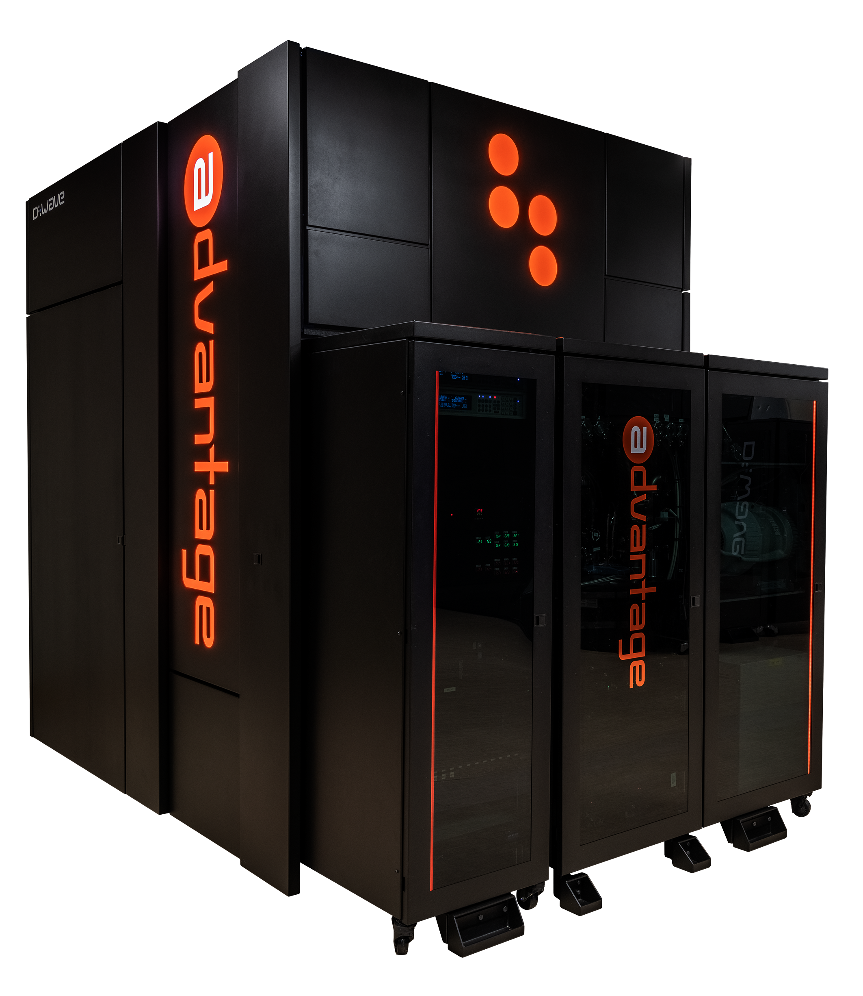
D-Wave Quantum Annealers (QAs)
D-Wave Systems Inc. is a Canadian company founded in 1999.
D-Wave produced quantum annealers or quantum samplers for solving optimization problems using the concept of quantum annealing.
The company designed their first qubit by using d-wave superconductors.
D-Wave quantum annealer history:
  2007: Orion Prototype
  2011: D-Wave One (127 qubits; 352 couplers)
  2013: D-Wave Two (512 qubits; 1472 couplers)
  2015: D-Wave 2X (1152 qubits; 3360 couplers)
  2017: D-Wave 2000Q (2048 qubits; 6016 couplers; Chimera topology)
  2020: D-Wave Advantage (5640 qubits; 40484 couplers; Pegasus topology)
D-Wave Advantage
(source: https://www.dwavesys.com/solutions-and-products/systems/)

Slide 5
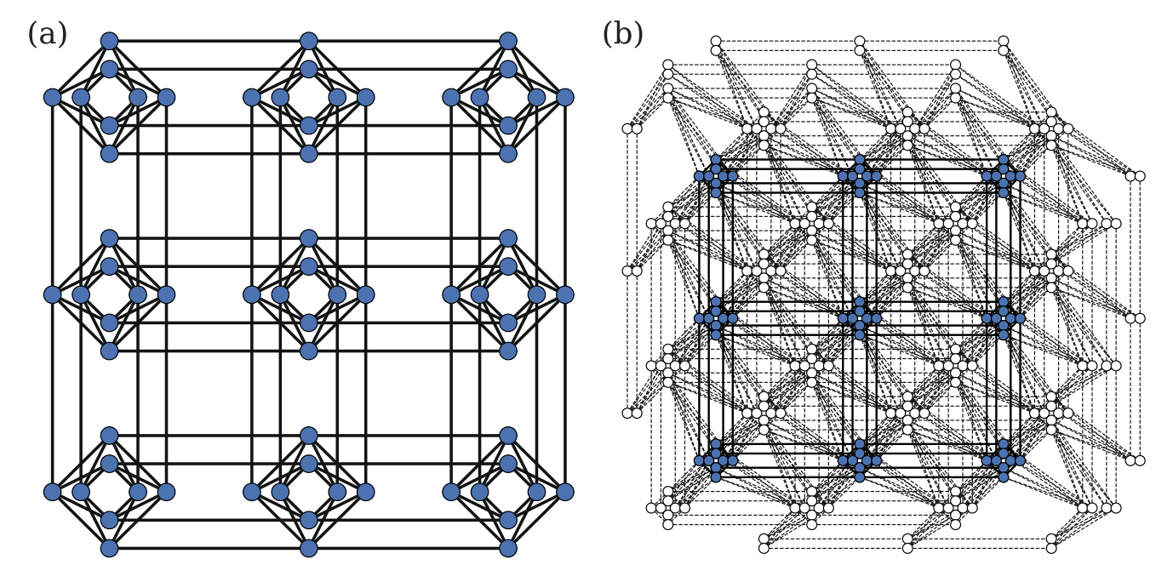
D-Wave QPU and Topology
The D-Wave quantum processing unit (QPU) is a lattice of interconnected qubits. Since some qubits connect to others via some couplers, the D-Wave QPU is not fully connected.
(a) Chimera of D-Wave 2000Q (b) Pegasus of D-Wave Advantage
Source: Gonzalez Calaza, C. D., Willsch, D., & Michielsen, K. (2021). Garden optimization problems for benchmarking quantum annealers. Quantum Information Processing, 20(9), 1-22.
Notes:
Greek Mythology A fire-breathing she-monster usually represented as a composite of a lion, goat, and serpent. 【希臘神話】 客邁拉：一種通常被描繪成獅子、山羊和蛇的組合體吐火的雌性怪物
Greek Mythology A winged horse that with a stroke of his hoof caused the fountain Hippocrene to spring forth from Mount Helicon. 【希臘神話】 佩加索斯：其蹄在赫利孔山上踏出希波克裏尼靈感泉的生有翼的飛馬

Slide 6
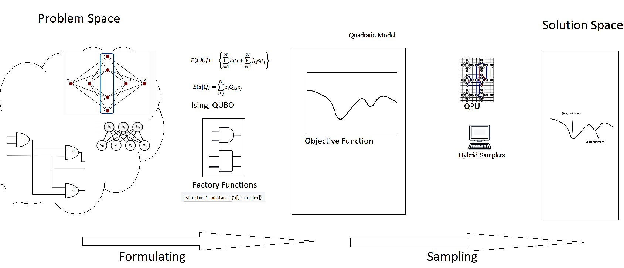
Problem Solving Workflow
Formulate the problem as an objective function, usually in the QUBO or 2D Ising format.
Map the QUBO function to the QPU topology (minor embedding).
QPU uses quantum annealing to seek the minimum of the resulting energy landscape, which corresponds to the solution to the problem.
Source: https://docs.ocean.dwavesys.com/en/stable/overview/solving_problems.html
Notes:
要用量子採樣器解決問題，我們可以將問題表述為目標函數，通常採用 Ising 或 QUBO 格式。 目標函數的低能量狀態代表了問題的良好解決方案。 因為我們可以將目標函數表示為圖形，所以我們可以將其映射到 QPU： 線性係數映射到量子比特偏差，二次係數映射到耦合器強度。 QPU 使用量子退火來尋找所產生的能量景觀的最小值，這對應於我們的問題的解決方案。
1.Formulate your problem as an objective function
目標（成本）函數是待優化問題的數學表達式；對於量子計算，這些是二次模型1，它們具有最低值（能量），可以很好地解決它們所代表的問題。
2.Find good solutions by sampling
採樣器是從目標函數的低能量狀態中採樣的過程。通過將我們的二次模型提交給 Ocean 的各種量子、經典和混合量子經典採樣器之一，找到好的解決方案。

Slide 7

QUBO
The Quadratic Unconstrained Binary Optimization (QUBO) equation or formula is used to model many optimization problems, with variables taking the value of either 1 (TRUE) or 0 (FALSE).
In the above equation, the terms Q_{i,i} are the linear coefficients, and terms Q_{i,j} are the quadratic coefficients.
The conversion between the QUBO model and the 2D Ising model is trivial.
Notes:
二次無約束二元優化問題傳統上用於計算機科學，變量取值為 1 (TRUE) 和 0 (FALSE)。 QUBO 問題是使用上對角矩陣 Q 定義的，Q 是一個 N x N 實係數上三角矩陣，以及 x，一個二元變量向量，作為最小化函數：
其中對角項 Qi,i 是線性係數，非零非對角項 Qi,j 是二次係數。 這可以更簡潔地表示為：
Ising 模型和 QUBO 之間的轉換是顯而易見的。

Slide 8
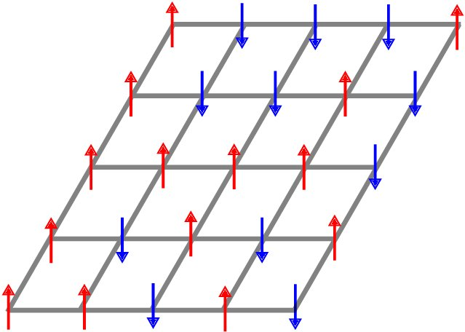

2D Ising Model
where the notation ⟨i j⟩ indicates that sites i and j are adjacent and µ is the external magnetic moment.
Source: Wald, S. S. (2017). Thermalisation and Relaxation of Quantum Systems (Doctoral dissertation, Université de Lorraine).
Notes:
The Ising model is a mathematical model of ferromagnetism in statistical mechanics. The model is composed of discrete variables representing the magnetic dipole moments of the atom's spins that can be in the state +1 or the state -1. In the 2D Ising model, the variables or spins are arranged in a 2D lattice in which each spin interacts with its neighbors. Certain interaction parameters are given between neighboring spins for specifying the interaction relationships of spins. The 2D Ising model can be represented mathematically as follows.
Ising模型中包含了可以用來描述單個原子磁矩(magnetic moment)的參數$\sigma _{i}$ ，其值只能為+1或-1，
Ising 模型是統計力學中鐵磁性的數學模型。這個模型由離散變量組成，這些變量表示原子自旋的磁偶極矩，可以處於狀態 +1 或狀態 -1。在 2D Ising 模型中，變量或自旋排列在 2D 晶格中，其中每個自旋與其相鄰的自旋相互作用。相鄰自旋之間給出了某些相互作用參數，用於指定自旋的相互作用關係。 2D Ising 模型可以用數學方式表示如下。
其中符號⟨ij⟩表示站點 i 和 j 是相鄰的，μ 是外部磁矩。
系統基態對應於哈密頓函數的最小值，該最小值又對應於優化問題的最優解。如果每個晶格點都是一個量子粒子（例如光子或電子），那麼量子退火可以利用量子隧穿效應來加速系統達到基態以獲得問題的最優解
Ising 模型是一個以德國物理學家恩斯特·易辛 (Ernst Ising) 為名的數學模型，它最初被創立是為了用來描述具有規則晶體結構材料的磁性行為。該模型包含了每個晶格上原子的自旋 (spin) 狀態$σ$，分為上旋或下旋；兩兩相鄰的原子彼此間的作用力參數 $J_{i,j}^{}$ ，偏好處在共同自旋向上（向下）或是處在一上一下的狀態；以及外部磁場對該晶格上的自旋狀態施加作用力參數 $h_{i}^{}$，導致其偏向某一個方向。

Slide 9
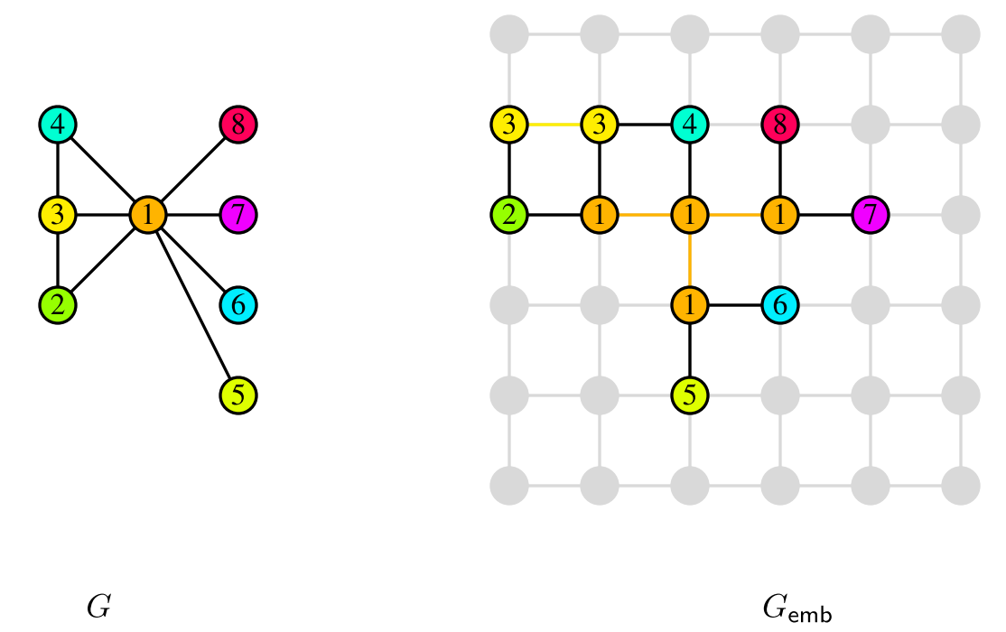
Minor-Embedding
Minor Embedding is to map QUBO into the QPU topology. Larger problems often require chains because the QPU topology is not fully connected.
Source: Choi, V. (2008). Minor-embedding in adiabatic quantum computation: I. The parameter setting problem. Quantum Information Processing, 7(5), 193-209.
Notes:
Chains : Larger problems often require chains because the QPU topology is not fully connected.
Chain Strength : For a chain of qubits to represent a variable, all its constituent qubits must return the same value for a sample. This is accomplished by setting a strong coupling to the edges connecting these qubits.
(鏈：較大的問題通常需要鏈，因為 QPU 拓撲不是完全連接的。
鏈強度：對於表示變量的量子比特鏈，它的所有組成量子比特必須為樣本返回相同的值。 這是通過對連接這些量子位的邊緣設置強耦合來實現的。)
要直接在 D-Wave 系統上解決任意提出的二元二次問題，需要映射到系統量子處理單元 (QPU) 的 QPU 拓撲，稱為minor-embedding次要嵌入。 這種預處理可以通過由 DWaveSampler() 和執行次要嵌入的組合組成的組合採樣器來完成。
三變量全連接問題（左側以圖表形式顯示）嵌入在 D-Wave 2000Q 上的四個量子位中，右側顯示為 Chimera 拓撲。 以深洋紅色突出顯示的變亮，由兩個量子位表示，數字 251 和 253。

Slide 10
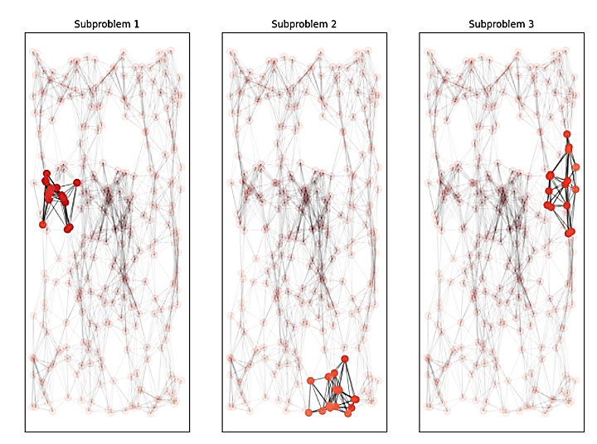
QPU Solvers: Decomposing Large Problems
A problem that is too large to be embedded in its entirety on the QPU is sequentially decomposed into smaller problems, each of which can fit on the QPU, with variables selected by highest impact on energy.
Source: https://docs.dwavesys.com/docs/latest/handbook_decomposing.html?highlight=decomposing
Notes:
有時候複雜的問題變數太多，受限於qubits數，所以對於大問題要使用分解
一個太大而無法完全嵌入 QPU 的問題會被依次分解為更小的問題，每個問題都可以放在 QPU 上，並根據對能量的最大影響選擇變量。
僅由最大能量影響選擇的變量可能不是直接連接的（沒有共享邊），也可能不代表問題的局部結構。配置諸如廣度優先 (BFS) 或優先級優先選擇 (PFS) 之類的遍歷模式可以捕獲表示問題中局部結構的特徵。
/*
由 Ocean 軟件的 EnergyImpactDecomposer 類實現的一種分解方法是選擇對問題能量貢獻最大的變量子問題。
*/

Slide 11
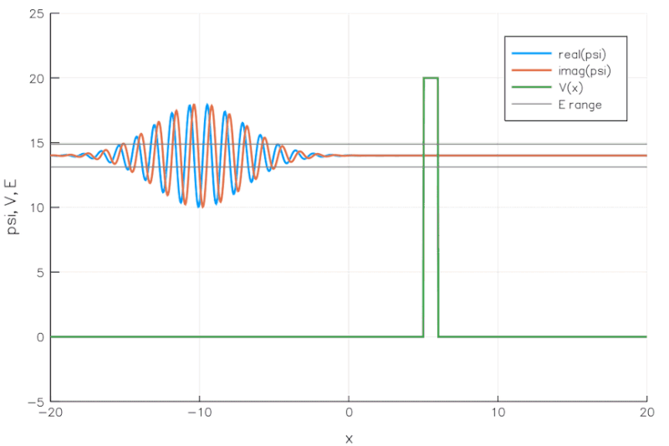
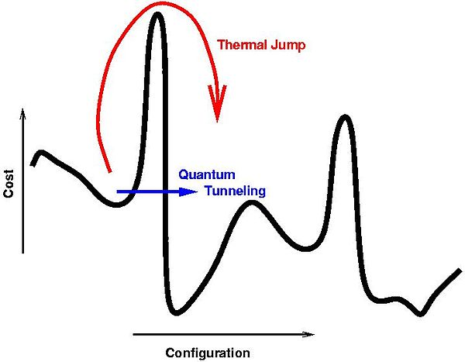
Quantum Tunneling and Quantum Annealing
Quantum tunneling is the quantum mechanical phenomenon where a wavefunction can propagate through a potential barrier.
Everything tends to seek a minimum energy state. Based on quantum tunneling phenomenon, quantum annealing can quickly find low-energy states associated with a problem and therefore the optimal or near-optimal solution to the problem.
source: https://commons.wikimedia.org/wiki/File:E14-V20-B1.gif by Becarlson CC BY-SA 4.0
Notes:
Quantum Tunneling: A simulation of a wave packet incident on a potential barrier according to the Time-Dependent Schrodinger Equation.
加拿大公司 D-Wave 使用稱為“量子退火”的技術開發了專用量子計算設備，通過利用量子穿隧效應找到優化問題的解決方案。
在優化問題中，我們需要從許多可能的組合中尋找最好的組合，物理學可以幫助解決這類問題， 物理學的一個基本規則是，一切都趨向於尋求最小能量狀態因為您可以將它們視為能量最小化問題。 物體滑下山坡； 熱的東西會隨著時間的推移而冷卻。 這種行為在量子物理學領域也是如此。 量子退火只是使用量子物理學來尋找問題的低能狀態，從而找到最佳或接近最佳的元素組合。
量子穿隧
量子穿隧效應屬於量子力學的研究領域，量子力學研究在量子尺度所發生的事件。設想一個運動中的粒子遭遇到一個位能壁壘，試圖從位能壁壘的一邊（區域 A）移動到另一邊（區域 C），這可以被類比為一個圓球試圖滾動過一座小山。量子力學與古典力學對於這問題給出不同的解答。古典力學預測，假若粒子所具有的能量低於位能壁壘的位能，則這粒子絕對無法從區域 A移動到區域 C。量子力學不同地預測，這粒子可以機率性地從區域 A穿越到區域 C。

Slide 12
Outline
D-Wave Quantum Annealer (QAs)
NP-hard Problems
Examples of Solving NP-hard Problems with QAs
QUBO Formula Classification
Conclusion

Slide 13
Problem Classification
NP
NP-hard
P
NP-complete
P: the class of problems which can be solved by a deterministic polynomial (time-complexity) algorithm.
NP : the class of problems which can be solved by a non-deterministic polynomial (time-complexity) algorithm.
NP-hard: the class of problems to which every NP problem reduces.
NP-complete (NPC): the class of problems which are NP-hard and belong to NP.

Slide 14
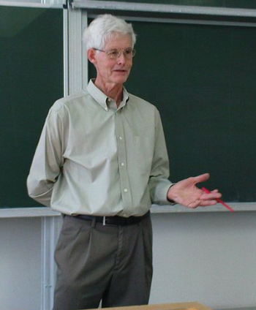
Cook’s Theorem (1971)
NP = P iff SAT ∈ P
That is, NP = P iff the satisfiability (SAT) problem is a P problem
SAT is NP-complete
It is the first NP-complete problem
Every NP problem reduces to SAT
Stephen Arthur Cook
(1939~, Distinguished Prof. of University of Toronto,
1982 Turing Award)
(source: https://en.wikipedia.org/wiki/Stephen_Cook
by Jiří Janíček CC BY-SA 3.0)

Slide 15
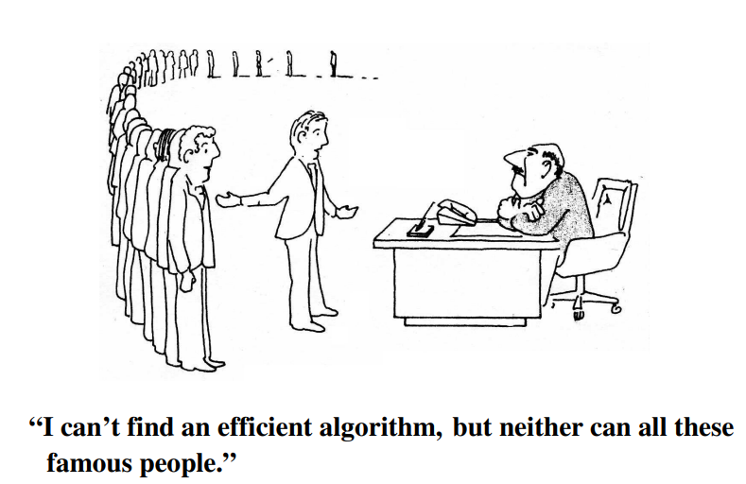
NP-hard Problems and NPC Problems
Source: M. R. Garey and D. S. Johnson. Computers and Intractability: A Guide to the Theory of NP-completeness. W. H. Freeman, New York, 1979.

Slide 16
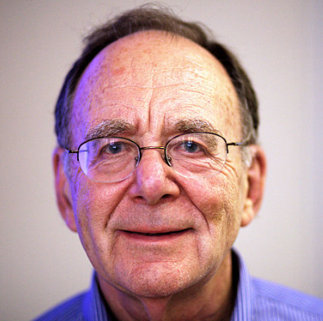
Karp's 21 NPC/NP-hard problems
SAT
Maximum-Cut
Directed Hamiltonian Circuit
Undirected Hamiltonian Circuit
Knapsack
Job sequencing
Partition
3-Dimensional Matching
Steiner Tree
Hitting Set
Clique
Exact Cover
Clique Cover
Graph Coloring Problem
3-SAT
Feedback Arc Set
Feedback Node Set
Set Covering
Vertex Cover
Set Packing
0-1 Integer Programming
Richard Manning Karp
(1935~ , Prof. UC Berkeley
Turing Award Winner,1985)
(Source: https://en.wikipedia.org/wiki/Richard_M._Karp By Rama CC BY-SA 2.0 fr)

Slide 17
Outline
D-Wave Quantum Annealer (QAs)
NP-hard Problems
Examples of Solving NP-hard Problems with QAs
QUBO Formula Classification
Conclusion

Slide 18
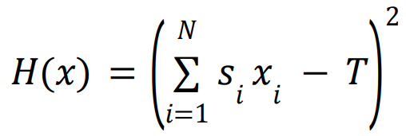
Subset Sum Problem (SS)
Given a set 𝑆 = {𝑠₁, 𝑠₂, . . . . , 𝑠_{𝑁} } with N integers, and a target integer T, the subset sum (SS) problem is to find a subset S’ of S such that the sum of the integers in the subset S’ is exactly T.
The QA algorithm solving the SS problem has the following QUBO formula:
S = {-7,4,12,5,2}, T = 9 ⇒ Yes, there is an answer.
4
-7
5
12
2

Slide 19
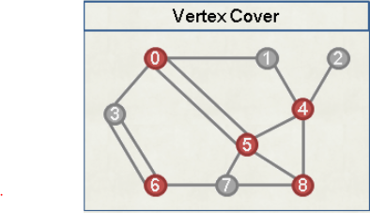
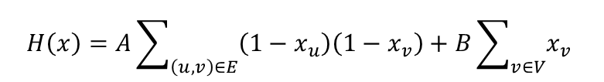
Vertex Cover (VC)
Given an undirected graph G=(V, E) with the vertex set V and the edge set E, the vertex cover (VC) problem is to find a minimum-size subset V’ of V, such that for every edge (u, v) in E, either u or v is in V’.
The QA algorithm solving the VC problem has the following QUBO formula:
$$H\left(x\right)=A\sum_{\left(u,v\right)∈E}{\left(1−x_{u}\right)\left(1−x_{v}\right)}+B\sum_{v∈V}{x_{v}}$$

Slide 20
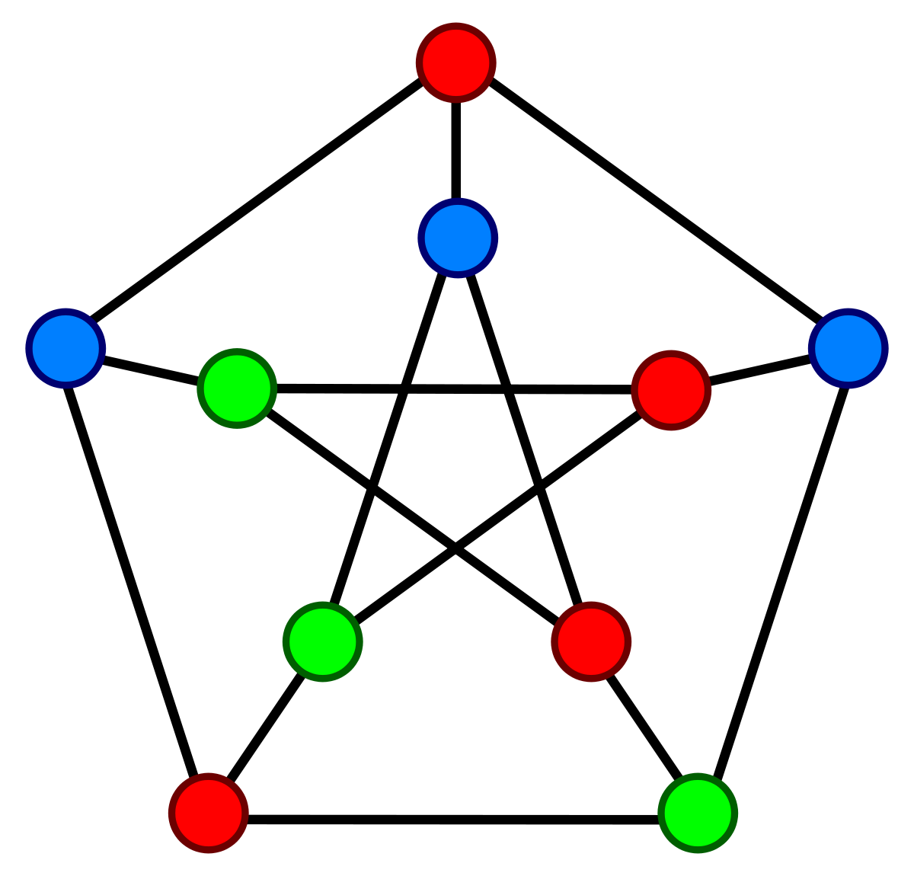
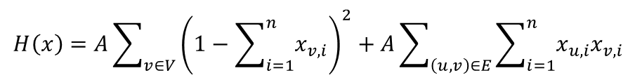
Graph Coloring (GC)
Given a chromatic number n, and an undirected graph G=(V, E) with the vertex set V and the edge set E, the graph coloring (GC) problem is to decide if it is possible to color all vertices in V such that for every edge (u, v) in E, u and v have different colors
The QA algorithm solving the GC problem has the following QUBO formula:
$$H\left(x\right)=A\sum_{v∈V}{{\left(1−\sum_{i=1}^{n}{x_{v,i}}\right)}^{2}}+A\sum_{\left(u,v\right)∈E}{\sum_{i=1}^{n}{x_{u,i}x_{v,i} }}$$

Slide 21
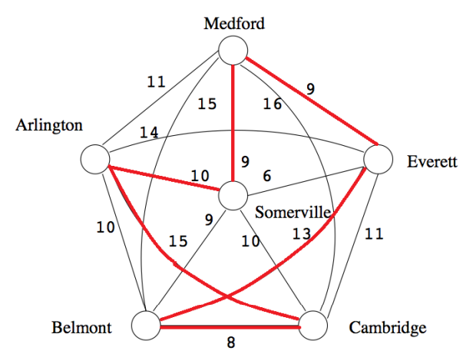
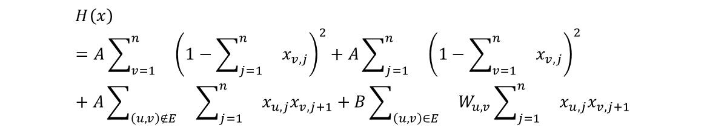
Traveling Salesman Problem (TSP)
Given a directed graph G=(V, E) with the vertex set V of n vertices and the edge set E, the TSP is to find a tour that first visits an arbitrary vertex v, then sequentially visits vertex exactly once, and at last visits vertex v, such that the sum of weights of edges included in the tour is minimized.
The QA algorithm solving the TSP has the following QUBO formula
$$H\left(x\right)=A\sum_{v=1}^{n}{}{\left(1−\sum_{j=1}^{n}{}x_{v,j}\right)}^{2}+A\sum_{j=1}^{n}{}{\left(1−\sum_{v=1}^{n}{}x_{v,j}\right)}^{2}+A\sum_{\left(u,v\right)∉E}{}\sum_{j=1}^{n}{}x_{u,j}x_{v,j+1}+B\sum_{\left(u, v\right)∈E}{}W_{u,v}\sum_{j=1}^{n}{}x_{u,j}x_{v,j+1}$$

Slide 22
Outline
D-Wave Quantum Annealer (QAs)
NP-hard Problems
Examples of Solving NP-hard Problems with QAs
QUBO Formula Classification
Conclusion

Slide 23
QUBO Formula Classification
Classification criterion 1 (CC1): Does the number of variables in the QUBO formula scale linearly with the input size of the problem ?
Classification criterion 2 (CC2): Does QUBO contain only optimization terms or only constraint terms?
CC1 CC2 | Yes | No
Yes | Category 1 (e.g. the QUBO formula for the SS problem) | Category 3 (e.g. the QUBO formula for the GC problem)
No | Category 2 (e.g. the QUBO formula for the VC problem) | Category 4 (e.g. the QUBO formula for the TSP)

Slide 24
Performance Comparisons of Algorithms Solving the SS Problem
SS Prob. | p01 | p02 | p03 | p04 | p05 | p06 | p07
CA-Sol | Y | Y | N | Y | Y | Y | Y
QAA-Sol | Y⁼ | Y⁼ | N⁼ | Y⁼ | Y⁼ | Y⁼ | Y⁼
CA-Time | 0.024 | 3.463 | 123.466 | 0.029 | 0.051 | 0.008 | 0.027
QAA-AT | 0.093< | 0.117> | 0.952> | 0.134< | 0.097< | 0.065< | 0.118<
QAA-QPUT | 0.077< | 0.031> | 0.323> | 0.066< | 0.057< | 0.051< | 0.081>
Red: Better than classical
Blue: Equal to classical
Green: Worse than classical

Slide 25
Performance Comparisons of Algorithms Solving the VC Problem
VC Prob. | p-hat300-1 | keller4 | brock400-2 | keller5 | DSJC500.5 | C1000.9 | keller6
CA-Sol | 292 | 160 | 371 | 745 | 487 | 932 | 3298
QAA-Sol | 292⁼ | 160⁼ | 371⁼ | 749< | 487⁼ | 932⁼ | 3305<
CA-Time | 0.560 | 0.006 | 0.935 | 2.380 | 177.790 | 0.498 | 186.540
QAA-AT | 53< | 37.22< | 34.13< | 49.2< | 47.797> | 20.756< | 171.7>
QAA-QPUT | 0.126> | 0.117 | 0.121> | 0.213> | 0.178> | 0.107> | 0.268>
Red: Better than classical
Blue: Equal to classical
Green: Worse than classical

Slide 26
Performance Comparisons of Algorithms Solving the GC Problem
GC Prob. | R125.1 | DSJC125.1 | DSJC125.5 | R250.1 | DSJC250.1 | DSJC250.5 | DSJC500.1 | le450_15d
CA-Sol | Y | Y | Y | Y | Y | Y | Y | Y
QAA-Sol | Y⁼ | Y⁼ | N< | Y⁼ | Y⁼ | N< | N< | N<
CA-Time | 0.001 | 0.029 | 0.143 | 0.002 | 0.017 | 10.9 | 720.3 | 983
QAA-AT | 15.647< | 14.577< | 47.199< | 19.054< | 30.11< | 47.199< | 139.687> | 238.58>
QAA-QPUT | 0.117< | 0.118< | 0.184< | 0.116< | 0.184< | 0.194> | 0.31> | 0.38>
Red: Better than classical
Blue: Equal to classical
Green: Worse than classical

Slide 27
Performance Comparisons of Algorithms Solving the TSP Problem
TSP Prob. | br17 | ftv33 | ftv35 | gr17 | gr21 | p43 | ry48p | kro124p
CA-Sol | 39 | 1355 | 1584 | 2085 | 2707 | 5635 | 14682 | 41232
QAA-Sol | 39⁼ | 1686< | 1990< | 2123< | 2909< | 5679< | 17883< | 105918<
CA-Time | 0.027 | 0.194 | 0.166 | 0.055 | 0.06 | 0.15 | 0.261 | 1.666
QAA-AT | 35.3< | 119.9< | 128.8< | 61.0< | 90.3< | 70.6< | 130.7< | 421.1<
QAA-QPUT | 0.121< | 0.173> | 0.121> | 0.213< | 0.198< | 0.243< | 0.244> | 0.476>
Red: Better than classical
Blue: Equal to classical
Green: Worse than classical

Slide 28
Outline
D-Wave Quantum Annealers (QAs)
NP-hard Problems
Examples of Solving NP-hard Problems with QAs
QUBO Formula Classification
Conclusion

Slide 29
Conclusion (1)
The D-Wave QA is used to solve NP-hard problems, namely the SS problem, the VC problem, the GC problem, and the TSP, by using QUBO formulas.
The results show that using quantum annealing algorithms to solve NP-hard problems is competitive in terms of the quality of the solution and the time to the solution.
Publication:
Jehn-Ruey Jiang, and Chun-Wei Chu, "Solving NP-hard Problems with Quantum Annealing," presented at IEEE Eurasia Conference on IOT, Communication and Engineering (IEEE ECICE 2022), Oct. 2022.

Slide 30
Conclusion (2)
The QUBO formulas used are classified into four categories according to two classification criteria:
        Classification criterion 1 (CC1):
        Does the number of QUBO variables scale linearly with the input size of the problem?
Classification criterion 2 (CC2):
Does the QUBO formula contain only optimization terms or only constraint terms?
The number of QUBO variables and couplers has the most significant impacts on performance.
Two types of terms can be assigned with different weights.
Ref: Ayodele, M. (2022). Penalty Weights in QUBO Formulations: Permutation Problems. In European Conference on Evolutionary Computation in Combinatorial Optimization (Part of EvoStar) (pp. 159-174). Springer, Cham.

Slide 31
Conclusion (3)
In the future, we plan to apply the QUBU formulas to develop algorithms for different machines that are similar to the quantum annealer, such as the digital annealer (DA) and the coherent Ising machine (CIM), to see if the DA or the CIM can obtain results with better performance with the help of QUBO formulas.

Slide 32
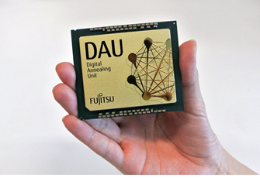
Fujitsu Digital Annealer Unit with 100k fully coupled emulated qubits
Source: Fujitsu.com
Notes:
Tohoku U. uses FPGA to simulate qubits of QA.
東北大学／とうほくだいがく Tōhoku daigaku；英語：Tohoku University），簡稱「東北大」，是一所本部位於日本東北地區宮城縣仙台市的公立研究型綜合大學，
Tohoku University目前(2022/12月)有70人做D-Wave量子退火，有一個startup company與一個中心，20~30人做FPGA數位退火，還有許多benchmark。

Slide 33
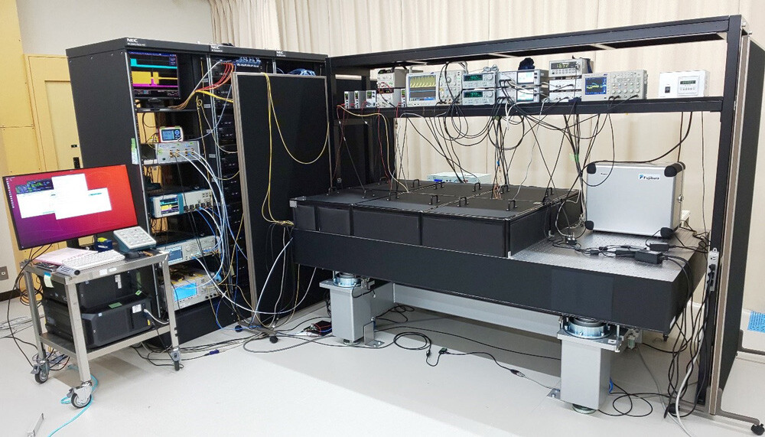
NTT 100,000-spin coherent Ising machine
Source: https://group.ntt/en/newsrelease/2021/09/30/210930a.html

Slide 34
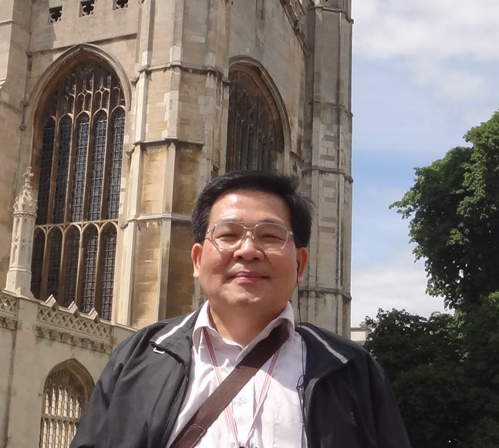
Q&A
Jehn-Ruey Jiang (江振瑞）
Email: jrjiang@g.ncu.edu.tw
Web: https://staff.csie.ncu.edu.tw/jrjiang/

Slide 35
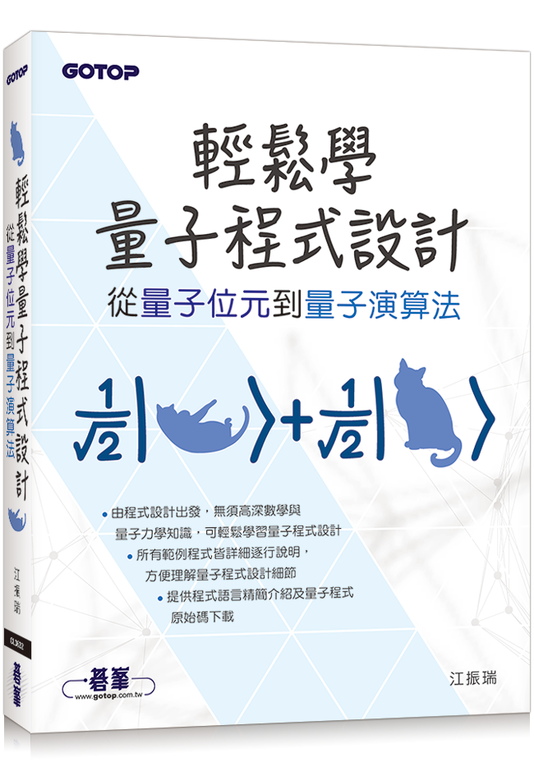
Easy to Learn Quantum Programming --
From Quantum Bit to Quantum Algorithm
My book published in August 2022.
ISBN: 9786263242715
You can buy the book via:
  https://www.books.com.tw/products/0010933217?sloc=main

