Slide 1
Solving NP-hard Problems with Quantum Annealing
By Jehn-Ruey Jiang (江振瑞) and Chun-Wei Chu (朱俊瑋)
ACAN Laboratory
CSIE Department
National Central University
Notes:
量子退火 : 找到哪一種狀態的qubits放入hamiltonian後會呈現最小值
coupler範圍大小(實際機器)
Ans:從編程方面來看，這些值可以設置為雙精度浮點數。
因為您使用 QUBO 作為輸入（即 Vartype.BINARY），所以偏差與 ising 偏差並不完全一致。
當問題被轉換為 QPU 的原生格式時，它們最終處於可接受的值範圍內。
等比例縮放
不同機器有不同的coupler值和bias值大小 advantage4.1 h_range(bias)[-4~4] j_range(coupler)[-1~1]
Chain strength
強度設置為等於對角線（或線性）偏差的最大絕對值。
對於具有各種線性和二次係數值的問題，過大的鏈強度會降低問題的定義。
建議檢查整個矩陣的最大絕對值，因為線性或二次偏差會導致斷鍊。這是一個簡單的三變量示例來演示。在這裡，我們將鏈
線性係數表示量子比特偏差，二次係數表示耦合器強度
sample

Slide 2
Outline
What are NP-hard Problems?
What is Quantum Annealing (QA)?
How to Solve NP-hard Problems with QA?
Examples of Solving NP-Hard Problems with QA
Conclusion

Slide 3
Outline
What are NP-hard Problems?
What is Quantum Annealing (QA)?
How to Solve NP-hard Problems with QA?
Examples of Solving NP-Hard Problems with QA
Conclusion

Slide 4
Problem Classification
NP
NP-hard
P
NP-complete
P: the class of problems which can be solved by a deterministic polynomial (time-complexity) algorithm.
NP : the class of problems which can be solved by a non-deterministic polynomial (time-complexity) algorithm.
NP-hard: the class of problems to which every NP problem reduces.
NP-complete (NPC): the class of problems which are NP-hard and belong to NP.

Slide 5
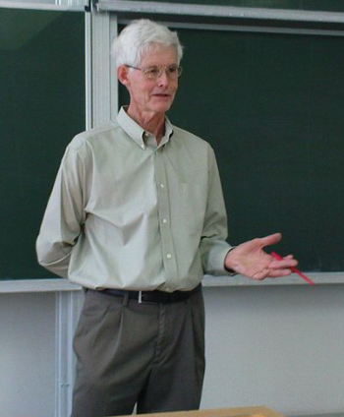
Cook’s Theorem (1971)
NP = P iff SAT ∈ P
That is, NP = P iff the satisfiability (SAT) problem is a P problem
SAT is NP-complete
It is the first NP-complete problem
Every NP problem reduces to SAT
Stephen Arthur Cook
(1939~, Distinguished Prof. of University of Toronto,
1982 Turing Award)
(source: https://en.wikipedia.org/wiki/Stephen_Cook
by Jiří Janíček CC BY-SA 3.0)
Notes:
Cook received his bachelor's degree in 1961 from the University of Michigan, and his master's degree and Ph.D. from Harvard University, respectively in 1962 and 1966, from the Mathematics Department.^{[2]} He joined the University of California, Berkeley, mathematics department in 1966 as an assistant professor, and stayed there until 1970 when he was denied reappointment.
In a speech celebrating the 30th anniversary of the Berkeley electrical engineering and computer sciences department, fellow Turing Award winner and Berkeley professor Richard Karp said that, "It is to our everlasting shame that we were unable to persuade the math department to give him tenure."^{[3]} Cook joined the faculty of the University of Toronto, Computer Science and Mathematics Departments in 1970 as an associate professor, where he was promoted to professor in 1975 and Distinguished Professor in 1985.
In his seminal 1971 paper "The Complexity of Theorem Proving Procedures",^{[4][5]} Cook formalized the notions of polynomial-time reduction (also known as Cook reduction) and NP-completeness, and proved the existence of an NP-complete problem by showing that the Boolean satisfiability problem (usually known as SAT) is NP-complete. This theorem was proven independently by Leonid Levin in the Soviet Union, and has thus been given the name the Cook–Levin theorem.
In 1982, Cook received the Turing Award for his contributions to complexity theory. His citation reads:
For his advancement of our understanding of the complexity of computation in a significant and profound way. His seminal paper, The Complexity of Theorem Proving Procedures, presented at the 1971 ACM SIGACT Symposium on the Theory of Computing, laid the foundations for the theory of NP-Completeness. The ensuing exploration of the boundaries and nature of NP-complete class of problems has been one of the most active and important research activities in computer science for the last decade.

Slide 6
The satisfiability (SAT) problem
Def: Given a Boolean formula, determine whether this formula is satisfiable or not.
  A literal (Boolean variable): x_{i} or -x_{i}
  A clause (disjunction of variables): c_{i} ≡ x₁ v x₂ v -x₃
  A formula : conjunctive normal form: c₁& c₂ & … & c_{m}
Eg: Given
f = x₁ v x₂ v x₃
& - x₁
& - x₂,
determine if f is satisfiable
Sol: f is satisfiable, as the assignment (-x₁, -x₂ , x₃) makes
f true, where (-x₁, -x₂ , x₃) represents x₁ ← F , x₂ ← F , x₃ ← T

Slide 7
Non-deterministic Algorithms (NDAs) (1)
A non-deterministic algorithm (NDA) is different form a deterministic algorithm (DA).
  An NDA consists of two phases:
    choosing (for selecting a choice)
    checking (for returning SUCCESS or FAILURE)
  An NDA is assumed to always make a correct choice for returning SUCCESS, if it is possible.

Slide 8
Nondeterministic Algorithms (NDAs) (2)
Machines for running NDAs do not exist currently and may never exist in reality.
  They can only be made by allowing unbounded parallelism in computation.
  Quantum computation may be an approximation.
NDAs are useful only because they help us define a class of problems: NP problems.
  A problem is called an NP problem if it can be solved by a non-deterministic polynomial algorithm, i.e., an NDA with a polynomial time complexity.

Slide 9
Nondeterministic Polynomial (NP) Algorithm Example
Algorithm: ND-SAT
input: a Boolean formula f(x₁,…,x_{n}) of n variables x₁,…,x_{n}
output: SUCCESS if f is satisfiable; FAILURE, otherwise.
for i ← 1 to n do
x_{i} ← choice(F, T) //guessing to set x_{i}
if f(x₁,…,x_{n})==True then return SUCCESS /* checking
else return FAILURE
The algorithm is an NDA. It always makes a correct choice for returning SUCCESS, if it is possible. It returns FAILURE iff there exists no choice leading to a return of SUCCESS.
The time complexity of the algorithm is polynomial, it is thus a non-deterministic polynomial (NP) algorithm. The SAT problem is thus an NP problem.

Slide 10
Facts about the SAT problem
Dr. Cook proved that every NP problem reduces to SAT. By definition, SAT is NP-hard.
Since SAT is also an NP problem, it is NP-complete (NPC) by definition.
SAT is the first NP-hard and the first NPC problem.
If SAT can be solved in polynomial time complexity by a DA, then so do any NP problem.
Notes:
一人得道雞犬升天
When one becomes an immortal, his chickens and dogs all fly to heaven.

Slide 11
A Nondeterministic Polynomial Algorithm Example: Unstructured Search Decision Algorithm (USDA)
Algorithm USDA
input: a array S of n numbers and a target number x to be found in S
output: SUCCESS if x is found; FAILURE, otherwise.
i ← choice(0..n-1) //guessing an index i of S between 0 and n-1
if S[i]== x then return SUCCESS /* checking
else return FAILURE
A nondeterministic algorithm return FAILURE iff there exist no choice leading to a return of SUCCESS.
The time required for choice(0..n-1) is O(1) in an ND algorithm instead of O(n) in a D algorithm.
Notes:
If the checking stage of a nondeterministic algorithm is of polynomial time-complexity, then this algorithm is called an NP (nondeterministic polynomial) algorithm.

Slide 12
Problem Reduction (Transformation)
Problem A polynomially reduces to problem B (A∝B) iff A can be solved by using an algorithm which solves B.
  Transform polynomially the instance of A’s input into the instance of B’s input.
  Obtain the solution of B.
  Transform polynomially B’s solution into the form of A’s solution.
If A∝B, B is more difficult. This is because if B is solved, then
A is solved, but not vice versa.

Slide 13
NP-hardness Proofs by Problem Reduction
Every NP problem
SAT
Clique
3-SAT
Vertex Cover
Chromatic Number
…
Dominating Set
…

Slide 14
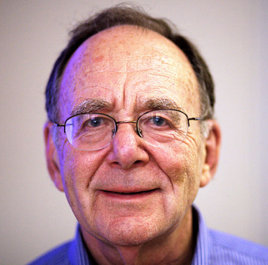
Karp's 21 NPC/NP-hard problems
SAT
Maximum-Cut
Directed Hamiltonian Circuit
Undirected Hamiltonian Circuit
Knapsack
Job sequencing
Partition
3-Dimensional Matching
Steiner Tree
Hitting Set
Clique
Exact Cover
Clique Cover
Graph Coloring Problem
3-SAT
Feedback Arc Set
Feedback Node Set
Set Covering
Vertex Cover
Set Packing
0-1 Integer Programming
Richard Manning Karp
(1935~ , Prof. UC Berkeley
Turing Award Winner,1985)
(Source: https://en.wikipedia.org/wiki/Richard_M._Karp By Rama CC BY-SA 2.0 fr)

Slide 15
Computation Model Classification
Computing
Quantum Computing
Classical Computing
Universal Quantum Computing
(e.g., IBM Q)
Quantum Annealing
(e.g., D-Wave QA)
Quantum-inspired Computing
Neuromorphic Computing
HPC, ...
Digital Annealing
(e.g., Fujitsu DA)
Universal QC Simulator

Slide 16
Outline
What are NP-hard Problems?
What is Quantum Annealing (QA)?
How to Solve NP-hard Problems with QA?
Examples of Solving NP-Hard Problems with QA
Conclusion

Slide 17
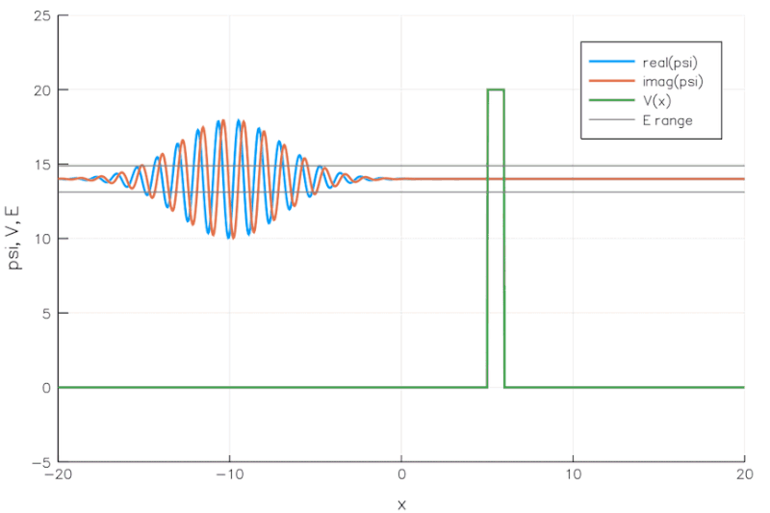
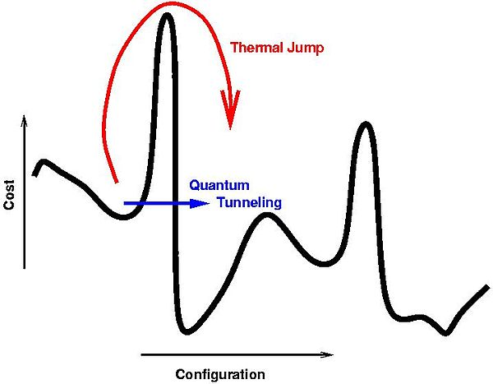
Quantum Annealing (QA)
Quantum annealing (QA) is an optimization process for finding the global minimum of a given objective function over a given set of candidate solutions (candidate states) by leveraging the effect of quantum tunneling.
  Quantum tunneling is the quantum mechanical phenomenon where a wavefunction can propagate through a potential barrier.
A fundamental rule of physics is that everything tends to seek a minimum energy state. Objects slide down hills; hot things cool down over time. This behavior is also true in the world of quantum physics. Quantum annealing simply uses quantum physics to find low-energy states of a problem and therefore the optimal or near-optimal combination of elements.
Quantum Tunneling: A simulation of a wave packet incident on a potential barrier according to the Time-Dependent Schrodinger Equation.
(source: https://commons.wikimedia.org/wiki/File:E14-V20-B1.gif by Becarlson CC BY-SA 4.0)
Notes:
加拿大公司 D-Wave 使用稱為“量子退火”的技術開發了專用量子計算設備，通過利用量子穿隧效應找到優化問題的解決方案。
在優化問題中，我們需要從許多可能的組合中尋找最好的組合，物理學可以幫助解決這類問題， 物理學的一個基本規則是，一切都趨向於尋求最小能量狀態因為您可以將它們視為能量最小化問題。 物體滑下山坡； 熱的東西會隨著時間的推移而冷卻。 這種行為在量子物理學領域也是如此。 量子退火只是使用量子物理學來尋找問題的低能狀態，從而找到最佳或接近最佳的元素組合。
量子穿隧
量子穿隧效應屬於量子力學的研究領域，量子力學研究在量子尺度所發生的事件。設想一個運動中的粒子遭遇到一個位能壁壘，試圖從位能壁壘的一邊（區域 A）移動到另一邊（區域 C），這可以被類比為一個圓球試圖滾動過一座小山。量子力學與古典力學對於這問題給出不同的解答。古典力學預測，假若粒子所具有的能量低於位能壁壘的位能，則這粒子絕對無法從區域 A移動到區域 C。量子力學不同地預測，這粒子可以機率性地從區域 A穿越到區域 C。

Slide 18
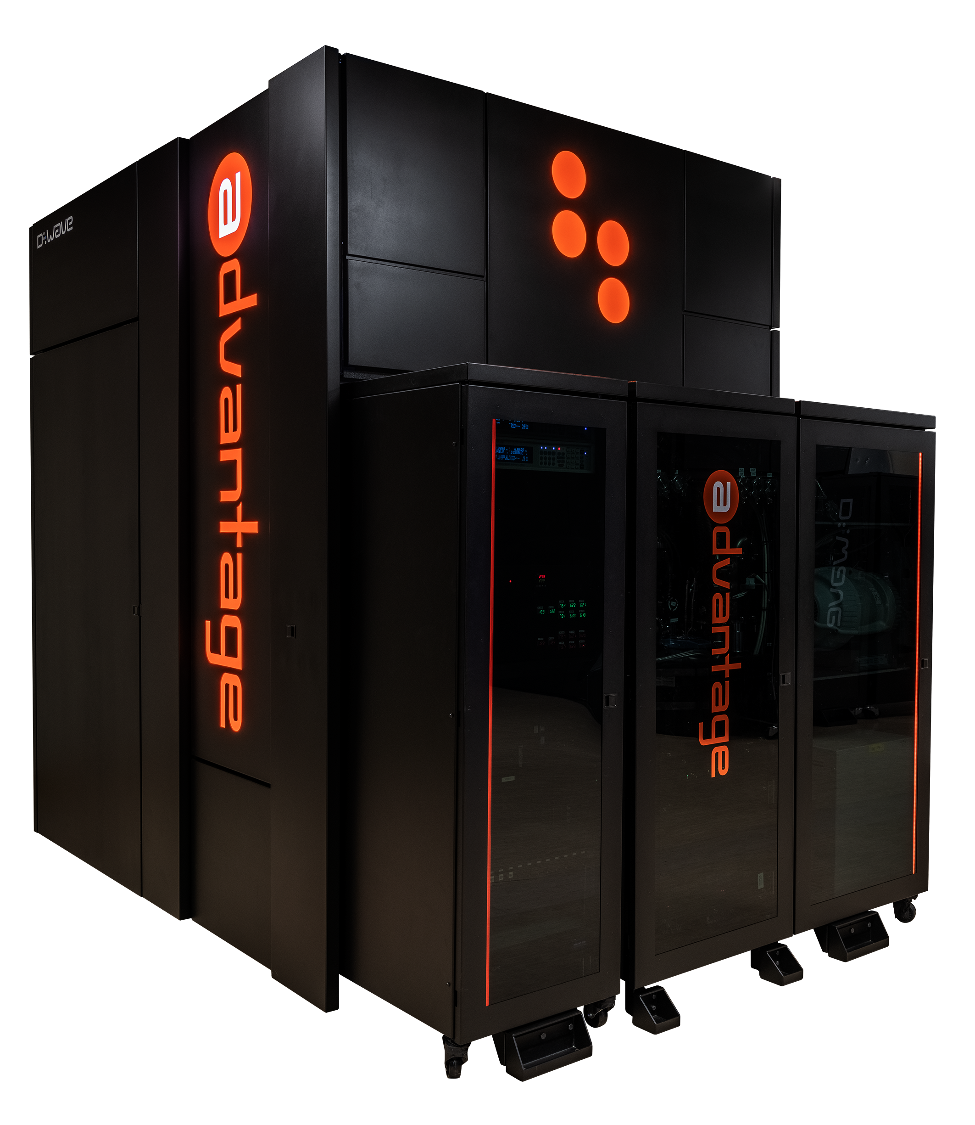
D-Wave Quantum Annealer
D-Wave Systems Inc. is a Canadian company founded in 1999.
D-Wave produced quantum annealers or quantum samplers for solving optimization problems using the concept of quantum annealing.
The company designed their first qubit by using d-wave superconductors.
D-Wave quantum annealer history:
  2007: Orion Prototype
  2011: D-Wave One (127 qubits; 352 couplers)
  2013: D-Wave Two (512 qubits; 1472 couplers)
  2015: D-Wave 2X (1152 qubits; 3360 couplers)
  2017: D-Wave 2000Q (2048 qubits; 6016 couplers; Chimera topology)
  2020: D-Wave Advantage (5640 qubits; 40484 couplers; Pegasus topology)
D-Wave Advantage
(source: https://www.dwavesys.com/solutions-and-products/systems/)
Notes:
The company name refers to their first qubit designs, which used d-wave superconductors.
Orion
[o`raIən; əˋraiən]
1 ‘天文’獵戶座
2 ‘希臘神話’歐來恩
(英俊的獵人)
chimera
[kə`mIrə, kaI-; kaiˋmiərə]
1 [C~]‘希臘神話’吐火獸
(獅頭、羊身、蛇尾的吐火怪獸)
Pegasus
[ˋpєgəsəs]
飛馬

Slide 19
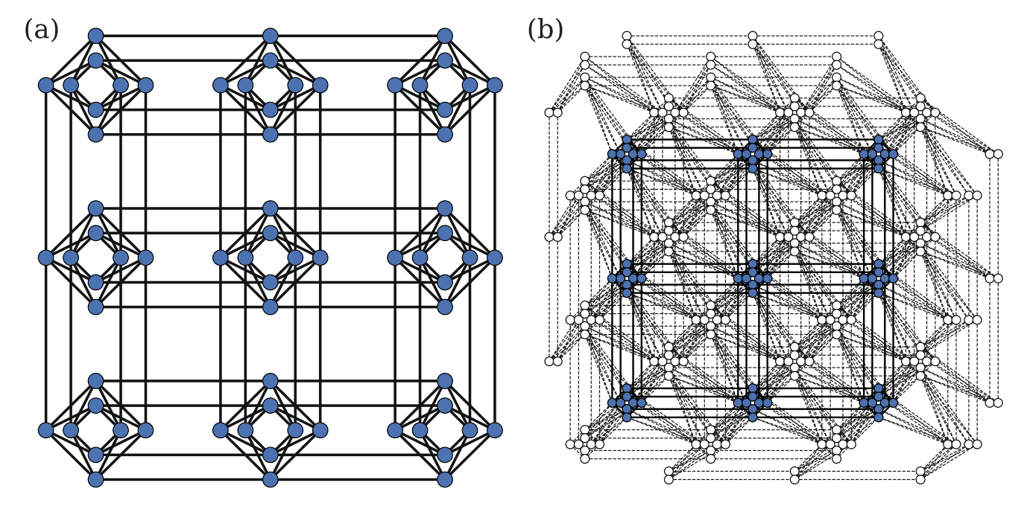
D-Wave QPU and Topology
The D-Wave quantum processing unit (QPU) is a lattice of interconnected qubits. Since some qubits connect to others via some couplers, the D-Wave QPU is not fully connected.
(a) Chimera of D-Wave 2000Q (b) Pegasus of D-Wave Advantage
Source: Gonzalez Calaza, C. D., Willsch, D., & Michielsen, K. (2021). Garden optimization problems for benchmarking quantum annealers. Quantum Information Processing, 20(9), 1-22.
Notes:
D-Wave 量子處理單元 (QPU) 是互連的量子位點陣。雖然一些量子位通過耦合器連接到其他量子位，但 D-Wave QPU 並未完全連接。相反，D-Wave 2000Q 和更早幾代 QPU 的量子比特在稱為Chimera的拓撲中互連，而 Advantage QPU 則包含Pegasus拓撲。
每個 D-Wave 2000Q QPU 都採用 Chimera 拓撲結構中的 2048 個量子位和 6016 個耦合器製造。
內部耦合器:Chimera 拓撲具有四個水平量子位耦合到四個垂直量子位的重複結構K4,4二部圖，稱為 單位單元
外部耦合器:外部耦合器連接共線的量子比特對——同一行或列中的平行量子比特
Advantage採pegasus量子比特的數量增加到超過 5000 個，將耦合器的數量增加到超過 35000 個
飛馬耦合器(degree15每個量子位具有 15 的度數（每個量子位連接到 15 個其他量子位）
(淺綠色代表Chimera unit cell K4,4)
每個量子位通過內部耦合連接到其他 12 個量子位。(綠色)
外部耦合器將垂直量子位連接到相鄰的垂直量子位，將水平量子位連接到相鄰的水平量子位(藍色)
奇數耦合器連接類似對齊的量子比特(紅色:綠色垂直量子位通過奇數耦合器偶河道紅色垂直量子位)

Slide 20
Outline
What are NP-hard Problems?
What is Quantum Annealing (QA)?
How to Solve NP-hard Problems with QA?
Examples of Solving NP-Hard Problems with QA
Conclusion

Slide 21
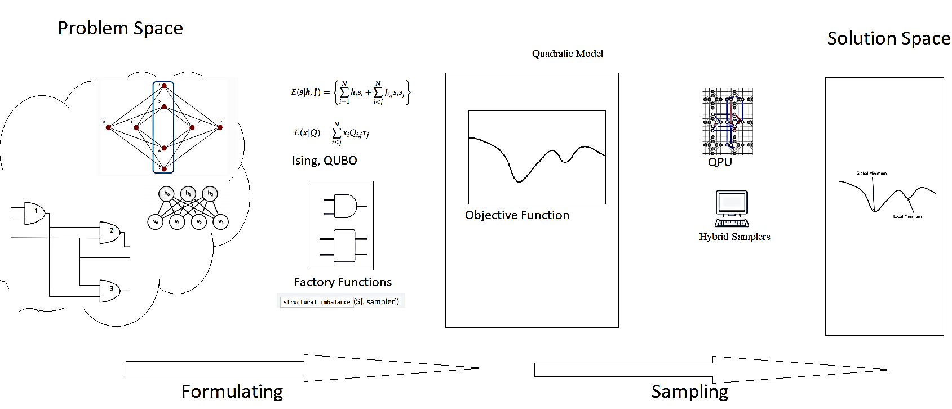
Problem Solving Workflow
Formulate the problem as an objective function, usually in 2D Ising or QUBO format.
Map QUBO to the QPU topology (minor embedding).
QPU uses quantum annealing to seek the minimum of the resulting energy landscape, which corresponds to the solution to the problem.
Source: https://docs.ocean.dwavesys.com/en/stable/overview/solving_problems.html
Notes:
要用量子採樣器解決問題，您可以將問題表述為目標函數，通常採用 Ising 或 QUBO 格式。 目標函數的低能量狀態代表了問題的良好解決方案。 因為您可以將目標函數表示為圖形，所以您可以將其映射到 QPU： 線性係數映射到量子比特偏差，二次係數映射到耦合器強度。 QPU 使用量子退火來尋找所產生的能量景觀的最小值，這對應於您的問題的解決方案。
1.Formulate your problem as an objective function
目標（成本）函數是待優化問題的數學表達式；對於量子計算，這些是二次模型1，它們具有最低值（能量），可以很好地解決它們所代表的問題。
2.Find good solutions by sampling
採樣器是從目標函數的低能量狀態中採樣的過程。通過將您的二次模型提交給 Ocean 的各種量子、經典和混合量子經典採樣器之一，找到好的解決方案。

Slide 22
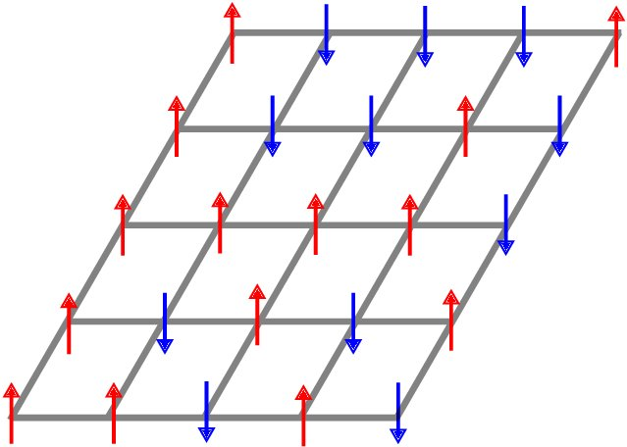

2D Ising Model
where the notation ⟨i j⟩ indicates that sites i and j are adjacent and µ is the external magnetic moment.
Source: Wald, S. S. (2017). Thermalisation and Relaxation of Quantum Systems (Doctoral dissertation, Université de Lorraine).
Notes:
The Ising model is a mathematical model of ferromagnetism in statistical mechanics. The model is composed of discrete variables representing the magnetic dipole moments of the atom's spins that can be in the state +1 or the state -1. In the 2D Ising model, the variables or spins are arranged in a 2D lattice in which each spin interacts with its neighbors. Certain interaction parameters are given between neighboring spins for specifying the interaction relationships of spins. The 2D Ising model can be represented mathematically as follows.
Ising模型中包含了可以用來描述單個原子磁矩(magnetic moment)的參數$\sigma _{i}$ ，其值只能為+1或-1，
Ising 模型是統計力學中鐵磁性的數學模型。這個模型由離散變量組成，這些變量表示原子自旋的磁偶極矩，可以處於狀態 +1 或狀態 -1。在 2D Ising 模型中，變量或自旋排列在 2D 晶格中，其中每個自旋與其相鄰的自旋相互作用。相鄰自旋之間給出了某些相互作用參數，用於指定自旋的相互作用關係。 2D Ising 模型可以用數學方式表示如下。
其中符號⟨ij⟩表示站點 i 和 j 是相鄰的，μ 是外部磁矩。
系統基態對應於哈密頓函數的最小值，該最小值又對應於優化問題的最優解。如果每個晶格點都是一個量子粒子（例如光子或電子），那麼量子退火可以利用量子隧穿效應來加速系統達到基態以獲得問題的最優解

Slide 23

QUBO
Quadratic Unconstrained Binary Optimization (QUBO) problems are traditionally used in computer science, with variables taking values 1 (TRUE) and 0 (FALSE).
In the above equation, the terms Q_{i,i} are the linear coefficients, and terms Q_{i,j} are the quadratic coefficients.
The conversion between Ising model and QUBO is trivial.
Notes:
二次無約束二元優化問題傳統上用於計算機科學，變量取值為 1 (TRUE) 和 0 (FALSE)。 QUBO 問題是使用上對角矩陣 Q 定義的，Q 是一個 N x N 實係數上三角矩陣，以及 x，一個二元變量向量，作為最小化函數：
其中對角項 Qi,i 是線性係數，非零非對角項 Qi,j 是二次係數。 這可以更簡潔地表示為：
Ising 模型和 QUBO 之間的轉換是顯而易見的。

Slide 24
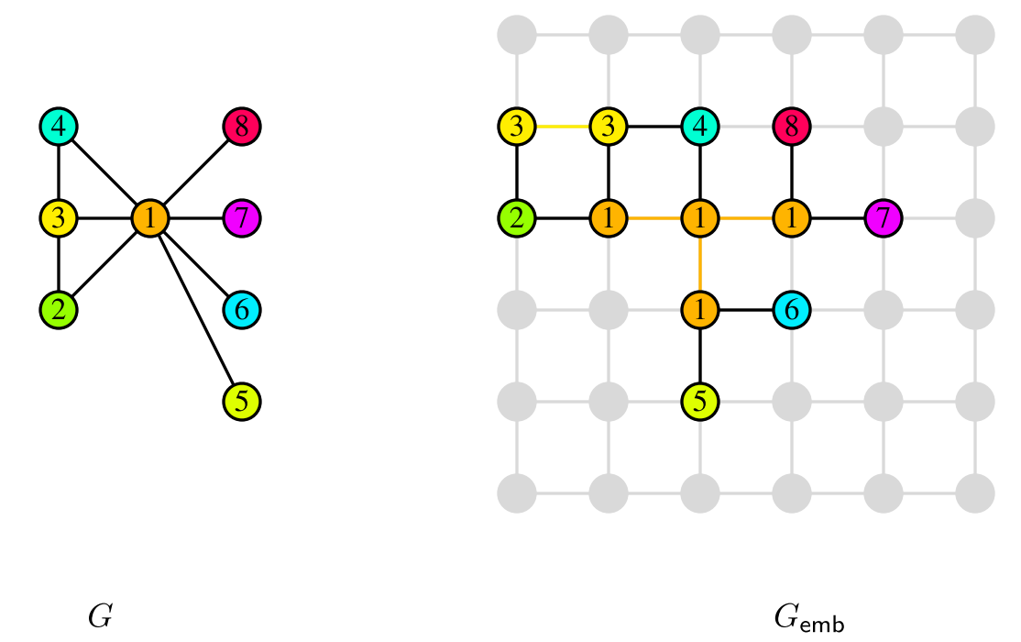
Minor-Embedding
Minor Embedding is to map QUBO into the QPU topology. Larger problems often require chains because the QPU topology is not fully connected.
Source: Choi, V. (2008). Minor-embedding in adiabatic quantum computation: I. The parameter setting problem. Quantum Information Processing, 7(5), 193-209.
Notes:
Chains : Larger problems often require chains because the QPU topology is not fully connected.
Chain Strength : For a chain of qubits to represent a variable, all its constituent qubits must return the same value for a sample. This is accomplished by setting a strong coupling to the edges connecting these qubits.
(鏈：較大的問題通常需要鏈，因為 QPU 拓撲不是完全連接的。
鏈強度：對於表示變量的量子比特鏈，它的所有組成量子比特必須為樣本返回相同的值。 這是通過對連接這些量子位的邊緣設置強耦合來實現的。)
要直接在 D-Wave 系統上解決任意提出的二元二次問題，需要映射到系統量子處理單元 (QPU) 的 QPU 拓撲，稱為minor-embedding次要嵌入。 這種預處理可以通過由 DWaveSampler() 和執行次要嵌入的組合組成的組合採樣器來完成。
三變量全連接問題（左側以圖表形式顯示）嵌入在 D-Wave 2000Q 上的四個量子位中，右側顯示為 Chimera 拓撲。 以深洋紅色突出顯示的變亮，由兩個量子位表示，數字 251 和 253。

Slide 25
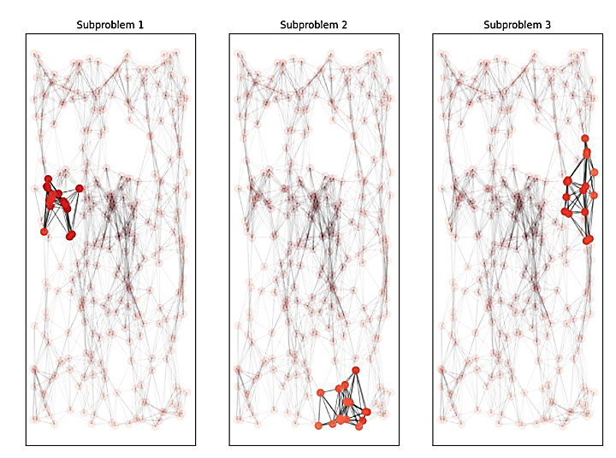
QPU Solvers: Decomposing Large Problems
A problem too large to be embedded in its entirety on the QPU is sequentially decomposed into smaller problems, each of which can fit on the QPU, with variables selected by highest impact on energy.
Source: https://docs.dwavesys.com/docs/latest/handbook_decomposing.html?highlight=decomposing
Notes:
有時候複雜的問題變數太多，受限於qubits數，所以對於大問題要使用分解
一個太大而無法完全嵌入 QPU 的問題會被依次分解為更小的問題，每個問題都可以放在 QPU 上，並根據對能量的最大影響選擇變量。
僅由最大能量影響選擇的變量可能不是直接連接的（沒有共享邊），也可能不代表問題的局部結構。配置諸如廣度優先 (BFS) 或優先級優先選擇 (PFS) 之類的遍歷模式可以捕獲表示問題中局部結構的特徵。
/*
由 Ocean 軟件的 EnergyImpactDecomposer 類實現的一種分解方法是選擇對問題能量貢獻最大的變量子問題。
*/

Slide 26
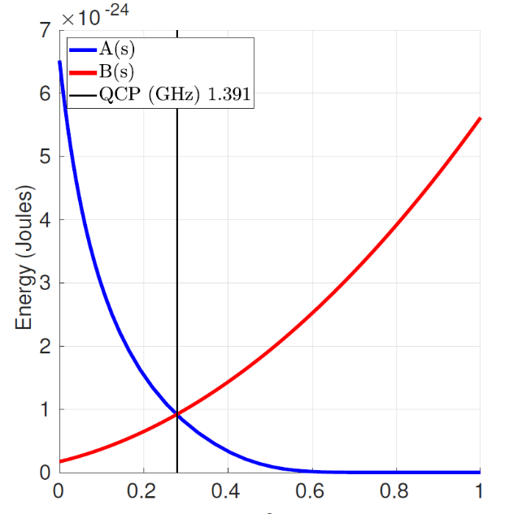
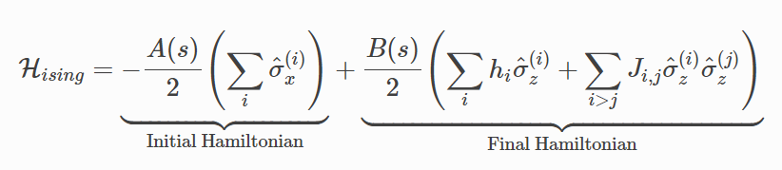
Hamiltonian
A classical Hamiltonian is a mathematical description of some physical system in terms of its energies. We can input any particular state of the system, and the Hamiltonian returns the energy for that state.
Source: https://docs.dwavesys.com/docs/latest/c_gs_2.html.
Notes:
經典哈密頓量是根據能量對某些物理系統的數學描述。我們可以輸入系統的任何特定狀態，哈密頓量返回該狀態的能量。
對於量子系統，哈密頓量是將某些狀態（稱為本徵態）映射到能量的函數。
在量子退火中，系統從初始哈密頓量的最低能量本徵態開始。當它退火時，它引入了包含偏差和耦合器的哈密頓量問題，它減少了初始哈密頓量的影響。在退火結束時，它處於問題哈密頓量的本徵態。理想情況下，它在整個量子退火過程中一直保持在最低能量狀態，因此到最後——它處於問題哈密頓量的最低能量狀態，因此對你想要解決的問題有答案。到退火結束時，每個量子比特都是一個經典對象。
(input 各量子狀態，output系統能量)
(將所有qubits可能狀態放入Hamiltonian，找到能量最小時的樣子)
其中 σ是在量子比特q 上運行的泡利矩陣 ， h 和 J 是量子比特偏差和耦合強度。 A(s)和B(s)是根據退火時間s演變的能量縮放函數。(A(s)會從很大到0 B(s)會從0到很大)
Initial Hamiltonian：把所有qubits變成01疊加狀態(初始哈密頓量的最低能量狀態是當所有量子位處於 0 和 1 的疊加狀態時。)
Final Hamiltonian：的最小值會對應於優化問題的最優解(最終哈密頓量的最低能量狀態是試圖解決的問題的答案。最終狀態是經典狀態)
Final哈密頓量的第二項為對每一對相鄰晶格點的總和(每一對只算一次)，代表所有自旋之間交互作用的能量
第二項則是磁場和自旋交互作用的能量
對於每個晶格點 k ∈ Λ 都有一個離散變數 σk ，其中 σk ∈ {+1, −1}，代表一個晶格點的自旋。而所有變數的集合σ = (σk)k∈Λ則稱作 自旋組態。
對於兩個相鄰的晶格點i, j ∈ Λ
"hat"帶表單位向量
where σ^(i)x,z are Pauli matrices operating on a qubit qi (the quantum one-dimensional Ising spin), and nonzero values of hi and Ji,j are limited to those available in the QPU graph
pauli matrix的x或z分量
J為相鄰兩自旋的鍵結交互作用強度
H為Z軸之橫磁場強度
where σˆ(i)x,z are Pauli matrices operating on a qubit qi
the 𝜎𝑧are Pauli spin matrices.
the action of the X operator is to introduce the bit flip
the action of the Z operator is to introduce the phase flip
A linear anneal sets s
s=t/tf (tf is the total time of the annealing) s是退火期間的當前時間與總退火時間之間的比率，其值介於 0 和 1 之間。
At t=0, A(0)≫B(0) 退火過程A會減少B會增加，最後只會剩下B
The quantum critical point (QCP) is the point in the anneal where the amplitudes of A(s) and B(s) are equal.
https://docs.dwavesys.com/docs/latest/c_gs_2.html
稍微有解釋到σˆ(i)x,z
https://www.dwavesys.com/media/fawfas04/14-1056a-a_zephyr_topology_of_d-wave_quantum_processors.pdf
In a standard quantum annealing protocol, the problem Hamiltonian (HˆP) is encoded with each spin si replaced by a Pauli operator σzi, and acts alongside quantum fluctuations induced via a transverse field driver Hamiltonian HˆD = −Σi(σxi).

Slide 27
Outline
What are NP-hard Problems?
What is Quantum Annealing (QA)?
How to Solve NP-hard Problems with QA?
Examples of Solving NP-Hard Problems with QA
Conclusion

Slide 28
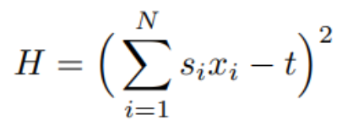
Subset Sum Problem
In this problem, we are given a set S = {s₁,s₂,...s_{N}} of N integers and a target value t ∈ Z, and the aim is to find a subset of S such that the elements of this subset sum to t. The subset sum problem is related to the knapsack problem and is one of Karp’s NP-complete problems. For this problem we introduce variables x_{i}, i ∈ {1,...,N}, where xi equals 1 if s_{i} is included in the subset.
A Hamiltonian of the form：
yields the optimal value zero if and only if the sum of the numbers included equals t.
S = {-7,4,12,5,2}, t = 9 ⇒ Yes, there is an answer.
Notes:
在這個問題中，給定 N 個整數的集合 S = {s1,s2,...sN} 和目標值 t ∈ Z，目標是找到 S 的子集，使得該子集的元素總和 到 t。 子集和問題與背包問題有關，是卡普的 NP 完全問題之一。
對於這個問題，我們引入變量 xi ：
Xi = 1 表示這個元素有被選到subset裡面
Xi = 0 表示這個元素沒有被選到子集合中

Slide 29
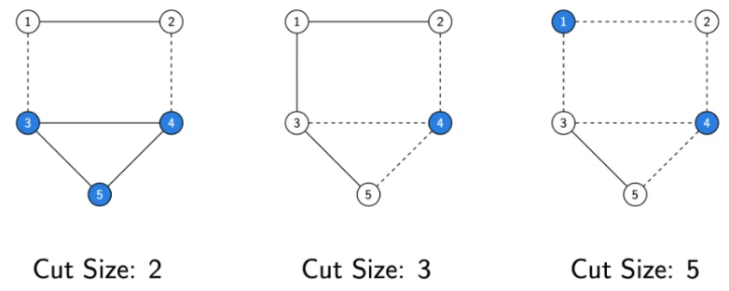
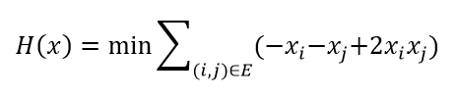
Maximum Cut
The MaxCut problem is one of the most famous NP-hard problems in combinatorial optimization. Given an undirected graph 𝐺(𝑉,𝐸) with a vertex set 𝑉 and an edge set 𝐸, the Max Cut problem seeks to partition 𝑉 into two sets such that the number of edges between the two sets (considered to be severed by the cut), is as large as possible.
Notes:
MaxCut 問題是組合優化中最著名的 NP-hard 問題之一。 給定一個具有頂點集 𝑉 和邊集 𝐸 的無向圖 𝐺(𝑉,𝐸)，Max Cut 問題試圖將 𝑉 劃分為兩個集合，使得這兩個集合之間的邊數（被認為被割斷） )，盡可能大。
變數xi
xi=0表示i被分到第1個集合
xi=1表示i被分到第2個集合
如果i跟j屬於同集合 則帶入H(x)的值會=0

Slide 30
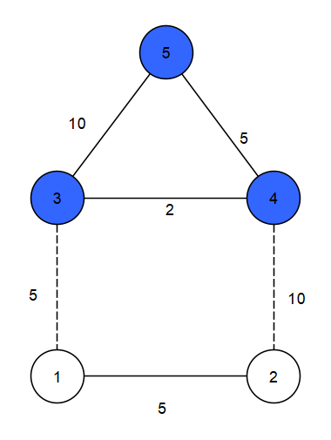
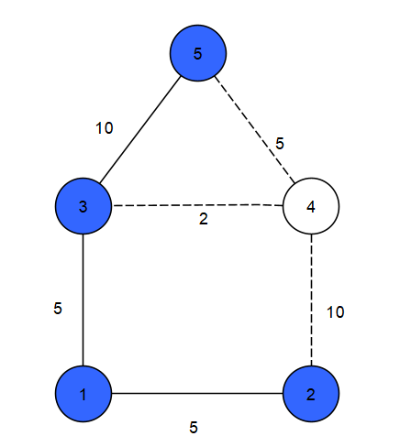
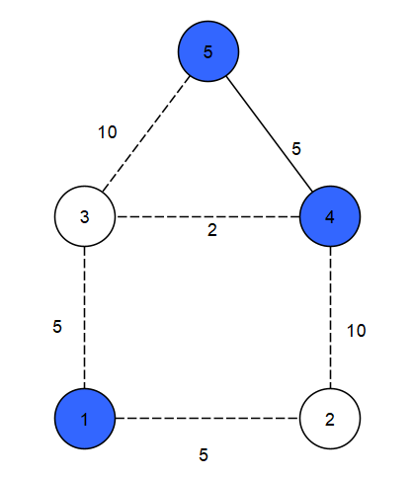
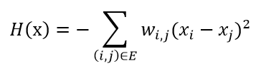
Weight Maximum Cut
The Weight Max Cut problem is very similar to the Max Cut problem, the difference is that each edge has different weights. Given an undirected graph 𝐺(𝑉,𝐸,W) with a vertex set 𝑉 and an edge set 𝐸 with weights W, the Max Cut problem seeks to partition 𝑉 into two sets such that the weight sum of edges between the two sets (considered to be severed by the cut), is as large as possible.
Cut Size : 15
Cut Size : 17
Cut Size : 32
Notes:
變數xi
xi=0表示i被分到第1個集合
xi=1表示i被分到第2個集合
wi,j表示(i,j)這條邊的weight

Slide 31
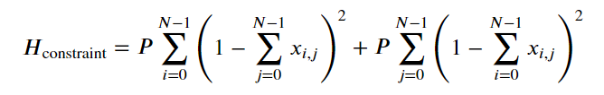


Traveling Salesman Problem
The travelling salesman problem is a well-known NP-hard problem in combinatorial optimization, asking for the shortest route or cycle that visits each city exactly once, given a list of cities and the distances between each pair of cities.
We need to account for the following constraints: (i) First, each city should occur exactly once in the cycle.(ii) Second, each position in the cycle should be assigned to exactly one city.
Notes:
旅行商問題是組合優化中著名的 NP-hard 問題，在給定城市列表和每對城市之間的距離的情況下，要求找到每個城市恰好訪問一次的最短路徑。 TSP 可以應用於計算機科學中，以找到數據在各個節點之間傳輸的最有效路線，包括識別網絡或硬件優化方法。TSP 的解決方案可以看作是加權圖中頂點的特定排序。以無向加權圖為例，城市對應圖的節點，路徑對應圖的邊，路徑的距離就是邊的權重。目標是找到權重最小的哈密頓循環。
變數Xi,k=1表示城市i在第k順序被拜訪
H_dist
其中𝐷𝑖，𝑗是城市𝑖和城市𝑗之間的距離。請注意，乘積 𝑥𝑖,𝑘*𝑥𝑗,𝑘+1=1，僅當城市 𝑖 位於循環中的位置 𝑘 並且城市 𝑗 在城市 𝑖 之後被訪問。
H_constraint
（i）每個城市應該在循環中恰好出現一次。
（ii）循環中的每個位置都應該恰好分配給一個城市。
懲罰參數 𝑃
我們將對懲罰參數 𝑃 執行超參數優化，以找到符合上述約束的良好解決方案。如果沒有正確選擇𝑃，則該算法可能會提供不可接受的解決方案

Slide 32



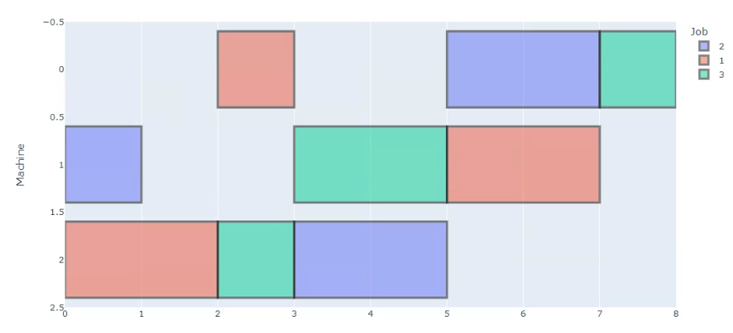

Job Shop Scheduling (JSP) Problem
The JSP can be described by a set J = {J₁,…, J_{n}} of n jobs that must be scheduled on a set M = {M₁, …, M_{m}} of m machines. Each job consists of a sequence of operations that have to be performed in a predefined order：
The problem consists in finding a schedule of the operations on the machines, taking into account the precedence constraints, that minimizes the makespan, that is, the finish time of the last operation completed in the schedule.
Notes:
給定 n 個工作，每個工作由若干必須在 m 台機器上處理的操作組成。 每個操作使用 m 台機器中的一台機器持續一段固定的時間。 每台機器一次最多可以處理一個操作，一旦一個操作在給定的機器上啟動處理，它必須在不中斷的情況下完成該機器上的處理。 給定作業的操作必須按給定順序處理。 問題在於找到機器上的操作計劃，考慮到優先約束，以最小化製造時間，即計劃中完成的最後一個操作的完成時間。
(h1)job中所有的操作必須依照給定的順序執行
(h2)在一台機器上一次只能執行一個操作
(h3)每個操作都必須且只能被執行一次

Slide 33
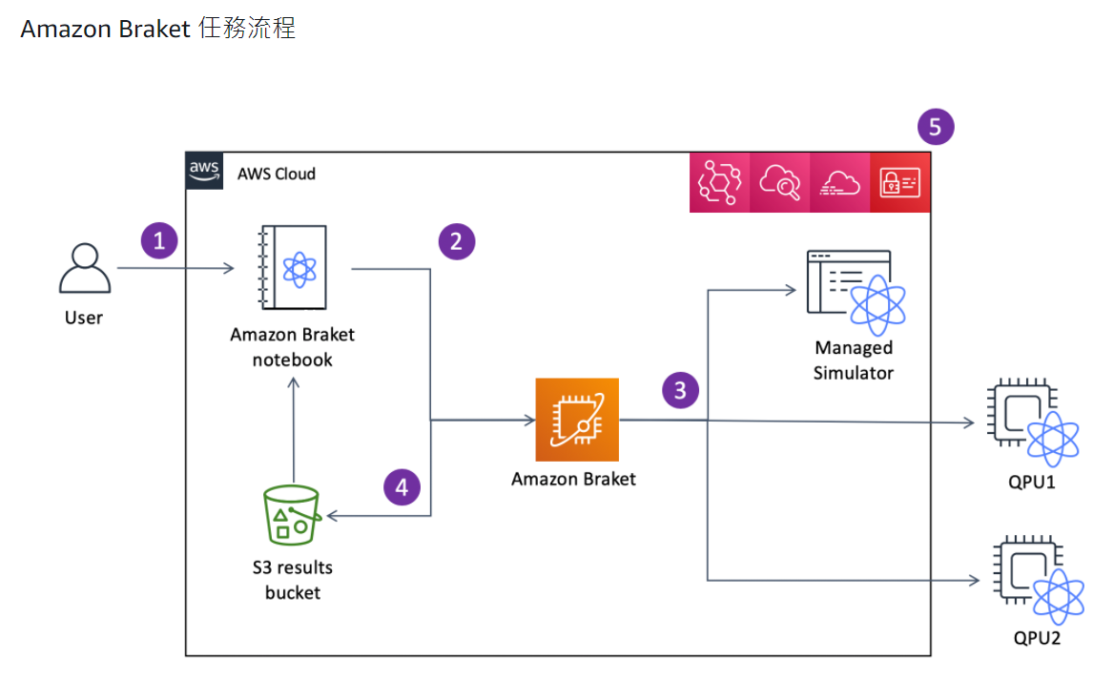
Amazon Braket
Source: https://docs.aws.amazon.com/zh_tw/braket/latest/developerguide/braket-how-it-works.html
Notes:
為了讓客户輕鬆定義、提交和監控他們的任務，Amazon Braket 提供了隨 Amazon Braket SDK 預裝的託管 Jupyter 筆記本 (1)。您可以直接在 SDK 中構建量子電路，或者為退火設備定義退火問題和參數。Amazon Braket SDK 還為 D-Wave 的海洋工具套件提供了一個插件，因此您可以對 D-Wave 設備進行本機編程。定義任務後，您可以選擇一個設備來執行任務，然後將其提交到 Amazon Braket API (2)。根據您選擇的設備，任務會排隊，直到設備可用並將任務發送到 QPU 或模擬器執行 (3)。Amazon Braket 繪讓您訪問 3 種不同類型的 QPU（D 波，IonQ，Rigetti）和一個託管模擬器，SV1。如需進一步了解，請參閱Amazon Braket 支援的裝置。
處理您的任務後，Amazon Braket 會將結果返回到 Amazon S3 存儲桶，其中數據存儲在您的 AWS 賬户中 (4)。與此同時，SDK 在後台輪詢結果，並在任務完成時將其加載到 Jupyter 筆記本中。您也可以在工作Amazon Braket 面，或通過使用GetQuantumTaskAmazon Braket 繪 API 的操作。
當然，Amazon Braket 與亞馬遜 Identity and Access Management (IAM)、Amazon CloudWatch、亞馬遜 CloudTrail 和 Amazon EventBridge 集成在一起，用於用户訪問管理、監控和日誌記錄，以及基於事件的處理 (5)。
To make it easy for customers to define, submit, and monitor their tasks, Amazon Braket provides managed Jupyter notebooks (1) that come pre-installed with the Amazon Braket SDK. You can build your quantum circuits directly in the SDK or, for annealing devices, define the annealing problem and parameter. The Amazon Braket SDK also provides a plugin for D-Wave’s Ocean tool suite, so you can natively program the D-Wave device. After your task is defined, you can choose a device to execute it on, and submit it to the Amazon Braket API (2). Depending on the device you chose, the task is queued until the device becomes available and the task is sent to the QPU or simulator for execution (3). Amazon Braket gives you access to 3 different types of QPUs (D-Wave, IonQ, Rigetti) and one managed Simulator, SV1. To learn more, see Amazon Braket supported devices.
After your task is processed, Amazon Braket returns the results to an Amazon S3 bucket, where the data is stored in your AWS account (4). At the same time, the SDK polls for the results in the background and loads them into the Jupyter notebook at task completion. You can also view and manage your tasks on the Tasks page in the Amazon Braket console, or by using the GetQuantumTask operation of the Amazon Braket API.
Of course, Amazon Braket is integrated with Amazon Identity and Access Management (IAM), Amazon CloudWatch, Amazon CloudTrail and Amazon EventBridge for user access management, monitoring and logging, as well as, for event based processing (5).

Slide 34
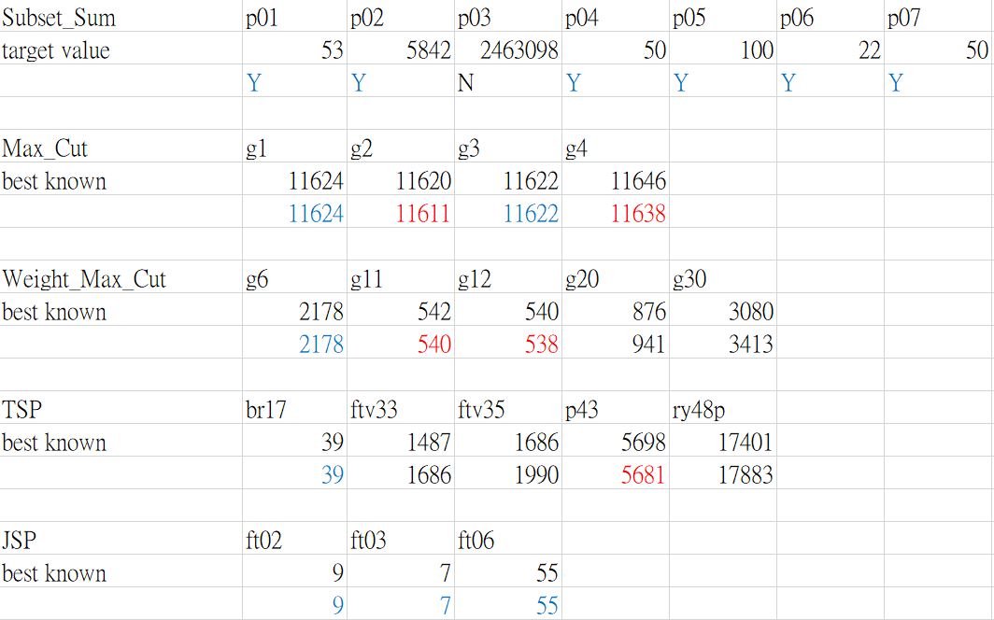
Comparisons with the best classical computation solutions
Red: Optimal Solution
Blue: Best of Known Solutions
Notes:
reference 列在投影片上面
藍色(等於)
紅色(唯一存在)
綠色(?)
Subset Sum instance(https://people.sc.fsu.edu/~jburkardt/datasets/subset_sum/subset_sum.html)
P01 is a set of N = 8 weights, for a target of 53. (9~32)
P02 is a set of N = 10 weights, for a target of 5842.(267~1922)
P03 is a set of N = 21 weights, for a target of 2463098. (78688~2074132)
P04 is a set of N = 10 weights, for a target of 50. (3~41)
P05 is a set of N = 9 weights, for a target of 100. (9~81)
P06 is a set of N = 6 weights, for a target of 22.(1~32)
P07 is a set of N = 10 weights, for a target of 50, and comes from Sam Loyd's Cyclopedia of Puzzles, 1914. (3~30)
Max Cut
This set consists of instances generated by Helmberg and Rendl (2000) who used rudy, a machine-independent graph generator by Giovanni Rinaldi, to create 54 instances ranging from n = 800 to 3,000. They consist of toroidal, planar, and random graphs with weights taking the values 1, 0, or −1.
(Solving large scale Max Cut problems via tabu search)整理best known
g1g2g3g4 800 19176 每條邊的weight是1
g6 800 19176 每條邊的weight是1, 0, or −1.
g11g12 800 1600 2021->564
G12 2021->556
G20 2021->941
g20 800 4672
g30 2000 19990
BRIM: Bistable Resistively-Coupled Ising Machine (2021IEEE)
https://ieeexplore.ieee.org/document/9407038
TSP
Come from TSPLIB
atsp instance number = cities numbers
(Focusing on the hybrid quantum computing - Tabu search algorithm: new results on the Asymmetric Salesman Problem)(2021)
https://dl.acm.org/doi/pdf/10.1145/3449726.3463123?casa_token=SjWfgqVFDagAAAAA:8sqTgxXWUjT0AgN-Idl7UAHdxYlMTdQHdsq69K9BkFMcW2JU3E5rK8SZ1T6NApTK-FY2ieNPUmFQ
JSP
Come from ORLIB
(Application research of a new neighbourhood structure with adaptive genetic algorithm for job shop scheduling problem)(2021)
https://www.tandfonline.com/doi/pdf/10.1080/00207543.2021.2007310?casa_token=YnD2CUEP8AIAAAAA:g-t-W7BldZFHcmGwQFml47Cn28ynVSc7vS-SQXhQtF1ISP9i2ZcHyiEVJ3fmESPrLZOmYw7HTHzI
Ft02 2*2 longest operation time = 5
Ft03 3*3 longest operation time =2
Ft06 6*6 longest operation time =10

Slide 35
Outline
What are NP-hard Problems?
What is Quantum Annealing (QA)?
How to Solve NP-hard Problems with QA?
Examples of Solving NP-Hard Problems with QA
Conclusion

Slide 36
Conclusion
It is an efficient way to solve NP-hard problems with quantum annealing to obtain solutions with high quality in a short time.
However, there are factors affecting the quality of solutions:
        The probabilistic nature of quantum computing
        The insufficiency of qubits
        …
We are trying to improve solution quality by tackling every factor.

Slide 37
Thanks for Listening!

