Slide 1
LOM: a Leader Oriented matchmaking algorithm for multiplayer online games
Jehn-Ruey Jiang, Guan-Yi Sung, Jih-wei Wu
National Central University, Taiwan
Presented by Prof. Jehn-Ruey Jiang

Slide 2
Outline
Introduction
Related Work
LOM Algorithm
Performance Evaluation
Conclusion

Slide 3
Outline
Introduction
Related Work
LOM Algorithm
Performance Evaluation
Conclusion

Slide 4
MOG (Multiplayer Online Game)
A popular networked game in which multiple geographically distributed players can join the same game and interact with each other simultaneously
First Person Shooter (FPS) Game
Real-Time Strategy (RTS) Game
Role Playing Game (RPG)

Slide 5
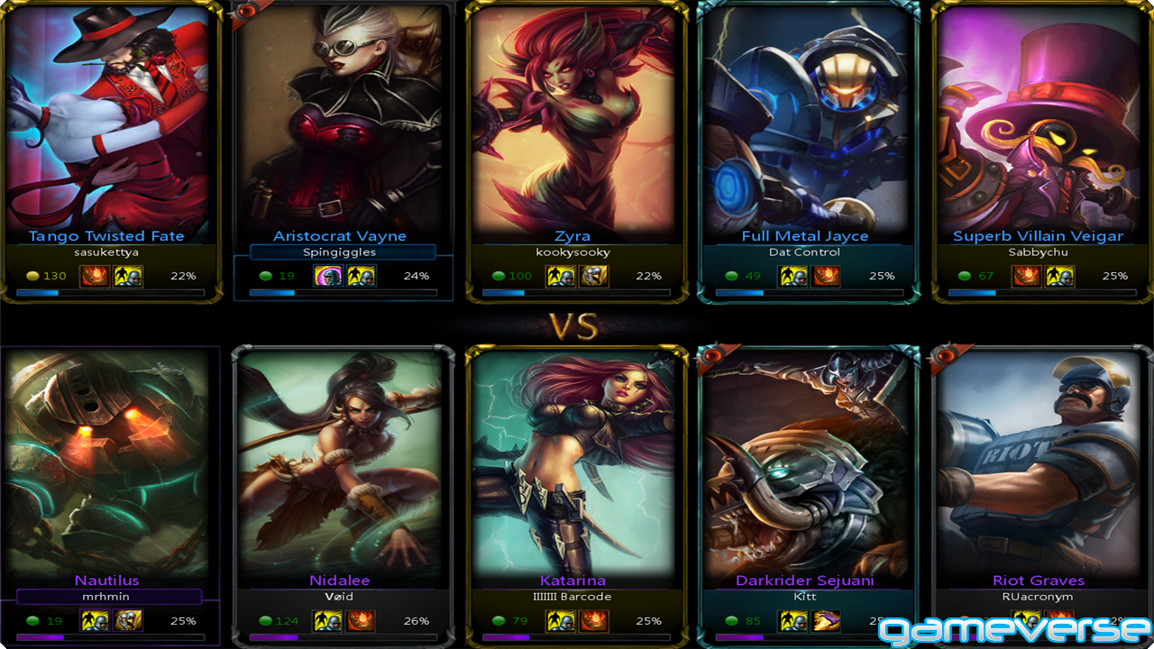
Matchmaking
The process to arrange players into online game teams/sessions

Slide 6
The Evolution of Matchmaking
Manual matchmaking
PC games
Players select server/team manually.
Automatic matchmaking
Mobile games, somatosensory games, modern PC games, etc.
The gaming system automatically arranges players into feasible session/team.

Slide 7
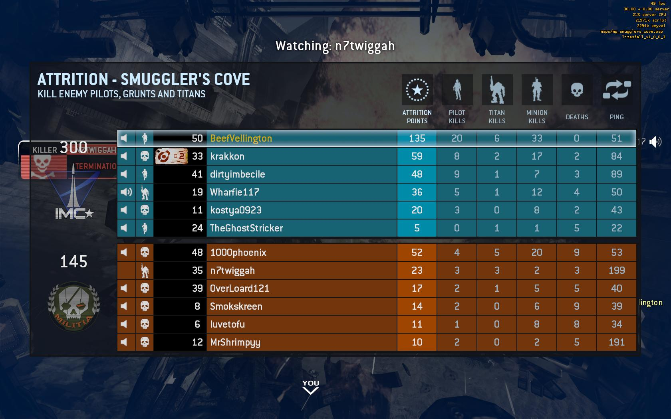
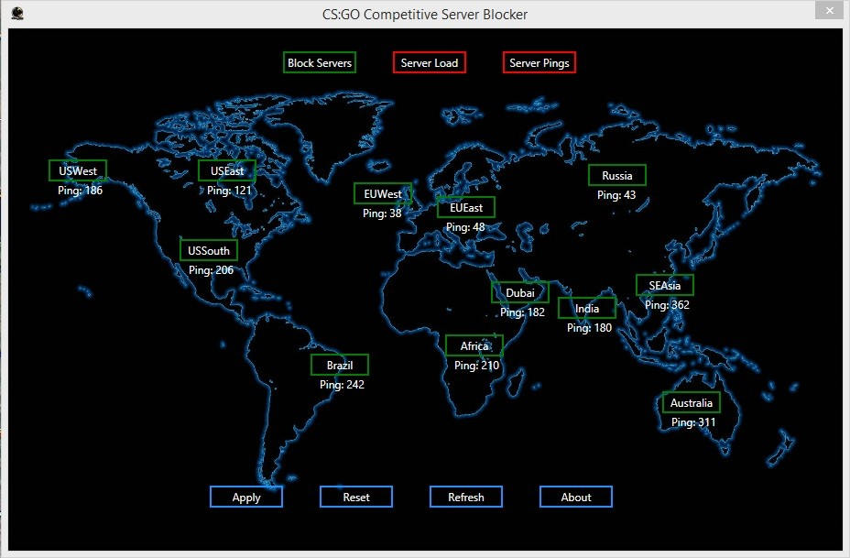
Types of Matchmaking
P2P MOG players with similar mutual network connection speeds are matched up and C/S MOG players with similar server connection speeds are matched up.
Players are estimated with a skill rating system on the basis of their game performances and experiences, and players with close skill ratings are matched up.
Connection-based
Skill-based

Slide 8
Outline
Introduction
Related Work
LOM Algorithm
Performance Evaluation
Conclusion

Slide 9
Related Work
Htrae [Agarwal and Lorch, 2009]
It is a connection-based matchmaking algorithm.
It synthesizes geolocations for all machines with a network coordination system.
Switchboard [Manweiler et. al., 2011]
It is a connection-based matchmaking algorithm.
It focuses on efficiently group players into game sessions on cellular networks.
It investigates how the cellular network latencies affect the performance of MOGs.

Slide 10
Related Work
FunNet [Delalleau et al., 2012]
It considers that player skill levels are hard to obtain and predict.
The FunNet model is constructed by the neural network to find out the significant factors that determine the "fun score".
Players’ Behavior Database [Véron et. al., 2014]
It gathers and analyzes more than 28 million game sessions of data from League of Legends.
It is a reusable database for establishing effective matchmaking criteria.

Slide 11
Outline
Introduction
Related Work
LOM Algorithm
Performance Evaluation
Conclusion

Slide 12
LOM: Leader Oriented Matchmaking
It relies on the association-based criterion, by which players with high association are grouped into a session/team.
Each game session/team has a preselected leader.
A player joins into a team whose leader has the highest association degree with the player.
It is an optimized association-based matching scheme on the basis of the minimum-cost maximum-flow (MCMF) algorithm.

Slide 13
The Bipartite Graph for LOM
Members
Leaders
Wl₁m₁
Wl₂m₂
Wl₁m₃
‧
‧
‧
‧
‧
‧
‧
Wl_{k}m_{n-k}
m₁
l₁
m₂
l₂
‧
‧
‧
m₃
‧
‧
‧
l_{k}
m_{n-k}
n: the total number of players
k=⎡n/h⎤: the number of teams/sessions, where h is the number of players per team/session
Wl_{x}m_{y} : the association degree between l_{x} and m_{y}.
The smaller Wl_{x}m_{y} is, the closer the association between l_{x} and m_{y}.

Slide 14
The Flow Network for LOM
Members
Leaders
(1, Wl₁m₁)
(1, Wl₁m₂)
(1, Wl₁m₃)
‧
‧
‧
‧
‧
‧
‧
‧
‧
(1, Wl_{k}m_{n-k})
m₁
l₁
(1, 0)
(1, 0)
(1, 0)
‧
‧
‧
‧
(1, 0)
(h-1, 0)
(h-1, 0)
‧
‧
‧
(h-1, 0)
m₂
l₂
S
‧
‧
‧
m₃
T
‧
‧
‧
l_{k}
m_{n-k}
h: the number of players per team/session
S is source node, and T is sink node in the MCMF algorithm.
Each edge has a capacity and a weight, denoted by the pair (capacity, weight).

Slide 15
LOM Relies on the MCMF Algorithm
Minimum-Cost Maximum-Flow (MCMF) Algorithm
It returns a flow plan with the maximum flows going from S to T of the minimum costs (weights)
The weight of edges incident to S and T is 0.
Every edge between a leader node and a member node has the capacity 1.
According to the minimum cost criterion of the MCMF algorithm, all the picked edges have a minimum summation of total weights.
The picked edges are the matched pairs who make the whole system has the minimum weight (highest association degree) in average.

Slide 16
Outline
Introduction
Related Work
LOM Algorithm
Performance Evaluation
Conclusion

Slide 17
Parameter Settings
Every member node, from the first to the last, selects an un-fully-matched leader node with the minimum association weight.
Schemes for Comparison
M2L Greedy
L2M Greedy
Random
The Scale of the Game
100, 200, 300, 400, 500 players
The Session Size is 10
Every leader node, from the first to the last, selects h-1 unselected member nodes with the top h-1 minimum association weights.
It randomly selects h-1 edges between a leader node and member nodes.

Slide 18
Comparisons

Slide 19
Comparisons

Slide 20
Observations
LOM outperforms L2M, M2L and Random algorithms.
The time complexity of LOM is O(n⁵), while the time complexities of L2M, M2L, and Random algorithms are O(n²), O(n²), and O(n), respectively.

Slide 21
Outline
Introduction
Related Work
LOM Algorithm
Performance Evaluation
Conclusion

Slide 22
Conclusion
LOM is an association-based matchmaking algorithm, which is a new matchmaking scheme other than connection-based and skill-based schemes.
LOM outperforms L2M, M2L and Random algorithms.
In practice, LOM is a globally optimized algorithm. However, it spends more time, especially for games of larger scales.
In the future, we will focus on the problem about how to calculate the association degree between two MOG players more accurately and more efficiently.

Slide 23
Thanks!

