Slide 1
Qiskit 及 IBM-Quantum 環境介紹
臺大-IBM量子電腦中心

Slide 2
Outline
Qiskit 環境介紹
Terra
Aer
Ignis
Aqua
IBM-Quantum 環境介紹
Composer mode
Python mode

Slide 3
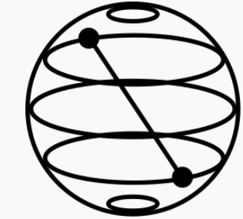
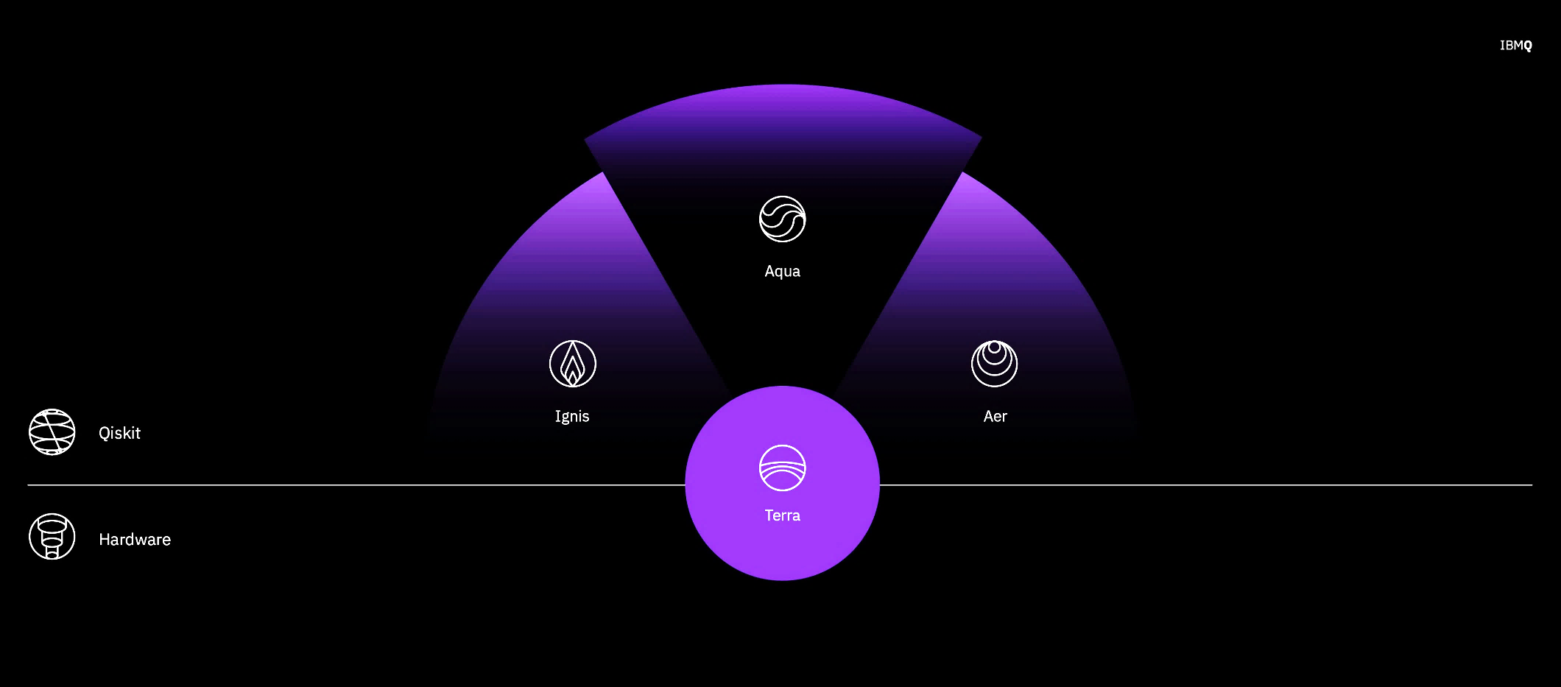
Qiskit
An open-source framework for quantum computing.

Slide 5
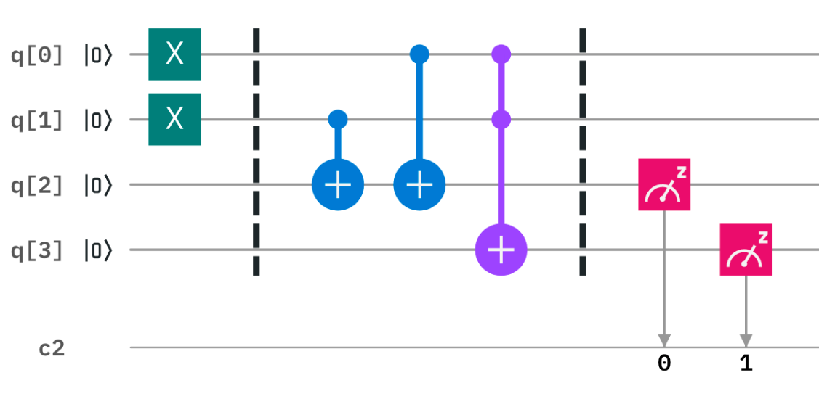
Qiskit—Terra
Terra ：地球
Terra （土）provide tools for creating quantum circuits and translate it into quantum machine code.

Slide 6
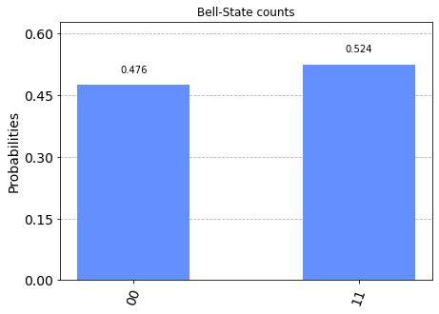
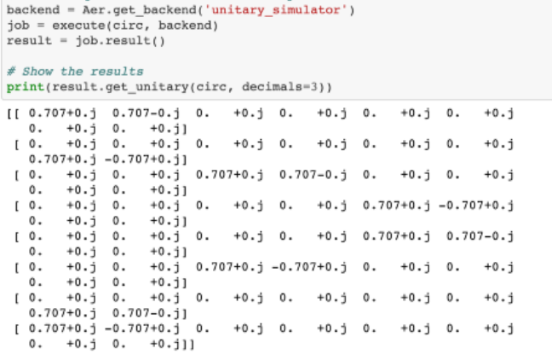
Qiskit—Aer
Aer （氣）provides simulators locally on the user’s device, which can also simulate simple or sophisticated noise model.
There are three kinds of simulator:
Qasm_simulator
Unitary_simulator
Statevector_simulator

Slide 7
Qiskit—Ignis
Ignis （火）provides tools for characterizing noise in near-term quantum devices.
Ignis can help us benchmarking near-term devices, conducting error mitigation, and error correction.

Slide 8
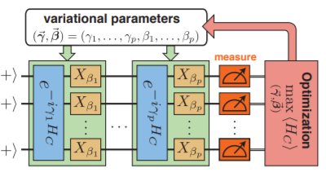
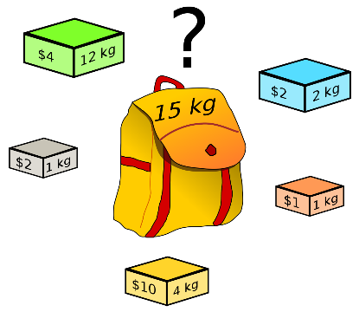
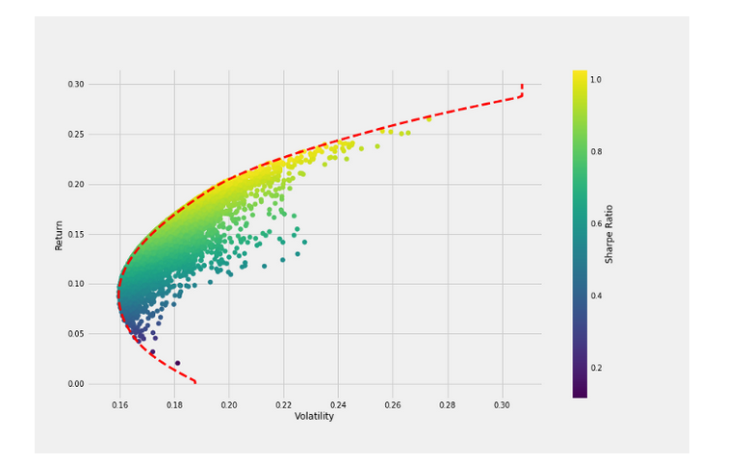
Qiskit—Aqua
Aqua （水）provides tools for several applications, include
Chemistry
Finance
Optimization
AI
…

Slide 9
IBM Quantum Experience
https://quantum-computing.ibm.com/

Slide 10
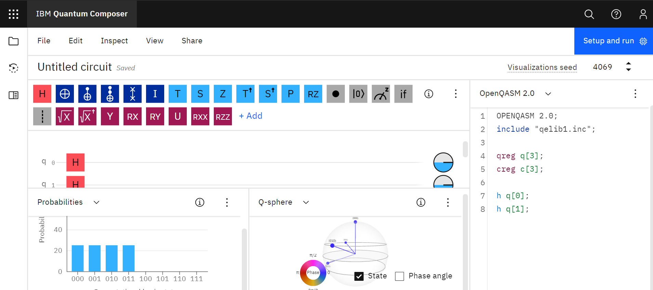
IBMQ環境介紹
Composer mode

Slide 11
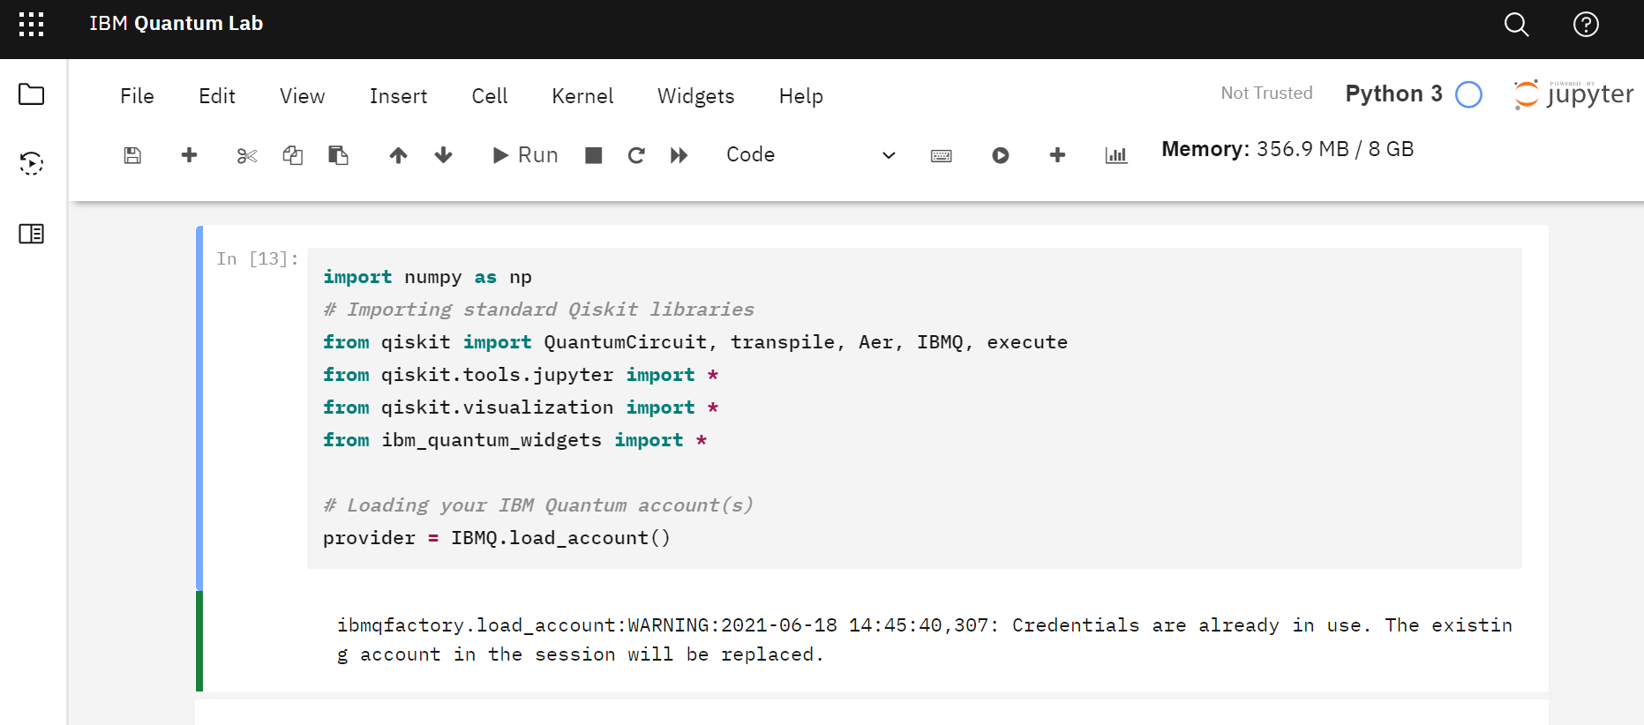
Python mode

