Slide 1
Energy Harvesting Technologies and Charger Deployment for Wireless Rechargable Sensor Networks
by Professor Jehn-Ruey Jiang from NCU, Taiwan

Slide 2
Part 1: Energy Harvesting Technologies

Slide 3
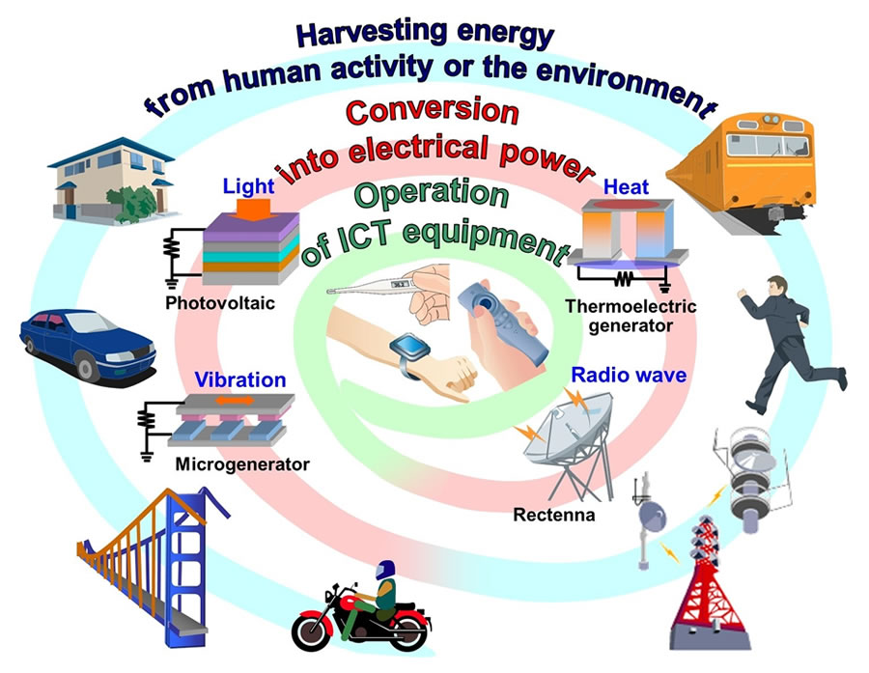
Energy Harvesting
Source: http://technologygreenenergy.blogspot.tw/2013/11/type-of-energy-sources.html
Notes:
http://technologygreenenergy.blogspot.tw/2013/11/type-of-energy-sources.html

Slide 4
Types of Energy Harvesting
Energy harvesting
Thermal energy
Mechanical energy
Radiant energy
Body heat Water heat
Other heat
Treading
Vibrations
Air flow
Magnetic Induction
Solar power
RF

Slide 5
Thermal energy

Slide 6
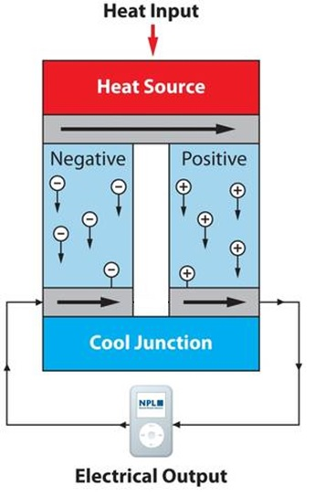
Thermoelectric Effect
Through thermoelectric effect, heat can be transformed into electricity.
Notes:
出處: http://experiment.phys.nchu.edu.tw/device/exp44.html

Slide 7
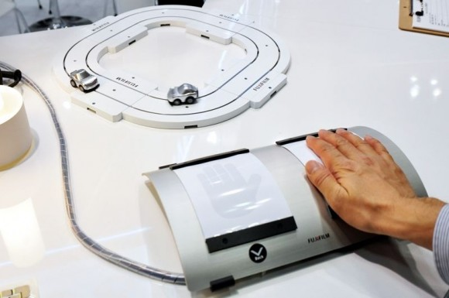
Body Heat

Slide 8
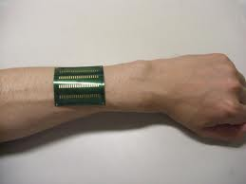
Body Heat

Slide 9
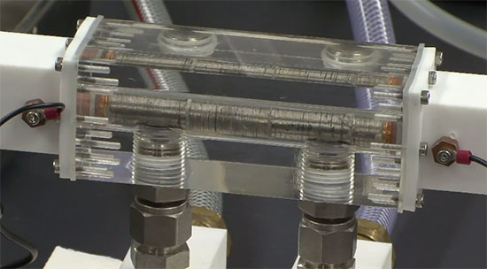
Water Heat
New thermoelectric material sucks electricity out of hot water

Slide 10
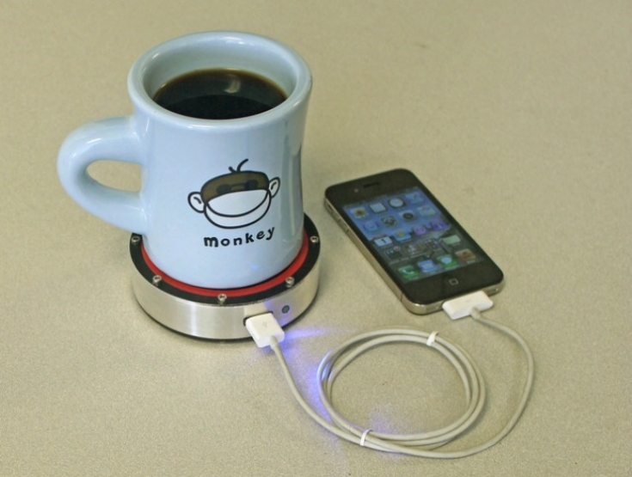
Other heat
Cup of coffee too hot? Harvest some of that waste energy to charge your gadgets.

Slide 11
Mechanical energy

Slide 12
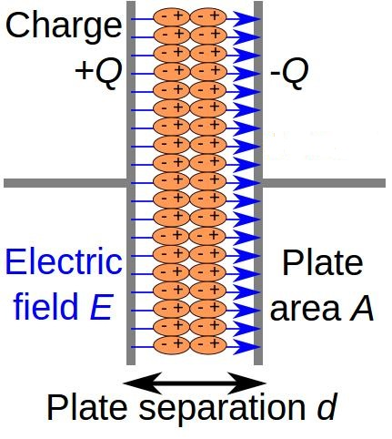
Piezoelectric Effect
Through piezoelectric effect, electricity is generated when a piezoelectric plate vibrates (or is pressed/released).
Notes:
出處網址: (1) http://zh.wikipedia.org/wiki/%E5%A3%93%E9%9B%BB%E6%95%88%E6%87%89
(2) http://www.aurumtec.com.tw/DB/Technology/%E5%A3%93%E9%9B%BB%E6%95%88%E6%87%89.htm
(3) http://highscope.ch.ntu.edu.tw/wordpress/?p=3331

Slide 13
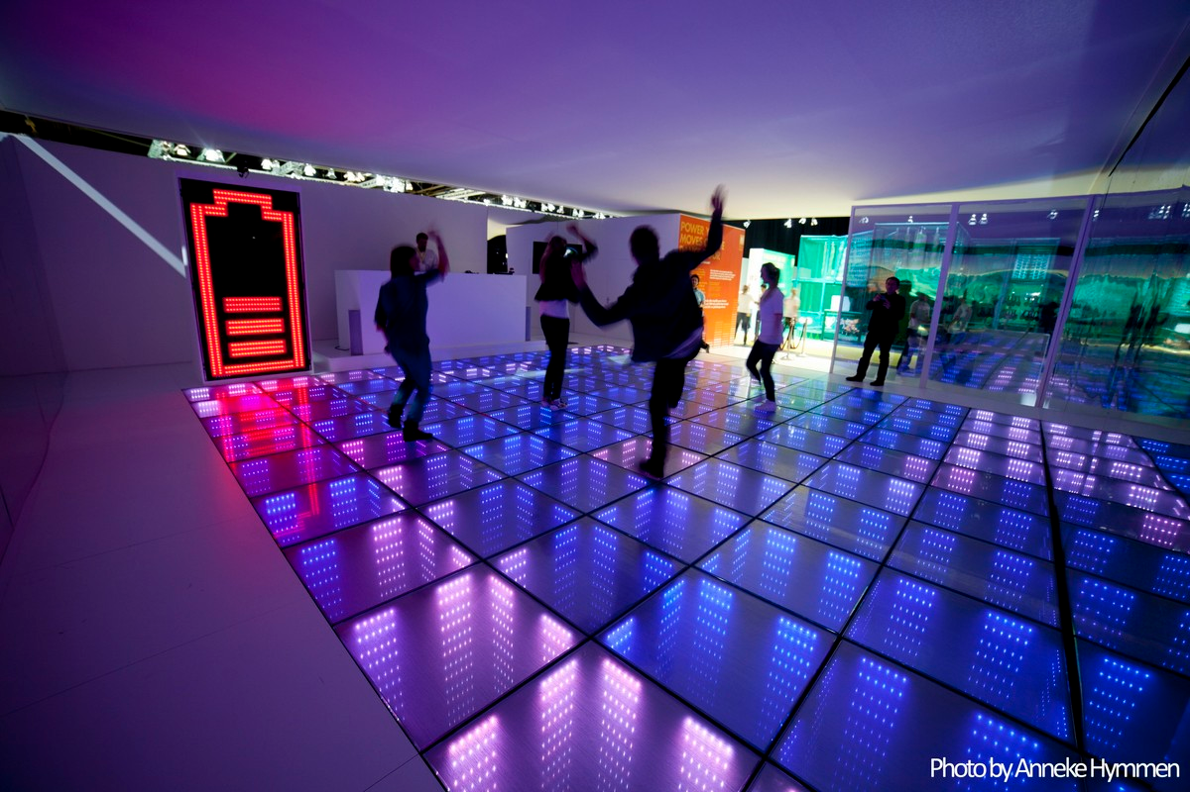
Treading

Slide 14
Treading

Slide 15
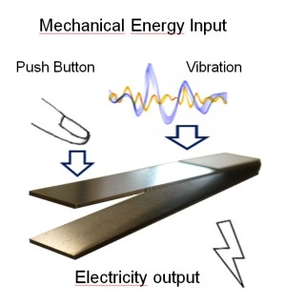
Vibrations
When we flap the plate, the plate vibrates and we gain electricity.
Notes:
When you flap the plate, the plate vibrate and you gain electricity.
出處網址: (1) http://www.cpr.cuhk.edu.hk/tc/press_detail.php?id=190
(2) http://www.nippon.com/hk/views/b01502/
振動能為再生能源的一種，遍布日常生活環境中，例如汽車及火車行駛時的顛簸、車流經過公路及橋樑時所引起的輕微振動，都可產生振動 能量，而壓電材料則可收集這些環境中的振動能量。
當壓電材料因振動而受拉或受壓時，部分振動機械能量就會轉化成電能，並可儲存在收集器內。

Slide 16
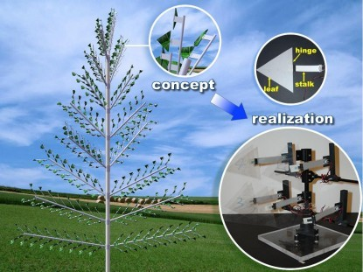
Air Flow
A flapping leaf generator for air-flow energy harvesting

Slide 17
Radiant energy

Slide 18
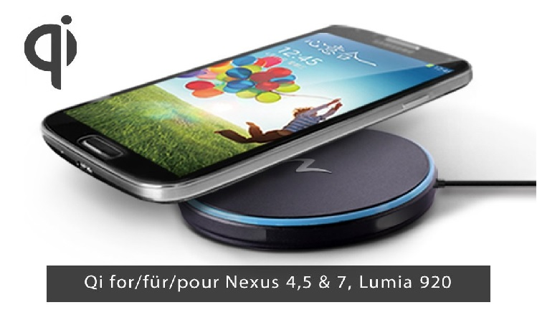
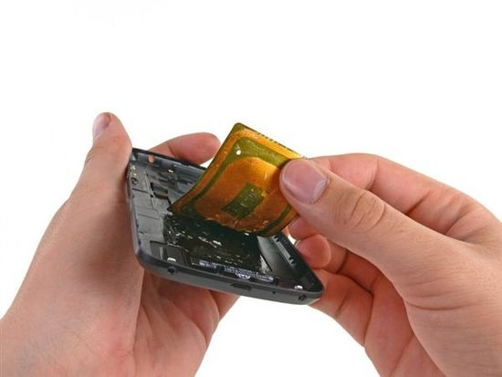
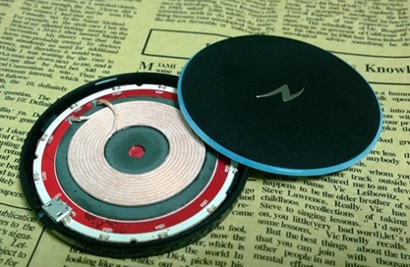
Magnetic Induction

Slide 19
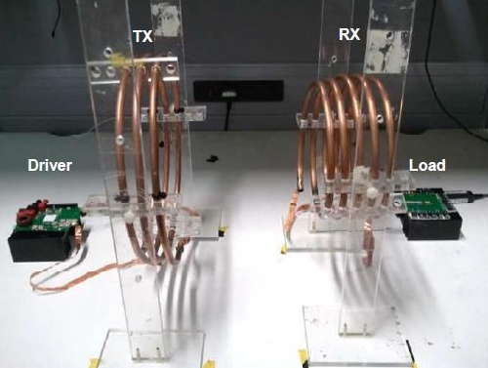
Magnetic Induction
Magnetic Induction (MI)
Change in the magnetic flux of the left coil induces a current in the right coil.
Notes:
出處網址: http://www.technical-direct.com/2013-05/%E7%84%A1%E7%B7%9A%E5%85%85%E9%9B%BB%E6%8A%80%E8%A1%93%EF%BC%88wireless-charging%EF%BC%89%E6%93%BA%E8%84%AB%E9%BA%BB%E7%85%A9%E5%85%85%E9%9B%BB%E5%99%A8%E5%AF%A6%E7%8F%BE%E7%84%A1%E9%99%90%E5%8F%AF/

Slide 20
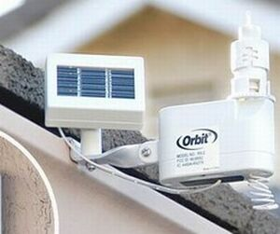
Solar Power

Slide 21
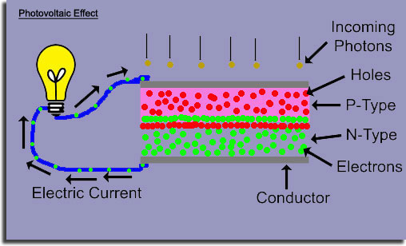
Photovoltaic Effect
Through photovoltaic effect, light energy is transformed into electricity.
Photovoltaic Effect
Notes:
出處網址: http://zh.wikipedia.org/wiki/%E5%85%89%E7%94%9F%E4%BC%8F%E6%89%93%E6%95%88%E5%BA%94

Slide 22
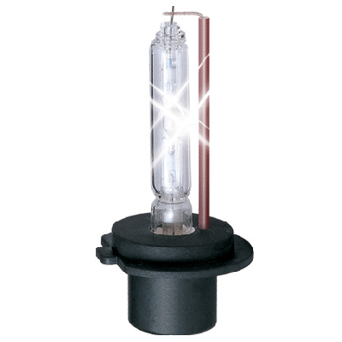
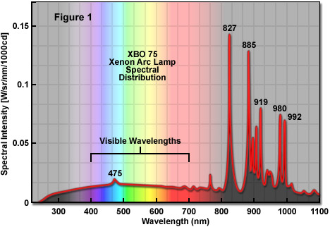
Xenon
The spectrum of a xenon lamp approximates that of the sun. So, it can be used as an “indoor solar power source.”

Slide 23
RF Power Sources
Notes:
RF Power Sources

Slide 24
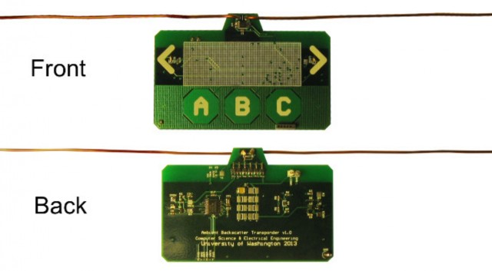
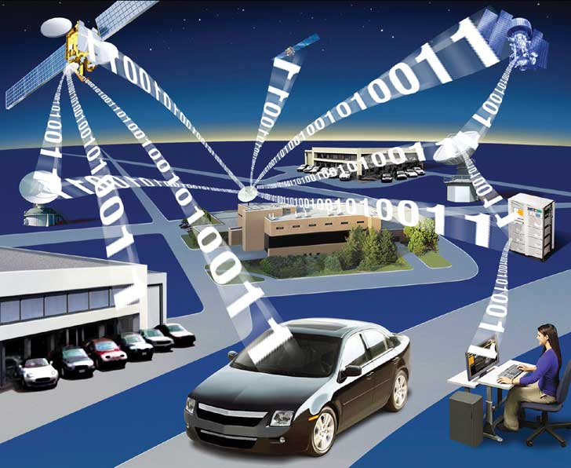
Ambient (Anticipated or Unknown) RF
The credit-card-sized device can suck power out of the air from TV, cellular transmissions, and other RF signals.
Ambient RF
Notes:
出處: http://www.extremetech.com/extreme/160634-ambient-backscatter-free-energy-harvesting-from-tv-signals-to-power-a-ubiquitous-internet-of-things

Slide 25
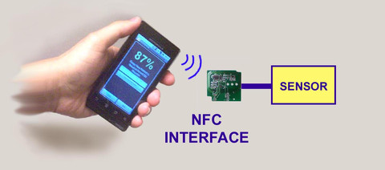
Intentional RF - WISP (wireless identification and sensing platform)
Tag
Reader
Notes:
WISP tag具備優點:
能偵測環境
通訊方面相容於UHF RFID Tag
可程式化
被動式，無須電池供電

Slide 26
WISP Tag
Onboard sensors
UHF RFID Tag
Programmable
Passive
Properties
Notes:
WISP tag具備優點:
能偵測環境
通訊方面相容於UHF RFID Tag
可程式化
被動式，無須電池供電

Slide 27
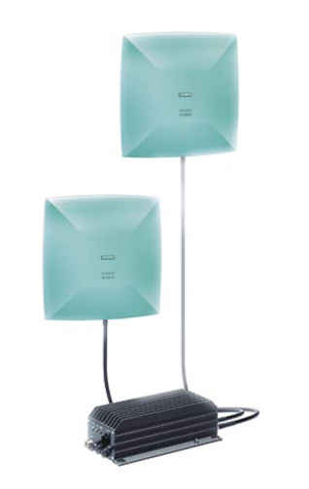
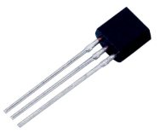
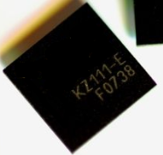
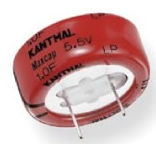
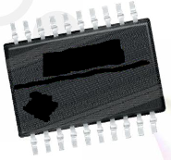
WISP Tag
RFID Reader
Passive Data Logger (PDL) Tag
Sensor
Storage Capacitor
Analog Front End
Power Management
Microcontroller
Antenna
Flash Memory
Notes:
WISP tag的構造:
天線
類比前端
電容，儲存電力
微控制器
快閃記憶體
感測器
實際上天線佔大部分面積 (最下面的方塊圖)

Slide 28
Compatible with EPC G2 tags
Reader
Tag
Tag Memory
ID Memory
User Memory
Sensor Data
Charge remaining
Time elapsed since last reset
Historical Sensor Measurements
EPC ID
Fully compatible with EPC Gen 2 specification
Notes:
Electronic Product Code™ - EPC
Gen 2 可讀寫多次 (且具大容量記憶體)，故將Tag Memory分成ID Memory與User Memory兩部分。
ID memory相當於該tag的身分證。
User Memory 存放感測資料。

Slide 29
Intentional RF – Charger and Harvester

Slide 30
Powercast Technology Overview
Trickle-charging means to charge a fully charged battery under no-load at a rate equal to its self-discharge rate, thus enabling the battery to remain at its fully charged level.
Notes:
Powercast Technology Overview

Slide 31
Powercast Recommended Power Profiles
Notes:
Recommended Power Profiles

Slide 32
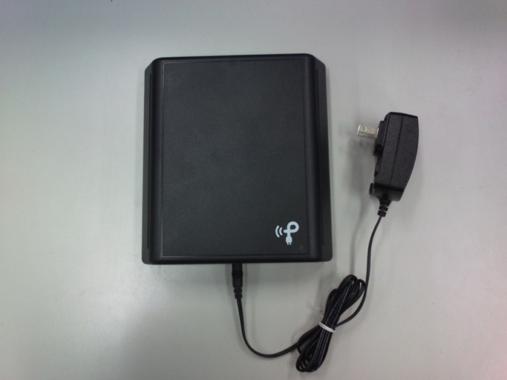
Powercast Charger TX91501
915 MHz center frequency
FCC and IC certified
1W or 3W EIRP (Equivalent Isotropically Radiated Power)
– TX91501-1W-ID
– TX91501-3W-ID
~60° beam pattern
Plug-and-play installation
Power virtually unlimited number of harvesters
Notes:
Federal Communications Commission (FCC)
IC (Industry Canada)
1.甚麼是trickle-charging batteries
A: 『涓流充電電池』，意思是當電池充飽了以後，仍以微弱的電力繼續對電池充電，以防電池電力隨時間自然衰減。
4. configurable and regulated
A: power harvester是能夠調整輸出的電壓與電流的。
5. RoHS compliant
A: RoHS認證，RoHS Directive方面，歐盟議會和歐盟部長級理事會一致同意自2006年7月起禁止在電子電器設備中使用鉛、鎘、汞、鉻（hexavalent chromium）等四種重金屬以及PBB和PBDE等兩種溴化物阻燃劑（brominated flame retardant）。且於2011年7月1日歐盟官方期刊上正式公布RoHS指令修訂版(2011/65/EU)，並於2011年7月21日生效、2013年1月3日正式取代/廢止舊指令(2002/95/EC)。
6. DSSS
A: Direct-sequence spread spectrum（直接序列展頻技術），將原本”0”與”1”的高功率、窄頻寬的位元訊號，透過虛擬隨機序列(Pseudo Random Sequence)和相位移轉技術（PSK；Phase Shift Keying），轉變成低功率、寬頻帶（在2.4Ghz頻帶，分以13個頻道，每個頻道頻寬為5MHz）的載波訊號，這些轉變後的載波訊號被稱為Spreading Chips，Chips數愈多可以增加資料安全性，愈低則增加使用者數目。一般普遍使用10-20 Chips。
7. EIRP
A: 等效全向輻射功率 (Equivalent Isotropically Radiated Power; EIRP)，射頻的天線發送出的功率（P）和該天線增益（G）的乘積，即： EIRP=P*G，
如果用dB計算，則為EIRP(dBW) = P(dBW) + G(dBW) ，EIRP 表示了發送功率和天線增益的聯合效果。
8. TX91501-1W-ID
A: Powercast的無線充電器的輸出功率分為兩種，TX91501-1W-ID即輸出功率為1W; 實驗室買的是TX91501-3W-ID即輸出功率為3W。

Slide 33
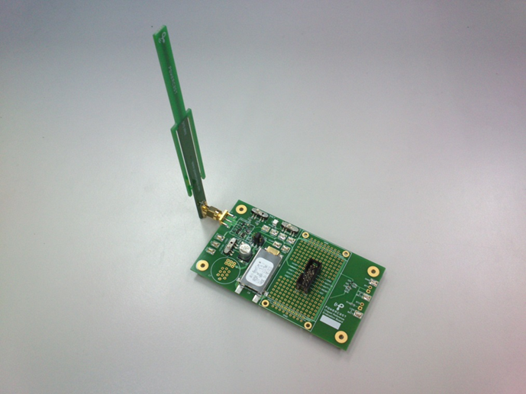
Power Harvester P2110CSR-EVB
Convert RF input to DC current
Frequency range: 850-950MHz
Output voltage: 1.8V to 5.25V
(configurable)
Range of at least 3 meters

Slide 34
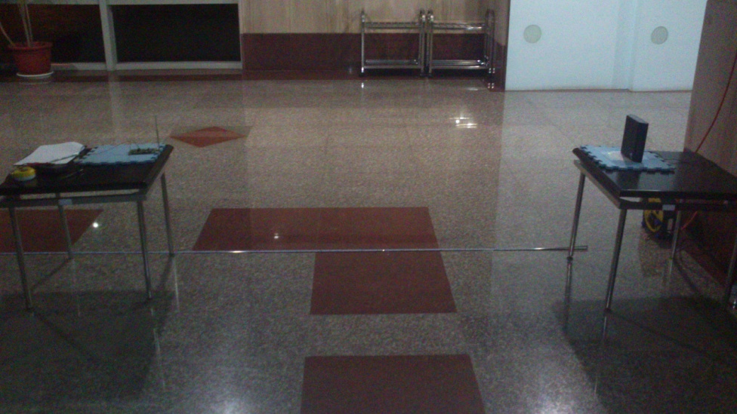
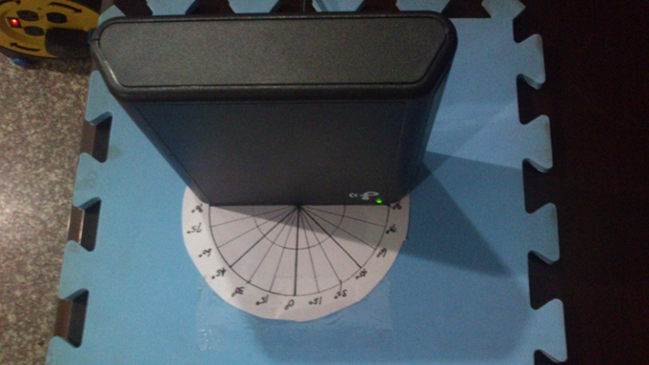
Experiment
Distance R
Normal vector $\overset{⃑}{N}$
$$θ$$

Slide 35
Experiment
Voltage (V) and distance (m) between $0^{°}{\sim 90}^{°}$
R /$θ$ | $$0^{°}$$ | $${15}^{°}$$ | $${30}^{°}$$ | $${45}^{°}$$ | $${60}^{°}$$ | $${75}^{°}$$ | $${90}^{°}$$
0.5 m | 4.21 | 4.21 | 4.21 | 4.20 | 4.20 | 4.20 | 4.20
1.0 m | 4.21 | 4.21 | 4.21 | 4.20 | 4.20 | 4.20 | 0.02
1.5 m | 4.21 | 4.21 | 4.21 | 4.21 | 3.04 | 2.01 | 0.02
2.0 m | 4.21 | 4.21 | 4.20 | 4.19 | 1.30 | 1.01 | --
2.5 m | 4.20 | 4.19 | 2.90 | 2.46 | 0.82 | 0.02 | --
3.0 m | 2.74 | 2.39 | 1.88 | 0.73 | 0.01 | -- | --
3.5 m | 1.01 | 0.03 | 0.02 | 0.03 | -- | -- | --
4.0 m | 0.04 | -- | -- | -- | -- | -- | --

Slide 36
Experiment (Cont.)
Voltage (V)
Distance (m)

Slide 37
Experiment (Cont.)
Current (mA) and distance (m) between $0^{°}{\sim 90}^{°}$
R /$θ$ | $$0^{°}$$ | $${15}^{°}$$ | $${30}^{°}$$ | $${45}^{°}$$ | $${60}^{°}$$ | $${75}^{°}$$ | $${90}^{°}$$
0.5 m | 35.5 | 33.6 | 26.9 | 22.7 | 12.8 | 4.20 | 2.52
1.0 m | 7.80 | 7.65 | 4.84 | 2.94 | 1.85 | 0.49 | 0.03
1.5 m | 4.50 | 3.58 | 2.99 | 1.98 | 0.18 | -- | --
2.0 m | 2.78 | 2.36 | 2.04 | 1.44 | -- | -- | --
2.5 m | 1.31 | 0.96 | 0.79 | 0.38 | -- | -- | --
3.0 m | 0.75 | 0.44 | 0.37 | -- | -- | -- | --
3.5 m | 0.07 | -- | -- | -- | -- | -- | --

Slide 38
Experiment (Cont.)
Current (mA)
Distance (m)

Slide 39
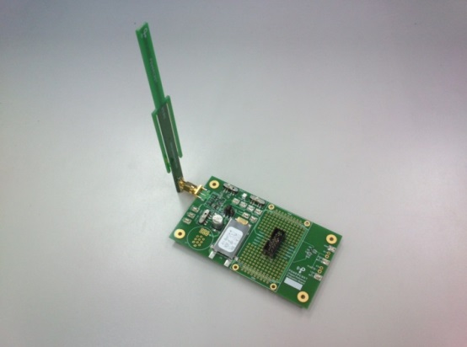
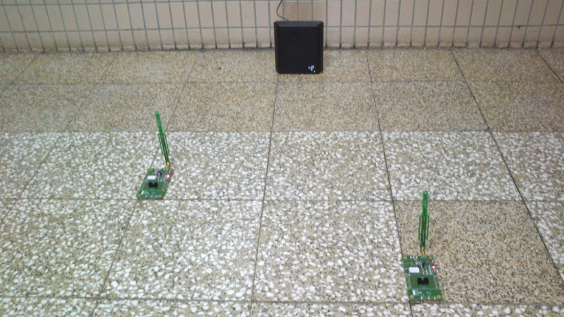
Powercast Charger Effective Charging Area
Powercast wireless charger
Powercast energy harvester
3 m
$${60}^{°}$$

Slide 40
Wireless Rechargable Sensor Network
Charger
+ Harvester
+ WSN (wireless sensor network)
= WRSN (wireless rechargable sensor network)

Slide 41
Part 2: Charger Deployment for Wireless Rechargable Sensor Networks

Slide 42
Part 2: Outline
Introduction
Problem Definition
Methods
Simulation
Conclusion

Slide 43
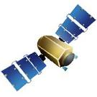
WSN: Wireless Sensor Network
Sensing Range
Sink Node
Sensor Node
Communication Range

Slide 44
Wireless Sensor Node Examples
A wireless sensor node is a device integrating sensing, communication, and computation. It is usually powered by batteries.

Slide 45
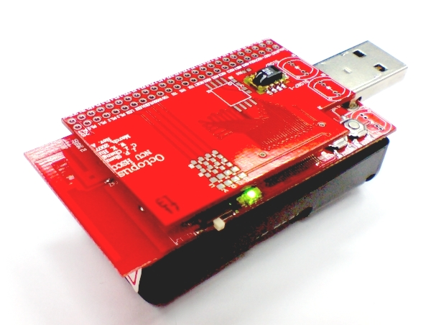
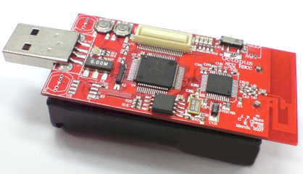
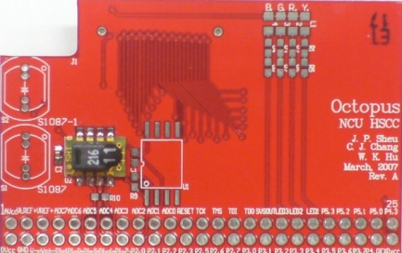
Wireless Sensor Node Example: Octopus II
MCU+Memory+RF
Sensing Module
+
=
Developed in National Central University and National Tsin Hua University
MCU: TI MSP430, 16-bit RISC microcontroller core @ 8Mz
Memory: 40KB in-system programmable flash,10KB RAM, 1MB expandable flash
RF: Chipcon CC2420, 2.4 GHz 802.15.4 (Zigbee) Transceiver (250KBps) (~450m)
Sensing Module: Temperature sensor, Light sensors, Gyroscope, 3-Axis accelerometer
Power: 2 AA battery

Slide 46
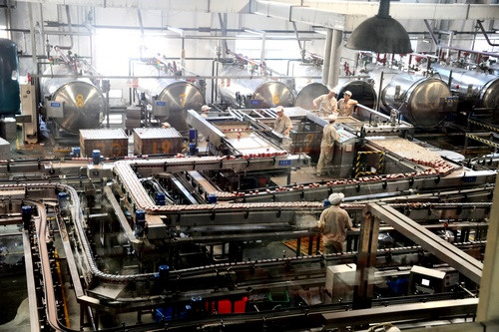
WSN Application Example
Temperature
Humidity
…
Temperature
Humidity
…
Temperature
Humidity
…
Temperature
Humidity
…
Temperature
Humidity
…

Slide 47
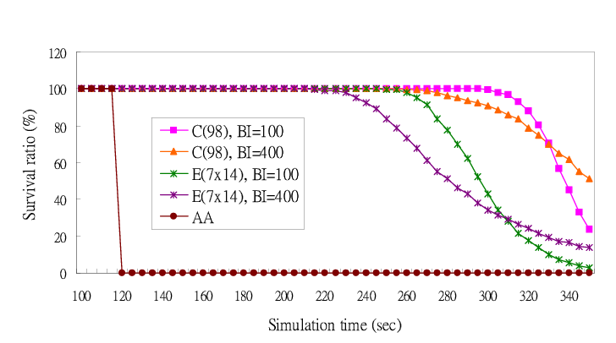
Q: How to make WSNs sustainable?
(hour)

Slide 48
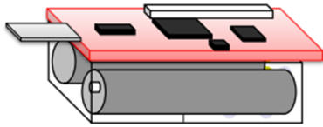
A: WSN + RF Charger Energy Harvesting
Energy Source: Charger
Energy Harvester
Energy-DC

Slide 49
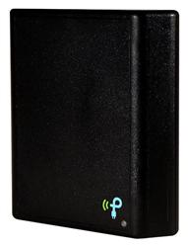
Wireless Charging Model
Charging
Distance
$$R=3m$$
Charger
$θ$ = ${30}^{°}$
$$\overset{⃑}{N}$$
Symmetrical Axis Vector
Sensor Node

Slide 50
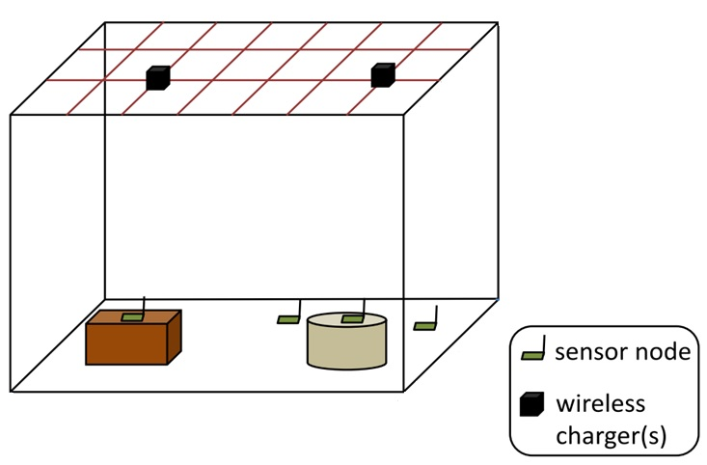
Scenario and Goals
Goal: Cover all sensor nodes with the minimum number of chargers to reduce the charger deployment cost.
Assumption:
Sensor nodes in the WRSN can be located on the ground or object surfaces in a cuboid.
The wireless chargers are assumed to be deployed at grid points on a grid of side length G.
G
Each grid point allows the deployment of several wireless chargers, each equipped with a directional antenna with an adjustable orientation.
H
Every node can decide the maximum number of chargers needed to make it sustainable.
W
L

Slide 51
Our Goal
Cover all sensor nodes with the minimum number of chargers to make the WRSN sustainable while keeping an as low as possible charger deployment cost.

Slide 52
Our proposed methods
Two greedy heuristic algorithms to minimize the number of chargers.
NB-GCS (Node Based Greedy Cone Selection)
PB-GCS (Pair Based Greedy Cone Selection)

Slide 53
Candidate cone generation for NB-GCS
For each grid point, first select the sensor nodes within its sphere coverage.
Then generate a vector for each node as the charger cone’s symmetric axis (or orientation).
Charging
Distance
Grid Point
$$R$$
g
A
B
E
D
C
Notes:
0917-342-520

Slide 54
Candidate cone generation for NB-GCS
Each vector stands for a cone.
For each cone, try to adjust its orientation for the cone to cover more nodes.
$$R$$
g
A
B
E
D
C

Slide 55
Candidate cone generation for NB-GCS
The cone orientation adjustment is done by unit vector summation.
g
$$\frac{\overset{⃑}{gA}}{\left\|\overset{⃑}{gA}\right\|}$$
$$\frac{\overset{⃑}{gB}}{\left\|\overset{⃑}{gB}\right\|}$$
A
B
$$\frac{\overset{⃑}{gA}}{\left\|\overset{⃑}{gA}\right\|}+\frac{\overset{⃑}{gB}}{\left\|\overset{⃑}{gB}\right\|}$$
E
D
C

Slide 56
Candidate cone generation for NB-GCS
g
Parallel with
$$\frac{\overset{⃑}{gA}}{\left\|\overset{⃑}{gA}\right\|}+\frac{\overset{⃑}{gB}}{\left\|\overset{⃑}{gB}\right\|}$$
A
B
E
D
C

Slide 57
Candidate cone generation for NB-GCS
Iterations for node A stops if the cone orientation adjustment cannot make the cone cover more nodes.
$$R$$
g
A
B
E
D
C

Slide 58
Candidate cone generation for PB-GCS
For each grid point, first select the sensor nodes within its sphere coverage.
Then generate a vector for each node as the charger cone’s symmetric axis (or orientation).
Then for each pair of nodes (or vectors), generate candidate cones.
Charging
Distance
Grid Point
$$R$$
g
A
B
E
D
C

Slide 59
Candidate cone generation for PB-GCS
Mapping each vector onto g’s unit sphere.
There are three cases to consider.
$d_{ij}>2r$
$d_{ij}=2r$
Unit sphere
1
g
Unit sphere
1
g
r
r
r
$$d_{ij}$$
$$d_{ij}$$
i
j
i
j

Slide 60
Candidate cone generation for PB-GCS
Unit sphere
$d_{ij}<2r$
1
g
$$d_{ij}$$
$$d_{ij}$$
r
i
j
i
j

Slide 61
Greedy cone selection for both methods
C3
C1
C2
Return set is empty initially
$$C=∅$$
B
#sensor a cone can cover
A
C1 | C2 | C3
4 | 3 | 1
C
D
#chargers needed by a sensor
A | B | C | D
1 | 1 | 1 | 2

Slide 62
Greedy cone selection for both methods
C3
C1
C2
$$C=\{C1\}$$
B
A
C1 | C2 | C3
0 | 0 | 1
C
D
A | B | C | D
0 | 0 | 0 | 1

Slide 63
Greedy cone selection for both methods
C3
C1
C2
$$C=\{C1, C3\}$$
B
A
C1 | C2 | C3
0 | 0 | 0
C
D
A | B | C | D
0 | 0 | 0 | 0
Finish!

Slide 64
Simulation
Item | Parameter
Region | 20 x 15 $m^{2}$
#Sensors | 50, 100, 150, 200, 250
Effective Charging Distance | 3.0 $m$
Angle Threshold | $${30}^{°}$$
The Height of the Deployment Plane | 2.3 $m$
Grid Length | 1.0, 1.4, 1.8 $m$
Simulator | C++

Slide 65
Simulation
grid length = 1
The most ideal case of 100%-0%, in which all sensor nodes need the 1-coverage requirement
#chargers
#sensors

Slide 66
Simulation
grid length = 1
80% of nodes require 1-coverage and 20% of
nodes require 2-covearge of chargers.
#chargers
#sensors

Slide 67
Simulation
The influence of the grid side length on the number of chargers.
#sensors = 150
The smaller, the better. But the computation is also larger.
#chargers
grid length

Slide 68
Part II: Short Summary
Our contribution:
Propose two near-optimal algorithms to minimize the number of chargers: NB-GCS & PB-GCS.
Comparisons:
 | NB-GCS | PB-GCS
Performance | Good | Better
Time Complexity | $$O(p^{2}n^{3})$$ | $$O(p^{2}n^{5})$$

Slide 69
Future Work
Allow the deployment of chargers at any place
Consider the obstacles between chargers and harvesters
Design duty-cycle scheduling schemes for chargers to save energy
Use novel heuristic or metaheuristic algorithms to solve the problem

Slide 70
Thank you!

