Slide 1
What is CPS
Presented by Jehn-Ruey Jiang
National Central University
Taoyuan City, Taiwan
Notes:
變大、變深、變朦!?
Gets big, deep, and foggy!?

Slide 2
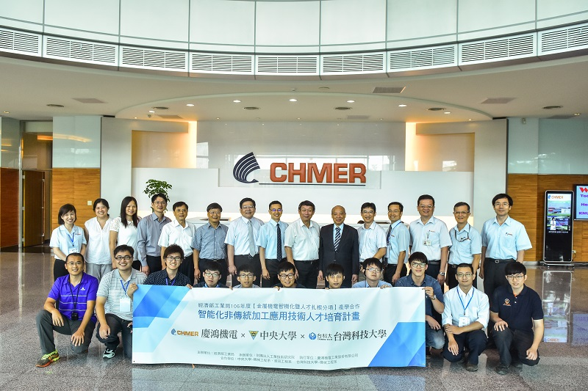
Source: http://www.businessweekly.com.tw/article.aspx?id=33360&type=Indep (商業周刊2017年10月1560期)
Notes:
經濟部工業局「金屬機電智機化暨人才扎根」產學合作
產官學攜手為智慧機械產業育才
2017.10.02
撰文者產官學攜手為智慧機械產業育才
廣編企劃瀏覽數：81
+A-A
智慧製造成為全球產業的顯學，經濟部工業局結合國內機械相關公協會整合智慧機械產業人才需求，推動厚植國產化關鍵技術研發及應用人才技能，為智慧機械產業全力育才。
智慧機械是台灣工具機產業目前必須轉型的新契機，但智慧機械需要的技術不再限於機械工程本身，而是跨及資訊科技等領域。
現今產業急需跨領域人才，因此經濟部工業局因應產業人才需求，推動「金屬機電智機化暨人才扎根」產學合作，促成企業及大學校院共同培育智慧機械產業所需人才， 強化產業人才加值及產業升級轉型。
人才是落實智慧機械的關鍵
慶鴻機電為台灣放電加工機業第一品牌並自主研發電腦控制器、其產品應用於航太、汽車、3C、醫療等產業的模具與零件。在全球工業4.0發展趨勢下，慶鴻不斷提升產品的高精度、智慧化功能來滿足客戶需求，然而人才將成為慶鴻技術提升及產品附加價值提高的關鍵。
慶鴻機電總經理王陳鴻表示，三年前開始透過經濟部工業局產學合作推動平台，與修平科大及僑光科大共同培育企業所需人才，慶鴻每學期皆指派技術團隊主管到學校協助教學，讓學生在學時就能學習到產業所需技術，並提供學生大四期間來慶鴻進行全年度的實務技能訓練，慶鴻把學生都視為為公司未來重要的資產，公司高階主管定期關懷學生實習情況，也安排學生進行產線各站訓練；此外，慶鴻協助學生規劃職涯發展，讓學生清楚知道每個階段需學習不同技能。
因智慧機械時代來臨，慶鴻更需要跨領域人才進入企業，今年在經濟部工業局產學合作平台協助下攜手中央大學機械系、資工系及臺科大機械系共同推動跨領域人才產學合作。
為實習生規劃職涯發展藍圖
修平科技大學機械系學生謝凱翔，大三時參加產業人才扎根計畫，於大四期間進入慶鴻展開整年度的實習。今年夏天剛從學校畢業的他，決定留在慶鴻就業，成為慶鴻正式員工。
「慶鴻在我進來實習前，會先規劃好我的工作內容與學習目標，不會讓我流於漫無目的的實習。而且慶鴻設有企業導師制，時時關懷我在實習期間的學習狀況。」產品最重要就是高精度，機械組立則是產品高精度製程的第一步，謝凱翔在師傅指導下進行鑄件組裝及精度測試，學習產品製程中最關鍵技術。他認為，慶鴻有完整職涯規劃外，更打造幸福企業環境，讓學生有家的感覺，因此促使他在畢業後，主動選擇進入慶鴻工作。
跨域、跨專業、跨學術與實務
慶鴻機電總經理王陳鴻表示，今年結合中央機械系、資工系及台科大機械系進行「跨域、跨專業、跨學術與實務的產學合作」，讓在校的機械系、資工系學生認同機械相關產業，之後學生畢業後才會願意進來機械相關產業工作。
中央大學機械工程學系教授顏炳華也指出，政府目前著力發展智慧機械、智慧製造，但眼前最缺乏跨領域的人才。推動智慧機械發展，一定要靠人才，而人才的產生來自教育。因此，中央機械工程學系與資訊工程學系、台科大機械工程系透過「金屬機電智機化暨人才扎根」計畫，與慶鴻展開合作，由慶鴻、研華科技、鼎新電腦擔任業師，規劃跨領域的課程，讓學生瞭解慶鴻的產品、發展願景、所需技術等。
中央機械系主任何正榮指出，產業遭遇製程相關的瓶頸，通常是系統的問題，學界要協助產業解決問題，也必須要組成跨科系的團隊，若以智慧機械來講，就得納入機械、資工、資管等領域，為機械產業解決特定題目，而學生透過產學合作提早認識產業發展，就會自動學習跨領域，並懂得跟不同領域的同學展開合作，甚至未來學生畢業後進入職場後，對跨領域的整合也不會感到陌生，同時對其他領域亦有涉獵。
此次更吸引中央資工系學生參加「金屬機電智機化暨人才扎根」計畫，學生們從產學合作中，首度瞭解到智慧機械未來發展的大好前景。中央資工系教授江振瑞表示，資工系學生來慶鴻做專題後，發現智慧機械是新領域，而且前景會更長遠，如果畢業後馬上進入這項領域工作，將會早別人一步，盼藉由經濟部工業局產學合作平台，鼓勵資工系學生投入這項產業。
經濟部工業局提供一個產學合作平台，協助企業解決人才需求缺口，王陳鴻說：「我們希望透過更多產學合作計畫，讓更多學校老師、學生能深入瞭解我們產業。」慶鴻藉由經濟部工業局產學合作平台資源，進入校園與學校攜手共同培育自己要的人才，也提供健全職涯規劃，讓學生知道自己未來的發展，這個模式成效非常豐碩，慶鴻未來會持續推動企業育才於校，將人才做為慶鴻最大資產。

Slide 3
Source: Siemens PLM Software
Notes:
工業物聯網(Industrial Internet of Things, IIoT)是實現德國政府所提工業4.0 (Industry 4.0, I4.0)[1]策略的核心技術。如文獻[2]中所描述:「工業4.0一詞最早是在 2011 年的漢諾瓦工業博覽會提出。2012年10月由羅伯特·博世有限公司的 Siegfried Dais 及利奧波第那科學院的孔翰寧組成的工業4.0工作小組，向德國聯邦政府提出了工業4.0的實施建議。2013年4月8日的漢諾瓦工業博覽會中，工業4.0工作小組提出了最終報告」。如圖1所示，工業4.0 的策略願景是藉由網實融合系統(Cyber-Physical System, CPS)[3]或網實融合生產系統(Cyber-Physical Production System, CPPS)[4]建構智慧工廠(Smart Factory)達成第四次工業革命。這是繼利用蒸汽動力生產的第一次工業革命、使用電力為基礎進行生產線式大量生產的第二次工業革命、及使用電子裝置及資訊技術以增進工業自動化製造的第三次工業革命之後的革命(revolution)或演進(evolution)。除了德國政府提出的工業4.0策略之外，還有許多其他國家政府或機構也提出類似的策略或概念[5]，包括台灣的生產力4.0 (Productivity 4.0)、美國再工業化(Reindustrialization)、中國製造2025、IBM的智慧地球（Smart Planet）、思科（Cisco）的萬物聯網（Internet of Everything, IoE）、奇異電子（GE）的工業網際網路（Industrial Internet）、阿里巴巴的C2B商業模式、海爾的互聯工廠與智慧家庭，如[5]所提到的，這些策略或概念講的都是同一件事，只是從不同角度切入與實踐而已。

Slide 4
Manufacturing Strategies of Leading Countries
Industry 4.0
Cyber-Physical System
Smart Factory
Internet of Things and Services
Europe 2020
Productivity 4.0
Smart Manufacturing
upgrade manufacturing from automation to smart production
Manufacturing
Renaissance
Advanced Manufacturing Partnership (AMP)
3D Printing, Big Data, Advanced Robots, Energy Saving
Reindustrialization
Robotics
Revolution
Human and Robots Coexist
Mutually-connected Robots, Autonomous Data Accumulating and Utilizing
J4.1
Made in China 2025
Higher Value-Added Manufacturing
Digital Manufacturing, Innovative Manufacturing
Source: http://www.epochtimes.com/b5/15/9/4/n4520369.htm
Notes:
產業發展概況
一、 農業 近年來臺灣農業結構快速調整，由以往單純的生產功能，轉為兼顧生活及生態層面。105年我國農業占GDP比重為1.82%，104年平均每戶農家所得（不含休廢耕）為102.6萬元，為歷年之最。
二、工業 70年代以來，我國製造業朝高科技方向快速發展。其中，資訊與通訊科技(ICT)產業已成為全球生產重鎮，104年晶圓代工產值占全球73.7％，積體電路(IC)封測占全球51.8％，均為世界第一。105年整體製造業占GDP比重為30.16％，工業占GDP比重則為35.04％。
三、服務業 服務業自70年代中期起，隨國民生活水準提高而蓬勃發展，105年服務業占GDP比重達63.15％，占總就業人數比重達59.17％，顯示服務業已為我國經濟活動之主體，亦為創造就業主要來源。
展望未來，在歐美國家開啟「新工業革命」、數位新經濟崛起、中國大陸本土供應鏈成形等趨勢下，臺灣過去擅長的精實生產、效率競爭模式，已漸漸無法扮演經濟成長的引擎。為此，政府刻推動「亞洲‧矽谷」、「生技醫藥」、「智慧機械」、「綠能科技」、「國防產業」、「新農業」等產業創新計畫，以在地需求為起點，善用地區優勢，並透過各項配套措施，結合中央與地方、國內與國外的資金、技術及人才，完善臺灣創新生態體系，並協助廠商由生產單一零組件、模組或產品，升級為軟硬系統整合之整體解決方案，以帶動整體產業創新轉型，為經濟成長注入新動能。(請參考 表6我國近三年來總體經濟指標)

Slide 5
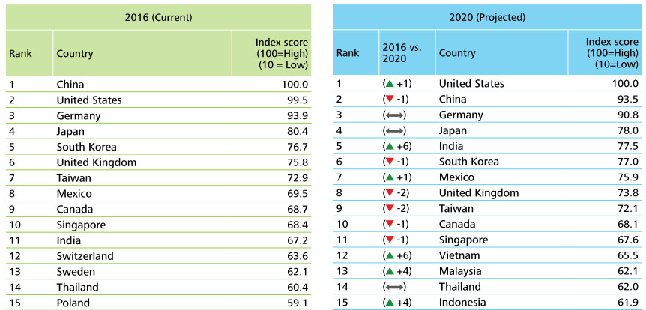
2016 Global Manufacturing Competitiveness Index (GMCI)
Source: https://www2.deloitte.com/content/dam/Deloitte/global/Documents/Manufacturing/gx-global-mfg-competitiveness-index-2016.pdf

Slide 6
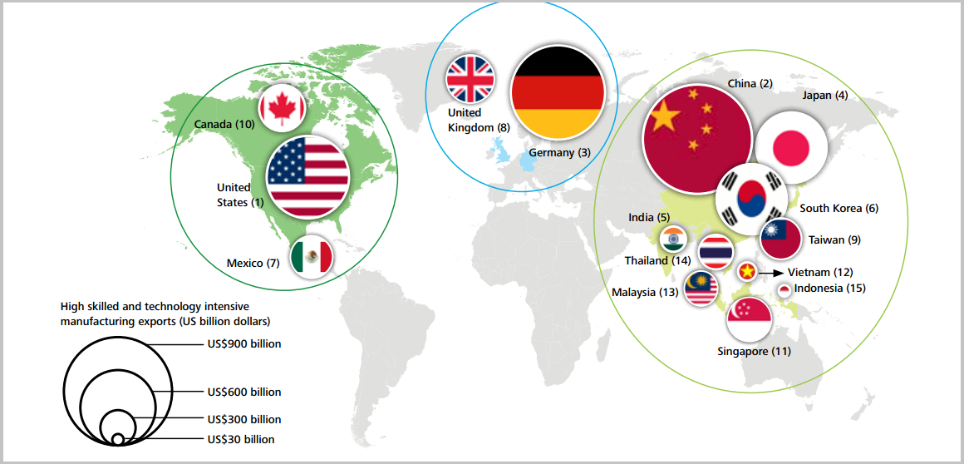
2020 Global Manufacturing Competitiveness Index (GMCI)
Source: https://www.weforum.org/agenda/2017/01/designing-iinnovation-policies-in-emerging-economies/
Notes:
Figure in parenthesis represent the projected 2020 GMCI rank by CEOs
Image: Deloitte Touche Tohmatsu Limited and US Council on Competitiveness
That is important because there are significant risks for emerging markets. Over the last decades, these countries have explored their competitive advantage on labour costs and natural resources availability. However, the industry of theFUTURE will demand fewer and more qualified workers on manufacturing systems, products will be more sustainable and it will be cost-effective to operate close to customers (reshoring). Governments and businesses from developing countries have to analyse where they could be competitive in a situation where previous advantages are fading away.
This article is part of the World Economic Forum Annual Meeting
Developing countries are interesting innovation policy schools. In places where the basic economic principles of limited resources versus unlimited needs are amplified, designing innovation policies becomes even more challenging.
You put together in a briefcase mass customization, 3D printing, advanced robotics, the internet of things, artificial intelligence and countless other fun developments – and you knock on several doors with your innovation pitch of "best INVESTMENT today for the development of tomorrow". The challenge is that people demand better health, education, employment and security today. So the pitch really has to be impressive.
The fourth industrial revolution will be more challenging for emerging economies because risks can be potentially bigger than opportunities. The impact will vary according to the answers to these three questions:
1) When will these advanced manufacturing technologies be widely adopted?
2) What public policies will be necessary to deal with this new species of economic development?
3) How fast will domestic companies adapt to the uncertainties created by new technologies and business models?
Nobody knows the answers yet because we are at the beginning of an industrial transformation whose impacts are almost impossible to predict. Nevertheless, we can certainly say that we'll see faster results than in previous industrial revolutions.
Figure in parenthesis represent the projected 2020 GMCI rank by CEOs
Image: Deloitte Touche Tohmatsu Limited and US Council on Competitiveness
Based on a situation dominated by uncertainty and complexity, it is mandatory that governments and businesses in developing countries identify as soon as possible the risks and opportunities for Industry 4.0. It is the first step to understand, plan and make decisions about how to deal with this new reality.
That is important because there are significant risks for emerging markets. Over the last decades, these countries have explored their competitive advantage on labour costs and natural resources availability. However, the industry of theFUTURE will demand fewer and more qualified workers on manufacturing systems, products will be more sustainable and it will be cost-effective to operate close to customers (reshoring). Governments and businesses from developing countries have to analyse where they could be competitive in a situation where previous advantages are fading away.
Another serious concern is jobs. Advanced manufacturing will require a different kind of worker in the future. As they learn to make their own decisions, robots look set to replace many mental activities, as well as physical. The worker of the future will need to be highly proficient at soft skills such as teamwork, creativity, critical thinking, as well as technical skills. It will be an enormous challenge for traditional education systems and long-term outcomes.
Industry 4.0 also presents potential opportunities for emerging economies. The first and obvious advantage is the size of the consumer market: it is an important motivation to foster local production, innovation and attract foreign directINVESTMENT to the country. One important aspect of this new revolution is reduced barriers to entry. Digital tools, low-cost and powerful sensors, 3D printing and other technologies have brought into being new businesses, business models and opportunities. It is an excellent opportunity to create customized products and services to local markets based on their own reality.
The world’sFUTURE growth will largely depend on the engines of emerging markets. The physical and digital infrastructure needs are immense, and so is the demand on more intelligent solutions for water, sanitation, education, housing; among others. Despite the current economic scenario, these economies are already rising up international rankings, such as Deloitte’s 2016 Global Manufacturing Competitiveness Index.
Complexity and speed are of essence once you understand the profound impacts that Industry 4.0 will have on global value chains, education, employment and many other critical economic and social aspects. With that in mind, in 2015 the Brazilian government brought together private sector, academia, research institutes and other parties to develop an advanced manufacturing policy. The main question was simple and complex: what should be an advanced manufacturing strategy for Brazil?
A large, inclusive and transparent process of public consultation was carried out from North to South of Brazil (a country which is 24 times the size of Germany). Since the beginning of 2016, hundreds of specialists from private sector, government and academia took part in structured workshops pointing out practical opportunities and challenges on the areas of technological convergence, regulation, human resources, value chains and infrastructure. A positive side effect of this process is the growing awareness about the topic in government and private sector.
Indeed several key questions remain open: which strategic choices will Brazil make in terms of Industry 4.0? How will the country position itself as value chains become more flexible but at the same time more fragmented? How will inter-operability and data security be ensured? What technologies should be prioritized based on our own capability? What is the ultimate goal: productivity increase, technology development or both? The most important aspect is that we are answering these questions together with the Brazilian society and not only on government cabinet offices.
The fact is that the world is a very different place today and new opportunities exist for emerging economies. KPMG’s Future State 2030 points out that in 1937 a company used to stay on average 75 years on S&P’s 500 Index. In 2011, it was 15 years. In 2025, this is expected to be five years. This is the core of the pitch.
If emerging economiesINVEST fast enough and properly on innovation policies, work with networks of local and global partners, take advantage of large consumer markets, they will certainly have a good story to tell in theFUTURE.

Slide 7
What is CPS?
Cyber-Physical System
Cyber is a prefix related to networking and computing
CPS was first defined as “a system composed of collaborative entities, equipped with calculation capabilities and actors of an intensive connection with the surrounding physical world and phenomena, using and providing all together services of treatment and communication of data available on the network” at an NSF workshop held in Austin, Texas, USA, in 2006.
CPS is regarded as the core concept of Industry 4.0 advocated by the German government for building smart factories to bring about the fourth industrial revolution.

Slide 8
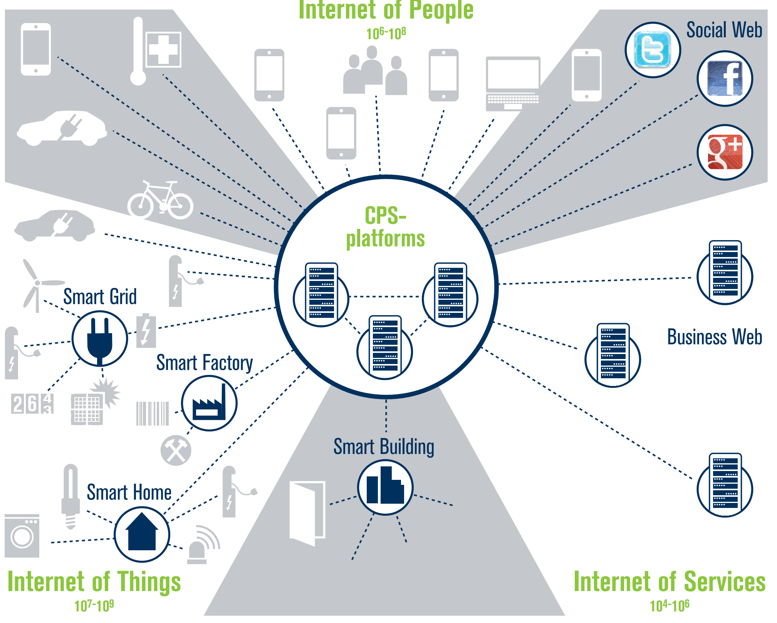
Source: Bosch Software Innovations, 2012

Slide 9
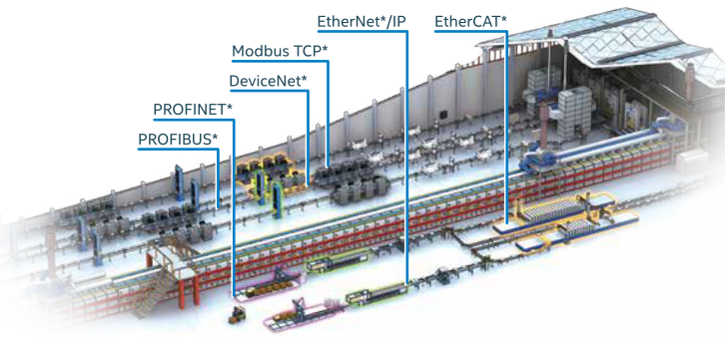
Fieldbus for Local Area Network for Factory
Source: http://www.nexcom.com.tw/news/Detail/brining-intelligence-to-manufacturing-with-the-internet-of-things-iot

Slide 10
Industrial Internet of Things (IIoT) Gateway
Source: http://www.nexcom.com.tw/news/Detail/brining-intelligence-to-manufacturing-with-the-internet-of-things-iot

Slide 11
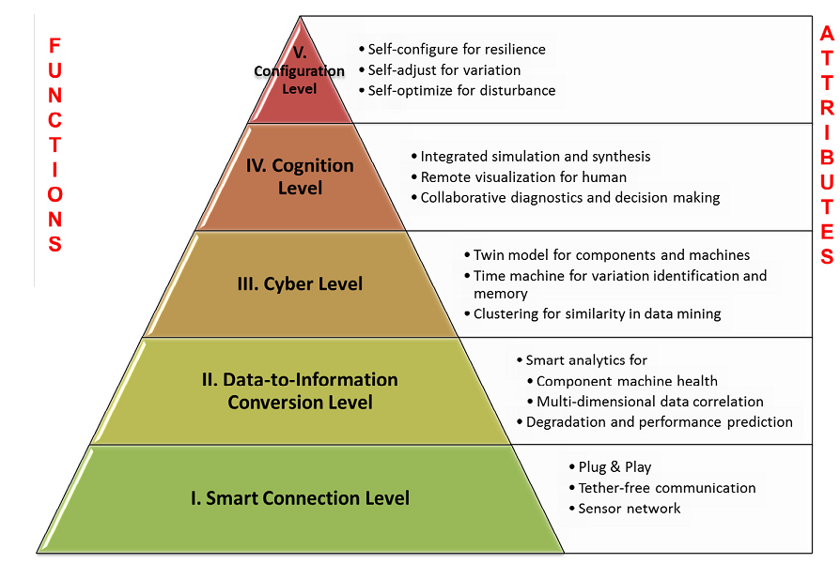
5C CPS Architecture (Lee et al., 2015)
Source: Lee, Jay, Behrad Bagheri, and Hung-An Kao. "A cyber-physical systems architecture for industry 4.0-based manufacturing systems." Manufacturing Letters 3 (2015): 18-23.

Slide 12
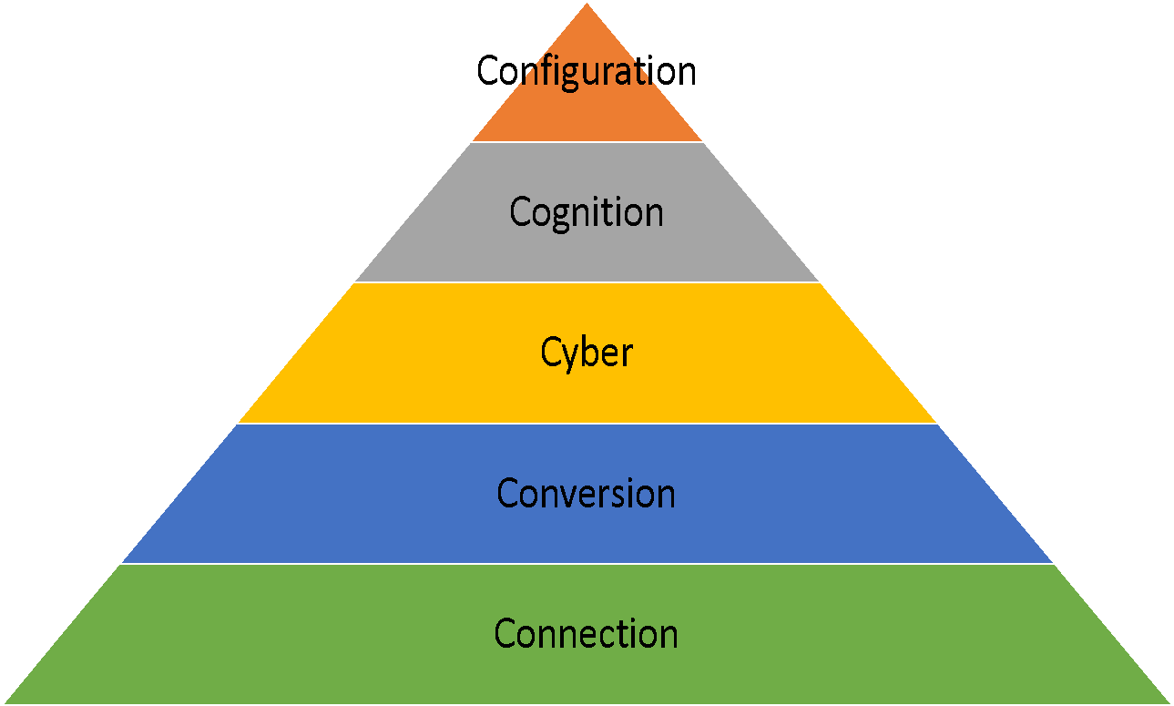
8C CPS Architecture (Jiang, 2017)
5C Levels
+ 3C Facets
Connection: connecting machines and their components for acquiring accurate and reliable data (measurements)
Conversion: data are converted into information to bring self-awareness properties, such as prognostics and machine lifetime prediction, to the machines
Cyber: playing the role of central information hub, which gathers massive information from machines in the machine network to extract in-depth analytic information
Cognition: proper presentation of analytic information is provided to users for making decisions
Configuration: giving feedback from the cyber part back to the physical part
Coalition: focusing on the value chain integration and production chain integration among different parties related products
Customer: focusing on the role which the customers play in the whole product life cycle, including the designing, producing, delivering, operating, using, maintaining, and recycling of the product
Content: focusing on the extracting, storing, and inquiring of product traceability record, like manufacturing parameters, machine states, and environment conditions, for optimizing the manufacturing process and providing better customer servcie
Customer
Content
Coalition

Slide 13
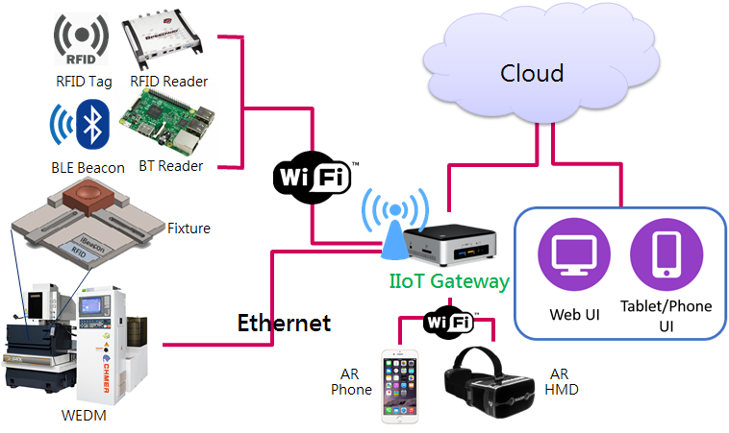
A 8C CPS for a Smart Factory

Slide 14
The End

