Slide 1
PINUS: Indoor Weighted Centroid Localization with Crowdsourced Calibration
Jehn-Ruey Jiang, Hanas Subakti, Ching-Chih Chen
Dept. of Comp. Sci. and Inf. Eng.
National Central University
Taoyuan City, Taiwan
Kazuya Sakai
Dept. of Elec. Eng. and Comp. Sci.
Tokyo Metropolitan University
Tokyo, Japan

Slide 2

Outline
____________
Introduction
Related Work
Proposed Method
Experiments
Conclusion

Slide 3
Introduction
The Indoor Localization system (ILS) is a popular topic
Global Navigation Satellite System, such as GPS, could not perform ILS
ILS should be redesigned
Many ILS applications: guidance and navigation, AGV steering, and item tracking
About PINUS or “PIN US”
PINUS is based on the weighted centroid localization (WCL)
Instead of using estimated distances to derive the target position directly (which mostly inaccurate), PINUS performs distance estimation calibration on the basis of the Friis equation, and uses distance ratios (i.e., weight) to derive target position
PINUS utilizes the crowdsourcing concept for devices to share calibration information
Experiments using Bluetooth Low Energy (BLE) Beacon as an anchor and Smartphone as a target are conducted.
Actually, other devices, such as WiFi AP, Arduino and Raspberry PI, can also be applied to realize the PINUS system.

Slide 4
Outline
____________
Introduction
Related Work
Proposed Method
Experiments
Conclusion

Slide 5
Weighted Centroid Localization
Adopt WCL based on Blumenthal et al. [8]
Using Friis Equation to estimates the distances
P_{r} is the power received by the receiver (i.e., target)
P_{t} is the transmission power of the transmitter (i.e., anchor)
G_{t} is the gain of the transmitter
G_{r} is the gain of the receiver
λ is the wavelength
d is the distance between the transmitter and the receiver.
Received Signal Strength Indicator (RSSI) calculation for P_{r}
RSSI of P_{r} is of the unit of dBm and is the ratio of the received power to the reference power P_{ref}, usually taken as 1 mW.
In this case we could put the Friis equation in relative decibel (dB) unit, we have the following equation
[8] J. Blumenthal, R. Grossmann, F. Golatowski and D. Timmermann, "Weighted Centroid Localization in Zigbee-based Sensor Networks," 2007 IEEE International Symposium on Intelligent Signal Processing, Alcala de Henares, 2007, pp. 1-6. doi: 10.1109/WISP.2007.4447528.

Slide 6
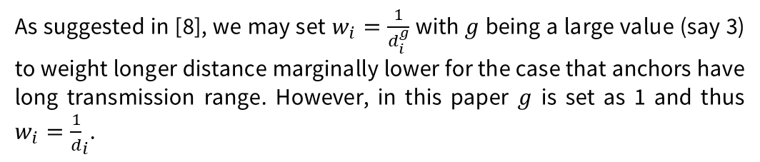
Weighted Centroid Localization(2)
On receiving signals from n anchors, a target can determine its position P=(Px, Py) according to the following equation, where n is usually taken as an integer at least 3.
As suggested in [8], we may set $w_{i}=\frac{1}{d_{i}^{g}}$ with $g$ being a large value (say 3) to weight longer distance marginally lower for the case that anchors have long transmission range. However, in this paper $g$ is set as 1 and thus $w_{i}={\frac{1}{d}}_{i}$.

Slide 7
Crowdsourced Indoor Localization
Fingerprinting localization
consists of two phases: offline site survey, and online positioning
In the site survey phase, a fingerprint (e.g., the RSSI values of WiFi APs) for every reference point (RP) is obtained
In the positioning phase, the observed fingerprint of a target (e.g., smartphone) is used as the key to find out k nearest fingerprints of k RPs for estimating target position, where k≥1.
Advantage of Crowdsourcing Fingerprinting
Crowdsourcing can relieve the burden of site survey by allowing common users to participate in fingerprinting.
A challenge of fingerprinting crowdsourcing is device diversity. Since crowds own devices with diverse brands, models, and hardware specifications, inconsistency of fingerprint measurements is likely to happen.

Slide 8
Outline
____________
Introduction
Related Work
Proposed Method
Experiments
Conclusion

Slide 9
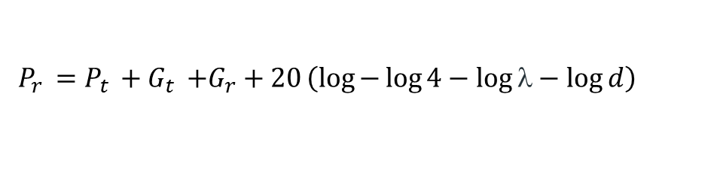
A. Calibration for WCL
When the WCL method is applied, a target can estimate the distance between itself and an anchor according to the RSSI value of the anchor’s signal received. This is under the assumption that the four values P_{t}, G_{t}, G_{r}, and λ in the Friis equation are known.
The calibration for WCL
Assume the target can receive the signal of a specific anchor with the RSSI value of P_{r} (in the unit of dBm) and the distance between the target and the anchor is d, we can derive the following equation on the basis of Eq. (3).
$$P_{r }={\left.P_{t }{+ G}_{t }+G_{r}+20\left(log\right.{−\log{4}}−\log{\text{λ}}−\log{d}\right)}^{ }$$

Slide 10

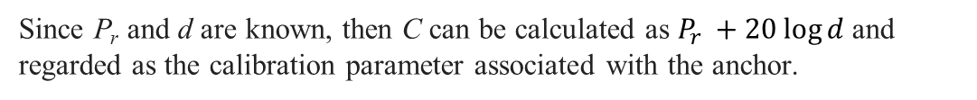
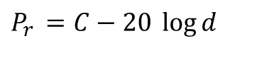
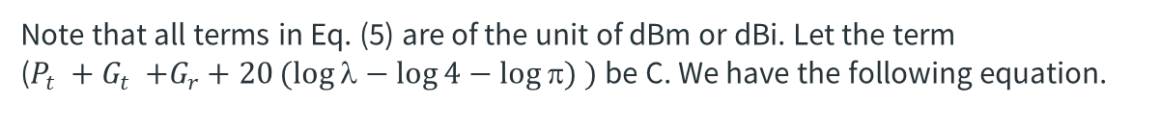
A. Calibration for WCL(2)
Note that all terms in Eq. (5) are of the unit of dBm or dBi. Let the term ($P_{t }{+ G}_{t }+G_{r}+20(log{λ−\log{4}}−\log{π}) )$ be C. We have the following equation.
$P_{r }={C−20 \log{d}}^{ }$
Since P_{r} and d are known, then C can be calculated as $P_{r }{+ 20\log{d}}^{ }$and regarded as the calibration parameter associated with the anchor.
After the calibration, when a target receives a signal from an anchor, it can use the RSSI value of Pr and the calibration parameter C associated with the anchor to derive the distance between itself and the anchor as follows.
$d={10}^{\frac{C−P_{r}}{20}}$
A target can derive the distance between itself and every anchor based on Eq. (7). Afterwards, it can derive the weight associated with every anchor and easily derive its estimated position on the basis of Eq. (4).

Slide 11
B. Crowdsourced Calibration for WCL
Crowdsourcing can be utilized to help complete comprehensive calibration
Crowdsourced calibration can be active or passive.
In active crowdsource calibration, a participant standing at a calibration point enters the coordinate of the calibration point to complete the calibration for all anchors whose signals can be received by the participant device.
In passive crowdsourced calibration, the sensors in the participant’s device can be used to derive location information or movement trajectory of the participant to allow the participant to do the calibration implicitly.
After performing the calibration for WCL, a target may upload the calibration parameters associated with some anchors to a web site for future sharing.
Note that a pseudo ID should also be uploaded or exchanged along with those parameters.

Slide 12
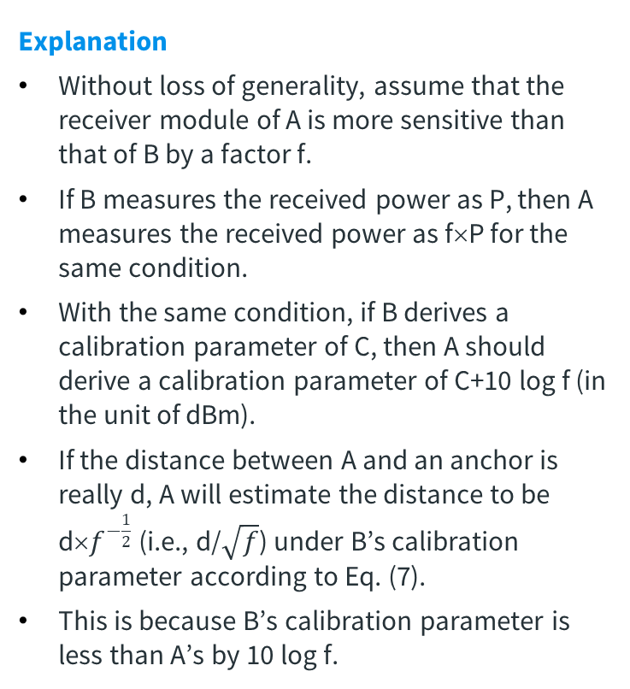
B. Crowdsourced Calibration for WCL(2)
Facing Device Diversity
The proposed crowdsourced calibration in practice has no device diversity problem.
A device A can directly use calibration parameters provided by another device B.
Explanation
Without loss of generality, assume that the receiver module of A is more sensitive than that of B by a factor f.
If B measures the received power as P, then A measures the received power as f×P for the same condition.
With the same condition, if B derives a calibration parameter of C, then A should derive a calibration parameter of C+10 log f (in the unit of dBm).
If the distance between A and an anchor is really d, A will estimate the distance to be d×$f^{−\frac{1}{2}}$ (i.e., d/$\sqrt{f}$) under B’s calibration parameter according to Eq. (7).
This is because B’s calibration parameter is less than A’s by 10 log f.

Slide 13
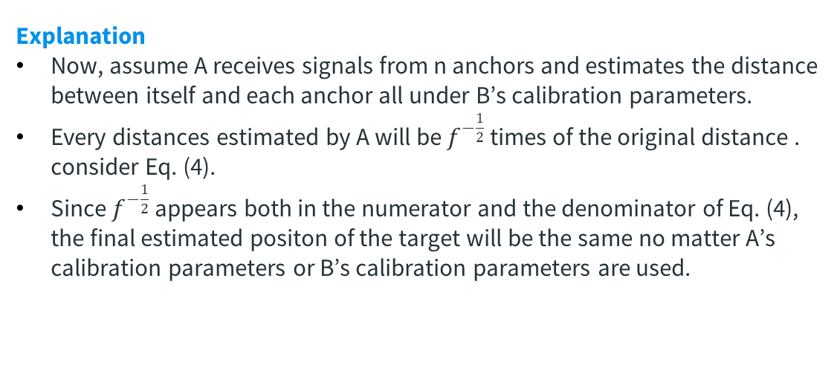
B. Crowdsourced Calibration for WCL(3)
Explanation
Now, assume A receives signals from n anchors and estimates the distance between itself and each anchor all under B’s calibration parameters.
Every distances estimated by A will be $f^{−\frac{1}{2}}$ times of the original distance . consider Eq. (4).
Since $f^{−\frac{1}{2}}$ appears both in the numerator and the denominator of Eq. (4), the final estimated positon of the target will be the same no matter A’s calibration parameters or B’s calibration parameters are used.
This also accounts for the reason why PINUS requires a target to use calibration parameters provided by a same participant when estimating its position.

Slide 14
Outline
____________
Introduction
Related Work
Proposed Method
Experiments
Conclusion

Slide 15

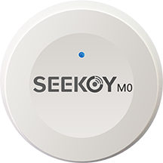
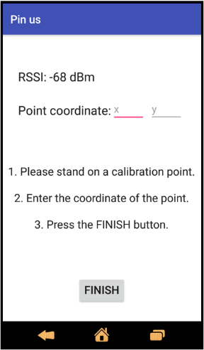
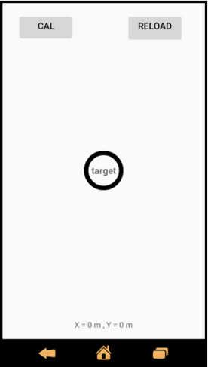
Implementation
PINUS is realized by an Android App as a target and a BLE beacon device as an anchor.
A BLE beacon device can periodically broadcast beacon signals that can be detected by smart devices nearby.

Slide 16
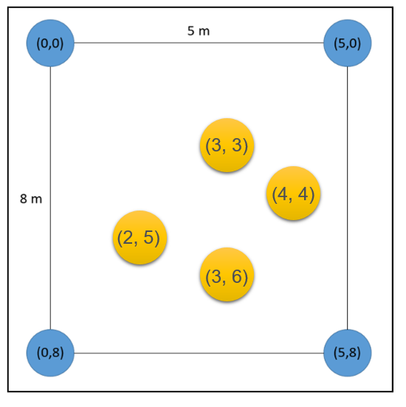
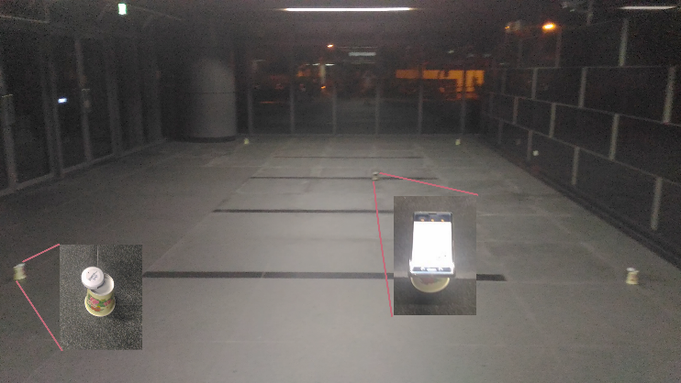
Experiment Environment Setting
Experiments are conducted in a 5m x 8m area at the lobby of Engineering Building V, National Central University, with four anchors deployed on the area corners.
A coordinate system is set up for the 5m x 8m area
30 continuous samples are taken for the error evaluation

Slide 17
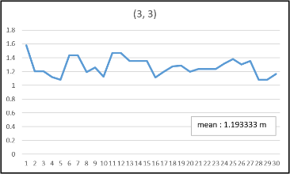
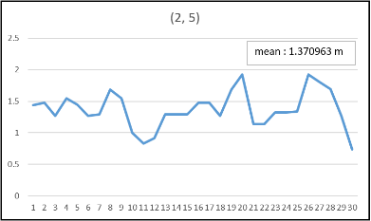
Experimental Results
Two types of smartphones are used as the target: device A is Sony Xperia XZ Premium, and device B is the Xiaomi Redmi 3S.
The experimental results for device A without calibration.

Slide 18
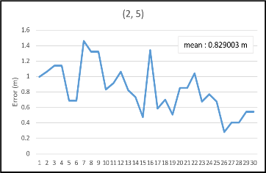
Experimental Results (2)
The experimental results for device A with calibration.

Slide 19
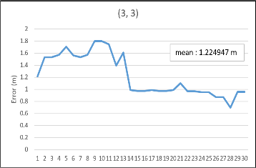
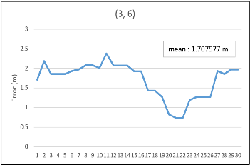
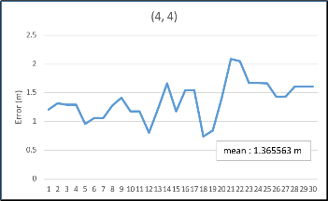
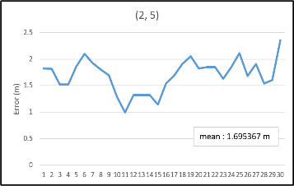
Experimental Results (3)
The experimental results for device B without calibration.

Slide 20
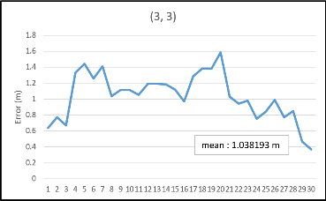
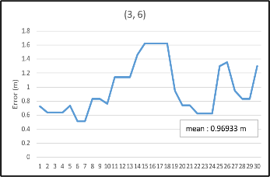
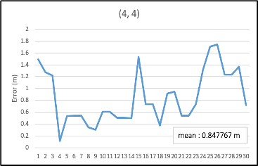
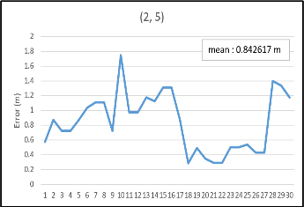
Experimental Results (4)
The experimental results for device B with calibration using device A’s calibration information

Slide 21
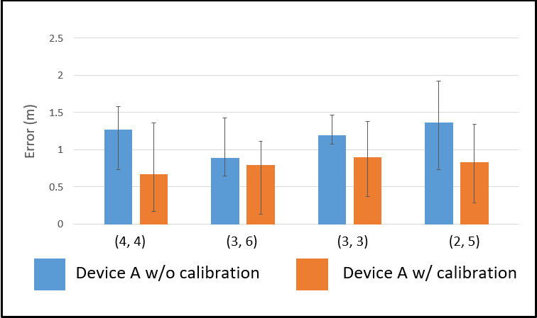
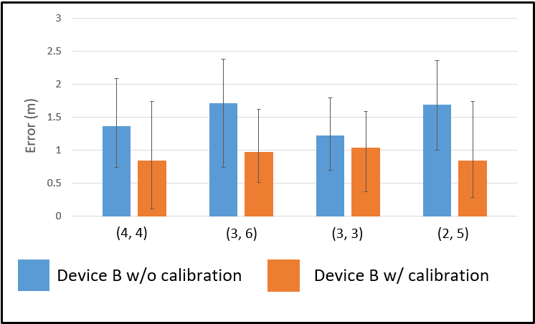
Experimental Results (5)
Mean, max, and min localization errors of device A.
Mean, max, and min localization errors of device B.

Slide 22
Outline
____________
Introduction
Related Work
Proposed Method
Experiments
Conclusion

Slide 23
This paper proposes PINUS, an indoor weighted centroid localization method with crowdsourced calibration, which does not have the device diversity problem.
Errors are reduced significantly when the calibration is applied even when a device uses another device’s calibration parameters for all anchors involved in the location process.

Slide 24
Future Work
Setting up a coordinate system for the Engineering Building V Building of NCU and attaching every WiFi AP to a unique coordinate
Performing the calibration process using a single device for all APs
Providing PINUS APP to all visitors or new-comers for the purpose of indoor navigation

Slide 25
Thanks!
Any questions?

