Slide 1
Avatar Path Clustering in
Networked Virtual Environments
Jehn-Ruey Jiang, Ching-Chuan Huang, and Chung-Hsien Tsai
Adaptive Computing and Networking Lab
Department of Computer Science and Information Engineering
National Central University
2010/12/08

Slide 2
Outline
Introduction
Related Work
Proposed Algorithms
Experiments and Performance
Conclusion

Slide 3
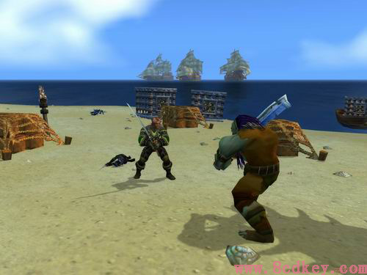

Introduction
Networked virtual environments (NVEs)
  virtual worlds full of numerous virtual objects to simulate a variety of real world scenes
  allowing multiple geographically distributed users to assume avatars to concurrently interact with each other via network connections.
  E.G., MMOGs: World of Warcraft (WoW), Second Life (SL)
Notes:
Networked virtual environments (NVEs) are virtual worlds full of numerous virtual objects created through computer graphics to simulate a variety of real world scenes, such as mountains, forests, and buildings, allowing multiple geographically distributed users to assume virtual representatives (or avatars) to concurrently interact with each other via network connections. Early SIMNET [1] and currently booming Massively Multiplayer Online Games (MMOGs), such as Second Life (SE) [2] and World of Warcraft (WoW) [3], are examples of NVEs.
For example, SE allows users to create fantastic objects and sell them in particular areas. Users with similar interests usually move towards similar areas for similar products and thus may have similar avatar paths.

Slide 4
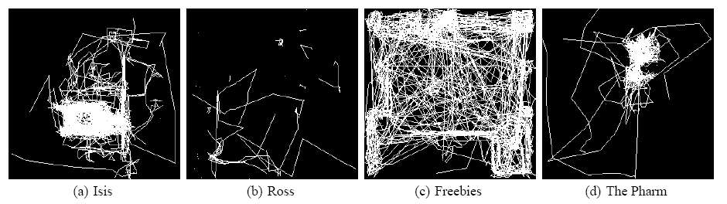
Avatar Path Clustering
Because of similar personalities, interests, or habits, users may possess similar behavior patterns, which in turn lead to similar avatar paths within the virtual world.
We would like to group similar avatar paths as a cluster and find a representative path (RP) for them.
Notes:
In order to verify the proposed avatar path clustering method in NVE, the study refers to the movement data of avatars gathered by [6] from Second Life. Second Life has a number of avatar motion paths on different regions. Each Region is the 256x256(unit²) of the virtual world, the AOI range of avatar is 16(unit). Each record includes avatar location data in the region within 24 hours(as seen in Figure 5). Data format for each location data includes date, time, user ID, and avatar location. Interval for data collection is approximately 10 seconds. Thus, the motion path of avatars is composed of a data series. The gathered avatar location data [6] is from the free will of players in the virtual world. This enabled it to correspond best with the actual avatar movements in NVE.

Slide 5
Related Work
Path Similarity
Clustering
  Partitioning
  Hierarchical
  Density-based
Notes:
In this section, we introduce some related research results about motion path similarity and clustering in spite that they are not intended for NVEs. Some path similarity methods are examined, followed by three classes of data clustering algorithms and relevant studies on path clustering.

Slide 6
Related Work
Path Similarity
Clustering
  Partitioning
  Hierarchical
  Density-based
Notes:
In this subsection we describe two methods of measuring the similarity of a pair of motion paths: Average Distance of Corresponding Points (ADOCP) and Longest Common Subsequence (LCSS) methods. ADOCP [4] is for measuring pairwise similarity of vehicle motion trajectories (i.e., paths) in real traffic video of a cross road scene. It is suitable for paths of similar beginnings and stops, since all paths appear and disappear at the video boundaries.

Slide 7
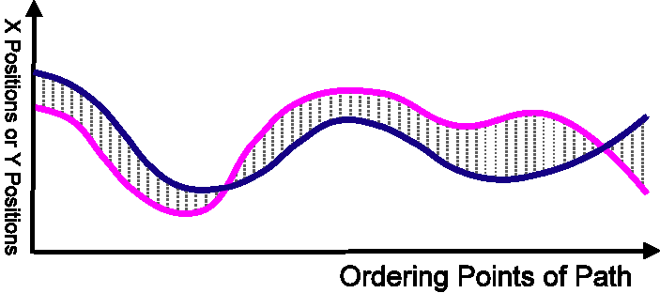
Path Similarity
For measuring pairwise similarity of vehicle motion paths in real traffic video of a cross road scene. It is suitable for paths of similar beginnings and stops.
Average Distance of Corresponding Points (ADOCP)
[Z.Fu et al. 2005]
Notes:
車子移動，處理雜訊，影響中的車子軌跡短
Before path similarity is measured, paths are pre-processed and resampled at equal space intervals. Two paths with similar beginnings and stops are then represented as two equal-sized sequences of points. Two points with the same sequence indices are regarded as corresponding points. The distance of every pair of corresponding points is measured and accumulated for calculating the average distance of the two paths to measure the similarity of the paths. ADOCP is sensitive to noise (e.g., zigzag segments in a motion trajectory), so some pre-processes are needed to eliminate the noise. Furthermore, since ADOCP requires that two paths for measuring have close beginnings and stops, paths should be aligned by padding additional points to path heads and tails until they reach the boundary.

Slide 8
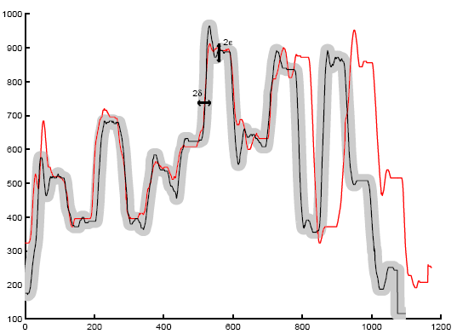
Path Similarity(2)
Similarity(A, B)=
LCSS(A, B)/min(|A|, |B|)
Longest Common Subsequence (LCSS)
[M.Vlachos et al. 2002] for discovering similar multidimensional trajectories
A=((ax,1,ay,1),…,
(ax,n,ay,n))
X position or y position
B=((bx,1,by,1),…,
(bx,m,by,m))
Time
Notes:
影像追蹤、澳洲符號語言
有提出可以移動X，Y座標以求不同位置時的相似軌跡。
CELL-BASED可以簡化LCSS求得路徑相似度的複雜度，這篇可能因為在某地停留較久，軌跡就會有所偏差。
我們認為網路虛擬環境中化身可能常會被一些事情暫時中斷移動，如真實世界的事務或者遊戲中與人聊天。
The other path similarity measuring method is the Longest Common Subsequence (LCSS) [5], which regards a path as a sequence of points for matching. Given two sequences S1 and S2, the LCSS method can return the longest subsequence L of matched points of the two sequences, where matched points are points that are close enough (within ε distance) and a subsequence of a sequence S is derived by deleting from S any number of points that are not necessary consecutive (e.g., sequences <A, C, E> and <B, C, D> are both subsequences of the sequence <A, B, C, D, E>).

Slide 9
Related Work
Path Similarity
Clustering
  Partitioning
  Hierarchical
  Density-based
Notes:
In this subsection, we describe some research work about data clustering which may be applied to clustering motion paths. As described in [9], data clustering partitions numerous data objects into clusters (or groups) according to their similarity. A cluster is a collection of data objects that are similar to one another within the same cluster and are dissimilar to the objects in other clusters. There are many data clustering methods proposed in the literature. Below, we introduce three categories of them: partitioning, hierarchical, and density-based methods.

Slide 10
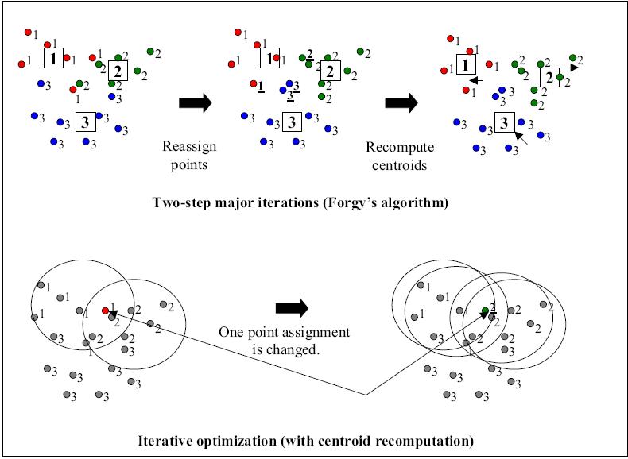
Partitioning
The method classifies the data into k clusters satisfying the following requirements: (1) each cluster must contain at least one object, and (2) each object must belong to exactly one cluster.
E.G.: The k-means algorithm first randomly selects k data objects, each of which initially represents a cluster mean. Each remaining data object is then assigned to the cluster to which it is the most similar. Afterwards, the new mean for each cluster is re-computed and data objects are re-assigned.
Cluster Number : K=3
10
Notes:
Given a set of n data objects, a partitioning method constructs k partitions of the data, where each partition represents a cluster and k≤n. To be more precise, the method classifies the data into k clusters satisfying the following requirements: (1) each cluster must contain at least one object, and (2) each object must belong to exactly one cluster. After partitioning data objects into k initial clusters, the method uses an iterative relocation technique attempting to improve the partitioning by moving objects from one cluster to another. The general criterion of a good partitioning is that data objects in the same cluster are similar to each other, whereas data objects of different clusters are dissimilar or very different.
The famous k-means algorithm [11] is one of the partitioning methods. It first randomly selects k of the data objects, each of which initially represents a cluster mean. Each of the remaining data objects is then assigned to the cluster to which it is the most similar on the basis of the distance between the data object and the cluster mean. Afterwards, the new mean for each cluster is re-computed and data objects are re-assigned. This process iterates until the criterion function, typically defined as the sum of square errors, converges. The k-medoids algorithm [8] is analogous to the k-means algorithm; however, it uses the medoid, the data object that is closest to the mean of the cluster, instead of the mean as the reference of the cluster. Furthermore, it uses the sum of absolute errors as the criterion function. The k-medoids algorithm is thus more robust to noise and outliers (i.e., the data objects that do not comply with the general object behavior) than the k-means algorithm.
K-means[14]
K-medoids [15]在處理雜訊以及外部資料較K-means健全。
K-mode [16]擴展K-means並透過使用範疇對象簡單相匹配不相似性測量。
K-prototypes[16]整合K-means及K-modes而能針對數值及範疇值作群組。
CLARANS起源於兩演算法，PAM(Partitioning Around Medoids)及CLARA(Clustering Large Application)，CLARANS 的缺點是被群組的物體都存在主記憶 體中，因此計算二群組間總距離的成本是昂貴的。
Easter et al. 整合R* tree[19]去改善CLARANS的效能。

Slide 11
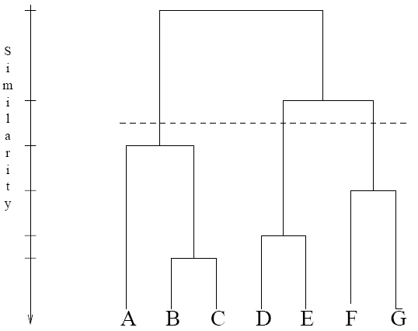
Hierarchical
Hierarchical methods seek to build a hierarchy of clusters of data objects, and they are
  either agglomerative ("bottom-up")
  or divisive ("top-down").
Notes:
Hierarchical methods seek to build a hierarchy of clusters of data objects, and they are either agglomerative ("bottom-up") or divisive ("top-down"). Agglomerative methods, such as BIRCH (Balanced Iterative Reducing and Clustering) algorithm [10], begin by taking each element as a separate cluster and then merge them into successively larger clusters. They are convenient to find and handle the outlier values. On the contrary, the divisive methods begin with the whole data objects in a cluster and proceed to divide it into successively smaller clusters. They need more memory than its counterparts to process the clustering.
此為由下往上 : 單一個體與相似物件群組，最終為全部物件同一群組。
另外由上往下 : 全部物件為同一群組，慢慢切割為數個群組，最終為一個物件一個群組。
Guha et al. [1998] introduced the hierarchical agglomerative clustering algorithm CURE (Clustering Using REpresentatives)

Slide 12
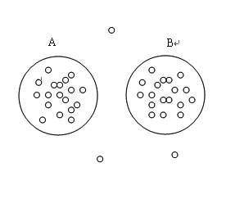
Density-based
Density-based methods typically regard clusters as dense regions of data objects in the data space that are separated by regions of low density.
E.G.: DBSCAN processes data objects one by one and regards an object as a core object to be grown into a cluster if the number of the object’s nearby objects within a specified radius r exceeds a threshold t.
Notes:
Density-based methods typically regard clusters as dense regions of data objects in the data space that are separated by regions of low density. In the methods, a cluster is regarded as a region satisfying a certain criterion (e.g., the density of data objects exceeds a threshold). DBSCAN (Density-Based Spatial Clustering of Applications with Noise) [12] and OPTICS (Ordering Points to Identify the Clustering Structure) [13] are two typical methods of this kind. DBSCAN [12] processes data objects one by one and regards an object as a core object to be grown into a cluster of arbitrary shape in a spatial database with noise if the number of the object’s nearby objects within a specified radius r exceeds a threshold t. After processing all data objects, those not belonging to any cluster are regarded as noises. A disadvantage of DBSCAN is that it is hard to find proper parameters, such as r and t, for clustering. To eliminate the drawback, OPTICS [13] computes the cluster ordering, instead of an explicit data clustering, for automatically and interactively extracting clustering information like cluster centers, etc.
某物件的群組半徑內的物件數量大於群組最低數量為核心路徑。
每個物件都存在和某一個核心物件距離小於群組半徑。
DBSCAN在含有雜訊之空間資料內，從中選出任何形狀的高密度區域之群組。
Optics計算一個密度基礎的群組順序，它擴充DBSCAN，根據此順序自動去處理參數。
DENCLUE[31]將資料存到cell中形成樹狀存取結構，計算速度較 DBSCAN快速。
相較於其他群組方法，密度基礎方法可以群組出非圓形且較任意的形狀
密度基礎方法可以有效的過濾雜訊
和階層式群組相同，密度基礎方法可以找到適合整個資料的群組個數(分割方法需先指定群組個數)，且較階層式群組更為快速

Slide 13
Proposed Algorithms
Pre-processing
ADOCP-DC algorithm
LCSS-DC algorithm

Slide 14
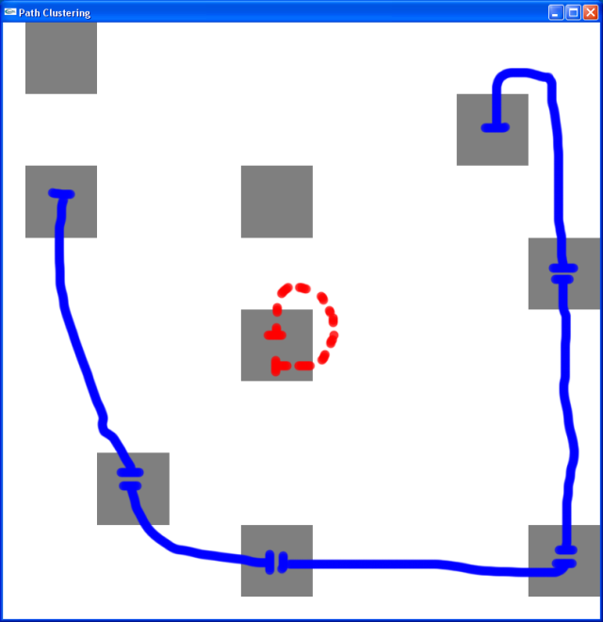
Pre-processing
Dividing paths into path segments by hotspots
Hotspot: an area that has attracted a large portion of avatars to stay long
Notes:
In NVEs, two avatars can see each other if they are within each other’s AOI (area of interest), which is usually assumed to be a circle centered at the avatar. The portions of two paths are thus regarded as similar if they are of distances less than the AOI diameter. In the proposed algorithms, the avatars are assumed to have the same AOI radius r and the whole NVE virtual world is divided into several numbered cells, which are squares of the side length 2r (i.e., the AOI diameter). It is likely that two avatars within the same cell can see each other or have overlap in their AOIs. As we will show, cells play an important role in the preprocessing of avatar paths.
Before being clustered, avatar paths need some preprocessing since they are usually with different length and different start and end points. In practice, paths are divided into path segments of which endpoints are hotspots, where a hotspot is a cell whose accumulated period of avatars staying is larger than those of all its neighboring cells. Note that loops, segments with the same beginning and stopping points, are not regarded as a segment. As illustrated in Fig. 1, the solid avatar path is divided into 5 segments and the dotted path is a loop which is not regarded as a segment. After dividing paths into path segments, the proposed algorithms can cluster them. Below, a path segment and a set of path segments are simply called a path and a path set, respectively.
目標點上的使用者數量通常高於附近的使用者數量，所以我們希望能先找到這些使用者數量高於鄰近區域的場所，
並且因為我們希望找到的路徑不是圍繞著目標點打轉，而是希望有明確的方向且長度較長的路徑，
所以我們希望取得的路徑其出發點與目標點位置不同。

Slide 15
Avatar Path Clustering Algorithms
Average Distance of Corresponding Points-Density Clustering(ADOCP-DC )
  Longest Common Subsequence-Density Clustering (LCSS-DC )

Slide 16
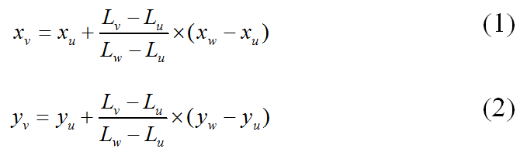
ADOCP-DC Algorithm
Corresponding point
Notes:
ADOCP-DC algorithm is based on the average distance of corresponding points on two paths to measure the similarity of them. Since avatars may move at random directions and random speeds, and path data are usually sampled per time ticks (e.g., per 10 seconds in [6]), even similar paths may have different number of sample points, leading to the difficulty of point data comparison. To overcome the difficulty, ADOCP-DC specifies the number of corresponding points for paths. For a certain path P of sample points v₀, v₂,…, v_{n}, the path length of P is defined to be , where d_{i} is the distance from v_{i−1} to v_{i}. Similarly, the length of sample point v_{j} is defined to be (note that the length of v₀ is defined to be 0). By dividing the path length and the number of corresponding points, the distance d between two consecutive corresponding points on the path is derived. By the distance d, the length of the corresponding point of index k is defined to be k×d (note that the first corresponding point is indexed by 0).

Slide 17
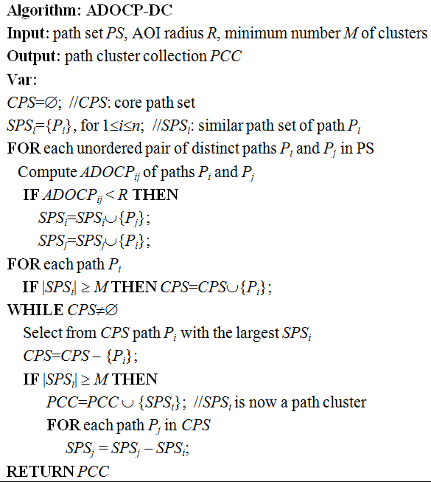
ADOCP-DC Algorithm
Notes:
The average distance of corresponding points (ADOCP) of two paths can be calculated by first deriving the distance of each pair of corresponding points and then averaging all derived distances. ADOCP is used to measure the similarity of two paths for clustering paths. In light of the concept of DBSCAN, a density-based clustering method is employed to cluster paths by specifying the similar path radius R and the minimum number M of paths in a cluster. R is set to be the AOI radius for the following reasons: (1) any pair of paths in the same cluster will have ADOCP value less than 2R; (2) two avatars with AOI overlap are of distance less than 2R will have some similar view and can be regarded as similar paths.
In ADOCP-DC algorithm, two paths are regarded as similar paths if their ADOCP value is less than R or the AOI radius. If the total number of the similar paths of a path exceeds M, the path is regarded as a core path and is associated with a similar path set (SPS). The core path, say p₁, with the most similar paths is first elected as the first representative path, and SPS₁ is regarded as the first cluster, where SPS₁ is the set containing p₁ and all its similar paths. All members of SPS₁ are then excluded from the SPS of every remaining core path. Afterwards, the remaining core path with the most similar paths is selected as the second representative path, and its associated SPS is the second cluster. The procedure proceeds until no core path exits.
在此之前要先定義兩個參數，分別是:群組半徑和群組最低數量。
在計算完每兩條路徑的平均距離後，如果距離小於群組半徑則有可能被分在同個一群組內，並且互相為對方的鄰居。
假如有一條路徑的鄰居數量超過群組最低數量，則這條路徑稱為核心路徑，
我們在這些核心路徑中挑選鄰居數目最高的路徑以及它的鄰居形成一個群組。
然後留下來剩餘的路徑再做一次鄰居數量的計算並且再從其中挑選出下一個群組，接下來依照這樣的步驟不斷的重複直到沒有存在任何一條核心路徑在剩餘未被挑選的路徑中
我們可以將群組半徑設定為AOI(Area of Interest，假設虛擬環境中的每個使用者擁有固定且相同的AOI半徑)的直徑長度，因為在這個距離內的兩個使用者擁有部分相同的視野。
而參數「群組最低數量」的數值設定的越低則群組的數量會越多，被分到某一群組的路徑數量也就越高。
但這樣可能會造成某些群組所包含的路徑太少，這些群組的效用非常低落。
所以在這邊我們找尋了計算群組品質的公式，並且經過幾次不斷的群組和測試群組路徑的品質來調整相關的參數，直到找到最合適的參數設定。

Slide 18
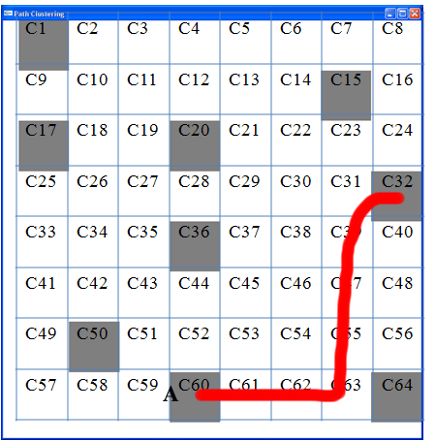
LCSS-DC－path transfers sequence
SeqA:C60.C61.C62.C63.C55.C47.C39.C31.C32
Notes:
In LCSS-DC, the entire virtual world is divided into numbered square cells whose length is of the AOI diameter. According to the cell numbers that the sample points of a path resides in, the path is represented by a sequence of cell numbers. Note that consecutive identical cell numbers in the sequence will be merged to be one number. For example, in Figure 3(a), path A is represented as <60, 61, 62, 63, 55, 47, 39, 31, 32>, and path B, <60, 61, 62, 54, 62, 63, 64>.
C60.C61.C62.C63.C55.C47.C39.C31.C32
首先我們將整個虛擬環境切割成數塊長寬(假設每個使用者擁有相同且固定的AOI半徑下，長度設定成AOI直徑，使得使用者的視野有重疊)相等的格子，每一個格子都有它的代號，而每一條路徑從開始到結束依序跨越數個不同的格子，我們在路徑跨越到不同的格子的時候為路徑序列增加一個格子代號，因此每一條路徑都可以以格子的代號當作序列的元素來表示

Slide 19
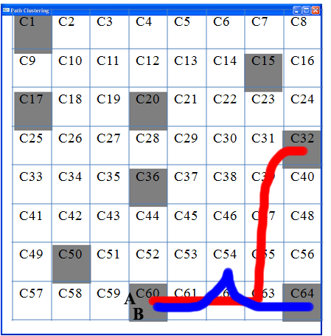
LCSS-DC－path similarity
SeqA :C60.C61.C62.C63.C55.C47.C39.C31.C32
SeqB :C60.C61.C62.C54.C62.C63.C64
LCSS_{AB} :C60.C61.C62. C63
Notes:
The similarity of two paths is measured by the longest common subsequence (LCSS) of the cell number sequences of the paths. Each cell number in the sequence is associated with the location of the sample data residing within the cell; a merged cell number is associated with the centroid of the locations of the sample data residing within the cell. Two cell numbers are regarded common if they are identical or their associated cells are adjacent in the virtual world and their associated locations are with the distance less than the AOI radius. For example, paths A and B in Figure 3(a) have the LCSS of <60, 61, 62, 63>.
A路徑轉換成序列為(C60.C61.C62.C63.C55.C47.C39.C31.C32)，長度|A|為9格cells，
B路徑轉換成序列為(C60.C61.C62.C54.C62.C63.C64)，長度|B|為7格cells，
它們的共同子序列S是(C60.C61.C62. C63)，S的長度|S|為4格cells。
不同於ADOCP，LCSS無法得到兩條路徑的平均距離，而是得到重疊的子序列長度。
所以和ADOCP的作法不同，LCSS中路徑的鄰居數值是將其他路徑的共同子序列長度全部加總起來，再挑選加總值最大的路徑成為代表路徑

Slide 20
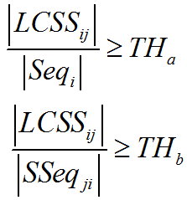
LCSS-DC － similar path thresholds
SeqA :C60.C61.C62.C63.C55.C47.C39.C31.C32
SeqB :C60.C61.C62.C54.C62.C63.C64
LCSS_{AB} :C60.C61.C62. C63
Notes:
After using LCSS algorithm to calculate the length of the paths, clustering is performed. LCSS-DC uses a pair of similar path thresholds TH_{a} and TH_{b}, instead of the similar path radius used in ADOCP-DC, as parameters of clustering. Path P_{i} takes path P_{j} as its similar path if Eqs. (3) and (4) are satisfied.
In Eqs. (3) and (4), Seq_{i} and Seq_{j} are the cell sequences of P_{i} and P_{j}, respectively, and LCSS_{ij} is the longest common subsequence of Seq_{i} and Seq_{j}, and SSeq_{ji} is the sub-sequence of path P_{j} containing the whole LCSS_{ij}.
Like ADOCP-DC, LCSS-DC also adopts the density-based clustering mechanism for clustering paths. When a path has many enough similar paths, it is regarded as a core path and become a candidate of representative paths. Note that the similarity relationship between two paths is asymmetric. To take paths in Figure 3(a) as examples, path B may take path A as a similar path, but not vise versa. The asymmetry is to avoid the case that dissimilar paths appear in the cluster. For example, if path A in Figure 3(b) considers both paths B and C to be similar, then path A is likely to be the representative path of the cluster covering paths A, B and C. It is obvious that such a cluster contains two very dissimilar paths, B and C.

Slide 21
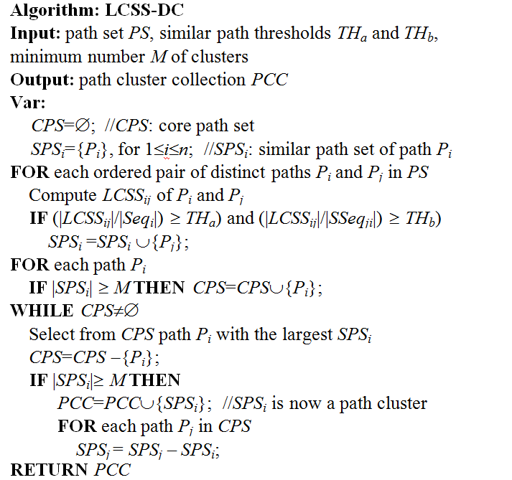
LCSS-DC Algorithm
Notes:
透過設定LCSS佔自身與對方包含LCSS最小區段的比例超過一定的門檻可以使得在做路徑群組時兼顧群組精確度下，
讓兩條長度、起點以及終點不同的路徑做鄰居權值的加總，並且找出相似的區段，這樣的相似性在ADOCP演算法中是無法被統計出來的。
重疊的部分要佔路徑長度多高的比例才能將對方視為自己的鄰居，以及加總後的總值必須高於多高的數值才能被拿來當代表路徑，
這些參數的設定都可以經過數次的群組品質測量來調整出最佳的參數設定。
短結:
第一種是ADOCP演算法，在這個方法中會因為兩條路徑的長度、起點與終點不同，造成兩條路徑在挑選比較點的間隔有所差異，
形成原本路徑中重疊程度很高的某個段落卻因為比較點挑的位置不適合而造成距離有所偏差。
另外，在先前我們提到使用LCSS會因為虛擬環境的切割結果進而影響到路徑相似度的計算，
因為在這邊我們假設虛擬環境中使用者的可視範圍是一個固定的值，且每個使用者的可視範圍是相同的，所以在做虛擬世界的切割時我們可以將區塊的大小設定為使用者的可視範圍，使得路徑在同一個區塊必定有部分相同的可視範圍，所以路徑在同樣區塊時被我們認定為相關的。

Slide 22
Experiments
Both methods are applied to the SL avatar trace data of Freebies Island.
Each record includes avatar location data in the region within 24 hours.
Notes:
In order to verify the proposed avatar path clustering method in NVE, the study refers to the movement data of avatars gathered by [6] from Second Life. Second Life has a number of avatar motion paths on different regions. Each Region is the 256x256(unit²) of the virtual world, the AOI range of avatar is 16(unit). Each record includes avatar location data in the region within 24 hours(as seen in Figure 5). Data format for each location data includes date, time, user ID, and avatar location. Interval for data collection is approximately 10 seconds. Thus, the motion path of avatars is composed of a data series. The gathered avatar location data [6] is from the free will of players in the virtual world. This enabled it to correspond best with the actual avatar movements in NVE.

Slide 23
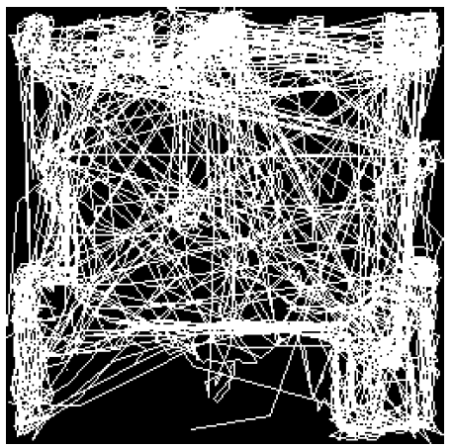
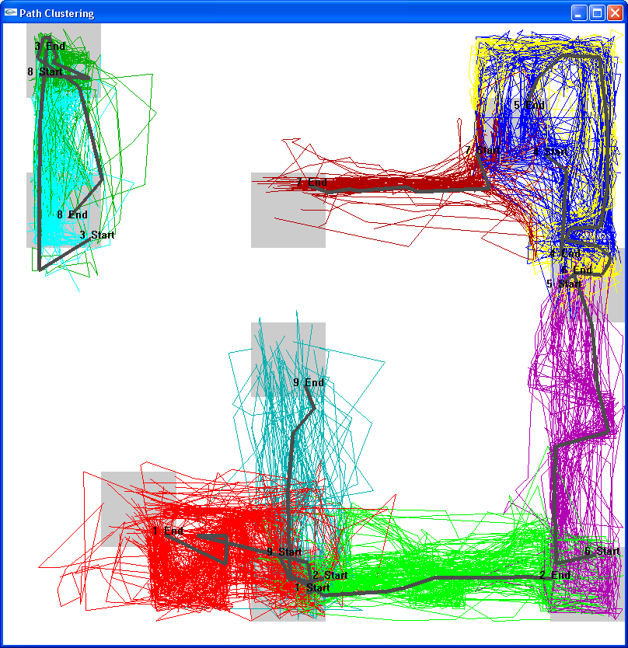
Experiment Results
Avatar Path Clustering for SE Freebies
Notes:
These results can be employed in peer-to-peer networked virtual environment (P2P-NVE) designs, load balancing on server clusters, and partitioning of NVEs; for example, NVE developer can use them to analyze avatar behavior and to find out popular paths for improving the virtual world design, etc. In the future, more measurement may assess the quality of avatar path clustering. The proposed clustering techniques can be applied in more networked virtual environments and used in more relevant applications.
本論文嘗試以路徑群組(path clustering)技術找出網路虛擬環境中移動路徑相近的使用者，以作為尋找行為模式相近使用者的依據。
群組完成後，每個群組都可以以一條鄰居數最多的路徑來代表，在此稱為代表路徑，其特性是虛擬環境中大多數的使用者會有與這些路徑相似的移動軌跡。
這些代表路徑可以提供給研究者做使用者的移動模組探討、同儕式網路虛擬環境(ex: FLoD)、叢集式伺服器的負擔平衡以及虛擬世界的切割等等…。
另外亦可提供遊戲開發或代理公司做虛擬世界中場景的佈置與改善。

Slide 24

Performance－Accuracy
Silhouette [L. Kaufman et al. 1990]
The value of Silhouette between from 1 to -1, the greater the Silhouette coefficient of the path, the higher path similarity in the cluster, and the lower path similarity with other cluster, which represents clustering result is better.
Notes:
The characteristics of a good clustering should have high similarity intra cluster and high dissimilarity inter cluster, so we can apply the (5) from Silhouette [6] to analyze the clustering degree of path similarity.
In (5), for Path P_{i}, a_{i} is the average dissimilarity of the cluster with P_{i}. And for each cluster, which i is not member, to compute the average dissimilarity of the cluster to find the largest average similarity is b(i). We can observe that the value of Silhouette between from 1 to -1, the greater the Silhouette coefficient of the path, the higher path similarity in the cluster, and the lower path similarity with other cluster, which represents clustering result is better. Follow the equation 6, we can compute the each Silhouette value of all the paths and further obtained the average Silhouette value. Cluster accuracy on the threshold of group classification, according to papers [7] experimental results, Silhouette value is greater than the overall accuracy of 0.7 can be regarded as high enough clustering results.

Slide 25
Performance－coverage
the number of clustering paths
Coverage=
the total of numbers of paths
Notes:
[8] further proposed a threshold classification for cluster accuracy. The analysis of results shows that the silhouette width of the overall data is greater than 0.7, which can be regarded as a sufficiently high accuracy. Aside from considering cluster accuracy, another metric for assessing cluster results is cluster coverage. The study hopes to measure cluster coverage with sufficiently high accuracy. It also hopes to allow for more cluster grouping. The following (6) assesses cluster coverage.
分子是所有有分到群組的路徑數量, 分母是總路徑數.
希望能包含儘量多的路徑, 即覆蓋度越大越好.

Slide 26
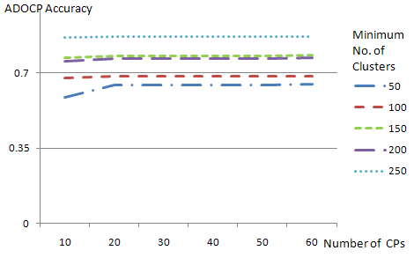
Accuracy Analysis in ADOCP-DC
Algorithm | ADOCP-DC
Clustering radius | 16(AOI radius)
Number of corresponding points | >=10
Minimum number of clusters | >=150
Notes:
Parameters for ADOCP-DC algorithm include the minimum number of clusters and number of corresponding points. For ADOCP-DC, as the number of corresponding points increases, cluster accuracy is higher, and the time complexity for clustering also grows. Even though adjusting the minimum cluster number and number of corresponding points changes the number of corresponding points for calculating cluster similarity, the number of corresponding points is set to a larger value to compute cluster accuracy accurately.
在這裡我們預設群組的數目為9，我們發現在群組最低數量為65的時候群組的數目可以為9。
我們也發現當比較點數目為50的時候精確度與覆蓋度已經趨於穩定，因此在這個範例中我們認為比較點數目只需要設定為50點就已經足夠了。

Slide 27
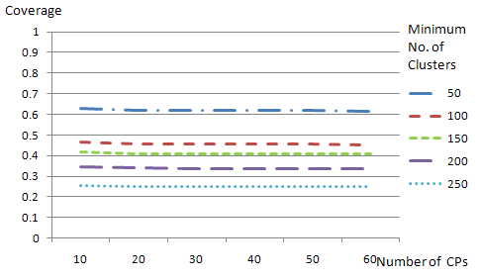
Coverage Analysis in ADOCP-DC
Algorithm | ADOCP-DC
Clustering radius | 16(AOI radius)
Number of corresponding points | >=10
Minimum number of clusters | >=150
Notes:
Figure 6 and Figure 7 point five different styles of dotted and solid lines in total. Each line represents for a different minimum number of clusters. The study observes that when the number of corresponding points increases, accuracy of ADOCP similarity slightly improves, while coverage slightly declines. This occurs because as cluster accuracy increases, certain paths are determined as noise, leading to a decline in coverage.
In addition, results from the simulation indicate that when the minimum number of clusters increases, cluster accuracy may also generally increase but the coverage decreases. That is because the rise in the minimum number of clusters leads to the higher cluster threshold. Thus, cluster with fewer paths are filtered out, accuracy increases but to decease the coverage. However, deceasing the lowest minimum number of clusters will have fewer clusters with fewer paths; these clusters may have noise to the overall clustering. It decreases the accuracy but to promote the coverage. Therefore, the most appropriate range is set for minimum cluster numbers, followed a determination of the most appropriate interval parameter settings. Based on the simulation results, when the minimum number of clusters is 150 in ADOCP-DC applied in Freebies Region, accuracy for ADOCP similarity is greater than 0.7; this is higher than the minimum acceptable threshold for accuracy in the study; lastly, coverage is greater than 0.41.

Slide 28
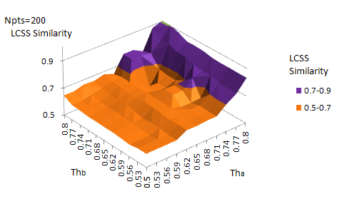
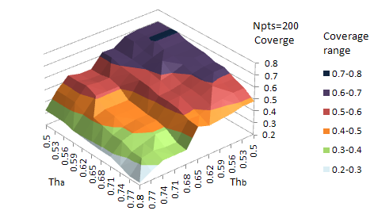
Accuracy Analysis in LCSS-DC
Algorithm | LCSS-DC
Cell diameter | 32(AOI radius)
THa | 0.74
THb | 0.56
Minimum number of clusters | 200
Notes:
Figures 8 are the results of adjusting neighbor threshold on accuracy and coverage of LCSS similarity when the minimum number of clusters is smaller than 200. From these results, when the minimum number of clusters is set to 200, TH_{a} is set to 0.74, and TH_{b} is set to 0.50, the accuracy for LCSS similarity is greater than the acceptable standard of 0.7 while featuring better coverage approximately equal to 0.54.

Slide 29
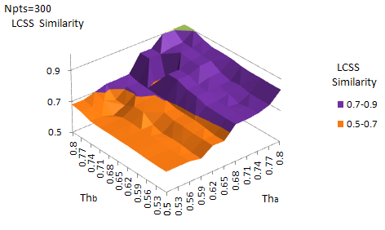
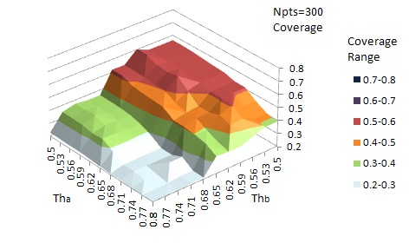
Coverage Analysis in LCSS-DC
Algorithm | LCSS-DC
Cell diameter | 32(AOI radius)
THa | 0.68
THb | 0.65
Minimum number of clusters | 300
Notes:
Figures 9 are the simulation results when the minimum number of clusters is set to 300, TH_{a} is set to 0.68, and TH_{b} is set to 0.65. Accuracy for LCSS similarity is greater than the acceptable standard of 0.7 and coverage is approximately equal to 0.41. In addition, as the minimum number of clusters continuously increases, coverage increasingly worsens.

Slide 30
Conclusion
Two schemes for avatar path clustering:
  Average Distance of Corresponding Points-Density Clustering (ADOCP-DC)
  Longest Common Subsequence-Density Clustering (LCSS-DC)
Applying the schemes to the SL trace data to evaluate the schemes’ silhouette degree and coverage ratio
Future work:
  Avatar Behavior Analysis
  NVE Redesign
  Load Balancing Based on Path Clustering
Notes:
The study based on NVE data to propose the Average Distance of Corresponding Points-Density Clustering (ADOCP-DC) and Longest Common Subsequence-Density Clustering (LCSS-DC) algorithms to calculate avatar path clustering. To successfully find similar paths, motion paths of avatars are first divided into appropriate segments. ADOCP and LCSS then measure the degree of similarity for each path. Finally, clustering is performed on paths with high similarity degree and using the density clustering, a more representative representation path (RP) is obtained. Within these, RP expresses each cluster. Location data of Second Life avatars serves as testing data for ADOCP-DC and LCSS-DC with accuracy and coverage measuring clustering quality. Simulation results show that ADOCP-DC accurately groups avatar paths in NVE where coverage is about 40%. Using LCSS-DC algorithms, more accurately clusters where coverage exceeds 54%. The main reason is that LCSS-DC finds segments with more similarity among paths as entire segments need not be similar. In addition, setting the neighbor threshold allows LCSS-DC to take clustering accuracy into account when covering more paths.

Slide 31
Thank You!

