Slide 1
Metasploit Framework (MSF)

Slide 2
Msfvenom creates payloads.
Meterpreter is one kind of payloads.
MSF (Metasploit) utilizes exploits to launch attacks and then MSF transmits payloads (such as one Meterpreter payload) to targets.

Slide 3
Intro to Metasploit _{[Vickie Li]}
In Metasploit, LHOST, RHOST and SRVHOST are some of the most commonly used variable names.
LHOST refers to the IP of your machine, which is usually used to create a reverse connection to your machine after the attack succeeds.
RHOST refers to the IP address of the target host.
And SRVHOST is where the module will connect to download additional payload elements.

Slide 4
Metasploit and Meterpreter _{[Rapid7]}
Generally, Meterpreter is the most popular payload type for Metasploit.
  If you are testing a Windows exploit, it’s better to use windows/meterpreter/reverse_tcp.
  If you’re on Linux, try linux/meterpreter/reverse_tcp.
  You should always choose a native Meterpreter if you can, but if you are unable to, you should try a cross-platform one, such as java/meterpreter/reverse_tcp.

Slide 5
meterpreter载荷执行过程及原理 _{[码农家园]}

Slide 6
滲透攻防工具篇-後滲透階段的Meterpreter _{[zusheng]}

Slide 8
Msfvenom Tutorials for Beginners _{[Raj Chandel]}
Msfvenom is a command line instance of Metasploit that is used to generate and output all of the various types of shell code that are available in Metasploit.

Slide 9
Abbreviations _{[Raj Chandel]}
Lhost= (IP of Kali)
Lport= (any port you wish to assign to the listener)
P= (Payload I.e. Windows, Android, PHP etc.)
F= file extension (i.e. windows=exe, android=apk etc.)

Slide 10
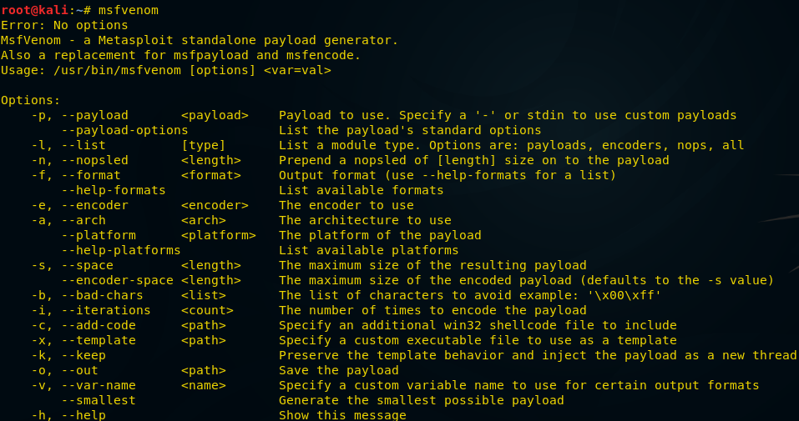
Execution of Msfvenom _{[Raj Chandel]}

Slide 11
Bind shell _{[Raj Chandel]}
A bind shell is a kind that opens up a new service on the target machine and requires the attacker to connect to it in order to get a session.
The bind_tcp option is helpful in case we get disconnected from victim machine while it is still running, we can execute the same command and get back the session without any intervention of the victim to run the exploit again.

Slide 12
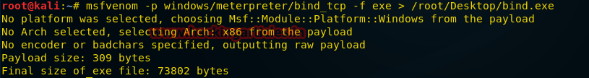
An Example of Payload Creation _{[Raj Chandel]}
Type the below “command” on your kali terminal.
msfvenom -p windows/meterpreter/bind_tcp -f exe > /root/Desktop/bind.exeIt will save the “exe” payload file on your desktop as specified on the command /root/Desktop/bind.exe.
We need to send this file to the victim machine through file share or by any social engineering technique and have it run on the system.

Slide 13
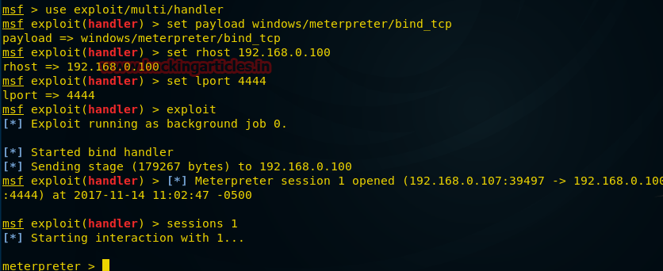
Launch an Attack _{[Raj Chandel]}
Now let us start msfconsole and type below command to get a session of the victim machine.
Once the file is executed on the machine we will get the victim machine meterpreter session as shown below.

Slide 14
Meterpreter Basic Commands _{[offensive security]}

Slide 15
Usage Example

Slide 16
Metasploit 初體驗 _{[cyrilwang]}

Slide 17
Principle of Payload Injection

Slide 18
Meterpreter 技術原理： 載荷執行 _{[看雪学院]}

Slide 19
Meterpreter reverse_http how does it communicate ? _{[frank]}

Slide 20
0x01初识Meterpreter _{[渗透测试中心]}

