Slide 1
Windows Fileless Malware

Slide 2
Fileless Malware _{[SentinelOne]}
Fileless malware is malicious code that does not require using an executable file on the endpoint’s file system besides those that are already there.
It is typically injected into some running process and executes only in RAM.
This makes it far more difficult for traditional antivirus software and other endpoint security products to detect or prevent because of the low footprint and the absence of files to scan.

Slide 3
Example _{[SentinelOne]}
One example that affected the U.S., Canada, and Europe, attackers launched a spam campaign that delivered malicious Word documents that executed macros when opened, delivering fileless malware in the process.
In cases like this, fileless refers to the fact that attackers leverage Windows PowerShell to load an executable file directly into memory rather than writing it to the disk (where it can be detected by average malware scanners).

Slide 4
Ways to Run Code without Using Executables _{[SentinelOne]}
There are many other ways to run code on a device without using binary executable files.
These often utilize system processes available and trusted by the OS.
A few examples include:
  Jscript interpreter
  VBScript interpreter
  PowerShell
  Windows Management Instrumentation (WMI)
  Mshta and rundll32 (or other Windows signed files capable of running malicious code)

Slide 5
Script Languages (1) _{[Bill Cozens]}
  Fileless attackers can use JScript or VBScript to run malicious code directly in memory within a web browser or other applications (e.g. interpreter, mshta) that support these scripting languages.

Slide 6
Script Languages (2) _{[Microsoft]}
  The JavaScript, VBScript, and PowerShell scripting languages are available by default on Windows platforms.
  Scripts have the same advantages as macros, they are textual files (not binary executables) and run within the context of the interpreter (like wscript.exe, powershell.exe), which is a clean and legitimate component.
    Windows Script Host Object
    Objects in VBScript

Slide 7
Malware Hidden in Documents
_{[SentinelOne]}
Malware hidden in documents are also Fileless-based Attacks.

Slide 8
Adobe Flash Player _{[Wikipedia]}
  Adobe Flash Player is prone to Adobe Flash Player is prone to a buffer overflow vulnerability.
    An attacker can exploit this issue to execute arbitrary code in the context of the user running the affected application. _{[trendmicro]}
  Flash Player is prone to a remote buffer-overflow vulnerability when processing SWF files with the 'DefineSceneAndFrameLabelData' tag (tag ID 0x56). _{[broadcom]}.
    The issue stems from an integer overflow when calculating pointers. Attackers can use this issue to write to arbitrary memory locations.

Slide 9
The Most Common form of Fileless Malware _{[SentinelOne][CISA]}
The most common form of fileless malware in the wild is when a victim clicks on a spam link within an email or fraudulent website.
That link or website then loads the Flash application and implements a relevant exploit in order to infect the user’s machine.
Afterward, the malware uses shellcode to run a command allowing it to download and execute the payload solely within memory.

Slide 10
Reference Materials for Fileless Malware _{[SentinelOne]}
Microsoft provides a Comprehensive classification of Fileless Malware in an article named fileless threats, which describes the fileless malware forms introduced in this file as a type of fileless malware.

Slide 11
Call PowerShell from JScript -posh.js _{[ukoloffStas Ukolov]}
var sh = WScript.CreateObject("WScript.Shell")
var posh = sh.Exec('powershell -Command - ')
var i = posh.StdIn
i.WriteLine('Get-PSProvider')
i.Close()
var o = posh.StdOut.ReadAll()
var e = posh.StdErr.ReadAll()
WScript.Echo('1>', o)
WScript.Echo('2>', e)
Can be replaced with any command an attacker wants to execute.

Slide 12
Explanation
After downloading posh.js to a computer, a user can directly execute the javascript file which in turn executes powershell.
However, if posh.js is in a web page, the javascript code inside it will not be executed.

Slide 13
<html><body>
Hello ! <br>
<script src="http://staff.csie.ncu.edu.tw/~hsufh/COURSES/FALL2023/posh.js"></script>
<script>
var sh = WScript.CreateObject("WScript.Shell");
var posh = sh.Exec('powershell -Command -');
var i=posh.StdIn;
i.WriteLine('Get-PSProvider');
i.Close();
var o = posh.StdOut.ReadAll();
var e = posh.StdErr.ReadAll();
WScript.Echo('1>', o);
WScript.Echo('2>', e);
</script>
Hi <br>
HI <br>
</body></html>

Slide 14
An Infection Scenario _{[Osama Khalid et al. ]}
The victim may be tricked into downloading a file containing a malicious macro or script. The file is stored on a hard disk.
However, when this file is executed, it uses PowerShell or another legitimate tool to execute its code in the system’s memory.
Once the code is executing in the memory, the malware may trigger PowerShell to connect to a malicious Command and Control (C&C) server and download the final payload of the malware.
This payload is then run directly in the system’s RAM without being stored on the hard disk

Slide 15
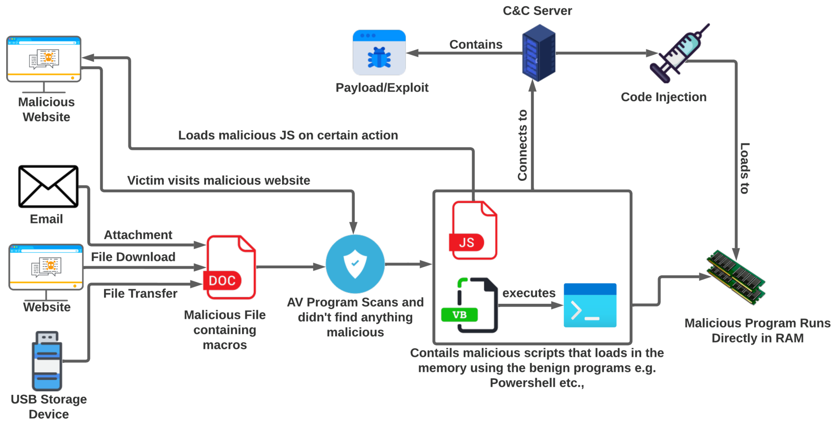
Common Fileless Malware Infection Chain _{[Osama Khalid et al. ]}

Slide 16
Malicious Website/MailSpam/Phishing Email _{[red team]}
Arrival via malicious websites or phishing emails uses script-based programs such as Macros, PowerShell, VBScript, JavaScript, HTA, etc., to run the malicious code directly to the memory.
Typically, the initial script acts as a downloader which connects to a malicious host and downloads the payload.

Slide 17
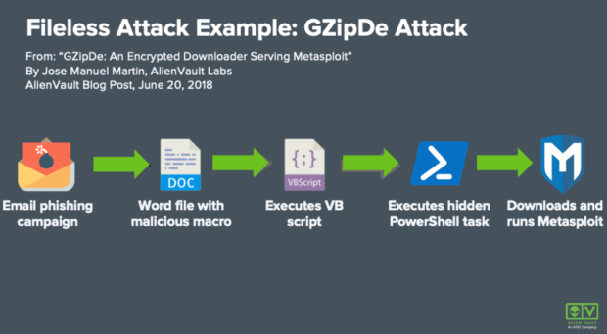
Graphic Explanation of the Fileless Attack Described in Previous Slide _{[Kate Brew]}

Slide 18
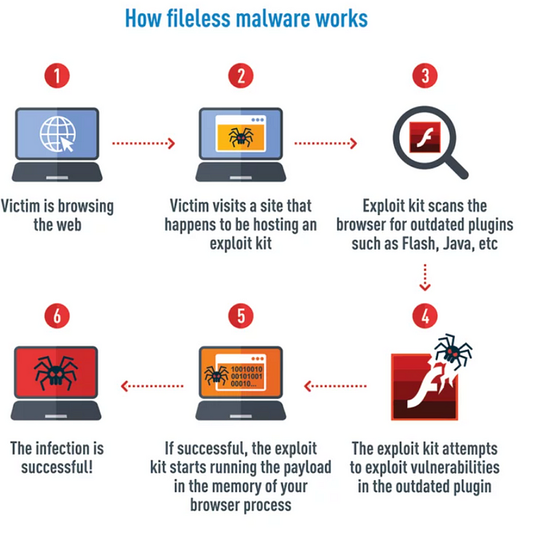
Fileless Malware Infection Chain Using Exploits _{[Nelson .A. Ojovbo]}

Slide 19
Exploit _{[red team][Kurt Baker]}
The fileless attack that arrives via Exploit may be referred to as “Completely Fileless”.
RCE (Remote Code Execution) allows an attacker to load shellcode directly to the memory without writing any files to disk.
Exploits are pieces of code, sequences of commands, or collections of data.
Exploit kits are collections of exploits.
Adversaries use these tools to take advantage of vulnerabilities that are known to exist in an operating system or an installed application.
Exploits are an efficient way to launch a fileless malware attack because they can be injected directly into memory without requiring anything to be written to disk. Adversaries can use them to automate initial compromises at scale.

Slide 20
Exploits and Vulnerabilities _{[Microsoft]}
Exploits take advantage of vulnerabilities in software.
A vulnerability is like a hole in your software that malware can use to get onto your device.
Malware exploits these vulnerabilities to bypass your computer's security safeguards to infect your device.

Slide 21
Exploits _{[Microsoft]}
Exploits are often the first part of a larger attack.
Hackers scan for outdated systems that contain critical vulnerabilities, which they then exploit by deploying targeted malware.
Exploits often include shellcode, which is a small malware payload used to download additional malware from attacker-controlled networks.
Shellcode allows hackers to infect devices and infiltrate organizations.

Slide 22
Exploit Kits _{[Microsoft]}
Exploit kits are more comprehensive tools that contain a collection of exploits.
These kits scan devices for different kinds of software vulnerabilities and, if any are detected, deploy additional malware to further infect a device.
Kits can use exploits targeting various software, including Adobe Flash Player, Adobe Reader, Internet Explorer, browser, plug-in, Oracle Java, and Sun Java.
Example:
  Several notable threats, including Wannacry, exploit the Server Message Block (SMB) vulnerability CVE-2017-0144 to launch malware.

Slide 23
Exploit Kit _{[paloalt0-1] [paloalto-2]}
Within the landing page is code that will profile the victim’s device for any vulnerable browser-based applications.

Slide 24
Browser Fingerprinting _{[Mozilla][SEON]}
Quietly assessing the unique configuration of web browsers that connect to a web domain is a process called device fingerprinting.
Naturally, the fingerprint being scrutinized is made up of more than simply the web browsing program, such as the installed languages, operating system, plugins, and in-browser time zone, among others.

Slide 25
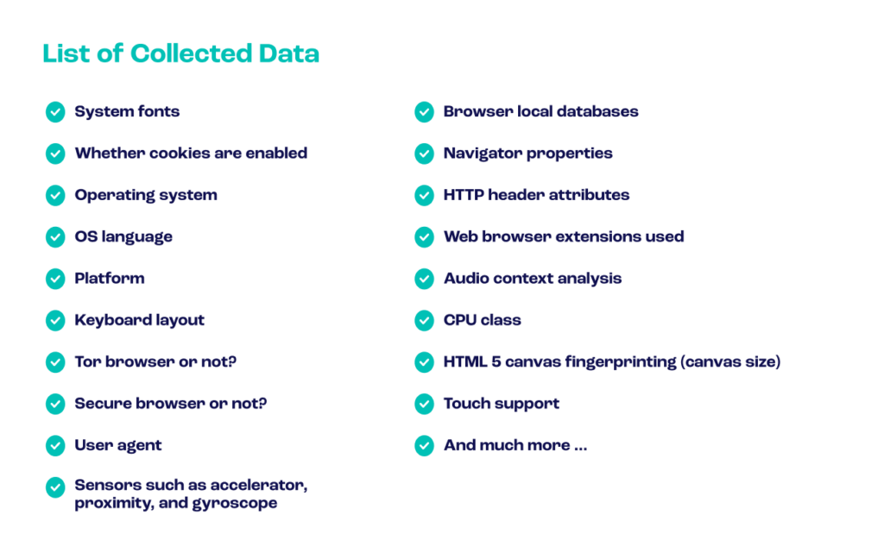
Data Collected _{[SEON]}

Slide 26
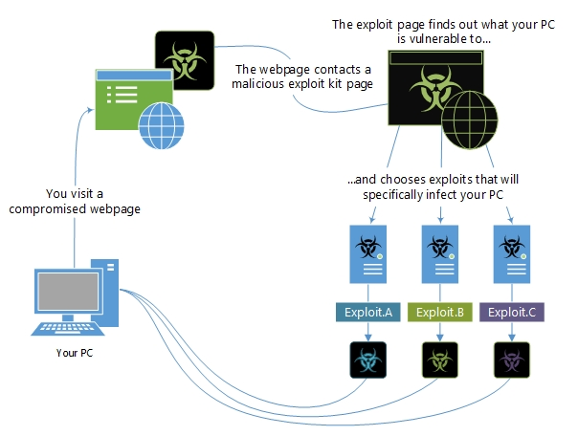
Example of How to Exploit Kits Work _{[Microsoft]}

Slide 27
Webpages and Exploit Kits _{[Microsoft]}
The most common method used by attackers to distribute exploits and exploit kits is through webpages, but exploits can also arrive in emails.
Some websites unknowingly and unwillingly host malicious code and exploits in their ads.

Slide 28
Examples of Exploit Kits _{[Microsoft]}
Angler / Axpergle
Neutrino
Nuclear

Slide 29
Five Common Techniques Used in Fileless Attacks _{[Bill Cozens]}
PowerShell
JavaScript and VBScript
Microsoft Office macros
P.S.: The above three have been introduced in the previous slides.
Process hollowing
Reflective DLL injection

Slide 30
Process Hollowing _{[Bill Cozens]}
Process hollowing is a fileless technique where attackers
  create a new process in a suspended state,
  replace its memory content with malicious code,
  and then resume the process.
The malicious code executes in memory without writing to the disk.

Slide 31
Reflective DLL Injection _{[Bill Cozens]}
In this fileless attack, attackers load a malicious Dynamic Link Library (DLL) into a legitimate process's memory without writing it to the disk.
The DLL is executed directly in memory, evading detection by traditional security software.

Slide 32
Windows Fileless Threats
_{[Microsoft]}

Slide 33
Categorization
There are three main types of fileless threats based on how much fingerprint they may leave on infected machines.

Slide 34
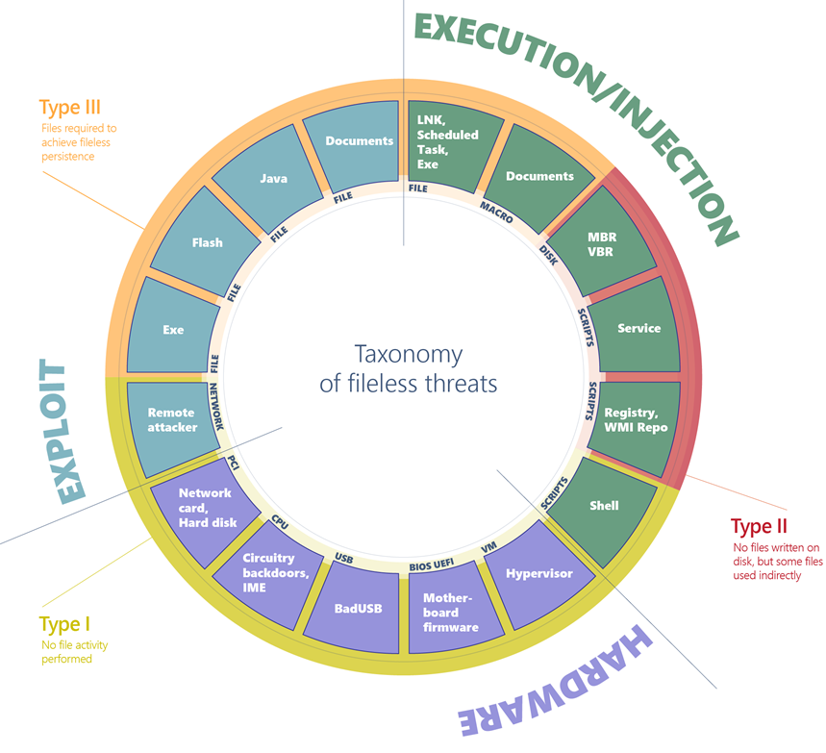
Comprehensive Diagram of Fileless Malware

Slide 35
Type I: No File Activity Performed
A fully fileless malware can be considered one that never requires writing a file on the disk.
How would such malware infect a machine in the first place?
  One example is where a target machine receives malicious network packets that exploit the EternalBlue vulnerability.
    The vulnerability allows the installation of the DoublePulsar backdoor, which ends up residing only in the kernel memory.
    In this case, there's no file or any data written on a file.

Slide 36
Compromised Device and Firmware
A compromised device may also have malicious code hiding in device firmware (such as a BIOS), a USB peripheral (like the BadUSB attack), or in the firmware of a network card.
All these examples don't require a file on the disk to run, and can theoretically live only in memory. The malicious code would survive reboots, disk reformats, and OS reinstalls.

Slide 37
Type II: Indirect File Activity
Fileless malware of this type doesn't directly write files on the file system, but they can end up using files indirectly.
  For example, with the Poshspy backdoor _{[alexia salone]} attackers installed a malicious PowerShell command within the WMI repository and configured a WMI filter to run the command periodically.

Slide 38
Type III: Files Required to Operate
Some malware can have a sort of fileless persistence, but not without using files to operate.
An example for this scenario is Kovter, which creates a shell open verb handler in the registry for a random file extension.
Opening a file with such extension will lead to the execution of a script through the legitimate tool mshta.exe.

Slide 39
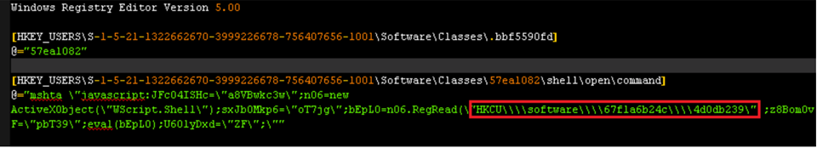
Kovter's registry key
mshta
ActiveXObject
Wscript.shell
RegRead
n06
bEpL0

Slide 40
Windows 注册表常用操作 _{[mb611f699425272]}
1 添加一個主鍵(比如在HKEY_LOCAL_MACHINE\SOFTWARE\中添加一個ABCEDFGHIJKLMN主鍵)
Windows Registry Editor Version 5.00
[HKEY_LOCAL_MACHINE\SOFTWARE\ABCEDFGHIJKLMN]

Slide 41
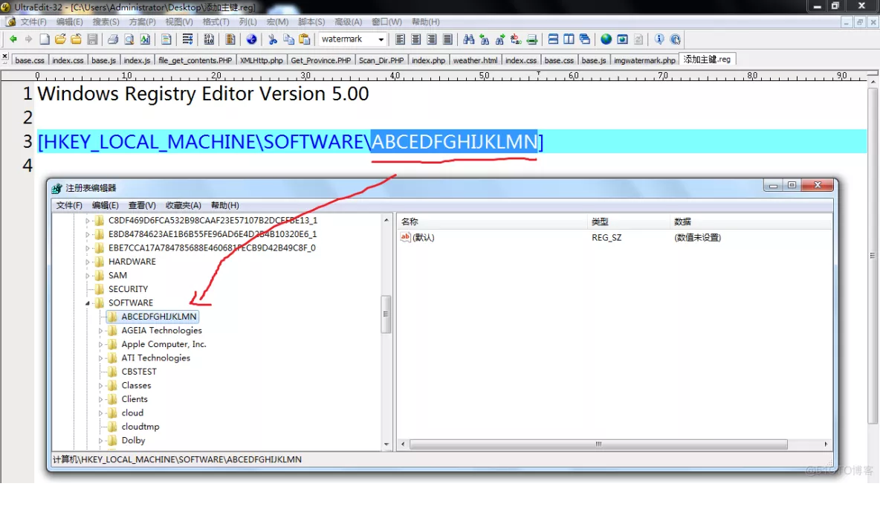
Windows 注册表常用操作範例 _{[mb611f699425272]}

Slide 42
添加鍵值_{[mb611f699425272]}
例如我們要在“HKEY_LOCAL_MACHINE\Software\ ABCEDFGHIJKLMN”主鍵下设置預設鍵值為“工作室”，並分别添加“姓名”鍵值項目(字符串值)、“年龄”鍵值項目(二進制值)、“婚否”鍵值項目(DWORD值)。相應的REG文件内容如下：
Windows Registry Editor Version 5.00
[HKEY_LOCAL_MACHINE\SOFTWARE\ABCEDFGHIJKLMN]
@="工作室"
"姓名"="陶海"
"年龄"=hex:23
"婚否"=dword:00000000

Slide 43
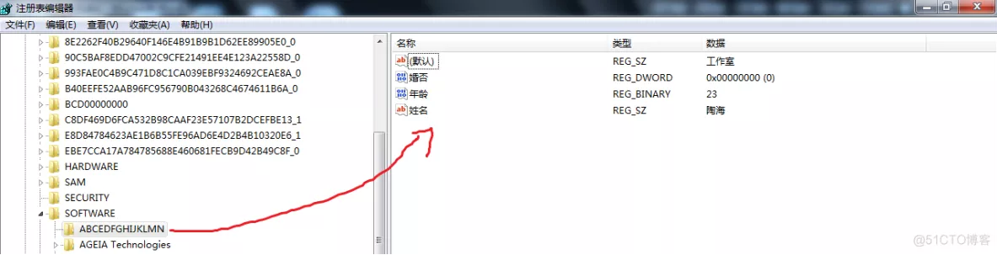
添加鍵值範例_{[mb611f699425272]}

Slide 44
How to Create Registry Script (.REG) Files in Windows_{[VG]}

Slide 45
mshta命令用法示例 _{[mdxy-dxy]}
mshta支持命令行參數，可以接收JS和VBS的方法。
範例（在命令行下測試）：
  JS:
    mshta vbscript:window.execScript("alert('hello world!');","javascript")
  VBS:
    mshta javascript:window.execScript("msgBox('hello world!'):window.close","vbs")

Slide 46
mshta多個命令 _{[mdxy-dxy]}
串接多個命令時，js 用分號 ;。
  mshta "javascript:alert('OK！');alert('1234');window.close()"
串接多個命令時，vbs 用&。
mshta "vbscript:msgbox("内容") & msgbox("1234") & window.close"
  ※注意&在bat中有特殊意義，所以此時mshta後面的程式碼必需用引號！

Slide 47
ActiveXObject _{[程式前沿]}

Slide 48
Explanation
When the open verb is invoked, the associated command from the registry is launched, which results in the execution of a small script.
This script reads data from a further registry key and executes it, in turn leading to the loading of the final payload.
However, to trigger the open verb in the first place, Kovter has to drop a file with the same extension targeted by the verb (in the example above, the extension is .bbf5590fd).
It also has to set an autorun key configured to open such file when the machine starts.

Slide 49
Execution and Injection of File-Based Fileless Malware
File-based (Type III: executables, DLLs, LNK files, scheduled tasks):
  This is the standard execution vector.
  A simple executable can be launched as a first-stage malware to run an additional payload in memory, or injected into other legitimate running processes.

Slide 50
Execution and Injection of Macro-Based Fileless Malware (1)
Macro-based (Type III: Office documents):
  The VBA language is a flexible and powerful tool designed to automate editing tasks and add dynamic functionality to documents.
  As such, it can be abused by attackers to carry out malicious operations like decoding, running, or injecting an executable payload, or even implementing an entire ransomware, like in the case of qkG.

Slide 51
Execution and Injection of Macro-Based Fileless Malware (2)
Macros are executed within the context of an Office process (e.g., Winword.exe) and implemented in a scripting language.
There's no binary executable that an antivirus can inspect.
While Office apps require explicit consent from the user to execute macros from a document, attackers use social engineering techniques to trick users into allowing macros to execute.

Slide 52
Execution and Injection of Script-Based Fileless Malware (1)
Script-based (Type II: file, service, registry, WMI repo, shell):
  The JavaScript, VBScript, and PowerShell scripting languages are available by default on Windows platforms.
  Scripts have the same advantages as macros, they are textual files (not binary executables) and run within the context of the interpreter (like wscript.exe, powershell.exe), which is a clean and legitimate component.

Slide 53
Execution and Injection of Script-Based Fileless Malware (2)
Scripts are versatile and can be run from a file (by double-clicking them) or executed directly on the command line of an interpreter.
Running on the command line allows malware to encode malicious scripts as autostart services inside autorun registry keys as WMI event subscriptions from the WMI repo.
Furthermore, an attacker who has gained access to an infected machine may input the script on the command prompt.

Slide 54
Supplementary Material 1

Slide 56
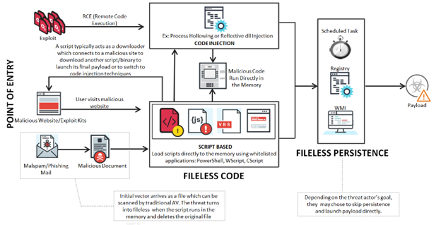
Chain of Fileless Malware Attacks _{[red team]}

Slide 57
Malicious Website/MailSpam/Phishing Email _{[red team]}
Arrival via malicious websites or phishing emails uses script-based programs such as Macros, PowerShell, VBScript, JavaScript, HTA, etc., to run the malicious code directly to the memory.
Typically, the initial script acts as a downloader which connects to a malicious host and downloads the payload.
The transition to fileless moves once the script runs in memory and deletes the document upon execution.

Slide 58
Memory Injection _{[red team]}
Memory Injection technique involves hiding malicious code in the memory of a legitimate process.
While processes that are critical to Windows activity are running, this malware distributes and re-injects itself into these processes, making it trickier to detect as these don’t trigger traditional red flags or whitelists.

Slide 59
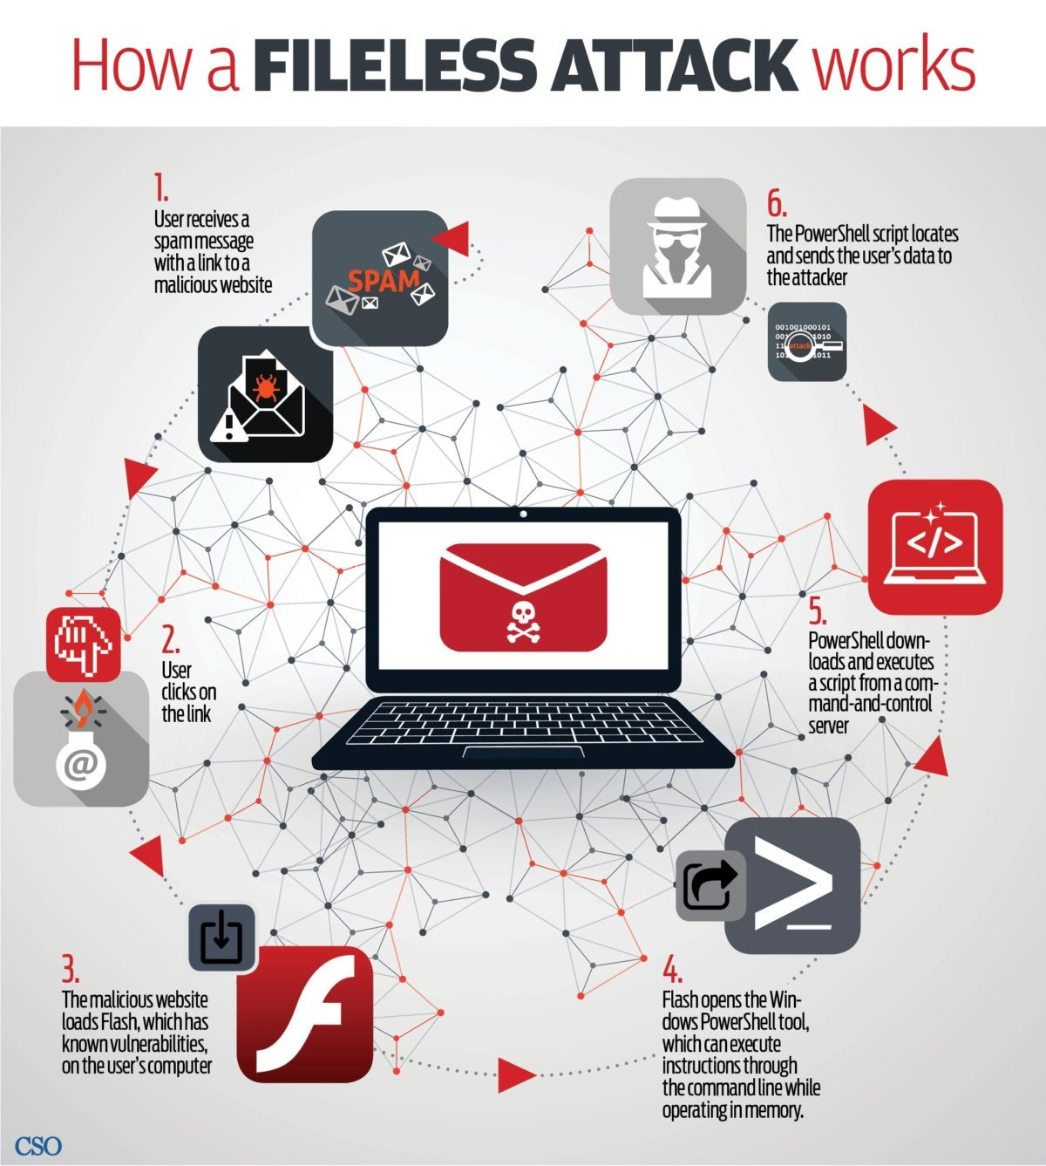
How Fileless Malware Work
_{[Maria Korolov]}
Fileless attacks also evade whitelisting.
With whitelisting, only approved applications are allowed to be installed a machine.
Fileless attacks take advantage of applications that are already installed and are on the approved list.

Slide 60
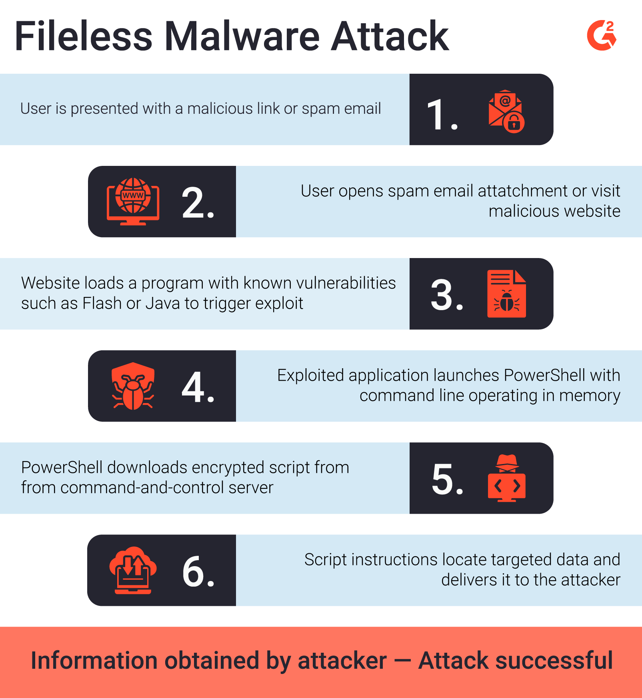
Fileless Malware Attack _{[Aaron Walker]}

Slide 61
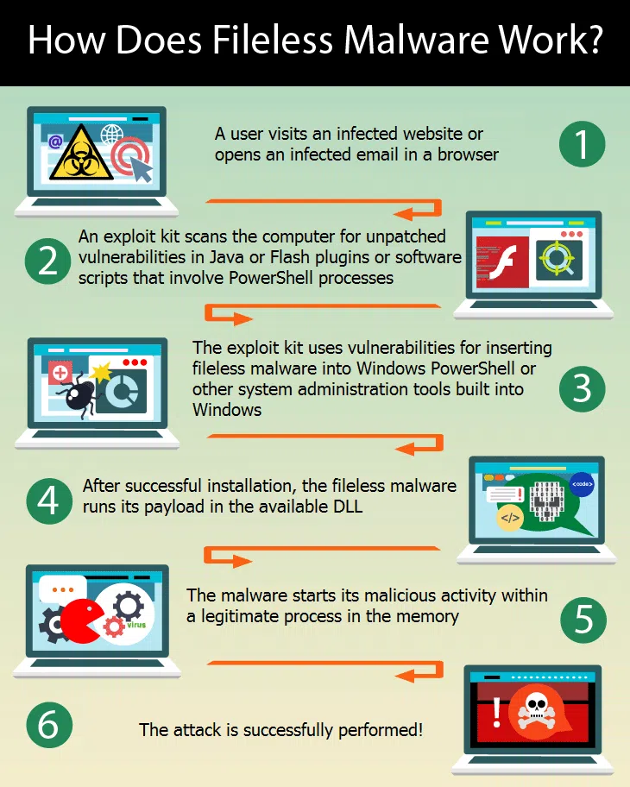
How Does Fileless Malware Work _{[Anton]}

Slide 62
JavaScript Malware
_{[ANDRA ZAHARIA]}

Slide 63
Malicious JavaScript Injection Campaign Infects 51k Websites
_{[Palo Alto Networks]}

Slide 64
How to Detect Malicious JavaScript Code _{[@induction]}

Slide 65
Supplementary Materials 2

Slide 66
What is fileless malware and how does it work? _{[Alison Grace]}
A new secret stash for “fileless” malware _{[DENIS LEGEZO]}

Slide 67
certutil.exe _{[Microsoft]}
certutil.exe is a command-line program, installed as part of Certificate Services.
You can use certutil.exe to dump and display certification authority (CA) configuration information, configure Certificate Services, backup and restore CA components, and verify certificates, key pairs, and certificate chains.

Slide 68
mshta.exe _{[file.net]}
The genuine mshta.exe file is a software component of Windows Internet Explorer by Microsoft Corporation.
The genuine "mshta.exe" file, if located in "C:\Windows\System32", is the Microsoft HTML Application Host program, a component of the Microsoft Windows operating system since 1999.

Slide 69
mshta.exe _{[file.net]}
HTML Application (.hta) files contain source code combining HTML, Dynamic HTML, and one or more scripting languages such as VBScript or Jscript.
Executing these HTA files in "mshta.exe", which shares much of its code with Internet Explorer, produces apps that look like web pages but can access local resources, (e.g., the local computer's file system).
Although "mshta.exe" is not malware it is often used by malware to execute rogue HTA code and store unwanted payloads.

Slide 70
Windows Shell _{[Microsoft]}
The Windows UI provides users with access to a wide variety of objects necessary for running applications and managing the operating system.
The most numerous and familiar of these objects are the folders and files that reside on computer disk drives.
There are also a number of virtual objects that allow the user to perform tasks such as sending files to remote printers or accessing the Recycle Bin.
The Shell organizes these objects into a hierarchical namespace and provides users and applications with a consistent and efficient way to access and manage objects.

