Slide 1
Introduction to Car Hacking:
The CAN Bus

Slide 2
Car Hacking: The ultimate guide! - Part I by Anastasis Vasileiadis _{[iguru]}
Car Hacking: The ultimate guide! - Part II by Anastasis Vasileiadis _{[iguru]}
Car Hacking: The ultimate guide! - Part III by Anastasis Vasileiadis _{[unSafe.sh - 不安全]}

Slide 3
CAN Bus [Anthony (RedHatAugust) Radzykewycz]
The car has door locks, a speedometer, a gas gauge, controls for the brakes, controls for the gas pedal, and many, MANY more devices.
The CAN bus (Controller Area Network bus) is a central network that a vehicle device use to communicate with other devices in the vehicle.
Many of these devices all communicate via this network.

Slide 4
Communication Using CAN Bus Network[Anthony (RedHatAugust) Radzykewycz]
If we press the lock button on our door, an electrical signal gets sent through the CAN bus to every device on the network, and the doors interpret the data frame.
In the data frame, there will be a command: lock or unlock.
The doors, receiving the data frame, will take that instruction and execute on the command in the data frame.

Slide 5
CAN Bus Network Basics
[Anthony (RedHatAugust) Radzykewycz]
Many devices in the vehicle operate in this way, where
  an action is triggered,
  data is sent on the network,
  and the appropriate device takes action with what the data packet designates.
Pressing the gas pedal would cause data frames to be sent in the network telling the gas flow to increase, and therefore make the car go faster.
This, in turn, may make the speedometer rise to reflect the appropriate speed the vehicle is going.

Slide 6
Format of Data Packets
[Anthony (RedHatAugust) Radzykewycz]
The frames sent on the network are made of two parts: the identifier and the data.
  The identifier is the representation for the device in the vehicle.
  The data field represents the instruction to be completed with the said device.
The identifier will not be the same between unlike vehicles in year, make, and model.

Slide 7
Example [Anthony (RedHatAugust) Radzykewycz]
120#F289632003200320
  The beginning section of the frame is the identifier.
  In this case, the identifier is 120.
  The remaining portion of the frame after the # is the data field.

Slide 8
CAN _{[wikepedia]}
CAN is a multi-master serial bus standard for connecting electronic control units (ECUs) also known as nodes (automotive electronics is a major application domain).
Two or more nodes are required on the same CAN network to communicate.

Slide 9
CAN _{[IGuru]}
The Controller Area Network aka CAN is the central nervous system that allows communication between all / certain parts of the car.
Before CAN was first developed by BOSCH in 1985, as an in-vehicle communication system, car manufacturers used point-to-point cabling systems.
  As we started to have more and more electronic components in cars, this became bulky and very expensive to maintain.
This problem was later corrected by replacing it with CAN.
CAN-Bus could be considered as a slower version of Ethernet LAN except that the traffic is UDP and not TCP.

Slide 10
Purpose of CAN_{[IGuru]}
Simply put, CAN allows different electronic modules in cars to communicate and share data with each other.
The main motivation of the CAN proposal was that it allowed communication of multiple ECUs (ECU = Electronic Control Unit = Car Control Unit) with only one cable.
A modern car can have up to 150 ECU.

Slide 11
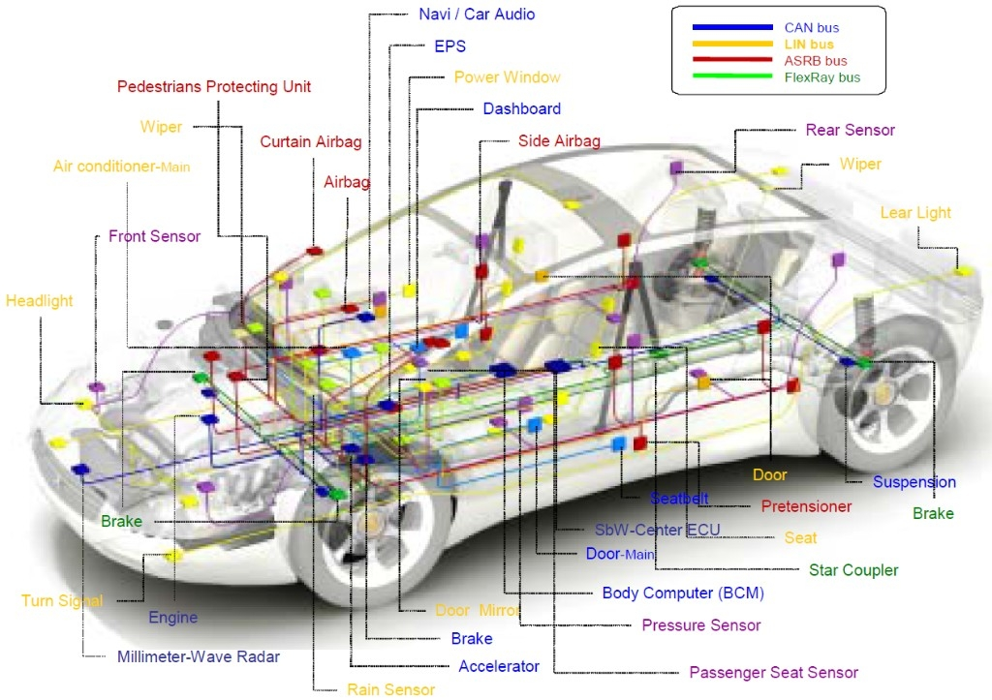
Communication Protocols Used in a Car _{[IGuru]}
It is worth noting that not all car control systems use CAN and also CAN is not the only communication protocol used in a car system.
There could be other protocols such as Bluetooth, GSM / LTE networks, satellite radios, LIN etc.
Be aware that CAN is not the only program that can be attacked. There are many more.

Slide 12
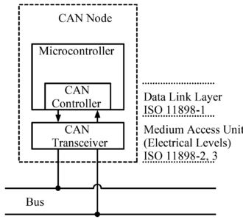
CAN Bus Node _{[wikepedia]}
Each node is able to send and receive messages, but not simultaneously.
A message or Frame consists primarily of the ID (identifier), which represents the priority of the message, and up to eight data bytes.

Slide 13
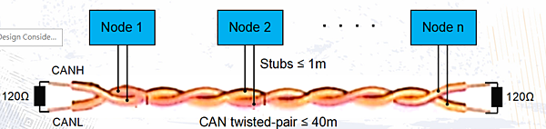
Connect Nodes [痞客邦] [David Maliniak and Mike Hertz]
The CAN bus uses two dedicated wires called CAN High and CAN Low.
All nodes are connected to each other through a physically conventional two wire bus.
The wires are a twisted pair with a 120 Ω (nominal) characteristic impedance.

Slide 14
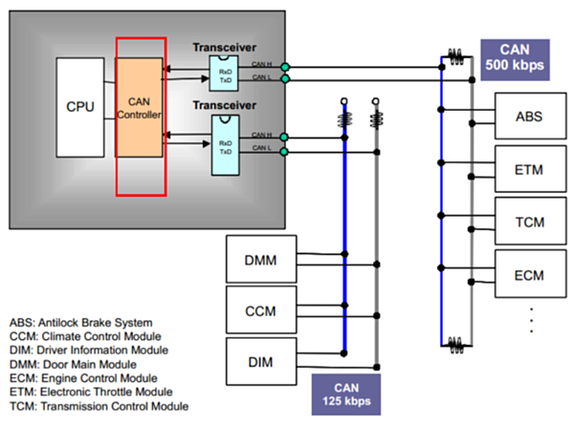
Multiple Nodes _{[痞客邦]}
在同一個CAN BUS上的所有裝置，速度也就是 Bitrate 都必須設定一樣，否則無法通訊。
Depending on the transmission rate, there are two kinds of CAN BUSs, distinguished as low speed, with bit rates from 40 kbit/s to 125 kbit/s, and high speed, with bit rates from 125 kbit/s to 1 Mbit/s .
The devices connected to the CAN Bus are connected at different speeds depending on their importance.

Slide 15
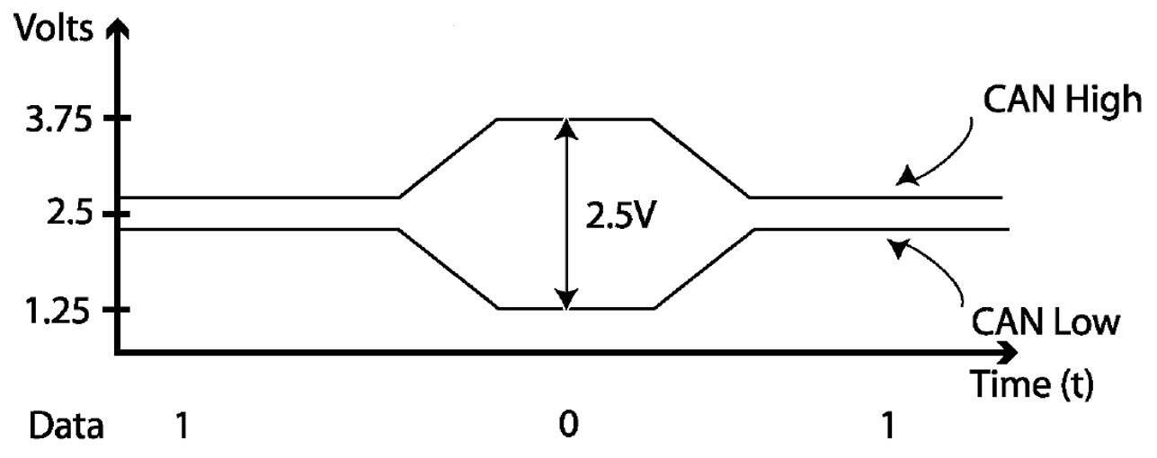
Voltage Difference and Data
[David Maliniak and Mike Hertz]
CAN bus uses voltage difference between line CAN high and line CAN to represent data 1 (low voltage difference) or data 0 (high voltage difference) .

Slide 16
Dominant Bits and Recessive Bits _{[Wikipedia]}
The CAN specifications use the terms dominant bits and recessive bits, where
  dominant is a logical 0 and
  recessive is a logical 1.
The idle state is represented by the recessive level (logical 1).

Slide 17
Frame Types _{[Wikipedia]}
CAN has four frame types:
  Data frame: a frame containing node data for transmission
  Remote frame: a frame requesting the transmission of a specific identifier
  Error frame: a frame transmitted by any node detecting an error
  Overload frame: a frame to inject a delay between data or remote frame

Slide 18
CAN Data Frame_{[IGuru]}
A car can have multiple nodes that are able to send and / or receive messages (frames).
Each message essentially consists of an ID, which is a priority of the message and can also contain a CAN message that can be eight bytes or less.
If two or more nodes start sending messages at the same time, the messages sent with lower ID will replace that of the higher ID. This is called priority-based bus arbitration.
Messages with numerically lower identifiers (IDs) are a higher priority and are always sent first.

Slide 19
CAN Data Frame Formats _{[Wikipedia]}
A CAN network can be configured to work with two different message (or frame) formats:
  the standard or base frame format (described in CAN 2.0 A and CAN 2.0 B), and
  the extended frame format (described only by CAN 2.0 B).
The only difference between the two formats is that
  the CAN base frame supports a length of 11 bits for the identifier, and
  the CAN extended frame supports a length of 29 bits for the identifier, made up of the 11-bit identifier (base identifier) and an 18-bit extension (identifier extension).

Slide 20
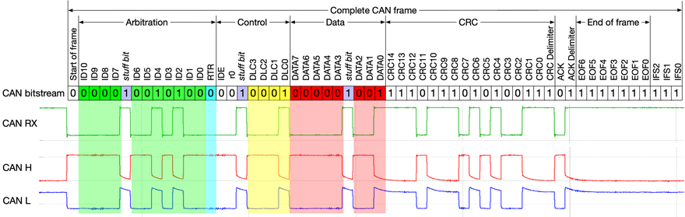
Basic Frame Format _{[Wikipedia]}

Slide 21
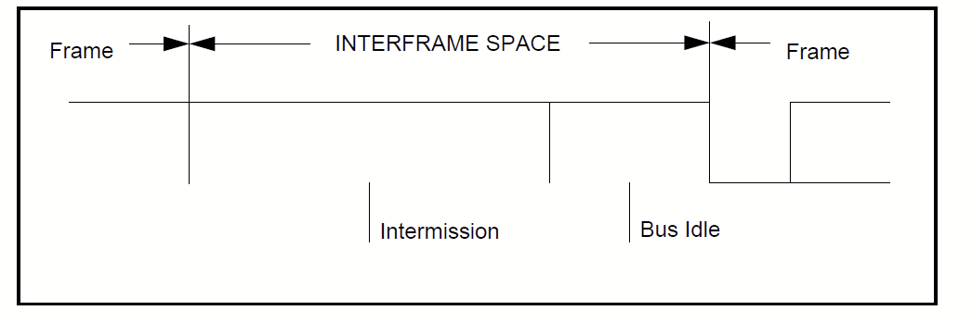
INTERFRAME SPACING _{[NCKU]}
INTERMISSION
consists of 3 'recessive' bits.
BUS IDLE
The period of BUS IDLE may be of arbitrary length

Slide 22
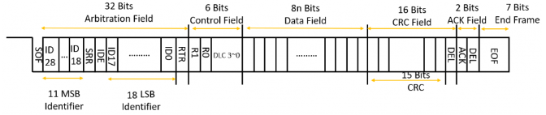
Extended Frame Format _{[IThome]}

Slide 23
Fields of a CAN Frame
SOF (1 bit): The Start of Frame is a 'dominant 0' to tell the other nodes that a CAN node intends to talk
ID (11/29 bits): The ID is the frame identifier - lower values have higher priority
RTR: The Remote Transmission Request indicates whether a node sends data or requests dedicated data from another node
Control: The Control contains the Identifier Extension Bit (IDE) which is a 'dominant 0' for 11-bit. It also contains the 4 bit Data Length Code (DLC) that specifies the length of the data bytes to be transmitted (0 to 8 bytes)
Data (0-64 bits): The Data contains the data bytes aka payload, which includes CAN signals that can be extracted and decoded for information
CRC: The Cyclic Redundancy Check is used to ensure data integrity
ACK: The ACK slot indicates if the node has acknowledged and received the data correctly
EOF(7 bits): The EOF marks the end of the CAN frame

Slide 24
Bit Stuffing _{[kvaser]}
When five consecutive bits of the same level have been transmitted by a node, it will add a sixth bit of the opposite level to the outgoing bit stream.
The receivers will remove this extra bit.
If more than five consecutive bits of the same level occurs on the bus, a Stuff Error is signaled.

Slide 25
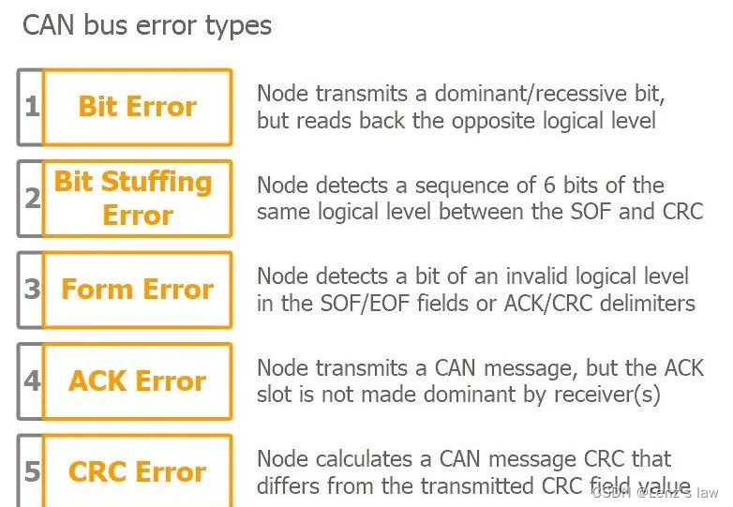
CAN Bus Error Type _{[CSDN]}

Slide 26
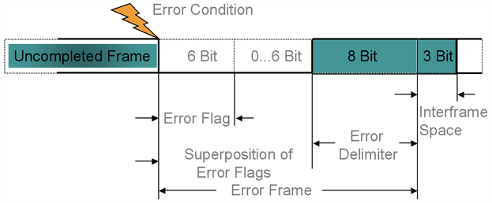

Error Frame [kvaser] [NCKU][CSS Electronics]
A primary error flag may overlap with a secondary error flag.
primary error flag
(bit error)
ps: Issued by a transmitting node
secondary error flag
(bit stuffing error)
ps: Issued by other nodes
The Error Frame consists of an Error Flag, which is 6 bits of the same value (thus violating the bit-stuffing rule) and an Error Delimiter, which is 8 recessive bits.
The Error Delimiter provides some space in which the other nodes on the bus can send their Error Flags when they detect the first Error Flag.

Slide 27
Error Flags _{[wikipedia]}
There are two types of error flags:
Active Error Flag
  6 dominant bits – Transmitted by a node detecting an error on the network that is in error state error active.
Passive Error Flag
  6 recessive bits – Transmitted by a node detecting an active error frame on the network that is in error state error passive.

Slide 28
Error Counters _{[Cho et al.]}
For any detected errors, the perceived node transmits an error frame on the bus and increases one of the two error counters it maintains:
  Transmit Error Counter (TEC)
  and
  Receive Error Counter (REC).

Slide 29
Rules for the Error Counters_{[Cho et al.]}
There are several rules governing the increase/decrease of these counters.
In essence, a node that detects an error during transmission increases TEC by 8, whereas if perceived during reception, REC is increased by 1.
Moreover, for any error-free transmission and reception, TEC and REC are decreased by 1, respectively.

Slide 30
Error States [Andrea Palanca et al.][vector]
Each CAN node can be in three distinct error states, depending on how many errors a certain node has generated or observed:
  Error Active: the CAN node normally takes part in bus communications and sends an active error flag (6 dominant bits) when it detects an error.
  Error Passive: the CAN node can normally take part in bus communications, but can only send a passive error flag (6 recessive bits) when it detects an error.
    When sending two consecutive data or remote frames, CAN controllers that are in the “Error Passive” state must wait the “Suspend Transmission Time” (8 bits).
  Bus Off: the CAN node cannot take part in any bus communication, not even reading frames o the bus.

Slide 31
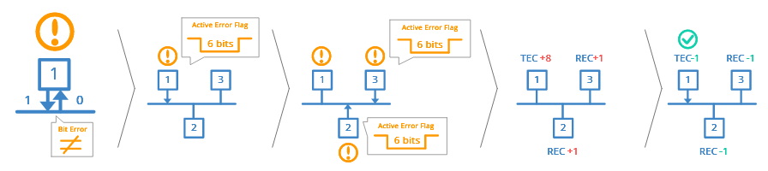
How does CAN Error Handling Work? _{[CSS ELECTRONICS]}

Slide 32
Step-by-Step Explanation _{[CSS ELECTRONICS]}
CAN node 1 transmits a message onto the CAN bus - and reads every bit it sends
In doing so, it discovers that one bit that was sent dominant was read recessive
This is a 'Bit Error' and node 1 raises an Active Error Flag to inform other nodes
In practice, this means that node 1 sends a sequence of 6 dominant bits onto the bus
In turn, the 6 dominant bits are seen as a 'Bit Stuffing Error' by other nodes
In response, nodes 2 and 3 simultaneously raise an Active Error Flag
This sequence of raised error flags comprise part of a 'CAN error frame'
CAN node 1, the transmitter, increases its 'Transmit Error Counter' (TEC) by 8
CAN nodes 2 and 3 increase their 'Receive Error Counter' (REC) by 1
CAN node 1 automatically re-transmits the message - and now succeeds
As a result, node 1 reduces its TEC by 1 and nodes 2 and 3 reduce their REC by 1

Slide 33
Bus Off _{[Andrea Palanca et al.]}
According to the protocol, whenever a transmitting node sends an error flag, its TEC must be increased by 8.
This means that, after 16 invalid transmissions, an Error Active node with a zeroed TEC will go in Error Passive state (TEC =16*8 = 128), and after another 16 invalid transmissions it will enter the Bus Off state (TEC = 256), denying all bus communication until a bus idle condition or a reset command (or both) are observed.

Slide 34
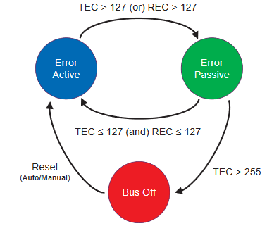
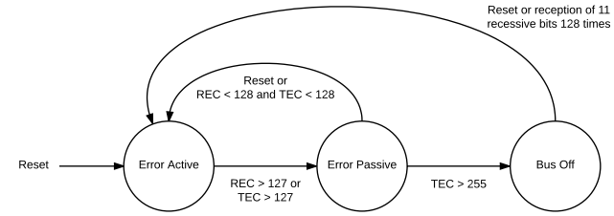
State Diagram of Fault Confinement in CAN [Andrea Palanca et al.] [Cho et al.]

Slide 35
Data Frame _{[Narayan Khatri et al.]}
Data frame is used for actual data transmission.
The Identifier field represents the message priority.
The priority of the message would be higher if it has lower ID value.
In addition, actual data field is in the range of 0-64 bits.

Slide 36
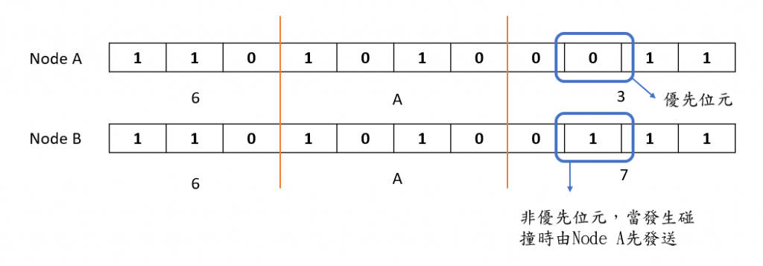
Arbitration _{[Wikipedia][ithelp]}
If one node transmits a dominant bit and another node transmits a recessive bit then there is a collision and the dominant bit wins.
  This means there is no delay to the higher-priority message.
  The node transmitting the lower-priority message automatically attempts to re-transmit 6-bit clocks after the end of the dominant message.
  This makes CAN very suitable as a real-time prioritized communications system.

Slide 37
Arbitration _{[Narayan Khatri et al.]}
When two or more than two nodes are transmitting data simultaneously, arbitration mechanism is used for contention resolution.
If any node is transmitting a dominant (0) bit in the bus, all other nodes in the bus will read this dominant bit regardless the bit they have transmitted. If the nodes see high priority messages in the bus, it stops transmission.

Slide 38
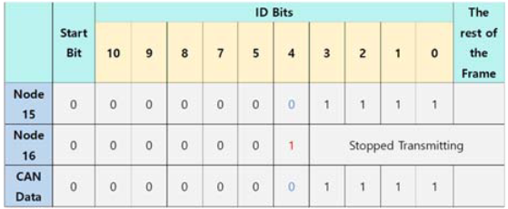
CAN Bus Arbitration Mechanism Example _{[Narayan Khatri et al.]}

Slide 39
OBD _{[IGURU]}
To access your car's CAN bus, you must have access to the cab diagnostic port, also known as the OBD.
While there may be hundreds of other diagnostic standards and ports, basically all cars these days use the OBD-II.
  This is exactly what your car mechanics use to diagnose damage to your car.
OBD is the most direct access to CAN.
Locating OBD-II is fairly easy.
  This is somewhere near the front passenger or driver's seat.

Slide 40
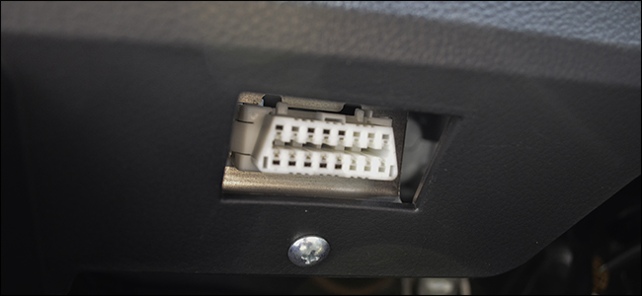
An OBD _{[IGURU]}

Slide 41
OBD-II [Anthony (RedHatAugust) Radzykewycz]
The OBD-II (On-board diagnostics 2) connector is a port on a vehicle that allows for easy diagnosis of vehicle codes.
Many times, when we bring our vehicles to a mechanic, they will plug a computer device into this port to get the error code the vehicle is sending.
This makes for much quicker resolutions for issues that may have turned on the check-engine light or even issues that don’t result in an indicator.

Slide 42
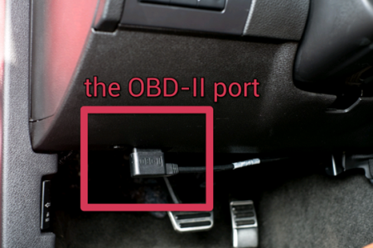
Location of OBD-II
[Anthony (RedHatAugust) Radzykewycz]
The access point to get communication on the CAN bus would be through the OBD-II port.

Slide 43
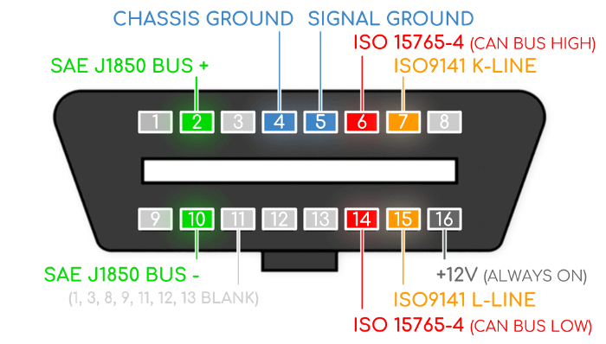
OBD Pinouts _{[IGURU]}

Slide 44
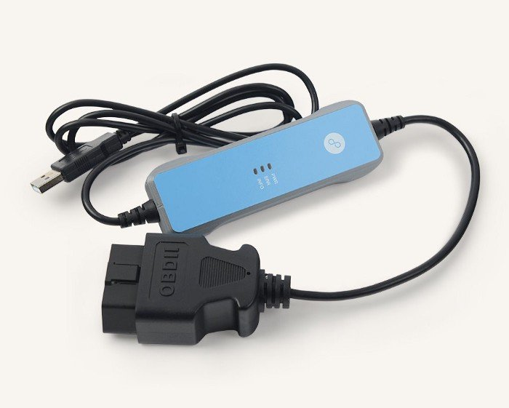
Hardware required to access CAN via OBD _{[IGURU]}

Slide 45
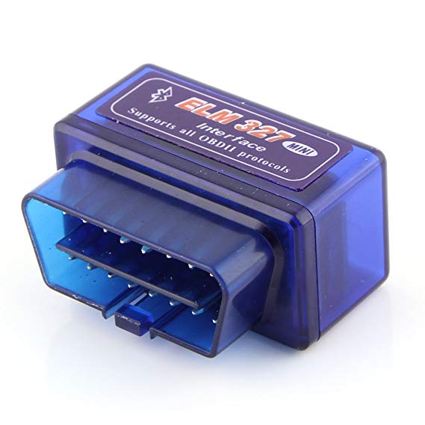
Hardware required to access CAN via OBD _{[IGURU]}

Slide 46
Software Required to Access CAN via OBD _{[IGURU]}
In terms of software, you have SocketCAN, can-utils, vcan embedded in the Linux kernel.
They serve the purpose of sending and receiving CAN packages, their encoding and / or decoding.
You also have Wireshark which can analyze CAN packages.

Slide 47
Vulnerabilities of CAN Bus
Lack of Addressing:
  Easily counterfeited
Lack of Authentication:
  Easily counterfeited
Broadcast messaging:
  Vulnerable to eavesdropping
Limited Bandwidth
Lack of Encryption:
  No protection

Slide 48
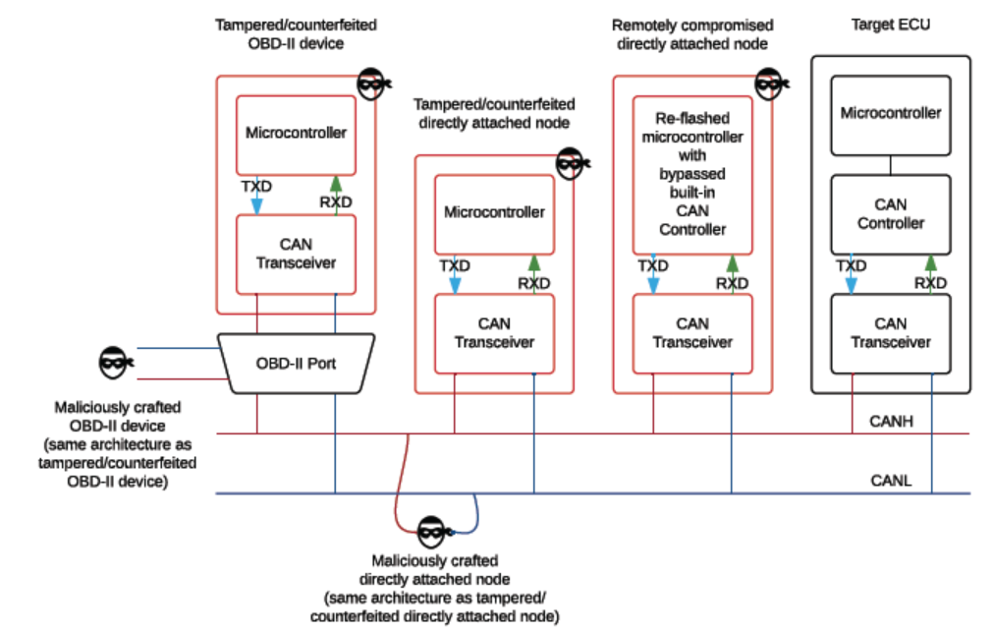
Examples of Attacking Nodes Architectures _{[Andrea Palanca et al.]}

Slide 49
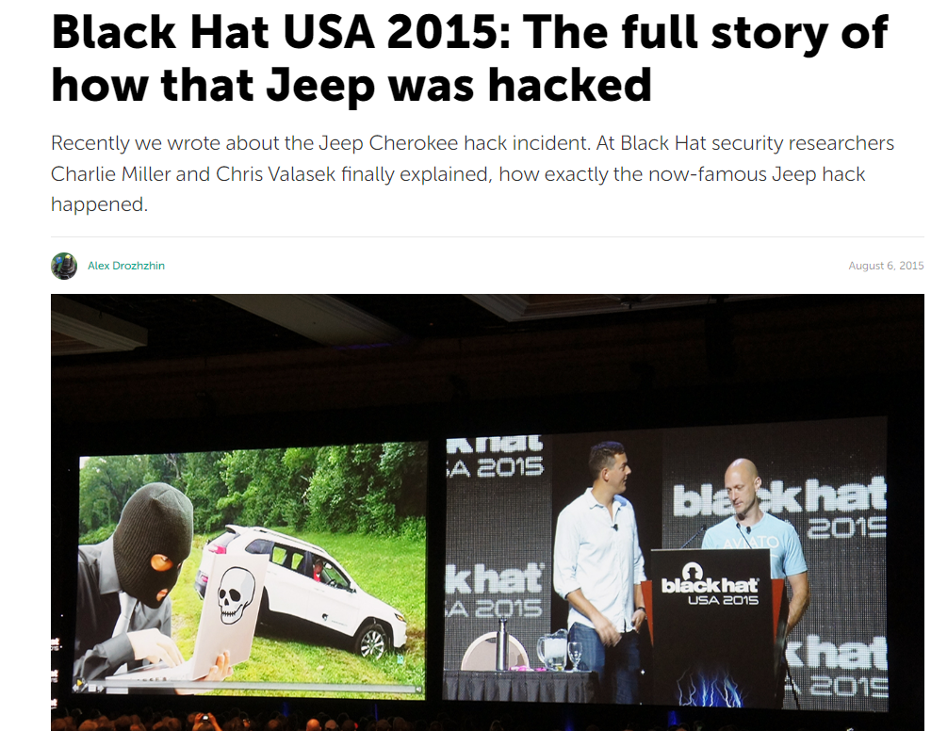
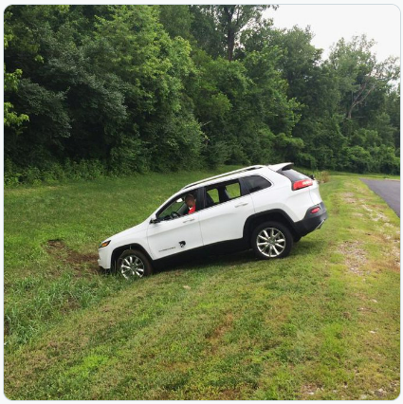
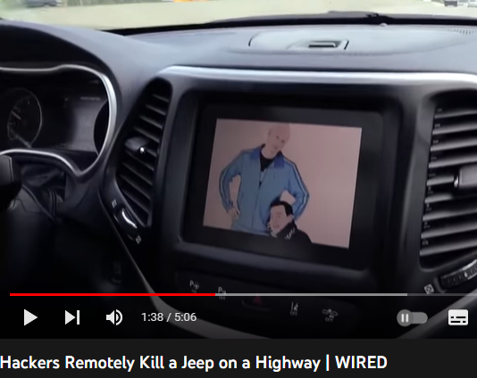
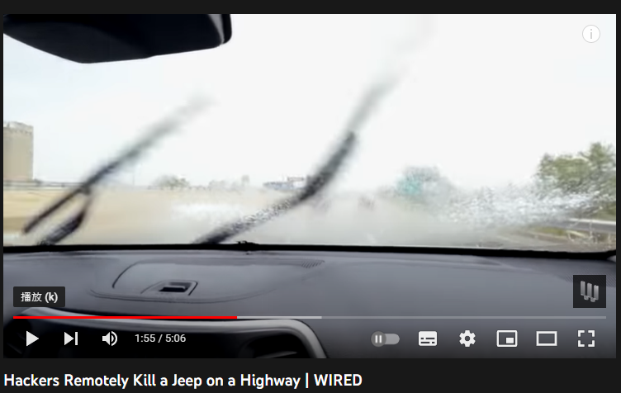
Hijack Attack
Source: https://www.kaspersky.com/blog/blackhat-jeep-cherokee-hack-explained/9493/
Notes:
當攻擊開始發生時 ，我正以每小時70英里的速度行駛在聖路易斯市中心 。儘管我沒有碰觸儀表板，但吉普車的出風口開始切換到最大值吹入冷空氣，通過車內空調系統冷卻我背上的汗水。接下來 ，收音機切換到當地的嘻哈台，開始把Skee -lo的音樂調到最大聲。
。接著 ，擋風玻璃上的雨刷打開了，雨刷液模糊了玻璃。當我試圖解決這些問題時 ，在汽車的數位螢幕上出現了兩名駭客的照片：Charlie Miller和Chris Valasek，穿著他們標誌性的運動服

Slide 50
Security of CAN Bus

Slide 51
DoS Attack – Smaller ID Frames _{[Narayan Khatri et al.]}
The ID based priority scheme makes CAN bus vulnerable to DoS attack.
When the malicious node transmits smaller ID frames at high rate then all other nodes in the bus will stop transmitting their frames due to arbitration mechanism of CAN bus.

Slide 52
Solution _{[Andrea Palanca et al.]}
However, these kinds of attacks are effectively detected and stopped with frame-analysis based IDS/IPS approaches.
Indeed, the essential aspect of such attacks is the injection of either unexpected frames or the transmission of frames at abnormal rates.

Slide 53
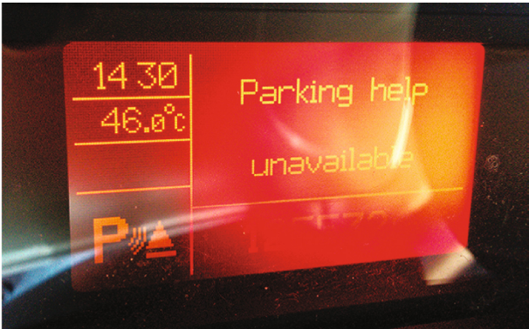
Bus-off Attack Error _{[trendmicro]}
CAN訊息（包括錯誤）被稱為“ frame”。當裝置讀到frame出現非預期的值時會出現錯誤。當設備偵測到這種事件時，它會寫入一個錯誤訊息到CAN匯流排來“回收”錯誤的frame，並通知其它設備忽視被回收的frame。這種事故很常見，通常都是自然造成，一次短暫的故障或是太多系統和模組試圖在同一時間透過CAN送出frame。
如果一個設備送出太多錯誤，那麼CAN標準規定它進入一個所謂的Bus-Off狀態，將它從CAN隔離，避免對CAN讀寫任何資料。此功能對於隔離故障設備並阻止它們觸發CAN其他模組/系統來說非常有用。
攻擊可透過足夠多的錯誤來觸發這種功能，讓CAN內的目標設備或系統進入Bus Off狀態，也就無法操作。這反過來可以極大地影響汽車性能，讓它變得危險甚至致命，特別是當像安全氣囊系統或防鎖死制動系統等關鍵系統失效的時候。所需要的只是將一個特製攻擊設備連上汽車的CAN，並且重新使用已經流通在CAN的frame而非注入新的frame。

Slide 54
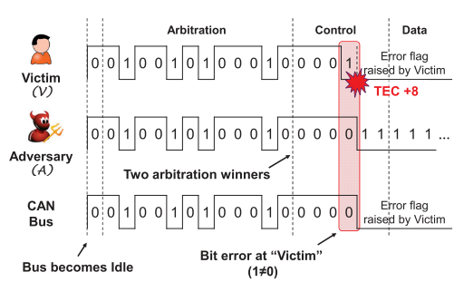
Bus-off Attack _{[Cho et al.]}
C1. ID - Same ID as message M created by the real ECU with the ID.
C2. Timing – Transmitted at the same time as M; and
C3. Contents – Having at least one bit position in which it is dominant(0), whereas it is recessive(1) in M. All preceding bits should be the same as M.
Notes:
網絡安全研究員在科爾維特的OBD-II端口插入了一個裝置，以此來侵入汽車的安全系統，在低速行駛狀態下介入雨刷控制器的開關並且也干預了煞車系統的動作。但其實 Chevrolet Corvette 的事件僅是 OBD 端子接口最近的新案例，在去年11月汽車網絡安全公司 Argus Cyber​​ Security 網絡安全工程師便已經透過一款名為 Zubie 的OBD-II 車載測速裝置成功對汽車進行遠端控制，在今年1月份 Digital Bond 實驗室的研究員也發現一款訊息追踪功能的車載測速裝置存在安全漏洞，而有超過200萬個美國前進保險公司客戶在使用這款產品。對此 GM 在 12 日表示，過去便一直有宣導消費者對於將第三方裝置連接到 OBD 端口時所存在的潛在風險，對於這項攻擊的防範目前則未提出任何解套。

Slide 55
Bus Flood Attack _{[Ken Tindell]}
A Bus Flood Attack is very simple denial-of-service attack: transmit CAN frames as fast as possible to soak up bus bandwidth, cause legitimate frames to be delayed and for parts of the system to fail when frames don’t turn up on time.

Slide 56
Factors Influencing the Results of Bus Flood Attacks_{[Ken Tindell]}
The success of the attack depends on what mitigations there might be in place.
  For an open bus, transmitting a frame with a CAN ID of 0 will block all other traffic because this is the highest priority frame.
  If there is a gateway that only allows certain IDs to pass through, then only the lower priority frames can be delayed: the higher priority frames will continue to be transmitted undisturbed.

Slide 57
Simple Frame Spoofing _{[Ken Tindell]}
Frame spoofing is a type of authentication attack: getting a receiver to accept a fake frame as if it came from a legitimate sender.
  If directly connected (e.g. via the OBD-II port) this is done by simply queueing the CAN frame through the drivers in the firmware of the connected device.
  If connected via a hijacked ECU (e.g. infotainment) this can be done by using the drivers in the device or with new drivers installed as part of the hijacking.

Slide 58
Problem with the Simple Spoofing Approach _{[Ken Tindell]}
One problem with this simple spoofing approach is that the frames from the legitimate ECU are also received and the receivers may act on both the legitimate frame and the spoofed one.

Slide 59
Arbitration Doom Loop _{[Ken Tindell]}
The CAN protocol requires that two frames with the same ID are not entered into arbitration at the same time.
If this does happen then after arbitration two controllers will be transmitting and when the bits transmitted differ then one of the controllers will see a bit error (transmitting a recessive bit but receiving a dominant bit) and signal an error frame, which causes all receivers to re-synchronize an arbitration to start again.
If no higher priority frame has been queued in the intervening time then these two frames will win arbitration again and the process will repeat.
This is denoted the Arbitration Doom Loop (ADL).

Slide 60
Results of ADL on Involving ECUs
_{[Ken Tindell] [Luca Fumarola]}
Each of the two controllers of the involving ECUs goes around the loop increases the Transmit Error Counter (TEC) in each of the two controllers.
And they will eventually both go into the bus-off state (i.e. be logically disconnected from the bus).
  The bus will be unusable by other nodes until those two nodes in the loop go on Bus Off state. This would then be a form of denial-of-service attack.
This takes about 4ms on a 500kbit/sec CAN bus.

Slide 61
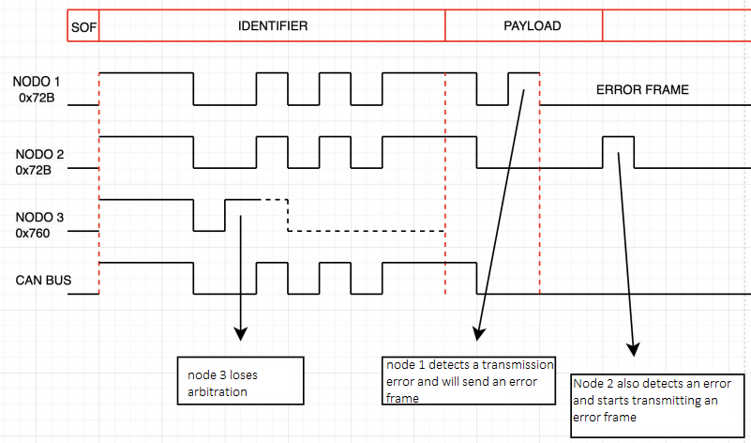
Explanation _{[Luca Fumarola]}

Slide 62
Adaptive Spoofing Attack _{[Ken Tindell]}
To avoid the ADL, an attacking device listens to the bus to see when the legitimate frame is sent and then queues the spoofed frame so that it does not clash.
In many designs a receiver does not act immediately on a received frame but instead stores it in a buffer associated with the ID for a control loop to look at later.

Slide 63
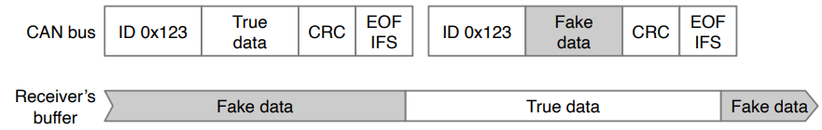
Maximizing the Chances of a Receiver Seeing Fake Data _{[Ken Tindell]}
If the spoofed frame is sent immediately after the legitimate frame, then it will overwrite the buffer and the receiver will most likely act on the contents of the spoofed frame.
There is only a small time-window when the true data is in the receiver’s buffer.

Slide 64
Mitigation Methods _{[Ken Tindell]}
The simple spoofing approaches outlined above can be detected by monitoring the bus and looking at the timing of frames: spoofed frames will be sent more often than expected and traffic analysis can detect anomalies.
However, retrospectively detecting an attack may not be of much use when an actuator has already been commanded.

Slide 65
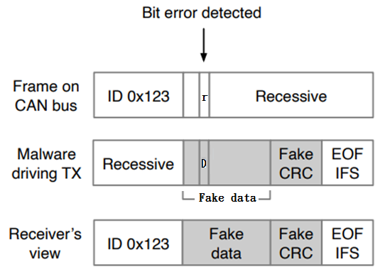
Error Passive Spoofing Attack_{[Ken Tindell]}

Slide 66
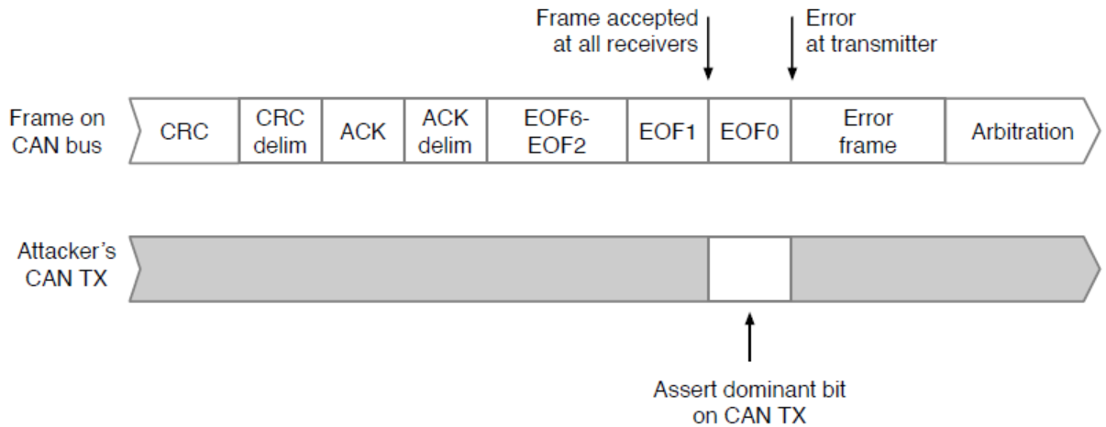
Double Receive Attack _{[Ken Tindell]}
The protocol defines that a receiver accepts a frame as finished at the second-to-last bit of the EOF field and that the transmitter accepts it as finished at the last bit of the EOF field.

Slide 67
Attack Mitigation Techniques
_{[Ken Tindell]}
Intrusion detection
Security gateway
Encryption
CAN security hardware

Slide 68
Intrusion Detection _{[Ken Tindell]}
This is a technique where the traffic on the bus is inspected for abnormal behaviours.
Without hardware support it cannot generally prevent an attack but even so has a use in intelligence gathering and in post-incident forensics.

Slide 69
Security Gateway
_{[Ken Tindell]}
This is a hardware approach using a device with two (or more) CAN bus interfaces.
The gateway copies only legitimate traffic between the trusted bus (typically a vehicle control network) and an untrusted bus that contains a device that is potentially compromised.

Slide 70
Encryption _{[Ken Tindell]}
This is generally a software technique (sometimes with hardware assistance) where an ECU protects its CAN bus traffic using cryptographic methods.
Only receivers with a key can decrypt a message and verify its legitimacy.
There are several issues around practical use of encryption for protecting CAN.

Slide 71
CAN Security Hardware _{[Ken Tindell]}
These approaches use a hardware device included on a PCB that monitors the CAN signals to and from the CAN bus and provides various levels of protection.

Slide 72
Supplementary Material

Slide 73
CAN Error Handling _{[Kvaser]}

Slide 74
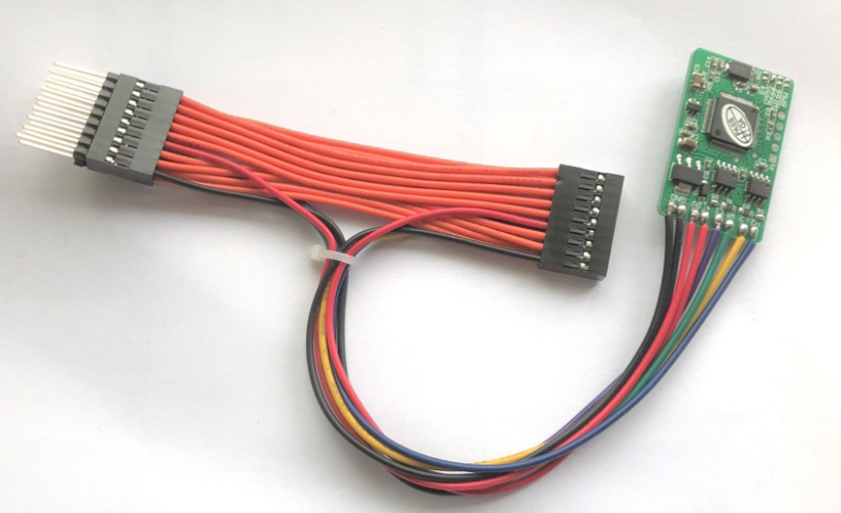
Wire-cutting Spoofing Attack _{[Ken Tindell]}
If an attacker has physical access to the CAN bus and can cut wires to partition the bus then they can spoof frames to one of the partitions by emulating the other partition by gatewaying other frames and generating spoofed frames directly.
device for spoofing odometer CAN frames

Slide 75
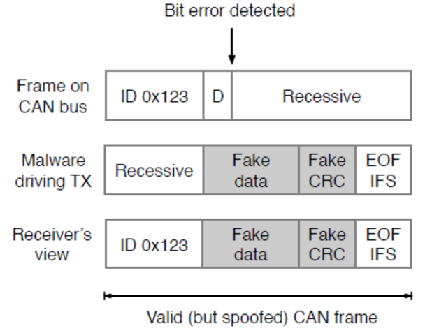
Error Passive Spoofing Attack_{[Ken Tindell]}

Slide 76
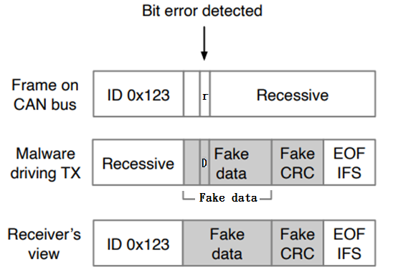
Error Passive Spoofing Attack_{[Ken Tindell]}

