Slide 1
Linux Kernel

Slide 2
Linux-insides _{[0xAX]}
Linux Kernel Reading _{[Chen Weixiang]}

Slide 3
Boot

Slide 4
Boot
The Kernel Setup Entry Point
Linux 内核揭密
The Kernel Boot Process (recommended)
Linux核心啟動過程分析 (recommended)
Linux内核的引導啟動
Linux内核的引導啟動 _{[tobyjiang]}
兩次 jmp
The Kernel Boot Process
x86體系結構下Linux-2.6.26起動流程 _{[何春晖]}
Linux啟動過程 _{[Houmin ]}

Slide 5
File Signatures _{[Wikipedia]}

Slide 6
File Signatures
File signatures are data used to identify or verify the content of a file.
Such signatures are also known as magic numbers or Magic Bytes.

Slide 7
File Signature Examples _{[Wikipedia]}
Hex signature | ISO 8859-1 | Offset | Filename extension | Description
23 21 | #! | 0 |  | Script or data to be passed to the program following the shebang (#!).
4D 5A | MZ | 0 | exe dll | DOS MZ executable file format and its descendants (including NE and PE)

Slide 8
Linker Script

Slide 9
GNU LD
GNU LD is a linker scripting language, you can find more information in its documentation.

Slide 10
Linker Script
GNU ld的linker script簡介_{[Wen Liao]}
Linker Script初探 _{[Wen Liao]}
linker script檔案解說 _{[ITREAD01.COM]}
linker script 簡單教學 _{[evshary]}

Slide 11
VMA and LMA _{[ITREAD01.COM]}
VMA (virtual memory address) : 虛擬記憶體地址或程式地址空間地址。
LMA (load memory address) : 載入記憶體地址或程序地址空間地址。
通常VMA和LMA是相同的。
但在嵌入式系統中, 經常存在載入地址和執行地址不同的情況: 比如將輸出檔案載入到開發板的flash中(由LMA指定), 而在執行時將位於flash中的輸出檔案複製到SDRAM中(由VMA指定)。

Slide 12
VMA and LMA explanation (1) _{[ITREAD01.COM]}
假設:
(1) .data section對應的VMA地址是0x08050000, 該section內包含了3個32位全域性變數, i、j和k,分別為1,2,3.
(2) .text section內包含由“printf( ”j=%d “, j );”程式片段產生的程式碼。

Slide 13
VMA and LMA explanation (2) _{[ITREAD01.COM]}
連線時指定.data section的VMA為0x08050000, 產生的printf指令是將地址為0x08050004處的4位元組內容作為一個整數打印出來。
如果.data section的LMA為0x08050000,顯然結果是j=2。
如果.data section的LMA為0x08050004,顯然結果是j=1。

Slide 14
Linker Script (Section Definition) for .head.text
SECTIONS
{
. = 0;
.head.text :
{ _head = . ;
HEAD_TEXT
_ehead = . ;
}
...
...
...
}

Slide 15
Macro __HEAD
#define __HEAD .section ".head.text","ax"

Slide 16
Linker Variable .
The . symbol is a special linker variable, the location counter.
The value assigned to it is an offset relative to the segment.

Slide 17
Section .head.text
.head.text is the name of the section and ax is a set of flags.
In our case, these flags show us that this section is executable or in other words contains code.
We can find the definition of this section in the arch/x86/boot/compressed/vmlinux.lds.S linker script.

Slide 18
Variable _end
Variable _end stores the value of the address of the end of the setup code.

Slide 19
Background Knowledge

Slide 20
Use 32 Bits Registers/Instructions in Real Mode (1) _{[ninjalj]}
When the processor operates in real mode (as it is immediately after booting), it defaults to 16-bit code. However, this does not mean that you are unable to use 32-bit instructions.

Slide 21
Use 32 Bits Registers/Instructions in Real Mode (2) _{[ninjalj]}
There is an "operand size override" prefix (66h) that changes the default mode for a single instruction.
When this prefix is used with an instruction executed in 16-bit real mode, it will switch the instruction to 32-bit.
Conversely, when this prefix is used with an instruction executed in 32-bit protected mode, it will switch the instruction to 16 bit. (A similar prefix, 67h, works to override address sizes.)

Slide 22
Use 32 Bits Registers/Instructions in Real Mode (3) _{[ninjalj]}
Using this prefix, then, allows you to use 32-bit registers in 16-bit real mode. Your assembler will almost certainly emit this prefix automatically when you try and use 32-bit operands with an instruction when assembling 16-bit code.
Unfortunately, there is no such override prefix for 64-bit instructions, so these cannot be used in real mode. You need to switch into "long mode" to allow these.

Slide 23
.code16, .code32, or .code64 (1) _{[[ zeuthen ]}
While as normally writes only “pure” 32-bit i386 code or 64-bit x86-64 code depending on the default configuration, it also supports writing code to run in real mode or in 16-bit protected mode code segments.
To do this, put a `.code16' or `.code16gcc' directive before the assembly language instructions to be run in 16-bit mode.
You can switch as to writing 32-bit code with the `.code32' directive or 64-bit code with the `.code64' directive

Slide 24
.code16, .code32, or .code64 (2) _{[[ zeuthen ]]}
The code which as generates in 16-bit mode will not necessarily run on a 16-bit pre-80386 processor.
To write code that runs on such a processor, you must refrain from using any 32-bit constructs which require as to output address or operand size prefixes.

Slide 25
.code16, .code32, or .code64 (_{[ zeuthen ]]}
Note that writing 16-bit code instructions by explicitly specifying a prefix or an instruction mnemonic suffix within a 32-bit code section generates different machine instructions than those generated for a 16-bit code segment.
In a 32-bit code section, the following code generates the machine opcode bytes `66 6a 04', which pushes the value `4' onto the stack, decrementing `%esp' by 2.
pushw $4 The same code in a 16-bit code section would generate the machine opcode bytes `6a 04' (i.e., without the operand size prefix), which is correct since the processor default operand size is assumed to be 16 bits in a 16-bit code section.

Slide 26
The Real-Mode Kernel Header
In the following text, and anywhere in the kernel boot sequence, “a sector” refers to 512 bytes.
  It is independent of the actual sector size of the underlying medium.
The first step in loading a Linux kernel should be to load the real-mode code (boot sector and setup code) and then examine the following header at offset 0x01f1.

Slide 27
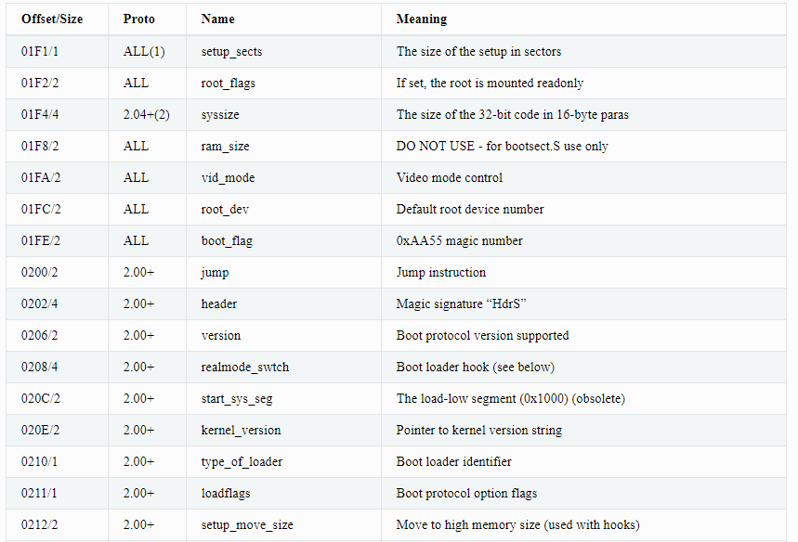
Partial Header

Slide 28
Some Fields of the Header
Offset/Size | Protocol | Name | Meaning
0211/1 | 2.00+ | loadflags | Boot protocol option flags
0224/2 | 2.01+ | heap_end_ptr | Free memory after setup end

Slide 29
Field loadflags
Field name: | loadflags
Type: | modify (obligatory)
Offset/size: | 0x211/1
Protocol: | 2.00+

Slide 30
Bits of Field loadflags
This field is a bitmask.
Bit 0 (read): LOADED_HIGH
  If 0, the protected-mode code is loaded at 0x10000.
  If 1, the protected-mode code is loaded at 0x100000.
Bit 7 (write): CAN_USE_HEAP
  Set this bit to 1 to indicate that the value entered in the heap_end_ptr is valid. If this field is clear, some setup code functionality will be disabled.

Slide 31
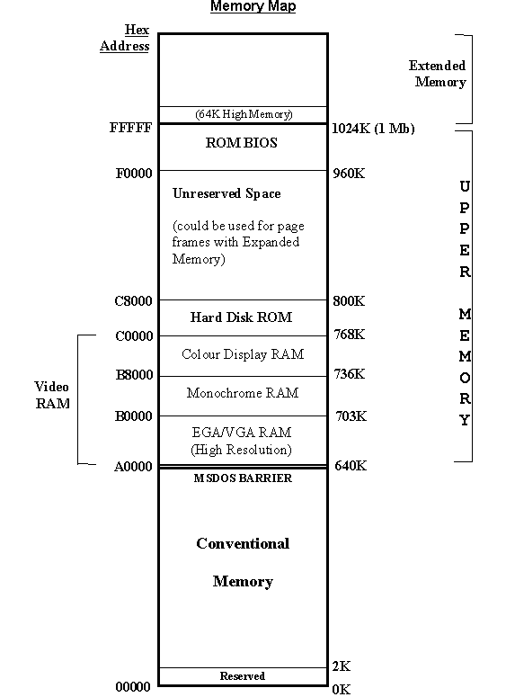
Low Memory Area _{[Ayesha] [wendi]}
In DOS memory management, The first memory segment (64 KB = 2¹⁶) of the conventional memory area is named lower memory or low memory area.
The upper memory area (UMA) refers to memory between the addresses of 640 KB and 1024 KB (0xA0000-0xFFFFF) in an IBM PC or compatible.
IBM reserved the uppermost 384 KB of the 8088 CPU's 1024 KB address space for ROM, RAM on peripherals, and memory-mapped input/output.

Slide 32
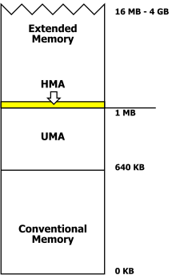
High Memory Area _{[wikipedia]}
In DOS memory management, the high memory area (HMA) is the RAM area consisting of the first 65520 bytes (64 KB) above the one megabyte in an IBM AT or compatible computer.

Slide 33
High Memory & Low Memory in Linux _{[cody_kai]}
Linux 核心採用了最簡單的對映方式來對映實體記憶體，即把實體地址＋PAGE_OFFSET按照線性關係直接對映到核心空間。
PAGE_OFFSET大小為0xC000000.但是linux核心並沒有把整個1G空間用於線性對映，而只映射了最多896M實體記憶體，預留了最高階的128M虛擬地址空間給IO裝置和其他用途。
所以，當系統實體記憶體較大時，超過896M的記憶體區域，核心就無法直接通過線性對映直接訪問了。這部分記憶體被稱作high memory。相應的可以對映的低端實體記憶體稱為low memory.

Slide 34
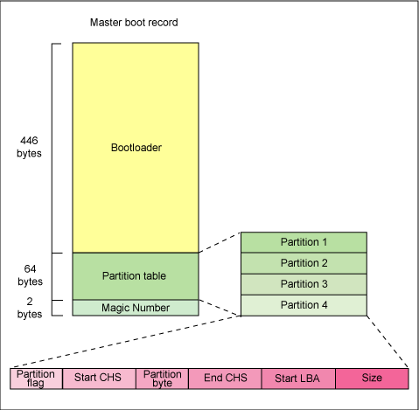
Anatomy of the MBR _{[旭旭]}

Slide 35
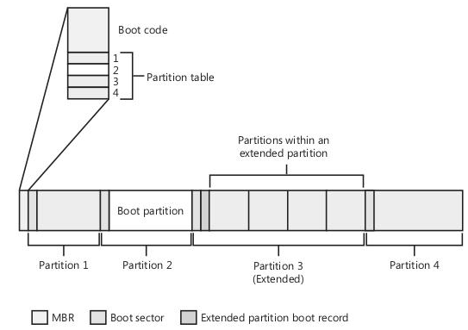
MBR and Boot Sectors _{[Li Bojie]}

Slide 36
MBR _{[Li Bojie]}
MBR (Master Boot Record) is a 446-byte boot code, which is loaded to 0x00007C00 by the BIOS and executed.
The hard disk partition table occupies 64 bytes of the master boot sector (0x01BE - 0x01FD), which can describe the information of the four partitions, and the information of each partition occupies 16 bytes.

Slide 37
vmlinux、vmlinuz、bzImage

Slide 38
vmlinuz _{[Bellevue Linux]}
vmlinuz is a compressed Linux kernel, and it is bootable.
Bootable means that it is capable of loading the operating system into memory so that the computer becomes usable and application programs can be run.
vmlinuz is not merely a compressed image. It also has gzip decompressor code built into it.
  gzip is one of the most popular compression utilities on Unix-like operating systems.

Slide 39
vmlinux _{[Bellevue Linux]}
vmlinuz should not be confused with vmlinux, which is the kernel in a non-compressed and non-bootable form.
vmlinux is generally just an intermediate step to producing vmlinuz.

Slide 40
vmlinux_{[[alexei]}
This is the Linux kernel in an statically linked executable file format.
It's just a intermediate step in the boot procedure.

Slide 41
vmlinuz _{[alexei]}
The vmlinux file usually gets compressed with zlib.
  Since 2.6.30 LZMA and bzip2 are also available.
By adding further boot and decompression capabilities to vmlinuz, the image can be used to boot a system with the vmlinux kernel.
The compression of vmlinux can occur with zImage or bzImage.

Slide 42
make bzImage _{[Bellevue Linux]}
The Linux kernel is compiled by issuing the following command:
make bzImage
This results in the creation of a file named bzImage in a directory such as /usr/src/linux/arch/i386/linux/boot/.

Slide 43
bzImage and vmlinuz _{[Bellevue Linux]}
bzImage is then copied using the cp (i.e., copy) command to the /boot directory and simultaneously renamed vmlinuz with a command such as
cp /usr/src/linux/arch/i386/linux/boot/bzImage /boot/vmlinuz

Slide 44
zImage _{[Bellevue Linux]}
A compiled kernel named zImage file is created on some older systems and is retained on newer ones for backward compatibility.

Slide 45
Differences between zImage and bzImage _{[Bellevue Linux]}
Both zImage and bzImage are compressed with gzip.
The difference is that zImage decompresses into low memory (i.e., the first 640kB), and bzImage decompresses into high memory (more than 1MB).
There is a common misconception that bzImage is compressed with the bzip2 utility; actually, the b just stands for big.

Slide 46
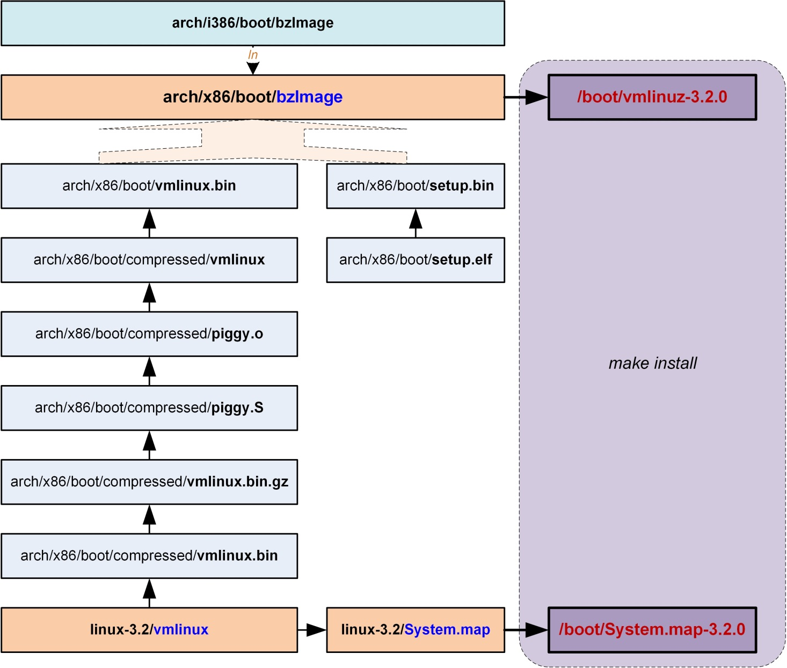
Files Used to generate bzImage _{[Chen Weixiang]}

Slide 47
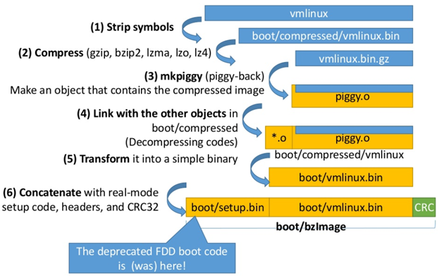
Steps to generate bzImage _{[Chen Weixiang]}

Slide 48
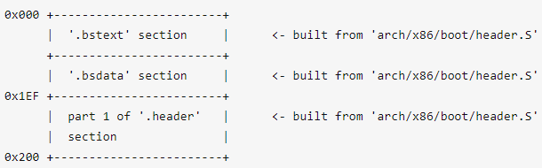
Layout of Kernel Boot Sector _{[king wag]}

Slide 49
zImage (make zImage) _{[[alexei]]}
This is the old format for small kernels (compressed, below 512KB).
At boot, this image gets loaded low in memory (the first 640KB of the RAM).

Slide 50
bzImage (make bzImage) _{[alexei]]}
The big zImage (this has nothing to do with bzip2), was created while the kernel grew and handles bigger images (compressed, over 512KB).
The image gets loaded high in memory (above 1MB RAM).
As today's kernels are way over 512KB, this is usually the preferred way.

Slide 51
vmlinuz _{[Lukman]}
vmlinuz is the name of the Linux kernel executable.
vmlinuz is a compressed Linux kernel, and it loads the OS into memory so that the server becomes usable.

Slide 52
vmlinuz and vmlinux _{[Lukman]}
vmlinuz = Virtual Memory LINUx gZip = Compressed Bootable Linux kernel Executable
vmlinux = Virtual Memory LINUX = Non-compressed Non-Bootable Linux Kernel Executable

Slide 53
Code at the head of vmlinuz _{[Lukman]}
At the head of the kernel image (vmlinuz) is a routine that
  does some minimal amount of hardware setup
  and then
  decompresses the kernel contained within the kernel image
  and
  places it into high memory.

Slide 54
Components of bzImage _{[何春晖]}
編譯體系結構setup代碼，並與帶自解壓的、壓縮過的vmlinux相連接，得到bzImage。

Slide 55
Major Components of Kernel Image _{[Chen Weixiang]}
Kernel Component | Mode | Source
Kernel boot sector | Real mode | v2.6.23及其之前版本的内核: arch/i386/boot/bootsect.S arch/x86_64/boot/bootsect.S v2.6.24及其之后版本的内核: arch/i386/boot/header.S arch/i386/boot/main.c
Kernel setup | Real mode | v2.6.23及其之前版本的内核: arch/i386/boot/setup.S arch/x86_64/boot/setup.S v2.6.24及其之后版本的内核: arch/i386/boot/header.S arch/i386/boot/main.c
Protected-mode kernel | Protected mode

Slide 56
Other Related Articles
Layout of bzImage _{[king wag]}
x86 bzImage _{[sakbk]}

Slide 57
The Linux/x86 Boot Protocol
_{[kernel development community]}

Slide 58
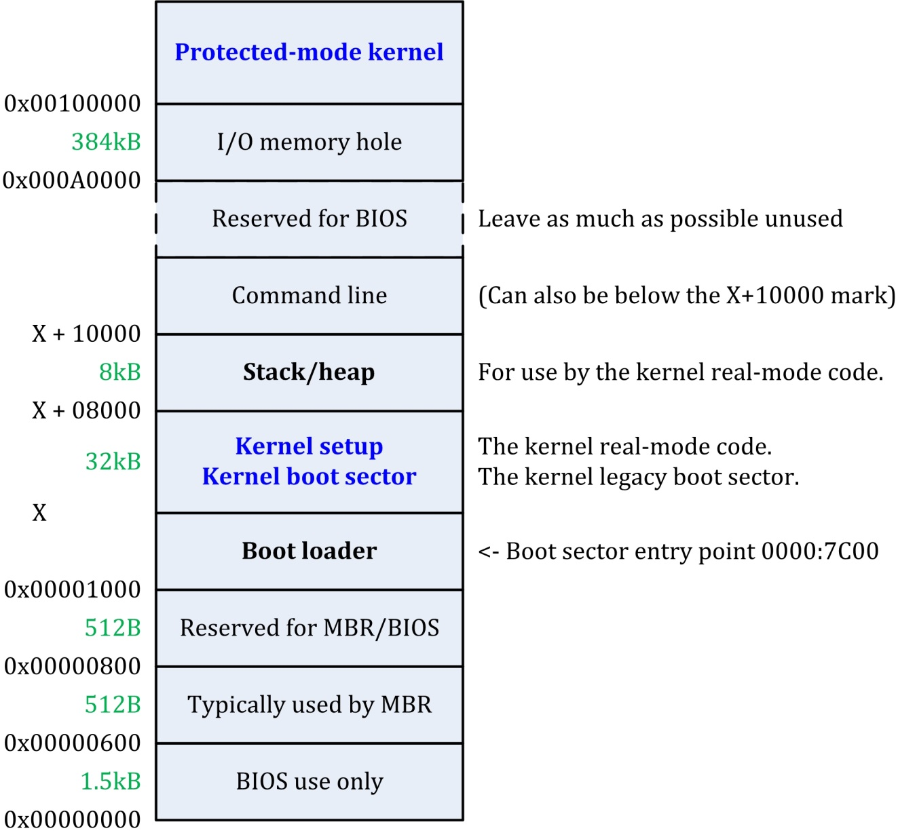
The Linux/x86 Boot Protocol _{[Chen Weixiang]}
where, the address X is as low as the design of the boot loader permits

Slide 59
Linux Boot Loader – GRUB2
GRUB 架構解析 _{[Hugh Chao]}

Slide 60
Boot Loader _{[tobyjiang]}
Usually the first sector of the boot device contains the code of boot loader, such as GRUB.

Slide 61
詳解GRUB開機管理程式 _{[黃明華]}
開機管理程式「GRUB」是自由軟體基金會GNU計畫下的子軟體計畫，因此全名是「GNU GRUB」，而GRUB是「GRand Unified Bootloader」的縮寫。

Slide 62
3 Stages of GRUB _{[黃明華]}
GRUB的啟動載入過程分成三個階段，以下也分三部分來加以說明：

Slide 63
Stage 1 _{[黃明華]}
GRUB在安裝時，會將boot.img寫入到主要啟動磁區內，因此BIOS在載入主要磁碟區程式碼時，主要就是載入boot.img檔案的程式內容，而boot.img取得主控權後的主要動作，就是緊接著載入第1.5階段所需的core.img檔案。

Slide 64
Stage 1.5 _{[黃明華]}
此一階段主控權會由boot.img交給core.img，而core.img的位置則依磁碟分割表（Partition Table）的型態而定。
core.img會由主要啟動磁區的下一個磁區開始，即編號1磁區（編號0磁區為開始第一個磁區）開始擺放，整個core.img會被放置在這段62個都是空白沒有使用的磁區裡面。
boot.img載入core.img後，便將主控權交給core.img，而core.img會載入設定及所需的相關模組，特別是檔案系統模組，讓GRUB可以在之後提供使用者檢視各個磁碟檔案系統的功能。

Slide 65
Stage 2 _{[黃明華]}
core.img在載入設定與模組後，便會從設定中找出「/boot/grub」在磁碟中的位置，並讀取在「/boot/grub」內有關作業系統載入與開機的相關資訊，然後使用者看到的便是在螢幕中的文字模式開機選項選單。此時，GRUB便處在等待使用者選擇選項開機或執行相關指令的狀態中。

Slide 66
boot.img _{[Hugh Chao]}
在PC BIOS系統上，這個image是在GRUB上第一個執行的部分(就像是舊版GRUB的stage 1)，這個image是將其寫成MBR或是partition的boot sector，因為PC boot sector是512 bytes，所以這個image的大小也剛好是512 bytes。
這個image唯一的功用就是從你的disk裡面的core image，將其第一個sector讀出來，然後將控制權交給core image。
因為size的限制，所以這個image不可能知道任何的檔案結構，所以grub-setup會將boot.img的第一個sector的位址給hardcode到裡面。

Slide 67
core.img _{[Hugh Chao]}
GRUB的主要核心image，是從『kernel image』和一堆的modules裡，借由『grub-mkimage』所建立出來的，通常這個image已經有足夠的module來存取『/boot/grub』，並且讀取『kernel.img』裡面的所有功能。這些模組化的設計讓這個core image可以保持的很小，有需要時在插入就好，畢竟在這個區域常常都會小於32KB。

Slide 68
Linux Kernel Boot Steps

Slide 69
grub2 _{[0xAX]}
Actually, the file header.S starts with the magic number MZ.
The actual kernel setup entry point is:
  // header.S
  .globl _start
  _start:
The bootloader (GRUB 2 and others) knows about this point (at an offset of 0x200 from MZ) and jumps directly to it.

Slide 70
grub2
grub2 loads kernel setup code at address 0x10000 by default and cs at 0x1020 because execution doesn't start from the start of the file, but from the jump here:
# offset 512 = 0x200, entry point
.globl _start
_start:
# Explicitly enter this as bytes, or the assembler
# tries to generate a 3-byte jump here, which causes
# everything else to push off to the wrong offset.
.byte 0xeb # short (2-byte) jump
.byte start_of_setup-1f
1:

Slide 71
Linux核心啟動過程分析
Linux bootloader 編寫方法 _{[範曉炬]}
GRUB是怎麼啟動linux的?
very good! ! ! Linux source code reading-kernel boot

Slide 72
Linux Kernel啟動流程 _{[tobyjiang]}
BIOS boot phase
Real mode setup phase
Protected mode startup_32
Kernel boot start_kernel()
Parameter passing during kernel boot

Slide 73
Turing on a Computer _{[tobyjiang]}
After turning on, the CS:IP of a CPU contains physical address 0xFFFF0. Using the code starting at this address the CPU begins to initialize the system.
In the 1 K physical memory starting from physical address 0, create the read mode interrupt vector table.
The subsequent 256 byte memory is used to store hardware information collected by BIOS.
BIOS loads the content of the first sector of the boot device to physical address 0x07C00 and jump to this address to execute boot loader.
Usually the first sector of the boot device contains the code of boot loader, such as GRUB.
Boot loader loads the Linux kernel into the physical memory.

Slide 74
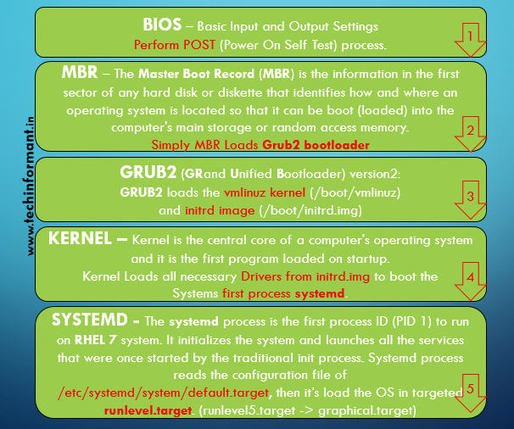
Linux Boot Process _{[Ashok Kalakoti ]}

Slide 75
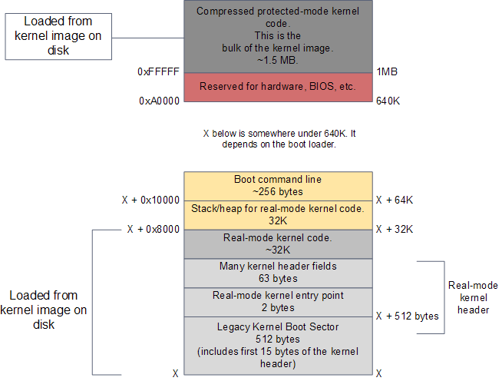
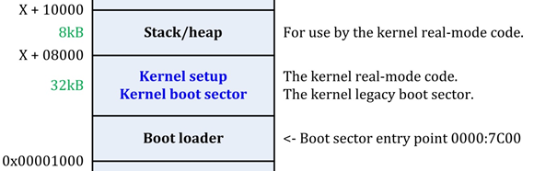

RAM contents after boot loader is done _{[Gustavo Duarte]}

Slide 76
Kernel Image and Boot Loader _{[Gustavo Duarte]}
The kernel image has been loaded to memory by the boot loader using the BIOS disk I/O services.
This image is an exact copy of the file in your hard drive that contains the kernel, e.g. /boot/vmlinuz-2.6.22-14-server.

Slide 77
Components of Kernel Image in Memory _{[Gustavo Duarte]}
The kernel image is split into two pieces:
  a small part containing the real-mode kernel code is loaded below the 640K barrier;
  the bulk of the kernel, which runs in protected mode, is loaded after the first megabyte of memory.

Slide 78
Real-Mode Kernel Header _{[Gustavo Duarte]}
This region of memory is used to implement the Linux boot protocol between the boot loader and the kernel.
Some of the values there are read by the boot loader while doing its work. These include amenities such as a human-readable string containing the kernel version, but also crucial information like the size of the real-mode kernel piece.
The boot loader also writes values to this region, such as the memory address for the command-line parameters given by the user in the boot menu.
Once the boot loader is finished it has filled in all of the parameters required by the kernel header. It's then time to jump into the kernel entry point.

Slide 79
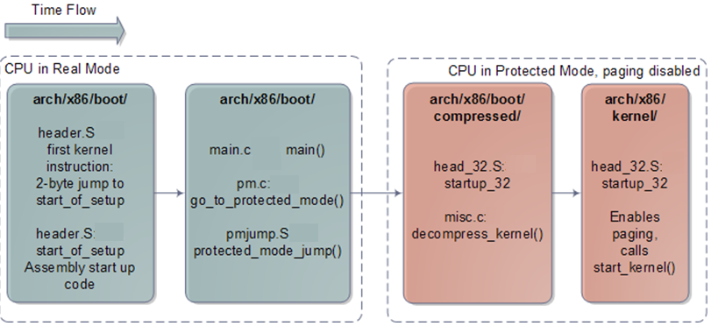
X86 Linux Kernel Initialization _{[Gustavo Duarte]}

Slide 80
Boot Code Stream _{[programmersought]}
_start() ->
start_of_setup() ->
main() ->
go_to_protected_mode() -> protected_mode_jump();

Slide 81
(Legacy) Kernel Boot Sector _{[Gustavo Duarte]}
The early kernel start-up for the Intel architecture is in file arch/x86/boot/header.S.
The start of this file actually contains boot sector code, a leftover from the days when Linux could work without a boot loader.
Nowadays this boot sector, if executed, only prints a "bugger_off_msg" to the user and reboots.
Modern boot loaders ignore this legacy code.
After the boot sector code we have the first 15 bytes of the real-mode kernel header.
The above two pieces together add up to 512 bytes, the size of a typical disk sector on Intel hardware.

Slide 82
Real-Mode Entry Point _{[Gustavo Duarte]}
After the kernel boot sector, at offset 0x200, we find the very first instruction that runs as part of the Linux kernel: the real-mode entry point.
It's in header.S and it is a 2-byte jump written directly in machine code as 0x3aeb. You can verify this by running hexdump on your kernel image and seeing the bytes at that offset - just a sanity check to make sure it's not all a dream.
The boot loader jumps into this location when it is finished, which in turn jumps to header.S where we have a regular assembly routine called start_of_setup.

Slide 83
start_of_setup _{[Gustavo Duarte]}
This short routine sets up a stack, zeroes the bss segment (the area that contains static variables, so they start with zero values) for the real-mode kernel and then jumps to good old C code at arch/x86/boot/main.c.

Slide 84
main() _{[Gustavo Duarte]}
main() does some house keeping like detecting memory layout, setting a video mode, etc. It then calls go_to_protected_mode().
Before the CPU can be set to protected mode, however, a few tasks must be done.
  There are two main issues: interrupts and memory.

Slide 85
Prepare to Go to The Protected Mode _{[Gustavo Duarte]}
In real-mode the interrupt vector table for the processor is always at memory address 0, whereas in protected mode the location of the interrupt vector table is stored in a CPU register called IDTR.
Meanwhile, the translation of logical memory addresses (the ones programs manipulate) to linear memory addresses (a raw number from 0 to the top of the memory) is different between real-mode and protected mode.
Protected mode requires a register called GDTR to be loaded with the address of a Global Descriptor Table for memory.
So go_to_protected_mode() calls setup_idt() and setup_gdt() to install a temporary interrupt descriptor table and global descriptor table.

Slide 86
protected_mode_jump _{[Gustavo Duarte]}
We're now ready for the plunge into protected mode, which is done by protected_mode_jump, another assembly routine.
This routine enables protected mode by setting the PE bit in the CR0 CPU register. At this point we're running with paging disabled; paging is an optional feature of the processor, even in protected mode, and there's no need for it yet.
What's important is that we're no longer confined to the 640K barrier and can now address up to 4GB of RAM.
The routine then calls the 32-bit kernel entry point, which is startup_32 for compressed kernels. This routine does some basic register initializations and calls __decompress(), a C function to do the actual decompression.

Slide 87
__decompress() _{[Gustavo Duarte]}
__decompress() prints the familiar "Decompressing Linux..." message.
Decompression happens in-place and once it's finished the uncompressed kernel image has overwritten the compressed one pictured in the first diagram.
Hence the uncompressed contents also start at 1MB.
__decompress() then prints "done." and the comforting "Booting the kernel."
By "Booting" it means a jump to the final entry point in this whole story which is the protected-mode kernel entry point at the start of the second megabyte of RAM (0x100000).
  That sacred location contains a routine called, uh, startup_32. But this one is in a different directory, you see.

Slide 88
startup_32 _{[Gustavo Duarte]}
The second incarnation of startup_32 is also an assembly routine, but it contains 32-bit mode initializations.
It
  clears the bss segment for the protected-mode kernel (which is the true kernel that will now run until the machine reboots or shuts down),
  sets up the final global descriptor table for memory,
  builds page tables so that paging can be turned on,
  enables paging,
  initializes a stack,
  creates the final interrupt descriptor table, and
  finally jumps to to the architecture-independent kernel start-up, start_kernel().

Slide 89
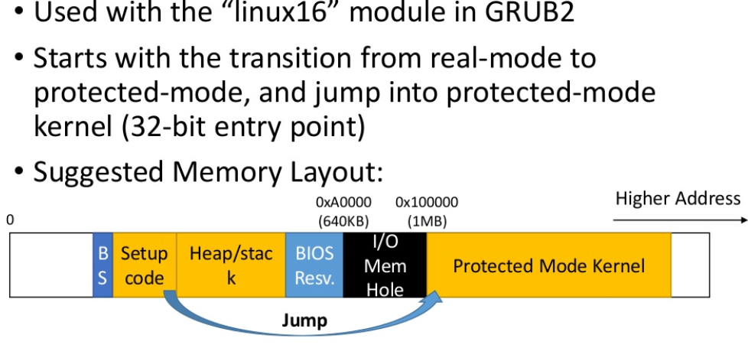
Real Mode Protocol _{[Chen Weixiang]}

Slide 90
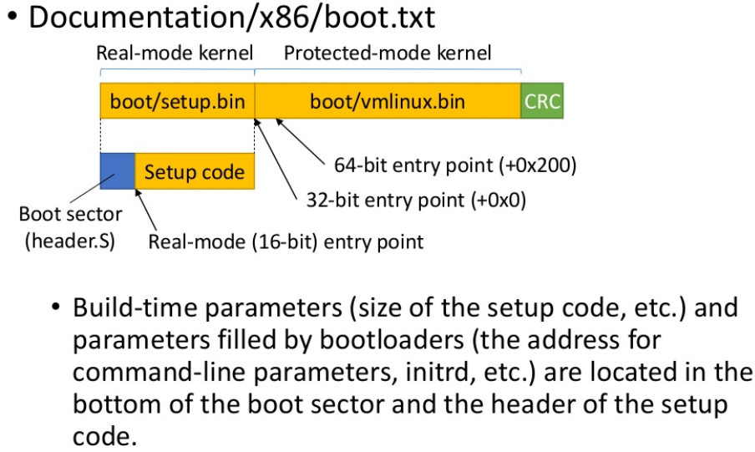
Boot Protocol _{[Chen Weixiang]}

Slide 91
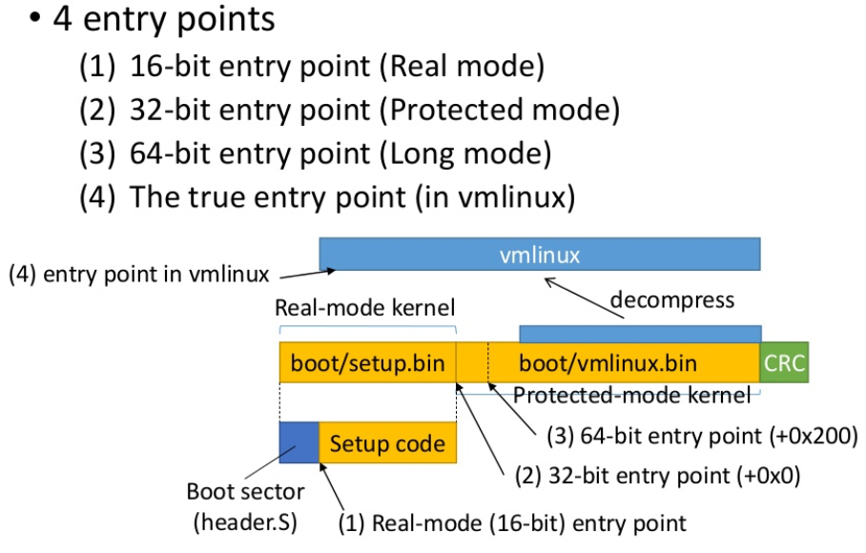
Boot Protocol in bzImage _{[Chen Weixiang]}

Slide 92
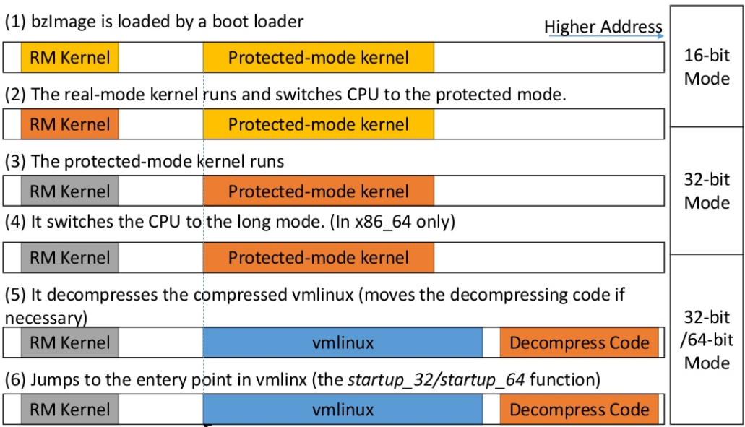
Fast Backward _{[Chen Weixiang]}

Slide 93
The Kernel Setup Entry Point _{[0xAX]}

Slide 94
_start
# offset 512, entry point
.globl _start
_start:
# Explicitly enter this as bytes, or the assembler
# tries to generate a 3-byte jump here, which causes
# everything else to push off to the wrong offset.
.byte 0xeb # short (2-byte) jump
.byte start_of_setup-1f
1:
setup用于体系结构相关的硬件初始化工作，在arch目录各个平台中都有类似功能的代码。在32位的x86平台中，setup的入口点是arch/x86/boot/header.S中的_start.
_start这里是硬编码一条跳转指令，它跳转至start_of_setup.

Slide 95
Kernel Setup Entry Point
.globl _start
_start:
.byte 0xeb
.byte start_of_setup-1f //[1][2]
# both start_of_setup and 1f are addresses.

Slide 96
start_of_setup _{[0xAX]}
After the jump to start_of_setup, the kernel needs to do the following:
  Make sure that all segment register values are equal
  Set up a correct stack, if needed
  Set up bss
  Jump to the C code in arch/x86/boot/main.c
Almost all of the setup code is for preparing the C language environment in real mode.

Slide 97
The Actual Kernel Setup Entry Point
# offset 512, entry point
.globl _start
_start:
# Explicitly enter this as bytes, or the assembler
# tries to generate a 3-byte jump here, which causes
# everything else to push off to the wrong offset.
.byte 0xeb # short (2-byte) jump
.byte start_of_setup-1f # start_of_setup minus 1f
1:
Here we can see a jmp instruction opcode (0xeb) that jumps to the start_of_setup-1f point.

Slide 98
start_of_setup
.section ".entrytext", "ax"
start_of_setup:
# Force %es = %ds
movw %ds, %ax
movw %ax, %es
cld
:
:
1: addw $STACK_SIZE, %dx
jnc 2f
xorw %dx, %dx # Prevent wraparound
2:

Slide 99
Set the ds and es registers
movw %ds, %ax
movw %ax, %es
cld
First of all, the kernel ensures that the ds and es segment registers point to the same address.
Next, it clears the direction flag using the cld instruction:

Slide 100
start_of_setup
.section ".entrytext", "ax"
start_of_setup:
:
:
movw %ss, %dx
cmpw %ax, %dx # %ds == %ss?
movw %sp, %dx
je 2f # -> assume %sp is reasonably set
:

Slide 101
start_of_setup
.section ".entrytext", "ax"
start_of_setup:
# Force %es = %ds
movw %ds, %ax
movw %ax, %es
cld
# Apparently some ancient versions of LILO invoked the kernel with %ss != %ds,
# which happened to work by accident for the old code. Recalculate the stack
# pointer if %ss is invalid. Otherwise leave it alone, LOADLIN sets up the
# stack behind its own code, so we can't blindly put it directly past the heap.
movw %ss, %dx
cmpw %ax, %dx # %ds == %ss?
movw %sp, %dx
je 2f # -> assume %sp is reasonably set

Slide 102
start_of_setup
The next step is checking the ss register's value and setting up a correct stack if ss is wrong:
movw %ss, %dx
cmpw %ax, %dx
movw %sp, %dx
je 2f
This can lead to 3 different cases.

Slide 103
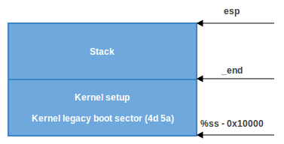
Stack Setup : Case 1
ss has a correct address (0x1000).
The value of ax (0x1000) was into ss.

Slide 104
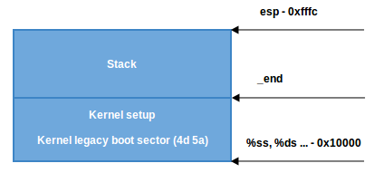
Stack Setup : Case 2
If the CAN_USE_HEAP bit is set, we put heap_end_ptr into dx (which points to _end) and add STACK_SIZE (the minimum stack size, 1024 bytes) to it.

Slide 105
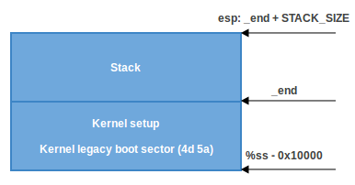
Stack Setup : Case 3
When CAN_USE_HEAP is not set, we just use a minimal stack from _end to _end + STACK_SIZE

Slide 106
BSS Setup – Check Signature
The last two steps that need to happen before we can jump to the main C code are setting up the BSS area and checking the "magic" signature.
First, signature checking:
cmpl $0x5a5aaa55, setup_sig
jne setup_bad
  This simply compares the setup_sig with the magic number 0x5a5aaa55.
  If they are not equal, a fatal error is reported.

Slide 107
Function of BSS Section
If the magic number matches, knowing we have a set of correct segment registers and a stack, we only need to set up the BSS section before jumping into the C code.
The BSS section is used to store statically allocated, uninitialized data.

Slide 108
Initialize the Content of BSS Section
Linux carefully ensures this area of memory is first zeroed using the following code:
movw $__bss_start, %di
movw $_end+3, %cx
xorl %eax, %eax
subw %di, %cx
shrw $2, %cx
rep; stosl
The net effect of this code is that zeros are written through all words in memory from __bss_start to _end.

Slide 109
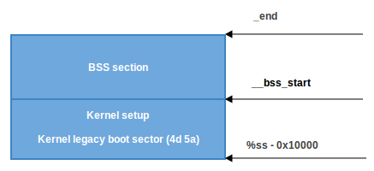
Layout of Memory

Slide 110
Call main()
We have the stack and BSS, so we can jump to the main() C function:
calll main

Slide 111
Function main()
void main(void)
{
/* First, copy the boot header into the "zeropage" */
copy_boot_params();
:
/* End of heap check */
init_heap();
:
/* Detect memory layout */
detect_memory();
:
set_video();
/* Do the last things and invoke protected mode */
go_to_protected_mode();
}

Slide 112
Protected Mode
Before we can move to the native Intel64 Long Mode, the kernel must switch the CPU into protected mode.
Protected mode was first added to the x86 architecture in 1982 and was the main mode of Intel processors from the 80286 processor until Intel 64 and long mode came.

Slide 113
main()- copy_boot_params(void)
The first function which is called in main is copy_boot_params(void).
It copies the kernel setup header into the corresponding field of the boot_params structure which is defined in the arch/x86/include/uapi/asm/bootparam.h header file.

Slide 114
struct boot_params
/* The so-called "zeropage" */
struct boot_params {
struct screen_info screen_info; /* 0x000 */
:
/*
* A bootloader is supposed to only take setup_header and put
* it into a clean boot_params buffer. If it turns out that
* it is clumsy or too generous with the buffer, it most
* probably will pick up the sentinel variable too. The fact
* that this variable then is still 0xff will let kernel
* know that some variables in boot_params are invalid and
* kernel should zero out certain portions of boot_params.
*/
__u8 sentinel; /* 0x1ef */
__u8 _pad6[1]; /* 0x1f0 */
struct setup_header hdr; /* setup header */ /* 0x1f1 */
:
__u8 _pad9[276]; /* 0xeec */
} __attribute__((packed));

Slide 115
Heap Initialization
After the stack and bss section have been prepared in header.S , the kernel needs to initialize the heap with the init_heap function.

Slide 116
Function init_heap
First of all init_heap checks the CAN_USE_HEAP flag from the loadflags structure in the kernel setup header and calculates the end of the stack if this flag was set:

Slide 117
Variable stack_end
char *stack_end;
if (boot_params.hdr.loadflags & CAN_USE_HEAP){
asm("leal %P1(%%esp),%0" : "=r" (stack_end) : "i" (-STACK_SIZE));
i. e. stack_end = esp - STACK_SIZE

Slide 118
Variable heap_end
Then there is the heap_end calculation:
heap_end = (char *)((size_t)boot_params.hdr.heap_end_ptr + 0x200);
  which means heap_end_ptr or _end + 512 (0x200h).
The last check is whether heap_end is greater than stack_end.
  If it is then stack_end is assigned to heap_end to make them equal.

Slide 119
Toward Protected Mode
Set up video mode
Set up the Interrupt Descriptor Table
Set up Global Descriptor Table

Slide 120
go_to_protected_mode()
void go_to_protected_mode(void)
{
:
/* Actual transition to protected mode... */
setup_idt();
setup_gdt();
protected_mode_jump(boot_params.hdr.code32_start,
(u32)&boot_params + (ds() << 4));
}

Slide 121
Macros (1)
#define SYM_FUNC_START_NOALIGN(name) \
SYM_START(name, SYM_L_GLOBAL, SYM_A_NONE)
#define SYM_START(name, linkage, align...) \
SYM_ENTRY(name, linkage, align)
#define SYM_ENTRY(name, linkage, align...) \
linkage(name) ASM_NL \
align ASM_NL \
name:
#define ASM_NL ;

Slide 122
Macros (2)
#define SYM_L_GLOBAL(name) .globl name
#define SYM_A_NONE /* nothing */

Slide 123
Function protected_mode_jump()
/* pmjump.S */
void __attribute__((noreturn))
protected_mode_jump(u32 entrypoint, u32 bootparams);

Slide 124
Parameter Passing of protected_mode_jump()_{[unknown]}
We know that common function call specifications (STD, cdecl) Use stack to pass parameters, that is, the parameter is pushed to the stack from right to right.
Here, the code under ARCH/boot in the kernel adopts another specification (fastcall): parameters of three or less use eax, edx, from left to right, ecx registers transmit parameters. More than three parameters are passed through the stack.

Slide 125
Parameters of protected_mode_jump()
protected_mode_jump(
boot_params.hdr.code32_start, (u32)&boot_params + (ds() << 4)
);
  It takes two parameters:
    address of the protected mode entry point
    address of boot_params
  The first parameter will be in the eax register and the second one is in edx.

Slide 126
Function ds()
static inline u16 ds(void)
{ u16 seg;
asm("movw %%ds,%0" : "=rm" (seg));
return seg;
}

Slide 127
struct boot_params
struct boot_params {
:
struct apm_bios_info apm_bios_info; /* 0x040 */
:
struct setup_header hdr; /* setup header *//* 0x1f1 */
:
} __attribute__((packed));

Slide 128
Variable boot_params
struct boot_params boot_params __attribute__((aligned(16)));

Slide 129
struct setup_header
struct setup_header {
:
__u8 loadflags;
__u16 setup_move_size;
__u32 code32_start;
__u32 ramdisk_image;
__u32 ramdisk_size;
__u32 bootsect_kludge;
__u16 heap_end_ptr;
:
} __attribute__((packed));

Slide 130
Instruction ljmp _{[oracle]}
ljmp $0xfebc, $0x12345678
Long jump, use 0xfebc for the CS register and 0x12345678 for the EIP register:

Slide 131
protected_mode_jump () (1) [Michael Petch][Mr. Shickadance]
xorl %ebx, %ebx
movw %cs, %bx
shll $4, %ebx
addl %ebx, 2f
This addl instruction overwrites the memory location marked as 2 with the value of ebx.

Slide 132
Explanation of Previous Code
First of all, this function puts the address of boot_params in the esi register and the address of the code segment register cs in bx.
After this, this function shifts bx by 4 bits and add it to the memory location labeled 2 (which is (cs << 4) + in_pm32, the physical address to jump after transitioned to 32-bit mode) and jump to label 1.
After the above instructions, in_pm32 in label 2 will be overwritten with (cs << 4) + in_pm32

Slide 133
protected_mode_jump () (2)
# Transition to 32-bit mode
.byte 0x66, 0xea # ljmpl opcode
2: .long .Lin_pm32 # offset
.word __BOOT_CS # segment
Using the above data to create the machine code of a ljmpl instruction.

Slide 134
Explanation of Previous Code
0x66 is the operand-size prefix which allows us to mix 16-bit and 32-bit code
0xea - is the jump opcode
Lin_pm32 is the segment offset under protect mode, which has value (cs << 4) + Lin_pm32 derived from real mode
__BOOT_CS is the code segment we want to jump to

Slide 135
Function .Lin_pm32 (1)
.code32
.section ".text32","ax"
SYM_FUNC_START_LOCAL_NOALIGN(.Lin_pm32)
# Set up data segments for flat 32-bit mode
movl %ecx, %ds
movl %ecx, %es
movl %ecx, %fs
movl %ecx, %gs
movl %ecx, %ss
function protected_mode_jump contains
movw $__BOOT_DS, %cx

Slide 136
Function .Lin_pm32 (2)
# Clear registers to allow for future extensions to the
# 32-bit boot protocol
xorl %ecx, %ecx
xorl %edx, %edx
xorl %ebx, %ebx
xorl %ebp, %ebp
xorl %edi, %edi

Slide 137
Function .Lin_pm32 (3)
jmpl *%eax # Jump to the 32-bit entry point
Remember that eax contains the address of the 32-bit entry (we passed it as the first parameter into protected_mode_jump).

Slide 139
SYM_T_FUNC
#define SYM_T_FUNC STT_FUNC
#define STT_FUNC 2

Slide 140
SYM_FUNC_END(name)
#define SYM_FUNC_END(name) \
SYM_END(name, SYM_T_FUNC)
#define SYM_END(name, sym_type) \
.type name sym_type ASM_NL \
.size name, .-name
#define ASM_NL ;

Slide 141
32-bit entry point
The 32-bit entry point is defined in the arch/x86/boot/compressed/head_64.S assembly source code file:
__HEAD
.code32
SYM_FUNC_START(startup_32)
....
....
....
SYM_FUNC_END(startup_32)

Slide 142
Compressed File bzimage
First, why is the directory named compressed? The answer to that is that bzimage is a gzipped package consisting of vmlinux, header and kernel setup code.
The main goal of the code in head_64.S is to
  prepare to enter long mode,
  enter it
  and then decompress the kernel.

Slide 143
Supplementary Materials

Slide 144
vmlinuz _{[ryan0988]}
vmlinuz是可引導的、壓縮過的核心。
  可引導意味著它有能力把作業系統載入至記憶體而使電腦能夠使用並且軟體程序可以運作。
  vm 代表“Virtual Memory”。
Linux 支援虛擬記憶體，不像古老的作業系統譬如DOS有640KB記憶體的限制。
Linux能夠使用硬碟空間作為虛擬記憶體，因此得名“vm”。
vmlinuz是可執行的Linux核心，它位於/boot/vmlinuz，它一般是一個 soft-link。

Slide 145
vmlinuz _{[肖楠]}
vmlinuz：
一個壓縮的，能bootable的Linux kernel文件。
vmlinuz是Linux kernel文件的歷史名字，它實際上就是zImage或bzImage。

Slide 146
vmlinuz 的建立 _{[ryan0988]}
vmlinuz的建立有兩種方式。
  一是編譯核心時通過“make zImage”產生，然後通過：
    cp /usr/src/linux-2.4/arch/i386/linux/boot/zImage /boot/vmlinuz 複製。
    zImage適用於小核心的情況，它的存在是為了向後的兼容性。
  二是核心編譯時通過命令"make bzImage"建立，然後通過：
    cp /usr/src/linux-2.4/arch/i386/linux/boot/bzImage /boot/vmlinuz 複製。
    bzImage是壓縮的核心映像檔案，
    需要注意，bzImage不是用bzip2壓縮的，bzImage中的bz容易引起誤解，bz表示“big zImage”。 bzImage中的b是“big”意思。

Slide 147
zImage and bzImage _{[ryan0988]}
zImage（vmlinuz）和bzImage（vmlinuz）都是使用gzip壓縮的。
  它們不僅是一個壓縮檔案，
  而且在這兩個檔案的開頭部分內嵌有已被gzip解壓縮原始碼。
  所以你不能用gunzip 或 gzip -dc來解壓縮vmlinuz來得到vmlinux。

Slide 148
More about vmlinuz _{[ryan0988]}
vmlinuz (核心檔案)中包含
  一個微型(小型)的已被gzip解壓縮程式碼。
    此程式碼用於解壓縮vmlinuz剩下的壓縮碼(核心)並引導它。
    剩下的壓縮碼(核心)解壓縮後為vmlinux。
    可引導意味著它有能力把作業系統載入至記憶體而使電腦能夠使用並且軟體程序可以運作。
兩者的不同之處在於，
  zImage解壓縮內核到低端內存（第一個640K），
  bzImage解壓縮內核到高端內存（1M以上）。
  如果內核比較小，那麼可以采用zImage 或bzImage之一，兩種方式引導的系統運行時是相同的。
  大的內核采用bzImage，不能采用zImage。
vmlinux是未壓縮的核心，vmlinuz是vmlinux的壓縮核心加上一個微型(小型)的已被gzip解壓縮程式碼。

Slide 149
vmlinux and vmlinuz_{[ryan0988]}
vmlinux 是ELF格式檔案，也就是編譯出来的最原始的檔案。
vmlinuz應該是由vmlinux經過arm-linux-objcopy後，並且經過壓縮後的核心檔案。
zImage是vmlinuz經過gzip壓縮後的檔案，適用於小核心。
bzImage是vmlinuz經過gzip壓縮後的檔案，適用於大核心。

Slide 150
Linux Kernel
The Linux kernel consists of two parts.
  The first is setup which is real mode code.
  The second is vmlinux which is protected mode code.
  A compiler combines these two parts as vmlinuz.

Slide 151
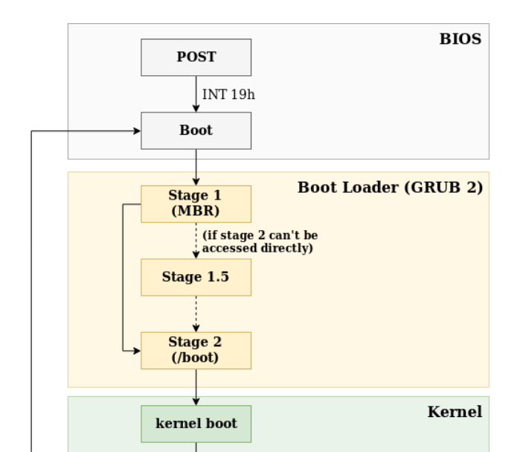
Linux Boot Process _{[A Cloud Chef]}

Slide 152
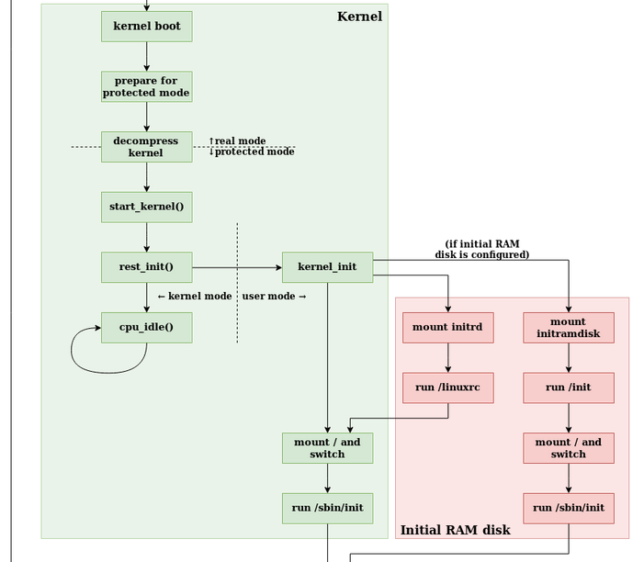
Linux Boot Process _{[A Cloud Chef]}

Slide 153
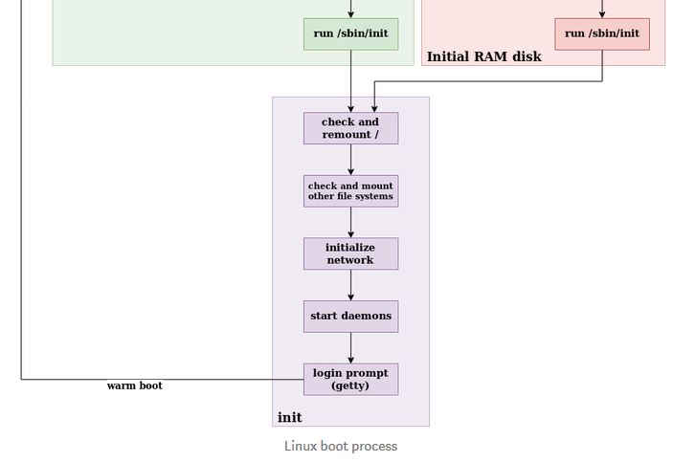
Linux Boot Process _{[A Cloud Chef]}

Slide 154
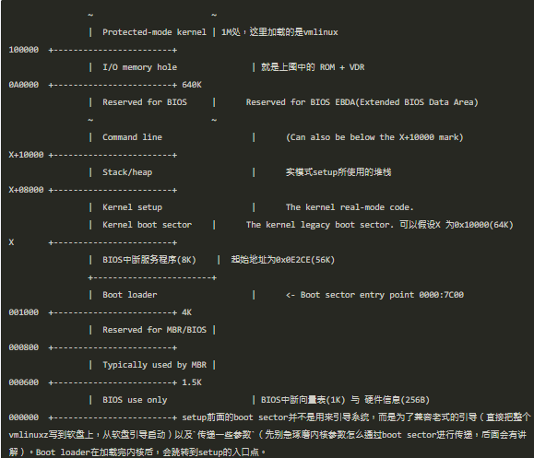
Physical Memory Layout after Boot _{[tobyjiang]}

