Slide 1
Vehicular Networking
An introduction
gugu@ACN-Lab.CSIE.NCU

Slide 2
Basics
The DSRC

Slide 3
DSRC Spectrum
Dedicated Short Range Communications – DSRC spectrum
1999 U.S. FCC granted
For public safety and non-safety applications
Non-safety applications are accommodated in the DSRC spectrum to encourage development and deployment of DSRC technology
Promote cost-efficiency
75MHz radio frequency band

Slide 4
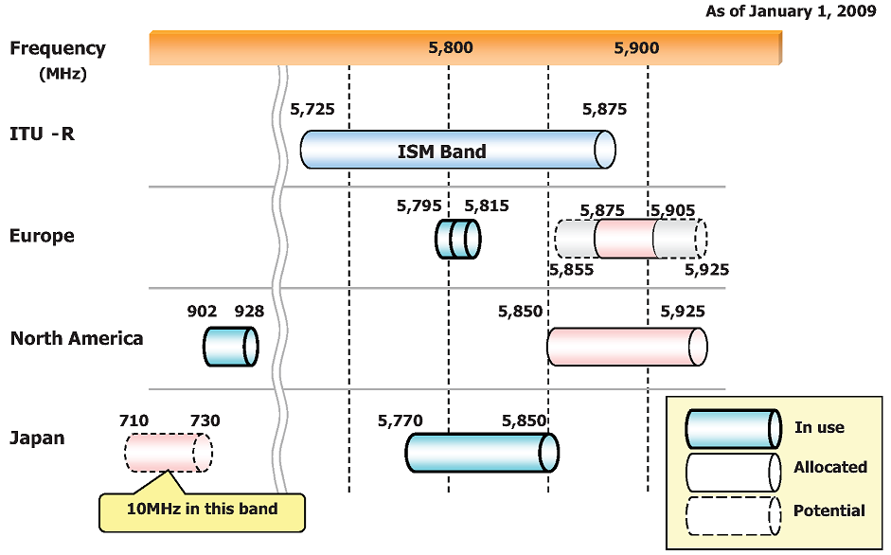
DSRC Spectrum

Slide 5
DSRC Spectrum
Located in the 5.85 – 5.925 GHz
Divided into seven 10 MHz channels
Channel 178 – Control Channel (CCH)
To achieve reliable safety message dissemination
Supports higher power levels
Be solely responsible for broadcasting
Safety related message
Other service announcements
Channel 184 – High Available Low Latency (HALL) Channel
Be left for future use

Slide 6
DSRC Spectrum
Channel 172 – unused in most current prototype
All non-safety communications take place on Service Channels (SCHs)

Slide 7
DSRC Spectrum
Each communication zone
Must utilize channel 178 as a CCH
For safety message
May utilize one or more SCH of the available four service channels
Typically used to communicate IP-based services

Slide 8
WAVE Standard Specification Suite
2004 – IEEE Task Group p started
Based on IEEE 802.11
Amendment – IEEE 802.11p
physical and MAC layers
IEEE started 1609 working group to specify the additional layers
IEEE 1609.1 – resource manager
IEEE 1609.2 – security
IEEE 1609.3 – networking
IEEE 1609.4 – multi-channel operation

Slide 9
WAVE Standard Specification Suite
Wireless Access in Vehicular Environments
IEEE 802.11p + IEEE 1609.x → WAVE

Slide 10
IEEE 802.11p Phy-1
Specifies the physical and MAC features
For IEEE 802.11 could work in a vehicular environment
Based on IEEE 802.11a
Operating in the 5.8/5.9 GHz band
The same as IEEE 802.11a
Based on an orthogonal frequency-division multiplexing (OFDM) PHY layer
The same as IEEE 802.11a

Slide 11
IEEE 802.11p Phy-2
Each channel has 10 MHz wide frequency band
A half to the 20-MHz channel of IEEE 802.11a
Data rates ranges from 3 to 27 Mb/s
A half to the corresponding data rates of IEEE 802.11a
6 to 54 Mb/s
For 0 – 60 km/hr vehicle speed
9, 12, 18, 24, and 27 Mbps
For 60 – 120 km/hr vehicle speed
3, 4.5, 6, 9, and 12 Mbps
Lower rates are often preferred in order to obtain robust communication

Slide 12
IEEE 802.11p Phy-3
The system comprises 52 subcarriers
Modulation schemes
BPSK, QPSK, 16-QAM, or 64-QAM
Coding rate
1/2, 2/3, or 3/4
Data rates are determined by the chosen coding rate and modulation scheme

Slide 13
IEEE 802.11p Phy-4
Single and multiple channel radios
Single-channel WAVE device
Exchanges data and/or listens to only one channel at a time
Multi-channel WAVE device
Exchanges data on one channel while, at least, actively listening on a second channel
A synchronization mechanism
To accommodate the limited capabilities of single channel device
To allow interoperability between single channel devices and multi-channel

Slide 14
IEEE 802.11p Phy-5
To ensure all WAVE devices monitor and/or utilize the CCH at common time intervals
Both CCH and SCH intervals are uniquely defined with respect to an accurate time reference
E.g. to CCH/SCH design
Synchronization
A typical device visit the CCH for a time period – CCH Interval (CCHI)
Switch to a SCH for a period – SCH Interval (SCHI)
Guard Interval (GI)
To accommodate for device differences

Slide 15
IEEE 802.11p Phy-6
Two popularized synchronization mechanisms
The earliest received clock signal
The availability of global clock signal

Slide 16
IEEE 802.11p Phy-7
The earliest received clock signal mechanism
Distributed
Built-in robustness
Roaming devices can adopt different clock reference as they move to newer communication zone
Any synchronization failure would be local to devices in a single communication zone
No concern about nation-wide failure
No fears of nation-wide attack

Slide 17
IEEE 802.11p Phy-8
Little guarantee
Devices may follow invalid or malicious clock
Continuously clock drifts result in lesser efficiency in radio resource utilization
Global clock signal mechanism
Needs sufficient accuracy
Devices align their radio resources to a globally accurate clock every time period
Suffers from being too centralized
Attacks or failure in the global clock leads to wide-spread irrecoverable failure of the DSRC network

Slide 18
IEEE 802.11p Phy-8
Current WAVE standards follow the global signal approach
A combination of the global signal and some other distributed approaches is most likely adpoted

Slide 19
IEEE 802.11p MAC-1
IEEE 802.11p is a member of IEEE 802.11 family
Inherits CSMA/CA multiple channel access scheme
Originally the system supports only one-hop broadcasts
DCF coordination
Guaranteed quality of service support cannot be given

Slide 20
IEEE 802.11p MAC-2
Quality of Service guarantee for prioritization
IEEE 802.11e – enhanced distributed channel access (EDCA) can be used

Slide 21
IEEE 802.11p MAC-3
Channel Router
For WAVE Short Message Protocol (WSMP) datagram
Checking the EtherType field of the 802.2 header
Then forwards the WSMP datagram to the correct queue based on
channel identified in the WSMP header
packet priority
If the WSMP datagram is carrying an invalid channel number
discard the packet
without issuing any error to the sending application

Slide 22
IEEE 802.11p MAC-4
For IP datagram
Before initializing IP data exchanges, the IP application registers the transmitter profile with the MLME
contains SCH number
power level
data rate
the adaptable status of power level and data rate
When an IPv6 datagram is passed from the LLC to the Channel Router
Channel Router routes the datagram to a data buffer that corresponds to the current SCH

Slide 23
IEEE 802.11p MAC-5
If the transmitter profile indicates specific SCH that is no longer valid
the IP packet is dropped
no error message is issued to originating application
Channel Selector
carries out multiple decisions as to
when to monitor a specific channel,
what are the set of legal channels at a particular point in time
how long the WAVE device monitors and utilizes a specific channel

Slide 24
IEEE 802.11p MAC-6
The Channel Selector also decides to drop data
if it is supposed to be transmitted over an invalid channel
E.g. when a channel does not exist any longer

Slide 25
Thank you for your attendance

