Slide 1
Bandwidth- and Latency-Aware Peer-to-Peer Instant Friendcast for Online Social Networks
J. R. Jiang, C.W. Hung, and J.W. Wu
Department of Computer Science and Information Engineering
National Central University, Taiwan, R.O.C.

Slide 2
Outline
Introduction
Preliminaries
Proposed Scheme
Performance Evaluation
Conclusions

Slide 3
Outline
Introduction
Preliminaries
Proposed Scheme
Performance Evaluation
Conclusions

Slide 4





Online Social Networks (OSNs)
An important class of Web 2.0 applications
Examples: ICQ, MSN Messenger, EtherPad, Facebook, MySpace, Twitter, and Plurk
Facebook has more than 500 million active users
Users spend over 700 billion minutes per month
Users share more than 30 billion pieces of content (e.g., web links, news stories, blog posts, notes, and photo albums) (http://www.facebook.com/press/info.php?statistics)
Notes:
Online Social Networks (OSNs), such as ICQ, MSN Messenger, EtherPad, Facebook, MySpace, Twitter, and Plurk, are an important class of Web 2.0 applications, in which users can share content with others, especially friends.
OSNs have become extremely popular nowadays. For example, Facebook has more than 500 million active users, which spend over 700 billion minutes per month on it to share more than 30 billion pieces of content (e.g., web links, news stories, blog posts, notes, and photo albums)

Slide 5

Instant Friendcast
A user sends a message in real time to all its friends in the OSN.
The message may be text, audio and/or video data.
Notes:
In this paper, We propose an efficient P2P friendcast scheme for OSNs.
We focus on the P2P instant friendcast operation in OSNs, by which a user can send a message to all of its online friends in real time under the P2P architecture.
Many P2P approaches that construct efficient multicast trees for the multicast service may be used to provide the friendcast service.
However, these approaches do not fully exert OSN characteristics in the sense that they do not integrate the friend relationships into the tree construction for better performance.
The objectives of this scheme is to transmit instant messages efficiently among peers in OSNs. Furthermore, it should be latency-aware and bandwidth-aware.

Slide 6
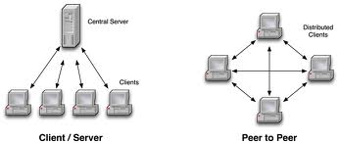
Network Architectures for OSNs
Client/Server (C/S)
Centralized and limited system and network resources
Poor scalability
Easy to coordinate and manage
Peer-to-Peer (P2P)
Every participating entity is both a resource provider and consumer
Better scalability
More complex to coordinate and manage
Notes:
Most of popular OSN applications, such as ICQ, MSN Messenger, EtherPad, Facebook, MySpace, Twitter and Plurk are established on legacy C/S architecture.
Because of the centralized and limited supply of computation ability, network bandwidth, and data storage in C/S architecture, the networks are unscalable. The server is tend to become a bottleneck of the whole network. The most advantage of C/S architecture is the easiness of coordination and management.
On the other hand, the peer-to-peer (P2P) architecture has every participating entity as a resource provider and consumer; it is thus scalable. In most cases, the system performance grows as the number of peers in the network increases. However, it is more complex in coordination and management tasks since the distributed characteristics of P2P networks.

Slide 7
P2P OSNs
Yeung et al. show that existing centralized C/S OSNs have some non-trivial limitations, such as limited bandwidth and computation resources.
Buchegger et al. advocate using the P2P architecture to implement OSNs so that users can store their data in a P2P manner to keep privacy and can use data even when Internet access is not available.
A P2P OSN called PeerSon (2008) is based on the distributed hash table (DHT).
Notes:
Most of popular OSN applications, such as ICQ, MSN Messenger, EtherPad, Facebook, MySpace, Twitter and Plurk are established on legacy C/S architecture. S. Buchegger and A. Datta (2009) shows that existing centralized OSNs have some non-trivial limitations, such as limited bandwidth and computation resources, and that decentralized OSNs may hence be promising in the future.
S. Buchegger and A. Datta (2009) advocates using the P2P architecture to implement OSNs so that users can store their data in a P2P manner to keep privacy and can use data even when Internet access is not available.
D. Schi¨oberg (2008) suggests the implementation of a P2P OSN called PeerSon based on the distributed hash table (DHT), a well-known efficient structure of P2P networking.
However, P2P also raises new problems. For example, system coordination becomes difficult when peers join and leave the system frequently. B. Yang and H. Garcia-Molina (2001) proposes to use the hybrid architecture to overcome the problems raised from P2P architecture. In such architecture, servers are deployed in the system to assist in the bootstrapping and the tracking of the system, while other participating entities also assist with running the system in a P2P manner.

Slide 8
Hybrid Architecture of OSNs
Yang and Garcia-Molina (2001) propose using the hybrid architecture to overcome the problems raised by both the P2P and the client/server architecture.
In such an architecture, a server (or a cluster of servers) is deployed for authenticating users and managing the system, while clients also assist with running the system in a P2P manner.
Notes:
Most of popular OSN applications, such as ICQ, MSN Messenger, EtherPad, Facebook, MySpace, Twitter and Plurk are established on legacy C/S architecture. S. Buchegger and A. Datta (2009) shows that existing centralized OSNs have some non-trivial limitations, such as limited bandwidth and computation resources, and that decentralized OSNs may hence be promising in the future.
S. Buchegger and A. Datta (2009) advocates using the P2P architecture to implement OSNs so that users can store their data in a P2P manner to keep privacy and can use data even when Internet access is not available.
D. Schi¨oberg (2008) suggests the implementation of a P2P OSN called PeerSon based on the distributed hash table (DHT), a well-known efficient structure of P2P networking.
However, P2P also raises new problems. For example, system coordination becomes difficult when peers join and leave the system frequently. B. Yang and H. Garcia-Molina (2001) proposes to use the hybrid architecture to overcome the problems raised from P2P architecture. In such architecture, servers are deployed in the system to assist in the bootstrapping and the tracking of the system, while other participating entities also assist with running the system in a P2P manner.

Slide 9
Our Goal
To design an efficient P2P instant friendcast scheme for OSNs under the hybrid architecture
We propose DAGTA algorithm to construct a friendcast tree (FCT)
Utilizing Vivaldi Network Coordinate System (NCS) for latency-awareness
Utilizing Available Out-Degree Estimation (AODE) for bandwidth-awareness
Notes:
We propose DAGTA algorithm for building both Latency-aware and bandwidth-aware friendcast trees. As shown by the simulation results, DAGTA outperforms other related schemes in terms of the latency and reachability. In addition, our work present a framework to implement the OSN system on P2P network. The P2P OSN framework is of great value for reference.

Slide 10
Outline
Introduction
Preliminaries
Proposed Scheme
Performance Evaluation
Conclusions

Slide 11
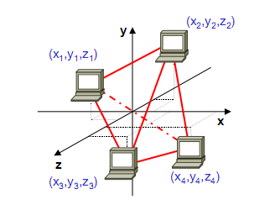
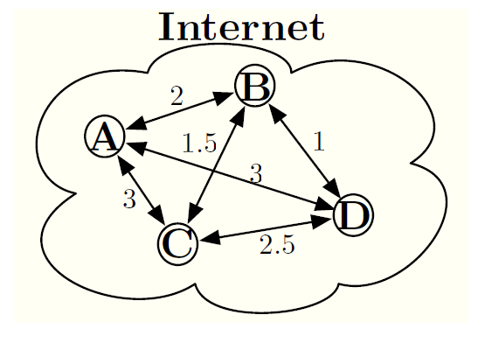
Network Coordinate System (NCS)
The NCS assigns synthetic coordinates to Internet peers, so that the Euclidean distance between two peers' coordinates can be used to predict the network latency between them.
Notes:
The NCS assigns synthetic coordinates to Internet peers, so that the Euclidean distance between two peers' coordinates can be used to predict the network latency between them. NCS has taken physical network topology and the capacity of underlying networks into account, therefore the interference from underlying networks can be minimized. Through the NCS, topology-aware applications can be established to achieve more responsive system behaviors, such as shorter data transmission latency and faster request response.
Due to their low overload and automatic adaptation to changes in the network, NCS is widely used in managing dynamic overlay networks.

Slide 12
Vivaldi NCS
Proposed by F. Dabek, R. Cox, F. Kaashoek, and R. Morris in 2004
A simulation-based algorithm
Vivaldi NCS models peers as entities in a spring system. It determines peers’ coordinates using spring relaxation simulation.
Peers tune their coordinates to minimize the prediction error. The low-energy state of the spring system corresponds to the coordinates with the minimum error.
Notes:
Vivaldi models peers as entities in a spring system. It determines peers’ coordinates using spring relaxation simulation.
The prediction error of the network distance measurement between a pair of peers is treated as the potential energy stored in a spring which connects these two peers.
Peers attract and repel each other according to network distance measurements. In the other words, peers tune their coordinates to minimize the prediction error. The low-energy state of the spring system corresponds to the coordinates with the minimum error.
Pharos is based on Vivaldi and it is hierarchical.
Each peer holds two sets of coordinate systems for long distance and short distance, respectively.
According to the distance scale of interest, peers can choose the proper set of coordinate systems to achieve higher prediction accuracy

Slide 13
Multicast Trees for Sending Messages to Friends
MST (Minimum Spanning Tree)
Shortest Path Tree
Modified ESM (End System Multicast) Tree (MESM Tree)(Y.H. Chu et. al.,2004)
LGK (Location-Guided k-ary) Tree (K. Chen, K. Nahrstedt, 2002)
VoroCast Tree (Jehn-Ruey Jiang, Yu-Li Huang and Shun-Yun Hu, 2008)
Notes:
Paul and Raphavan (2002) indicate that “multicast” is an efficient scheme suitable to one-to-many or many-to-many communications paradigm. In practice, most multicast algorithms rely on constructing multicast trees to improve transmission efficiency, since the trees minimize duplication of forwarding messages.
The MST (Minimum Spanning Tree) algorithm is based on classical Prim’s algorithm to construct the minimum spanning tree by greedily selecting the shortest links measured by NCS coordinates.
The modified ESM (End System Multicast) algorithm is a variant of the broadcast ESM protocol. A new peer first obtains a randomly sampled partial list of on-tree nodes, and then selects the one with the smallest latency as its parent. In the simplified version of modified ESM, the link capacity or node degrees are ignored.
The LGK (Location-Guided k-ary) algorithm constructs a k-ary tree by exploring node location information on a plane.
An LGK tree is constructed as follows: (1) the root node selects the closest k nodes as its child nodes; (2) the remaining nodes are clustered to the k child node according to geometric proximity. As a result, each of the k child nodes is the root of a subtree consisting of the nodes closer to it than to other child nodes. The multicast tree is formed as each subtree repeats the two steps of child selection and clustering.
It has been shown that k =2 gives the best tradeoff between the delivery delay and overhead of the node.

Slide 14
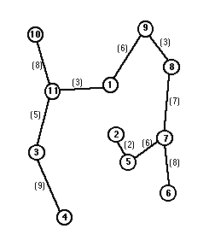
Multicast Trees for Sending Messages to Friends
MST (Minimum Spanning Tree)
Notes:
Paul and Raphavan (2002) indicate that “multicast” is an efficient scheme suitable to one-to-many or many-to-many communications paradigm. In practice, most multicast algorithms rely on constructing multicast trees to improve transmission efficiency, since the trees minimize duplication of forwarding messages.
The MST (Minimum Spanning Tree) algorithm is based on classical Prim’s algorithm to construct the minimum spanning tree by greedily selecting the shortest links measured by NCS coordinates.
The modified ESM (End System Multicast) algorithm is a variant of the broadcast ESM protocol. A new peer first obtains a randomly sampled partial list of on-tree nodes, and then selects the one with the smallest latency as its parent. In the simplified version of modified ESM, the link capacity or node degrees are ignored.
The LGK (Location-Guided k-ary) algorithm constructs a k-ary tree by exploring node location information on a plane.
An LGK tree is constructed as follows: (1) the root node selects the closest k nodes as its child nodes; (2) the remaining nodes are clustered to the k child node according to geometric proximity. As a result, each of the k child nodes is the root of a subtree consisting of the nodes closer to it than to other child nodes. The multicast tree is formed as each subtree repeats the two steps of child selection and clustering.
It has been shown that k =2 gives the best tradeoff between the delivery delay and overhead of the node.

Slide 15
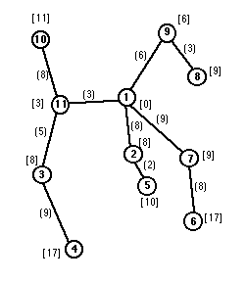
Multicast Trees for Sending Messages to Friends
Shortest Path Tree
source node
Notes:
Paul and Raphavan (2002) indicate that “multicast” is an efficient scheme suitable to one-to-many or many-to-many communications paradigm. In practice, most multicast algorithms rely on constructing multicast trees to improve transmission efficiency, since the trees minimize duplication of forwarding messages.
The MST (Minimum Spanning Tree) algorithm is based on classical Prim’s algorithm to construct the minimum spanning tree by greedily selecting the shortest links measured by NCS coordinates.
The modified ESM (End System Multicast) algorithm is a variant of the broadcast ESM protocol. A new peer first obtains a randomly sampled partial list of on-tree nodes, and then selects the one with the smallest latency as its parent. In the simplified version of modified ESM, the link capacity or node degrees are ignored.
The LGK (Location-Guided k-ary) algorithm constructs a k-ary tree by exploring node location information on a plane.
An LGK tree is constructed as follows: (1) the root node selects the closest k nodes as its child nodes; (2) the remaining nodes are clustered to the k child node according to geometric proximity. As a result, each of the k child nodes is the root of a subtree consisting of the nodes closer to it than to other child nodes. The multicast tree is formed as each subtree repeats the two steps of child selection and clustering.
It has been shown that k =2 gives the best tradeoff between the delivery delay and overhead of the node.

Slide 16

Multicast Trees for Sending Messages to Friends
Modified ESM (End System Multicast) Tree (MESM Tree)
A new node first obtains a randomly sampled partial list of on-tree nodes.
It then selects the one with the smallest latency as its parent.
new node
Notes:
Paul and Raphavan (2002) indicate that “multicast” is an efficient scheme suitable to one-to-many or many-to-many communications paradigm. In practice, most multicast algorithms rely on constructing multicast trees to improve transmission efficiency, since the trees minimize duplication of forwarding messages.
The MST (Minimum Spanning Tree) algorithm is based on classical Prim’s algorithm to construct the minimum spanning tree by greedily selecting the shortest links measured by NCS coordinates.
The modified ESM (End System Multicast) algorithm is a variant of the broadcast ESM protocol. A new peer first obtains a randomly sampled partial list of on-tree nodes, and then selects the one with the smallest latency as its parent. In the simplified version of modified ESM, the link capacity or node degrees are ignored.
The LGK (Location-Guided k-ary) algorithm constructs a k-ary tree by exploring node location information on a plane.
An LGK tree is constructed as follows: (1) the root node selects the closest k nodes as its child nodes; (2) the remaining nodes are clustered to the k child node according to geometric proximity. As a result, each of the k child nodes is the root of a subtree consisting of the nodes closer to it than to other child nodes. The multicast tree is formed as each subtree repeats the two steps of child selection and clustering.
It has been shown that k =2 gives the best tradeoff between the delivery delay and overhead of the node.

Slide 17
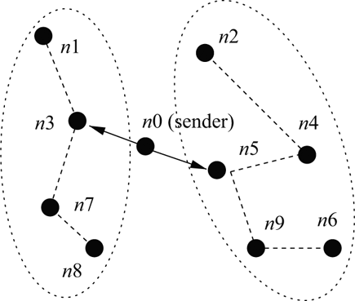
Multicast Trees for Sending Messages to Friends
LGK (Location-Guided k-ary) Tree
LGK algorithm constructs a k-ary tree by exploring node location information on a plane.
The root node selects the closest k nodes as its child nodes.
The remaining nodes are recursively clustered to the k child nodes according to geometric proximity.
Notes:
Paul and Raphavan (2002) indicate that “multicast” is an efficient scheme suitable to one-to-many or many-to-many communications paradigm. In practice, most multicast algorithms rely on constructing multicast trees to improve transmission efficiency, since the trees minimize duplication of forwarding messages.
The MST (Minimum Spanning Tree) algorithm is based on classical Prim’s algorithm to construct the minimum spanning tree by greedily selecting the shortest links measured by NCS coordinates.
The modified ESM (End System Multicast) algorithm is a variant of the broadcast ESM protocol. A new peer first obtains a randomly sampled partial list of on-tree nodes, and then selects the one with the smallest latency as its parent. In the simplified version of modified ESM, the link capacity or node degrees are ignored.
The LGK (Location-Guided k-ary) algorithm constructs a k-ary tree by exploring node location information on a plane.
An LGK tree is constructed as follows: (1) the root node selects the closest k nodes as its child nodes; (2) the remaining nodes are clustered to the k child node according to geometric proximity. As a result, each of the k child nodes is the root of a subtree consisting of the nodes closer to it than to other child nodes. The multicast tree is formed as each subtree repeats the two steps of child selection and clustering.
It has been shown that k =2 gives the best tradeoff between the delivery delay and overhead of the node.

Slide 18
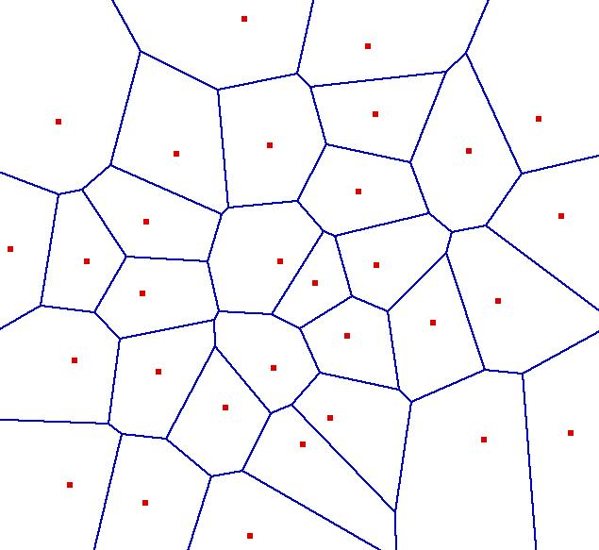
Multicast Trees for Sending Messages to Friends
VoroCast Tree
J
K
L
I
M
B
C
A
N
root
H
E
O
D
G
F
P
Q
Notes:
VoroCast is a special multicast scheme derived from the VON project [9] for P2P networked virtual environments (NVEs).
The basic idea of VoroCast is to construct a multicast tree spanning all AOI neighbors for each node. Messages can then be sent along the tree edges without redundancy.
Each node organizes its neighbors with a Voronoi diagram and separates them and itself into various Voronoi regions.
In the child selecting procedure, the message sender assumes itself as the root node. And the enclosing neighbors of the root, whose regions are adjacent to the root’s, select the root as their parent. The other nodes just select their enclosing neighbors that are nearest to the root as their parents. In this way, the multicast tree is constructed.

Slide 19
Outline
Introduction
Preliminaries
Proposed Scheme
Performance Evaluation
Conclusions

Slide 20
System Architecture
Hybrid network
A lightweight server takes the housekeeping tasks.
Other participating entities assist with running the system in a P2P manner.
1. Login to Server
2. Send A the list of online friends
and their NCS coordinates, etc.
A
Server
3. Calculate A’s NCS coordinate and send it back to Server
4. Compute FCT
A
D
K
G
F
Vivaldi NCS
J
Notes:
For the sake of simplicity, we assume there is a lightweight server to take the housekeeping tasks. It is noted that the server is actually of light load since it is only responsible of logining, providing friend peer information and managing peer statuses.

Slide 21
FCT Construction
Each peer computes its own Vivaldi NCS coordinate and sends it back to the server.
When a peer joins the system
logins to the server
to get its IDs and the list of online friend peers
To get IP addresses and NCS coordinates.
Available Out-Degree Estimation (AODE) is used to evaluate the proper out-degree of each node in the FCT.
Notes:
When a peer joins the system, it first logins to the server to get its ID and the list of online friend peers along with their IDs, IP addresses and NCS coordinates.
If the peer has not got a NCS coordinate yet, it computes its own Vivaldi NCS coordinate and sends it back to the server.
Available Out-Degree Estimation (AODE) is used to evaluate the proper out-degree of each node in the FCT.

Slide 22


AODE
S is the size of the message
C_{i} is the outgoing bandwidth of n_{i}
f_{i} is the current number of friend peers of n_{i}
p_{i} is the estimated probability that n_{i} is asked by its friend peers to forward messages
p_{i}×f_{i}×S means the current estimated traffic load shared by n_{i}
R_{i} is the accumulated number of forwarding requests that n_{i} receives from its friend peers
F_{i} is the accumulated number of friend peers during the last specified estimation period
Notes:
For AODE
p_{i}×f_{i} denotes the estimated number of forwarding requests that n_{i} will receive from its friend peers in the meanwhile.
p_{i}×f_{i}×S means the current estimated traffic load shared by n_{i}. The out-degree of n_{i} is set to 1 if C_{i} is less than p_{i}×f_{i}×S; otherwise, it is set to .
The numerator of AODE means the capacity of network of a peer.
The denominator of AODE means the demand of communication in a peer.
For p_{i}
It is noted that R_{i} is increased by 1 and F_{i} is increased by the number of friend peers of n_{i} every time when peer n_{i} receives a request during the last specified estimation period. The value of p_{i} is the ratio of R_{i} to F_{i}.

Slide 23
DAGTA
Degree-Adapted Greedy Tree Algorithm (DATGA) is used to construct FCT.
Latency-aware
Bandwidth-aware
The detail of DAGTA
Given the friendcast source peer (node) n₀ and its m friend peers n₁,…,n_{m} .
We suppose that n₁,...,n_{m} are listed in the order of their AODE values.
The parameters of a peer n_{i}
OD_{i} keeps the current out-degree (the number of child peers) of n_{i}
l_{i} stores the current accumulated latency that n₀ transmits a message to n_{i}
d_{k,i} is the latency measured by the distance of NCS coordinates of peers n_{k} and n_{i}.
For each n_{i} , 1≤i≤m
Selects n_{k} which has the minimum l_{k}+d_{k,i} for 0≤k≤i−1 as the parent node of n_{i} in the FCT, if OD_{k}＜AODE_{k}.
Randomly selects n_{k} for 0≤k≤i−1 as the parent node of n_{i} in the FCT, if none of n_{k} fit the condition of OD_{k} <AODE_{k}.
Notes:
Algorithm is shown on next page.

Slide 24
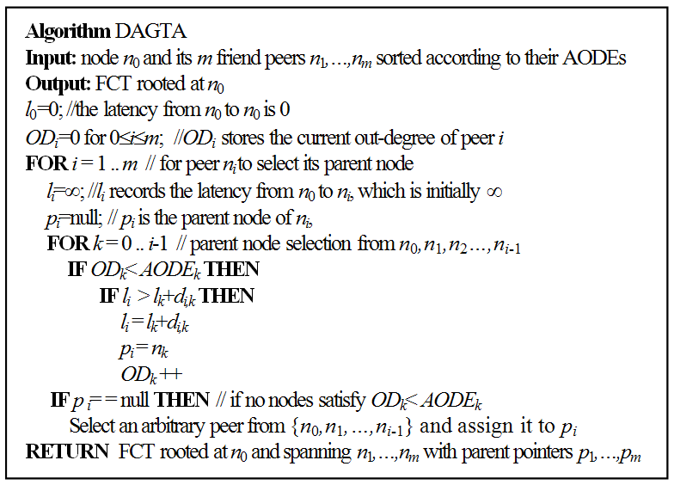
DAGTA Pseudo Code

Slide 25
DAGTA Example
An Example
n_{i} (AODE_{i}, d_{0,i}, OD_{i}, l_{i})
To select one node as the parent of n₄
1.Check if n_{k} fits OD_{k}＜AODE_{k}
K=0,1,2,3
n₀(2, 0, 2, 0)
n₁(3, 5, 1, 5) √
n₂(3, 9, 0, 9) √
n₃(2, 4, 0, 9) √
n₀(2, 0, 2, 0)
2.Compute l_{k}+d_{k,i} of n_{k} and get the
minimum one
n₁: d_{1,4}+5 = 6+5 = 11√
n₂: d_{2,4}+9 = 8+9 = 17
n₃: d_{3,4}+9 = 5+9 = 14
n₃(2, 4, 0, 9)
6
5
n₁(3, 5, 1, 5)
8
n₂(3, 9, 0, 9)
n₄(2, 8, 0,l₄)
Notes:
A parent selection example of DAGTA is illustrated in the figure , where five nodes n₀,...,n₄ are depicted and the parameters of a peer n_{i}, 0≤i≤4, are represented as a 4-tuple: (AODE_{i}, d_{0,i}, OD_{i}, l_{i}) after n₁, n₂ and n₃ have selected their parent nodes.
Peer n₄ will takes n₁ as its parent peer since n₁,n₂ and n₃ all meet the requirement of OD_{i}＜AODE_{i} (1≤i≤3), and l₁+d_{1,4} is the smallest among l₁+d_{1,4}, l₂+d_{2,4} and l₃+d_{3,4}.
The animated slide page contain 4 steps: (Click left mouse key to play)
1-2. Check if n_{k} fits OD_{k}＜AODE_{k} , for K=0,1,2,3 . We get n₁, n₂, n₃ since their OD are smaller than their AODE.
3-4. Compute l_{k}+d_{k,i} of n_{k} and get the minimum one. We get n₁ since it has the minimum accumulated NCS distance (i.e. latency) from the root n₀.

Slide 26
Outline
Introduction
Preliminaries
Proposed Scheme
Performance Evaluation
Conclusions

Slide 27
Evaluation
Simulation settings
We use MIT King data set to calculate NCS coordinates of peers in the friendcast trees.
Simulation parameters
Network Size | 300 peers
Simulation Steps | 1000
Average Number of Friends (ANF) | 20, 30, or 40
Churn Rate | 0% or 20%
Message Load | 2 /10s
c_{c} and c_{e} | 0.25
Message Size (MS) | 1500 bytes
Buffer Size | ANF*MS (bytes)
Processing Delay | 30 ms
Notes:
The MIT King data set contains measurements of the latencies between a set of 1,740 DNS servers collected using the King method.
Simulation period is100 seconds in this evaluation. (1000 steps x 100ms/step)
c_{c} is the constant fraction of the estimation error.
c_{e} is the local estimation error between the practical latency and the latency estimated by Vivaldi NCS.

Slide 28
Evaluation
Simulation settings
Upload bandwidth distribution of peers
Uplink (KB/sec) | Fraction of peers
10 | 0.05
30 | 0.45
100 | 0.40
625 | 0.10
Multicast schemes using multicast trees for comparison
Degree-constrained Prim’s MST (DCPrim)
Modified ESM (mESM)
LGK, k=2 and k=15
VoroCast
Dijkstra (Shortest Path Tree)
STAR (Directly Sending)
Notes:
We also assume peers have the upload bandwidth distribution proposed in [K. Chen, K. Nahrstedt, Infocomm 2008], which is shown in Table .
DCPrim uses Prim’s algorithm to construct the multicast tree and uses AODE to limit the out-degree of every peer.
We set k=2 and k=15 for LGK to cover both the low out-degree and high out-degree situations.
A basic scheme, called STAR, in which a peer directly sends messages to all of its friend peers is also evaluated for the sake of comparison.

Slide 29
Evaluation
Performance metrics

Slide 30
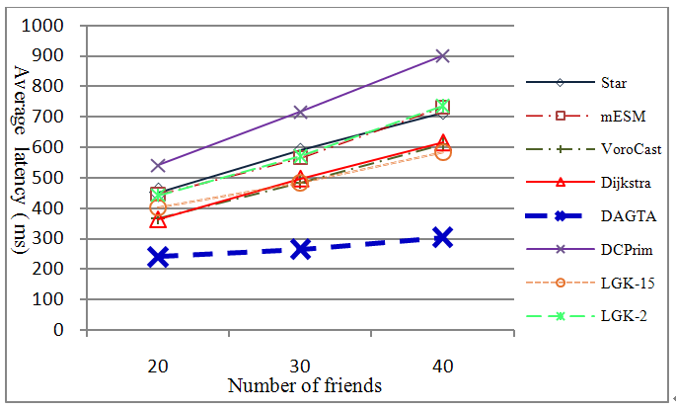
Simulation Results
Average latency for churn rate=0%
Notes:
For the churn rates of 0% and 20%, DAGTA outperforms others in terms of the average latency.
If peers’ out-degrees are not set properly, the outgoing bandwidth may be exhausted and the messages waiting to transmit are stored in the message buffer temporarily, which lengthens the latency.
In case buffer is full and some incoming messages arrive in the mean while, the peer must drop some messages.
This is because DAGTA tries to keep FCT as low as possible under the consideration of setting proper peer out-degrees by AODE.
This also counts for the reason why some algorithms with low tree heights (e.g., STAR and Dijkstra’s algorithms) have worse performance than DAGTA.

Slide 31
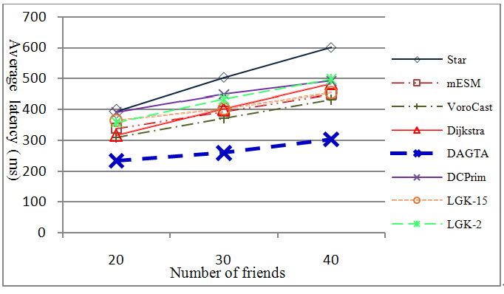
Simulation Results
Average latency for churn rate=20%
Notes:
DAGTA has relatively stable average latency while churn rates increase.
It is worth mentioning that the performance degrades with the number of friends for all algorithms, since more friends lead to more loads.

Slide 32
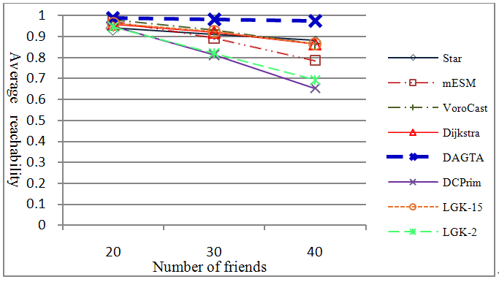
Simulation Results
Average reachablilty for churn rate=0%
Notes:
For the churn rates of 0% and 20%, DAGTA outperforms others in terms of average reachability.

Slide 33
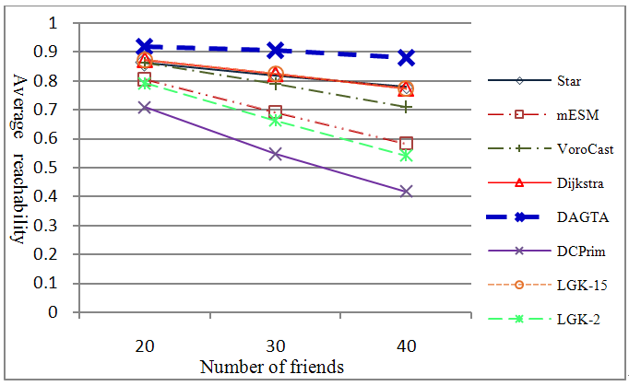
Simulation Results
Average reachablilty for churn rate=20%
Notes:
DAGTA has relatively stable average reachability while churn rates increase.
When churn rates go up, the leaving peers prevent messages from reaching some peers deeper in the tree.
This leads to lower reachability and accounts for the reason why some algorithms with high tree heights (e.g., DCPrim, modified ESM and LGK-2) have worse performance than DAGTA.

Slide 34
Evaluation
Discussion
For the churn rates of 0% and 20%, DAGTA outperforms others in terms of the average latency and average reachability.
If outgoing bandwidth of peers are not exhausted, the multicast trees with lower height has better performance.
DAGTA has relatively stable average latency and average reachability while churn rates increase. It has lower probability of messages-dropping since the outgoing bandwidth is taken into account.

Slide 35
Outline
Introduction
Preliminaries
Proposed Scheme
Performance Evaluation
Conclusions

Slide 36
Conclusions
This paper proposes a new bandwidth- and latency-aware P2P instant friendcast scheme, DAGTA, for OSNs under the hybrid architecture to achieve
latency-aware: on the basic of Vivaldi NCS coordinates
bandwidth-aware: on the basic of AODE estimation.

Slide 37
Conclusions
Future work
To study the consistency and fault-tolerance issues about the scheme.
To apply DAGTA to other bandwidth-hungry and time-constrained P2P applications, e.g., 3D streaming and video streaming.

Slide 38

Thanks for Listening!

