Slide 1
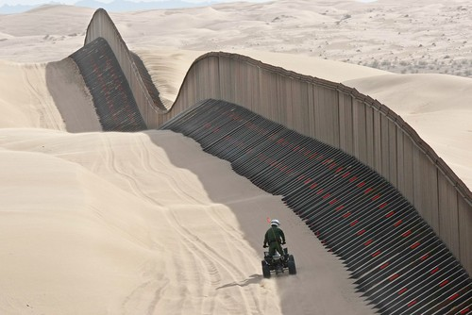
Barrier Coverage with Optimized Quality for Wireless Sensor Networks
Yung-Liang Lai*, Jehn-Ruey Jiang
National Central University
Taoyuan Innovation Institute of Technology*
Taiwan

Slide 2
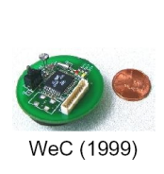
Wireless Sensor based Barrier Coverage
USA
Wireless sensor
Notes:
We can deploy some wireless sensors in a protected area
to detect the intruders.
The wireless sensors are

Slide 3
Barrier Coverage Optimization Problem
How to construct a barrier coverage such that :
Degree of Detecting intruders is Maximized ,
Probability of Detecting intruders is Maximized Data transmission time is Minimized?
Notes:
In this paper,
We model a barrier coverage optimization problem.
The problem is how to construct a barrier coverage such that degree ….

Slide 4
Barrier Coverage Optimization Problem
To optimize Quality of Barrier Coverage
We define three Quality metrics
detection degree, detection probability, expected transmission time
We model the problem as a Graph Problem
Solve it by the Minimum Cost Maximum Flow Algorithm
Notes:
In this paper, we study the barrier coverage optimization problem, which is used to optimize quality of barrier coverage
We define three quality metrics : detection degree, detection probability, expected transmission time
We model the problem as a graph problem
And solve it by maximum flow minimum cost planning approach

Slide 5
Outline
Background
Network Modeling
Barrier Coverage Optimization Problem
Optimal Barrier Coverage Algorithm
Time Complexity Analysis
Conclusion
Notes:
This is the outline

Slide 6
Background
k-Barrier Coverage Problem
Sink Connected Barrier Coverage
Notes:
We introduce two definitions

Slide 7
k-Barrier Coverage Problem
Degree (k) is the number of virtual detection lines
How to select nodes to maximize degree (k)
Solution: k=2
Given:
Notes:
Degree (k) is the number of virtual detection lines
As shown in right, its degree is 2, which means the number of virtual detection lines is 2.
It means a intruder will be detected at least two times.
The k-Barrier Coverage problem is how to select nodes to maximize degree (k) in an given nodes set.

Slide 8
Sink Connected Barrier Coverage
Sensor node (center dot) with a sensing area for detecting and forwarding events
Sensor node for only forwarding events
Detection Line
Transmission Link
Sink Node
Boundary area
Intruder
Notes:
In our previous work, we define the sink connected barrier coverage, which is to construct a barrier coverage with connectivity to the sink nodes

Slide 9
Outline
Background
Network Modeling
Barrier Coverage Optimization Problem
Optimal Barrier Coverage Algorithm
Time Complexity Analysis
Conclusion

Slide 10
Network Model
Coverage Graph Gc
Transmission Graph Gt
Notes:
To model our problem, we define two graphs : coverage graph and transmission graph

Slide 11
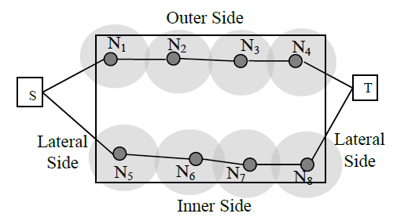
Coverage Graph (Gc)
Ni and Nj have overlapped sensing coverage, then Edge (Ni, Nj) exists
Notes:
In a coverage graph, if two nodes have overlapped coverage, then edge exists in coverage graph

Slide 12
Coverage Graph (Gc)
Detection Probability
depend on distance
P(d)=e^{-αd}
Detection Quality
Worst Case of P
P_{w}(Si, Sj)=P( Dist / 2 )
Distance (d)
sensor
target
P(d)
Dist
S i
S j
Intruder Path in Middle
(Worst Case)
Notes:
Now, we will define

Slide 13
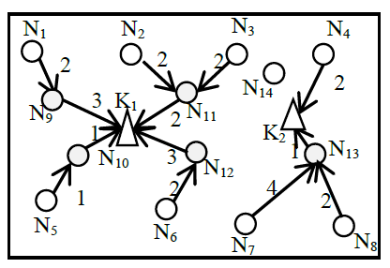
Transmission Graph (Quality)
<Ni, Nj> = node Ni can transmit data to Nj
Detection Quality

Slide 14
Transmission Graph (Gt)
Weight of edge on Gt
Quality of Link:
$ETT\left(Ni,Nj\right)=\frac{1}{R\left(Ni,Nj\right)∙R\left(Nj,Ni\right)}\frac{S}{B}$
Packet size
Bandwidth
Successful Ratio of Sending Packet
Successful Ratio of ACK Packet
N₁
N₂
N₃
N₄
2
2
2
K₁
N₁₄
2
N₉
3
N₁₁
1
2
K₂
N₁₀
1
N₁₃
3
N₁₂
1
2
4
2
N₅
N₆
N₈
N₇

Slide 15
Transmission Graph (Gt)
Quality of Path Set:
To measure the expected transmission time of a path set(PS)
$ETT(PS)=\frac{1}{|PS|}\sum_{h∈PS}{ETT\left(h\right)}$
N₁
N₂
N₃
N₄
2
2
2
N₁₄
2
K₁
3
N₁₁
N₉
2
1
K₂
N₁₀
1
N₁₃
3
N₁₂
1
2
4
2
N₅
N₆
N₇
N₈

Slide 16
Outline
Background
Network Modeling
Barrier Coverage Optimization Problem
Optimal Barrier Coverage Algorithm
Time Complexity Analysis
Conclusion

Slide 17
Barrier Coverage Optimization Problem
(k,p,t)–Barrier Coverage Optimization Problem
How to select nodes from randomly deployed sensor nodes to reach three goals :
Goal 1: Maximizing the degree k of barrier coverage
Goal 2: Maximizing the minimum probability p of detecting intruders crossing the monitoring region
Goal 3: Minimizing the expected transmission time t to send data to the sink nodes.

Slide 18
Outline
Background
Barrier Coverage Optimization Problem
Optimal Barrier Coverage Algorithm
Optimal Barrier Coverage Algorithm
Backgroud: Maximum Flow Algorithm & Maximum Flow Minimum Algorithm
Optimal Barrier Coverage Algorithm
Time Complexity Analysis
Conclusion

Slide 19
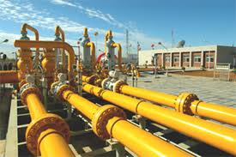
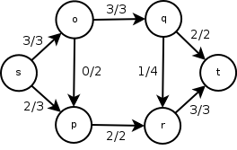
Background: Maximum Flow Algorithm
Maximum Flow (MaxFlow) ALG
Each edge is assigned capacity constraint
To find some flows from s to t , such that:
Number of Flow is Maximized
Maximum Flow Plan = 2 Flows
capacity
Flow on edge
Notes:
Now, we introduce the maximum flow algorithm.
The maximum flow algorithm is to find some flows from s to t, such that number of flow is maximized under capacity constraints

Slide 20
Background: Maximum Flow Algorithm
Maximum Flow (MaxFlow) ALG
To find MaxFlow plan from s to t , such that:
Number of Flow (→) is Maximized
2 Flows
Notes:
In this example, the maximum number of flow is 2.

Slide 21
Background: Maximum Flow Minimum Cost Algorithm
Maximum Flow Minimum Cost (MaxFlowMinCost) ALG
To find flows from s to t , such that:
$1
$1
$2
$3
$1
$1
$1
$2
capacity
Flow value

Slide 22
Background: Maximum Flow Minimum Cost Algorithm
Maximum Flow Minimum Cost (MaxFlowMinCost) ALG
To find flows from s to t , such that:
Number of Flow(→) is Maximized
Total Cost ($) is Minimized
$1
$1
$2
$3
$1
$1
$1
$2
capacity
Flow value

Slide 23
Optimal Barrier Coverage Algorithm
Basic Idea : 3 Phases
Phase1)To find a set of nodes (FP) with maximized number of node-disjointed flows (k) in Coverage Graph (Gc) by MaxFlow ALG
Phase2)To refine FP such that minimum detection probability (p) is maximized by MaxFlow ALG
Phase3)To select some additional nodes for connecting sink nodes with minimized Expected Transmission Time (t) by MaxFlowMinCost ALG

Slide 24
Phase1
To find a set of nodes (FP) with maximized number of node-disjointed flows (k) in Coverage Graph (Gc) by MaxFlow ALG
K=2

Slide 25
Phase 2
(Repeatedly remove edges such that minimum detection probability (p) is Maximized without loss number of flows in Phase 1
Quality of Barrier Coverage = 0.4
Quality of Barrier Coverage = 0.5
N₁
N₂
N₃
N₄
N₁
N₂
N₃
N₄
0.6
0.7
0.6
0.6
0.7
0.6
X
N₉
N₉
N₅
N₆
0.6
0.5
N₅
N₆
0.6
0.5
N₇
N₇
N₈
N₈
0.6
0.6
0.4
0.6
0.6
Minimum detection probability =0.5
Minimum detection probability =0.4

Slide 26
Phase 3
To select some additional nodes for connecting sink nodes with minimized Expected Transmission Time (t) by MaxFlowMinCost ALG
(5)
(4)
(4)
(2)
N₁
N₂
N₃
N₄
N₁
N₂
N₃
N₄
2
2
2
2
2
2
N₁₄
2
2
K₁
3
K₁
3
N₁₁
N₉
2
K₂
N₁₁
N₉
2
K₂
1
1
3
1
N₁₃
3
1
N₁₀
N₁₂
N₁₂
N₁₃
N₁₀
1
2
4
2
4
2
1
2
N₅
N₅
N₆
N₈
N₆
N₇
N₈
N₇
(2)
(5)
(5)
(3)
Expected Transmission Time = (5+4+4+2 + 2+5+5+3)/8
, which is Optimized

Slide 27
Optimal Barrier Coverage Algorithm
Step 1: Construct a coverage graph Gc
Each edge is associated with a weight (detection probability)
N₁
N₂
N₃
N₄
0.6
0.7
0.6
N₉
N₅
0.5
0.5
N₆
N₇
N₈
0.6
0.5
0.4

Slide 28
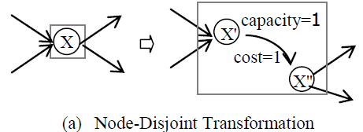
Optimal Barrier Coverage Algorithm
Step 2: Execute to Node-Disjoint Transformation transfer Gc into the new graph Gc*
For Multiple-in & Multiple-Out
Node-Disjoint Transformation

Slide 29
Optimal Barrier Coverage Algorithm
Step 3:(To Find Maximum barrier coverage)
Execute the maximum flow algorithm on Gc* to decide the maximum flow plan FP
N₁
N₂
N₃
N₄
0.6
0.7
0.6
S
T
N₉
N₅
0.5
0.5
N₆
N₇
N₈
0.6
0.5
0.4

Slide 30
Optimal Barrier Coverage Algorithm
Step 4: Remove all edges with the minimal probability without loss of Degree(k)
Can we remove the MIN edge without loss number of flows?
Yes, remove it and continue to test
No, quality is maximized
S
T
0.6
0.5
0.6
0.6
0.4

Slide 31
Optimal Barrier Coverage Algorithm
Step 4: Remove all edges with the minimal probability without loss of Degree(k)
Can we remove the MIN edge without loss number of flows?
Yes, remove it and continue to test
No, quality is maximized
S
T
0.6
0.5
0.6
0.6
0.4

Slide 32
Optimal Barrier Coverage Algorithm
Step 4: Remove all edges with the minimal probability without loss of Degree(k)
Can we remove the MIN edge without loss number of flows?
Yes, remove it and continue to test
No, quality is maximized
S
T
0.6
0.5
0.6
0.6
A Barrier is constructed with MIN_Quality=0.5

Slide 33
Optimal Barrier Coverage Algorithm
Step 5: Construct a transmission graph
Add a virtual source node S and a virtual target node T
S
T

Slide 34
Optimal Barrier Coverage Algorithm
Step 6: For each node selected in Step. 4, add an edge from S, For each sink node, add edge to T
The ETT (Expected Transmission Time) is assigned on each edge
S
T

Slide 35
Optimal Barrier Coverage Algorithm
Step 7: Execute Maximum Flow Minimum Cost Algorithm
Maximum Flow with Minimized Cost
S
T
Thus, a node set with maximized degree (k),
maximized minimum_detection_probability (p), and
minimized average transmission time (t) is determined

Slide 36
Time Complexity Analysis
Time complexity of Optimal Barrier Coverage Algorithm is dominated by step 4
Try to remove minimum weight edge on coverage graph and to execute maximum flow algorithm, repeatedly (in step 4)
Time complexity in step 4: O(E •V•E²)= O(V•E³)
E is the number of edges, Maximum flow algorithm needs O(V•E²)
Notes:
Time complexity of Optimal Barrier Coverage Algorithm is dominated by step 4
In step 4, we try to remove …
E times V times E squae

Slide 37
Conclusions
Barrier Coverage with Optimized Quality Problem is molded and solved in this paper
Aiming at this problem, we proposed a Optimal Barrier Coverage Algorithm (OBCA)
The OBCA is time-efficient (polynomial time complexity)
▆

